Slide 1

Argos — Visual Speech Recognition
Built-In Confidence. Ready to Deploy.
Yoad Oxman · Argos / The Orchard · April 2026
1
Notes:
Open with the product positioning: working pipeline + trust signals + we deploy it on your infrastructure. Set expectation that this is a deep dive, not a pitch — they'll see the system run end-to-end.

Slide 2
Argos
We build production-grade visual speech recognition.
Lip-reading at scale, with built-in confidence.
WHAT WE DO
WHO USES IT
WHY IT MATTERS
End-to-end pipeline: face detection, mouth cropping, visual feature extraction, language decoding — and confidence scoring on every word.
Teams that need to recover speech from footage where the audio is missing, noisy, or untrustworthy: media, broadcast, accessibility, investigations.
Most speech-to-text systems hand you a transcript and a hope. We hand you a transcript with a per-word trust signal so you know what to review.
Argos / The Orchard.
2
Notes:
Open with the brand. 30-second elevator pitch — what we are, who we serve, what makes us different. Don't go deep on any one column; the next slide explains what we built.

Slide 3
What we built — concretely
Six things actually exist today, end-to-end, on real data.
1. PIPELINE
2. WEB UI
3. MODEL
Nine automatic stages from raw video to confidence-scored transcript. Containerized; runs anywhere with a GPU.
Drag-and-drop, live progress, downloadable HTML report. No command line required.
Visual-only encoder + LLaMA-2 decoder, fine-tuned on lip-reading. Same architecture VSP-LLM published, our own training run.
4. CONFIDENCE
5. EVALUATION
6. INTEGRATION
Per-word green/yellow/red. Per-segment Intelligibility Score. Hallucination auto-flagging.
1,497-segment baseline with WER, IS, and expert-judge agreement metrics. Reproducible from raw inputs.
On-premise install, cloud deployment, or both. We deploy and hand off.
Everything you'll see today is in production today — not a 'with more research it could…' projection.
3
Notes:
Six concrete deliverables. Each is a real artifact you can show. Frame this as 'this is what your team gets', not 'this is what we research.' The footnote is the closer: don't oversell future improvements.

Slide 4
What is visual speech recognition?
Reading speech from video alone — no audio.
Same problem a deaf lip reader solves, automated and at scale.
WHEN AUDIO ISN'T USABLE
MUTED
NOISY
UNRELIABLE
AUDIO-LESS
Surveillance footage, archive video, clips with no recorded audio.
Crowds, machinery, wind, overlapping speakers.
Suspected dub, voice-over, mismatched lip sync.
Silent film, distant CCTV, streams that lost audio.
We've shipped this end-to-end. The next slides show the numbers.
4
Notes:
Background slide. Most clients haven't heard of visual speech recognition. Spend 60 seconds: define the problem, name 4 use cases, then move on. The four cards are deliberately broad so the client maps their own use case onto one.

Slide 5
Three numbers, in plain English
62%
23%
1 in 5
useful output
clearly conveyed
auto-flagged
Six of every ten segments deliver usable text — viewers can extract meaning even when the wording isn't perfect.
About one in four segments needs no review — delivered cleanly with no further work.
The system flags low-confidence segments before you ever see them. You review the flagged ones, not all of them.
Measured on 1,497 segments of unfiltered real-world video — varied lighting, head angles, multi-speaker scenes, no curation.
Validated against an independent expert reviewer.
5
Notes:
Numbers from MEMORY.md > Key Project Numbers. 62% = 922/1497 NIV Y+P (rounded from 61.6%). 23% = 346/1497 NIV Y (rounded from 23.1%). 1 in 5 = 20.5% hallucination/auto-flag rate. Validation κ=0.818 vs Opus expert judge — phrased as '8 of 10' on slide. Don't read out NIV / κ on the slide; they're for your reference here. Lean into the difficulty caveat — these numbers are on real-world hard data, not a curated benchmark, and the client should hear that explicitly. Anything cleaner-than-YouTube will perform better.

Slide 6
What you'll see today
• Live demo — the system processing a real video, end-to-end
• Output gallery — what good, partial, and flagged segments look like
• How confidence works — per-word color coding and per-segment scoring
• How we validated it — independent expert agreement
• What's next — pre-processing, stronger model, Arabic, integration
6
Notes:
5-minute orientation. Don't go deep on any one item here.

Slide 7
Watch the system process a real video
Nothing here is pre-cached. The pipeline runs in your browser. Drag in, walk away, come back to color-coded results.
Press play on the next slide to start the walkthrough.
7
Notes:
Cue the embedded video on the next slide. Pause briefly so the audience focuses.

Slide 8
Live UI Demo
Live UI walkthrough
End-to-end demo recorded by the presenter.
Approximately 4-5 minutes · press play in PowerPoint to start
If video does not embed before the meeting, narrate the demo: drag-drop upload → 9-stage pipeline → color-coded report.
8
Notes:
This slide is a placeholder until the UI walkthrough video is recorded. When recorded, embed the .mp4 directly (not a link) so it plays offline.

Slide 9
What you just saw
• Drag-drop upload — no command line, no scripting
• Nine automatic stages — face detection, mouth cropping, recognition, decoding
• Per-word color coding — green confident, yellow review, red likely error
• Per-segment Intelligibility Score — calibrated against expert judgment
• Output is a downloadable HTML report you can hand a reviewer
9
Notes:
Tie back to the demo. If a beat didn't land in the video, restate it here.

Slide 10
OUTPUT EXAMPLES
What good, partial, and flagged segments look like
10
Notes:
Section transition: OUTPUT EXAMPLES. Pause briefly.

Slide 11
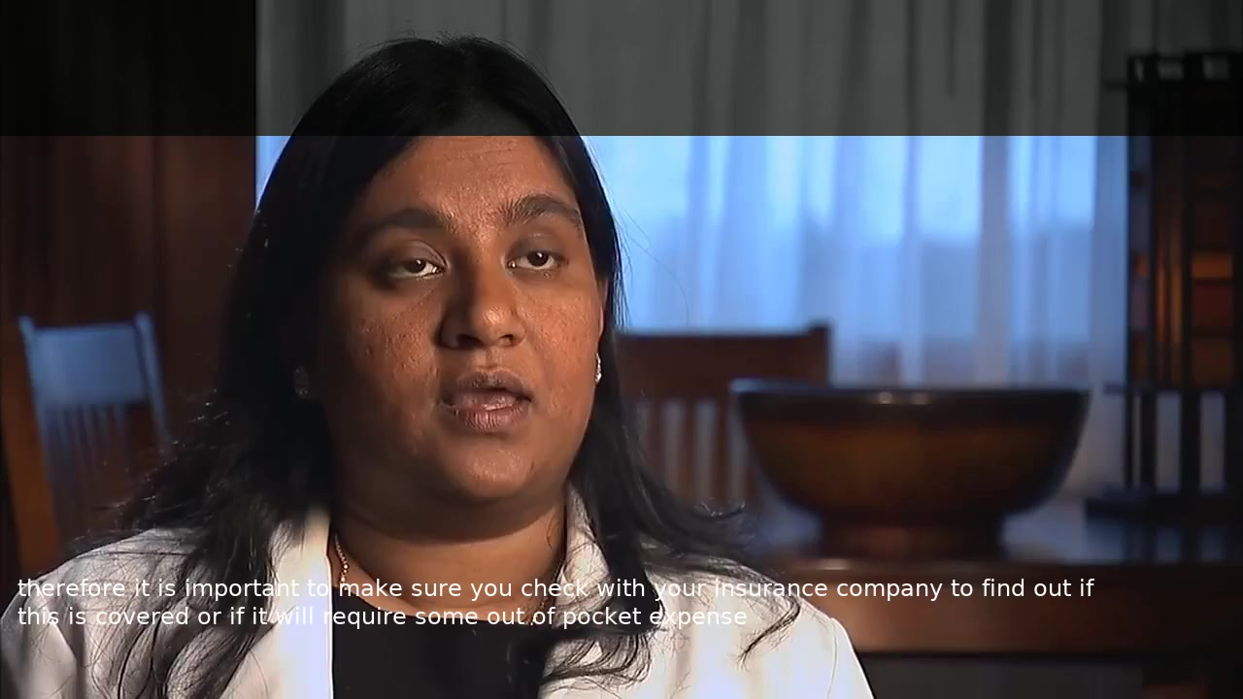
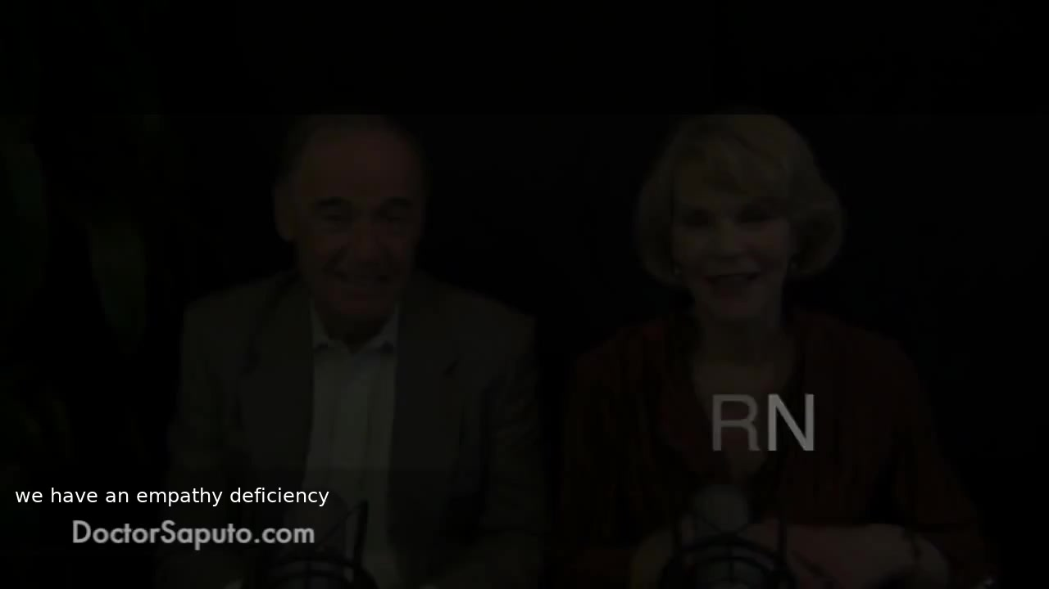
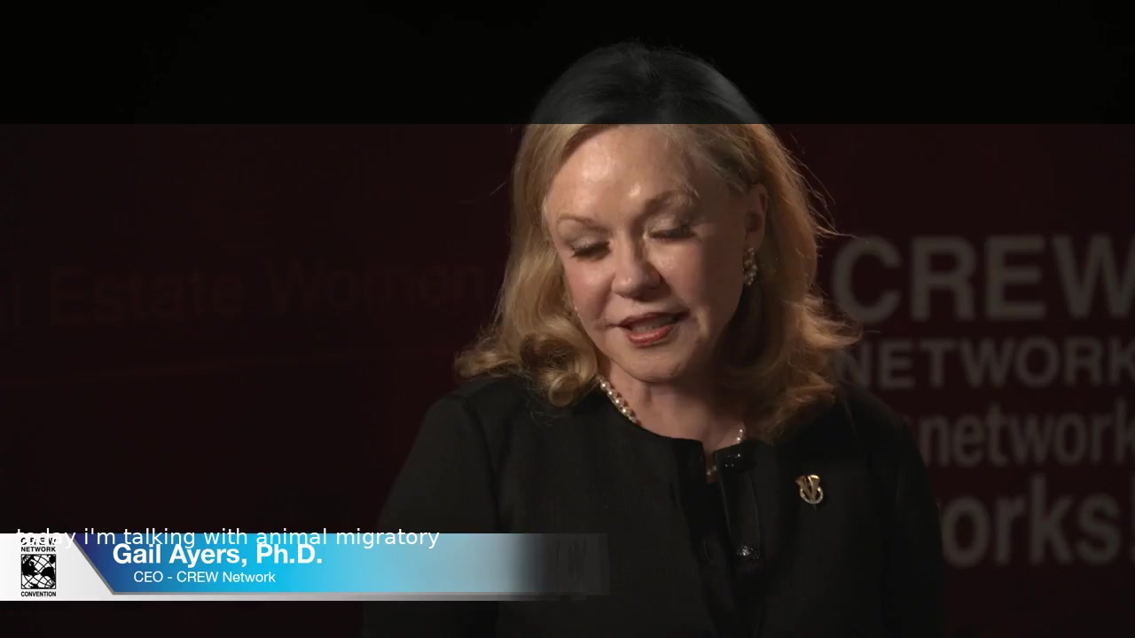
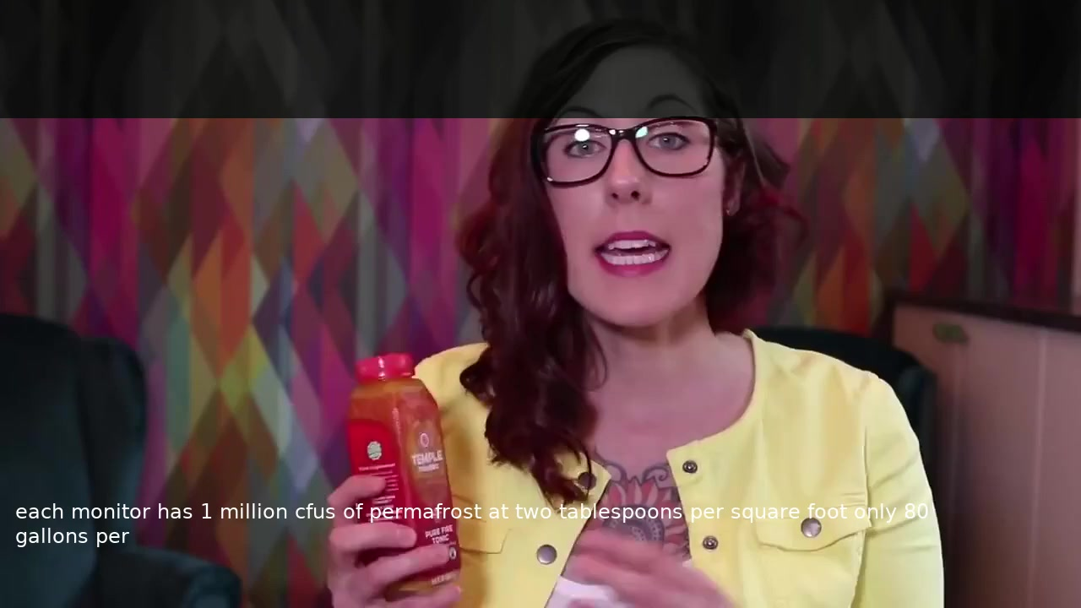
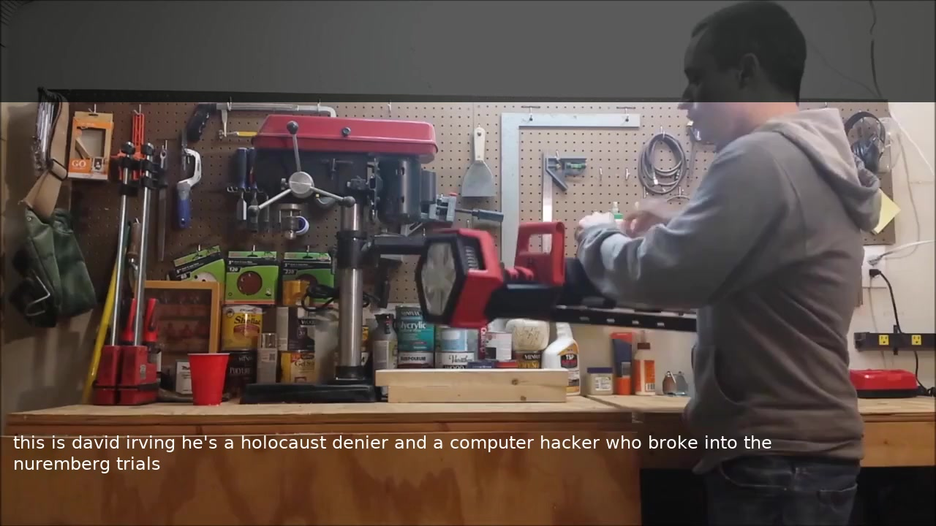
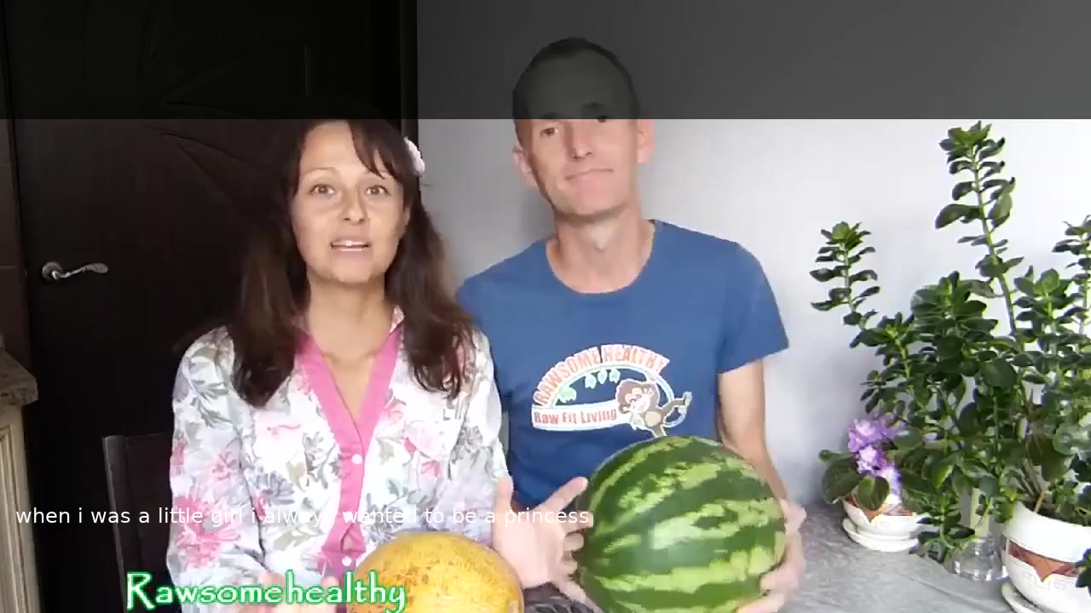
Real outputs — pick any tile to play
Six real segments decoded by the model. Click a tile in PowerPoint to play.
▶
▶
▶
PERFECT
ALMOST PERFECT
PARTIAL
Clean visual, clean output
Near-verbatim transcription
Right gist, wrong specifics
▶
▶
▶
NEAR MISS
HALLUCINATION
TOPIC DRIFT
Off by a phrase, recoverable with context
Fluent but wrong — auto-flagged
Model lost the thread, system flags it
These six are a deliberate spread — best-case to worst-case. All visually decoded, no audio, on real-world video.
11
Notes:
Pick 1-2 tiles to actually play during the meeting. Recommend starting with 'perfect' (sets the bar) then 'halluc' (shows the system catches the bad ones). Don't play all 6 — pick what fits your audience. All videos are static poster frames at deck-build time; in PowerPoint they have hyperlinks/embeds set by helpers.

Slide 12
What good, partial, and flagged look like
Three real segments from the Obama bin Laden announcement, decoded by the live model, color-coded by real per-word confidence.
CLEAN
PARTIAL
FLAGGED
Segment 14
Segment 31
Segment 5
WER 0%. All confident.
WER 22%. Substitutions in yellow.
WER 45%. Hallucination caught.
12
Notes:
Three concrete examples on the next three slides.

Slide 13
Example 1 — Clean speech, perfect transcription
Obama bin Laden announcement · segment #14 · 41.95–45.55 s
REFERENCE
and our allies over the last 10 years thanks to the tireless and heroic work of our military and our counterterrorism professionals we've made great strides in that effort
HYPOTHESIS
and our allies over the last 10 years thanks to the tireless and heroic work of our military and our counterterrorism professionals we've made great strides in that effort
WER 0%. 27 of 29 words at high confidence. No reviewer intervention needed.
GREEN: confident YELLOW: review RED: likely error
13

Slide 14
Example 2 — Partial recovery, model knows where it slipped
Obama bin Laden announcement · segment #31 · 92.90–96.50 s
REFERENCE
as president bush did shortly after 9 11 that our war is not against islam bin laden was not a muslim leader he was a mass murderer of muslims indeed al qaeda has slaughtered so many muslims
HYPOTHESIS
president bush said shortly after 9 11 that our war is not against islam bin laden was not a muslim leader he was a mass murderer of muslims then al qaeda slithered
WER 22%. "president bush did" became "president bush said". Substitutions appear in yellow — reviewer goes straight to them.
GREEN: confident YELLOW: review RED: likely error
14

Slide 15
Example 3 — Flagged before it ever reached you
Obama bin Laden announcement · segment #5 · 14.98–18.58 s
REFERENCE
heroic citizens saved even more heartbreak and destruction and yet we know that the worst images are those that were unseen to the world the empty seat at the dinner table
HYPOTHESIS
rwanda's genocide even more heartbreaking is russia and yet we know that the worst images are those that were unseen in the world mt killer whale
WER 45%. The model fabricated "rwanda's genocide" — and knew it. Lowest-confidence word at p=0.02. The system flags the line before the reviewer ever sees the transcript.
GREEN: confident YELLOW: review RED: likely error
15

Slide 16
CONFIDENCE & TRUST
How the system tells you what to trust
16
Notes:
Section transition: CONFIDENCE & TRUST. Pause briefly.

Slide 17
How do you know when to trust an output?
Most speech-to-text systems hand you a transcript. You read all of it. If something's wrong, you find out the hard way.
Argos is different. Every word and every segment carries a confidence signal. You read what's flagged — not everything.
17
Notes:
Set up the two-layer story on the next slide. Don't go deep yet.

Slide 18
Two layers of confidence
1. PER-WORD
2. PER-SEGMENT
From the model itself
From the score system
• Every predicted word has a probability the model assigned it
• We surface those as green / yellow / red inline in the report
• You see exactly where the model was unsure
• Intelligibility Score — a 0–5 score per segment
• Predicts whether a viewer will understand the output
• Calibrated against an independent expert reviewer
18
Notes:
Layer 1 is per-token softmax probability from LLaMA, aggregated to per-word using min() across sub-tokens (conservative). Layer 2 is the Intelligibility Score (IS) — a 6-signal composite designed at design time by Claude (no LLM call at evaluation time). Calibrated κ=0.818 vs Opus judge (Y+P). Don't say κ on the slide.

Slide 19
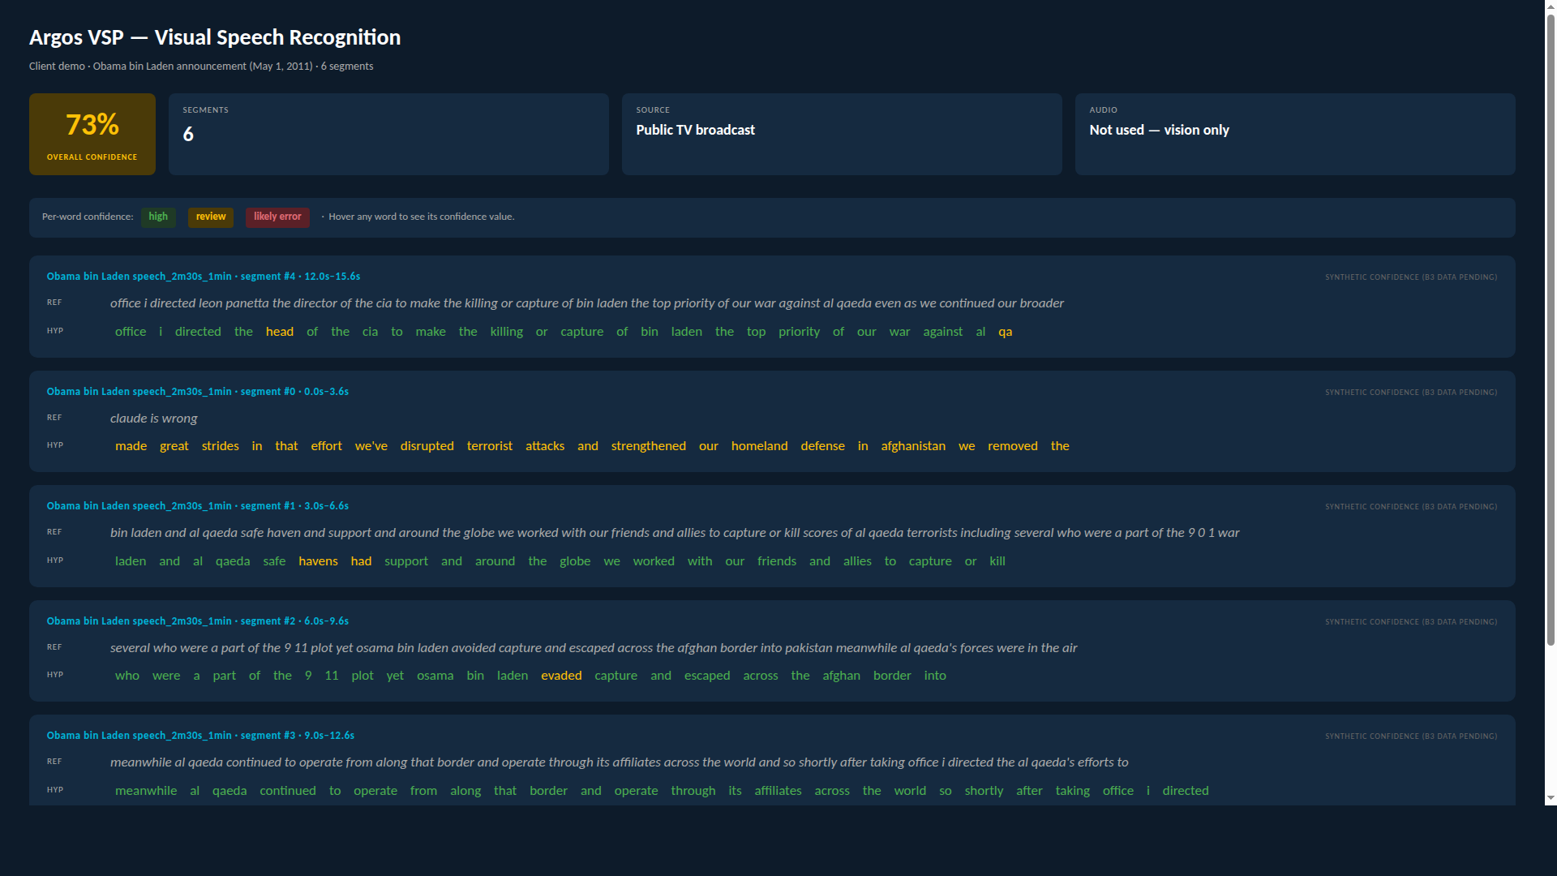
Per-word color coding on a real example
Per-word confidence —
GREEN: confident
YELLOW: review
RED: likely error
19
Notes:
Walk the audience through one segment of the Obama bin Laden speech report. Hover or point at a green run, then a yellow word, then the red mismatch. The recognizable content lets clients track what's right and what's not even though the audio isn't being played. Note that the per-word confidence on THIS screenshot is currently synthetic (derived from WER alignment) until B3's real sequence-confidence sidecar lands — visual treatment is identical, the underlying signal will swap when the GPU run completes. The Obama speech is the demo input recommended for your live UI walkthrough recording (vsp_input/050111_OsamaBinLadenStatement_HD.mp4).

Slide 20
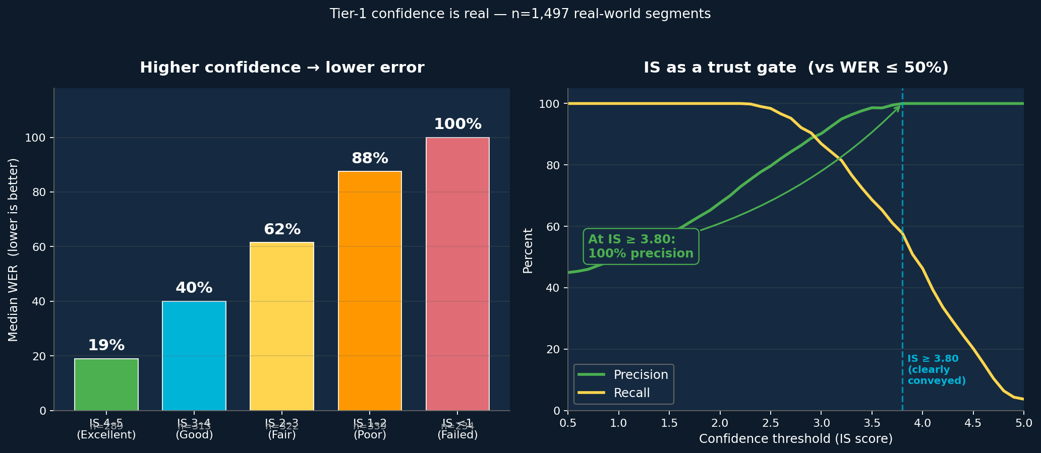
Higher confidence → lower error, every time
When the system rates a segment "clearly conveyed," it really is — 100% precision across 1,497 real-world segments.
20
Notes:
Real data on the full 1,497-segment baseline. Pearson r(IS, WER) = -0.850. Spearman ρ = -0.943. Median WER staircase by IS tier: 4-5 → 19%, 3-4 → 40%, 2-3 → 62%, 1-2 → 88%, <1 → 100%+. Zero false positives at IS ≥ 3.80 for the WER ≤ 50% definition of 'good' — every single segment the system flagged 'clearly conveyed' actually had WER below 50%. This is the conditional-lift story we deferred earlier; we have it today at the Tier-1 (Intelligibility Score) level. A future Tier-2 chart from per-token model confidence will complement (not replace) this one once the GPU subset run completes. Don't say 'IS' on the slide — say 'when the system rates a segment clearly conveyed.'

Slide 21
62% useful — on real-world video, not benchmark data
62%
WHAT THAT 62% IS UP AGAINST
• Real YouTube footage — not a curated benchmark dataset
• Varied lighting, head angles, and camera distances
• Multi-speaker scenes, off-axis faces, partial occlusion
• Domain vocabulary the model has never seen
• No pre-filtering — the system processes whatever was uploaded
of segments deliver useful output today
Measured on 1,497 segments of unfiltered real-world video
On segments the system flags as high-confidence, performance lifts further — we'll measure that conditional rate in the next iteration.
21
Notes:
62% = NIV Y+P (61.6% rounded). The point of this slide is twofold: (1) anchor the 62% as the headline 'useful' number without giving the client labels for what counts as useful or partial — they decide their own bar; (2) make crystal clear that this is real-world hard data, not a benchmark we hand-picked. The conditional 'on high-confidence segments only' lift is real but we're holding back the precise number until per-segment sequence-confidence data is in (B3 in the plan). Don't say NIV / kappa / r=. The user explicitly rejected the 39% partial / 38% needs-review breakdown — we don't anchor the client's threshold for 'useful' on our terms.

Slide 22
When the model fabricates, the system flags it
1 in 5
• When the model produces fluent text it isn't sure about, we catch it
• Detection rules combine length anomalies and per-token confidence
• These are the dangerous failures — fluent but wrong
• You don't have to find them. The system finds them for you.
segments auto-flagged
before they ever reach you
Detection combines length-anomaly rules with per-token confidence — the model can fabricate fluent text but it usually 'knows' it.
22
Notes:
20.5% hallucination rate translated to '1 in 5'. The detection rules are the WER≥100% length anomaly plus per-token confidence flag. Don't enumerate the rules on the slide — stay client-friendly.

Slide 23
What this means for your workflow
• You review the flagged segments — not all of them. Hours saved per video.
• Reviewers go straight to the suspicious words instead of skimming text.
• Confidence is auditable — every claim has a number behind it.
• Bad output is a known unknown, not a hidden surprise.
23
Notes:
Land the value prop. Connect this back to their actual workflow if you know it.

Slide 24
VALIDATION
An independent expert agreed in 8 of 10 cases
24
Notes:
Section transition: VALIDATION. Pause briefly.

Slide 25
How we validated the trust signals
• 1,497 real-world segments — not benchmark data
• Independent expert reviewer scored every one
• We compared the system's confidence signals to that judgment
• Result: the trust score and the expert agree on most segments
Real-world YouTube footage — varied lighting, head angles, multi-speaker scenes, accents. Not curated lab footage.
25
Notes:
The 'independent expert reviewer' is Claude Opus 4.6 acting as a calibration judge — don't name it on the slide; clients hear 'AI validating AI' and discount it. Frame it as the methodology that produced the calibrated thresholds.

Slide 26
Agrees with the expert reviewer 82% of the time
82%
18%
AGREES WITH EXPERT
DISAGREES
Validated on the same 1,497 segments — "any useful meaning" judgment.
26
Notes:
82% comes from κ=0.818 for NIV Y+P translated to a plain agreement rate. Source: MEMORY.md.

Slide 27
The trust signal stays stable
• We changed decode settings 16 different ways
• The trust signal moved less than a percentage point
• Translation: it isn't a fluke of one specific run
What this means: the confidence numbers you see in the demo are the same confidence numbers you'd see on your data, on your infrastructure, on your settings.
Tested across 16 different decode configurations on the same 1,497 segments.
27
Notes:
Cross-config Pearson r=0.925, std=0.015 across 16 decode configs. Don't say r on the slide.

Slide 28
An independent expert agreed 82% of the time
Not validated by us. Validated by an independent reviewer that didn't see our code, our scores, or our reasoning. That's the credibility behind every confidence number on every slide.
28
Notes:
Closing on the validation section. Make eye contact.

Slide 29
PIPELINE & ARCHITECTURE
What runs under the hood — light touch
29
Notes:
Section transition: PIPELINE & ARCHITECTURE. Pause briefly.

Slide 30
How It Works: Data Flow
1
Video Frames — 25 fps raw video input
↓
2
Mouth Crop — 96×96 pixel region around lips
↓
3
Visual Features — AV-HuBERT encoder → 1024-dim vectors
↓
4
Projection — Linear layer: 1024 → 4096-dim (LLM input space)
↓
5
LLM Generates Text — LLaMA-2-7B decodes features into words
Visual encoder is frozen (pre-trained on LRS3). Only projection + LoRA adapters are trained.
30
Notes:
Five-step data flow. Raw video at 25fps is cropped to 96x96 mouth region. AV-HuBERT extracts 1024-dim visual features. Linear projection maps to 4096-dim LLM input space. LLaMA-2-7B generates text. The visual encoder is frozen — only the projection layer and LoRA adapters are trained.

Slide 31
Why lip reading is hard
Many words look identical on the lips. The model has to choose.
LOOK IDENTICAL
LOOK IDENTICAL
LOOK IDENTICAL
pat · bat · mat
thin · fin · shin
see · zee · thee
Plosive sounds — same lip closure
Fricatives — invisible airflow
Voicing — invisible vibration
The system uses language context and confidence scoring to pick the right one — and tells you when it can't.
31
Notes:
These are visemes (groups of phonemes that look the same on the lips). Don't say 'visemes' on the slide. The teaching beat is: this is why the problem is hard, and why our confidence signal matters.

Slide 32
Three components, end-to-end
From a raw video frame to a confidence-scored transcript.
1.
2.
3.
FACE DETECTION & MOUTH CROPPING
VISUAL FEATURE EXTRACTION
LANGUAGE DECODING
Find the speaker. Crop a stable, centered window around the mouth across every frame.
Convert the mouth movement into a compact representation the language model can read.
Generate the transcript word-by-word. Capture per-word confidence as we go.
32
Notes:
Behind the scenes these are auto_avsr, av_hubert, and VSP-LLM. Don't name those repos for clients. The narrative beat: we own the whole stack, not a vendor stitch-up.

Slide 33
Deploys where you need it
Same pipeline, two deployment paths. You pick.
CLOUD
ON-PREMISE
Hosted on your AWS / GCP / Azure account. We run the GPU infra; you pay per minute of video.
Containerized install on your hardware. Your data never leaves your network.
• Faster setup, no hardware procurement
• Scales elastically with your queue
• We patch and update the stack
• Air-gapped operation supported
• GPU on your own machines (T4 minimum)
• We support and maintain remotely
33
Notes:
Headline: same code, two deployment models.

Slide 34
Live Demo
▶
We will now run the full pipeline live
Upload a video → 8-stage processing → Per-segment results with IS scores
☁
⚙
✔
Drag & Drop
8 Stages
IS Scoring
No command line
Fully automatic
Per-segment quality
34
Notes:
Switch to live demo now. The web UI provides drag-and-drop video upload, real-time pipeline progress display, and per-segment results with IS scores. Under the hood: 8 pipeline stages run automatically — normalize, mouth crop, ASR, LRS3 prep, manifests, K-means clustering, decode, and report generation.

Slide 35
PRE-PROCESSING ROADMAP
Making it better starts before the model runs
35
Notes:
Section transition: PRE-PROCESSING ROADMAP. Pause briefly.

Slide 36
Pre-processing 1 — Per-speaker entity split
INPUT — multi-speaker frame
OUTPUT — per-speaker crops
Speaker A → centered crop
FACE DETECTION + TRACKER
(runs locally)
Speaker B → centered crop
Speaker A
Speaker B
Two speakers in one frame become two centered crops. Each speaker gets its own clean lip-reading pass.
Status: planned ablation. Runs locally. No cloud dependency.
36
Notes:
Native python-pptx shapes (not embedded matplotlib). The 'face detection + tracker' framing leaves implementation open — YOLO, RetinaFace, MediaPipe, etc. Emphasize 'runs locally' for client comfort: no extra cloud dependency, no extra cost. Status is explicitly 'planned ablation' — we are NOT claiming this is shipping today.

Slide 37
Pre-processing 2 — Quality pre-filter
Reject bad clips before they reach the model.
All uploaded clips
100%
Head angle ≤ N°
90%
rejected: face too profile (-10%)
Mouth visibility
82%
rejected: mouth occluded (-8%)
Lighting / contrast
75%
rejected: too dark or washed out (-7%)
Reaches the model
75%
Three frame-level CV checks, all running locally. Status: planned ablation. Percentages illustrative — actual rejection rates depend on your video conditions.
37
Notes:
Native python-pptx funnel (no matplotlib). Frame as 'highest leverage per dollar.' The model is never tested in isolation; what reaches it is what matters. The funnel percentages shown are illustrative — actual rejection rates depend on the client's own video conditions, which is exactly what the ablation would measure. Status is 'planned ablation' — not yet shipping.

Slide 38
Why pre-processing is the highest-leverage work
The model is never tested in isolation. What reaches it is what matters.
• Both stages run on your local machine — no extra cloud cost
• Both reduce wasted compute on unusable footage
• Both ship as clear ablation studies with measurable impact
• Together: a more reliable, more efficient pipeline by default
38
Notes:
Bridge from pre-processing into the model-improvement roadmap.

Slide 39
ROADMAP & INVESTMENT
Where we're going and what it takes to get there
39
Notes:
Section transition: ROADMAP & INVESTMENT. Pause briefly.

Slide 40
Where we are vs. where we're going
TODAY
NEXT
AFTER
Working pipeline, validated trust signals, deployable today.
Stronger model, more training data, pre-processing live.
Domain-specialized fine-tunes for your content.
40
Notes:
Direction-only. No specific numbers per phase — the v3 plan strips those.

Slide 41
A stronger model, same architecture
The same pipeline. A larger, better-trained brain on the back.
• Drop-in upgrade of the language model that produces the final transcript
• Better grasp of context, named entities, and uncommon vocabulary
• No change to your integration — same inputs, same outputs, better text
• Requires retraining — not a switch, an investment
Biggest expected lift: yellow / red segments — where richer language priors help disambiguate visemically-identical words.
41
Notes:
Don't say 'LLaMA-2 → Llama 3.1 8B' on the slide. Don't say 'LoRA' or 'rank' or token counts. Say 'larger and better-trained brain on the back.'

Slide 42
Today's data is a slice. There's a ceiling.
• We've identified the data ceiling on the current dataset
• Expanding the training set is the next unlock
• More data → better domain coverage → fewer flagged segments
• Especially powerful when paired with the stronger model
Direction matters more than the exact number here — we know which way the curve points.
42
Notes:
Direction-only framing. Speak about 'the data ceiling' and 'the next unlock' rather than naming the current and target dataset sizes. Specific dataset numbers belong in the technical follow-up, not the meeting room.

Slide 43
Arabic Pipeline: Replication Roadmap
What’s Needed & How We’ll Do It
Practical Timeline
• Arabic AV-HuBERT encoder (BOTTLENECK)
• Arabic has different phonemes (pharyngeals, emphatics) — without fine-tuning, Arabic lips map to wrong clusters
Step | Effort | Risks / Unknowns
AV-HuBERT fine-tune + K-means | 5–10 weeks | Arabic visual data quality unknown
Arabic LLM swap | 1–2 weeks | Tokenizer quality varies by model
Eval dataset | 4–8 weeks | No benchmark exists; needs native speakers
RTL normalization + testing | 3–6 weeks | RTL handling + end-to-end validation
• Arabic LLM backend
• Swap Llama-2 for Arabic-capable LLM (e.g. Jais, AceGPT, or Arabic-tuned Llama 3)
• Arabic evaluation dataset (UNKNOWN)
• No Arabic lip-reading benchmark exists — needs native speakers for MSA + dialect coverage
• Training infrastructure
• AWS GPU instance (existing) for AV-HuBERT fine-tuning and K-means reclustering
• RTL text & normalization
• RTL handling, spaCy Arabic, diacritic handling, Arabic NER — maturity unknown
Realistic estimate: 2–3 months (encoder pre-training is the bottleneck)
Pipeline code is language-agnostic. Main bottlenecks: encoder pre-training data and eval dataset collection. No Arabic lip-reading benchmark exists.
43
Notes:
Arabic replication roadmap with realistic, conservative estimates. Key insight: AV-HuBERT learned English visemes — Arabic has different phonemes (pharyngeals, emphatics) producing distinct lip movements, so fine-tuning is essential, not optional.
Key unknowns and bottlenecks:
1. Arabic visual data quality unverified for AV-HuBERT fine-tuning.
2. No Arabic lip-reading benchmark exists — eval dataset must be built from scratch with native speakers.
3. RTL text handling and Arabic NER tooling maturity is unknown.
Steps: fine-tune AV-HuBERT + recluster K-means (5-10 weeks), swap to Arabic LLM (1-2 weeks), build eval dataset (4-8 weeks, parallel), RTL normalization + end-to-end testing (3-6 weeks). Total 2-3 months realistic. Pipeline code itself is language-agnostic.

Slide 44
What it takes to ship the next model
To train the next model on the data scale needed, we need a training-budget commitment.
Compute
Data
Engineering
GPU hours for full training, not a quick partial pass.
Curated and labeled domain segments — your domain.
Pipeline integration, testing, and on-prem handoff.
Specific numbers in the follow-up — today is direction, not invoice.
44
Notes:
Be direct. The ask is real. Numbers go in the follow-up email, not this slide — leaves room for negotiation and avoids anchoring.

Slide 45
INTEGRATION & NEXT STEPS
How we deploy this on your infrastructure
45
Notes:
Section transition: INTEGRATION & NEXT STEPS. Pause briefly.

Slide 46
Three things to take with you
IT WORKS
YOU CAN TRUST IT
WE DEPLOY IT
Real pipeline, finished UI, usable today.
Two layers of confidence — per word and per segment.
End-to-end on your infrastructure, not an API call.
46
Notes:
The three emotional beats from the deck — in order. Repeat them out loud.

Slide 47
We deploy this on your infrastructure
You're not buying an API call. You're buying a working pipeline that runs in your environment.
1. INSTALL
2. INTEGRATE
3. TRAIN
4. HANDOFF
On-premise or your cloud. Your hardware, your rules.
Wire into your existing systems and workflow.
Onboard your team end-to-end — ops, review, troubleshoot.
Documented, supported, owned by you.
Typical handoff: 4-8 weeks from contract to first end-to-end run on your data.
47
Notes:
Reinforce the integration commitment. Important for clients evaluating vendor risk — they want a real handoff, not a black box.

Slide 48
Next steps
Pilot dataset
Integration scope
Size, content type, sample source
Systems and pipelines to wire into
Timeline
Success criteria
Weeks to first end-to-end run on your data
What good looks like for your team
Customize per-client during prep — placeholder copy intentionally generic.
48
Notes:
Customize before the meeting. Use the client's own language for each bullet.

Slide 49
Thank You
Questions & Discussion
1,497 segments • 6 quality signals • 5 failure categories • 13 experiments 8-stage pipeline • 37 bugs fixed • 8 research reports
49
Notes:
Final slide. Thank the audience and open for questions.

