Slide 1

A working product, deployed at a client, on a prototype-grade model - and the client has offered the path to continuation.
What’s proven · What the client agreed to · What continuation requires
Argos · internal continuation review · July 2026
1
Notes:
Open with the thesis sentence verbatim, then the three questions of the talk. Context for Amosi: I hand over soon (3 workdays this week + 4 in early August); this session is the continuation decision, not a status meeting. The handover one-liner is deliberate: product works and is deployed; the model underneath is prototype-grade; the client meeting gave us a concrete path to 'continue'. Everything today hangs off those three clauses.

Slide 2
Proven and shipped
Consensus decoding - default
Trust gate + word confidence
Judge-useful 71.1% vs 68.4% WER 63.8 (top-1: 64.1)
≥30% green → 65.2% recall, 5.6% FPR
1,497 wild segments · p = 0.0002
word colors in every report
Phonetic substitution - GO
Guessing game · Jul 16
2 corrections shipped figured → forgot
7 videos, hypothesis-only, audio stripped
dual-engine agreement arm
zero leaks · awaiting their read
All four live in production · IS 2.547 vs 2.532 · sources in notes.
2
Notes:
Prompt: 'all of this is live in production, not slideware.' Canonical source: docs/evaluation/after_amosi_audit.md. MBR consensus is the displayed output since May 2 (blind-judge useful rate 68.4->71.1% on 1,497 segments, paired McNemar p=0.0002; WER 64.05->63.84; IS 2.532->2.547). Trust gate at >=30% green words: 65.2% recall of useful segments at 5.6% false-positive rate (precision 95.6%, 630 segments trusted). Phonetic substitution ships only dual-engine-agreed word fixes (2 on the client set, both real script words). Guessing-game package: 412 MB zip shipped Jul 16, QA 14/14 streams, leak greps all zero.

Slide 3
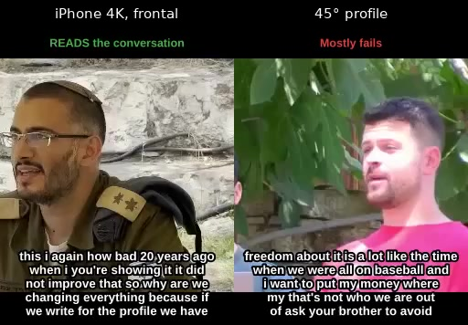
Mid-July client meeting - what we showed
Their footage, end-to-end
21 conversations · reports + subtitle videos
Capability on good capture
Best video: 3 of 4 turns understood
It knows when it’s right
Confident subset 70–92% useful
Their footage: best vs worst conditions
3
Notes:
Amosi missed this meeting - 90-second replay of what was on the wall (client side: Altman + Shier, ~1 hour). We showed the full evaluation of their own 21 conversations: per-video reports, subtitle videos, and the confidence story. The three proof points are the same trio the July 13 deck carried: best video (img_6825) 3 of 4 turns understood with the plot recoverable; self-flagged confident subset 70–92% useful (70% keeping top 10%, 92% keeping 3%); and capture conditions dominating everything downstream - expanded on the capture-chain slide. Vibe: supportive, not yet convinced; I stayed confident. Source: docs/evaluation/egla_kafe/findings.md.

Slide 4
Where the client landed
Their posture
Supportive, not yet convinced wants it to work
Agreed in the room
Capture protocol + re-shoot · guessing game now
Delivered since
Guessing-game package Jul 16 no feedback yet
In the room: “hard to tell it works unless you know the topic.”
4
Notes:
Their posture in one line: engaged and rooting for it, but not yet convinced by the raw output - their words: usable but requires sitting down and analyzing; scattered correct bits. They accepted the screen-recording explanation without pushback and worried their camera is too weak; I reassured them full HD with enough mouth pixels is fine. Agreed: they adopt the capture protocol, we run the guessing game (shipped Jul 16, hypothesis-only, no feedback yet), then a filming round 2. A follow-up client meeting still needs a date - that lands on whoever continues this.

Slide 5
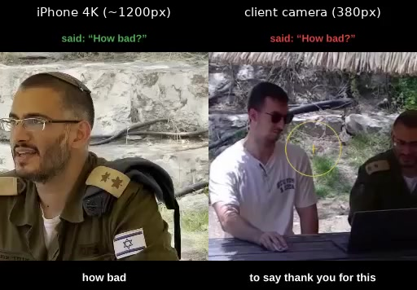
Why their footage failed - the filming spec
Screen recordings - not their camera. 4K = 2K = 1080p (175 pairs, n.s.)
1 · Framing first
Mouth ≥100 px in frame
2 · Original file exports
Never screen-record
3 · Resolution last
Full HD suffices
iPhone vs screen-recorded camera - clear turns 13.7% vs 0.8% (17×)
5
Notes:
Told to the client openly and accepted: their footage was ruined by HOW it was captured - screen recordings of the viewer app (odd sizes like 1258×696, 3–4 Mbps, UI chrome baked into pixels) - not by their camera. Same scene: iPhone IS 1.51 vs screen-rec 0.88 (p=2.3e-05); clearly conveyed 13.7% vs 0.8%. The ablation kills the resolution excuse: 4K/2K/1080p paired on 175 segments, IS 1.554/1.505/1.564/1.586, every test n.s. - the pipeline warps every mouth to ~45 px in a 96×96 crop. Biggest measured effect was the second lossy encode. Frontality is the other real lever (IS 1.62 front vs 1.03 at 45°). This slide doubles as the round-2 filming spec; the viewer app has zoom, so original exports may even make a re-shoot unnecessary. Sources: docs/evaluation/egla_kafe/resolution_ablation.md, docs/evaluation/egla_kafe/findings.md.

Slide 6
What it actually delivers today
It delivers
It does not
Gist-level comprehension
Names and places
Cold read: 33–56% of turns land
0% recovered - confident fabrications
guessing-game answer key, per video
“Abu dhabi” at 0.997 confidence
Trustable green words
Unattended automation
Green common nouns ~82% correct
Analyst effort required - ~half of segments useful
~10% of words are green
hallucination in 20.5% of segments
“Useful” ≠ “automatic” - NIV useful 61.9% · judge-useful 71.1%.
6
Notes:
The honest envelope, stated before anyone else states it: gist-level comprehension with scattered correct bits, real analyst effort required. Cold-read rates from our own guessing-game answer key: 33–56% of turns land (per video); green common nouns ~82% correct but only ~10% coverage; names and places 0% recovered and dangerously confident when fabricated ('Abu dhabi' at 0.997). Roughly half the segments carry useful content (NIV-Y+P 61.9%, salvage-adjusted ~62%); hallucination still hits 20.5% of segments. Prompt: this honesty is exactly why the next slide - the persuasion plan - exists.

Slide 7
The path the client proposed
1 · Guessing game
2 · Filming round 2
3 · Wow reel
4 · Their verdict
Shipped - awaiting their read
Long sentences
Framing
File exports
Cherry-picked - for their bosses
“We need this - continue”
→
→
→
Their offer: direct line to our bosses + ongoing tests, footage, feedback - possibly small budget.
7
Notes:
The heart of the decision case. Step 2 'realistic settings' as the client described: two people talking naturally, filmed from a distance, simple camera, longer sentences, direct exports - they defer to our judgment on specifics. Step 3: emotional impact over literal usefulness; cherry-picking is acceptable in their culture. Step 4 is the payoff: our management wants a client saying 'it works well' before continuing - the client explicitly offered to talk to our management directly, to keep investing time in tests, filming and feedback, and possibly small money (not heavy - they avoid funding politics). Prompt: the client volunteered to be exactly the voice our bosses asked for.

Slide 8
Two new technical asks from the client
A · Predetermined word subsets
B · Arabic transition
Anchor a wordlist
Prompting tested: worse
Route 1: constrained decode
Route 2: vocab fine-tune
~80% of stack carries over
Retrain k-means + LLM
Bottleneck: Arabic corpus
2–3 months from green-light
topic labels: WER 86.6→87.6 · 24% echo
ask: which Arabic - MSA / Levantine / Gulf?
Neither is promised - both are scoped · detail in backup slides.
8
Notes:
Both asks came from the client in the meeting. Word subsets: a genuinely good idea we have NOT built - be precise with Amosi. The only decode-time injection we measured (topic labels, 284 segments) made things worse: WER 86.6->87.6 and 24% of outputs echoed the instruction, because the model is QLoRA-locked to a fixed prompt. Two honest routes: constrained beam decoding / logit biasing (engineering, no code exists, testable), or vocab-conditioned fine-tuning, which rides the Llama-3.1 + 20K-segment bet. Arabic: AV-HuBERT is ~80% language-agnostic; retrain k-means (an Arabic k-means artifact already exists), swap in an Arabic-capable LLM (Jais/AceGPT/Llama-3 - with the caveat that multilingual pretraining can hurt VSR), retrain the Q-Former bridge. Real bottleneck: no Arabic LRS3-scale corpus - scraping is manageable but is the long pole. Framing precedent: 'roadmap mapped, work not started, 2–3 months from green-light.' Sources: docs/prompts/topic_label_experiment.md, docs/paper/arabic-vsp-adaptation.md.

Slide 9
What did not work - closed bets
Decode-param tuning
13 experiments - baseline wins best alt: +13% hallucinations
Small-data LoRA
1,273 segments overfit real need: 20K–50K + stronger LLM
xseg_merge
Silent no-op; wired, it breaks 1 : 10.7 - retired
Span substitution
149 fixed / 303 broken on wild data - NO-GO
Each closed with data and documented - the successor never re-runs these.
9
Notes:
Credibility slide: what we spent effort on and shut down. Decode-parameter tuning: 13 experiments (A–M); baseline beam=20/lenpen=0 most robust; the best alternative bought +0.08 IS at +13% hallucinations. LoRA fine-tuning on 1,273 segments: IS fell 2.487 → 2.312 (r=16) → 2.023 (r=64) with empty outputs 7.1% → 26.8% - a data-scale problem, not capacity; the honest requirement is 20K–50K segments plus a stronger LLM. xseg_merge shipped as a silent no-op (0 neighbors on all 1,497); simulated fixed, it breaks ~10.7 segments for every one it fixes - retired. Span-level substitution broke twice what it fixed (149F/303B, p≈4e-13 in the wrong direction) - only the word-level dual-engine arm shipped.

Slide 10
What continuation requires
People
Data
7 lead workdays remain finish vs transfer
Filming round 2 (client) · LRS3 sourcing
draft split in notes · successor unstaffed
LRS3 blocks the Llama-3.1 bet
Compute
Scale
Llama-3.1 ready - needs p4d quota (~$300, ~10h)
Continue at what level open decision
M4.1 calibration: ~1 GPU-day
second group waiting: ~100h footage handed over
Decision owner: Amosi - discussion, not a pitch.
10
Notes:
Deliberately neutral - no recommendation on the slide; mine is delivered verbally here. DRAFT finish-vs-transfer split for my 7 remaining workdays (edit live): FINISH - guessing-game feedback intake, scheduling the next client meeting, M4.1 confidence calibration if a GPU day is available, handover polish. TRANSFER - executing the Llama-3.1 migration (code ready, smoke-tested; blocked on LRS3 sourcing + p4d.24xlarge quota, ~$300 and ~10h when unblocked; swap alone ~1–2pp WER, the real unlock is context injection + domain-data scaling), the three 5-day briefs, filming round 2, Arabic scoping. Demand signal for the scale card: a second interested group already handed over ~100 hours of real footage (Q2 summary).

Slide 11
Handover - where everything lives
Handover doc
First-week checklist scripted - docs/guides/
Ready-to-assign briefs
3 × 5-day: quality pre-filter, multi-speaker, additivity
Working assets
Deployed container · client eval re-runs in days
Nothing lives only in my head.
11
Notes:
Close: succession is prepared, not aspirational. docs/guides/project-handover-july2026.md carries system state, deployment doctrine, client commitments, open bets, traps, and a scripted first week (read the docs in order, run the 37-test suite, one video end-to-end, learn the overlay sync, own the client follow-ups). Three onboarding-sized 5-day project briefs are written and estimated: M15 video-quality pre-filter (high value, no dependencies - the intended ramp project), M12 multi-speaker (client-requested), M4.2 signal-additivity. The client-eval pipeline re-runs on any new footage in days, not weeks - whoever takes over can repeat the Egla-Kafe evaluation on round-2 footage immediately.

Slide 12
Backup

Slide 13
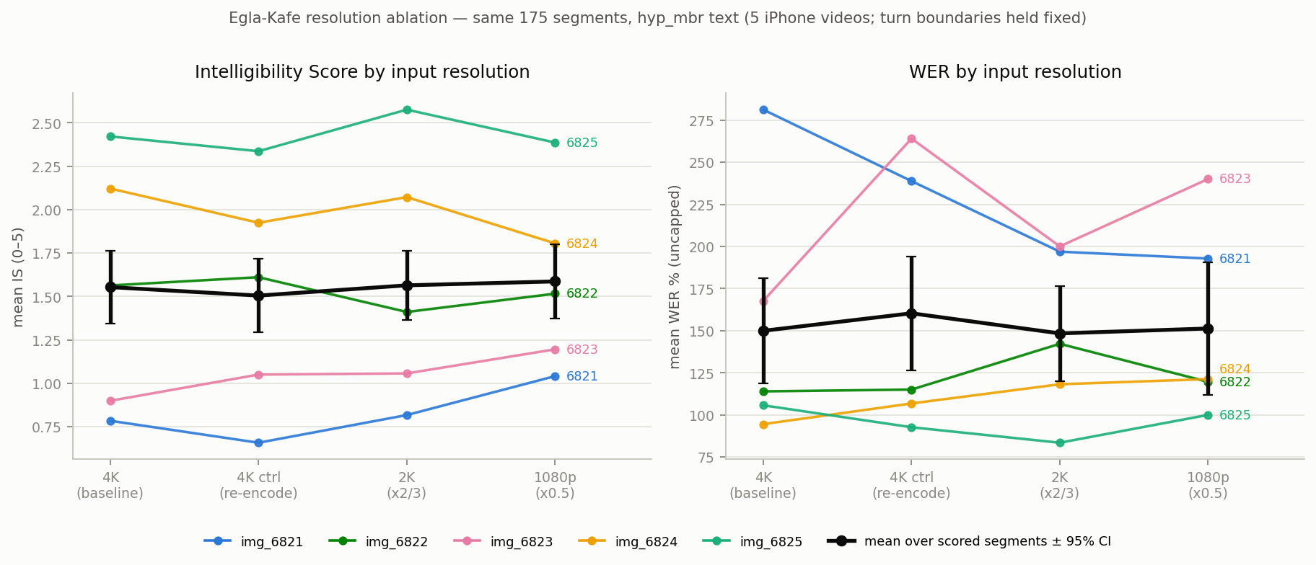
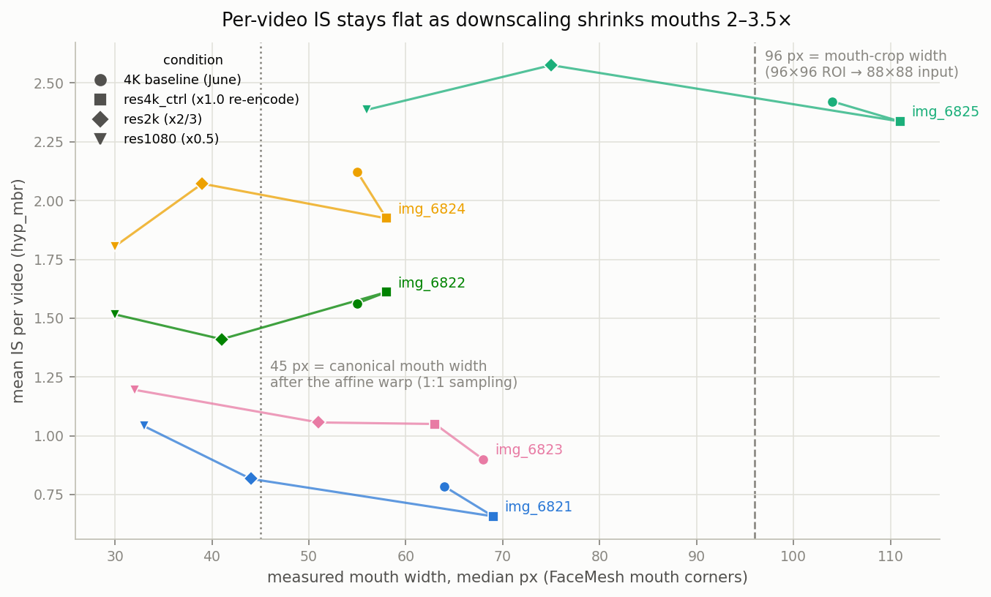
Backup · resolution ablation
Every mouth is warped to ~45 px in a 96×96 crop
IS / WER per condition
Mouth px vs quality delta - no cliff
IS 1.554 / 1.505 / 1.564 / 1.586 (4K / re-encode / 2K / 1080p) - all n.s. Biggest measured effect: the second lossy encode
B1
Notes:
For 'just buy a better camera' pushback. Paired sweep, same 175 segments per arm, byte-identical segmentation, decode identical. Native 4K mouths are only 55–68 px (one subject 104 px); 1080p mouths 30–33 px get mildly upsampled toward the ~45 px canonical scale - which is why resolution washes out, and 4K's extra pixels are discarded at input. The model's own mean word probability is 0.40 at every resolution. Re-encoding once (control arm) cost as much IS as discarding 75% of pixels. Frontality is the lever that survives: front IS 1.62 vs 1.03 at 45° (p=2e-03). Source: docs/evaluation/egla_kafe/resolution_ablation.md.

Slide 14
Backup · word subsets - evidence and routes
Motivation
19% of segments (284) domain-vocab confusion
Evidence
Topic labels: WER 86.6 → 87.6 24% instruction echo
Route 1 - decoding
Constrained beam / logit bias - no code today
Route 2 - training
Vocab-conditioned fine-tune Llama 3.1 + 20K segments
Prompting alone cannot fix domain vocabulary - the model is prompt-locked.
B2
Notes:
The client's ask maps to Report 3 Strategy 3 (vocabulary constraints) - proposed in February, never implemented. The measured neighbor experiment: injecting topic labels on the 284 domain-confused segments made WER worse (86.6→87.6) and 24% of outputs echoed the instruction text instead of transcribing - the QLoRA fine-tune locked the model to one prompt format and extra tokens shift visual features into positions the mapping never saw. Mislabeled topics cost up to -10.3pp. So: route 1 modifies the beam search itself (penalize/boost wordlist tokens - clean engineering experiment, unbuilt); route 2 bakes vocab conditioning into fine-tuning, which needs the Llama-3.1 migration plus 20K+ segments. Sources: docs/prompts/report_3_prompt_engineering.md §3.3, docs/prompts/topic_label_experiment.md.

Slide 15
Backup · Arabic - what it takes
Transfers (~80%)
AV-HuBERT visual stack is language-agnostic
Must retrain
k-means (artifact exists) · Arabic LLM · bridge
Bottleneck
No Arabic LRS3-scale corpus collection required
Estimate
2–3 months from green-light ask: which dialect?
Same data-scale reality that closed the English fine-tuning bets.
B3
Notes:
Lip/jaw geometry is largely universal, so the frozen AV-HuBERT encoder plus Arabic-retrained downstream is a viable first attempt (subtle gap: Arabic emphatics were never learned). Concretely: retrain k-means on Arabic audio (an arabic_flat_kmeans_200.bin artifact already exists), swap the LLM for an Arabic-capable model (Jais, AceGPT, multilingual Llama-3 - caveat: heavy multilingual pretraining measurably hurt VSR when we compared LLMs), retrain the Q-Former bridge + LoRA on Arabic pairs. The long pole is data: no Arabic LRS3 equivalent exists; broadcast/YouTube collection is manageable but real work. Phased plan and 2–3-month estimate: docs/paper/arabic-vsp-adaptation.md. Open question for the client: which Arabic (MSA / Levantine / Egyptian / Gulf).

