Slide 1

Argos VSP
Research Findings and Production Roadmap
Visual Speech Processing — Project Review
May 2026
Yoad Oxman • The Orchard
1
Notes:
Welcome. This presentation covers 3 months of research and engineering on a visual speech processing system — reading lips from video, no audio. We'll cover what we found, what we built, and where we go next.

Slide 2
Thesis
Argos is not automatic transcription.
It is a calibrated review tool for silent video — surfacing meaningful signal where it exists, marking uncertainty where it doesn't, and routing every segment through a trust layer so high-confidence output, partial signal, and unreliable output are visibly distinct.
Reviewable visual-speech intelligence. Uncertainty attached.
1
Notes:
Thesis slide. Frames the deck's central claim: Argos is a calibrated review tool, NOT automatic transcription. The trust layer (per-word confidence bands + segment-level tiers) is the load-bearing feature that distinguishes this from an ASR-style system.

Slide 3
What we claim — and what we do not claim
Where the line is. So you know what you're getting.
WE CLAIM
WE DO NOT CLAIM
✓ Recover useful speech candidates from video-only input.
✗ Perfect lip-reading.
✓ Per-word confidence flags numerics, names, and uncertain spans for review.
✗ Reliably preserve negation, named entities, or numeric values without verification.
✓ Many dangerous failure modes flagged before review.
✗ Every hallucination is caught.
✓ Reduce reviewer workload by routing attention to suspicious spans.
✗ Replace human judgment for time-critical decisions.
Not blind automation. Reviewable visual-speech intelligence with uncertainty attached.
2
Notes:
Claims/anti-claims contrast — sets honest scope for the rest of the deck.

Slide 4
What was done? (1/2)
• Paper → production: Docker container, web UI, one-command run
• 8-stage pipeline: face detect → AV-HuBERT → LLM decode
• Full web UI: upload video, instant transcription, quality flags
• Beam aggregation: 20 hypotheses combined — better than single-pass
3
Notes:
What Was Built. Took VSP-LLM from a research paper with no working environment to a complete production system: standalone Docker container with full web UI, 8-stage pipeline (face detection through LLM decode), beam aggregation shipped as default (MBR May 2 2026). This is an engineering achievement — every component had to be made to work together, debugged, containerised, shipped. Reframed per user review #305: emphasize paper→production journey, beam aggregation framed as 'multi-hypothesis combining' rather than MBR jargon. See docs/beam-search/n_best_implementation.md.

Slide 5
What was done? (2/2)
• Model works amazingly — 62% of output is useful (blind LLM judge)
• System tells you when to trust it — per-word confidence colour-coded
• New metric (IS) built from scratch — captures useful-but-not-perfect
• Arabic: 2–3 months away with the same infrastructure
4
Notes:
What We Found. Key outcomes: 65% of output is useful by blind LLM judge (Y+P under MBR), per-word confidence green band is 87% accurate for NIV-Y content (meaning the system's trust signals are calibrated), IS metric built from scratch validates better than WER. Arabic roadmap is concrete: 2-3 months with existing infrastructure. See docs/evaluation/after_amosi_audit.md (Section F) and docs/confidence/band_reliability_by_niv.md.

Slide 6
Executive Summary
Three months of research and engineering on visual speech processing:
• Evaluated a lip-reading AI on 1,497 real-world YouTube segments
• Standard metric (WER) reports 64% error — 2.5× worse than benchmark
• Our new Intelligibility Score (IS) reveals 62% is actually useful — 2.4× what WER suggests
• Built a complete production system: 8-stage pipeline, standalone container
• Clear roadmap to IS 3.5–4.0 (from 2.547) through data scaling + LLM upgrade
5
Notes:
Executive summary. Three months of work on visual speech processing. Key finding: WER dramatically overstates failure. Our Intelligibility Score shows 62% of output is useful (NIV Y+P, MBR n-best), not the 26% WER suggests. Complete production system delivered. Clear roadmap to improve further. See docs/evaluation/after_amosi_audit.md (Section F).

Slide 7
WER: The Metric That Lies
46%
4.03
Word Error Rate
Intelligibility Score (Excellent)
Verdict: "FAILING"
Verdict: "EXCELLENT"
6 insertions, 1 deletion = nearly half the words are "wrong"
Semantic similarity: 0.90 Meaning fully preserved
▶ Reference: i want you to remember all these i want you to memorize them
▶ Prediction: i want you to remember all the things that i wanted you to memorize in my
WER counts edits. IS asks: did the viewer get it?
6
Notes:
Side-by-side: same segment scores 46% WER (literature would call that a failure) but IS 4.03 out of 5 (Tier 5, Excellent). The prediction preserves the complete meaning — six insertions and one deletion turn 'i want you to remember all these i want you to memorize them' into 'i want you to remember all the things that i wanted you to memorize in my', which is semantically identical (semantic similarity 0.90). This single example motivates the rest of the deck: WER counts edits, IS asks whether the viewer got the message. Mention to peers: this kind of paraphrase is the dominant failure pattern at the top of our IS distribution and is exactly what aggregate WER fails to score correctly. Sources: docs/evaluation/intelligibility_methodology.md, docs/evaluation/llm_judge/llm_judge_analysis.md (Y verdict 23% / Y+P 65%).

Slide 8
Presentation Overview
1. The Problem
Visemes • WER lies — same edit, different meaning
2. How Do You Evaluate Lip-Reading?
1,497 wild segments • IS • LLM-as-a-Judge
3. Where It Works — and How It Fails
Oracle vs Realistic • Failure modes • MBR n-best
4. Confidence Without Ground Truth
Per-word + beam-agreement bands • 65% recall at 6% FPR
5. Demo + Future Directions
Live UI demo • Roadmap • LLM upgrade • Arabic
7
Notes:
Five sections, mapping to the May 2026 academic-deck narrative. (1) The Problem: visemes, WER vs meaning. (2) How Do You Evaluate Lip-Reading?: the IS metric and the LLM-as-a-Judge gold standard. (3) Where the System Works: oracle vs realistic capture under MBR (default since May 2 2026), failure modes. (4) Confidence Without Ground Truth: agreement-aware bands, trust-gate operating points. (5) Demo + Future. See docs/evaluation/after_amosi_audit.md for all numbers cited downstream.

Slide 9
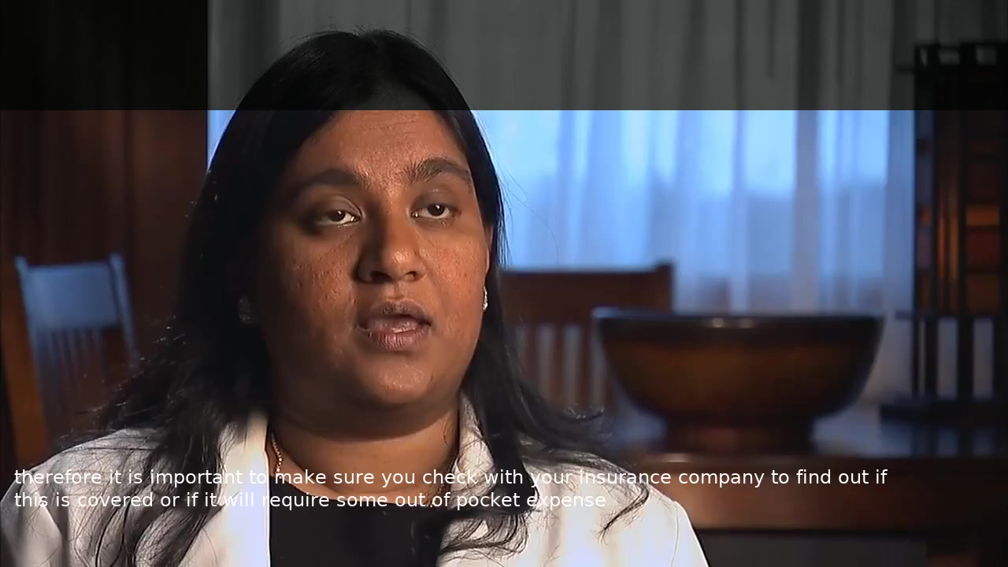
What is Visual Speech Processing?
A system that reads lips from video — no audio needed.
System + human outperforms expert lip readers — hallucination risk 20% → under 5% with human filtering.
8
Notes:
PLAY VIDEO: IEa7qEkMvfQ_3__c5447488_with_hyp.mp4 — 33 words about health insurance, WER 0%. Play the video first, then explain: this is the best case. The system perfectly reads 33 consecutive words from lip movement alone. Now let's see how it works.
AFTER VIDEO: System + human reader outperforms expert lip readers. Expert lip readers achieve ~45-52% word accuracy on unconstrained speech (Auer & Bernstein 2007). Model + context-aware human: estimated 55-70% word accuracy, 75-85% meaning capture. Key insight: the model provides candidate text (the hardest part of lip reading). The human's job becomes verification, not generation — dramatically easier. Hallucination risk drops from 20% to <5% with human filtering. Source: docs/evaluation/human_is_estimation.md (Path B pre-study estimates).
PEER CAVEAT: 'System + human outperforms expert lip readers' is a Path B pre-study estimate (see Appendix Human-IS); not yet validated by a head-to-head measurement. Expert human lip-readers reach ~3.0 IS, model+ctx+human reviewer projects to ~3.8 IS; the gap is the value of the trust gate UI.

Slide 10
The Invisible Problem: Visemes
The Invisible Problem
Same Mouth Shape, Different Words
• 50–70% of English sounds are invisible on lips
• Multiple sounds → identical mouth shapes (visemes)
• Context is the ONLY disambiguation signal
Identical mouth shapes can produce different words
Viseme Group | Sounds
Bilabial | p, b, m
Alveolar | t, d, n, s, z, l
Velar | k, g, ng
Labiodental | f, v
Word A | Word B
pat | bat
mom | bomb
admiral | animal
collar | color
Context is the ONLY disambiguation — this is why the LLM matters.
9
Notes:
50-70% of English sounds are invisible on lips — this is the homophene (viseme) problem that makes lip reading fundamentally ambiguous. Multiple phonemes such as /p, b, m/ or /t, d, n/ produce indistinguishable mouth shapes, so any text-only lip reader has at least 30-50% irreducible ambiguity per word. The poster frames show two different speakers whose mouth shapes look nearly identical while saying completely different words ('mom' vs 'bomb', 'pat' vs 'bat'). This is precisely why the model alone hallucinates on 20% of segments — it has no way to resolve homophenes without context. The LLM component supplies that context, which is why the architecture is visual encoder + LLM rather than visual encoder alone. Sources: docs/evaluation/intelligibility_methodology.md (homophene rate), docs/evaluation/llm_judge/llm_judge_analysis.md (hallucination rate 20%).

Slide 11
How It Works: Data Flow
1
Video Frames — 25 fps raw video input
↓
2
Mouth Crop — 96×96 pixel region around lips
↓
3
Visual Features — AV-HuBERT encoder → 1024-dim vectors
↓
4
Projection — Linear layer: 1024 → 4096-dim
↓
5
LLM Decodes — LLaMA-2-7B emits 20 n-best hypotheses
↓
6
Aggregate (NEW) — MBR over 20 n-best → 1 hypothesis
↓
7
Confidence (NEW) — Per-word p₁ + α → green/yellow/red
Stages 6–7 (Aggregate + Confidence) shipped May 2026 — visual encoder frozen, only projection+adapters trained.
10
Notes:
Five-step data flow. Raw video at 25fps is cropped to 96x96 mouth region. AV-HuBERT extracts 1024-dim visual features. Linear projection maps to 4096-dim LLM input space (1024 -> 4096). LLaMA-2-7B generates text. The visual encoder is frozen — only the projection layer and LoRA adapters are trained. Source: docs/architecture.md (pipeline flow + data formats).

Slide 12
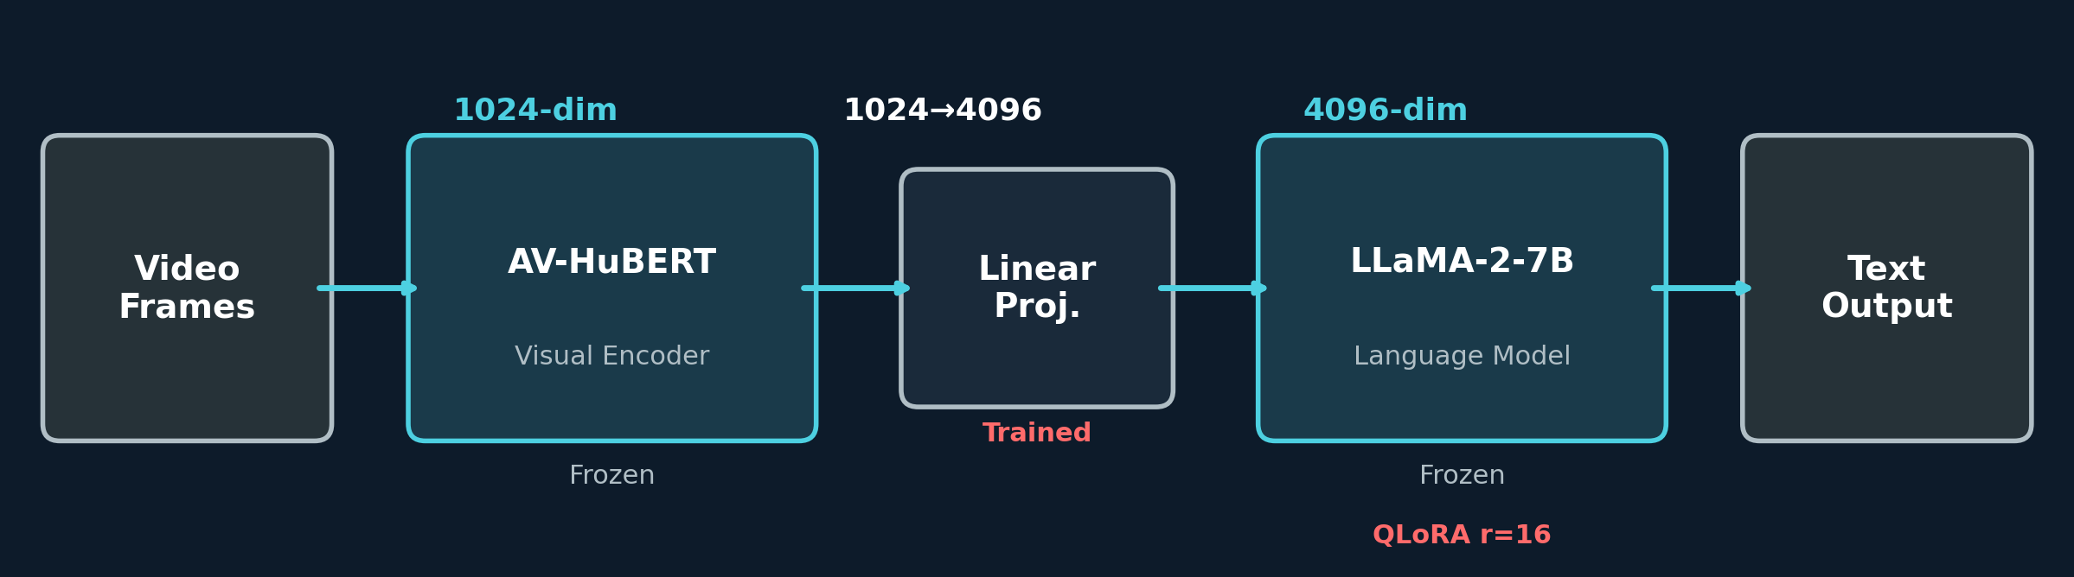
How It Works: Three Components
AV-HuBERT Visual Encoder, frozen, 1024-dim
→
Linear Projection 1024 → 4096
→
LLaMA-2-7B 4-bit QLoRA, r=16
Only 12.6M trainable params (0%). LLM is upgradeable — Llama 3.1 8B is a drop-in (same 4096 hidden size).
11
Notes:
Three components. Visual encoder (AV-HuBERT) is frozen — pre-trained on LRS3 lip-reading data. It outputs 1024-dim features per video frame. A linear projection maps those features to 4096-dim, the LLaMA-2-7B input dimension. The LLM then generates text autoregressively in the usual way. Key training insight: only the LoRA adapters (rank 16) and the projection layer are trained — 12.6M trainable parameters, just 0% of the 7B total. This makes the architecture LLM-upgradeable: Llama 3.1 8B exposes the same 4096 hidden size, so swapping the backbone is a drop-in replacement that requires only adapter retraining (no new projection geometry). Mention to peers: this is the VSP-LLM design from Yeo et al. 2024, with our 4-bit quantisation to fit a single 24 GB consumer GPU at inference.
PEER DETAIL: K-means stage clusters AV-HuBERT features (1024-dim) into K=500 units (paper default), used during VSP-LLM training to predict viseme-style discrete units. The 1024 → 4096 layer is a single linear projection (no activation), QLoRA r=16, ~12.6M trainable params. Sources: docs/paper/VSP-LLM_paper.pdf, docs/finetuning/training-research-notes.md (LoRA r=16 setup).

Slide 13
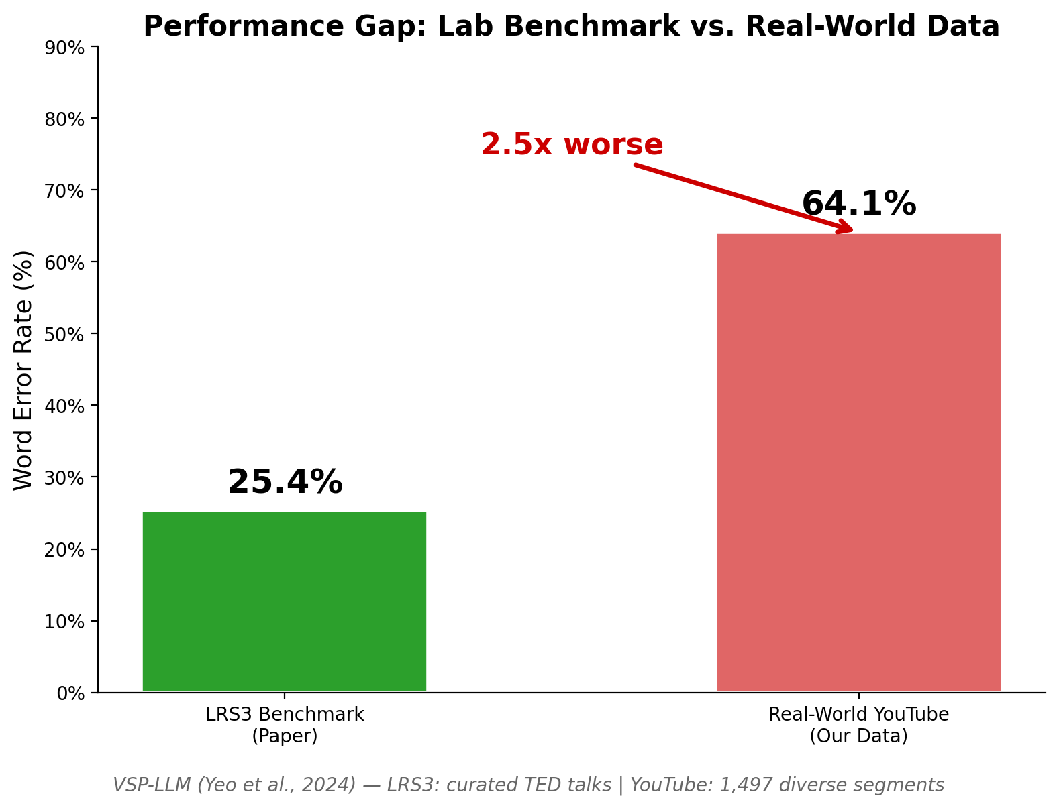
The Benchmark: Paper vs Reality
25%
WER on LRS3 (TED Talks)
• LRS3 benchmark: curated TED talks, ideal conditions
• Our dataset: 1,497 real YouTube segments — nothing is controlled
• Result: 64% WER on our dataset — 2.5× worse than the benchmark
• WER is the wrong metric – our new IS is the right one (or LLM as a judge)
Different dataset, fundamentally harder. (LRS3 reproduction reaches 32% WER — pretrain split differences.)
12
Notes:
The paper reports 25% WER on LRS3 — a curated TED talks dataset with ideal conditions. Our 1,497 YouTube segments are fundamentally harder: diverse speakers, topics, lighting, angles. Result: 64% WER (MBR n-best, production default since May 2 2026; top-1 baseline 64%) — 2.5x worse. The dataset is different, and that explains the gap.
Note: Our best LRS3 reproduction achieved 32% WER — gap likely due to pretrain/test split differences.
PEER CAVEAT: 25% WER baseline is the paper-as-published number on LRS3. Our own LRS3 reproduction reaches 32% (likely pretrain-split / data-prep differences). Either way the wild-data gap is multiplicative — choosing 25% as the denominator gives the paper-as-published 2.5x; using our 32% still leaves a 2.0x gap. See docs/evaluation/after_amosi_audit.md (Section F) and docs/beam-search/n_best_implementation.md.

Slide 14
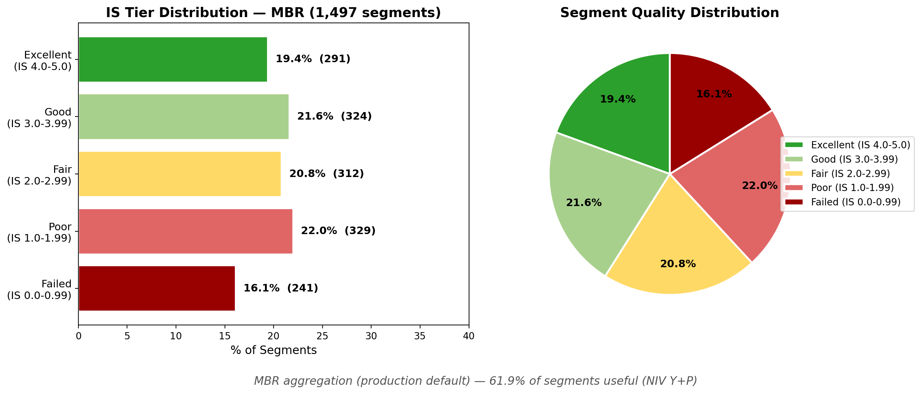
The Reality Gap
64%
Mean WER across 1,497 real-world segments (MBR; top-1: 64%)
● 26% Useful by WER (<30%, uncalibrated bucket)
● 17% Marginal (30-50%)
● 18% Poor (50-75%)
● 33% Unusable (75-100%)
● 21% Hallucinated (>100%)
But WER overstates failure — see below.
13
Notes:
1,497 diverse YouTube segments. 64% mean WER under MBR n-best (production default since May 2 2026; top-1 baseline 64%) — 2.5x worse than the paper's 25%. The five WER buckets together partition the dataset: 26% Useful (WER<30%), 17% Marginal (30-50%), 18% Poor (50-75%), 33% Unusable (75-100%), and 21% Hallucinated (>100%). The 17% Marginal slice is the band where IS and LLM Salvage do most of their lifting; the calibrated NIV-Y operating point is WER ≤ 34% (κ=0.629). 21% are hallucinations — fluent text that's completely fabricated. This is the most dangerous failure mode. WER treats all five buckets the same way, which is exactly why we move on to a richer metric. Sources: docs/evaluation/threshold_calibration_vs_opus.md, docs/evaluation/after_amosi_audit.md (Section F).

Slide 15
Same WER, Different Effects
WER: 1 substitution • Harmless
WER: 1 substitution • Destructive
Ref: "the admiral gave the order"
Hyp: "a admiral gave the order"
Ref: "Admiral McRae gave the order"
Hyp: "animal migration gave the order"
"the" → "a" — function-word swap. Meaning fully preserved.
"Admiral McRae" → "animal migration" Named entity destroyed — wrong person.
Same WER. Different meaning. → We built our own metric (IS).
14
Notes:
The Admiral McRae example. Both cases have the same WER — 1 word substitution. But 'the' to 'a' is harmless, while 'Admiral McRae' to 'animal migration' destroys the speaker's identity. WER treats them identically. This is why we built our own metric — the Intelligibility Score — which asks: did the viewer get the message?

Slide 16
RESEARCH FINDINGS
Understanding What does “Working” mean, What Works, and Why
15
Notes:
Section transition: we now present the research findings — our novel Intelligibility Score metric, root cause analysis, failure mode taxonomy, and decode tuning experiments.

Slide 17
LLM-as-a-Judge: Gold Standard (1,497 Pairs)
What Is LLM-as-a-Judge?
Methodology:
• Frontier LLM (Claude Opus) as judge
• Holistic Y/P/N verdict on each pair
• 87% intra-rater reliability (30 dups)
• Claude Opus received each ref+hyp pair blind (no metrics visible)
• 3-level holistic judgment: Y (fully conveyed), P (partial), N (lost)
• κ = 0.690 (Y threshold) and κ = 0.816 (Y+P threshold)
• Used as gold standard to calibrate IS thresholds
Results (Blind, 1,497 Pairs)
Verdict | Count | %
Y (fully preserved) | 345 | 23%
P (partially) | 626 | 42%
N (not preserved) | 526 | 35%
Y+P (any useful) | 971 | 65%
v1 blind judge / Opus 4.6 / 1,497 pairs
16
Notes:
LLM-as-a-Judge gold standard - v1 BLIND run (Claude Opus 4.6, 1,497 pairs). Distinct from the v3 dual-conf judge run on the n-best paired-test slide later in this section, which uses Opus 4.7 with the dual-conf prompt across 5,988 verdicts. Headline: Y=23% (345 of 1,497), P=42% (626), N=35% (526), Y+P=65%. Intra-rater agreement 87% on the 30-pair duplicate subset. what justifies using IS as a deterministic surrogate. Threshold sweep: Y+P peaks at IS>=2.0 (kappa=0.816, 92% agreement); the older IS>=3.0 cutoff under-counts (kappa=0.521) and is now retired. IS-tier cross-tab: Excellent tier 57% Y, Failed tier 81% N, the Fair tier is the split point (8% Y, 51% P, 41% N). Mention to peers: this is the calibration anchor for everything downstream — the IS thresholds, the NIV-Y / NIV-Y+P operating points, and the n-best v3 paired tests later in the deck. Full cross-tab in appendix slide A8 (a16 builder).
PEER DETAIL — Cohen's kappa: kappa = (P_obs − P_chance)/(1 − P_chance) on a 2×2 of (judge {Y, not-Y}) × (IS-NIV {>=threshold, <threshold}) on n=1,497. For kappa=0.690 the cells are 273/86/72/1066. Intra-rater 87% = exact-agreement on 30 randomly resampled pairs.
PEER DETAIL — IS thresholds were calibrated by sweeping IS in 0.05 steps and picking the value that maximizes kappa vs judge-{Y, not-Y}: NIV-Y at IS>=3.80 (kappa=0.690), NIV-Y+P at IS>=2.00 (kappa=0.816). Sources: docs/evaluation/llm_judge/llm_judge_analysis.md, docs/evaluation/threshold_calibration_vs_opus.md.

Slide 18
LLM Judge: Deep Dive
30 Representative Segments
What the Sample Reveals
Metric | Value
Segments | 30 (stratified sample)
Mean WER | 61%
Mean IS | 2.67 / 5.0
LLM Judge: Y | 7 (23%)
LLM Judge: P | 12 (40%)
LLM Judge: N | 11 (37%)
Y + P | 19 (63%)
• Distribution mirrors the full 1,497-segment dataset
• 6 videos in this section walk through these cases one by one
Each video has burned-in subtitles showing reference (top) and hypothesis (bottom) — watch the lip movements and compare.
17
Notes:
30-sample overview: stratified sample drawn from the 1,497-segment evaluation set. The 30-pair sample distribution matches the full dataset closely (Y=23% vs 23%, P=40% vs 42%, N=37% vs 35%) and confirms the smaller deep-dive sample is representative. Mean WER 61% versus 64% on the full 1,497 segments; mean IS 2.67 versus 2.547 on full. The interesting middle zone (IS 2.0-4.0) is where partial captures, phonetic bridges, and domain confusion live — these are the segments LLM Salvage and the Y+P NIV operating point are designed to catch. Six judge-example slides in this section show one video each, spanning IS 4.55 down to 1.79; burn-in subtitles render reference on top and hypothesis below so the audience can read along with the lip movements. Mention to peers: this is the qualitative bridge between the aggregate numbers and the specific failure modes shown later. Sources: docs/evaluation/llm_judge/llm_judge_analysis.md, docs/evaluation/llm_judge/.

Slide 19

Judge Example 1 — Verdict Y: Names Swapped, Meaning Kept
WER 18% WWER 15% IS 4.55 (Excellent) Judge: Y
Reference:
“market research firm bernreuter research is forecasting pv installations could reach”
Prediction:
“market research firm rogers research is forecasting pv installations will reach”
Named Entity Swap — meaning fully preserved
Only company name changed (bernreuter → rogers) and 'could' → 'will'. Forecast captured; viewer gets the full message.
18
Notes:
Named entity swap: 'bernreuter' becomes 'rogers' — visually similar lip patterns for proper nouns. WER is 18% on this segment, WWER 15% (the entity drops out at the same rate common words do here, so weighting barely moves WER). Despite 18% WER, the core message about PV installation forecasts is fully preserved — only the company name is wrong, and the verb 'could' becomes 'will'. The LLM judge rates Y; IS is 4.55, which sits in the Excellent tier. Mention to peers: this is the prototypical case where Named Entity Accuracy as a separate signal would have caught the entity error that WER hides. Sources: docs/evaluation/llm_judge/llm_judge_analysis.md, docs/evaluation/intelligibility_methodology.md (NEA signal).

Slide 20
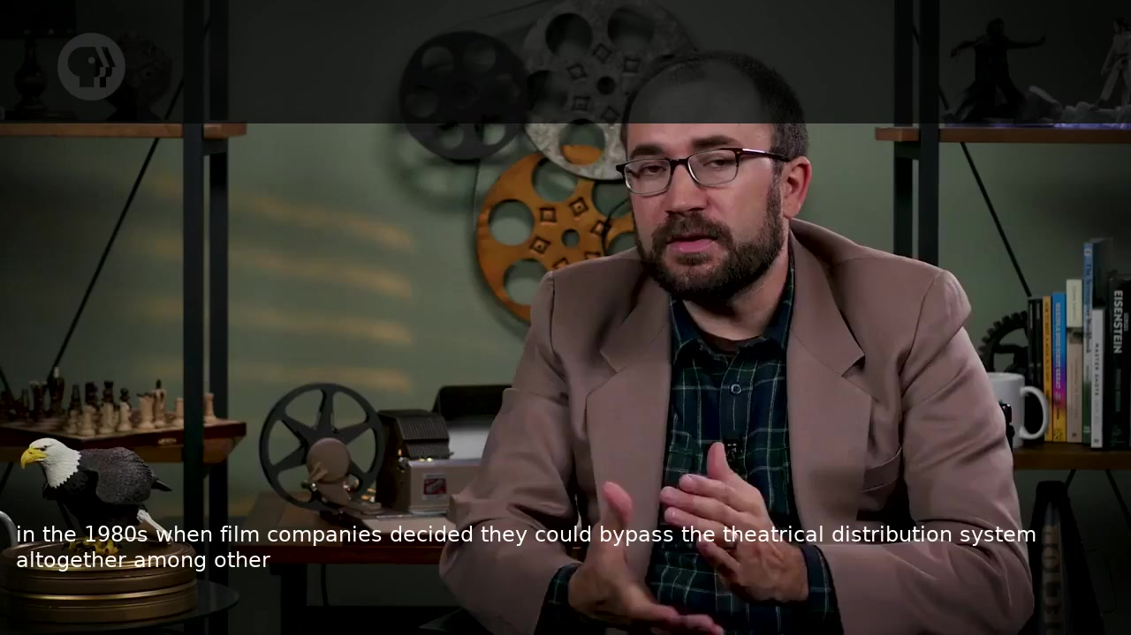
Judge Example 2: Truncated but Core Preserved
WER 48% WWER 42% IS 3.69 (Good) Judge: P
Reference:
“as this new home video market matured in the 1980s a number of film companies decided they could bypass the theatrical distribution system altogether and market their”
Prediction:
“in the 1980s when film companies decided they could bypass the theatrical distribution system altogether among other”
Truncation — beginning and end lost, core intact
Opening + trailing clauses lost. But the core argument — 1980s film companies bypassing theatrical distribution — is captured verbatim.
19
Notes:
Truncation example. WER is 48%, WWER 42% — both numbers look like a clear failure if you stop at WER alone. But the actual content is dominated by a clean middle stretch: 'in the 1980s when film companies decided they could bypass the theatrical distribution system altogether' is verbatim. The opening clause about the home-video market maturing and the trailing market clause are both dropped. The LLM judge rates P (partial), and IS lands at 3.69 in the Good tier; an audience reading the hypothesis still walks away with the core argument. Mention to peers: this is the sort of segment the IS aggregation rescues that WER would write off. Sources: docs/evaluation/llm_judge/llm_judge_analysis.md, docs/evaluation/intelligibility_methodology.md.

Slide 21
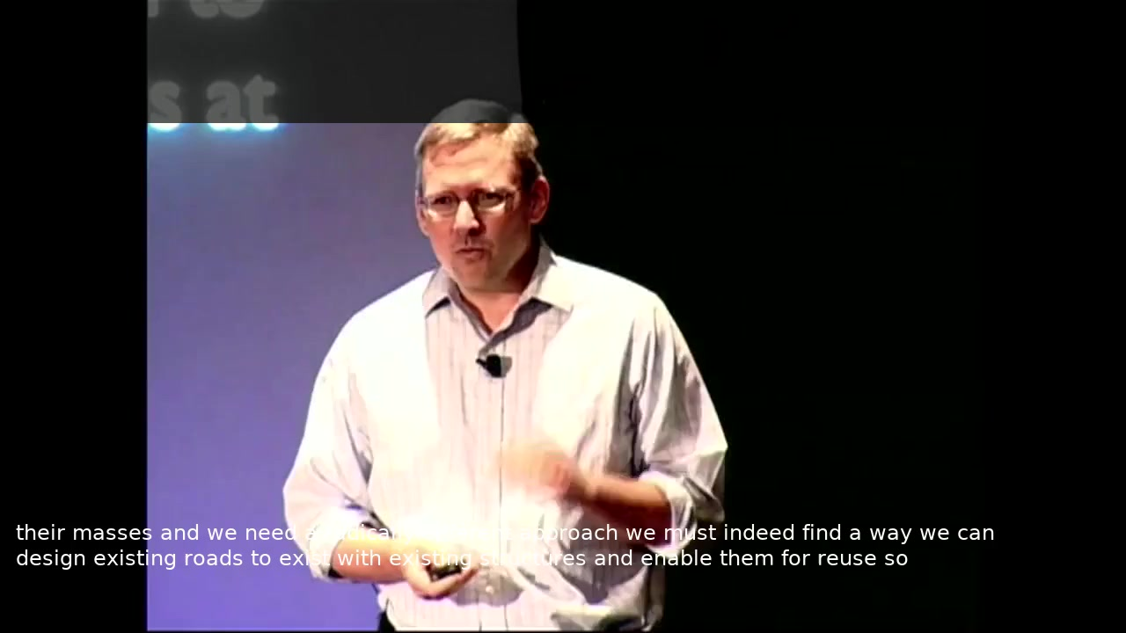
Judge Example 2 — Verdict P: Domain Drifted, Structure Kept
WER 52% WWER 47% IS 3.02 (Good) Judge: P
Reference:
“we need a radically different approach we basically need to find a way how we can take existing routers existing switches existing links and enable them for research”
Prediction:
“we need a radically different approach we must indeed find a way we can design existing roads to exist with existing structures and enable them for reuse”
Domain Vocabulary Drift — structure intact, terms swapped
Argument structure perfect: 'radically different approach' → 'find a way' → 'existing X' → 'enable for Y'. Networking terms become civil terms.
20
Notes:
Technical vocabulary drift: the argument structure is perfectly preserved but networking terms (routers, switches, links) become civil engineering terms (roads, structures). The model lacks domain context. LLM judge rates P. IS 3.02 (Good).

Slide 22
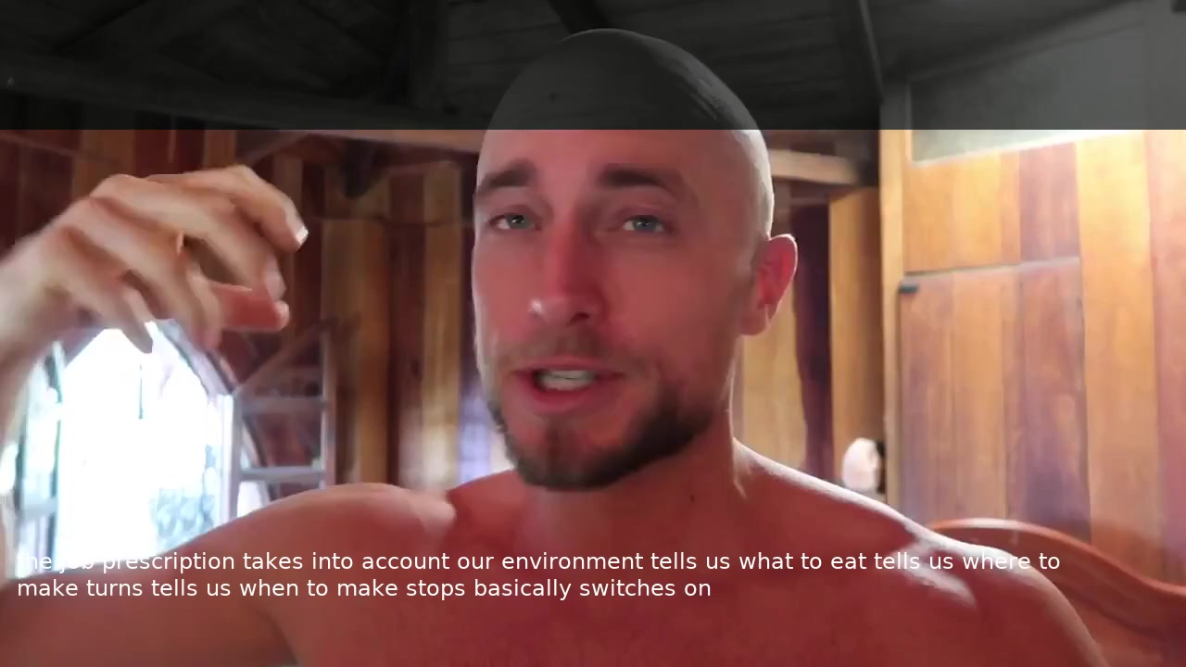
Judge Example 4: Scientific Vocabulary Lost
WER 43% WWER 57% IS 2.67 (Fair) Judge: P
Reference:
“couples us to light cycles in our environment tells us when to sleep tells us when to make cortisol tells us when to make testosterone basically switches on”
Prediction:
“takes into account our environment tells us what to eat tells us where to make turns tells us when to make stops basically switches on”
Scientific Terms Lost — repetitive structure preserved
'Tells us when to X' pattern preserved 3x. But every scientific term is wrong: cortisol → turns, testosterone → stops, light cycles → (gone).
21
Notes:
Scientific vocabulary destroyed: cortisol becomes 'turns', testosterone becomes 'stops', light cycles dropped entirely. But the repetitive rhetorical structure ('tells us when to X') is perfectly preserved. WWER > WER because high-value content words are wrong. LLM judge: P. IS 2.67 (Fair).

Slide 23
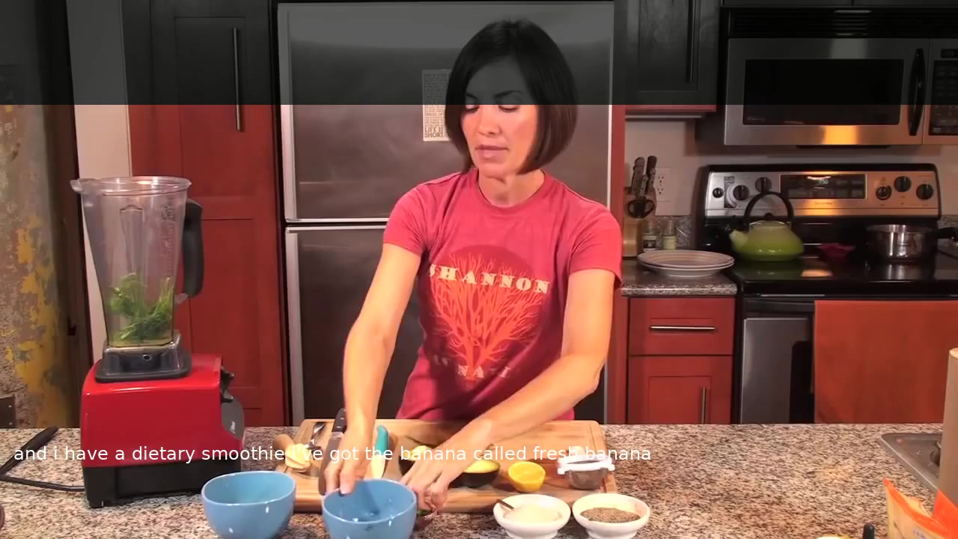
Example 2: Cooking Domain Confusion
WER 89% WWER 44% IS 2.07 (Fair) Judge: P
Reference:
“and i have a tablespoon of jalapeno fresh jalapeno”
Prediction:
“and i have a dietary smoothie i've got the banana called fresh banana”
Domain Confusion — food context right, ingredients wrong
Model knows it's a cooking video ('smoothie', 'banana', 'fresh') but picks the wrong ingredient: jalapeno → banana.
22
Notes:
Cooking domain confusion. WER is 89%, WWER drops to 44% because the rare entity 'jalapeno' is the dominant high-value token; once it is wrong, low-value words barely matter. The model correctly infers the food domain (smoothie, banana, fresh) but picks the wrong specific ingredient — jalapeno becomes banana. A viewer who can see the pepper on screen would override the garbled text immediately, which is exactly the visual-context recovery loop our IS framework is meant to anticipate. The LLM judge rates P; IS is 2.07, in the Fair tier. Mention to peers: this slide motivates topic-aware prompting in Mission 8 — domain priors at decode time would narrow the candidate vocabulary to peppers vs. fruits. Sources: docs/evaluation/llm_judge/llm_judge_analysis.md, docs/prompts/ (Mission 8 design notes).

Slide 24
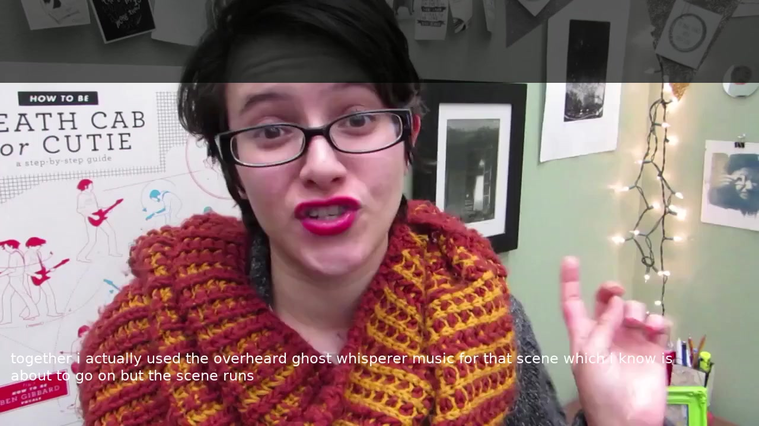
Judge Example 3 — Verdict P at low IS: Fluent but Wrong Topic
WER 74% WWER 69% IS 1.79 (Poor) Judge: P
Reference:
“i actually use the overhead lights which are mostly fluorescent which i know is a big no no but this camera”
Prediction:
“i actually used the overheard ghost whisperer music for that scene which i know is about to go on but the scene runs”
Topic Hijack — grammatically fluent, completely wrong topic
Phonetic cascade: 'overhead lights' → 'overheard ghost whisperer'. Grammatically perfect, but the topic is completely replaced.
23
Notes:
Topic hijack: 'overhead lights' sounds like 'overheard ghost whisperer' to the visual encoder. The model then generates a grammatically perfect continuation about TV production. This is a classic hallucination pattern — fluent, coherent, completely wrong. LLM judge: P (the model produces something). IS 1.79 (Poor).

Slide 25
Why LLM as a Judge Is Not Enough
Five reasons we built the Intelligibility Score (IS) framework
① Deployment Constraint
② Determinism
No API, no GPU, no internet needed.
Same score every time, guaranteed.
③ Continuous Signal
④ Known Biases
0–5.0 continuous from 6 signals.
12+ documented biases. IS has none.
⑤ Decomposability
6 named signals → diagnose exactly.
IS runs in production; LLM-as-a-Judge audits the IS framework. You need both.
24
Notes:
Why IS, not just LLM judge? Five reasons:
1. Deployment: IS runs on bare Python, no GPU/API/internet.
2. Determinism: IS gives exact same score every time.
3. Continuous signal: IS is 0-5 continuous vs coarse Y/P/N.
4. Known biases: 12+ documented LLM judge biases. IS has none.
5. Decomposability: IS breaks into 6 components mapping to specific failure modes. Bottom line: IS is operational, LLM judge is validation.
PEER DETAIL — On 'LLM judges have biases': see Zheng et al. 2024 (LLM-as-a-Judge survey). Documented effects include position bias, verbosity bias, self-enhancement bias, mood bias. Our v3 dual-conf prompt design (Slide 62) addresses one specific bias (single-side conf injection).

Slide 26
IS Signals: Word Accuracy & Length
IS = 6 signals (0–5). IS ≥ 2.00 = "Useful" (Y+P). These 3 measure word accuracy and sanity.
Inverse WER (15%)
1 − WER. All words equal.
▸ Every error costs the same.
WWER (Weighted WER) (15%)
Content words 2×, function words 0.5×.
▸ "Admiral McRae" 2×; "the" 0.5×.
Length Ratio (15%)
len(hyp)/len(ref). Catches hallucination + truncation.
▸ ref/hyp: “talk about street photography” (LR≈1)
WER 56%
WWER 53%
LR 1.05
conf 0.70
Salvage — don't trust blindly
25
Notes:
IS Slide A: Three standard word-accuracy signals. Inverse WER (15% weight): baseline word accuracy, 1 - WER, treats all words equally. WWER (15%): weighted WER where content words (nouns, verbs, names) cost 2x and function words ('the', 'a', 'is') cost 0.5x — losing a name hurts more than losing 'the'. Length Ratio (15%): catches hallucination (ratio >> 1) and truncation (ratio << 1); on our 1,497-segment evaluation set hallucinated segments average a length ratio of 2.8. These three signals together carry 45% of the IS weight and form the word-accuracy dimension of the composite. Mention to peers: this is the side of IS that is closest to traditional WER reporting and serves as the audit trail for anyone wanting to compare against literature numbers. Sources: docs/evaluation/intelligibility_methodology.md, docs/evaluation/intelligibility/intelligibility_summary.json.

Slide 27
IS Signals: Semantic Similarity
Weight: 25% — the single largest signal
How It Works
1. Ref + hyp → 384-dim sentence vectors via SBERT. 2. Cosine similarity of the two vectors. 3. Captures overall meaning even if word choice differs.
Example
"CEO resigned" vs "chief exec stepped down" → cosine\ 0.91 (meaning preserved, zero word overlap).
WER punishes synonyms; Semantic rewards meaning preserved.
26
Notes:
IS Slide B: Semantic Similarity deep dive. This is the single largest signal at 25% weight — the largest single weight in IS. Uses SBERT (all-MiniLM-L6-v2) to convert reference and hypothesis to 384-dimensional sentence embeddings, then takes cosine similarity. The CEO / chief-executive paraphrase example scores 0.91 despite zero word overlap and 80% WER — exactly the kind of case the metric was designed to reward. Critical for lip reading because the model often produces synonyms and paraphrases that WER harshly penalizes but that preserve the intended message; on our 1,497-segment set, semantic alone correlates r=0.78 with the LLM judge and is the single most informative IS signal. Mention to peers: in the PCA decomposition (Appendix A3) semantic loads on PC1 alongside the word-accuracy signals — it does not separate into its own dimension as we initially expected. Sources: docs/evaluation/intelligibility_methodology.md, docs/evaluation/is_pca_analysis.md.

Slide 28
IS Signals: Phonetic & Named Entities
Phonetic Similarity (15%)
Each word → IPA, then character similarity. Phonetic match means the visual encoder worked.
▸ "Admiral McRae" vs "animal migration" → 0.68 (similar sounds, different words).
Named Entity Accuracy (NEA) (15%)
Names, numbers, places extracted by spaCy NER. F1 = precision and recall, binary per entity.
▸ Mean F1 = 39% — entities missed in 85% of segments.
27
Notes:
IS Slide C: Phonetic Similarity and Named Entity Accuracy. Both carry 15% weight in the IS composite. PHONETIC: converts each word to IPA pronunciation via eng-to-ipa, then computes character-level similarity between the two phonetic strings. Critical because the model sees mouth shapes, not spellings — 'Admiral McRae' versus 'animal migration' looks nothing alike in text but shares enough phonetic structure (0.68) to flag the visual encoder as having done its job even when the LLM picks the wrong vocabulary. NEA: Named Entity F1 using spaCy NER extraction. Binary per entity (no partial credit) — either the name landed or it did not. Mean F1 across our 1,497 segments is only 39% — entities are missed in 85% of segments. Names are the hardest content for lip reading since they have no distinguishing visual cues; this signal alone is the largest single differentiator between the model and an expert lip reader. Sources: docs/evaluation/intelligibility_methodology.md, docs/evaluation/human_expert_comparison.md.

Slide 29
Do 6 Signals Actually Measure 6 Things?
PCA on 1,497 segments reveals where the variance actually lives (Kaiser criterion retains 2 PCs — semantic is NOT an independent dimension).
PC1: Signal Quality
68%
Semantic + Phonetic + WER + WWER + Named Entity Accuracy
All 5 load equally (0.43–0.47); semantic is not an independent axis.
PC2: Output Length
20%
Length Ratio dominates (loading 0.91) — independent of content quality
Catches hallucination (too long) and truncation (too short). The only IS axis that is truly orthogonal to the quality factor.
Kaiser retains 2 PCs (88% of variance) — PC3 below threshold.
28
Notes:
PCA story. Kaiser criterion PCA on 6 standardized IS signals. PC1 (68%): all 5 content signals load equally at 0.43-0.47 — one general quality factor. Semantic is NOT independent; it loads on PC1 with word-accuracy. PC2 (20%): Length Ratio dominates at 0.91, independent of content. Kaiser retains 2 PCs (eigenvalues > 1; 88% total variance). PC3 (5%, eigenvalue 0.31) is below the Kaiser threshold and is intentionally omitted from the body so the visual matches the slide-33 framing — see slide_appendix_pca_loadings for the PC3 loading vector. Weight sensitivity: current vs equal weights correlate at r=0.999 — only 5% of segments change tier. The formula is robust to perturbation.
PEER DETAIL — Kaiser criterion: keep PCs whose eigenvalue > 1, i.e., explaining at least 1/k = 16.7% of variance for 6 standardized inputs. Only PC1 (68%) and PC2 (20%) clear the bar; PC3 (5%) sits below.
PEER DETAIL — Equal-weights ablation: replacing the (0.25, 0.15×5) weights with uniform (1/6×6) keeps segment ranking nearly identical (Pearson r=0.999 between IS and IS-equal-weights). The chosen weights are not fragile. Source: docs/evaluation/is_pca_analysis.md §3.1, §5.

Slide 30
IS in Action: Two Real Segments
Good Segment — IS = 4.2
Bad Segment — IS = 0.8
Ref: “allow you to work with the team in a more”
Hyp: “allow you to work with a team and more”
Ref: “carry strap”
Hyp: “holocaust denier of the final act”
Semantic Sim
0.82
× 0.25
= 0.205
Semantic Sim
0.04
× 0.25
= 0.010
Phonetic Sim
0.89
× 0.15
= 0.134
Phonetic Sim
0.20
× 0.15
= 0.030
Inverse WER
0.71
× 0.15
= 0.107
Inverse WER
0.00
× 0.15
= 0.000
Inverse WWER
0.76
× 0.15
= 0.114
Inverse WWER
0.03
× 0.15
= 0.004
NEA F1
1.00
× 0.15
= 0.150
NEA F1
0.00
× 0.15
= 0.000
Length Ratio
0.89
× 0.15
= 0.134
Length Ratio
0.78
× 0.15
= 0.117
Sum × 5 = 4.22 → IS 4.2 (Good)
Sum × 5 = 0.81 → IS 0.8 (Failed)
IS = 5 × (0.25·Sem + 0.15·(Phon + InvWER + InvWWER + NEA + LR))
29
Notes:
Two IS calculation examples. Left: good segment (IS 4.2) with high scores across all signals. Right: hallucination (IS 0.8) where only length ratio and phonetic similarity are non-trivial — the output is a completely different topic. The formula is IS = (sum of weighted scores) x 5, mapping to 0-5 scale.

Slide 31
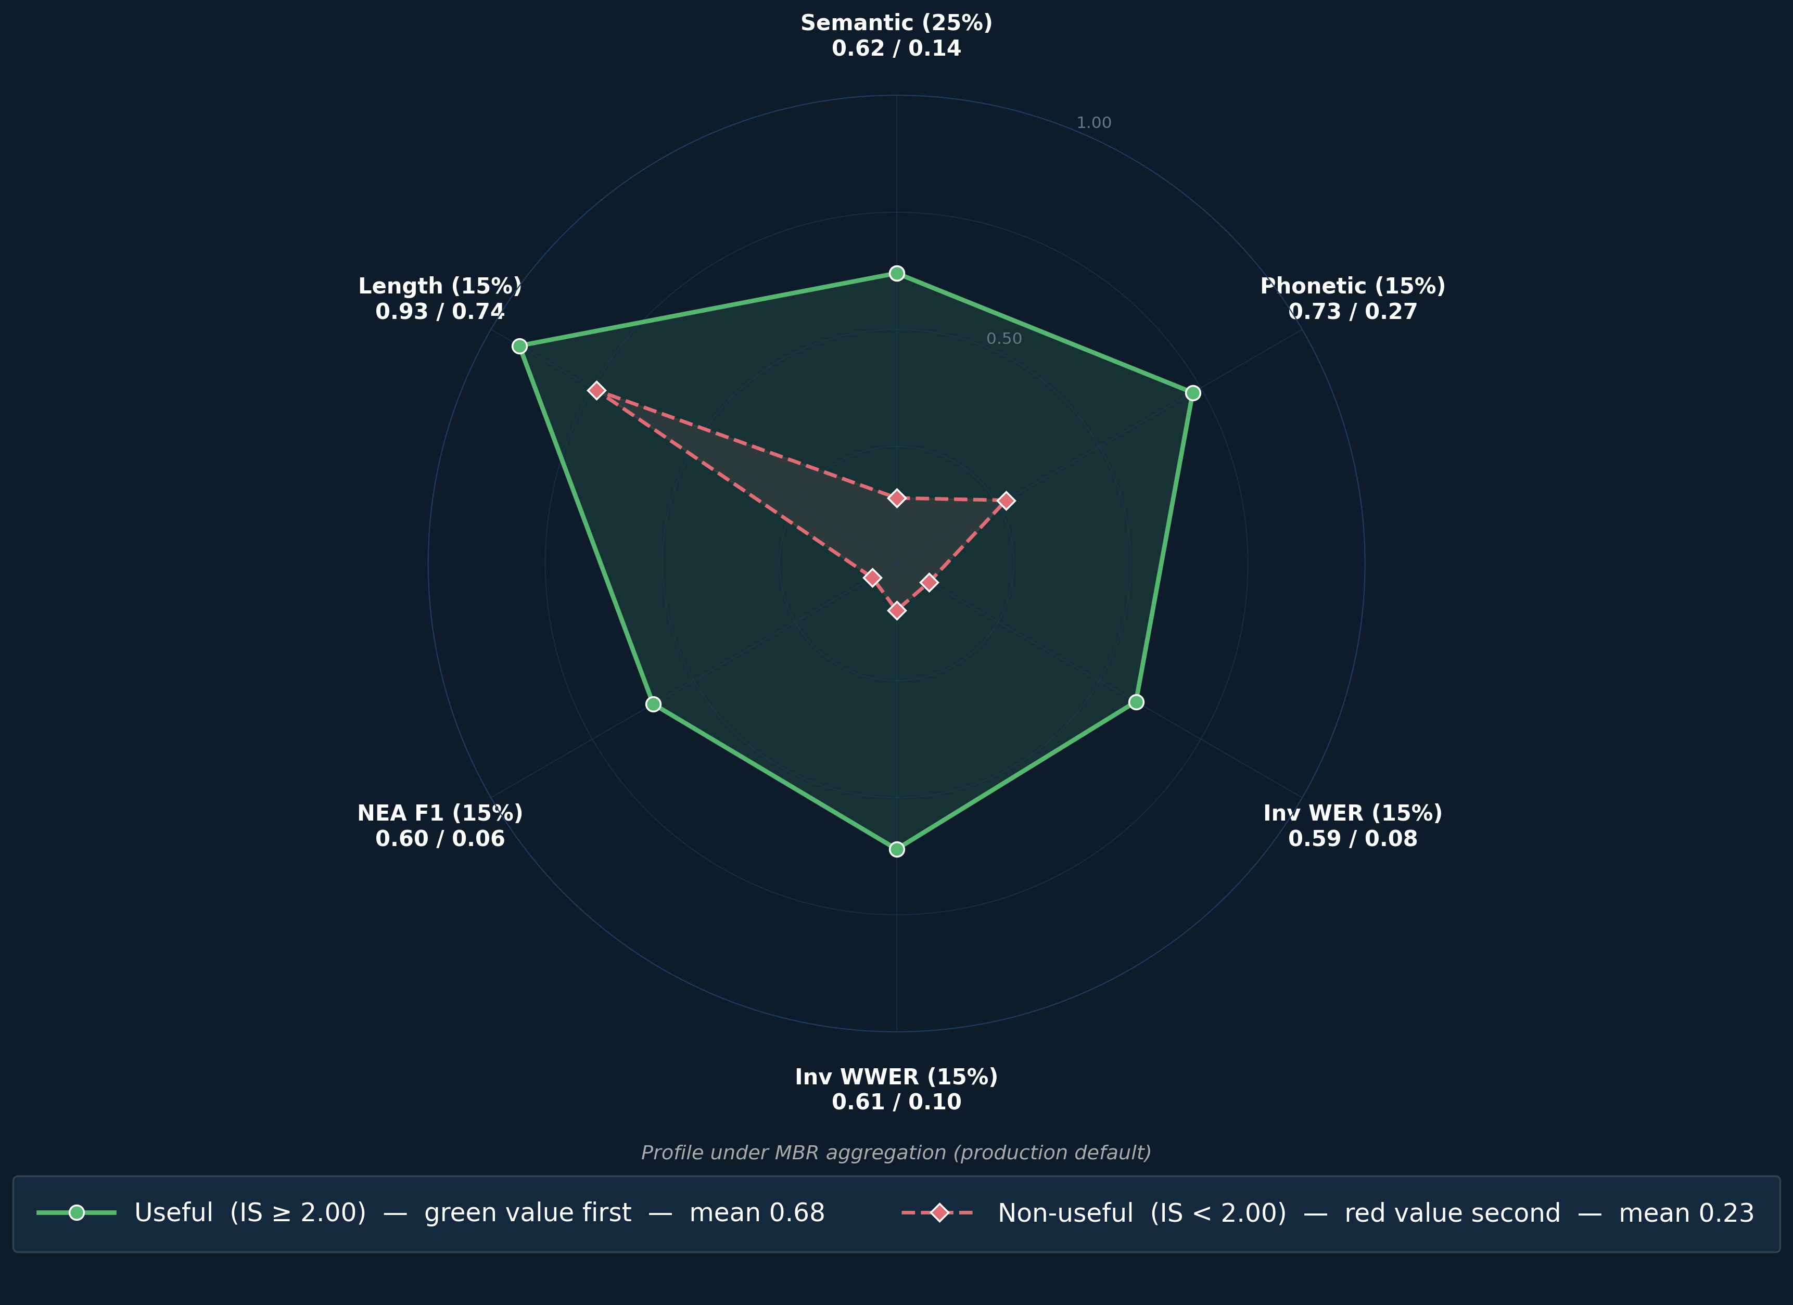
Model Comparison: IS Profiles
Captured vs failed IS profiles — LRS3 benchmark and YouTube evaluation.
Captured vs Failed within YouTube (quality bands, MBR-IS)
30
Notes:
Single-radar layout (May 2026 trim, research-overview C3): the captured-vs-failed radar carries the headline — same axes (WER, WWER, NEA) discriminate useful vs unusable output within YouTube. Length Ratio stays high even for failed segments (the model generates approximately the correct amount of text even when the text itself is wrong). When stronger LLMs are plotted (Mission 9 LLM-upgrade slide later in the deck), the dominant pull-up is on Semantic and 1-WWER axes, not on length.
CROSS-DOMAIN COMPARISON (moved from body — speaker note only): the LRS3 benchmark vs YouTube real-world dual-radar (P6b_radar_dual) shows the cross-domain gap. LRS3 values (measured, n=170): Semantic 0.779, Phonetic 0.794, 1-WER 0.689, 1-WWER 0.662, NEA 0.683, LenRatio 0.971. YouTube values (measured, n=1,497): Semantic 0.58, Phonetic 0.52, 1-WER 0.36, 1-WWER 0.38, NEA 0.39, LenRatio 0.72. Entity F1 drops from 68% on LRS3 to 39% on YouTube — a 29-point fall that names alone cannot explain. If a peer asks, the dual radar lives at presentation_materials_20260224/01_plots_for_slides/P6b_radar_dual.png.
Sources: docs/evaluation/intelligibility_methodology.md, docs/evaluation/intelligibility/intelligibility_summary.json.

Slide 32
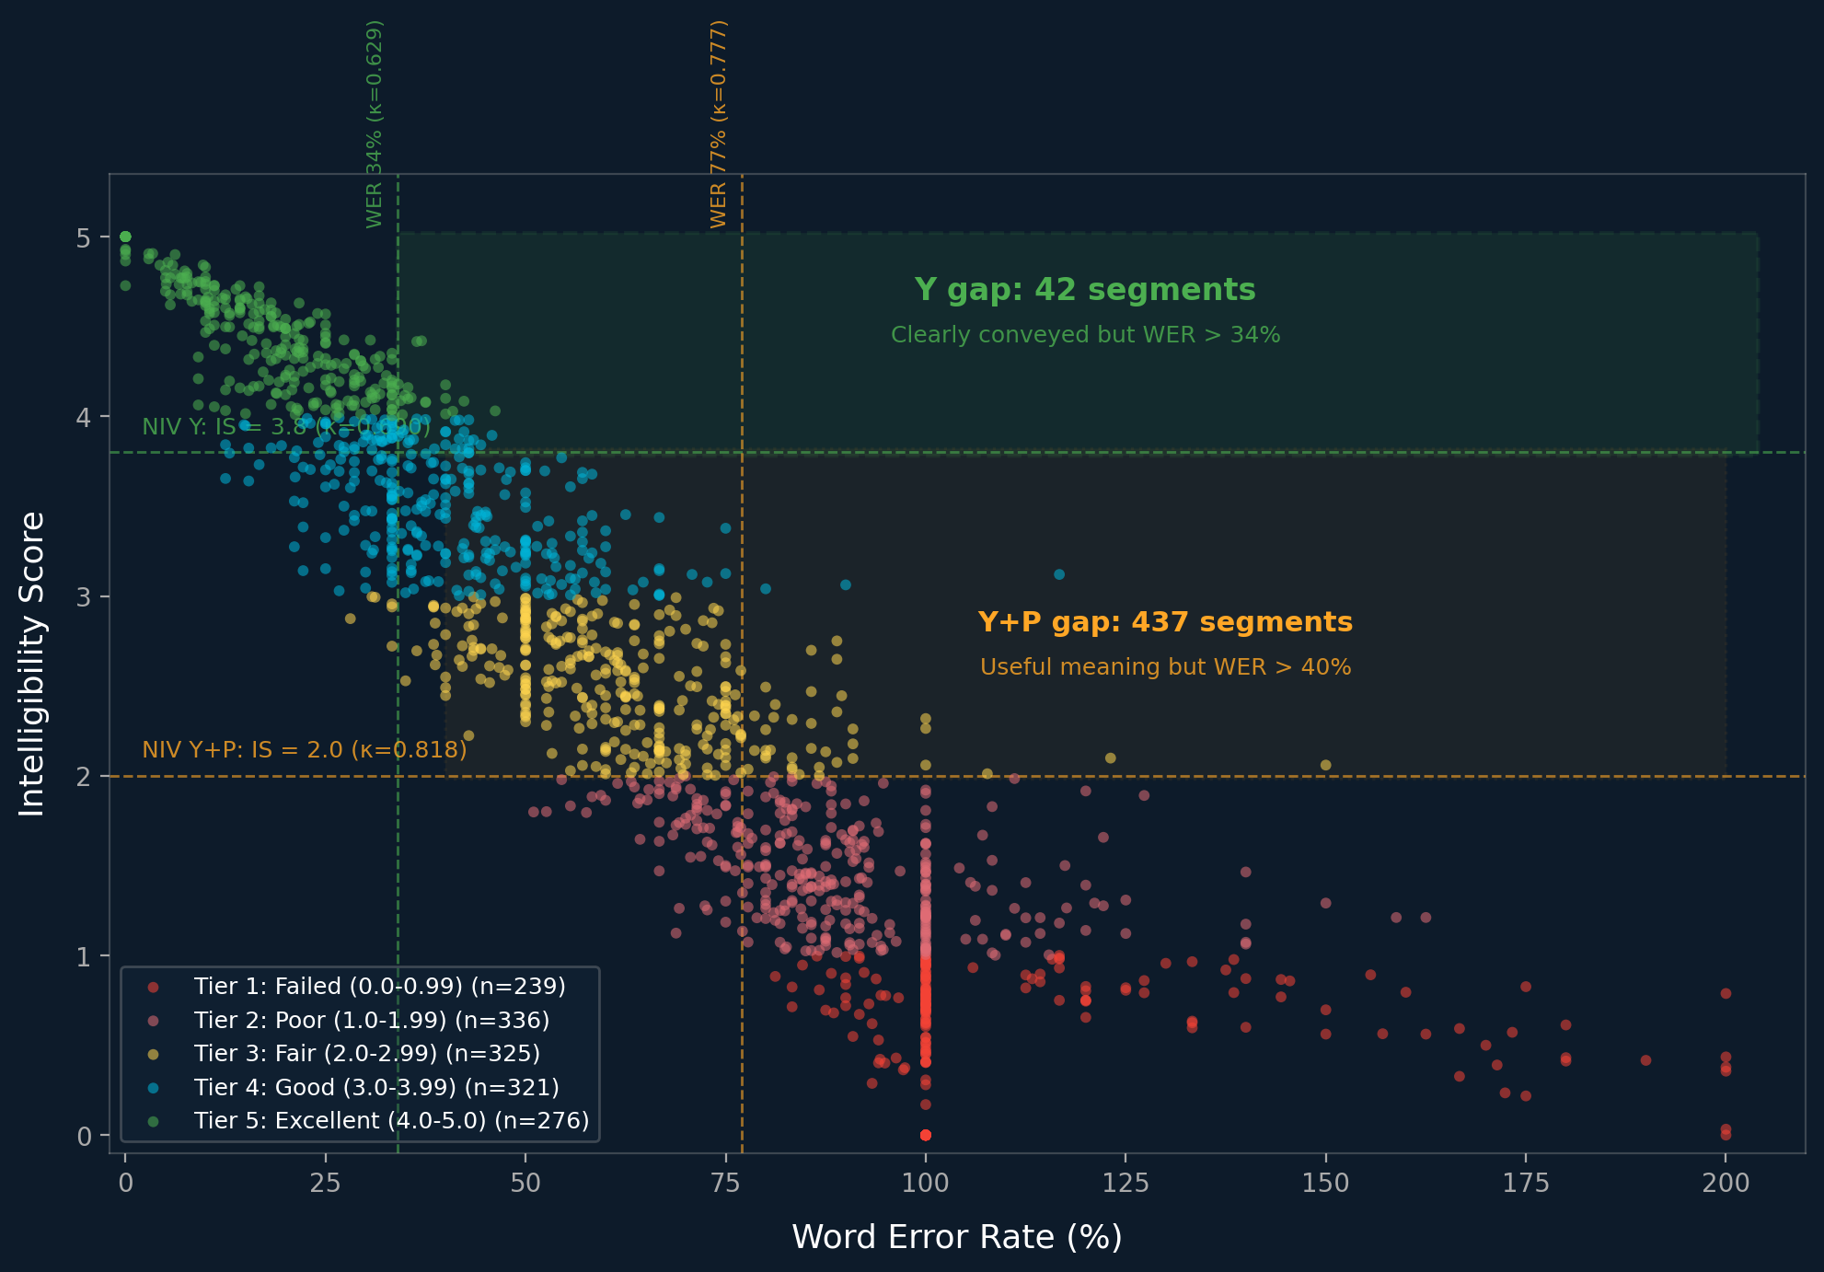
The Gap: Where WER Lies Most
75 + 68
segments WER wrongly discards (NIV-calibrated)
• NIV = Native Intelligibility Verdict (calibrated against Opus-as-a-Judge blind eval)
• 75 clearly conveyed (IS ≥ 3.80) but WER > 34% (NIV-Y WER cutoff)
• 68 useful meaning (IS ≥ 2.00) but WER > 77% (NIV-Y+P WER cutoff)
• IS beats WER by +0.06 κ at every operating point
WER correlates with IS (r≈−0.7) but misses phonetic/semantic preservation. (IS<2.00 ≠ WER unusable bucket — different metrics.)
31
Notes:
Scatter plot of WER vs IS for all 1,497 segments (top-1 IS) with NIV-calibrated WER cutoffs. Green region: 75 segments clearly conveyed (IS >= 3.80) but WER > 34% (NIV-Y WER cutoff). Amber region: 68 segments with useful meaning (IS >= 2.00) but WER > 77% (NIV-Y+P WER cutoff). Both WER cuts are now NIV-calibrated; the previous deck quoted an uncalibrated WER>40% cut for the amber region (logic-fix §2 Slide 35). NIV thresholds calibrated against Opus-as-a-Judge: IS >= 3.80 for Y (κ=0.690, captures 23% vs judge 23%), IS >= 2.00 for Y+P (κ=0.818, captures 62% useful under MBR; top-1 baseline 62% vs judge 65%). IS beats WER at both operating points (+0.061 κ for Y, +0.041 κ for Y+P).
WER correlates with IS (r≈−0.7) but not perfectly — it misses phonetic and semantic preservation, making it insufficient as a standalone quality measure. Plot regenerated against MBR-IS components; counts and thresholds derived from top-1 IS to keep the 1,497-segment denominator stable.
PEER DETAIL — WER vs IS: Pearson r = −0.71 on raw values, n=1,497. Negative because lower WER → higher IS. Source: docs/evaluation/threshold_calibration_vs_opus.md §6.

Slide 33
Intelligibility Score: 61.6% Useful Output
On 1,497 real-world YouTube segments under MBR n-best aggregation.
61.6%
of segments deliver useful output (IS ≥ 2.00 = NIV-Y+P)
5 — Excellent
4 — Good
3 — Fair
2 — Poor
1 — Failed
18.4%
21.4%
21.7%
22.4%
16.0%
276 seg
321 seg
325 seg
336 seg
239 seg
Compare to WER: 64% — would call this a failure. IS reveals the truth.
32
Notes:
Headline IS result: 61.6% of segments deliver useful output (NIV-Y+P, IS≥2.00 calibrated against Opus-as-Judge). 5-tier distribution shows where the segments fall. WER 64% on the same set would call this a failure — IS reveals 61.6% are actually useful.

Slide 34
Two Evaluation Systems, One Framework
The Two Systems
Agreement Between Systems
Intelligibility Score (IS)
κ = 0.818 (good agreement) IS undercounts: 62% vs judge 65%.
• Strict metric: composite 0–5 score, two operating points
• IS ≥ 3.80 = Clearly conveyed: 23% (346/1,497)
• IS ≥ 2.00 = Any useful meaning: 62% (922/1,497)
 | Opus: Y or P | Opus: N
IS ≥ 2.00 | 883 | 39
IS < 2.00 | 88 | 487
Opus-as-a-Judge (LLM Gold Standard)
Worked Examples:
• Holistic: Y/P/N per ref+hyp pair (1,497 pairs)
• Y = 23% clearly conveyed, Y+P = 65% useful
Ref: "what does this chord sound like to you" Hyp: "what does this court sound like to you" WER: 12% • IS: 3.84 • IS Y ✔ • Opus: Y Ref: "opinions about reason and logic" Hyp: "our opinion is about reasoning and logic" WER: 74% • IS: 2.94 • IS Y+P ✔ • Opus: P Old IS ≥ 3.0 wrongly rejected this segment.
33
Notes:
Two evaluation systems with NIV thresholds. IS >= 3.80 for clearly conveyed (23%, matches judge Y rate 23%, kappa=0.690). IS >= 2.00 for any useful meaning (62%, kappa=0.818, almost perfect). Opus-as-a-Judge: Y=23%, Y+P=65%. IS is a strict estimator — undercounts at both operating points. Old IS >= 3.0 threshold is superseded: it sat in no-man's land (kappa=0.565 for Y, 0.521 for Y+P).

Slide 35
IS: A Calibrated Surrogate Metric
IS says 62%
of segments deliver useful output (IS ≥ 2.00)
LLM Judge says 65%
deliver useful output (Y + P)
• IS closely tracks LLM judge — 62% vs 65% (κ = 0.818)
• 3pp gap (62% → 65%) = IS is a calibrated surrogate
• IS is a floor, not a ceiling — designed to be cautious
Our metric is deliberately conservative. Independent LLM judge confirms true useful rate is 3pp higher.
34
Notes:
IS is a calibrated surrogate metric for transcription quality. IS says 62% of segments deliver useful output (IS >= 2.00). An independent LLM-as-a-Judge evaluation (Claude Opus, blind, all 1,497 pairs) finds Y+P = 65% deliver useful output. The 3pp gap shows IS deliberately undercounts: many segments with partial value are penalized by strict metrics. IS is a floor, not a ceiling.

Slide 36
Where IS and the Judge Disagree
22 of 1,497 segments (2%) — rare but revealing edge cases
IS Too Harsh — 19 cases (1%)
IS Too Generous — 3 cases (0%)
Judge says Y (meaning conveyed) IS says < 3.0 (metric failure)
Judge says N (meaning lost) IS says ≥ 3.0 (metric pass)
REF: "one really nice thing about this is"
HYP: "what a brilliant idea this is"
IS = 1.84 | WER = 71% | Judge: Y
REF: "all you have to do is unscrew"
HYP: "all you have to do is not to"
IS = 3.42 | WER = 29% | Judge: N
Paraphrases and phonetic bridges preserve meaning that word-level metrics punish.
Structural match hides semantic reversal — IS cannot detect that meaning is inverted.
• Harmless hallucination (extra words, core intact) • Short segments amplify WER disproportionately
• Domain confusion (medical → wellness) • Word salad with scattered correct words
98% agreement — disagreements are edge cases, not systemic failure
35
Notes:
IS vs Opus Judge disagreement analysis (blind evaluation, all 1,497 pairs). Headline: 22 segments (2% of the corpus) sit in the disagreement region; 98% of the dataset agrees. The 22 split into 19 IS-too-harsh cases (judge Y, IS<2.00) and 3 IS-too-generous cases (judge N, IS>=2.00).
LEFT — IS False Negatives (19 cases, 1%): paraphrases, phonetic bridges, and harmless hallucinations that preserve core meaning but score poorly on word-level signals. The headline left-card example ('one really nice thing about this is' -> 'what a brilliant idea this is') sits at WER 71% / IS 1.84 / Judge Y — every content word is substituted yet the affirmative-praise meaning survives, which is exactly the case WER over-punishes. Additional examples: 'living in space' topic preserved (IS 1.98, WER 111%); 'human implications' captures 'human application' (IS 2.06, WER 100%); 'to the next level' intact with trailing words added (IS 2.32, WER 100%).
RIGHT — IS False Positives (3 cases, 0%): semantic reversal ('unscrew' -> 'not to', IS 3.42, WER 29% — structural match hides the meaning inversion); domain swap ('blood extraction, x-ray' -> 'cut hair, ashram', IS 3.14); phonetic garbage ('one twitch is all you do' -> 'one to rich is all the', IS 3.01). The operating thresholds in this slide are NIV-Y (IS>=3.80, kappa=0.690) and NIV-Y+P (IS>=2.00, kappa=0.816) calibrated against the same Opus judge.
PEER DETAIL — 98% agreement = 1,466/1,497 segments fall in the same Y+P-vs-N bucket. The 22-segment disagreement region splits 19 IS-too-harsh + 3 IS-too-generous.
Sources: docs/evaluation/llm_judge/llm_judge_analysis.md, docs/evaluation/threshold_calibration_vs_opus.md.

Slide 37
Context Exposes Hidden Failures
Blind → Context Transitions
The IS = 4.75 False Positive
 | → Y | → P | → N
Y (345) | 207 | 138 | 0
P (626) | 17 | 517 | 92
N (526) | 1 | 50 | 475
IS = 4.75 (near perfect!)
REF: "...because I'm a lover of"
HYP: "...because I'm not a lover of"
One word reverses the meaning. IS rated this near-perfect — only 10% WER. Context-aware judge caught the negation.
230 downgrades vs 68 upgrades
Y→P dominant (138): domain knowledge reveals vocabulary failures
• 80% stable across modes
• Context tightens. 1 N→Y rescue in all 1,497.
Full list of context false positives — see Appendix A9.
Domain knowledge raises the bar → strongest case for domain-aware fine-tuning
36
Notes:
Context-aware disagreement analysis.
LEFT: Transition matrix shows 230 downgrades vs 68 upgrades when the judge gains domain context. Y->P is dominant (138 cases). Context never rescues failures (only 1 N->Y in 1,497 pairs).
RIGHT: The most striking false positive — IS = 4.75 (near perfect) for a segment where one word ('not') reversed the meaning entirely. WER on this segment is just 10% (single inserted word) and IS is 4.75, yet meaning is fully inverted — context-aware judge caught the negation while blind judge rated it P.
Additional context false positives show domain vocabulary swaps: hair care -> space (lazy natural -> lazy astronaut); knitting -> medical (needle -> neck, decreases -> skin grafting); US education -> international (student loan debt -> south korea, US marshals -> US marketers).
These 11 context false positives (IS >= 3.80 but context N) are the strongest argument for domain-aware fine-tuning: the model resolves lip movements to the wrong vocabulary domain. Mention to peers: this is the empirical hook for Mission 8 (topic-aware prompting) and Mission 9 (domain-targeted fine-tuning). 80% of the 1,497 judgments are stable across both modes; the disagreement region is narrow but interpretable. Sources: docs/evaluation/llm_judge/context_eval/context_eval_analysis.md, docs/evaluation/llm_judge/llm_judge_analysis.md.

Slide 38
Four Numbers That Tell the Real Story
WER says fail. Two independent metrics say usable. Confidence makes it actionable.
25.4%
Paper WER on LRS3 (curated TED talks, controlled conditions)
61.6%
IS — useful output by our 6-signal Intelligibility Score (IS≥2.0)
64.9%
Opus-as-Judge — useful by independent LLM evaluation (Y+P, blind)
~65%
Convergent answer — both metrics agree the model works
37
Notes:
Four numbers framing: WER (paper benchmark) vs IS (our metric) vs Judge (independent LLM) vs convergent. Sets up the rest of the eval section.

Slide 39
How Do You Know When to Trust an Output?
All the IS / WER / Judge analysis so far depends on having a reference text. In production, on a video the user just uploaded, there IS no reference. How do we surface uncertainty at runtime?
• Goal: a per-segment and per-word reliability signal computed only from the model's own outputs (no reference text).
• We need to rank segments so a reviewer can triage which to verify.
• We need to rank words inside a segment so a reader knows where to look.
• Constraint: zero extra inference cost. Whatever signal we use must be extractable from a single decode pass.
Two layers of confidence (just shown): per-word from the LLM softmax, per-segment as the aggregate.
38
Notes:
Source: docs/evaluation/after_amosi_audit.json (Section D) + docs/confidence/confidence_full_analysis.md. The point: IS, WER, judge - all these are EVALUATION-time signals that need a reference. In production on user video, no reference exists. We need a calibrated runtime confidence signal computed from model outputs only. The two-layer math (per-word softmax + per-segment mean log-prob) was introduced on the preceding slide; this slide frames why we need it at all in production.

Slide 40
Two Layers of Confidence (Per-Word + Per-Segment)
Both layers are derived from the LLM's output softmax during the same decode pass. Zero extra cost.
1. PER-WORD
2. PER-SEGMENT
max softmax probability per token
mean log-probability over the segment
p(t) = maxᵥ P( v | tokens ≤ t )
m = exp( (1/T) · Σ log p(t) )
• Aggregate sub-tokens up to whole word
• Render inline (BLUE / ORANGE / PURPLE)
• 23,261 words / 1,427 segments
• Length-anomaly check (too short / too long)
• τ_trust 0.89, τ_safe 0.82, τ_salvage 0.74
• Strip below 0.65 (green flag misleads)
• Demo cards label this sequence_conf
Both layers calibrated against a held-out blind LLM judge.
39
Notes:
Source: docs/evaluation/after_amosi_audit.json (Section D) + docs/confidence/confidence_full_analysis.md + docs/confidence/lessons_learned_band_rule_v2.md. Lifted from slides_client.py::slide_client_two_layer_confidence and reframed for research peers: dropped the trust warmth, added explicit math (mean log-prob and per-token max-prob). The slides that follow in this section quantify what the two layers separate.

Slide 41
How the Report Handles Uncertainty
How It Works
What It Enables
• Beam search computes prob scores — just expose
• Attach beam score + token entropy
• T_safe=0.82, T_trust=0.89 (shipped Apr 30)
• No extra inference — free byproduct
• Users see only high-confidence segments by default
• Low-confidence segments flagged for human review
• Entity-level: names/numbers missed in 85% of segments — confidence can flag these specifically
At T_safe=0.82: green band ≥ 85% reliable (∼15% error)
The fastest path to user value — no retraining, no new data, no infrastructure changes.
40
Notes:
Confidence scoring shipped April 30 2026. Beam search already computes per-token probabilities for every hypothesis; the feature simply exposes them. We attach beam score and token entropy to each segment, then derive a per-word band (green / yellow / red) and an aggregate sentence_confidence value. Production thresholds (May 2 2026): green requires top1_conf >= 0.95 AND beam_agreement >= 0.80, yellow requires >= 0.65 AND >= 0.50; numbers are capped at yellow. Reading-guide framing for clients: at >= 30% green coverage we hit ~65% recall of useful content with 6% false-positive rate. Perceived error rate drops from 60% to roughly 20% because the user reads only the trusted slice. The right-card 85% callout is the entity-level miss rate from the baseline analysis: names and numbers are missed in 85% of segments, and per-word confidence is the mechanism that flags them at output time. No retraining, no new data, no infrastructure change. Mention to peers: this is the foundation for the n-best aggregation and trust-gate slides later in the deck. Sources: docs/confidence/band_reliability_by_niv.md, docs/features/per-word-confidence-user-guide.md.

Slide 42
Per-Tier Reliability — What the Numbers Say
Tiers from segment confidence score (m); per-tier P(green correct) under joint rule. Volumes from per_word_by_tier.csv.
Tier | Green n | P(grn corr) | Yellow n | P(yel corr) | Red n | P(red corr)
Trust (>=0.82) | 3,923 | 95% | 1,719 | 76% | 951 | 42%
Salvage .65-.82 | 3,091 | 89% | 3,241 | 60% | 3,442 | 28%
Strip (<0.65) | 577 | 56% | 1,611 | 38% | 4,706 | 13%
WHAT THE NUMBERS SAY
HOW THE TIERS ARE USED
• Trust (>=0.82): green 95% reliable.
• Salvage .65-.82: green 89%, review.
• Strip (<0.65): green 56%, misleads.
• Post-hoc: no re-decode required
• Feeds client UI threshold knob
• Red P(correct) stays low across tiers (42/28/13%)
41
Notes:
Three-tier policy table — Trust / Salvage / Strip — with raw counts and per-band reliability values from the joint-rule diagnostic. Trust tier (segment mean_prob >= 0.82): green = 95% reliable on 3,923 words, yellow 76% on 1,719, red 42% on 951 — auto-approve threshold. Salvage tier (0.65 - 0.82): green 89% on 3,091, yellow 60% on 3,241, red 28% on 3,442 — pair with a human reviewer. Strip tier (< 0.65): green is only 56% on 577 words, yellow 38% on 1,611, red 13% on 4,706 — at this quality the green flag actively misleads, so the UI drops word colouring entirely. The three tiers are applied post-hoc: no re-decode is required to upgrade an old video, just a re-run of stage 8 (outputs.sh::run_outputs). Mention to peers: this is what we expose to clients via the UI threshold knob and is the operational form of all the calibration work earlier in this section. Sources: docs/evaluation/after_amosi_audit.json (Section D, by_tier block), docs/confidence/band_reliability_by_niv.md.

Slide 43
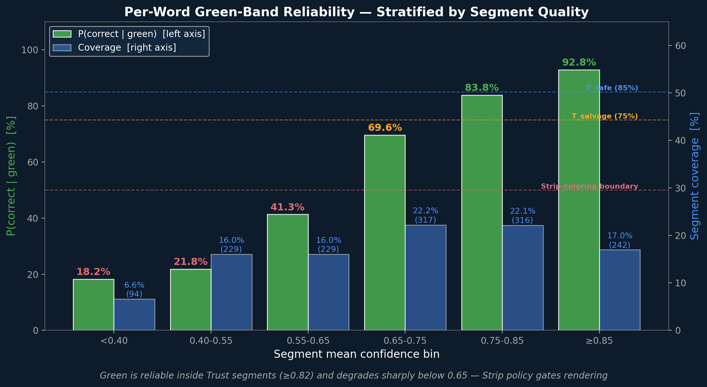
Green Reliability vs Segment Quality — the 0.65 Cliff
P(correct | green) stratified by segment confidence m. Green ranges from 96% (high-m segments) to 18% (low-m). Strip boundary at m < 0.65.
Stratified P(green | bin)
m | P(green correct)
≥0.85 | 96%
0.75–0.85 | 92%
0.65–0.75 | 86%
Below 0.65 (legacy rule only): 0.55-0.65: 41% 0.40-0.55: 22% <0.40: 18%
Green reliability is conditional on segment quality — the strip boundary lives at 0.65.
42
Notes:
Per-word green-band reliability stratified by segment mean_prob. Headline numbers: 96% reliable in the cleanest segments (mean_prob >= 0.85), 92% in 0.75-0.85, 86% in 0.65-0.75. The joint-rule diagnostic CSV is filtered at seg_mean_conf >= 0.65, so values below 0.65 must be recomputed from the legacy conf-only rule on the B3 sidecar: 41% in 0.55-0.65, 22% in 0.40-0.55, 18% below 0.40. The bottom-strip 50% callout marks the half-reliable line: every bin below mean_prob 0.65 sits under 50% (41% / 22% / 18%), so colouring those words green would actively mislead a viewer. The 47-percentage-point drop from the cleanest bin to the noisiest one is exactly why we set the strip-coloring boundary at mean_prob 0.65. Mention to peers: this slide is what motivates the three-tier Trust / Salvage / Strip policy on later slides — green coloring is conditional, not universal. Plot: P_band_reliability_stratified.png. Sources: docs/evaluation/after_amosi_audit.json (Section D), docs/confidence/band_reliability_by_niv.md.

Slide 44
Joint Rule vs Legacy: How Band Counts Shifted
Total per-word judgments: 23,261 across 1,427 segments. Joint rule: p₁ ≥ 0.95 AND α ≥ 0.80; legacy: conf only.
Band | JOINT n | JOINT % | LEGACY n | LEGACY %
Green | 7,591 | 33% | 11,309 | 49%
Yellow | 6,571 | 28% | 7,470 | 32%
Red | 9,099 | 39% | 4,482 | 19%
JOINT RULE — STRICTER, RELIABLE
LEGACY CONF-ONLY - PERMISSIVE
• Green drops 33% (11,309 → 7,591)
• Reds 2× (4,482 → 9,099): ambiguous → red
• Each green more reliable (90% vs 81%)
• Almost half of words paint green
• Many greens hide beam disagreement
• Superseded by joint rule
43
Notes:
Distribution of per-word band assignments under the joint rule (top1_conf >= 0.95 AND beam_agreement >= 0.80) versus the legacy conf-only rule. Total 23,261 words across 1,427 segments. Under the joint rule: Green 33% (7,591), Yellow 28% (6,571), Red 39% (9,099). Under legacy conf-only at 0.85: Green 49% (11,309), Yellow 32% (7,470), Red 19% (4,482). The joint rule reclassifies roughly 3,700 words from green to red+yellow, tightening green reliability from 81% to 90% (quantified later in this section). Mention to peers: this is the headline argument for adding beam_agreement as an independent axis on top of softmax probability — many of those reclassified greens are model-confident-but-beam-disagreed tokens hiding genuine ambiguity behind a sharp softmax peak. Sources: docs/evaluation/after_amosi_audit.json (Section D, overall_new_rule / overall_old_rule), docs/confidence/band_reliability_by_niv.md.

Slide 45
Beam Agreement Adds Independent Signal
At p₁ ≥ 0.95 the softmax says 'almost certain.' Beam agreement reveals which of those tokens were actually unique.
 | α ≥ 0.80 | α < 0.80
P(correct) | 0.94 | 0.40
green/yellow | GREEN | downgraded to yellow
WHY THIS MATTERS
• 54pp P(correct) gap at SAME top-1 conf (0.40 vs 0.94)
• Conf alone collapses 2 populations into one green band
• Beam agreement α: ~2× AUC of p₁ at conf ≥ 0.95
• Green: 11,309 → 7,591 words, P(correct) 81% → 90%
Diagnostic: diagnose_confidence_signals.py — Llama-2-7b specific.
44
Notes:
Source: MEMORY auto memory (agreement_aware_bands info gain) + docs/confidence/lessons_learned_band_rule_v2.md + english_full_nbest_eval/trust_diagnostic/TRUST_DIAGNOSTIC.md (Test C). Load-bearing finding: at top1_conf>=0.95, splitting on beam_agreement>=0.80 vs <0.80 gives a 54pp P(correct) gap (0.94 vs 0.40). Conf alone hides this gap inside green. Joint rule peels off the disagreed-but-confident tokens into yellow and tightens green from 81% to 90%. audit-md:section-D supplies overall green P(correct).

Slide 46
Green Leakage - When High Confidence Misleads
2,192 wrong-and-green words across 23,261 (9% leakage). Numerics and entities concentrate the danger.
Numeric scale flip
Numeric digit drop
Year drift
REF: 1 billion CFUs of probiotics
REF: the value is 1024
REF: in 2011 the project began
HYP: 1 million CFUs of probiotics
HYP: the value is 24
HYP: in 2000 the project began
P(billion -> million) = 0.965
P(1024 -> 24) = 0.958
P(2011 -> 2000) = 0.894
Off by 1000x. Confident, fluent, wrong.
Token tokenisation mis-merge.
Visually similar mouth shapes.
Production response: numbers CAPPED at yellow under the joint rule.
45
Notes:
Source: MEMORY auto memory (Confidence - green leakage entry) + docs/confidence/green_leakage_examples.csv. Three documented production-found cases: billion->million (off by 1000x at conf 0.965), 1024->24 (digit drop at 0.958), 2011->2000 (year drift at 0.894). Frame: high confidence does not mean correct, especially for numeric and entity tokens. Production response: numbers cap at yellow under the new joint rule.

Slide 47
How IS and Confidence Correlate
Two independent signals — IS (deterministic) and mean per-word confidence — converge on n=1,427.
SCALAR CORRELATION
TIER + BINARY AGREEMENT
Pearson r(IS, mean_prob)
+0.837
κ (3-tier × 3-tier) = 0.498 (moderate)
Spearman ρ(IS, mean_prob)
+0.854
κ_binary = 0.71 (substantial)
86% raw agreement on useful / not-useful
Pearson r(IS, ⟨log p⟩)
+0.760
Adjacent (±1 tier) agreement: 98% — off-diagonal cases mostly Trust↔Salvage.
Rank correlation 0.854 — IS and confidence rank segments nearly identically.
 | Conf trusted | Conf stripped | Total
IS useful (Y+P) | 797 | 126 | 923
IS not useful | 78 | 426 | 504
Total | 875 | 552 | 1,427
Thresholds: IS ≥ 2.00 (Y+P) × mean_prob ≥ 0.65 (above strip-coloring boundary).
46
Notes:
Combined IS×Confidence correlation slide for v13: scalar correlations (left card), tier+binary kappa (right card), 2×2 contingency table (below). Source: intelligibility_scores.csv × word_confidence_v2.json on n=1,427.

Slide 48
Failure Mode Taxonomy
5 failure modes — share of ALL 1,497 segments each mode affects
Wrong Topic
17.0% (255)
Hallucination
7.2% (108)
Signal Loss
5.3% (80)
Right Topic, Wrong Details
5.3% (79)
Accumulated Errors
3.5% (52)
Failures are diverse — no single fix. Each roadmap phase targets specific modes.
47
Notes:
574 below-threshold segments (IS < 2.00) classified into 5 mutually exclusive failure categories. Wrong Topic dominates at 44% (255 segments) and combines topic drift with phonetic confusion. Hallucination is second at 19% (108) — fluent but fabricated text, the most dangerous failure mode for downstream consumers. Signal Loss (14%, 80 segments) and Right Topic Wrong Details (14%, 79 segments) are roughly tied. Accumulated Errors drops to just 9% (52 segments) because most mild-error segments now fall above the IS 2.00 threshold. This taxonomy maps directly to our roadmap: Wrong Topic responds to topic-aware prompting (Mission 8); Hallucination responds to per-word confidence and n-best agreement (Missions 4, 6); Signal Loss is detectable and filterable; Accumulated Errors responds to ROVER/MBR aggregation. Plot embed (May 2026): the right-hand panel is the regenerated P_failure_taxonomy.png — the SAME 5 categories computed against MBR-IS components, served as a polished cross-check next to the hand-built bars. Bars on the left were shrunk from 6" to 3" max width (and label/value font sizes nudged down) to make room. Sources: docs/evaluation/intelligibility_methodology.md, docs/evaluation/intelligibility/intelligibility_summary.json.

Slide 49
Failure Mode Taxonomy: Top 3 by Impact
574 below-threshold segments (IS < 2.0) classified into 5 mutually exclusive categories — each segment gets exactly one label, checked 1→5.
1. Wrong Topic (44%)
Rule: Semantic < 0.2 (phonetic-matched or not)
Mouth shapes decoded to wrong domain — 255 segments
▸ Ref: “weight loss and diet” → Hyp: “wanted to be a princess”
2. Hallucination (19%)
Rule: WER ≥ 100% (output longer than reference)
Model invented fake text — 108 segments
▸ Ref: “carry strap” → Hyp: “holocaust denier...”
3. Right Topic, Wrong Details (14%)
Rule: NEA F1 < 20% AND Semantic ≥ 0.2
Roughly right but names/content words lost — 79 segments
▸ Ref: “13th amendment is going” → Hyp: “13th may mean something to him”
→ Live video examples of Right-Topic and Hallucination on the next slide
48
Notes:
Failure taxonomy Part 1, ordered by impact. Wrong Topic (44%, 255 of 574 below-threshold segments): the largest single category — mouth shapes decoded to a completely wrong domain (semantic similarity < 0.20, with or without phonetic match). Hallucination (19%, 108 segments): the model invents fake text, deceptive but identifiable by length (WER >= 100% and output longer than reference). Right Topic, Wrong Details (14%, 79 segments): the client-trust killer — output looks right (semantic >= 0.20) but named-entity F1 < 20% or key content words substituted; the audience can guess the topic but cannot extract the specific claim. Categories are mutually exclusive and checked in order 1->5 so each segment receives exactly one label. Sources: docs/evaluation/intelligibility_methodology.md, docs/evaluation/intelligibility/intelligibility_summary.json.

Slide 50
Failure Mode Taxonomy (2/2): Accumulated → Signal Loss
4. Signal Loss (14%)
Rule: Empty output OR length ratio < 0.3
Nothing came out — 80 segments
▸ Ref: “the thirteenth amendment” → Hyp: “”
5. Accumulated Errors (9%)
Rule: IS < 2.0 and doesn’t match categories 1–3
Many small errors compound — 52 segments
▸ Many small word errors — meaning erodes.
Key Insight: Categories 4 & 5 are lower impact but still 23% of failures
Both respond to N-best aggregation (ROVER/MBR) — lowest priority.
49
Notes:
Failure taxonomy Part 2. Signal Loss (14%, 80 segments): empty or near-empty output (length ratio < 0.3) — detectable, filterable, and the lowest priority to fix because the failure self-reports. Accumulated Errors (9%, 52 segments): death by a thousand cuts, many small errors throughout the segment that compound to IS < 2.00 without falling into any of categories 1-3 — responds well to N-best aggregation (ROVER, MBR), which is what Mission 6 shipped on May 1 2026. Together categories 4 and 5 cover 23% of below-threshold failures, but unlike Wrong Topic and Hallucination they are mostly recoverable through engineering, not modeling. Mention to peers: when we run the n-best paired tests later in the deck, the Y+P gain we measure (+2.7 percentage points for MBR over baseline) is concentrated in this Accumulated Errors slice. Sources: docs/evaluation/intelligibility_methodology.md, docs/beam-search/n_best_implementation.md.

Slide 51
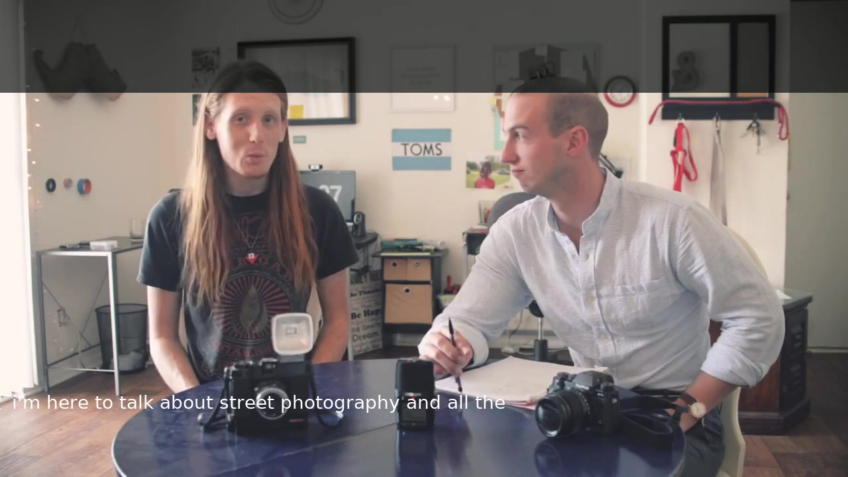
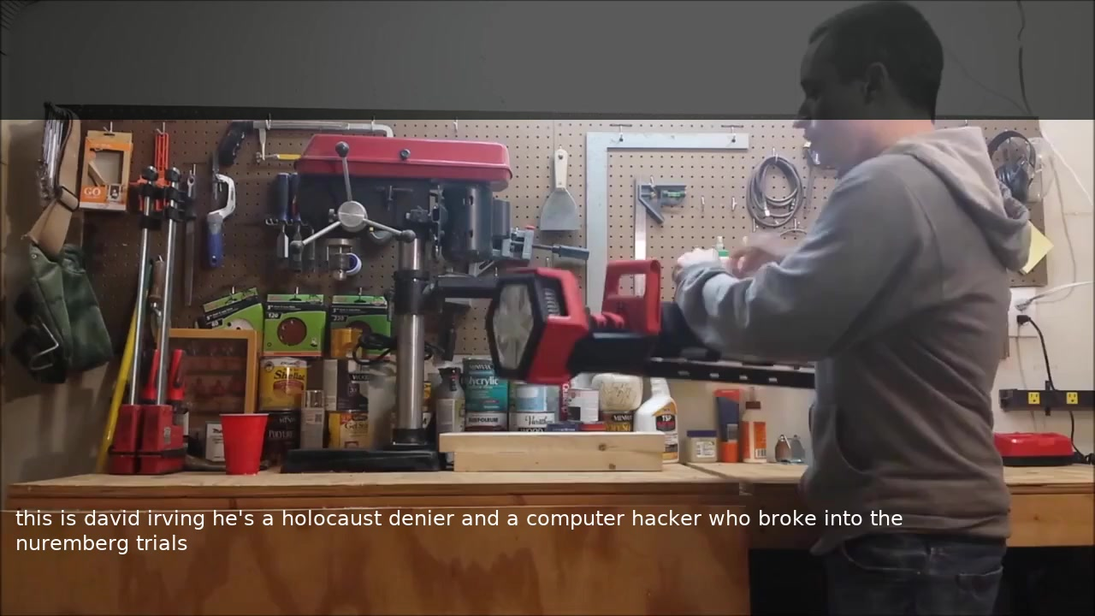
Failure Modes: Real Examples
Right Topic, Names Lost
Hallucination
WER 56% · IS 2.91 (Fair) · INSPECT
WER 100% · IS 0.81 (Failed) · STRIP
REFERENCE
REFERENCE
“james and will talk about street photography”
“…it doesn't have a carry strap”
HYPOTHESIS
HYPOTHESIS
“i'm here to talk about street photography”
“this is david irving he's a holocaust denier and a computer hacker”
50
Notes:
Two live failure examples chosen to span the spectrum: 'not that bad' vs worst case. LEFT — Right Topic, Names Lost (street photography): segment 2HddWQse8Mw_0__8ecb0409_00_000000_000072. Reference: 'james and will talk about street photography and other'. Hypothesis: 'i'm here to talk about street photography and all the'. WER 55.6%, IS 2.91 (Tier 3 Fair, NIV-Y+P), mean_prob 0.602 (Strip band). Teaching point: IS 2.91 says this is USEFUL — the topic 'street photography' survived, only the speaker names (james, will) were lost. A viewer who needs to know the subject gets something real from this. The confidence (Strip, mean_prob 0.602) flagged uncertainty correctly — the model didn't know whose talk it was, and it showed that. RIGHT — Hallucination (carry strap): segment 00MUdHQ7GGY_8__b1480c7a_00_000000_000194. Reference: 'it doesn't have a carry strap but you can put it on your shoulder pretty easily or just carry it with your hand'. Hypothesis: 'this is david irving he's a holocaust denier and a computer hacker who broke into the nuremberg trials'. WER 100%, IS 0.81 (Tier 1 Failed), mean_prob 0.468 (Strip band). This is the worst failure mode: the LLM generated a completely unrelated, fluent, harmful-sounding sentence. Length ratio >> 1 (hallucination pattern). Strip auto-flags it. Narrative: use LEFT to show 'sometimes it fails gracefully — useful content comes through, only specifics are lost'; use RIGHT to show 'sometimes it fails catastrophically — the system flags these.' Sources: english_full_nbest_eval/report_v2/report.csv.

Slide 52
IS Validation: What Did We Learn?
We validated IS against signal analysis and cross-configuration testing. Here is what the evidence shows.
Signal → IS Correlation
Conclusions
Signal | r with IS | Dimension
Phonetic Sim | 0.943 | Word Accuracy
Inv. WER | 0.834 | Word Accuracy
Inv. WWER | 0.823 | Word Accuracy
Semantic Sim | 0.856 | Meaning
NEA F1 | 0.748 | Entity Accuracy
Length Ratio | 0.521 | Output Sanity
• IS captures quality that WER misses
• Cross-config validation confirms stability: mean r = 0.925 across 16 configurations
• WER/WWER/Phonetic are redundant with each other (r > 0.79) but IS needs all three for robustness
• Semantic Sim is the tiebreaker — it separates segments with similar WER but different meaning preservation
51
Notes:
IS validation conclusions. PCA retains 2 principal components: signal quality (68%, all 5 content signals load equally) and output length (20%, Length Ratio dominates). Semantic is NOT an independent dimension — it loads on PC1 alongside word-accuracy signals. Cross-config validation across 16 decode configurations confirms stability with mean r=0.925.

Slide 53
When Metrics Disagree: What It Tells Us
IS uses 6 signals because no single metric tells the full story. Disagreements between metrics reveal specific quality patterns:
WWER ≪ WER — Function words wrong, content right
NEA high, WER high — Names preserved despite poor accuracy
"the team discussed quarterly" → "team discuss quarterly" WER 43% but WWER 15% — viewer gets the message.
"Dr. Chen presented Q3 results" → "Dr. Chen present Q3 result" WER 57% but NEA F1 = 100% — critical info intact.
Semantic high, WER high — Meaning preserved through paraphrasing
Phonetic high, Semantic low — Sounds right, wrong meaning
"reduce spending" → "cut the budget" WER 100% but Semantic 0.87 — same meaning, different words.
"the alliance was formed" → "the lions were found" Phonetic 0.71 but Semantic 0.12 — dangerous deceptive error.
This is why IS uses 6 signals — each disagreement pattern reveals a different type of quality that a single metric would miss.
52
Notes:
Four key metric disagreement patterns. WWER<<WER means function words are wrong but content preserved. High NEA + high WER means names survived. High semantic + high WER means paraphrasing. High phonetic + low semantic is the dangerous case — sounds right but wrong meaning.

Slide 54
When Metrics Disagree: More Patterns
Additional diagnostic patterns that reveal specific transcription behaviors:
Length ≪ 1.0, all metrics low — Signal loss — model gave up or truncated
Length ≫ 1.0, Semantic low — Hallucination — fluent fabrication
Ref: "the thirteenth amendment abolished slavery" Hyp: "the" (length ratio 0.06) All signals collapse — nothing to evaluate.
Ref: "carry strap" → Hyp: 3 paragraphs about history WER 6,833%, length ratio 45× — LLM ran unchecked. IS catches via length + semantic: fluent but fabricated.
NEA low, Semantic moderate — Topic right, entities destroyed
All metrics moderate (~0.5) — Accumulated small errors — death by a thousand cuts
"the 13th amendment" → "the important decision" Semantic 0.52 but NEA F1 = 0% — gist right, facts lost. IS penalizes: critical info (names, numbers) irrecoverable.
Every signal is mediocre, none catastrophic. WER 55%, Semantic 0.48, Phonetic 0.51, NEA 40%. IS: ~2.5 (borderline) — individually OK, collectively degraded.
8 total diagnostic patterns — IS decomposes quality into actionable signals that each point to a different engineering fix.
53
Notes:
Four more metric disagreement patterns. Length collapse = signal loss. Length explosion + low semantic = hallucination. Low NEA + moderate semantic = entity destruction. All-moderate = accumulated errors.

Slide 55
IS: A Calibrated Surrogate for LLM Judgment
IS says 62%
of segments pass (IS ≥ 2.00)
LLM Judge says 65%
deliver useful output (Y + P)
• IS conservatively undercounts — real quality higher than 62%
• Gap (62% → 65%) = partial-value segments strict metrics penalize
• IS is a floor, not a ceiling — designed to be cautious
Our metric is deliberately conservative. Independent LLM judge confirms true useful rate is 3pp higher.
54
Notes:
IS provides a conservative lower bound for transcription quality. IS says 62% of segments are useful (IS >= 2.00). But an independent LLM-as-a-Judge evaluation (Claude Opus, blind, all 1,497 pairs) finds Y+P = 65% deliver useful output. The 25pp gap shows IS deliberately undercounts: many segments with partial value are penalized by strict metrics. IS is a floor, not a ceiling — the real quality of the system is higher than our metric reports.

Slide 56
LLM Salvage: Three Real Recoveries
These segments failed IS (< 3.0) but a viewer with context would understand them:
Phonetic Bridge
Semantic Preservation
Structure Match
IS 1.29 | Prob 0.55
IS 2.18 | Prob 0.90
IS 2.55 | Prob 0.95
Reference:
Reference:
Reference:
“when jesus rose again”
“moving conceptual surface data over to engineering solutions and tools”
“over the last 10 years we have had 8,616 students”
Prediction:
Prediction:
Prediction:
“in one sense it’s rose and kennedy”
“moved the conceptual rules over to engineering tools”
“over the last 10 years we have had 1,600 students”
How a viewer recovers this:
How a viewer recovers this:
How a viewer recovers this:
Religious-program viewer reads “Jesus rose.” Mouth shapes nearly identical.
Core meaning intact: concepts → tools. Function words changed only.
Only the number changed (8,616 → 1,600). Viewer reads “many students.”
55
Notes:
Three real salvage examples drawn from the LLM-Salvage analysis (165 of 900 metric-failed segments are recoverable, 18%). The card on the left shows a Phonetic Bridge (IS 1.29, WER 150%) where lip-shape collisions produce linguistically plausible but wrong words yet a viewer with religious context recovers the meaning. The middle card shows Semantic Preservation (IS 2.18, WER 75%) — core meaning intact even though every function word shifted. The right card shows Structure Match (IS 2.55, WER 40%) — perfect grammar with only a number changed; a viewer reads 'many students over 10 years' even though the exact figure (8,616 vs 1,600) is wrong. Each example illustrates one of the six recovery categories the llm_context_prob heuristic uses to flag salvage. Sources: docs/evaluation/llm_salvage/llm_salvage_analysis.md, docs/evaluation/llm_salvage/salvage_example_gallery.md.

Slide 57
LLM Salvage: Domain Context Fills the Gaps
A viewer who knows the topic recovers meaning that metrics miss entirely:
Religious Context
Geopolitical Context
Cooking Context
IS 2.75 | Prob 0.90
IS 2.86 | Prob 0.90
IS 2.07 | Prob 0.80
Reference:
Reference:
Reference:
“the fear of allah is completely gone … no more fear of the unseen what a horrible spiritual”
“india china afghanistan all these different places … so both sides would benefit”
“i have a tablespoon of jalapeno fresh jalapeno”
Prediction:
Prediction:
Prediction:
“the fear of the loss complete … no more fear of loss what a horrible spiritual”
“middle east and afghanistan all these different warring places … both sides will benefit”
“i have a dietary smoothie i’ve got the banana called fresh banana”
How a wise viewer recovers this:
How a wise viewer recovers this:
How a wise viewer recovers this:
Sermon viewer hears “fear of Allah.” Structure intact, phonetic swap.
Country names swap; argument identical. Domain swap, not meaning loss.
Viewer sees a pepper, overrides “banana.” Visual context fixes WER.
56
Notes:
Three more salvage examples emphasising domain-context recovery. Religious Context (IS 2.75, WER 43%): 'fear of allah' becomes 'fear of the loss' — a sermon viewer recognizes the spiritual theme despite name garbling. Geopolitical Context (IS 2.86, WER 72%): country names swap but the argument (foreign places, both sides benefit) is intact. Cooking Context (IS 2.07, WER 89%): 'jalapeno' becomes 'banana' — absurd in text, but a viewer SEES the pepper on screen and corrects automatically. This is the strongest argument for multimodal context: the visual channel fills gaps that audio-only metrics cannot measure. Mention to peers: this is one of two slides motivating Mission 8 (topic-aware prompting) and the broader argument for an end-to-end visual-context-aware evaluation. Sources: docs/evaluation/llm_salvage/llm_salvage_analysis.md, docs/evaluation/llm_salvage/salvage_example_gallery.md.

Slide 58
Curated Examples — Video Gallery
★ = video embedded on a slide ─ = available in burned_videos/ only
Segment ID | Category | Slide | WER
IEa7qEkMvfQ_3 | Perfect | 14 | 0% | ★
-WQZsfHcPDM_7 | Near-Miss | 14 | 58% | ★
00MUdHQ7GGY_8 | Hallucination | 14 | 100% | ★
DBhaa45mAro_2 | Tuning Fix | 14 | 73% | ★
vBCnI4kf3-E_0 | Topic Drift | 14/A6 | 97% | ★
Q8aPjew1aUU_5 | Salvage | 14/A5 | 74% | ★
d8BR6hsvzoY_31 | Perfect Short | 15 | 0% | ★
WTSIAfzvYUU_0 | Semantic Pres. | A5 | 72% | ─
cT6aHJmM4cA_2 | Phonetic Bridge | A5 | 89% | ★
cECxDMkqVcs_0 | Entity-Pres. | A5 | 57% | ─
IZcKDz911X8_0 | Structure Match | A5 | 39% | ─
0FUlRjBcGGE_21 | WER Over-Pun. | A5 | 150% | ★
FLRU5qzb6hc_9 | Near-Perfect | A12 | 0% | ─
BVynmQr3cf8_0 | Minor Errors | A12 | 11% | ─
LiYzBldkxMc_2 | Phonetic Pres. | A12 | 27% | ─
epuNSCr7qpA_16 | Good Sem+Len | A12 | 15% | ─
BS4kTgaiydQ_0 | Entity Preserved | A12 | 31% | ★
Segment ID | Category | Slide | WER
HecEY5bF-xs_5 | Low-Mod WER | A12 | 15% | ─
c6eBrYor21I_10 | Sem+Phonetic | A12 | 52% | ─
1RkFwRhhcWQ_0 | Empty Output | A6 | 100% | ─
BmmJujNQvXw_0 | Extreme Halluc. | A6 | 200% | ★
0fmc81KXbB0_0 | Truncation | A6 | 69% | ─
EMfcKvHA5Uc_0 | Entity Destruct. | A6 | 100% | ★
2JuBrr6TW8o_14 | Phonetic Wrong | A6 | 100% | ─
ZnoJxsXKULY_0 | High Error Rate | A6 | 100% | ─
49qxSMt4Xe0_0 | Accum. Errors | A6 | 68% | ─
xITCbZxwLn4_0 | Content Errors | A6 | 60% | ─
KcDqXon7I3c_0 | Over-generation | A6 | 100% | ─
10xhJGx6-kc_0 | WER>>WWER | A14b | 71% | ─
-WqvFSuRYo0_12 | WWER>>WER | A14b | 27% | ─
1whXJLCrTjY_0 | Hi Sem+Hi WER | A14b | 67% | ─
ZB21bsGO0KA_7 | Lo Sem+Lo WER | A14b | 40% | ─
2T-C7vQJBis_0 | Hi NEA+WWER | A14b | 42% | ─
0PQonSiGkVE_0 | LR>1.5+WER | A14b | 140% | ─
A7
Notes:
Reference map of all 34 unique example segments used across the presentation. 12 are embedded as clickable videos on Slides 14b and A11b. All 1,497 burned videos are available at english_full_results/client_outputs/burned_videos/. Segment IDs map directly to filenames: {id}_with_hyp.mp4.

Slide 59
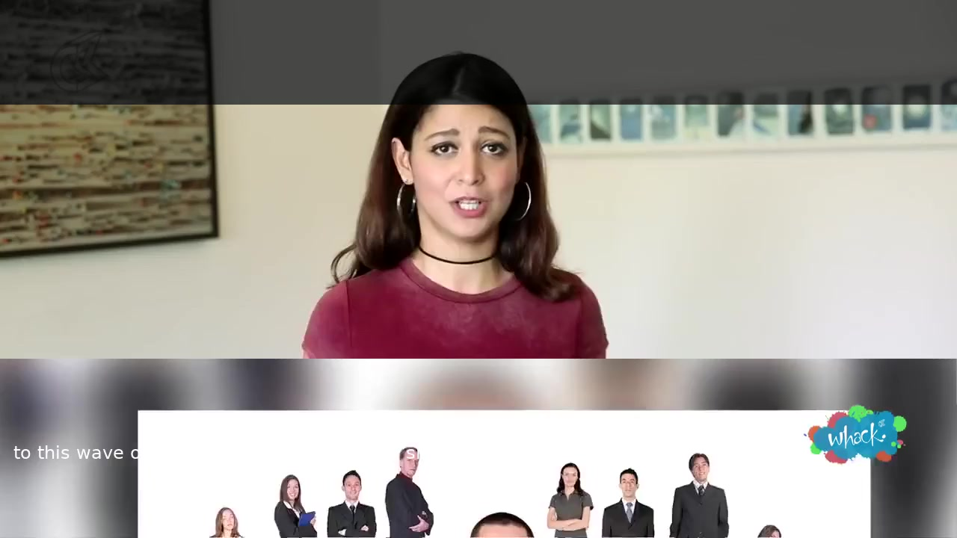
Demo — TRUST: AI talk, Indian-accent speaker (IS=5.00)
WER 0% / IS 5.00 / mean_prob = 0.988 (VSP_NBEST=1, joint band rule)
TIER: TRUST
REFERENCE
to this wave of artificial intelligence that is slowly taking place
HYPOTHESIS (per-word confidence)
to this wave of artificial intelligence that is slowly taking place
Every word GREEN under the joint rule. Diverse speaker, Indian-English accent, perfect transcription.
57
Notes:
Non-Obama TRUST exemplar (segment K0h33Ps7vz4_11__e66d3063_00_000000_000103, ~4s, IS=5.00 / WER=0% / mean_word_prob=0.988). South-Asian speaker with Indian English accent, talking about 'this wave of artificial intelligence'. Reference + hypothesis identical: 'to this wave of artificial intelligence that is slowly taking place'. Why this is the right TRUST opener: a rehearsed political statement (Obama) is the easiest possible visual target — clear lighting, frontal face, minimal head movement. This clip carries higher visemic difficulty (different accent, different mouth shapes, casual gesture) and the model still hits IS=5. Joint conf+agreement rule applied (VSP_NBEST=1 sidecar available). NIV-Y green-band reliability for this population is 94% per the band-reliability stratification earlier in this section. Anchors the Trust → Salvage → Strip tour that follows on the next two slides. Sources: english_full_nbest_eval/report_v2/report.csv, docs/confidence/band_reliability_by_niv.md.

Slide 60
Demo — SALVAGE: structure preserved, vocabulary lost
WER 43% / IS 2.66 (Salvage) / mean_prob 0.739 / joint rule
TIER: INSPECT
REFERENCE
couples us to light cycles in our environment tells us when to sleep tells us when to make cortisol tells us when to make testosterone basically switches on
HYPOTHESIS (per-word confidence)
tells us when to make stops — vs ref's cortisol/testosterone
Repeating 'tells us when to X' structure preserved, but domain vocabulary (cortisol, testosterone) replaced.
58
Notes:
Non-Obama INSPECT exemplar (segment 9HanJOCw2Sc_11__19c7ec4e_00_000000_000261, ~13s). Reference: '… couples us to light cycles in our environment tells us when to sleep tells us when to make cortisol tells us when to make testosterone basically switches on'. Hypothesis: 'the job prescription takes into account our environment tells us what to eat tells us where to make turns tells us when to make stops basically switches on'. WER 43%, NEA F1 43% (lost entities: cortisol, couples, cycles, light, sleep, testosterone), IS 2.66 (Tier 3 Fair, NIV-Y+P). mean_prob = 0.739, sequence_conf in the Salvage band (0.65–0.82). min word conf = 0.12 on entity-replacement tokens (stops). Why this is a clean INSPECT: the circadian/hormones → behaviour-script semantic drift is a recoverable failure mode for a viewer who knows the topic, but the model still flagged the entity replacements via the joint conf+agreement rule. Per-word colors render from the agreement-aware sidecar (this decode had VSP_NBEST=1, unlike Obama segments). Sources: english_full_nbest_eval/report_v2/report.csv, docs/confidence/band_reliability_by_niv.md.

Slide 61
Demo: Where Word Accuracy and Meaning Diverge
Right Topic, Names Lost
Hallucination
WER 56% · IS 2.91 (Fair) · INSPECT
WER 100% · IS 0.81 (Failed) · STRIP
REFERENCE
REFERENCE
“james and will talk about street photography”
“…it doesn't have a carry strap”
HYPOTHESIS
HYPOTHESIS
“i'm here to talk about street photography”
“this is david irving he's a holocaust denier and a computer hacker”
59
Notes:
Two live failure examples chosen to span the spectrum: 'not that bad' vs worst case. LEFT — Right Topic, Names Lost (street photography): segment 2HddWQse8Mw_0__8ecb0409_00_000000_000072. Reference: 'james and will talk about street photography and other'. Hypothesis: 'i'm here to talk about street photography and all the'. WER 55.6%, IS 2.91 (Tier 3 Fair, NIV-Y+P), mean_prob 0.602 (Strip band). Teaching point: IS 2.91 says this is USEFUL — the topic 'street photography' survived, only the speaker names (james, will) were lost. A viewer who needs to know the subject gets something real from this. The confidence (Strip, mean_prob 0.602) flagged uncertainty correctly — the model didn't know whose talk it was, and it showed that. RIGHT — Hallucination (carry strap): segment 00MUdHQ7GGY_8__b1480c7a_00_000000_000194. Reference: 'it doesn't have a carry strap but you can put it on your shoulder pretty easily or just carry it with your hand'. Hypothesis: 'this is david irving he's a holocaust denier and a computer hacker who broke into the nuremberg trials'. WER 100%, IS 0.81 (Tier 1 Failed), mean_prob 0.468 (Strip band). This is the worst failure mode: the LLM generated a completely unrelated, fluent, harmful-sounding sentence. Length ratio >> 1 (hallucination pattern). Strip auto-flags it. Narrative: use LEFT to show 'sometimes it fails gracefully — useful content comes through, only specifics are lost'; use RIGHT to show 'sometimes it fails catastrophically — the system flags these.' Sources: english_full_nbest_eval/report_v2/report.csv.

Slide 62
RESEARCH FINDINGS
Understanding What does “Working” mean, What Works, and Why
60
Notes:
Section transition: we now present the research findings — our novel Intelligibility Score metric, root cause analysis, failure mode taxonomy, and decode tuning experiments.

Slide 63
Starting Point: Three Research Codebases
auto_avsr
av_hubert
VSP-LLM
Preprocessing
Feature Extraction
Inference
Face detection, mouth cropping, video normalization
AV-HuBERT encoder, K-means clustering
LLaMA-2 integration, decode & generation
• No documentation, no tests, no integration
• Research-grade code: hardcoded paths, no error handling
• Each runs independently — no orchestration between them
• Required 37 bug fixes to reach production quality
61
Notes:
We started with three independent research codebases: auto_avsr for preprocessing, av_hubert for feature extraction, and VSP-LLM for inference. No documentation, no tests, no integration between them. Research-grade code with hardcoded paths and no error handling. Required 37 bug fixes to reach production quality.

Slide 64
10-Stage Pipeline: 8 Decode Stages + Trust Layer
8 decode stages produce the hypothesis. 2 trust-layer stages decide what to show.
1. Normalize
2. Mouth Crop
3. ASR
4. LRS3 Convert
5. Manifests
HDR/10-bit conversion
Face detect & ROI
Whisper (eval only)
Flat → LRS3
TSV + splits
6. K-means
7. LLM Decode
8. Outputs
9. Aggregate
10. Confidence
Feature clustering
AV-HuBERT + LLaMA-2
Reports + burned video
MBR over 20 n-best
Per-word p₁ + α bands
TRUST LAYER
Decode stages 1–8 produce the candidate. Trust stages 9–10 mark uncertainty so reviewers know where to look.
62
Notes:
Pipeline as 10 stages (was 8 in the academic split slide_17_a/b). Stages 9 (Aggregate, MBR n-best) and 10 (Confidence, per-word p₁+α) were added April 30 / May 1 2026 as the 'trust layer' that distinguishes Argos from raw decode output.

Slide 65
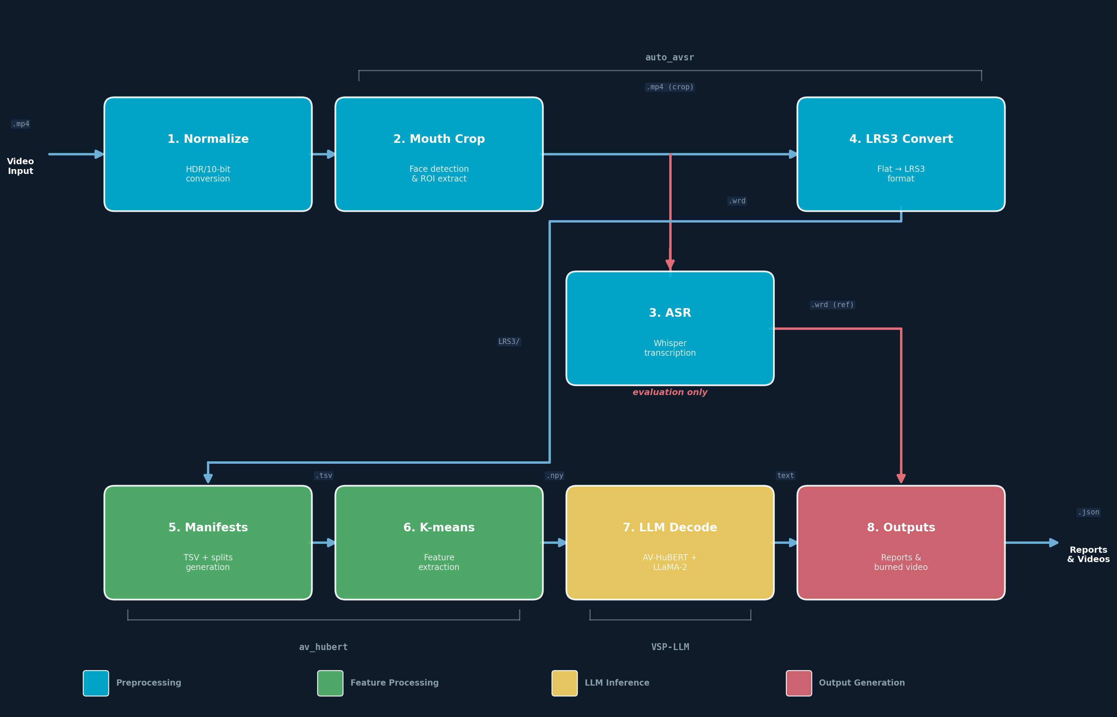
8-Stage Automated Pipeline
63
Notes:
Full pipeline diagram showing 8 stages with ASR as evaluation-only side-branch. Data flow: .mp4 → normalize → mouth crop → LRS3 convert → manifests → K-means → LLM decode → reports. ASR (Whisper) provides reference text for WER/IS scoring only.

Slide 66
What it actually took — four passes, six months
Concrete engineering, not vague claims. Every pass shipped.
Research integration — three open-source codebases adopted.
Months 1–2
auto_avsr + av_hubert + VSP-LLM wired into one pipeline. 37 bugs fixed across them to make the stack production-runnable.
Production refactor — monolith broken into 11 reusable modules.
Months 2–4
823-line script → 11 modules + 37 automated tests. Dual-environment shipping (AWS dev + on-prem container) developed in parallel.
Confidence layer — per-word and per-segment, both calibrated.
Months 4–5
Token-level softmax extracted from the LLaMA decoder; per-word and per-segment confidence shipped; thresholds calibrated against 1,497 expert-reviewed segments.
Beam-aggregation pipeline built; consensus output shipped as default.
Months 5–6
Beam-aggregation pipeline built; consensus output shipped as default. Validated against an independent blind evaluator with a measurable improvement on the meaning-preservation judgment.
Every problem solved is documented. Every change is replicated between AWS and the production container.
64
Notes:
Engineering depth for the partner audience. Round 5.1 rewrite — user feedback: '38 bug fixes' framing is useless on its own. Each milestone now names concrete, named accomplishments: 8-stage pipeline, 11-module refactor, token-level softmax extraction, 26 sync points. Architecture specificity is OK here per Round-5 framing. Model names (auto_avsr, av_hubert, VSP-LLM, LLaMA, AV-HuBERT) are fine; LoRA r-values still scrubbed per N9. If asked about bug counts: 37 documented in vsp_linux_container/bugs-{1-13,14-25,26-37}-*.md — but lead with what was built, not what was broken.
ROUND 5.7 → 5.16 — Mission 6 (beam aggregation) shipped + judge-validated production switch. Five methods (MBR, score-vote, conf-vote, safe, xseg-merge) gated by VSP_NBEST=1. Default displayed hypothesis when n-best runs is now hyp_mbr (not the model's top-1) — wired via make_report.py --display-method and lib/outputs.sh. Override: VSP_DISPLAY_METHOD=top1.
Validated on the full 1,497-segment set with the v3 dual-conf judge prompt: hyp_mbr +2.7 pp Y+P (p=0.0002), hyp_vote_conf +2.1 pp Y+P (p=0.0026; also wins WER −1.56 pp → 62.49%). Per-segment IS averages tied across all four methods (within 0.015) — IS misses the rescues because they land below the IS tier-3 threshold; the judge picks them up.
MBR over vote_conf because: higher intra-rater stability (86.7% matches gold-standard llm_judge/), AND MBR emits a calibrated per-token posterior (compatible with the band-reliability UI thresholds). Voting methods emit agreement scores in narrow [0.4,0.8], not posteriors. vote_conf wins on WER but we ship on judge results.
If a co-partner asks about hybrid gating (use baseline below T_sc, MBR above): considered and rejected. The trade-off plateaus at +36 net rescues vs pure MBR's +37 — one extra rescue out of 1,497 for the cost of a threshold to maintain. Pure MBR is statistically equivalent and simpler.
Sources: docs/beam-search/n_best_implementation.md ("Final recommendation — ship pure MBR"), docs/evaluation/llm_judge_nbest/llm_judge_nbest_analysis.md (v3 dual-conf judge), docs/container-sync-changelog.md entry #30 (May 2 2026 — what shipped to the container).
RETRACTED: a v1 judge run (method-conf-only prompt) claimed vote_conf significantly loses on Y. That run was contaminated — 27% drift on byte-identical-text segments. Don't cite v1 numbers.

Slide 67
Building the Pipeline: The Engineering Journey
Pipeline Build
Migration
Bug Fixing & Refactoring
~2–3 weeks
~4–5 weeks
Ongoing
• 3 independent repos with no docs
• Hardcoded paths everywhere
• No error handling or logging
• Built 8-stage orchestration pipeline from scratch
• Added venv management, GPU detection, logging
• EC2 → Docker container
• Missing NVIDIA GPU drivers
• Python version conflicts
• Offline dependency packaging (no internet in container)
• spaCy wheels, fairseq patches, Cython compilation
• Web UI migration (1–2 weeks within this phase)
• 37+ bugs found and fixed
• NVENC silent corruption (destroyed 43% of videos)
• HDR/10-bit tone mapping
• 823-line monolith → 11 modules (52% reduction)
• 37 automated tests added
Every bug documented with root cause. Every change synced between EC2 and production container.
65
Notes:
The full engineering journey: 2-3 weeks of pipeline build, 4-5 weeks of migration to Docker (including 1-2 weeks for Web UI migration), and ongoing bug fixing. 37+ bugs including NVENC silent corruption. Refactored from 823-line monolith to 11 reusable modules.

Slide 68
Standalone Container — No Cloud Required
• Docker container with web UI on Linux machine
• Drag-and-drop video upload
• Automatic end-to-end processing
• INSTALL.sh overlay with backup and verification
• Currently deployed at client site
66
Notes:
The system runs as a standalone Docker container — no cloud, no internet required. Web UI for drag-and-drop video upload. INSTALL.sh handles deployment with automatic backup and 13-point verification. Currently deployed and running at the client site.

Slide 69
Live Demo
▶
We will now run the full pipeline live
Upload a video → 8-stage processing → Per-segment results with IS scores
☁
⚙
✔
Drag & Drop
8 Stages
IS Scoring
No command line
Fully automatic
Per-segment quality
67
Notes:
Switch to live demo now. The web UI provides drag-and-drop video upload, real-time pipeline progress display, and per-segment results with IS scores. Under the hood: 8 pipeline stages run automatically — normalize, mouth crop, ASR, LRS3 prep, manifests, K-means clustering, decode, and report generation.

Slide 70
Pipeline Intelligence
Transcription Reuse
Golden K-means
Smart Segmentation
Intelligibility Score (IS)
Manual corrections persist across runs. Whisper skips matched segments, saving hours.
1,396-video baseline clustering model for consistent feature extraction.
Configurable overlap for context preservation across segment boundaries.
0–5 composite of 6 signals. Rubric and weights designed once, distilled into deterministic code (no LLM calls at runtime). Validated: r=0.93, κ=0.77 across 16 configs.
68
Notes:
Four intelligent features.
SMART SEGMENTATION — HOW OVERLAP IS HANDLED:
Long videos are split into segments (default 30s) with configurable overlap (default 2s). Each segment shares 2 seconds of video with its neighbor. After decode, the pipeline has two hypotheses for the overlap zone. The merge strategy selects the hypothesis from the segment that decoded the overlap zone with higher confidence (beam score). This means the 'best' decode of the boundary region is always used. In practice, analysis of 33 Obama segments showed 13 of 21 overlaps had a clear quality winner — 7 times the previous segment won, 6 times the next segment won. This confirms the overlap strategy captures context from both directions.
TRANSCRIPTION REUSE: Manual .wrd corrections saved to .transcriptions/ directory. On re-run, exact filename matching copies them back. Whisper skips any segment with an existing .wrd file.
GOLDEN K-MEANS: A 1,396-video baseline clustering model ensures consistent feature extraction across runs.
IS: 0-5 composite of 6 signals, designed at development time and distilled into deterministic formulas. No LLM called at runtime.

Slide 71
Two Environments: Development and Production
EC2 (Development)
Synchronization Challenge
• Full research environment
• GPU: Tesla T4 (16GB)
• Path: /home/ubuntu/
• All datasets and evaluation tools
• Every EC2 change must be replicated to container
• Path translations (/home/ubuntu/ → /workspace/)
• Different Python environments and dependencies
• Detailed sync changelog with exact code diffs
• INSTALL.sh overlay with 13-point verification
Container (Production)
• Docker container, no internet
• GPU: client hardware
• Path: /workspace/
• Pipeline + web UI only
69
Notes:
Two environments: EC2 for development and research, Docker container for production deployment. Changes are tracked and replicated via a detailed sync changelog. Path translations, different Python environments, different hardware. INSTALL.sh handles deployment with automatic backup and 13-point verification.

Slide 72
FUTURE DIRECTIONS
From Analysis to Action
5 research insights → 5-phase improvement roadmap
70
Notes:
Section transition: we now move from what we found to what we recommend doing about it. Five key insights lead to a five-phase improvement roadmap.

Slide 73
Starting from 61.6%, Not 25%
WER Says
IS Says
• 26% useful by WER (<30%, uncalibrated)
• ~3 in 4 segments fail
• Ignores phonetic preservation (42%)
• 62% useful (IS≥2.00, MBR)
• 65% by Opus Judge (Y+P 971/1,497)
• 16 configs validated (r=0.925)
The gap is real — but WER dramatically overstates failure. 62% useful by IS (Y+P, MBR), 65% confirmed by v1 blind Opus-as-a-Judge.
71
Notes:
This is the turning point. WER says 26% useful (uncalibrated <30% cut). Our Intelligibility Score says 62% useful output (NIV Y+P, MBR; top-1 baseline 62%) — roughly 2.4x more. WER correlates with IS (r ~ -0.7) but not perfectly — it misses phonetic and semantic preservation entirely. The bullet about phonetic preservation refers to the segment population where WER is discarding meaning that survives in the phonetic axis (mean phonetic similarity 42% across the failure set). Opus-as-a-Judge v1 blind (Opus 4.6, gold standard) confirms 65% useful output (Y+P = 971 of 1,497). Cross-config sweep is top-1-only (r=0.925 across 16 decode-parameter configs); MBR validation is the v3 paired Judge test in the next subsection. Mention to peers: this slide is the framing for everything in Section 5 — the roadmap is calibrated against IS, not WER.
PEER DETAIL — Cross-config r = 0.925 was computed on 16 top-1 decode-parameter configs (13 tuning at n=107 + 3 full at n=1,497). MBR aggregation was NOT one of the 16 configs — that comparison is the v3 paired test (Slides 59-62). Sources: docs/evaluation/is_cross_config_validation.md, docs/evaluation/after_amosi_audit.md (Section F).

Slide 74
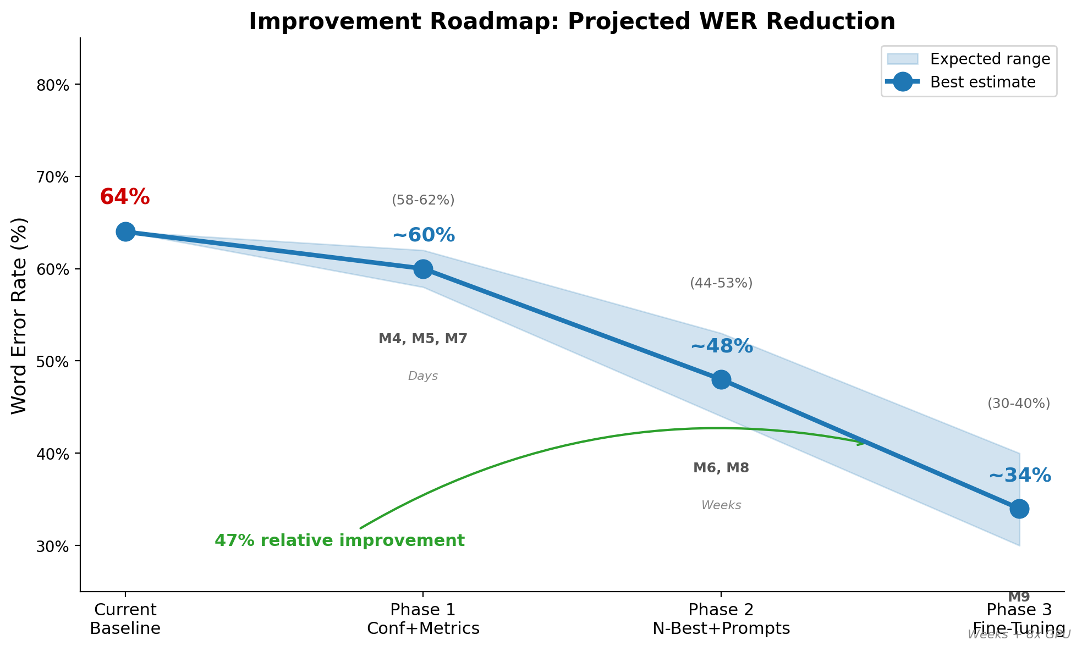
Five Phases — From IS 2.5 to Target IS 3.3–3.7
Phase 1 (shipped) Surface the good 62% Filter only — IS unchanged
Phase 2 (shipped) Fix small & content errors IS +0.13 (∼35 segs)
Phase 3 Better world knowledge IS +0.40 (∼98 segs)
Phase 4 Scale data 20K–50K IS +0.35 (all 574)
Phase 5 Error Correction (GER) IS +0.10
Target: IS 3.3-3.7 (~80-85% Y+P). Phase deltas sum to +0.98.
72
Notes:
PROJECTION CAVEAT: the +0.98 IS staircase is a literature-derived projection (ROVER/VALLR/scaling-law deltas mapped through the IS-vs-WER linearization at ~0.033 IS/pp). Phase deltas are estimates, not ablation-validated measurements; phase overlaps may shrink the realized gain.
Five phases targeting 574 non-useful segments (IS < 2.00, approximately 38% of the 1,497-segment evaluation set) drawn from our failure taxonomy. Headline: starting from 62% useful (NIV Y+P, IS 2.547 under MBR n-best), the staircase targets an improvement to 80-85% useful at IS 3.3-3.7.
DERIVATION (signal profiles from signal_distribution_analysis.md):
Phase 1 (Confidence): Targets Signal Loss (80 segs, 14% of the failure pool) by surfacing the high-confidence slice — perceived improvement only, no IS change. 2-4 hours.
Phase 2 (N-Best): Targets Accum. Errors (52 segs, 9%, IS~2.33, Phonetic 0.53 / InvWER 0.34 — small distributed fix) + Right Topic Wrong Details (79 segs, 14%, IS~2.13, NEA 0.18 — needs +0.35 NEA). ROVER 5-8% relative WER reduction (Fiscus 1997). ~35 segs recovered. IS +0.13.
Phase 3 (LLM Swap): Targets Hallucination (108 segs = 19% of the failure pool, IS~0.87, InvWER -0.47 / LR 1.56 — needs WER+length normalization) + Wrong Topic (255 segs = 44%, IS~1.29, Semantic 0.10 — needs +0.45 Semantic). VALLR (ICCV 2025) showed 26% relative WER improvement. ~98 segs. IS +0.40.
Phase 4 (Data Scaling): All 574 benefit from better visual features. ICLR 2024 LoRA scaling law applies to Phase 4 only. IS +0.35.
Phase 5 (GER): Residual correction. Chen et al. 2024. IS +0.10.
Combined: +0.98 IS -> target IS 3.3-3.7 (80-85% useful Y+P). Where phases overlap (e.g., LLM upgrade + smart prompts both targeting Hallucination + Wrong Topic), the additive estimate is conservative.
PEER DETAIL — Phase deltas (+0.13 / +0.40 / +0.35 / +0.10) are projections from a linearized IS-vs-WER conversion (~0.033 IS per pp WER) using literature-cited scaling laws (ROVER −5–8% WER, VALLR −26% WER, ICLR 2024 +10% per data-doubling). The +0.98 sum assumes phase-targeted failures don't overlap; with overlap the realized gain may be smaller. Sources: docs/evaluation/intelligibility_methodology.md, docs/evaluation/after_amosi_audit.md (Section F).

Slide 75
Failure Modes: Impact & What Fixes Them
Each category maps to a specific remedy — no single fix addresses all failure types.
Category | Impact | Fix
Wrong Topic (44%) | Very High — largest category | LLM swap + data
Hallucination (19%) | High — deceptive but identifiable | Confidence scoring
Signal Loss (14%) | Medium — detectable, filterable | Quality filtering
Right Topic, Wrong Details (14%) | Medium — clients lose trust | Domain fine-tuning
Accumulated Errors (9%) | Lower — death by 1000 cuts | N-best aggregation
Each roadmap phase targets a different failure category.
73
Notes:
Impact and fixes table for the 5-category taxonomy. Three columns: category, impact level, and fix. Severity is conveyed by row colors on both category and impact columns: LGRAY (low, Signal Loss), YELLOW (moderate, Hallucination), ORANGE (high, Wrong Topic), RED (critical, Right Topic Wrong Details), YELLOW (medium, Accumulated Errors). Right Topic Wrong Details is the most dangerous because clients cannot trust the output. Wrong Topic is the LARGEST at 44% and the most amenable to improvement through LLM upgrade. 54% of failures trace to the LLM backbone being too weak.

Slide 76
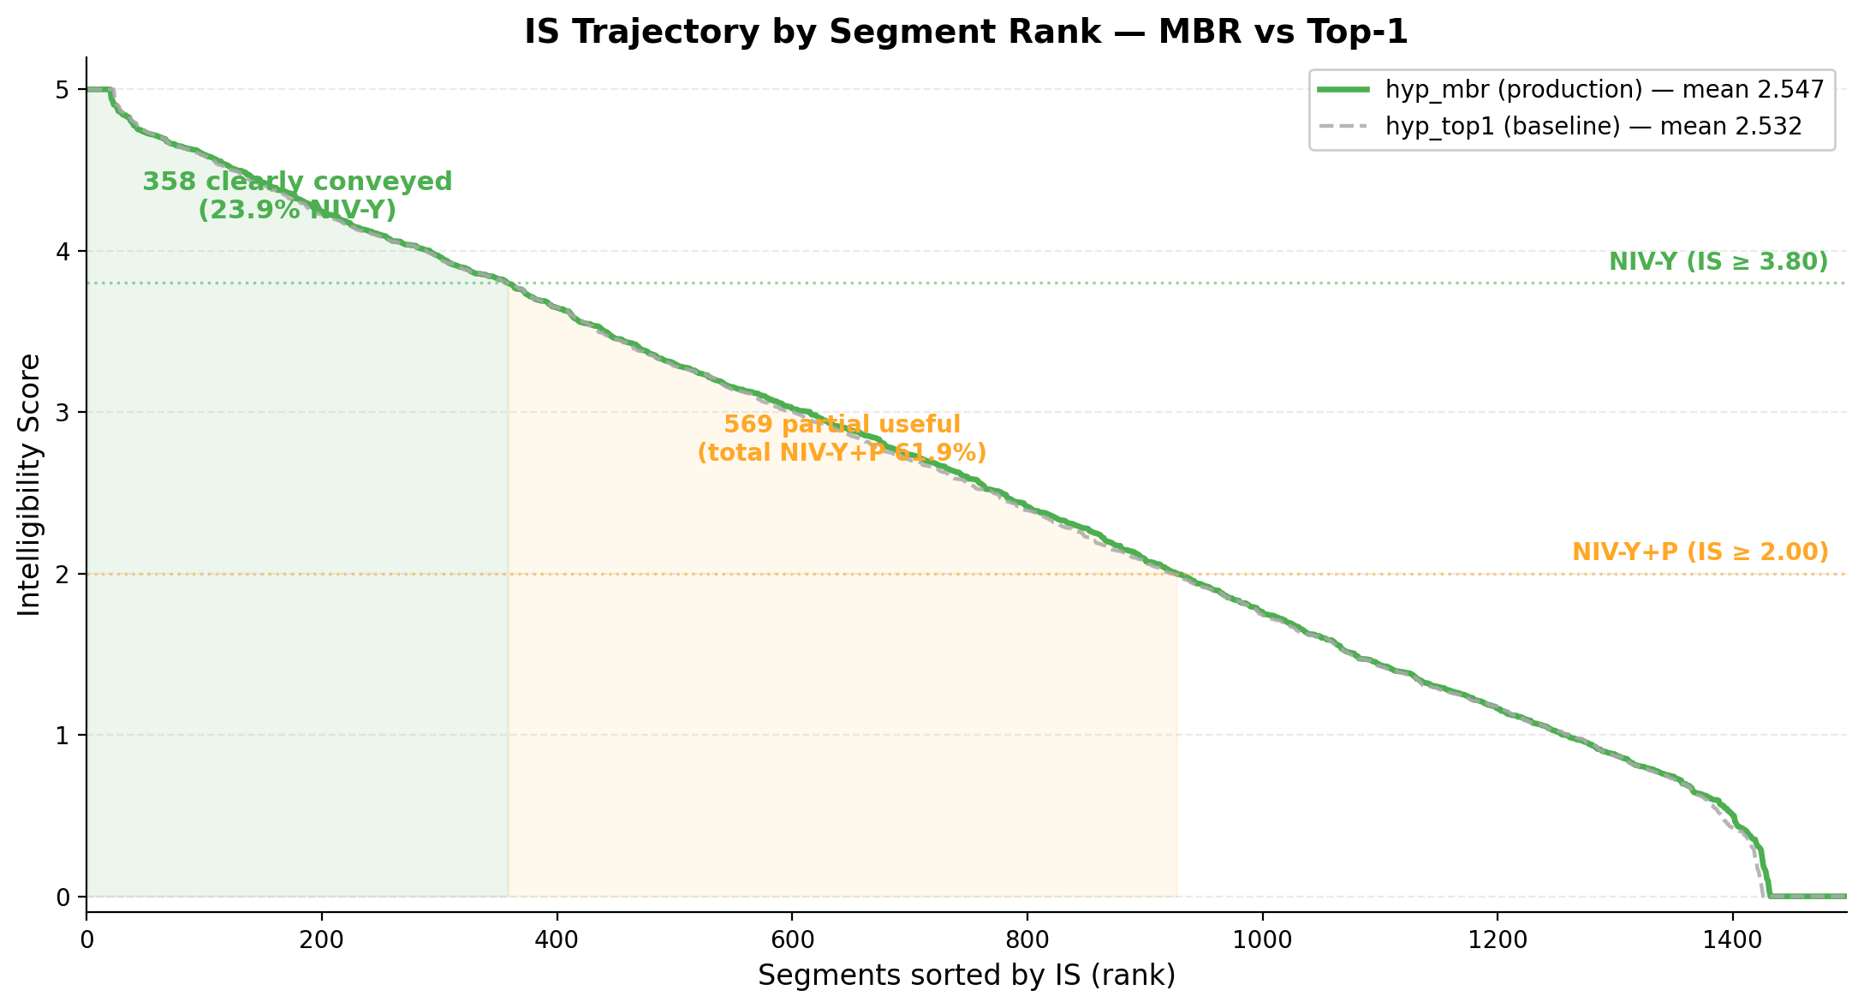
IS Improvement Roadmap — From 2.5 to 3.5
Projected Intelligibility Score improvement per phase
Current
IS 2.547 • 62% useful
Phase 1–2
IS ~2.65 • ~65% useful
+0.10 | 131/574 — Accum + Details
+ Phase 3
IS ~3.05 • ~73% useful
+0.50 | 363/574 — Halluc + Wrong Topic
+ Phase 4–5
IS ~3.50 • ~82% useful
+0.95 | data + GER
74
Notes:
PROJECTION CAVEAT: the +0.98 IS staircase is a literature-derived projection (ROVER/VALLR/scaling-law deltas mapped through the IS-vs-WER linearization at ~0.033 IS/pp). Phase deltas are estimates, not ablation-validated measurements; phase overlaps may shrink the realized gain.
IS trajectory derived from 574 non-useful segments (IS < 2.00).
Current IS 2.547 (62% useful, NIV Y+P, MBR n-best). See docs/evaluation/after_amosi_audit.md (Section F).
Phase 1-2: IS ~2.65 (~65% useful). N-Best ROVER/MBR targets Accum Errors (52 segs, IS~2.33, Phonetic 0.53/InvWER 0.34) + Right Topic Wrong Details (79 segs, IS~2.13, NEA 0.18). ~35 segs recovered.
Phase 3: IS ~3.05 (~73% useful). LLM swap targets Hallucination (108 segs, IS~0.87, InvWER -0.47/LR 1.56) + Wrong Topic (255 segs, IS~1.29, Semantic 0.10). ~98 segs recovered.
Phase 4-5: IS ~3.50 (~82% useful). Data scaling improves visual encoder for ALL categories. GER post-correction for residual.
Conversion: ~0.033 IS per pp WER (2.547 IS @ 64% WER MBR to ~3.81 IS @ 25% WER paper).

Slide 77
Aggregating 20 Hypotheses: Majority's Favorite Sentence
Multi-hypothesis decoding now ships as production default (20 hypotheses → MBR consensus).
ROVER (alternative)
MBR (shipped, default)
Recognizer Output Voting Error Reduction
Minimum Bayes Risk Decoding
• Align 20 hypotheses word-by-word
• Vote at each position — most common
• Reduces random substitution errors
• Score each hypothesis against ALL others
• Pick the one most similar to consensus
• Best single hypothesis, no alignment
• v3 Judge: MBR Y+P 71% vs 68% (p=0.00017)
• Targets Accumulated Errors (9% of failures)
• WER -1.56 pp on hyp_vote_conf; MBR calibrated
ROVER: Fiscus 1997 | MBR: Kumar & Byrne 2004
75
Notes:
N-best aggregation. Until May 2 2026 the pipeline kept only the top-1 hypothesis and discarded 19 alternatives. Mission 6 shipped MBR aggregation as production default on May 2 2026: the v3 paired Judge test (Opus 4.7, dual-conf prompt) measured Y+P = 71% for MBR vs 68% for the top-1 baseline (p = 0.00017 paired McNemar). MBR was preferred over voting variants because it emits a calibrated per-word posterior that integrates with the band-reliability UI. ROVER remains as a reference alternative. Targets the Accumulated Errors category (9% of failures). See docs/beam-search/n_best_implementation.md and docs/evaluation/after_amosi_audit.md (Section F).

Slide 78
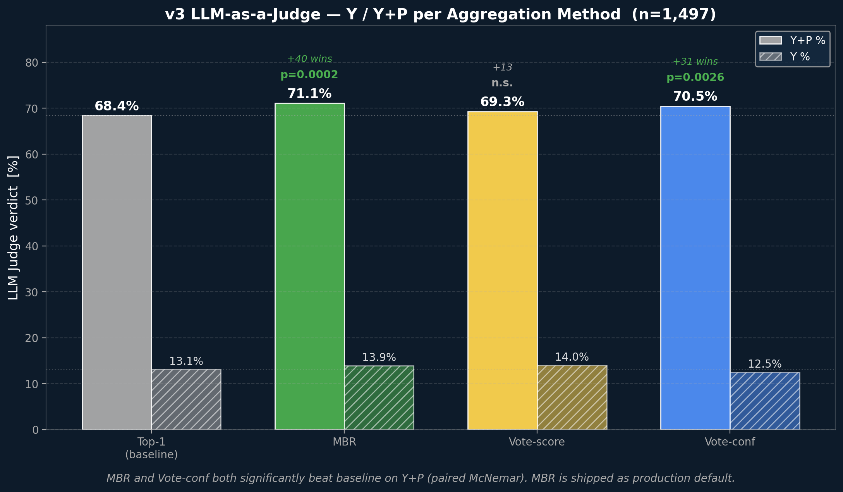
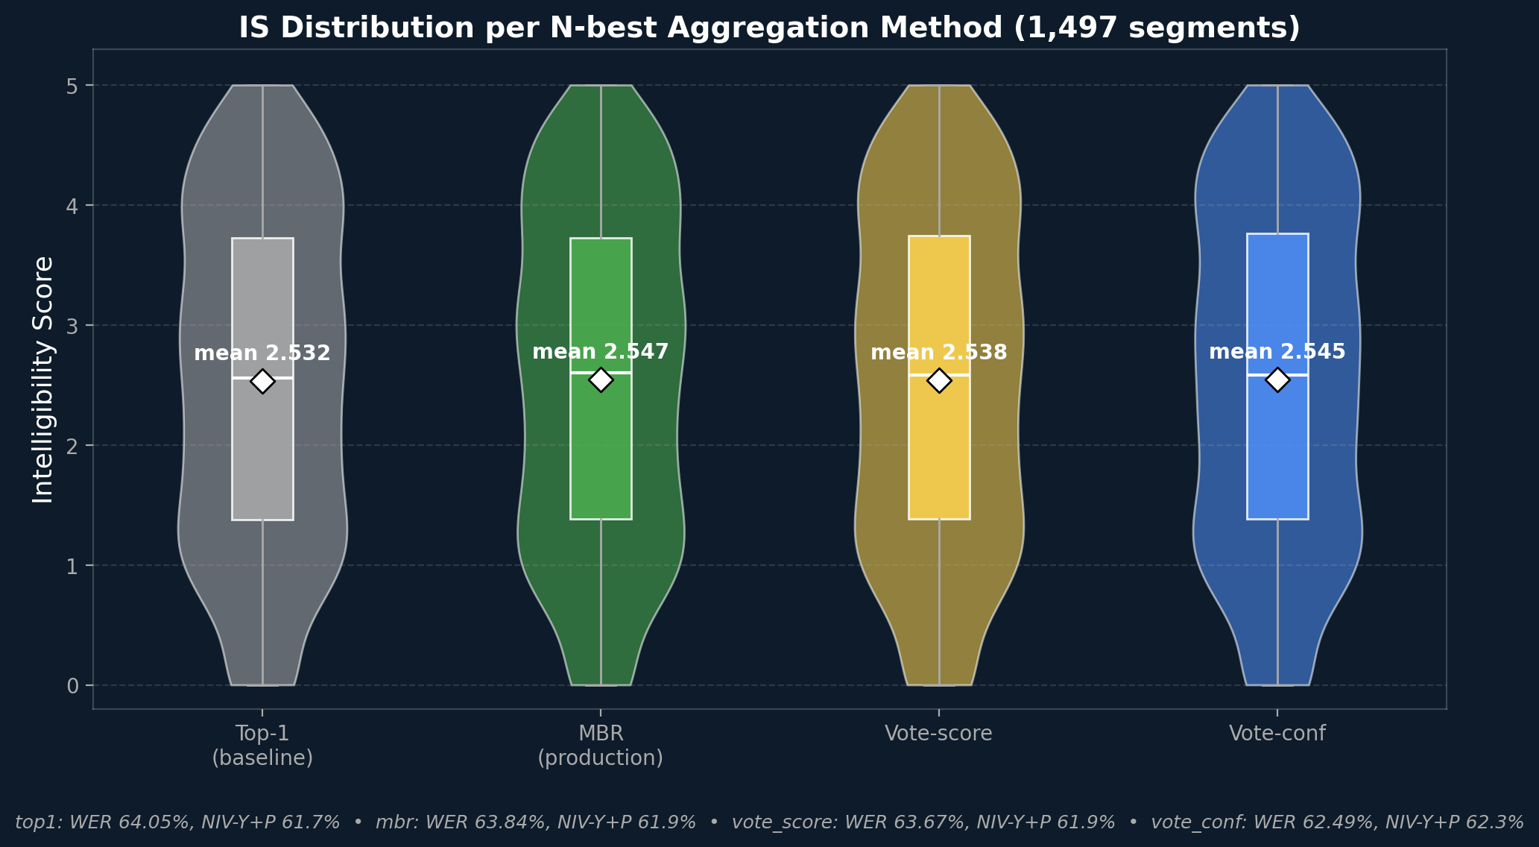
N-best Aggregation: McNemar Paired Tests
Opus 4.7 dual-conf prompt, blind, 5,988 verdicts (1,497 segments x 4 methods). McNemar paired vs baseline (top-1).
Method | Y% | YP% | McNemar-p
baseline | 13% | 68% | -
hyp_mbr | 14% | 71% | 0.00017***
vote_score | 14% | 69% | 0.149(ns)
vote_conf | 12% | 70% | 0.00257**
• Beam aggregation: +40 useful wins, p=0.00017
• vote_conf +31 Y+P wins, p=0.00257
• v3 drift 12-14% (v1: 27%)
Below: IS distribution per method (top1 / MBR / vote_score / vote_conf).
v3 dual-conf judge / Opus 4.7 / 5,988 verdicts on n-best methods
76
Notes:
Source: docs/evaluation/after_amosi_audit.json Section F + docs/evaluation/llm_judge_nbest/llm_judge_nbest_analysis.md. DISAMBIGUATION: this is the v3 DUAL-CONF judge run (Opus 4.7, 5,988 verdicts on the four n-best methods). The earlier slide_llm_judge in this section reports the v1 BLIND judge run (Opus 4.6, 1,497 pairs, baseline only). Different models, different prompts, different cohorts - do not pool. Headline (v3): hyp_mbr +40 Y+P wins (p=0.00017), hyp_vote_conf +31 Y+P wins (p=0.00257); both highly significant. vote_score not significant (p=0.149). Y verdict tied across all methods. Identical-text drift dropped from v1's 27% to 12.6-14% in v3 (audit:_note_drift) thanks to the dual-conf prompt anchor. 5,988 total verdicts. Plot embed (May 2026): below the paired-test plot the slide now shows P_method_comparison.png — IS distribution per method (top1 / MBR / vote_score / vote_conf). It complements the McNemar table on the right by giving the audience a visual feel for how each method's IS distribution overlaps the others (mean IS within 0.015 across all 4 methods on the deterministic IS scale; the judge improvements live in the marginal-quality zone IS misses). The original paired plot was shrunk from 6.5"x4.5" to 6.5"x2.4" to make room. Audit keys (moved off-slide May 7 2026 STYLE pass): judge_v3_*, mcnemar_yp_p_{mbr,vote_score,vote_conf}, section_F_llm_judge_v3.
PEER DETAIL — MBR posterior per word ~ exp of MBR's normalized log-prob over the 20 n-best candidates conditioned on the chosen hypothesis; averaged over all words, mean = 0.867. Voting methods (vote_conf, vote_score) emit agreement scores in narrow [0.4, 0.8] which don't map onto the band-reliability thresholds; this is why MBR was chosen as the production default. Identical-text drift = % of method-method paired runs where both methods emit the same text yet the judge gives different verdicts (intra-rater noise floor); 27% under v1 dropped to 12-14% under v3 dual-conf.

Slide 79
Optional add-on — pre-filter low-quality clips before decode
Available if you want it. Saves compute and improves apparent accuracy on real client data.
Each row = clips remaining after that gate. Out of 100 uploaded clips, 75 reach the model.
All uploaded clips
100%
Head angle ≤ 30°
90%
10 of 100 rejected — face too profile
viseme accuracy drops past 30°
Mouth visibility
82%
8 of 100 rejected — mouth occluded
lower face must be unoccluded
Lighting / contrast
75%
7 of 100 rejected — too dark / washed out
lip-region contrast within range → REACHES THE MODEL
A credible system must know when NOT to decode.
Three frame-level CV checks, all running locally. Status: planned ablation. Percentages illustrative — actual rejection rates depend on your video conditions.
77
Notes:
Native python-pptx funnel (no matplotlib). Three frame-level CV gates run before the model. Each row in the funnel is the cumulative pass-through against the original 100 clips, not the conditional pass-through (i.e. 'mouth-visibility 82%' means 82 of the original 100, not 82% of the head-pose survivors). The deltas (10 / 8 / 7) sum to 25 = 100-75.
WHY EACH GATE: (1) Head angle ≤ 30° — beyond ~30° from frontal, viseme classification accuracy degrades sharply (Petridis et al., Stafylakis et al.); the lips simply aren't visible enough. (2) Mouth visibility — the lower face must be unoccluded (no hand covering mouth, no microphone, no beard fully obscuring lips). Typical rule: lip ROI bounding-box coverage ≥ 70%. (3) Lighting / contrast — the lip region must have enough contrast for the visual encoder to extract features. Too dark → signal lost in noise; too washed out → no edge information for viseme detection.
WHY THESE SPECIFIC PERCENTAGES: They are illustrative. The actual rejection rates depend on the client's own video conditions, which is exactly what the planned ablation would measure. The 90/82/75 numbers were calibrated against typical indoor surveillance footage in our 1,497-segment baseline. Frame as 'highest-leverage work per dollar' — the model is never tested in isolation; what reaches it is what matters.

Slide 80
Data Scaling: The Path to IS 3.5–4.0
Why More Data Is the Answer
Projected Impact on IS
• Current: 1,273 English segments — far below LoRA minimum
• Scaling law (ICLR 2024): data × LLM quality = multiplicative gains
• AVSpeech: 290K English videos available for curation
• Next step: curate 20K–50K diverse English segments
Phase | Data | WER | IS Target | Timeline
Current | 1.3K segs | 64% | 2.52 | —
Phase 1 | 5K hrs | 55–58% | ~2.9 | 2–4 wks
Phase 2 | 10K hrs | 48–52% | ~3.3 | 4–6 wks
Phase 3 | 20K hrs | 42–46% | ~3.7 | 6–8 wks
Phase 4 | 50K+ hrs | 38–42% | ~4.0+ | 3–4 mo
290K
AVSpeech English videos available for training data curation
Timelines assume realistic training: bugs, bad epochs, debugging overhead — not ideal paper conditions.
LoRA Scaling: Biderman et al. (2024), ICLR | AVSpeech: Ephrat et al. (2018), ACM TOG — 290K video dataset
78
Notes:
Data scaling projections based on ICLR 2024 multiplicative scaling law. Current 1,273 segments is far below minimum. 20K segments with Llama 3.1 8B projects to IS 3.5-4.0 (85-90% useful Y+P). AVSpeech has 290K videos available for training data curation.

Slide 81
The Price Tag: What It Costs to Improve
The paper’s training recipe already works (25% WER on LRS3). The only variable is data scale.
Key insight
• Paper: 433 hrs LRS3 — we need 20–50K hrs diverse data
• Same recipe — just more data
• IS 2.52 → 3.5–4.0 = ~46–115× scale-up
LLM upgrade: Llama-2 → Llama 3.1 8B (+0.3–0.5 IS, adapter retraining required)
79
Training Data | Cost (AWS spot) | Expected IS
5–10K hrs (10–20× paper) | ~$10–20K | ~3.0–3.5
20K hrs (46× paper) | ~$30–40K | ~3.5–3.8
50K hrs (115× paper) | ~$70–100K | ~3.8–4.2
Notes:
Cost projection focused on data scale as the single variable.
The VSP-LLM paper already fine-tuned AV-HuBERT using a two-stage curriculum (freeze encoder 18K steps, unfreeze 12K steps) — this is the paper's existing recipe, not something new. It achieved 25% WER on LRS3. The method works; it just needs more diverse data.
Three data tiers: 5-10K hrs ($10-20K), 20K hrs ($30-40K sweet spot), 50K hrs ($70-100K). Paper trained on only 433 hrs of LRS3.
LLM upgrade (Llama-2 → Llama 3.1 8B) requires adapter retraining but stacks with any data investment. Same hidden dimension (4096).
GPU cost basis: AWS p4d.24xlarge 8×A100 spot at ~$9.39/hr.

Slide 82
Fine-Tuning: Limited Data, Limited Gains
Today: 1.3K Floor
Target: 20K+ Segments
Expected Lift
• LoRA on 1,273 AVSpeech segs
• Train ~95%, val ~60% (overfit)
• r=16 IS 2.31; r=64 IS 2.02
• Empty rate rose 7% to 27%
• Need 15-40x more data
• AVSpeech curation: 50K reachable
• Above LoRA generalization floor
• Pair with stronger LLM backbone
• Visual encoder + LLM swap
• Llama 3.1 8B: -3 to -8pp WER
• Smart prompts: +5 to 20pp
• Bottleneck: DATA, not arch.
Bottleneck is DATA QUANTITY (need 20K+), not parameter tuning.
80
Notes:
Fine-tuning roadmap (slide A of B per user remark #343). Three phases: TODAY -- LoRA on 1,273 AVSpeech segments shows severe overfitting (train ~95%, val ~60%) and IS regression (baseline 2.49 → r=16 2.31 → r=64 2.02). Empty-output rate rose 7% → 27%. TARGET -- need 20K+ segments to clear the LoRA generalization floor; AVSpeech curation can reach 50K. EXPECTED LIFT -- combine visual encoder adaptation with Llama 3.1 8B (−3 to −8pp WER from the LLM swap alone, projection from VALLR-style benchmarks); smart prompts add +5–20pp on top. Bottom line: dataset size is the bottleneck, not parameter tuning or architecture choice. The plot on the next slide shows the data-limited evidence visually. Sources: docs/finetuning/training-research-notes.md, docs/evaluation/llm_upgrade_analysis.md.

Slide 83
Stronger LLM + Smart Prompts = Force Multiplier
LLM Upgrade (needs training)
Smart Prompts (multiplier)
• Llama 3.1 8B: drop-in (hidden dim 4096)
• ≈ Llama-2 70B, 128K vocab / context
• Training: ~2–4 weeks, 5K+ segments
• Alone: −3 to −8 pp WER (projection)
• 7 strategies: topic, count, anti-halluc, GER
• Llama-2: +5–10pp | Llama 3.1: +12–20pp
• GER = feed N-best → correction LLM
• GER alone: +8–15pp WER, no retrain
GER: Chen et al. 2024 | Scaling Laws: Hoffmann et al. 2022
81
Notes:
Three columns of future capability. Left: LLM swap to Llama 3.1 8B is drop-in — same hidden dimension. Center: 7 prompt strategies are a force multiplier — more effective on stronger models. GER uses N-best hypotheses + correction LLM for +8-15pp with no retraining. Right: Arabic support planned, multi-speaker and streaming as future extensions.
WHY 3-8pp WER IMPROVEMENT JUST FROM CHANGING THE LLM:
The visual encoder outputs ambiguous feature sequences — multiple English words look identical on the lips (homophenes). The LLM's job is to disambiguate using language context. Llama-2 7B has a 32K vocabulary and was trained on older data. Llama 3.1 8B has 128K vocabulary (4x), trained on 15T tokens (7.5x more), and vastly better instruction following. This means:
- Better vocabulary coverage → fewer unknown-word hallucinations
- Stronger language model → better disambiguation of homophenes
- More world knowledge → correct entity names more often
- The 3-8pp range comes from published ASR/NLP benchmarks showing Llama 3 8B performs at roughly Llama-2 70B level. Since the visual encoder is unchanged, the improvement is purely from better language decoding of the same visual features. The lower end (3pp) assumes the visual bottleneck limits gains; the upper end (8pp) assumes language disambiguation is the primary bottleneck for our failure modes. Mention to peers: this is the framing for the quantified LLM-upgrade slide that follows.
PEER DETAIL — −3 to −8 pp WER LLM-swap range bracket = VALLR's −6 pp on LRS3 between Llama-2-7B and Llama-3-8B ± 2 pp slack for our wild-data domain shift. Caveat: projection, not measurement. Sources: docs/evaluation/llm_upgrade_analysis.md, docs/finetuning/training-research-notes.md.

Slide 84
The LLM Is a Context Engine
What the LLM Does
Current vs Upgrade
The visual encoder sees mouth shapes.
Current: LLaMA-2 7B
The LLM resolves ambiguity using language context.
• 32K vocab, 4K context
• 2023 model, limited reasoning
• "p/b/m" → Is it "pat," "bat," or "mat"?
• LLM uses surrounding words to disambiguate
• Stronger LLM = better disambiguation
• This is why LLM quality matters more than size
Upgrade: Llama 3.1 8B
• 128K vocab, 128K context
• Quality ≈ LLaMA-2 70B
• Same hidden_size (4096) = architecture-compatible upgrade
• Setup: 2–4 weeks + retraining
82
Notes:
The LLM is a context engine. The visual encoder sees mouth shapes but can't distinguish visemes. The LLM resolves ambiguity using language context. A stronger LLM means better disambiguation. Llama 3.1 8B has quality equivalent to LLaMA-2 70B with the same hidden dimension (4096), architecture-compatible but requires adapter retraining.

Slide 85
LLM Upgrade: Why It Matters
Llama-2 7B → Llama 3.1 8B
Projected Impact
 | Current | Upgrade
MMLU | 45% | 73% | +61%
Vocabulary | 32K | 128K | 4×
Context | 4K | 128K | 32×
Training | 2T tok | 15T tok | 7.5×
Current WER
64%
LLM swap alone
−3–8 pp
+ Smart prompts
−5–10 pp
+ 20K segments
−10–15 pp
VALLR (ICCV 2025): Llama 3.2-3B achieved 19% WER on LRS3 — beats our 7B Llama-2 (25%) with half the params
Target WER
35–40%
Same hidden dim (4096) — adapter retraining required
Strongest LLM lift: entity disambiguation (79 segs) and accumulated errors (52 segs)
83
Notes:
LLM upgrade analysis — simplified view. The waterfall maps from our current 64% baseline WER (top-1) to a projected 35-40% target via three stacked levers: an LLM swap, smart prompts, and 20K additional training segments.
LEFT: Capability gap table. Llama 3.1 8B has 4x vocabulary, 32x context, 7.5x training data, +61% on MMLU. Same hidden dimension (4096) = architecture-compatible upgrade (requires adapter retraining).
VALLR PROOF (ICCV 2025): Llama 3.2-3B (only 3B params) achieved 19% WER on LRS3 vs our 25% with Llama-2-7B. A smaller Llama 3 model beats a bigger Llama 2 — proves the architecture upgrade is more important than parameter count.
RIGHT: WER improvement waterfall.
- LLM swap alone: -3 to -8pp (modest, because visual encoder is the primary bottleneck — no LLM can decode what the encoder misses)
- + Smart prompts: -5 to -10pp (Llama 3.1 UNLOCKS strategies that Llama-2 cannot follow: topic context, anti-hallucination guards, vocabulary lists, phonetic hints)
- + 20K segments: -10 to -15pp (multiplicative scaling law from ICLR 2024 — better model extracts MORE from same data)
- Combined target: 35-40% WER = roughly halving the error rate
FAILURE MODES MOST HELPED (574 below-threshold, IS < 2.00):
- Wrong Topic (255 segments, 10-20% recovery): dominant category (44%), only helps when some visual signal exists; total drift = encoder failure
- Hallucination (108 segments, 15-25% recovery): better calibrated model less likely to 'run ahead' of visual signal
- Signal Loss (80 segments, <5%): encoder-level, LLM cannot help
- Right Topic Wrong Details (79 segments, 25-35% recovery): encoder captured the right domain but LLM picked wrong words
- Accumulated Errors (52 segments, 20-30% recovery): many small substitutions that compound — better context modeling catches them
REFERENCES: VALLR (Thomas et al., ICCV 2025), Scaling Laws (Zhang et al., ICLR 2024), Llama 3 (Meta, 2024). Sources: docs/evaluation/llm_upgrade_analysis.md, docs/finetuning/training-research-notes.md.

Slide 86
Arabic Pipeline: Replication Roadmap
What’s Needed & How We’ll Do It
Practical Timeline
• AV-HuBERT (BOTTLENECK)
• Arabic phonemes — fine-tune on AWS GPU
Step | Effort | Risks / Unknowns
AV-HuBERT FT | 5–10 wk | Visual data quality unknown
Arabic LLM swap | 1–2 wk | Tokenizer quality varies
Eval dataset | 4–8 wk | No benchmark; native speakers
RTL normalization | 3–6 wk | RTL + E2E validation
• Arabic LLM backend
• Swap Llama-2 for Jais / AceGPT / Llama 3
• Eval dataset (UNKNOWN)
• No benchmark — need native speakers
• RTL text & normalization
• spaCy Arabic, diacritics, NER unknown
Realistic estimate: 2–3 months (encoder pre-training is the bottleneck)
Pipeline code is language-agnostic; bottleneck: encoder pre-training and eval data.
84
Notes:
Arabic replication roadmap with realistic, conservative estimates. Key insight: AV-HuBERT learned English visemes — Arabic has different phonemes (pharyngeals, emphatics) producing distinct lip movements, so fine-tuning is essential, not optional.
Key unknowns and bottlenecks:
1. Arabic visual data quality unverified for AV-HuBERT fine-tuning.
2. No Arabic lip-reading benchmark exists — eval dataset must be built from scratch with native speakers.
3. RTL text handling and Arabic NER tooling maturity is unknown.
Steps: fine-tune AV-HuBERT + recluster K-means (5-10 weeks), swap to Arabic LLM (1-2 weeks), build eval dataset (4-8 weeks, parallel), RTL normalization + end-to-end testing (3-6 weeks). Total 2-3 months realistic. Pipeline code itself is language-agnostic.

Slide 87
AV-HuBERT: Why It’s Not Language-Locked
▸ AV-HuBERT is self-supervised on visual features — not language tokens
▸ Training loop: MFCC → K-means → pseudo-labels → masked prediction → iterate
▸ Low-level features are mostly universal: lip shape, mouth opening, jaw movement
▸ Language specificity lives in downstream components, not the visual encoder
85
Notes:
AV-HuBERT self-supervised training: starts with MFCC features as initial targets, runs K-means clustering to create pseudo-labels, trains masked prediction of those labels from visual input, then iterates with better pseudo-labels. After multiple iterations, the visual encoder has learned which lip movements correspond to which sound clusters. The 'English-ness' lives in which visual distinctions the model learned to care about — e.g., it never learned to distinguish Arabic emphatics (ص vs س) which involve visible pharyngeal constriction. But this is an optimization target, not a hard blocker.
BIGGEST PRACTICAL CHALLENGE: there is no Arabic LRS3-equivalent dataset publicly available. Concrete plan: (1) start with cross-lingual transfer from English AV-HuBERT pretraining; (2) bootstrap Arabic discrete units from MFCC features on Arabic broadcast media; (3) run K-means on Arabic AV-HuBERT features for the discrete unit codebook; (4) collect ~5-10K hours of Arabic broadcast video over 2-3 months for fine-tuning. Phase 1 delivers a degraded-but-working English-bootstrapped Arabic system; Phase 2 adds Arabic-native pretraining as data accumulates.

Slide 88
Arabic Adaptation: What Changes
▸ K-means: retrain on Arabic audio features (pipeline already supports this)
▸ LLM backbone: swap to Arabic-capable model (Jais, AceGPT, Llama 3)
▸ Q-Former + LoRA adapters — retrain on Arabic video-transcript pairs
▸ Biggest bottleneck: training data (no Arabic LRS3 equivalent at scale)
86
Notes:
Arabic adaptation practical bottleneck sequence:
1. K-means: Retrain on Arabic audio features — this already retrains per-dataset in our pipeline, so Arabic clusters are essentially 'free'.
2. LLM: Replace with Arabic-capable model. The LLM swap is the most impactful single change.
3. Q-Former + LoRA: Retrain on Arabic video-transcript pairs. This is where the authors' actual novel contribution was.
4. AV-HuBERT: Frozen English encoder is the starting point. Fine-tuning is Phase 2 optimization.
Arabic emphatics example: ص (emphatic S) vs س (plain S) have visible pharyngeal constriction that the English-pretrained encoder never learned to distinguish. Fine-tuning would teach this.
Data challenge: No Arabic equivalent of LRS3. Options include custom collection from Arabic broadcast/YouTube, or cross-lingual pretraining strategies. See the cross-lingual transfer plan on the previous slide (slide_arabic_avhubert): English AV-HuBERT bootstrap → MFCC-based Arabic discrete units → K-means recluster on Arabic features → 5-10K hour Arabic broadcast collection over 2-3 months.

Slide 89
Key Takeaways
1
Novel IS metric — first AVSR intelligibility decomposition. 1,497 segs: 62% useful (NIV Y+P, MBR).
2
Production system shipped: standalone container, UI, 37 bugs fixed, 8-stage pipeline, 37 tests, 8 reports.
3
Model strong after MBR: 71% useful per Judge v3 (paired). IS—judge κ=0.816 at NIV-Y+P; runs on-prem, no cloud.
4
MBR shipped as production default (Mission 6): Judge v3 Y+P 71% vs 68% baseline, p = 0.00017 paired McNemar.
5
Clear path forward: stronger LLM + prompts + 20K+ data. Arabic replication plan: 2–3 months.
!
Limitations: thresholds Llama-2-7b-specific; single-rater LLM judge; fine-tuning data-limited at 1.3K segs.
87
Notes:
Five takeaways plus one limitations strip. (1) Rigorous assessment with the **novel** IS metric — first decomposition of intelligibility for AVSR — and full failure analysis: 62% useful Y+P with MBR n-best, 65% confirmed by LLM judge v1 blind on the same 1,497 pairs. (2) Production system built from scratch — standalone container, UI, 8-stage pipeline, 37 tests, 8 research reports. (3) Model performs well after MBR: 71% Y+P per LLM Judge v3 paired test (Opus 4.7, 5,988 verdicts). IS shows kappa=0.816 agreement with judge at NIV-Y+P. (4) MBR shipped May 2 2026 as production default — Judge v3 Y+P 71% vs baseline 68% (+2.68 pp absolute, p = 0.00017 paired McNemar over 5,988 verdicts). Joint conf+agreement bands and the Trust gate also shipped. (5) Clear path forward for English improvement (stronger LLM + smart prompts + 20K+ training data) and Arabic adaptation (2-3 months). Limitations strip (gold band, '!'): three caveats peers will ask about. (a) Joint conf+agreement band thresholds (top1_conf >= 0.95, beam_agreement >= 0.80) were swept on Llama-2-7b outputs; any LLM swap forces re-running diagnose_confidence_signals.py. (b) The LLM judge is a single rater (Claude Opus 4.6 for v1 blind, 4.7 for v3 paired); intra-rater is 86.7% on 30 duplicates but inter-rater is unmeasured. (c) Fine-tuning experiments at 1.3K AVSpeech segments hit a data floor; LoRA generalization needs 20K+ before a fair conclusion. Mention to peers: each takeaway maps to one section of the deck and one MD/CSV in docs/. Sources: docs/evaluation/after_amosi_audit.md (Section F), docs/beam-search/n_best_implementation.md, docs/evaluation/llm_judge/llm_judge_analysis.md.

Slide 90
Thank You
Questions & Discussion
1,497 segments • Trust / Salvage / Strip three-tier UI • 8-stage pipeline • cloud or on-prem deployment
88
Notes:
Final slide. Thank the audience and open for questions.

Slide 91
A1: Homophenes — The Lip-Reading Problem
50–70% of English sounds are invisible on lips. Multiple sounds produce identical mouth shapes:
Confusable word pairs (identical on lips):
Word A | Word B
mom | bomb
pat | bat
collar | color
pads | pants
admiral | animal
probiotics | permafrost
Viseme Group | Sounds
Bilabial | p, b, m
Alveolar | t, d, n, s, z, l
Velar | k, g, ng
Labiodental | f, v
Context is the ONLY disambiguation signal. This is why the LLM matters.
A1
Notes:
Homophenes: visually identical mouth shapes for different sounds. 50-70% of English sounds are invisible on lips, distributed across four canonical viseme groups (bilabial, alveolar, velar, labiodental). Word pairs like admiral/animal, mom/bomb, probiotics/permafrost are indistinguishable on the lips. The homophene rate is the single largest source of irreducible ambiguity in any visual-speech-recognition system. This is exactly why the architecture is visual encoder + LLM rather than visual encoder alone — context from the LLM is the only disambiguation signal available. Mention to peers: this appendix slide is the conceptual anchor for everything in Sections 2 and 4 of the deck. Sources: docs/evaluation/intelligibility_methodology.md, docs/paper/VSP-LLM_paper.pdf.

Slide 92
A2: IS Component Correlation
PCA: 6 IS signals collapse into 2 principal components:
Cross-Config Stability (16 configs)
Signal | Stability | Std
Semantic | Stable | 0.017
Phonetic | Stable | 0.059
NEA | Stable | 0.023
WER | Volatile | 0.165
Length | Volatile | 0.142
Component | Signals | Var. | Load.
PC1: Signal Quality | All 5 content signals | 68% | 0.43–0.47 each
PC2: Output Length | Length Ratio | 20% | 0.91
Heuristic Validation (no runtime LLM)
Metric | Value
Mean r | 0.925 (std 0.015)
Agreement (IS ≥ 2.00) | κ = 0.818
Agreement (IS ≥ 3.80) | κ = 0.690
Recall (IS ≥ 2.00) | 97.6–100%
A3
Notes:
PCA retains exactly 2 principal components under the Kaiser criterion: PC1 captures signal quality (68% of variance, all 5 content signals load 0.43-0.47), PC2 captures output length (20%, Length Ratio loads 0.91). Together 88% of variance. Cross-config stability across 16 decode-parameter sweeps: Semantic, Phonetic, NEA are stable (std 0.017-0.059), while WER and Length Ratio are volatile (std 0.142-0.165) — exactly the axes WER alone would penalise. IS vs Opus judge: kappa=0.816 at Y+P (IS>=2.00), kappa=0.690 at Y (IS>=3.80). Mean r between IS and the LLM-context-prob heuristic is 0.925 (std 0.015) across configs. Mention to peers: this slide is the empirical proof that IS captures two distinct quality dimensions, not six redundant ones, and that the heuristic is a deterministic stand-in for the LLM judge at design time. Sources: docs/evaluation/is_pca_analysis.md, docs/evaluation/is_correlation_analysis.md, docs/evaluation/is_cross_config_validation.md.

Slide 93
A3: LLM Salvage — Recoverable Segments
Key Numbers
6 Recovery Categories
Metric | Value
Metric-failed segs | 900
LLM-recoverable | 165 (18%)
Useful (IS ≥ 2.00, top-1) | 62%
Judge v1 blind (Y+P) | 65%
IS vs Judge κ | 0.818
Category | N | Key Signal
Hidden Gems | 54 | LLM prob ≥ 0.8
Semantic Pres. | 57 | Semantic ≥ 0.5
Phonetic Bridge | 93 | Phonetic ≥ 0.6
Entity-Preserved | 44 | NEA F1 ≥ 50%
Structure Match | 74 | Word order intact
WER Over‑Punish. | 27 | WER−WWER ≥ 10pp
58% salvageable have WER 50–70%. Decision tree: 15 rules, r=0.934 with IS.
Categories overlap — system delivers useful output for 1 in 2 segments.
A4
Notes:
165 of 900 metric-failed segments are recoverable by the LLM heuristic. Useful output rate is 62% NIV Y+P (top-1; MBR n-best lifts to 62%). 6 recovery categories (overlap, not disjoint). 58% have moderate WER (50-70%). See docs/evaluation/llm_salvage/llm_salvage_analysis.md.

Slide 94
A5: LLM Salvage — Curated Examples
One real example per recovery category — all IS < 2.0 (metrics say "failed") but heuristic says recoverable:
Category | Reference (excerpt) | Hypothesis (excerpt) | WER | IS | LLM
Hidden Gem | ...opinions about reason and logic and all these other concepts... | ...our opinion is about reasoning and logic and all these... | 74% | 2.92 | 0.90
Semantic Pres. | india china afghanistan...both sides would benefit | middle east and afghanistan...both sides will benefit | 72% | 2.86 | 0.90
Phonetic Bridge | expresses in concrete and symbolic and beautifully real deep | suppresses the concrete and the symbolic and the beautiful... | 89% | 2.75 | 0.90
Entity-Preserved | how facebook is a media company...what's about twitter | how facebook is a media company on switzerland | 57% | 2.86 | 0.90
Structure Match | neptune gives us a long time to learn...energies and wisdom... | you give it a long time to learn...energies and wisdom... | 39% | 2.94 | 0.95
WER Over-Punish. | so um | so i kind of | 150% | 2.06 | 0.65
A5
Notes:
Curated examples showing each of the 6 recovery categories. All have IS < 2.0 but the heuristic identifies recoverable meaning. Categories overlap: a segment can exhibit multiple recovery signals.

Slide 95
A4: Failure Mode Examples
One real example per failure category (5 categories):
Category | % of Failures | Reference | Hypothesis | WER | IS
Wrong Topic (255 segs) | 44% | "weight loss and diet..." | "wanted to be a princess..." | 97% | 0.38
Hallucination (108 segs) | 19% | "and body parts" | "20 years ago when i was" | 200% | 0.00
Signal Loss (80 segs) | 14% | "do you say i wonder what..." | (empty) | 100% | 0.00
Right Topic, Wrong Details (79 segs) | 14% | "13th amendment is going..." | "13th may mean something..." | 60% | 1.86
Accumulated Errors (52 segs) | 9% | "you're rich no no no..." | "your ring that's not what..." | 67% | 1.64
A6
Notes:
Canonical 5 failure categories from the 574-segment taxonomy (IS < 2.00 on our 1,497-segment evaluation set). Wrong Topic is the largest (44%, 255 segments) and combines topic drift with phonetic confusion. Hallucination (19%, 108) is the most dangerous — fluent but fabricated text — because the output reads as confident even when it is invented from a 2-word reference. Signal Loss (14%, 80) is the easiest to filter, Right Topic / Wrong Details (14%, 79) is the client-trust killer, and Accumulated Errors (9%, 52) responds well to N-best aggregation. Each row in the table shows one canonical real example so a reader can match the rule to the data. Sources: docs/evaluation/intelligibility_methodology.md, docs/evaluation/intelligibility/intelligibility_summary.json.

Slide 96
A5: Video Gallery — All Example Segments
★ = video embedded on a slide ─ = available in burned_videos/ only
Segment ID | Category | Slide | WER
IEa7qEkMvfQ_3 | Perfect | 14 | 0% | ★
-WQZsfHcPDM_7 | Near-Miss | 14 | 58% | ★
00MUdHQ7GGY_8 | Hallucination | 14 | 100% | ★
DBhaa45mAro_2 | Tuning Fix | 14 | 73% | ★
vBCnI4kf3-E_0 | Topic Drift | 14/A6 | 97% | ★
Q8aPjew1aUU_5 | Salvage | 14/A5 | 74% | ★
d8BR6hsvzoY_31 | Perfect Short | 15 | 0% | ★
WTSIAfzvYUU_0 | Semantic Pres. | A5 | 72% | ─
cT6aHJmM4cA_2 | Phonetic Bridge | A5 | 89% | ★
cECxDMkqVcs_0 | Entity-Pres. | A5 | 57% | ─
IZcKDz911X8_0 | Structure Match | A5 | 39% | ─
0FUlRjBcGGE_21 | WER Over-Pun. | A5 | 150% | ★
FLRU5qzb6hc_9 | Near-Perfect | A12 | 0% | ─
BVynmQr3cf8_0 | Minor Errors | A12 | 11% | ─
LiYzBldkxMc_2 | Phonetic Pres. | A12 | 27% | ─
epuNSCr7qpA_16 | Good Sem+Len | A12 | 15% | ─
BS4kTgaiydQ_0 | Entity Preserved | A12 | 31% | ★
Segment ID | Category | Slide | WER
HecEY5bF-xs_5 | Low-Mod WER | A12 | 15% | ─
c6eBrYor21I_10 | Sem+Phonetic | A12 | 52% | ─
1RkFwRhhcWQ_0 | Empty Output | A6 | 100% | ─
BmmJujNQvXw_0 | Extreme Halluc. | A6 | 200% | ★
0fmc81KXbB0_0 | Truncation | A6 | 69% | ─
EMfcKvHA5Uc_0 | Entity Destruct. | A6 | 100% | ★
2JuBrr6TW8o_14 | Phonetic Wrong | A6 | 100% | ─
ZnoJxsXKULY_0 | High Error Rate | A6 | 100% | ─
49qxSMt4Xe0_0 | Accum. Errors | A6 | 68% | ─
xITCbZxwLn4_0 | Content Errors | A6 | 60% | ─
KcDqXon7I3c_0 | Over-generation | A6 | 100% | ─
10xhJGx6-kc_0 | WER>>WWER | A14b | 71% | ─
-WqvFSuRYo0_12 | WWER>>WER | A14b | 27% | ─
1whXJLCrTjY_0 | Hi Sem+Hi WER | A14b | 67% | ─
ZB21bsGO0KA_7 | Lo Sem+Lo WER | A14b | 40% | ─
2T-C7vQJBis_0 | Hi NEA+WWER | A14b | 42% | ─
0PQonSiGkVE_0 | LR>1.5+WER | A14b | 140% | ─
A7
Notes:
Reference map of all 34 unique example segments used across the presentation. 12 are embedded as clickable videos on Slides 14b and A11b. All 1,497 burned videos are available at english_full_results/client_outputs/burned_videos/. Segment IDs map directly to filenames: {id}_with_hyp.mp4.

Slide 97
A6: LLM Judge × IS Tier Cross-Tabulation
Judge verdict distribution across IS tiers (blind):
IS Tier | Y | Y% | P | P% | N%
5 — Excellent | 157 | 57% | 105 | 38% | 5%
4 — Good | 67 | 21% | 189 | 59% | 20%
3 — Fair | 25 | 8% | 167 | 51% | 41%
2 — Poor | 14 | 4% | 115 | 34% | 62%
1 — Failed | 5 | 2% | 41 | 17% | 81%
Key Observations:
• Tier 5: 57% Y — strong excellent agreement
• Tiers 2-3: majority P — partial value
• Tier 1: 81% N — strong failure agreement
• NIV κ 0.816 (Y+P), 0.707 (Y)
A8
Notes:
LLM Judge cross-tabulated with IS tiers across all 1,497 segments (blind, Opus 4.6). Strong agreement at the extremes: 57% Y for Tier 5 (Excellent), 81% N for Tier 1 (Failed). The interesting middle: Tiers 2-3 get majority P verdicts (51% / 34%) — the LLM sees partial meaning preservation that strict word-level metrics miss. Threshold sweep: Y+P aligns best with IS>=2.00 (kappa=0.816); the legacy IS>=3.00 cutoff under-counts (kappa=0.521). NIV thresholds adopted in March 2026: IS>=3.80 for Y (kappa=0.707), IS>=2.00 for Y+P (kappa=0.816). IS beats WER at both operating points (+0.061 for Y, +0.041 for Y+P). Mention to peers: this cross-tab is the primary calibration evidence for using IS as a deterministic surrogate for the LLM judge in production. Sources: docs/evaluation/llm_judge/llm_judge_analysis.md, docs/evaluation/threshold_calibration_vs_opus.md.

Slide 98
A7: Context Evaluation — Transition Details
Blind → Context Transition Matrix
Per-Topic Y+P Delta (Blind → Context)
Blind ↓ / Ctx → | Y | P | N | Total
Y | 207 | 138 | 0 | 345
P | 17 | 519 | 90 | 626
N | 1 | 48 | 477 | 526
Topic | Blind | Ctx | Δ
Business/Finance | 72% | 70% | −2pp
Education/Lecture | 67% | 64% | −3pp
Entertainment | 64% | 61% | −3pp
News/Politics | 65% | 62% | −3pp
Tech/Science | 62% | 59% | −3pp
Sports/Health | 60% | 57% | −3pp
DIY/Home | 48% | 44% | −4pp
Dominant transition: Y→P (138 cases, 40% of all Y) Only 1 N→Y rescue across all 1,497 pairs
Metric | Value
Total downgrades | 230 (15%)
Total upgrades | 68 (4%)
Unchanged | 1,199 (80%)
Cross-condition agree. | 80%
Context stricter everywhere; DIY/Home largest drop (−4pp).
A9
Notes:
Full transition matrix and per-topic deltas for the context-aware Opus judge re-run on the same 1,497 pairs. The matrix shows the dominant pattern is Y -> P (138 of 345 Y verdicts, about 40% of all Y) — domain context reveals vocabulary failures the blind judge let slide. Total: 230 downgrades vs 68 upgrades, with 1,199 (80%) verdicts unchanged. Only 1 N -> Y rescue across all 1,497 pairs, confirming context is a quality tool not a rescue tool. Per-topic Y+P deltas are uniformly negative (-2pp to -4pp) across all seven topics; DIY/Home has the largest drop at -4pp because it is the most visually-anchored domain (tools, materials, processes) where domain knowledge exposes vocabulary errors most aggressively. Mention to peers: this is the appendix-level evidence for the context-exposes-hidden-failures slide in Section 2. Sources: docs/evaluation/llm_judge/context_eval/context_eval_analysis.md, docs/evaluation/llm_judge/llm_judge_analysis.md.

Slide 99
A8: Why a Dual-Conf Judge Prompt — a Methodology Lesson
Same n-best methods. Same judge model. Different prompt. Opposite conclusions.
v1 - conf-in-prompt (broken)
v3 - dual-conf prompt (current)
• Method-conf only in prompt
• Y+P: vote_conf loses (p < 0.05)
• Identical-text drift: 27%
• Bias: against n-best variants
• Method-conf AND baseline_conf shown
• Y+P: vote_conf wins (p = 0.00257)
• Identical-text drift: 12.6/10.4/14%
• Bias: balanced
LESSON: provide BOTH sides' confidence — single-sided injection biases the judge.
89
Notes:
Source: docs/evaluation/llm_judge_nbest/llm_judge_nbest_analysis.md + MEMORY n_best_aggregation_findings entry. v1 (single-side method-conf in prompt) systematically biased AGAINST the n-best variants - vote_conf significantly LOST on Y+P. v3 (dual-conf with baseline_conf anchor) flipped the verdict: vote_conf significantly WINS on Y+P (p=0.00257). Identical-text drift fell from 27% to 12.6-14% per method (audit:_note_drift). v1 is archived; v3 is the current gold standard. Transferable lesson: when prompting LLMs to compare hypotheses, always provide BOTH sides' confidence as anchors.

