Slide 1

Visual Speech Recognition
Egla-Kafe footage evaluation
Reading speech from the lips alone — no audio
Argos — The Orchard · June 2026
1
Notes:
Honest-positive framing. We evaluated our visual speech recognition model on your real conversation footage (no audio track used). This deck: what we built, what it recovers, what you can trust, the honest limits, and recommendations.

Slide 2
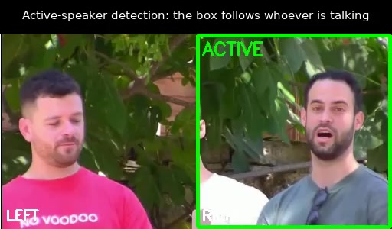
What we built
1
2
3
Find the speaker
Read the lips
Evaluate
Who is talking, from mouth motion — no audio
The model transcribes the active speaker's lips
Score each turn; flag what to trust vs verify
Active-speaker stream: green box marks who is talking
2
Notes:
Footage had no usable audio, so we detect the speaker visually from mouth-openness variance (speech oscillates; a smile is a sustained stretch), build a single active-speaker stream, then lip-read each turn and score it. All 11 scene-1/2 streams: speaker alternation 1.0.

Slide 3
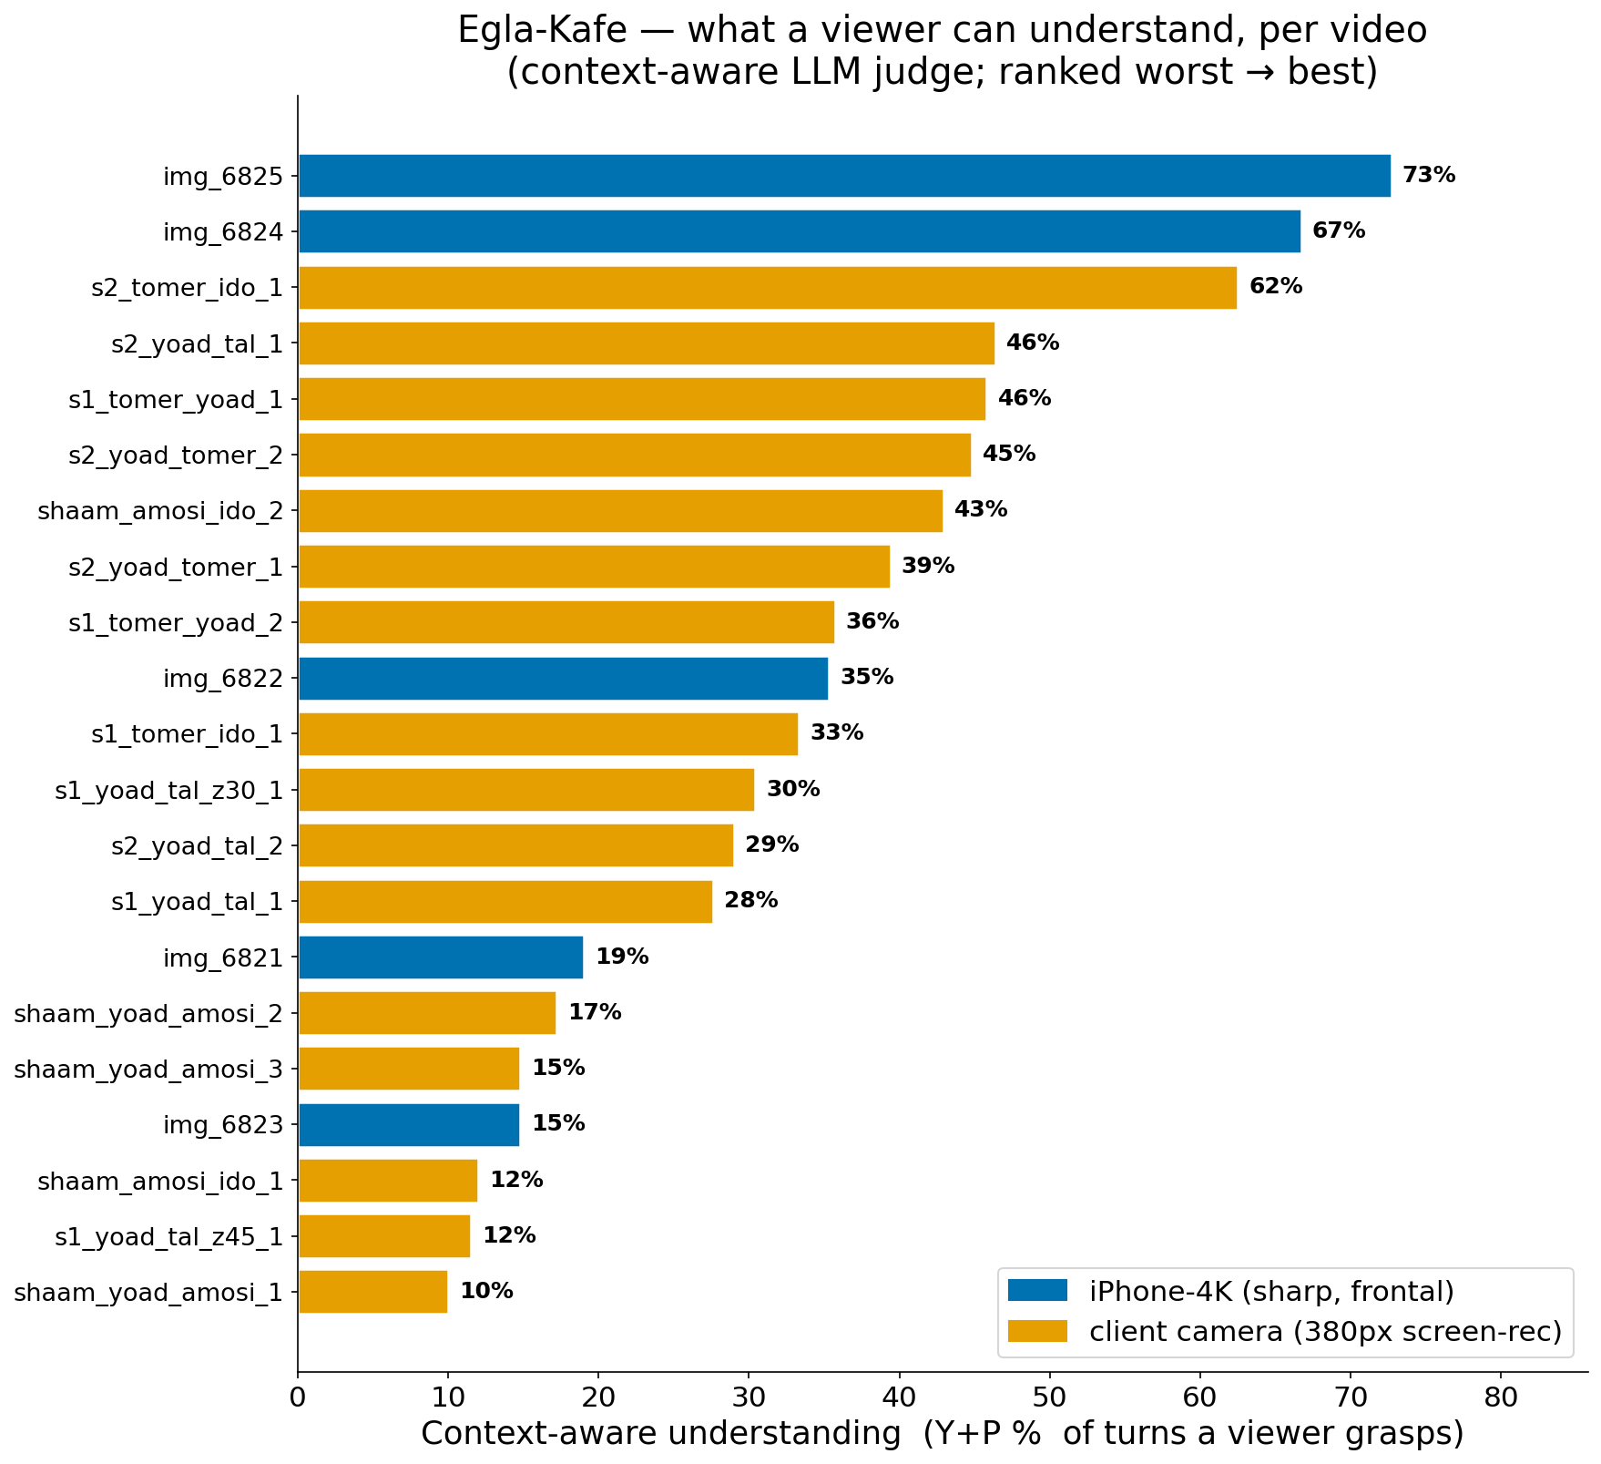
On good footage, the conversation comes through
Up to 73% of turns understood on the best-captured video
Context-aware recovery (Y+P): share of turns a viewer grasps with conversation context.
3
Notes:
The pessimistic average hides a high ceiling. On the best video (iPhone 4K, frontal, Military script) a context-aware viewer grasps 73% of turns and the full plot is recoverable. The model isn't incapable on this footage — it locks on intermittently; capture quality and confidence-gating decide how much you get.

Slide 4
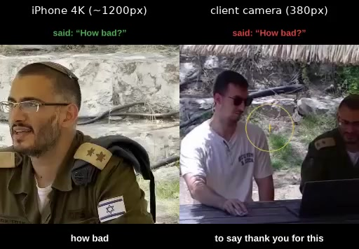
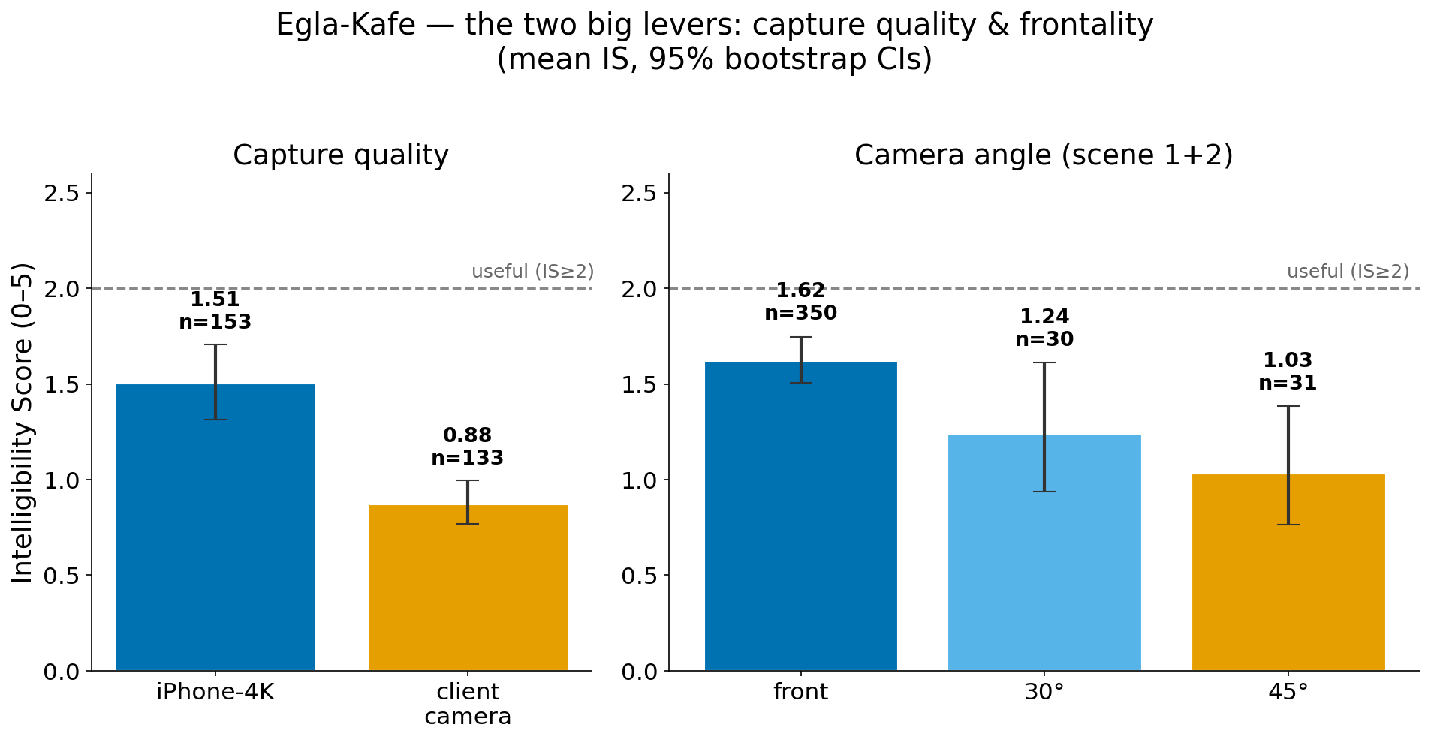
Three controllable levers
Capture quality
iPhone 4K vs client camera
iPhone 4K beats screen-rec
IS 1.51 vs 0.88
Frontality
Face the camera, not 45°
IS 1.62 vs 1.03
Content
Distinctive words survive
Military > small-talk
4
Notes:
Capture quality and frontality are the only statistically robust levers (Mann-Whitney: iPhone-vs-camera p=2e-5, front-vs-45° p=2e-3). Content helps via distinctive words surviving + cross-turn redundancy, not a per-segment IS gap. All three are within the client's control at capture time.

Slide 5
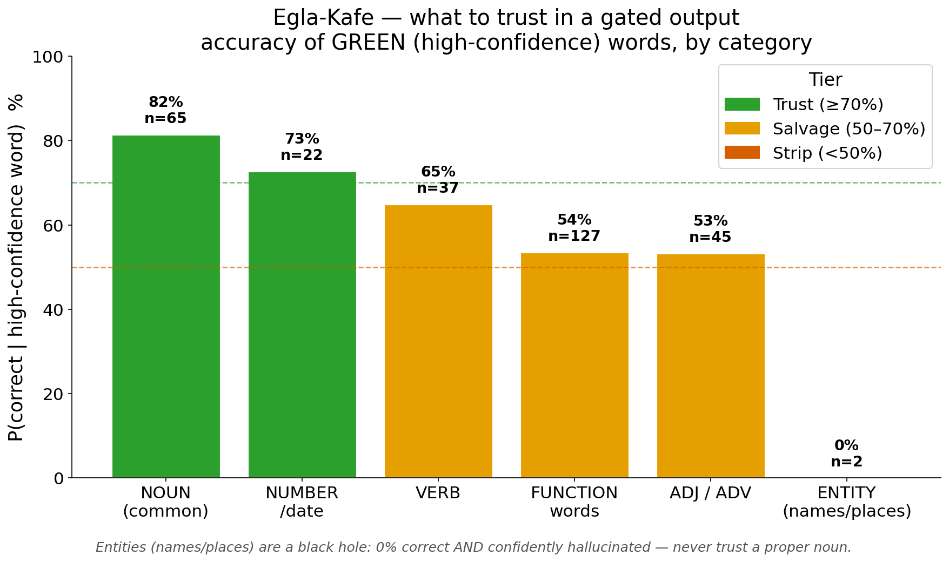
What you can trust
Trust the gist and topic. Verify names and numbers.
TRUST
• Common nouns — 82% correct
• Topic / gist of the turn
VERIFY
• Names / places — hallucinated
• Numbers / dates — confident, unsafe
P(correct) for high-confidence words, by category. All 778 scored segments.
5
Notes:
A gated output gives a topical skeleton, not full sentences. Green common-nouns are ~82% reliable but only ~10% of nouns are recovered — a scatter of trustworthy content words to fuse with context. Names/places are 0% recovered AND the model emits confident fake entities (Abu Dhabi 0.997, Wikipedia). Numbers ~73% green but still need verification.

Slide 6
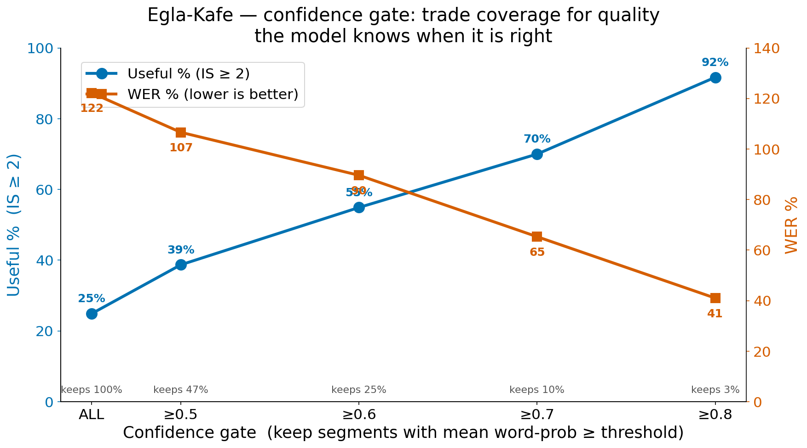
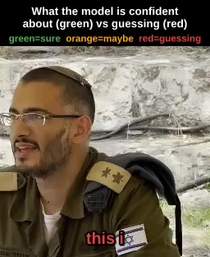
The model flags its own good output
On the confident subset: 75–90% of turns are useful
Per-word confidence
Gate by the model's own confidence — no reference text needed. conf≥0.7 keeps top 10% at 70% useful.
6
Notes:
The model knows when it's right. Gating by its own word confidence reproduces the ceiling: conf≥0.6 keeps a quarter at 55% useful; conf≥0.7 keeps the top 10% at 70% useful, WER 65% (English-benchmark quality); conf≥0.8 keeps 3% at 92% useful. Deliver the sure parts; flag the rest.

Slide 7
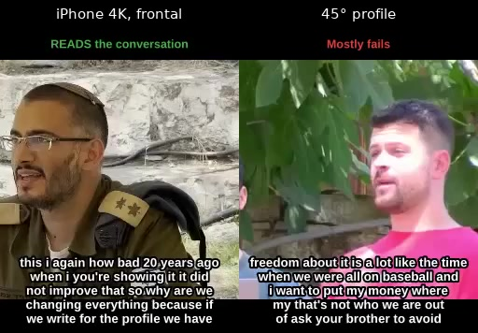
Best vs worst conditions
Same model, same pipeline — capture decides the outcome
BEST: frontal 4K → plot recoverable
WORST: 45° / low-res → near-total loss
7
Notes:
Left: best-conditions turn (frontal, high-res) — the model locks on and the line is readable. Right: worst-conditions turn (45° profile / 380px screen-rec) — near-total loss, fluent hallucination. The model is frontal-trained; lip-reading collapses as the face turns to profile.

Slide 8
Honest limits
Names & numbers
What we CLAIM
Hallucinated — never trust unverified
• Gist & topic on good footage
• A self-flagged confident subset
Profile / low-res
45° or screen-rec not usable
What we do NOT claim
Word coverage
• Verbatim transcripts
• Reliable names, numbers, dates
~10% of words recovered overall
8
Notes:
Stated plainly and constructively. The 122% per-segment average is a coverage problem, not a capability ceiling — but on this footage word coverage is ~10%, profile/low-res clips are not usable, and names/numbers are hallucinated. We claim gist + a trustworthy confident subset; we do not claim verbatim text or reliable specifics.

Slide 9
Recommendations
📹
🧭
🛡️
📝
Capture native, high-res
Keep faces frontal
Use confidence-gating
Expect gist, not verbatim
Frontal, 1080p+, no screen-recording
Avoid profile / 45° angles
Deliver sure turns; flag the rest
Read for meaning; verify specifics
9
Notes:
Four practical levers, all within the client's control. The biggest wins are upstream of the model: native high-res frontal capture, plus confidence-gating downstream and reading for gist rather than verbatim text.

Slide 10
What's next
Dynamic active-speaker
Per-frame face tracking; use the masters' audio for audio-visual speaker detection
More & better data
Frontal, high-res captures to lift coverage beyond the confident subset
Calibrated confidence
Tune the trust gate to your accept/verify tradeoff
The model is capable on well-captured footage — the path forward is more of the right input and smarter gating.
10
Notes:
Phase B: dynamic per-frame cropping + audio-visual active-speaker detection (the masters have audio). More frontal high-res data to raise coverage. Calibrate the confidence gate to the client's accept/verify tradeoff.

Slide 11
Thank you
Trust the gist · verify specifics · capture frontal & high-res
Argos — The Orchard
11
Notes:
Close. One-line takeaway repeats the operating doctrine.

