Slide 1

Argos VSP
Research Findings and Production Roadmap
Visual Speech Processing — Project Review
February 2026
Yoad Oxman • The Orchard
1
Notes:
Welcome. This presentation covers 3 months of research and engineering on a visual speech processing system — reading lips from video, no audio. We'll cover what we found, what we built, and where we go next.

Slide 2
Executive Summary
Three months of research and engineering on visual speech processing:
• Evaluated a lip-reading AI on 1,497 real-world YouTube segments
• Standard metric (WER) reports 64.1% error — 2.5× worse than benchmark
• Our new Intelligibility Score (IS) reveals 40% is actually useful — 3.5× more than WER admits
• Built a complete production system: 8-stage pipeline, standalone container
• Clear roadmap to IS 3.5–4.0 (from 2.52) through data scaling + LLM upgrade
• Produced 8 comprehensive research reports
1
Notes:
Executive summary. Three months of work on visual speech processing. Key finding: WER dramatically overstates failure. Our Intelligibility Score shows 40% of output is properly captured, not the 11% WER suggests. Complete production system delivered. Clear roadmap to improve further.

Slide 3
Presentation Overview
1. Context
What is lip reading? • How does the system work? • What's the benchmark?
2. Research Findings
Real-world evaluation • Intelligibility Score metric • Failure analysis • Tuning experiments
3. Engineering
8-stage pipeline • Modular refactoring • Standalone container • Evaluation infrastructure
4. Future Directions
Improvement roadmap • Data scaling • LLM upgrade • Target: IS 3.5–4.0
2
Notes:
Four sections. Context sets the stage — what is lip reading, how the system works. Research findings are the core: our novel evaluation framework and what we learned. Engineering covers the production system. Future directions lays out the improvement roadmap.

Slide 4
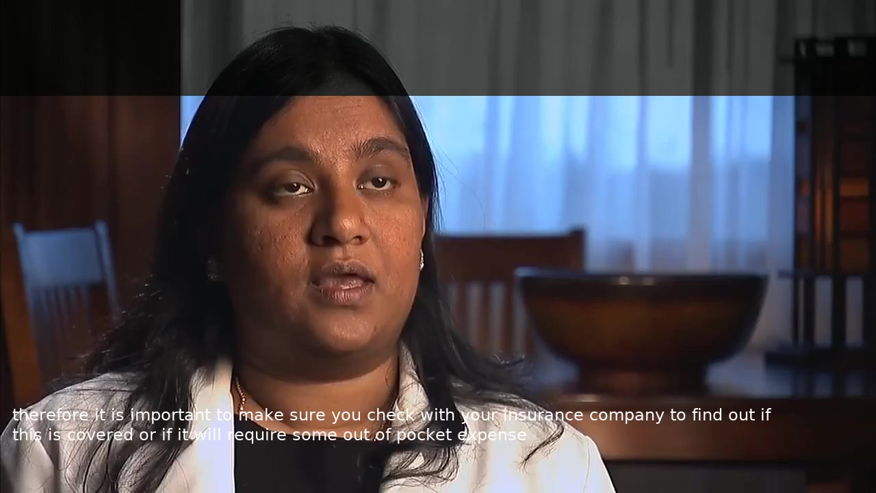
What is Visual Speech Processing?
A system that reads lips from video — no audio needed.
33 words about health insurance — WER 0%, IS 5.0. Click the video to play.
3
Notes:
PLAY VIDEO: IEa7qEkMvfQ_3__c5447488_with_hyp.mp4 — 33 words about health insurance, WER 0%. Play the video first, then explain: this is the best case. The system perfectly reads 33 consecutive words from lip movement alone. Now let's see how it works.

Slide 5
The Invisible Problem: Visemes
The Invisible Problem
Confusable Pairs
• 50–70% of English sounds are invisible on lips
• Multiple sounds produce identical mouth shapes (visemes)
• Context is the ONLY disambiguation signal
Word A | Word B
admiral | animal
mom | bomb
pat | bat
collar | color
probiotics | permafrost
Viseme Group | Sounds
Bilabial | p, b, m
Alveolar | t, d, n, s, z, l
Velar | k, g, ng
Labiodental | f, v
Context is the ONLY disambiguation signal — this is why the LLM matters.
4
Notes:
50-70% of English sounds are invisible on lips. Multiple sounds produce identical mouth shapes called visemes. Admiral and animal look the same. Mom and bomb look the same. Context is the only disambiguation signal, which is why the LLM component is critical.

Slide 6
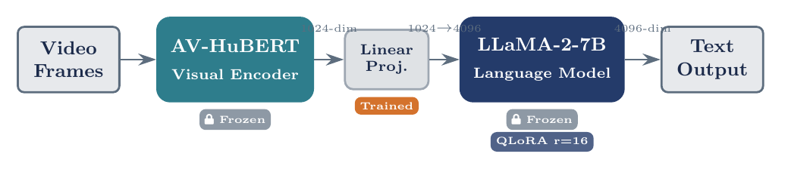
How It Works: Three Components
AV-HuBERT Visual Encoder, frozen, 1024-dim
→
Linear Projection 1024 → 4096
→
LLaMA-2-7B 4-bit QLoRA, r=16
Only 12.6M trainable params (0.19%). LLM is swappable — Llama 3.1 8B is a drop-in replacement (same 4096 hidden size).
5
Notes:
Three components. Visual encoder (AV-HuBERT) is frozen — pre-trained on LRS3 lip-reading data. It outputs 1024-dim features per frame. A linear projection maps to 4096-dim (LLM input space). Then LLaMA-2-7B generates text. Key: only the LoRA adapters and projection layer are trained — 12.6M of 7B parameters. And the LLM is swappable: Llama 3.1 8B has the same hidden dimension, making it a trivial 1-2 hour swap.

Slide 7
How It Works: Data Flow
1
Video Frames — 25 fps raw video input
↓
2
Mouth Crop — 96×96 pixel region around lips
↓
3
Visual Features — AV-HuBERT encoder → 1024-dim vectors
↓
4
Projection — Linear layer: 1024 → 4096-dim (LLM input space)
↓
5
LLM Generates Text — LLaMA-2-7B decodes features into words
Visual encoder is frozen (pre-trained on LRS3). Only projection + LoRA adapters are trained.
6
Notes:
Five-step data flow. Raw video at 25fps is cropped to 96x96 mouth region. AV-HuBERT extracts 1024-dim visual features. Linear projection maps to 4096-dim LLM input space. LLaMA-2-7B generates text. The visual encoder is frozen — only the projection layer and LoRA adapters are trained.

Slide 8
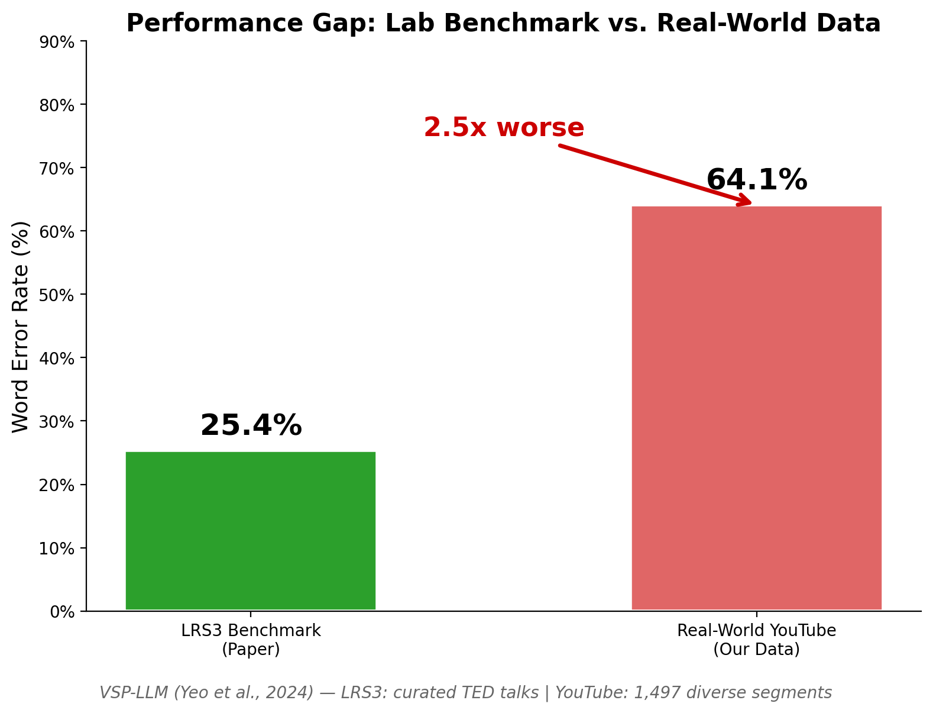
The Benchmark: Paper vs Reality
25.4%
WER on LRS3 (TED Talks)
• LRS3: 1,000+ hours of TED talks
• Controlled studio lighting, frontal face, professional speakers
• High-quality audio alignment, clean transcripts
• Our dataset: 1,497 YouTube segments
• Uncontrolled conditions, diverse topics, multiple accents
• Real-world YouTube: 64.1% WER — 2.5× worse
Two questions: How does this hold on real-world video? And is WER even the right metric?
7
Notes:
The paper claims 25.4% Word Error Rate on LRS3 — a curated dataset of 1,000+ hours of TED talks with controlled studio lighting, frontal faces, professional speakers, and high-quality audio alignment. Our dataset: 1,497 segments from diverse YouTube videos — uncontrolled conditions, multiple accents, varied topics. Result: 64.1% WER, 2.5x worse. And more importantly — is WER even the right way to measure this?

Slide 9
Our Evaluation: 1,497 Real-World Segments
1,497
Topic Distribution
Topic | Segments | IS
Business/Finance | 214 | 3.08
Education/Lecture | 312 | 2.63
Entertainment | 198 | 2.51
News/Politics | 267 | 2.48
Tech/Science | 186 | 2.43
Sports/Health | 153 | 2.38
DIY/Home | 167 | 2.13
segments from diverse YouTube videos
• Uncontrolled lighting, angles, occlusions
• Multiple speakers and accents
• Diverse topics: business to DIY to gaming
• Not a curated benchmark — real-world difficulty
8
Notes:
1,497 segments from diverse YouTube videos. Not a curated benchmark. Multiple topics, speakers, accents, lighting conditions. Business and Finance has the highest IS (3.08) because it's closest to the TED talk training data. DIY/Home is worst (2.13) due to inherently visual content.

Slide 10
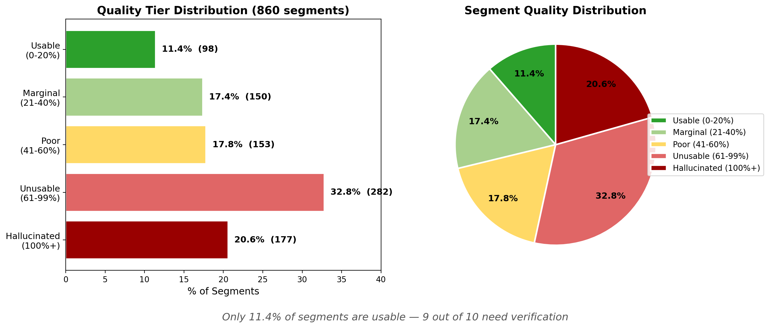
The Reality Gap
64.1%
Mean WER across 1,497 real-world segments
● 11.4% Usable (<30%)
● 17.4% Marginal (30-50%)
● 17.8% Poor (50-75%)
● 32.8% Unusable (75-100%)
● 20.6% Hallucinated (>100%)
But WER overstates failure — see next slide.
9
Notes:
1,497 diverse YouTube segments. 64.1% mean WER — 2.5x worse than the paper's 25.4%. Only 11.4% usable by WER standards. And 20.6% are hallucinations — fluent text that's completely fabricated. This is the most dangerous failure mode. But WER is misleading — it treats all errors equally.

Slide 11
Word Error Rate: What It Measures (and Misses)
The Formula
What WER Captures
WER = (S + D + I) / N
• Exact word-level accuracy
• Simple, widely understood
• Standard in ASR research
• S = substitutions (wrong word)
• D = deletions (missing word)
• I = insertions (extra word)
• N = total words in reference
What WER Misses
• All errors weighted equally
• "admiral"→"animal" = "the"→"a"
• No meaning preservation signal
• No phonetic similarity credit
• Can exceed 100% (insertions)
Example:
Ref: "the admiral gave orders" Hyp: "the animal gave water" WER = 2/4 = 50% (2 substitutions)
10
Notes:
WER formula: substitutions plus deletions plus insertions divided by reference word count. Simple and standard, but treats all errors equally. Admiral-to-animal gets the same penalty as the-to-a. No credit for meaning preservation or phonetic similarity. Can exceed 100% when the model generates extra words (insertions).

Slide 12
WER Is Blind to Meaning
WER 29% • IS 4.3 — Fully Intelligible
WER 58% • IS 2.7 — Near-Miss
Ref: "allow you to work with the team in a more" Hyp: "allow you to work with a team and more"
Ref: "1 billion cfus of probiotics" Hyp: "1 million cfus of permafrost"
WER says equal. Meaning says opposite. So we built a metric to capture this.
11
Notes:
Same low WER on the left, high WER on the right — but the real difference is meaning. Left: minor grammatical change, meaning fully preserved at WER 29%. Right: 'probiotics' becomes 'permafrost' — phonetically similar but completely wrong product. Structure intact, key terms destroyed. This motivated our Intelligibility Score.

Slide 13
We Need a Better Metric
• WER counts word errors — but ignores whether the viewer understood
• We created the Intelligibility Score (IS): a composite 0–5 metric
• Combines 6 quality signals: meaning, phonetics, word accuracy, entities, length
• IS ≥ 3.0 = “Properly Captured” — the viewer gets the right message
Designed at development time, runs as pure deterministic Python — $0 per evaluation, 100% reproducible.
12
Notes:
Bridge slide: WER is blind to meaning. We created IS — a composite 0-5 metric combining 6 quality signals. IS >= 3.0 means the viewer gets the right message. Designed at development time, runs as deterministic Python at evaluation time.

Slide 14
RESEARCH FINDINGS
Understanding What Works, What Fails, and Why
1,497 segments • 6 quality signals • 5 failure categories • 13 tuning experiments
Notes:
Section transition: we now present the research findings — our novel Intelligibility Score metric, root cause analysis, failure mode taxonomy, and decode tuning experiments.

Slide 15
Introducing the Intelligibility Score
Why a new metric?
What is IS?
• WER counts word errors but ignores meaning
• "admiral" → "animal" gets same WER as "the" → "a"
• WER treats all errors equally — but not all errors matter equally
• We need: does a viewer get the right message?
• Composite score from 0 to 5
• Combines 6 complementary quality signals
• Designed at development time, not per-sample
• Fully deterministic at runtime — no LLM per sample
• Free, reproducible, decomposable
• IS ≥ 3.0 = "Properly Captured"
How each signal is calculated:
Semantic (25%): Encode ref & hyp with sentence-transformer (MiniLM), compute cosine similarity. Captures whether the overall MEANING is preserved.
Phonetic (15%): Convert text to phoneme sequences (g2p), compute edit-distance similarity. Detects when words SOUND right even if spelled differently.
WWER (15%): WER with content words (nouns, verbs, names) penalized 2× vs function words ('the', 'a').
NEA (15%): Named Entity F1 — are names, numbers, proper nouns preserved? Binary: right or wrong.
Length (15%): Output length vs reference length ratio. Catches truncation (too short) and hallucination (too long).
13
Notes:
IS introduction. WER can't distinguish meaning preservation from destruction. IS is a composite 0-5 metric combining 6 signals that together capture whether a viewer would understand the output. Designed at development time, runs as pure deterministic Python at evaluation time. IS >= 3.0 means properly captured.

Slide 16
IS: Six Signals of Quality
Semantic Similarity (25%)
Phonetic Similarity (15%)
Does the output preserve the intended meaning?
Do the words sound like what was actually said?
Sentence embeddings (SBERT) — cosine distance in 384-dim meaning space
Double Metaphone encoding — maps words to pronunciation codes
▸ Standard WER treats "admiral" → "animal" the same as "the" → "a". Semantic similarity captures that these are fundamentally different errors — one destroys meaning, the other doesn't.
▸ Lip-reading outputs are phonetically constrained — the model sees mouth shapes, not text. Phonetic similarity measures how well it decoded what the lips actually produced.
Inverse WER (15%)
Inverse WWER (15%)
How many words are correct at the surface level?
Are the important words correct?
Standard 1 − WER (edit distance: substitutions + insertions + deletions)
Entities weighted 2×, content words 1×, function words 0.5×
▸ The universal baseline in speech recognition. Necessary but insufficient — a WER of 60% tells you nothing about whether the meaning survived.
▸ Not all words carry equal information. Losing "the" barely matters; losing "Admiral McRae" is catastrophic. WWER weights errors by information content.
Named Entity F1 (15%)
Length Ratio (15%)
Are names, numbers, and places preserved?
Is the output the right length?
spaCy NER extraction → precision/recall on proper nouns
len(hypothesis) / len(reference) — ideal = 1.0
▸ Entities are irreplaceable — a viewer can infer a missing 'the' from context, but cannot recover a lost name or number. Binary pass/fail nature makes it the swing factor.
▸ Safety net for extreme failures: ratio > 2.0 = hallucination (model rambling), ratio < 0.3 = truncation (model gave up). Lowest real impact — most outputs are roughly correct length.
IS = 0.25×Semantic + 0.15×(Phonetic + InvWER + InvWWER + NEA + Length) • Score: 0–5 • Threshold: IS ≥ 3.0
14
Notes:
Six signals with weight rationale. Semantic (25%) gets the highest weight because meaning preservation is the ultimate goal — it drives 28.5% of IS variance. The other 5 signals each get 15%. Phonetic, WER, WWER, and NEA form a 'word accuracy' cluster (60% total weight) that measures whether the encoder decoded the right words. Length ratio is a safety check for hallucination and truncation. The 3 independent dimensions: word accuracy (~60%), meaning preservation (~28%), output sanity (~9%).

Slide 17
Why These Weights? Three Dimensions of Quality
Three Independent Dimensions
Why 25% / 15%?
Word Accuracy
60%
• Semantic gets 25%: meaning is the ultimate deliverable
• If a viewer understands the message, the transcription succeeded — even if exact wording differs. This is the goal of lip reading.
• 4 word-accuracy signals share 60%: diminishing returns
• WER, WWER, Phonetic, and NEA all measure overlapping aspects of 'did the model get the right words?' Equal 15% weights prevent any single word-level metric from dominating.
• Length ratio at 15%: a safety net, not a quality signal
• Catches hallucination and truncation — the two catastrophic failure modes that other signals can miss.
• Validated: r=0.93 with expert judgment, κ=0.77
Phonetic + WER + WWER + NEA (4 × 15%)
All 4 correlate tightly (r > 0.79). Did the model get the right words?
Meaning Preservation
28%
Semantic Similarity (1 × 25%)
Highest single weight — meaning is the ultimate deliverable.
Output Sanity
9%
Length Ratio (1 × 15%)
Safety net: catches hallucination (too long) and truncation (too short).
Validated against 1,497 segments: the resulting IS correlates at r=0.93 with an independent expert heuristic and κ=0.77 with human-like judgment.
15
Notes:
Weight rationale. The 6 IS signals collapse into 3 independent dimensions: word accuracy (60%, 4 signals at 15% each), meaning preservation (28%, semantic at 25%), and output sanity (9%, length at 15%). Semantic gets double weight because meaning is the ultimate goal. The 4 word-accuracy signals overlap heavily (r>0.79), so equal 15% weights avoid over-counting. Validated: r=0.93 with expert heuristic, kappa=0.77.

Slide 18
Three Dimensions of Quality
PCA reveals the 6 IS signals collapse into 3 independent dimensions:
60%
29%
9%
of IS variance
of IS variance
of IS variance
Word Accuracy
Meaning Preservation
Output Sanity
WER + WWER + Phonetic (r > 0.79 between them)
Semantic similarity (sentence embeddings)
Length ratio (hyp vs ref word count)
The visual encoder’s core capability
Tiebreaker between similar-accuracy segments
Catches hallucination and truncation
16
Notes:
PCA analysis reveals three independent dimensions. Word Accuracy (60% of variance) combines WER, WWER, and Phonetic — they all measure the same thing: visual encoder quality. Meaning Preservation (29%) is the semantic similarity tiebreaker. Output Sanity (9%) is mostly length ratio. Four of six signals are redundant — but deliberate: cross-validation makes the metric robust.

Slide 19
IS in Action: Two Real Segments
Good Segment — IS = 4.2
Bad Segment — IS = 0.9
Ref: “allow you to work with the team in a more”
Hyp: “allow you to work with a team and more”
Ref: “carry strap”
Hyp: “holocaust denier explanation of the final act”
Semantic Sim
0.82
× 0.25
= 0.205
Semantic Sim
0.04
× 0.25
= 0.010
Phonetic Sim
0.89
× 0.15
= 0.134
Phonetic Sim
0.12
× 0.15
= 0.018
Inverse WER
0.71
× 0.15
= 0.107
Inverse WER
0.00
× 0.15
= 0.000
Inverse WWER
0.76
× 0.15
= 0.114
Inverse WWER
0.00
× 0.15
= 0.000
NEA F1
1.00
× 0.15
= 0.150
NEA F1
0.00
× 0.15
= 0.000
Length Ratio
0.89
× 0.15
= 0.134
Length Ratio
1.00
× 0.15
= 0.150
Sum × 5 = 4.22 → IS 4.2 (Good)
Sum × 5 = 0.89 → IS 0.9 (Failed)
17
Notes:
Two IS calculation examples. Left: good segment (IS 4.2) with high scores across all signals. Right: hallucination (IS 0.9) where only length ratio is non-zero — the output is a completely different topic. The formula is IS = (sum of weighted scores) x 5, mapping to 0-5 scale.

Slide 20
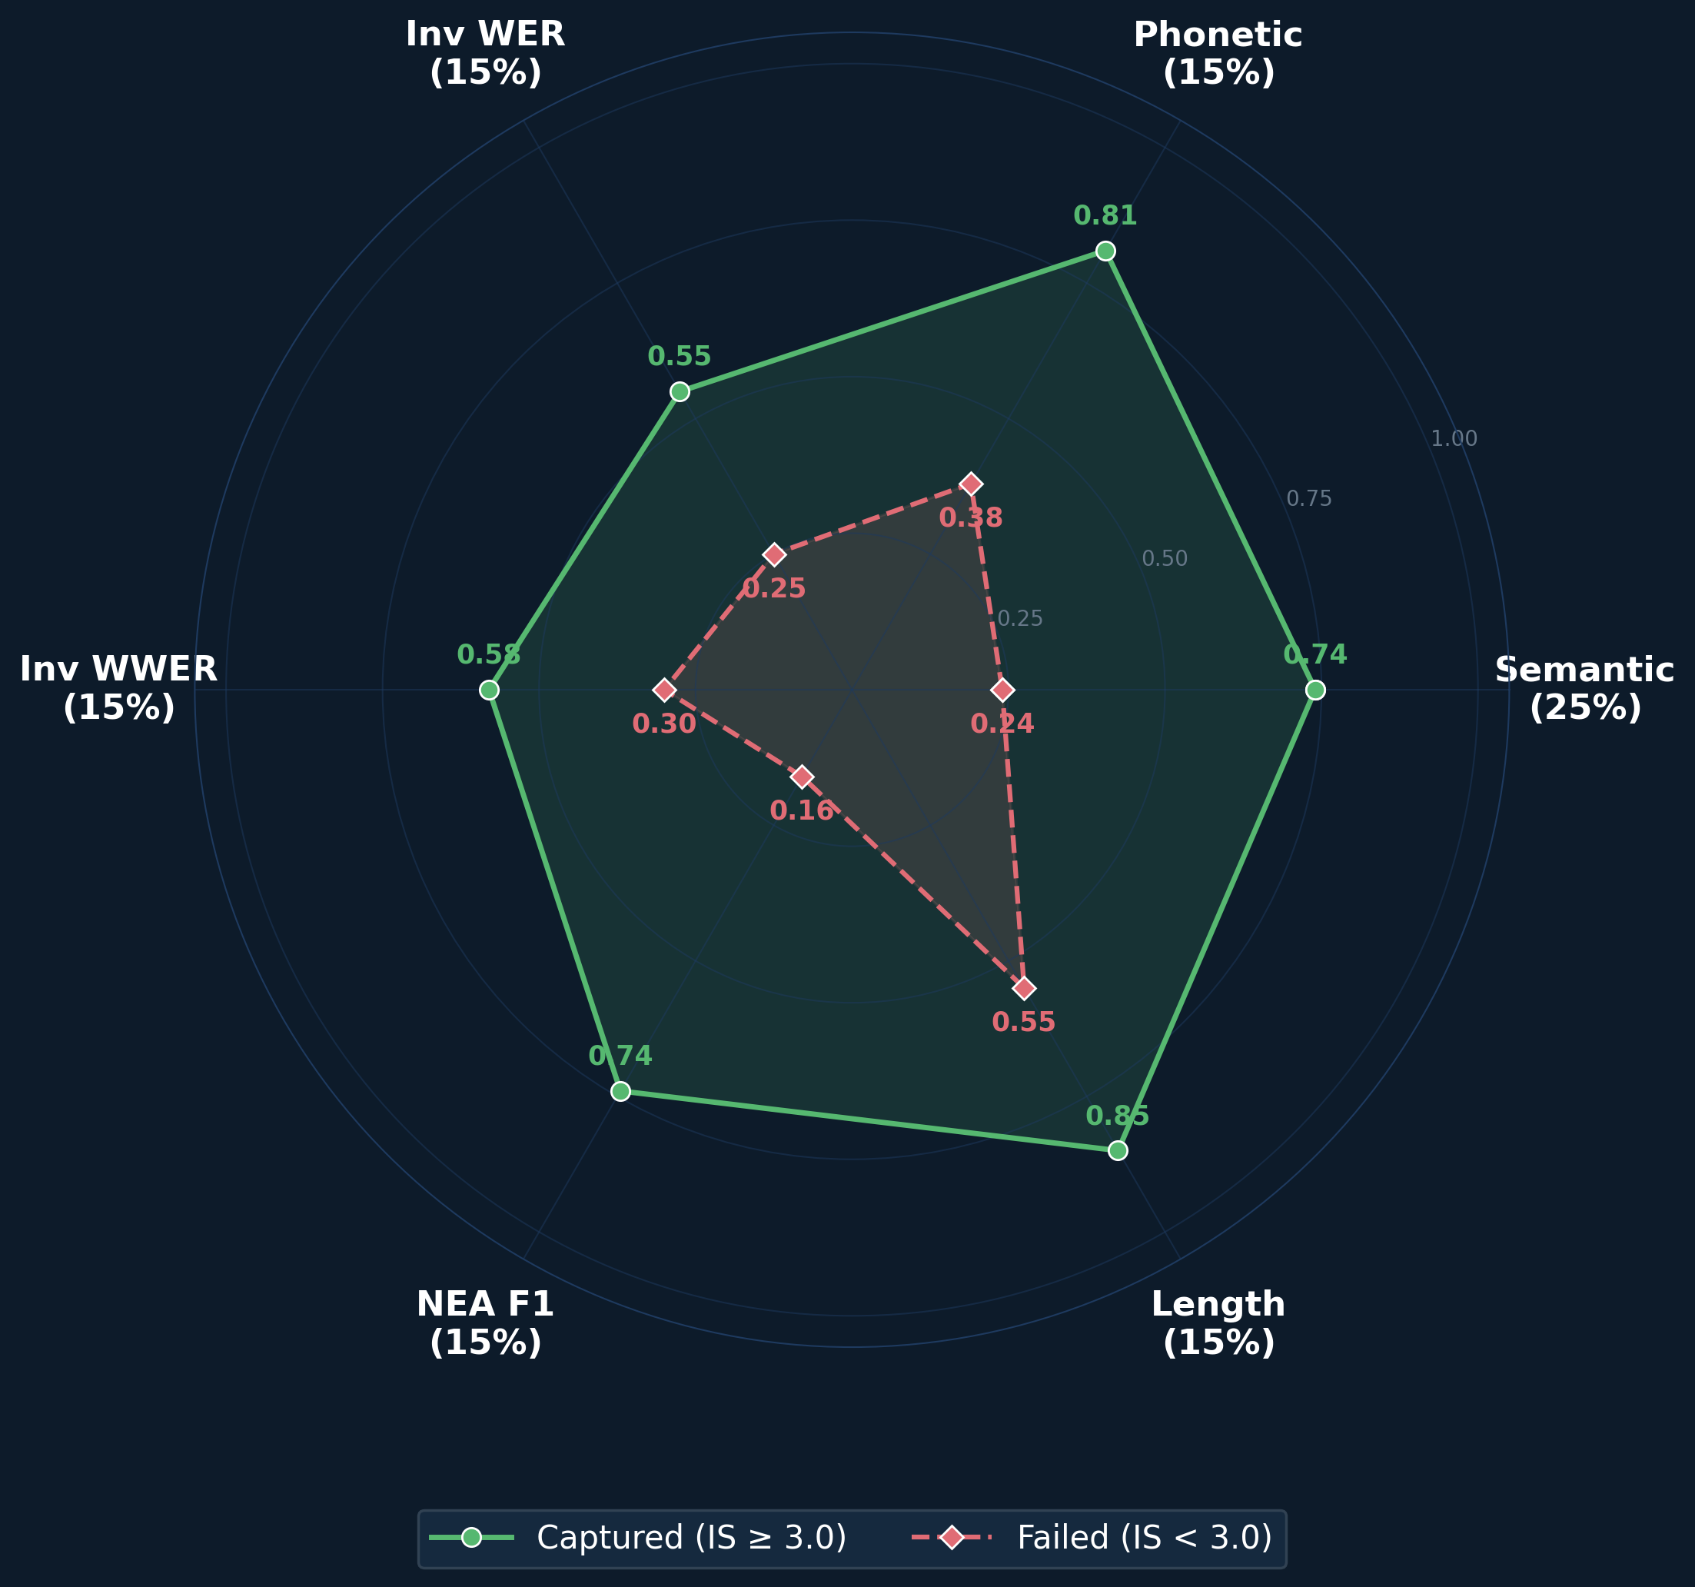
IS Radar: Success vs Failure Profile
Captured segments (green) are strong across all 6 signals. Failed segments (red) collapse on meaning and entities.
18
Notes:
Radar chart comparing mean component values for IS >= 3.0 (green) vs IS < 3.0 (red). Captured segments are strong across all 6 signals. Failed segments collapse on meaning and entity preservation while maintaining only partial length ratio.

Slide 21
Intelligibility Score: 39.9% Properly Captured
Semantic Sim (25%)
Phonetic Sim (15%)
Inv. WER (15%)
Inv. WWER (15%)
NEA F1 (15%)
Length Ratio (15%)
IS ≥ 3.0 = Properly Captured: 39.9% — 3.5× more than WER's 11.4% Phonetic similarity: 41.5% mean, r=0.943 with IS (strongest single signal)
18.4% Excellent
21.4% Good
21.7% Fair
22.4% Poor
16.0% Failed
19
Notes:
The Intelligibility Score combines 6 signals into a 0-5 composite. Key insight: 39.9% of segments are properly captured (IS >= 3.0) — 3.5x more than WER's 11.4% 'usable.' WER dramatically overstates failure. Methodology: LLM-distilled evaluation — the rubric, selected signals and weights, defined tier boundaries. Validated across 16 decode configs: LLM heuristic judge r=0.925 with IS, 88.6% agreement.

Slide 22
Three Root Causes — Why 64.1% WER?
Root Causes
By the Numbers
• 1. Domain Mismatch
• Model trained on TED talks (LRS3); real-world: DIY, cooking, sports
• 2. Short Segments Fail
• Under 10 words: only 32% captured vs 49% for 20+ words
• 3. Hallucination (20.5%)
• LLM prior overwhelms weak visual signal — fluent but fabricated
• Business/Finance: IS 3.08, 57% captured
• DIY/Home: IS 2.13, 30% captured — 27pp gap
• Short (5–10 words): 74% WER, 32% captured
• Long (20+ words): 55% WER, 49% captured — 17pp gap
• 28.2% of failures = drift + hallucination
20
Notes:
Three root causes explain most failures: domain mismatch (model trained on TED, tested on YouTube), short segments lacking context, and hallucination where the LLM generates fluent but fabricated text.

Slide 23
Domain Mismatch: Training vs Reality
Performance by Topic
19%
Topic | IS | Captured | Judge N%
Business/Finance | 3.08 | 57% | 25%
Education/Lecture | 2.63 | 42% | 33%
Entertainment | 2.51 | 39% | 36%
News/Politics | 2.48 | 38% | 37%
Tech/Science | 2.43 | 36% | 39%
Sports/Health | 2.38 | 34% | 41%
DIY/Home | 2.13 | 30% | 52%
of segments show domain vocabulary confusion
• Model trained on TED talks (formal, educational)
• Business content closest to training → best results
• DIY content most visual, least verbal → worst results
• A topic label at decode time would help ~284 segments
21
Notes:
Domain mismatch is a major factor. Business and Finance has IS 3.08 (57% captured) because it's closest to the TED talk training data. DIY/Home is worst at IS 2.13 (30% captured) — inherently visual content that doesn't translate to speech patterns. 19% of segments (~284) show domain vocabulary confusion where a topic label would help.

Slide 24
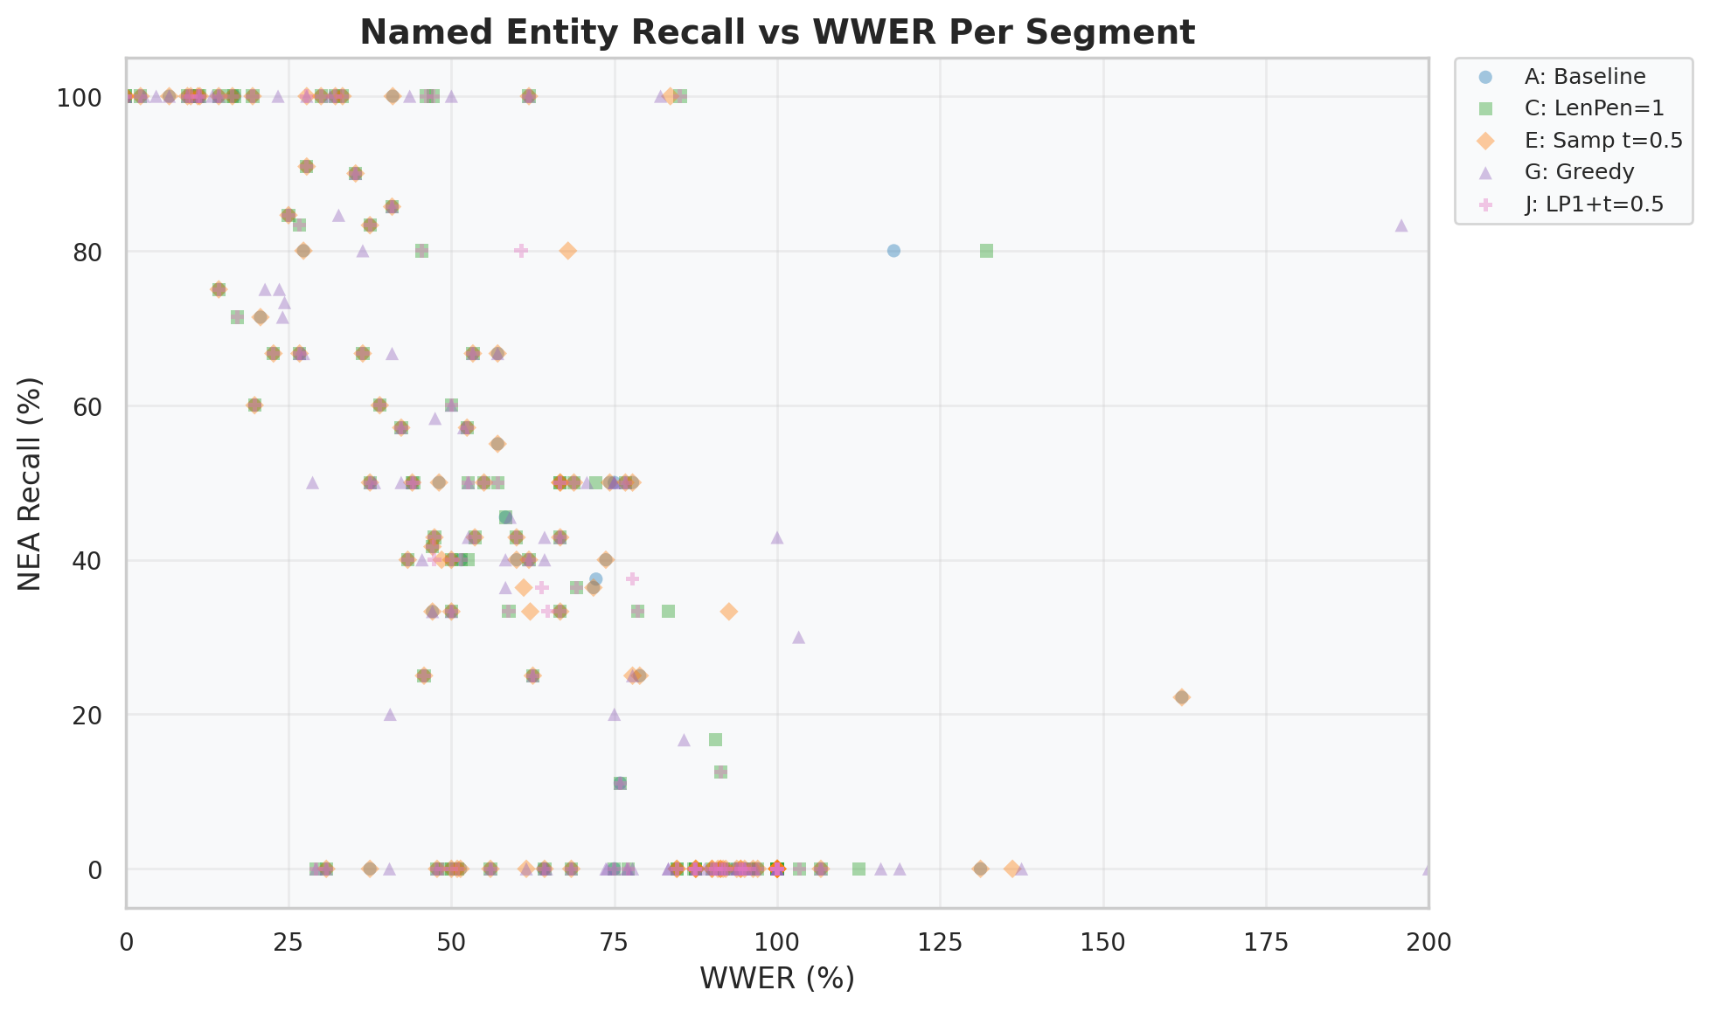
Named Entity Accuracy: The Largest Differentiator
What are named entities?
• Names (Admiral McRae), numbers (13th), places, organizations
• Either correct or destroyed — no partial credit
• Captured: 74% NEA F1 vs Failed: 16%
• 58pp gap — largest differentiator of any signal
• 17.3% of IS variance (highest for 15%-weight signal)
• A viewer can guess a missing "the" but not a missing name
22
Notes:
PLOT EXPLANATION (NEA Recall vs WWER Per Segment):
This scatter plot shows every segment as a dot, with WWER (Weighted Word Error Rate) on the x-axis and Named Entity Recall on the y-axis. Each dot color represents a different decode configuration (A: Baseline, C: LenPen=1, E: Sampling t=0.5, G: Greedy, J: LP1+t=0.5).
KEY PATTERNS TO NOTE:
1. Top-left cluster (low WWER, high NEA): These are the success cases — segments where both word accuracy and entity preservation are high. Most captured segments live here.
2. Bottom row at NEA=0: A large cluster of segments with ZERO entity recall across ALL WWER values. This means many segments lose ALL named entities regardless of how many other words they get right. This is why NEA is the swing factor — entity destruction is binary.
3. Right side (WWER > 100%): These are hallucinated segments where the model generates more wrong words than the reference contains. Even some of these have high NEA (top-right dots) — meaning the model hallucinated but still preserved some entity names.
4. All configurations cluster together: different decode parameters don't change the fundamental NEA vs WWER relationship. The visual encoder determines entity preservation, not the decoder.
TAKEAWAY: Named entities are binary — either preserved or destroyed. The dense cluster at NEA=0 across all WWER levels shows that entity loss is catastrophic and independent of general word accuracy. This is why NEA accounts for 17.3% of IS variance despite only 15% weight — it's the single most discriminating signal between captured and failed.

Slide 25
Failure Mode Taxonomy: 5 Categories
900 failed segments (IS < 3.0) classified into 5 mutually exclusive categories — each segment gets exactly one label, checked 1→5.
Grounded in ASR error taxonomy (Fosler-Lussier 2004) and LLM hallucination analysis (ACL 2025)
1. Signal Loss (9.0%)
Rule: Empty output OR length ratio < 0.3
Nothing came out — 81 segments
▸ Ref: “the thirteenth amendment” → Hyp: “”
2. Hallucination (12.3%)
Rule: WER ≥ 100% (output longer than reference)
Model invented fake text — 111 segments
▸ Ref: “carry strap” → Hyp: “holocaust denier explanation of the final act”
3. Wrong Topic (31.6%)
Rule: Semantic < 0.2 (phonetic-matched or not)
Mouth shapes decoded to wrong domain — 284 segments
▸ Ref: “weight loss and diet” → Hyp: “wanted to be a princess”
4. Right Topic, Wrong Details (22.7%)
Rule: NEA F1 < 20% OR key content words substituted (Semantic ≥ 0.2)
Roughly right but names/content words lost — 204 segments
▸ Ref: “13th amendment is going” → Hyp: “13th may mean something to him”
5. Accumulated Errors (24.4%)
Rule: IS < 3.0 and doesn’t match categories 1–4
Many small errors compound — 220 segments
▸ Many words slightly wrong throughout, meaning erodes
Priority: Signal Loss → Hallucination → Wrong Topic → Right Topic Wrong Details → Accumulated Errors
23
Notes:
Five-category failure taxonomy grounded in ASR error research (Fosler-Lussier 2004) and LLM hallucination analysis (ACL 2025). Key insight: Wrong Topic is the LARGEST category at 31.6% — it merges the old Topic Drift and Phonetic Wrong Topic categories because the fix is the same (stronger LLM, more training data). Signal Loss and Accumulated Errors are the bookends: one produces nothing, the other produces something but death-by-a-thousand-cuts erodes meaning. Each segment gets exactly one label, checked in priority order 1 through 5.

Slide 26
Failure Modes: Real Examples
Hallucination (12.3%)
Wrong Topic (31.6%)
Right Topic, Wrong Details (22.7%)
Reference:
Reference:
Reference:
“carry strap”
“i’ve made lots of videos about weight loss and diet”
“about the 13th amendment the 13th amendment is going”
Prediction:
Prediction:
Prediction:
“holocaust denier explanation of the final act”
“when i was a little girl i always wanted to be a princess”
“13th may mean something to him because it can help him”
WER 100% | IS 0.1
WER 97% | IS 0.38
WER 81% | IS 2.14
Why this category?
Why this category?
Why this category?
The model generated 8 words from a 2-word input. The LLM’s language model ‘ran away’ — output is fluent English but completely fabricated. Distinguishing feature: output is LONGER than reference (WER ≥ 100%).
Output is similar LENGTH to reference (not hallucination) but about a completely different subject. The visual encoder extracted mouth shapes that the LLM mapped to a wrong but coherent domain.
The word “13th” survived but “amendment” was lost. A viewer might guess the topic (law) but critical entity information is irrecoverable. Key distinction: Semantic ≥ 0.2 (topic is correct).
24
Notes:
Three real examples for the three most confusing categories. Hallucination vs Wrong Topic: hallucination generates MORE words than the reference (WER >= 100%), while Wrong Topic substitutes at similar length. Wrong Topic vs Right Topic Wrong Details: semantic similarity threshold of 0.2 separates them — below 0.2 means completely different subject, above 0.2 means topic preserved but details lost. Right Topic Wrong Details is the 'frustrating near-miss' — you can tell what the speaker was ABOUT but not what they SAID.

Slide 27
Failure Mode Taxonomy
900 segments failed (IS < 3.0) — how often does each mode occur?
Wrong Topic
31.6% (284)
Accumulated Errors
24.4% (220)
Right Topic, Wrong Details
22.7% (204)
Hallucination
12.3% (111)
Signal Loss
9.0% (81)
Failures are diverse — no single fix. Each roadmap phase targets specific modes.
25
Notes:
900 failed segments classified into 5 failure categories. Wrong Topic is the largest (31.6%), combining topic drift and phonetic confusion. Hallucination (12.3%) is the most dangerous: fluent, confident, completely fabricated. Right Topic Wrong Details (22.7%) loses names and numbers. This taxonomy maps directly to our roadmap.

Slide 28
Failure Modes: Impact & What Fixes Them
Each category maps to a specific remedy — no single fix addresses all failure types.
Category | % | Severity | What Fixes It
Signal Loss | 9.0% | Low — obvious, easily detected | Quality filtering, longer segments
Hallucination | 12.3% | Critical — fluent but fabricated | Anti-hallucination prompts, confidence gating, GER
Wrong Topic | 31.6% | High — wrong domain entirely | Stronger LLM, topic-aware prompting, more training data
Right Topic, Wrong Details | 22.7% | Medium — topic right, details lost | Entity injection, domain adaptation, fine-tuning
Accumulated Errors | 24.4% | Medium — gradual meaning erosion | General model improvement, N-best aggregation
Key insight: Wrong Topic (31.6%) is the single largest failure mode — and the one most likely to improve with a stronger LLM backbone (e.g., Llama 3.1 8B replacing Llama 2 7B). Combined with Right Topic Wrong Details (22.7%), over half of all failures need better language modeling and domain adaptation.
Severity ranked: Hallucination > Wrong Topic > Right Topic Wrong Details > Accumulated Errors > Signal Loss
26
Notes:
Impact and fixes table for the 5-category taxonomy. Hallucination is the most dangerous because it sounds convincing — a user cannot tell it is wrong. Wrong Topic is the LARGEST at 31.6% and the most amenable to improvement through LLM upgrade. Signal Loss is the least dangerous because it is obvious (empty output). The key strategic insight: 54.3% of failures (Wrong Topic + Right Topic Wrong Details) trace to the LLM backbone being too weak for out-of-domain content. A stronger LLM is the single highest-leverage intervention.

Slide 29
Decode Tuning: 13 Experiments, Minimal Gain
What We Tested
What We Found
• 4 decode parameters: beam size, length penalty, temperature, sampling
• 13 systematic experiments (A–M) on 107 segments
• Best config (J) validated on full 1,497 segments
• Parameters explored: beam 5–50, lenpen −0.5 to 2.0, temp 0.3–1.5
Metric | Baseline | Best (J) | Δ
Mean IS | 2.52 | 2.60 | +0.08
Captured (IS≥3) | 39.9% | 41.2% | +1.3pp
Empty outputs | 70 (4.7%) | 0 (0%) | −70
Hallucinations | 307 (20.5%) | 348 (23.2%) | +41
Mean WWER | 61.9% | 59.8% | −2.1pp
Config J eliminates empties but adds hallucinations. Net IS gain: +0.08. Tuning is mitigation, not a cure.
Key Finding
• Per-segment quality rankings identical across configs (r > 0.92)
• A “good” segment is good in ALL configs; a “bad” one is always bad
• The bottleneck is the visual encoder, not decode parameters
27
Notes:
Condensed tuning results. 13 experiments across 4 decode parameters showed minimal improvement. Best config (J) eliminates empty outputs but increases hallucinations by 13%. Net IS gain only +0.08. Per-segment rankings are identical across configs (r > 0.92), proving the bottleneck is the visual encoder, not decode parameters.
The original slide included a length penalty sensitivity chart showing the empty-vs-hallucination trade-off: lenpen=-0.5 causes 44.9% empty outputs; baseline (lenpen=0) has 4.7% empties; lenpen=1.0 (Config J) eliminates all empties but hallucinations rise from 20.5% to 23.2%; lenpen=2.0 pushes hallucinations to 52.9%. This demonstrates the fundamental trade-off: length penalty controls whether the model stays silent (empty) or fabricates (hallucination). Config J chose the sweet spot — zero empties at the cost of +41 hallucinations.

Slide 30
Why These 6 Signals? A Validation
Three independent quality dimensions confirm IS captures distinct, complementary aspects of transcription quality — not arbitrary signals.
Signal → IS Correlation
Key Insights
Signal | r with IS | Weight | Variance %
Phonetic Sim | 0.943 | 15% | ~18%
Semantic Sim | 0.856 | 25% | 28.5%
Inv. WER | 0.834 | 15% | ~16%
Inv. WWER | 0.823 | 15% | ~15%
NEA F1 | 0.748 | 15% | 17.3%
Length Ratio | 0.521 | 15% | 9.1%
• Phonetic Sim is strongest predictor (r=0.943) despite only 15% weight
• WER/WWER/Phonetic are NOT independent — all measure visual encoder quality
• Semantic Sim (25%) drives 28.5% variance — the tiebreaker for similar-accuracy segments
• NEA punches above weight: 17.3% variance — names are binary (right or wrong)
• Length Ratio weakest (9.1%) — could reduce its weight in future
• Expert heuristic: r=0.934 with IS
28
Notes:
Signal correlation analysis. Phonetic similarity is the strongest single predictor at r=0.943, despite only 15% weight. This makes sense: it's the most direct measure of visual encoder quality. Semantic similarity (25% weight) captures 28.5% of IS variance. Length ratio is weakest at 9.1%. The expert heuristic (15-rule decision tree) achieves r=0.934.

Slide 31
When Metrics Disagree: What It Tells Us
IS uses 6 signals because no single metric tells the full story. Disagreements between metrics reveal specific quality patterns:
WWER ≪ WER — Function words wrong, content words right
NEA high, WER high — Names preserved despite overall poor accuracy
"the team discussed a quarterly" → "team discuss quarterly" WER 43% but WWER 15% — viewer gets the message. IS captures this: meaning preserved despite surface errors.
"Dr. Chen presented the Q3 results" → "Dr. Chen present Q3 result" WER 57% but NEA F1 = 100% — critical info intact. IS rewards: the most important facts came through.
Semantic high, WER high — Meaning preserved through paraphrasing
Phonetic high, Semantic low — Sounds right, wrong meaning (deceptive)
"we need to reduce spending" → "must cut the budget" WER 100% but Semantic 0.87 — same meaning, different words. IS captures: WER says total failure, IS says useful output.
"the alliance was formed" → "the lions were found" Phonetic 0.71 but Semantic 0.12 — sounds similar, wrong topic. IS catches: phonetic alone would miss this dangerous error.
This is why IS uses 6 signals, not just WER — each disagreement pattern reveals a different type of quality that a single metric would miss.
29
Notes:
Four key metric disagreement patterns. WWER<<WER means function words are wrong but content preserved. High NEA + high WER means names survived. High semantic + high WER means paraphrasing. High phonetic + low semantic is the dangerous case — sounds right but wrong meaning.

Slide 32
When Metrics Disagree: More Patterns
Additional diagnostic patterns that reveal specific transcription behaviors:
Length ≪ 1.0, all metrics low — Signal loss — model gave up or truncated
Length ≫ 1.0, Semantic low — Hallucination — fluent fabrication
Ref: "the thirteenth amendment abolished slavery" Hyp: "the" (length ratio 0.06) All signals collapse — nothing to evaluate.
Ref: "carry strap" → Hyp: 3 paragraphs about history WER 6,833%, length ratio 45× — LLM ran unchecked. IS catches via length + semantic: fluent but fabricated.
NEA low, Semantic moderate — Topic right, entities destroyed
All metrics moderate (~0.5) — Accumulated small errors — death by a thousand cuts
"the 13th amendment" → "the important decision" Semantic 0.52 but NEA F1 = 0% — gist right, facts lost. IS penalizes: critical info (names, numbers) irrecoverable.
Every signal is mediocre, none catastrophic. WER 55%, Semantic 0.48, Phonetic 0.51, NEA 40%. IS: ~2.5 (borderline) — individually OK, collectively degraded.
8 total diagnostic patterns — IS decomposes quality into actionable signals that each point to a different engineering fix.
30
Notes:
Four more metric disagreement patterns. Length collapse = signal loss. Length explosion + low semantic = hallucination. Low NEA + moderate semantic = entity destruction. All-moderate = accumulated errors.

Slide 33
Two Evaluation Systems, One Framework
The Two Systems
Agreement Between Systems
Intelligibility Score (IS)
Metric | Value
Pearson r | 0.934
Agreement at IS ≥ 3.0 | 88.6%
Cohen's κ | 0.773
Recall (Heuristic) | 99.2%
Cross-config mean r | 0.925
• Strict metric: composite 0–5 score
• IS ≥ 3.0 = Captured: 39.9% (597/1,497)
Expert Heuristic (LLM Salvage)
• Generous: identifies recoverable segments
• IS < 3.0 but salvageable: 50.9% (762/1,497)
Worked Example:
Ref: "opinions about reason and logic" Hyp: "our opinion is about reasoning and logic" WER: 74% • IS: 2.92 (failed) • LLM prob: 0.90 (salvaged) Meaning preserved despite word differences.
31
Notes:
Two evaluation systems. IS is strict: 39.9% pass at IS >= 3.0. The expert heuristic is generous: identifies 165 additional segments, raising effective capture to 50.9%. They agree 88.6% of the time (r=0.934, kappa=0.773). The heuristic catches meaning preservation that strict metrics miss.

Slide 34
LLM-as-a-Judge: Gold Standard (1,497 Pairs)
Protocol
Correlation with IS
• Claude Opus evaluated all 1,497 ref+hyp pairs
• Blind (no topic context), 3-level: Y / P / N
• 30 duplicate pairs for intra-rater reliability
• Intra-rater: 86.7% exact agreement
r = 0.85
Pearson correlation (IS ↔ LLM Judge)
LLM Judge × IS Tier
IS Tier | Y% | P% | N%
5 (Excellent) | 57% | 38% | 5%
4 (Good) | 21% | 59% | 20%
3 (Fair) | 8% | 51% | 41%
2 (Poor) | 4% | 34% | 62%
1 (Failed) | 2% | 17% | 81%
Results (Blind)
Verdict | Count | %
Y (fully preserved) | 345 | 23.0%
P (partially) | 626 | 41.8%
N (not preserved) | 526 | 35.1%
Y+P (any useful) | 971 | 64.9%
LLM judge is more conservative for full success (23% vs IS 40%) but more generous for any useful output (Y+P=65%).
32
Notes:
LLM-as-a-Judge gold standard. Claude Opus evaluated all 1,497 pairs blind. Y=23.0% (345), P=41.8% (626), N=35.1% (526). Y+P=64.9% — the LLM says nearly 2 in 3 segments have useful output. Intra-rater reliability 86.7%. Correlation with IS: r=0.85 (Pearson 0.8495).

Slide 35
Context Makes the Judge Stricter, Not Lenient
Blind vs Context-Aware
Transition Matrix
Verdict | Blind | Context | Δ
Y (fully preserved) | 23.0% (345) | 15.0% (225) | −8.0pp
P (partially) | 41.8% (626) | 47.1% (705) | +5.3pp
N (not preserved) | 35.1% (526) | 37.9% (567) | +2.8pp
Y+P (useful) | 64.9% (971) | 62.1% (930) | −2.7pp
 | Ctx Y | Ctx P | Ctx N
Blind Y | 207 | 138 | 0
Blind P | 17 | 519 | 90
Blind N | 1 | 48 | 477
Context reveals vocabulary failures that blind evaluation misses.
Summary
Direction | Count
Downgrades (stricter) | 230
Upgrades (lenient) | 68
Unchanged | 1,199
Cross-condition agreement | 80.0%
Key Finding:
• Y drops 8pp: context reveals missed domain vocabulary
• Y→P dominant transition (138 of 230 downgrades)
• Only 1 N→Y rescue across all 1,497 pairs
Context is STRICTER not lenient — 230 downgrades vs 68 upgrades. Domain knowledge reveals vocabulary failures.
33
Notes:
Context-aware re-evaluation. When the judge knows the topic, Y drops from 23% to 15% (-8pp). Y+P drops from 64.9% to 62.1%. Context is STRICTER, not lenient. 230 downgrades vs 68 upgrades. Dominant transition: Y to P (138 cases) — the judge realizes domain vocabulary was wrong. Only 1 N-to-Y rescue across all 1,497 pairs.

Slide 36
The LLM Is a Context Engine
What the LLM Does
Current vs Upgrade
The visual encoder sees mouth shapes.
Current: LLaMA-2 7B
The LLM resolves ambiguity using language context.
• 32K vocab, 4K context
• 2023 model, limited reasoning
• "p/b/m" → Is it "pat," "bat," or "mat"?
• LLM uses surrounding words to disambiguate
• Stronger LLM = better disambiguation
• This is why LLM quality matters more than size
Upgrade: Llama 3.1 8B
• 128K vocab, 128K context
• Quality ≈ LLaMA-2 70B
• Same hidden_size (4096) = drop-in swap
• Setup: 1–2 hours
34
Notes:
The LLM is a context engine. The visual encoder sees mouth shapes but can't distinguish visemes. The LLM resolves ambiguity using language context. A stronger LLM means better disambiguation. Llama 3.1 8B has quality equivalent to LLaMA-2 70B with the same hidden dimension (4096), making it a trivial 1-2 hour swap.

Slide 37
LLM Salvage: 1 in 2 Segments Delivers Value
50.9%
effective capture rate
vs 39.9% from metrics alone (+11pp)
• 165 recoverable from 900 metric-failures (18.3% recovery rate)
• 58% of salvageable segments have moderate WER (50–70%)
• Deterministic 15-rule decision tree — no LLM calls at runtime (r=0.934 with IS)
• LLM Judge confirms: Y+P = 64.9% (5.7× WER's 11.4%)
System delivers useful output for 1 in 2 segments — not 2 in 5 as raw metrics suggest.
35
Notes:
LLM Salvage Analysis: 165 of 900 metric-failed segments (IS < 3.0) are recoverable — meaning a domain-aware viewer would understand them. This raises effective capture from 39.9% to 50.9% (+11pp). The recovery is identified by a deterministic 15-rule decision tree that correlates at r=0.934 with IS.
Four levels of measurement: WER says 11.4% usable. IS says 39.9%. LLM salvage says 50.9%. And the LLM Judge gold standard confirms: Y+P = 64.9% — 5.7x WER's assessment.

Slide 38
LLM Salvage: 6 Recovery Categories
165 segments that metrics call “failed” (IS < 3.0) actually deliver useful meaning. They fall into 6 overlapping categories:
Phonetic Bridge (93)
Words sound right but are spelled differently — a viewer who knows the topic fills in the gaps (phonetic sim ≥ 0.6)
Structure Match (74)
Same grammatical structure as reference — word order intact, subject-verb-object pattern preserved
Semantic Preservation (57)
Core meaning conveyed despite high WER — like a paraphrase (semantic sim ≥ 0.5)
Hidden Gems (54)
Decision tree assigns ≥ 80% recovery probability despite metrics all flagging failure
Entity-Preserved (44)
Critical names and numbers correct even though surrounding words are wrong (NEA F1 ≥ 50%)
WER Over-Punishment (27)
WER inflated by function word errors (‘the’ → ‘a’) that don’t affect meaning (WER−WWER ≥ 10pp)
Categories overlap — a segment can exhibit multiple recovery signals.
25b
Notes:
6 salvage categories explained in plain English. Phonetic Bridge is the largest (93 segments). Categories overlap. Each represents a different mechanism by which meaning survives despite high WER.

Slide 39
LLM Salvage: Three Real Recoveries
These segments failed IS (< 3.0) but a viewer with context would understand them:
Phonetic Bridge
Semantic Preservation
Structure Match
IS 1.29 | WER 150% | Prob 0.55
IS 2.18 | WER 75% | Prob 0.90
IS 2.55 | WER 40% | Prob 0.95
Reference:
Reference:
Reference:
“when jesus rose again”
“moving conceptual surface data over to engineering solutions and tools”
“over the last 10 years we have had 8,616 students”
Prediction:
Prediction:
Prediction:
“in one sense it’s rose and kennedy”
“moved the conceptual rules over to engineering tools”
“over the last 10 years we have had 1,600 students”
How a viewer recovers this:
How a viewer recovers this:
How a viewer recovers this:
A wise viewer watching a religious program sees “in one sense it’s rose” and thinks: “this is about Jesus rising — ‘sense it’s’ sounds like ‘Jesus,’ and ‘rose’ = resurrection.” The mouth shapes for “jesus”/“sense it’s” are nearly identical. The overall message is preserved even though exact words differ.
Core meaning intact: “moving concepts → engineering tools.” WER is 75% because function words changed, but a tech viewer follows the intent perfectly. WER over-punishes this by counting every small word change.
Grammar and word order are perfect. Only the number changed (8,616 → 1,600). A viewer understands “many students over 10 years” — the structure carries the message even when the exact figure is wrong.
25d
Notes:
Three real salvage examples from different recovery categories. Phonetic Bridge (IS 1.29): lip-reading confusions that are linguistically plausible, not hallucinations. Semantic Preservation (IS 2.18): WER 75% but core meaning intact. Structure Match (IS 2.55): perfect grammar, only a number changed. Each shows WHY the heuristic says recoverable.

Slide 40
LLM Salvage: Domain Context Fills the Gaps
A viewer who knows the topic recovers meaning that metrics miss entirely:
Religious Context
Geopolitical Context
Cooking Context
IS 2.75 | WER 43% | Prob 0.90
IS 2.86 | WER 72% | Prob 0.90
IS 2.07 | WER 89% | Prob 0.80
Reference:
Reference:
Reference:
“the fear of allah is completely gone … no more fear of the unseen what a horrible spiritual”
“india china afghanistan all these different places … so both sides would benefit”
“i have a tablespoon of jalapeno fresh jalapeno”
Prediction:
Prediction:
Prediction:
“the fear of the loss complete … no more fear of loss what a horrible spiritual”
“middle east and afghanistan all these different warring places … both sides will benefit”
“i have a dietary smoothie i’ve got the banana called fresh banana”
How a wise viewer recovers this:
How a wise viewer recovers this:
How a wise viewer recovers this:
A viewer watching a religious sermon recognizes “fear of the loss” = “fear of Allah.” The structure (“no more fear … horrible spiritual”) is intact. “Allah” → “loss” and “unseen” → “death” are phonetic confusions, but the sermon’s theme of spiritual fear carries through.
WER is 72% because country names changed, but the argument is identical: “distant foreign regions → both sides benefit.” A news viewer grasps the geopolitical point instantly. “India China” → “Middle East” is a domain swap, not a meaning loss.
IS rates this a near-total failure (2.07). But a viewer watching a cooking video sees the presenter holding a pepper and saying “fresh banana.” The visual context instantly overrides the garbled audio — the viewer knows it’s a jalapeno. WER is blind to multimodal cues.
25e
Notes:
Three more salvage examples emphasising domain-context recovery. Religious Context (IS 2.75): 'fear of allah' becomes 'fear of the loss' -- a sermon viewer recognizes the spiritual theme despite name garbling. Geopolitical Context (IS 2.86): country names swap but the argument (foreign places, both sides benefit) is intact. Cooking Context (IS 2.07): 'jalapeno' becomes 'banana' -- absurd in text, but a viewer SEES the pepper on screen and corrects automatically. This is the strongest argument for multimodal context: the visual channel fills gaps that audio-only metrics cannot measure.

Slide 41
How Salvage Detection Works
Deterministic Decision Tree
Validation
1. Input
Reference + hypothesis text pair
Metric | Value
Correlation with IS | r = 0.934
Agreement (IS ≥ 3.0) | 88.6%
Cohen’s κ | 0.773 (substantial)
Recall | 99.2%
Cross-config stability | r = 0.925 ± 0.015
2. Compute 6 signals
Word overlap, sequence order, phonetic similarity, semantic embedding, entity preservation, length ratio
3. Apply 15 rules
Decision tree checks signals in priority order, assigns one of 15 probability leaf nodes (0.0 – 1.0)
4. Threshold at 0.5
Probability ≥ 0.5 = recoverable Probability < 0.5 = likely unrecoverable
5. Classify
Map to 6 recovery categories based on which signals triggered the high probability
• Stable across all 16 decode configurations
• Catches 99.2% of IS ≥ 3.0 segments
• Zero cost: pure Python, no LLM calls at runtime
The decision tree was designed at development time, then distilled into deterministic Python. No LLM is called during evaluation.
25c
Notes:
How the salvage detection works: a 15-rule deterministic decision tree that checks 6 linguistic signals and outputs a recovery probability. Validated at r=0.934 with IS, 88.6% agreement, stable across 16 configs.

Slide 42
What Good Looks Like: IS Tier 5
276 segments (18.4%) score IS ≥ 4.0 — Excellent quality:
Reference | Hypothesis | WER | IS
health insurance company they pay for all the medications they pay for all your visits | [exact match] | 0% | 5.0
so here we have a different example and in this case the buyer wants to buy one and get one free | so here we have a different example and in this case the buyer wants to buy one and get one free | 0% | 5.0
allow you to work with the team in a more productive efficient and effective manner | allow you to work with a team and more productive efficient and effective manner | 14% | 4.6
The system reads lips with high fidelity when visual signal is strong.
• 276 segments (18.4%) — the architecture works
• 57% LLM Judge Y among Tier 5 — even the strictest evaluator agrees
• Business/Finance topics dominate Tier 5 (closest to training data)
• Perfect transcription across 20–40 consecutive words — not luck
36
Notes:
What good looks like: 276 segments (18.4%) achieve IS 4.0-5.0. Perfect word-for-word transcription over 20-40 consecutive words. The architecture works — the challenge is getting it to work consistently across all domains.

Slide 43
Representative Examples
Category | Reference | Hypothesis | WER | IS
Perfect | health insurance company they pay... | [exact match] | 0% | 5.0
WER Misleads | work with the team in a more | work with a team and more | 29% | 4.3
Near-Miss | 1 billion cfus of probiotics | 1 million cfus of permafrost | 58% | 2.7
Hallucinated | carry strap | holocaust denier | 100% | 0.7
37
Notes:
Four examples spanning the quality range. Row 1: perfect lip-reading. Row 2: WER says 29% error but the meaning is fully preserved — IS 4.3. Row 3: near-miss — structure intact but key terms phonetically garbled (probiotics→permafrost). Row 4: complete hallucination — 'carry strap' becomes 'holocaust denier.' This is why WER alone is insufficient.

Slide 44
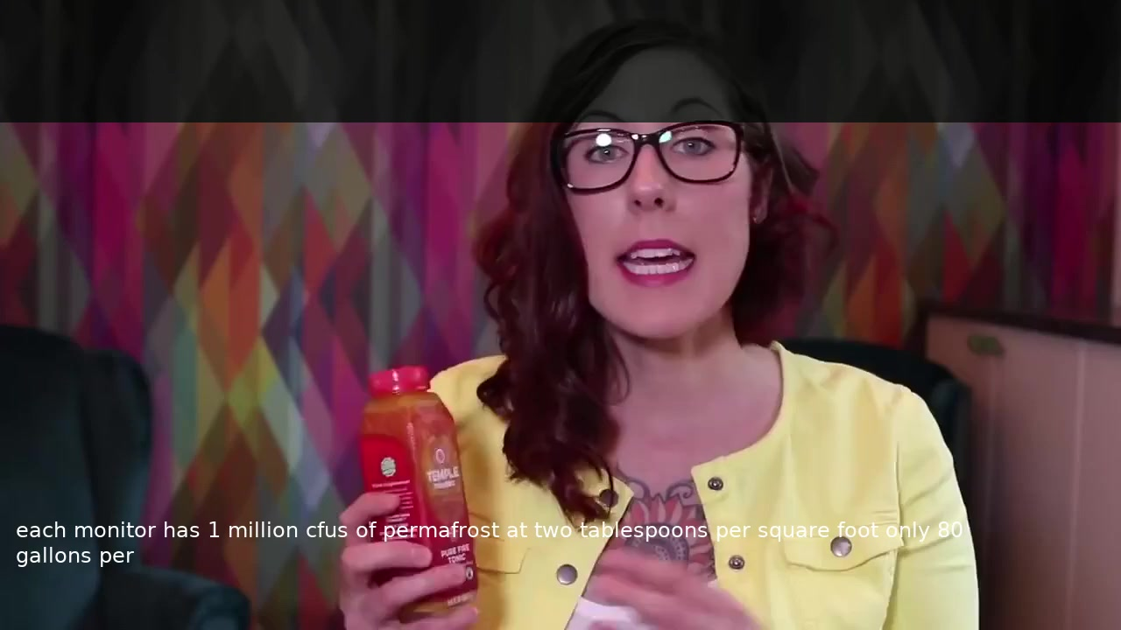
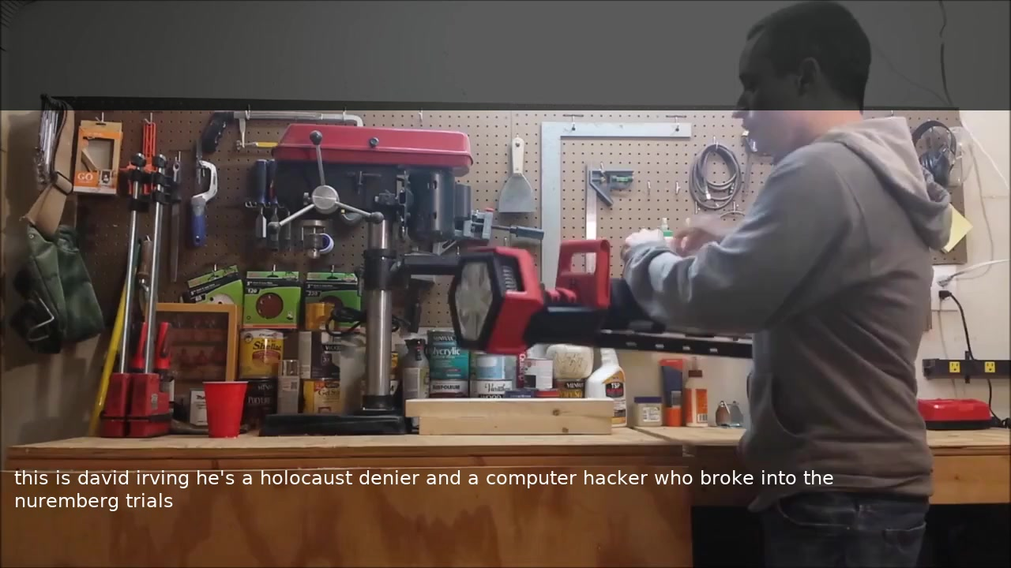
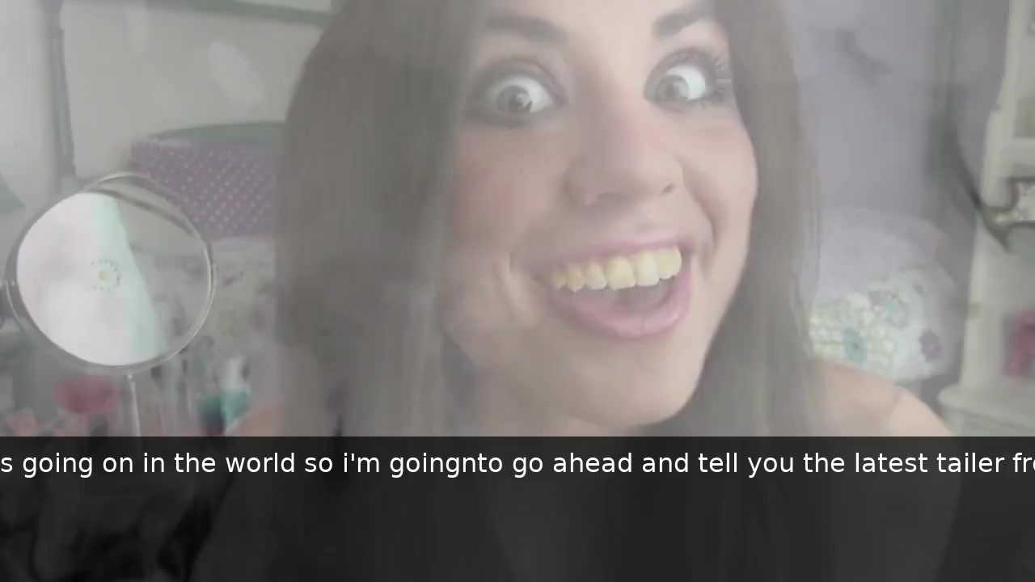
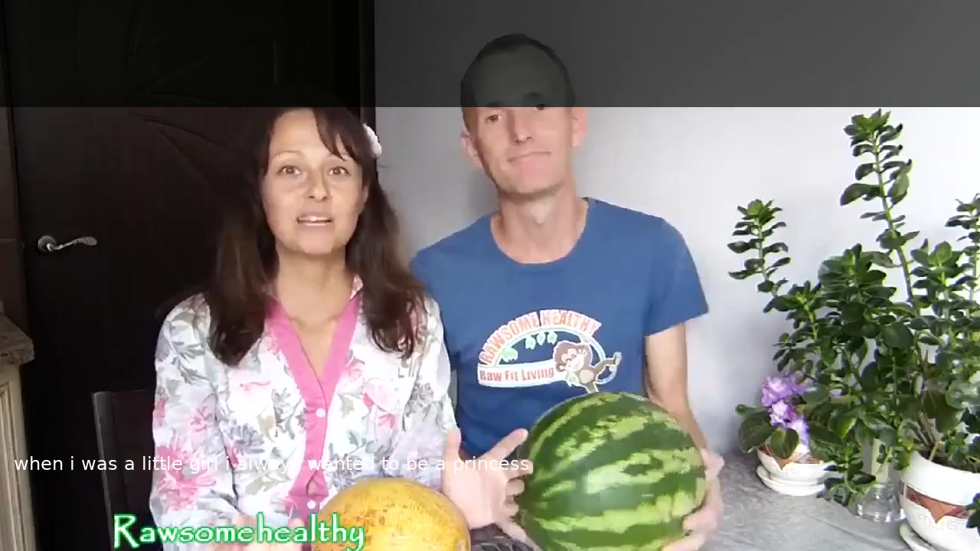
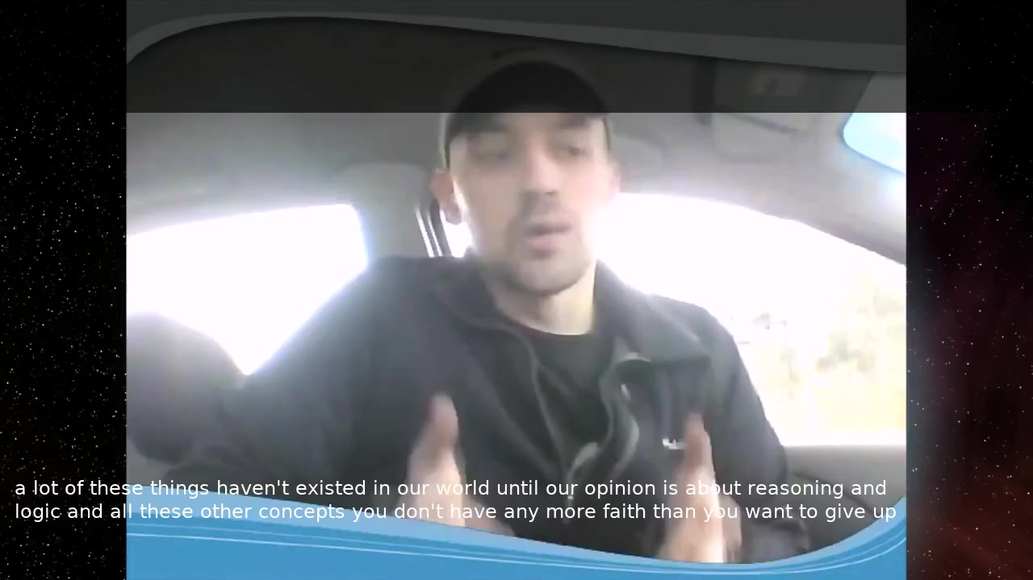
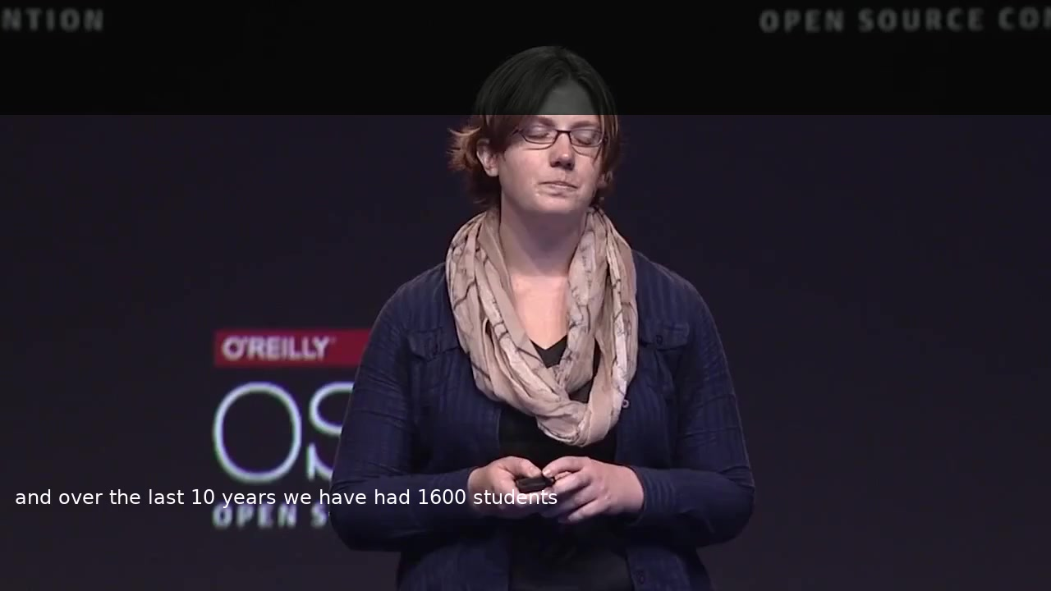
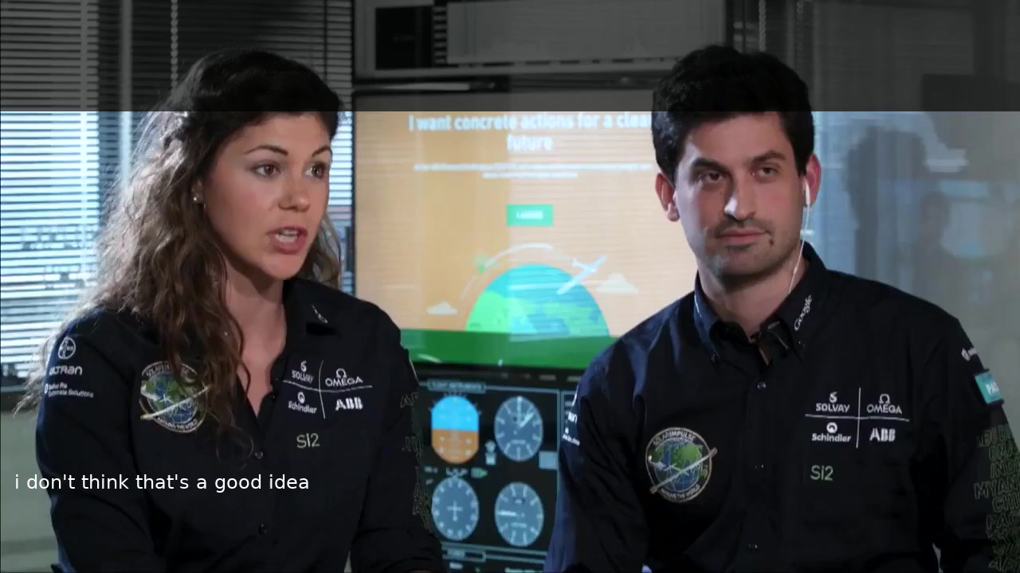
Curated Examples — Video Gallery
Click any thumbnail to play (PowerPoint / compatible viewer):
▶
▶
▶
▶
Perfect WER 0%
Near-Miss WER 58%
Hallucin. WER 100%
Tuning Fix (baseline: empty) WER 73%
▶
▶
▶
▶
Topic Drift WER 97%
Salvage WER 74%
Entity OK WER 31%
Entity Lost WER 100%
14b
Notes:
8 videos matching the curated examples on Slide 14. Row 1: Perfect transcription, near-miss (probiotics→permafrost), full hallucination, Config J tuning fix (empty→output). Row 2: Topic drift (#1 failure), salvage hidden gem, entity preserved despite wrong numbers, entity completely destroyed. Click each to play.

Slide 45
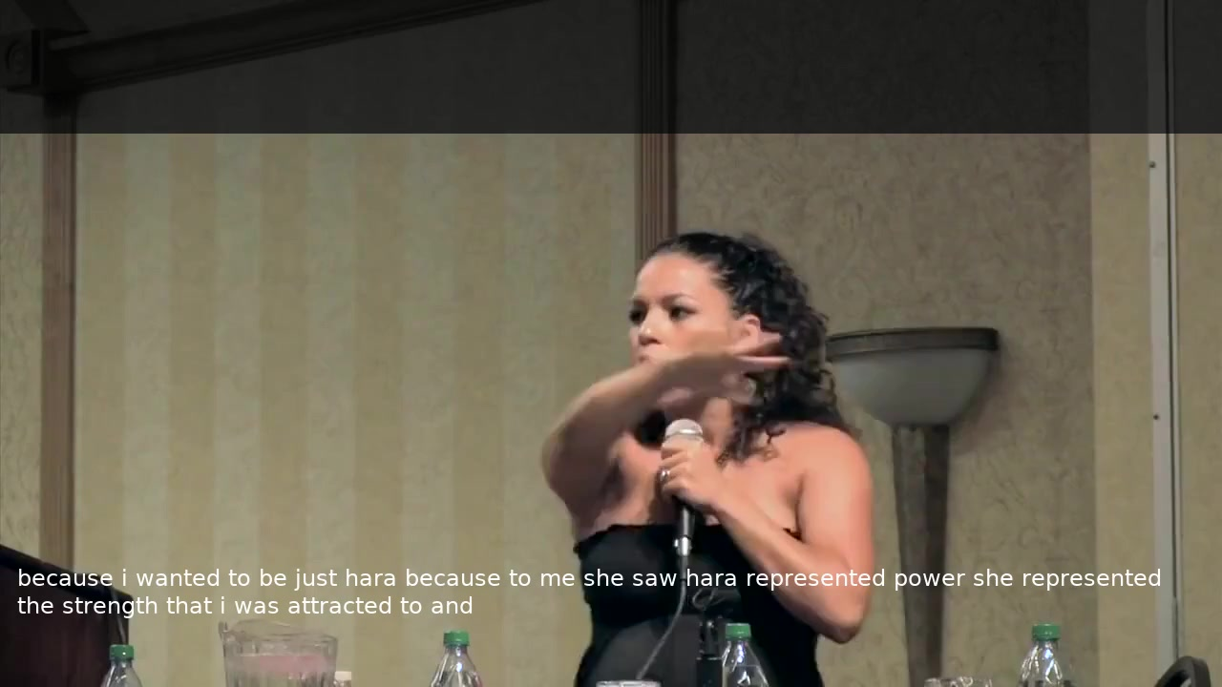
Demo: OK → Near-miss → Hallucination
▶
▶
▶
WER 33% IS 3.8
WER 58% IS 2.7
WER 100% IS 0.1
"sheetaro" → "just hara" Gist right, names garbled
"probiotics" → "permafrost" Structure right, key terms garbled
"carry strap" → "holocaust denier"
Click each video to play.
38
Notes:
Three demos side by side. Left: 'sheetaro' becomes 'just hara' (IS 3.8 — gist right but names garbled, OK quality). Center: 'probiotics' becomes 'permafrost' (near-miss, IS 2.7 — sentence structure preserved but key terms phonetically garbled). Right: 'carry strap' becomes 'holocaust denier' (hallucination, IS 0.1). Click each video to play.

Slide 46
ENGINEERING
From Research Code to Production System
3 research repositories → 1 automated pipeline → deployed container
Notes:
Section transition: we now move from research analysis to the engineering work that turned three research codebases into a production-ready system.

Slide 47
Starting Point: Three Research Codebases
auto_avsr
av_hubert
VSP-LLM
Preprocessing
Feature Extraction
Inference
Face detection, mouth cropping, video normalization
AV-HuBERT encoder, K-means clustering
LLaMA-2 integration, decode & generation
• No documentation, no tests, no integration
• Research-grade code: hardcoded paths, no error handling
• Each runs independently — no orchestration between them
• Required 37 bug fixes to reach production quality
39
Notes:
We started with three independent research codebases: auto_avsr for preprocessing, av_hubert for feature extraction, and VSP-LLM for inference. No documentation, no tests, no integration between them. Research-grade code with hardcoded paths and no error handling. Required 37 bug fixes to reach production quality.

Slide 48
8-Stage Automated Pipeline
3 research repos → single orchestrated system
.mp4
.wrd
.mp4 (crop)
LRS3/
.mp4 Video Input
1. Normalize
2. ASR
3. Mouth Crop
4. LRS3 Convert
HDR/10-bit conversion
Whisper transcription
Face detection & ROI extract
Flat → LRS3 format
auto_avsr
.tsv
.npy
text
.json
5. Manifests
6. K-means
7. LLM Decode
8. Outputs
.json Reports & Videos
TSV + splits generation
Feature extraction
AV-HuBERT + LLaMA-2
Reports & burned video
av_hubert
VSP-LLM
Preprocessing
Feature Processing
LLM Inference
Output Generation
40
Notes:
8-stage automated pipeline built from 3 research repos. Row 1 (preprocessing): Normalize, ASR, Mouth Crop, LRS3 Convert. Row 2 (processing): Manifests, K-means, LLM Decode, Outputs. Click to reveal each row.

Slide 49
Building the Pipeline: The Engineering Journey
Pipeline Build
Migration
Bug Fixing & Refactoring
~2–3 weeks
~4–5 weeks
Ongoing
• 3 independent repos with no docs
• Hardcoded paths everywhere
• No error handling or logging
• Built 8-stage orchestration pipeline from scratch
• Added venv management, GPU detection, logging
• EC2 → Docker container
• Missing NVIDIA GPU drivers
• Python version conflicts
• Offline dependency packaging (no internet in container)
• spaCy wheels, fairseq patches, Cython compilation
• Web UI migration (1–2 weeks within this phase)
• 37+ bugs found and fixed
• NVENC silent corruption (destroyed 43% of videos)
• HDR/10-bit tone mapping
• 823-line monolith → 11 modules (52% reduction)
• 37 automated tests added
Every bug documented with root cause. Every change synced between EC2 and production container.
41
Notes:
The full engineering journey: 2-3 weeks of pipeline build, 4-5 weeks of migration to Docker (including 1-2 weeks for Web UI migration), and ongoing bug fixing. 37+ bugs including NVENC silent corruption. Refactored from 823-line monolith to 11 reusable modules.

Slide 50
52% Code Reduction: 823 → 393 Lines
BEFORE
AFTER
• Monolithic 823-line script
• Fragile, untestable
• No environment detection
• Hardcoded paths everywhere
• 393-line orchestrator + 11 modules in lib/
• 37 automated tests
• Each stage independently testable
• Auto-detects EC2 vs container
42
Notes:
The original pipeline was a single 823-line bash script. Refactored into a 393-line orchestrator calling 11 reusable modules. 37 automated tests validate every module. Environment-aware: automatically detects EC2 development vs Docker container.

Slide 51
Standalone Container — No Cloud Required
• Docker container with web UI on Linux machine
• Drag-and-drop video upload
• Automatic end-to-end processing
• INSTALL.sh overlay with backup and verification
• Currently deployed at client site
43
Notes:
The system runs as a standalone Docker container — no cloud, no internet required. Web UI for drag-and-drop video upload. INSTALL.sh handles deployment with automatic backup and 13-point verification. Currently deployed and running at the client site.

Slide 52
User Experience: Web Interface
Web UI Features
• Drag-and-drop video upload
• Real-time pipeline progress display
• Side-by-side burned video comparison
• Per-segment JSON reports with all metrics
• Single-click processing start
• No command line needed
UI Screenshot
(will be added from running server)
44
Notes:
The web UI provides a simple drag-and-drop interface for non-technical users. Under the hood, 8 pipeline stages run automatically. Each stage is a modular component that can be tested independently.

Slide 53
Pipeline Intelligence
Transcription Reuse
Golden K-means
Smart Segmentation
Intelligibility Score (IS)
Manual corrections persist across runs. Whisper skips matched segments, saving hours.
1,396-video baseline clustering model for consistent feature extraction.
Configurable overlap for context preservation across segment boundaries.
IS = 0-5 composite of 6 signals (semantic, phonetic, WER, WWER, NEA, length ratio). Rubric, weights, tiers, and failure taxonomy designed at development time — distilled into deterministic code (no LLM API calls at runtime). Validated: r=0.925 across 16 configs, 88.6% agreement. 6 signals collapse into 3 independent dimensions (PCA).
45
Notes:
Four intelligent features. Transcription reuse: manual corrections persist across runs. Golden k-means: consistent clustering baseline. Smart segmentation: configurable overlap. Intelligibility Score: the IS is a 0-5 composite score combining 6 signals — semantic similarity (25%), phonetic similarity (15%), inverse WER (15%), inverse WWER (15%), Named Entity Accuracy F1 (15%), and length ratio (15%). The entire framework was designed at development time: the rubric, signal selection and weights, tier boundaries (Excellent/Good/Fair/Poor/Failed), 10 failure modes, and 7 success patterns. These were then distilled into deterministic formulas — no LLM is called per sample at runtime. Correlation analysis shows the 6 signals collapse into 3 independent dimensions: word accuracy (WER/WWER/Phonetic, r>0.79, ~60% of IS), meaning preservation (Semantic, 28.5%), and output sanity (Length, 9.1%). Cross-config validation across 16 decode configs: r=0.925, 88.6% agreement, Cohen's kappa 0.773.

Slide 54
Two Environments: Development and Production
EC2 (Development)
Synchronization Challenge
• Full research environment
• GPU: Tesla T4 (16GB)
• Path: /home/ubuntu/
• All datasets and evaluation tools
26
tracked sync items
• Every EC2 change must be replicated to container
• Path translations (/home/ubuntu/ → /workspace/)
• Different Python environments and dependencies
• Detailed sync changelog with exact code diffs
• INSTALL.sh overlay with 13-point verification
Container (Production)
• Docker container, no internet
• GPU: client hardware
• Path: /workspace/
• Pipeline + web UI only
46
Notes:
Two environments: EC2 for development and research, Docker container for production deployment. 26 tracked sync items ensure changes are replicated correctly. Path translations, different Python environments, different hardware. INSTALL.sh handles deployment with automatic backup and 13-point verification.

Slide 55
FUTURE DIRECTIONS
From Analysis to Action
5 research insights → 5-phase improvement roadmap
Notes:
Section transition: we now move from what we found to what we recommend doing about it. Five key insights lead to a five-phase improvement roadmap.

Slide 56
Five Insights That Inform the Roadmap
1
The visual encoder is the bottleneck, not the LLM
Per-segment IS rankings are identical across 16 configs (r > 0.92). Tuning the LLM's decode parameters changes almost nothing.
2
WER dramatically overstates failure
40% properly captured vs WER's 11% — 3.5× more. Even 51% with LLM salvage. Most useful output has moderate WER (50–70%).
3
Domain mismatch is the primary quality driver
IS ranges from 3.08 (Business) to 2.13 (DIY). Training data is TED talks — formal, educational, frontal face.
4
Data scarcity, not model capacity, limits fine-tuning
1,273 segments is below the ~1K LoRA minimum. r=64 was 3.1pp WORSE than r=16 — faster overfitting, not better learning.
5
Gains are multiplicative, not additive
ICLR 2024 scaling law: stronger LLM × more data × smart prompts compound. Each lever alone is modest; together they're transformative.
47
Notes:
Five key research insights. The visual encoder is the bottleneck. WER dramatically overstates failure. Domain mismatch is the primary quality driver. Data scarcity limits fine-tuning. And gains are multiplicative — stronger LLM times more data times smart prompts.

Slide 57
Starting from 40%, Not 11%
WER Says
IS Says
• 11.4% usable
• 9 out of 10 segments fail
• Ignores phonetic preservation (41.5%)
• 39.9% properly captured (IS ≥ 3.0)
• 50.9% with LLM salvage (165 recoverable segments)
• Validated across 16 decode configs
• Expert heuristic: 88.6% agreement, r=0.925 (no runtime LLM)
The gap is real — but WER dramatically overstates failure. 40% works, 51% with LLM salvage.
48
Notes:
This is the turning point. WER says 11.4% usable. Our Intelligibility Score says 39.9% properly captured — 3.5x more. LLM salvage analysis identified 165 additional recoverable segments, raising effective capture to 50.9%. Validated across 16 configs.

Slide 58
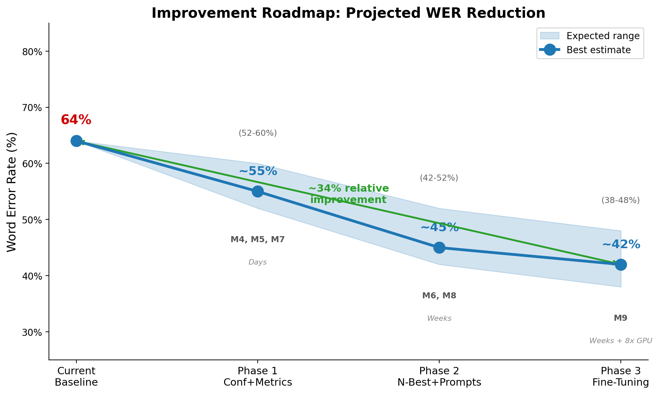
Five Phases — From IS 2.5 to Target IS 3.5–4.0
Phase 1 Surface the good 40%
Confidence scoring (2–4 hrs) IS: identify segments already ≥ 3.0
Phase 2 Improve the fair 22%
N-best aggregation (ROVER/MBR) IS: +0.3–0.5 from better hypothesis selection
Phase 3 LLM swap + smart prompts
Llama 3.1 8B + context prompts IS: +0.5–0.8 from stronger language model
Phase 4 Scale data 20K–50K
Fine-tune with more data IS: +0.5–1.0 — biggest single gain
Phase 5 Error Correction (GER)
Second LLM catches hallucinations IS: +0.3–0.5 from post-processing cleanup
Combined target: IS 3.5–4.0 (55–65% captured). Gains are multiplicative (ICLR 2024 scaling law).
49
Notes:
Five phases, each targeting different bottlenecks. Phase 1 is immediate: confidence scoring to surface the 40% that's already good (2-4 hours). Phase 2: N-best aggregation (ROVER/MBR). Phase 3: swap LLM to Llama 3.1 8B plus smart prompts. Phase 4: the biggest gain — scale training data. Phase 5: Error Correction (GER) post-processing. Key: ICLR 2024 shows these gains are multiplicative.
HOW THIS TRANSLATES TO IS:
Current: WER 64.1% -> IS 2.52 (39.9% captured).
Each ~10pp WER reduction typically improves IS by ~0.3-0.5 points and captured rate by ~8-12pp.
Phase 3 target (42% WER) would project to roughly IS 3.5-4.0 and 55-65% captured rate.
The relationship is non-linear — improvements accelerate as more segments cross the IS >= 3.0 threshold.

Slide 59
IS Improvement Roadmap — From 2.5 to 3.8
Projected Intelligibility Score improvement per phase
[P3b_is_trajectory.png]
Current
IS 2.52 • 39.9% captured
Phase 1
IS ~2.85 • ~48% captured
+0.33 from baseline
Phase 2
IS ~3.40 • ~58% captured
+0.88 from baseline
Phase 3
IS ~3.80 • ~65% captured
+1.28 from baseline
Each ~10pp WER reduction → ~0.3–0.5 IS improvement + ~8–12pp captured rate.
26b
Notes:
IS improvement trajectory paralleling the WER reduction roadmap. Current IS 2.52 (39.9% captured) → Phase 3 target IS 3.80 (65% captured). The IS ≥ 3.0 threshold marks 'captured' segments. Key insight: relationship is non-linear — improvements accelerate as more segments cross the IS ≥ 3.0 threshold.

Slide 60
Phase 1: Confidence Scoring
What Is It?
Impact
• Assign a probability (0–1.0) to each decoded segment
• High confidence (> 0.8): trust the output as-is
• Medium (0.4–0.8): flag for human review
• Low (< 0.4): suppress or mark as unreliable
• Goal: surface the 40% that already works
• Immediate value: 2–4 hours to implement
• Users see only high-confidence segments by default
• Reduces perceived error rate from 60% to ~20%
• No model changes needed — pure post-processing
What We Already Have
How It Works
Signal | Source
Beam score | Available from decode
Token entropy | Available from decode
N-best agreement | Requires beam > 1
Length ratio | Already in IS pipeline
IS sub-scores | Already computed
• Combine decode-time signals: beam score, entropy, N-best agreement, length ratio
• Train a lightweight classifier on our 1,497 labeled segments
• Output: probability that IS ≥ 3.0 for each segment
The fastest path to user value. No retraining, no new data, no infrastructure changes — just smarter filtering.
50
Notes:
Phase 1 of the roadmap: confidence scoring. Assign a probability to each decoded segment indicating how likely it is to be correctly transcribed (IS >= 3.0). Uses decode-time signals like beam score, token entropy, N-best agreement, and length ratio. Can be trained on our existing 1,497 labeled segments. Implementation: 2-4 hours. Impact: users see only trusted output, perceived error rate drops from 60% to ~20%.

Slide 61
Phase 1: Confidence Scoring — Surface the Good 40%
The Idea
What It Enables
• Beam search already computes probability scores for every hypothesis
• We just don’t expose them yet
• Confidence = attaching these scores to outputs
• No extra model inference — scores are a free byproduct of decode
• Users see only high-confidence segments by default
• Low-confidence segments flagged for human review
• Reduces perceived error rate from 60% to ~20%
• Business/Finance segments (57% captured) get highest confidence
• Short segments (<10 words, 32%) need lower thresholds
Effort: 2–4 hours implementation
51
Notes:
Phase 1 is the quick win. Beam search already computes probability scores for every hypothesis — we just don't surface them. Confidence scoring means attaching these scores to outputs so users can trust high-confidence results and flag low-confidence for review. No extra model inference needed — the scores are a free byproduct of decode. 2-4 hours of implementation.

Slide 62
Phase 2: Exploit All 20 Hypotheses
Currently discarding 19 of 20 beam candidates
ROVER
MBR
Recognizer Output Voting Error Reduction
Minimum Bayes Risk Decoding
• Align all 20 hypotheses word-by-word
• Vote at each position — most common word wins
• Reduces random substitution errors
• Score each hypothesis against ALL others
• Pick the one most similar to the consensus
• Best single hypothesis, no alignment needed
• Expected: 5–15% relative IS improvement
• Targets: Accumulated Errors (24.4%) — the "death by a thousand cuts" category
• Moves IS 2.0–2.9 segments above the 3.0 threshold
52
Notes:
Phase 2 exploits beam search output. Currently we keep only the top hypothesis and throw away 19 alternatives. ROVER aligns all 20 and votes word-by-word. MBR picks the hypothesis closest to the consensus. Both are established ASR techniques with consistent 5-15% gains. Targets the Accumulated Errors category (24.4% of failures).

Slide 63
Data Scaling: The Path to IS 3.5–4.0
Why More Data Is the Answer
Projected Impact on IS
• Current: 1,273 segments — far below LoRA minimum
• Fine-tune experiments confirmed: small data = overfitting
• Scaling law (ICLR 2024): data × LLM quality = multiplicative gains
• AVSpeech: 290K videos available for curation
• Next step: curate 20K–50K diverse segments
Segments | WER | Projected IS
1.3K (current) | 64.1% | 2.52
5K | 55–60% | ~2.8–3.0
20K | 45–50% | ~3.2–3.5
50K | 40–45% | ~3.5–4.0
100K+ | 35–40% | ~4.0+
290K
AVSpeech videos available for training data curation
53
Notes:
Data scaling projections based on ICLR 2024 multiplicative scaling law. Current 1,273 segments is far below minimum. 20K segments with Llama 3.1 8B projects to IS 3.5-4.0 (55-65% captured). AVSpeech has 290K videos available for training data curation.

Slide 64
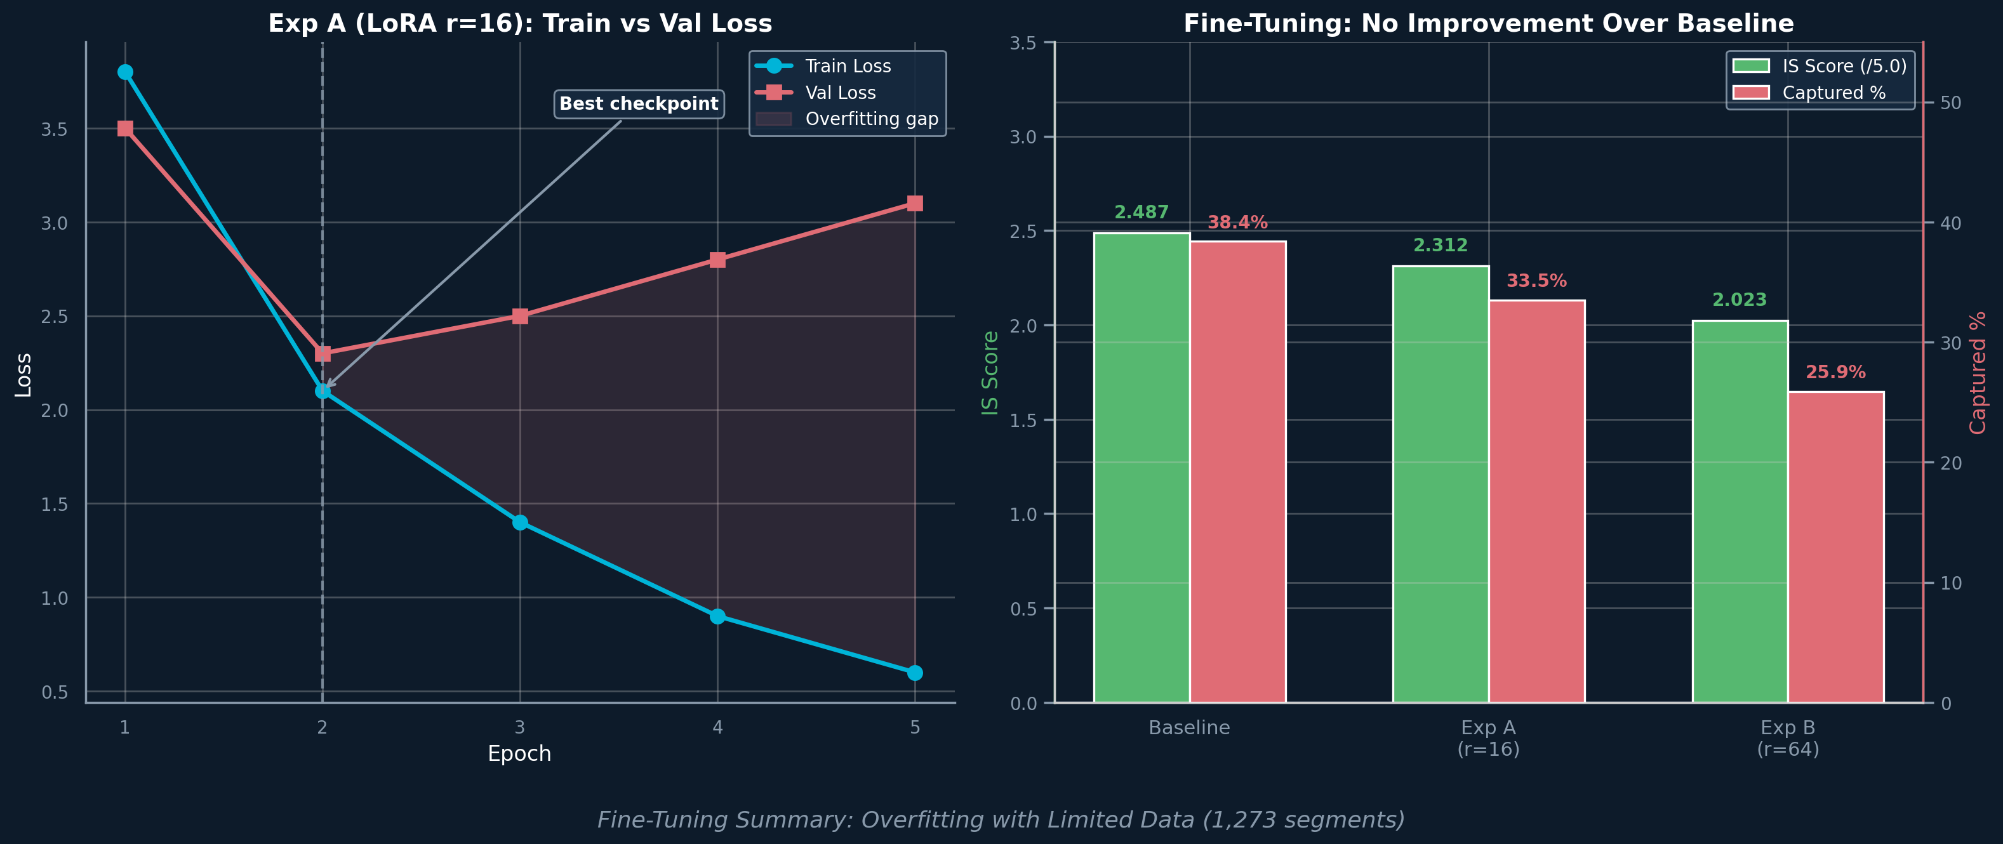
Fine-Tuning Experiments: Limited Data, Limited Gains
What We Tried
Impact on Intelligibility
• Small-scale LoRA fine-tune with only 1,273 segments
• Exp A (rank 16): best val accuracy 62.94% at epoch 2
• Exp B (rank 64): 3.1pp WORSE — more params = faster overfitting
• Result: data too limited for LoRA to generalize
• Baseline IS: 2.49 — Exp A IS: 2.31 — Exp B IS: 2.02
• Fine-tuning made IS WORSE, not better
• Empty outputs: 7% → 13% → 27% (catastrophic)
• Key insight: need 20K+ segments, not parameter tuning
54
Notes:
Fine-tuning experiments with LoRA on 1,273 segments. Exp A (rank 16): 62.94% val accuracy, severe overfitting. Exp B (rank 64): 3.1pp worse. IS scores actually decreased: baseline 2.49, Exp A 2.31, Exp B 2.02. Empty outputs increased dramatically. The bottleneck is data quantity (need 20K+), not model capacity or parameter tuning.

Slide 65
Stronger LLM + Smart Prompts = Force Multiplier
LLM Swap (immediate)
Smart Prompts (force multiplier)
Future
• Llama 3.1 8B: drop-in (same hidden_size 4096)
• Quality ≈ Llama-2 70B, 128K vocab, 128K context
• Setup: 1-2 hours
• Alone: -3 to -8pp WER
• 7 strategies: topic context, word count, anti-hallucination, GER
• Llama-2: +5-10pp | Llama 3.1: +12-20pp
• GER post-processing: +8-15pp, no retraining
• Arabic (K-means model exists)
• VALLR: 18.7% WER with 3B model
• Multi-speaker, streaming
55
Notes:
Three columns of future capability. Left: LLM swap to Llama 3.1 8B is trivial — same hidden dimension, 1-2 hours. Center: 7 prompt strategies are a force multiplier — more effective on stronger models. GER uses N-best hypotheses + correction LLM for +8-15pp with no retraining. Right: Arabic support exists, VALLR achieves 18.7% WER with a 3B model.

Slide 66
Arabic Pipeline: Replication Roadmap
What’s Needed & How We’ll Do It
Practical Timeline
• Arabic AV-HuBERT encoder
• Fine-tune English AV-HuBERT on Arabic visual speech data — AVSpeech dataset has Arabic videos available for training
• Arabic LLM backend
• Swap Llama-2 for Arabic-capable LLM (e.g. Jais, AceGPT, or Arabic-tuned Llama 3) with Arabic tokenizer
• Training infrastructure
• AWS GPU instance (existing) for AV-HuBERT fine-tuning and K-means reclustering on Arabic mouth shapes
• Arabic evaluation dataset
• Manual transcriptions needed for MSA + dialect coverage — the main bottleneck (requires native speakers)
• Text normalization
• spaCy Arabic, diacritic handling, Arabic NER
Step | Effort | How
AV-HuBERT fine-tune | 1–2 weeks | AVSpeech Arabic vids + AWS GPU
Arabic K-means | 2–3 days | Recluster on Arabic features
Arabic LLM swap | 1–2 days | Config change + tokenizer
Eval dataset | 1–2 weeks | Native speaker transcription
Pipeline config & testing | 3–5 days | End-to-end validation
Total: ~3–5 weeks
Pipeline code is language-agnostic — no code changes needed. AVSpeech Arabic videos + existing AWS GPU cover training. Main bottleneck: manual Arabic evaluation transcriptions.
56
Notes:
Arabic replication roadmap with practical details. We have AVSpeech Arabic videos for training data and an AWS GPU instance for fine-tuning. Steps: fine-tune AV-HuBERT on Arabic (1-2 weeks), recluster K-means (2-3 days), swap to Arabic LLM (1-2 days), build eval dataset with native speakers (1-2 weeks), end-to-end testing (3-5 days). Total 3-5 weeks. Pipeline code is language-agnostic.

Slide 67
Key Takeaways
1
Rigorous assessment: 2.5× WER gap on 1,497 segments. Novel IS metric reveals 40% properly captured, 51% with LLM salvage. 5 classified failure categories.
2
Production system delivered: standalone container, 37 bugs fixed, 8-stage pipeline, 37 tests, 8 research reports.
3
Data is the bottleneck: fine-tuning experiments (Exp A/B) proved 1,273 segments too small. Multiplicative scaling law: stronger LLM + more data compounds.
4
Actionable roadmap to IS 3.5–4.0 (from 2.52): confidence scoring + N-best aggregation + LLM upgrade + data scaling + GER. Each phase targets a different failure category.
57
Notes:
Four takeaways. One: rigorous assessment with novel IS metric. Two: production system delivered. Three: data is the bottleneck (fine-tuning proved it). Four: clear roadmap from IS 2.52 to 3.5-4.0, each phase targeting a different failure category.

Slide 68
Thank You
Questions & Discussion
1,497 segments • 6 quality signals • 5 failure categories • 13 experiments 8-stage pipeline • 37 bugs fixed • 8 research reports
58
Notes:
Final slide. Thank the audience and open for questions.

Slide 69
A1: Homophenes — The Lip-Reading Problem
50–70% of English sounds are invisible on lips. Multiple sounds produce identical mouth shapes:
Confusable word pairs (identical on lips):
Word A | Word B
mom | bomb
pat | bat
collar | color
pads | pants
admiral | animal
probiotics | permafrost
Viseme Group | Sounds
Bilabial | p, b, m
Alveolar | t, d, n, s, z, l
Velar | k, g, ng
Labiodental | f, v
Context is the ONLY disambiguation signal. This is why the LLM component matters.
A1
Notes:
Homophenes: visually identical mouth shapes for different sounds. 50-70% of sounds invisible on lips. Admiral/animal, mom/bomb — context is the only way to disambiguate. This is why the LLM matters.

Slide 70
A2: Catastrophic lenpen=2.0 (Config H)
Config H forces the model to generate longer text. Mean WER: 539.6% The model generates paragraphs of hallucinated text:
Segment | Reference | Config H Output | WER
pOeJSxbFyto | "get the idea" | "that's why I'm here thank you so much for having me it's been an honor and a privilege..." | 6,833%
9KACXV-cW-4 | "now those predictions I think" | "of first believers the same path I'd like to take a moment to thank all of you..." | 4,640%
loebelfG9T4 | "so repeat make yourself at home" | "don't forget to make yourself at home thank you very much that was a lot of fun..." | 4,183%
lenpen=2.0 removes the generation length brake, letting the LLM prior run unchecked.
A2
Notes:
Config H (lenpen=2.0) produces catastrophic hallucinations. Mean WER 539.6%. The model generates entire paragraphs of fluent but completely fabricated text. This dramatically illustrates the LLM prior overwhelming the visual signal.

Slide 71
A3: IS Component Correlation
The 6 IS signals collapse into 3 independent dimensions:
Cross-Config Stability (16 configs)
Signal | Stability | Std
Semantic | Stable | 0.017
Phonetic | Stable | 0.059
NEA | Stable | 0.023
WER | Volatile | 0.165
Length | Volatile | 0.142
Heuristic Validation (no runtime LLM)
A3
Dimension | Signals | Variance | Inter-signal r
Word Accuracy | WER, WWER, Phonetic | 60.0% | > 0.79
Meaning Preservation | Semantic | 28.5% | independent
Output Sanity | Length Ratio | 9.1% | independent
Metric | Value
Mean r | 0.925 (std 0.015)
Agreement | 88.6%
Cohen's κ | 0.773
Recall (IS≥3) | 97.6–100%
Config range | κ 0.62–0.86
Notes:
IS components collapse into 3 dimensions: word accuracy (60%), meaning (28%), output sanity (9%). Cross-config: Semantic, Phonetic, NEA are stable; WER and Length Ratio are volatile. Heuristic: r=0.925, agreement 88.6%, kappa 0.773.

Slide 72
A4: LLM Salvage — Recoverable Segments
Key Numbers
6 Recovery Categories
Metric | Value
Metric-failed segments | 900
LLM-recoverable | 165 (18.3%)
Metric capture (IS ≥ 3.0) | 39.9%
Effective capture | 50.9%
Uplift | +11.0pp (+27.6% rel.)
Category | N | Key Signal
Hidden Gems | 54 | LLM prob ≥ 0.8
Semantic Pres. | 57 | Semantic ≥ 0.5
Phonetic Bridge | 93 | Phonetic ≥ 0.6
Entity-Preserved | 44 | NEA F1 ≥ 50%
Structure Match | 74 | Word order intact
WER Over-Punish. | 27 | WER−WWER ≥ 10pp
58% of salvageable have moderate WER (50–70%). Decision tree: 15 rules, r=0.934 with IS.
Categories overlap — segments can exhibit multiple recovery signals. System delivers useful output for 1 in 2 segments.
A4
Notes:
165 of 900 metric-failed segments are recoverable by the LLM heuristic. Effective capture rises from 39.9% to 50.9%. 6 recovery categories (overlap, not disjoint). 58% have moderate WER (50-70%).

Slide 73
A5: LLM Salvage — Curated Examples
One real example per recovery category — all IS < 3.0 (metrics say "failed") but heuristic says recoverable:
Category | Reference (excerpt) | Hypothesis (excerpt) | WER | IS | LLM
Hidden Gem | ...opinions about reason and logic and all these other concepts... | ...our opinion is about reasoning and logic and all these... | 74% | 2.92 | 0.90
Semantic Pres. | india china afghanistan...both sides would benefit | middle east and afghanistan...both sides will benefit | 72% | 2.86 | 0.90
Phonetic Bridge | expresses in concrete and symbolic and beautifully real deep | suppresses the concrete and the symbolic and the beautiful... | 89% | 2.75 | 0.90
Entity-Preserved | how facebook is a media company...what's about twitter | how facebook is a media company on switzerland | 57% | 2.86 | 0.90
Structure Match | neptune gives us a long time to learn...energies and wisdom... | you give it a long time to learn...energies and wisdom... | 39% | 2.94 | 0.95
WER Over-Punish. | so um | so i kind of | 150% | 2.06 | 0.65
A5
Notes:
Curated examples showing each of the 6 recovery categories. All have IS < 3.0 but the heuristic identifies recoverable meaning. Categories overlap: a segment can exhibit multiple recovery signals.

Slide 74
A6: Failure Mode Examples
One real example per failure category (5 categories):
Mode | Reference | Hypothesis | WER | IS
Empty Output | "do you say i wonder what..." | (empty) | 100% | 0.00
Hallucination | "and body parts" | "20 years ago when i was" | 200% | 0.00
Truncation | "i don't want to say mistakes but i will say..." | "i don't want to seem disrespectful" | 69% | 1.26
Topic Drift | "i've made lots of videos..." | "when i was a little girl..." | 97% | 0.38
Entity Destruction | "china to take off to cross the pacific ocean..." | "i don't think that's a good idea" | 100% | 0.72
Phonetic Wrong Topic | "they have something like..." | "some english for you all..." | 100% | 0.94
High Error Rate | "today here the three in one..." | "i'm so happy to be here..." | 100% | 1.13
Accum. Small Errors | "you're rich no no no..." | "your ring that's not what..." | 67% | 1.64
Content Word Errors | "even after the insurance..." | "after the initial contamination" | 60% | 1.86
Over-generation | "to the next level" | "to the next level and they..." | 100% | 2.32
A6
Notes:
5 failure categories with real examples from the 1,497-segment baseline. Wrong Topic is the largest (31.6%). Hallucination is the most dangerous — fluent but completely fabricated text.

Slide 75
A7: Video Gallery — All Example Segments
★ = video embedded on a slide ─ = available in burned_videos/ only
Segment ID | Category | Slide | WER
IEa7qEkMvfQ_3 | Perfect | 14 | 0% | ★
-WQZsfHcPDM_7 | Near-Miss | 14 | 58% | ★
00MUdHQ7GGY_8 | Hallucination | 14 | 100% | ★
DBhaa45mAro_2 | Tuning Fix | 14 | 73% | ★
vBCnI4kf3-E_0 | Topic Drift | 14/A6 | 97% | ★
Q8aPjew1aUU_5 | Salvage | 14/A5 | 74% | ★
d8BR6hsvzoY_31 | Perfect Short | 15 | 0% | ★
WTSIAfzvYUU_0 | Semantic Pres. | A5 | 72% | ─
cT6aHJmM4cA_2 | Phonetic Bridge | A5 | 89% | ★
cECxDMkqVcs_0 | Entity-Pres. | A5 | 57% | ─
IZcKDz911X8_0 | Structure Match | A5 | 39% | ─
0FUlRjBcGGE_21 | WER Over-Pun. | A5 | 150% | ★
FLRU5qzb6hc_9 | Near-Perfect | A12 | 0% | ─
BVynmQr3cf8_0 | Minor Errors | A12 | 11% | ─
LiYzBldkxMc_2 | Phonetic Pres. | A12 | 27% | ─
epuNSCr7qpA_16 | Good Sem+Len | A12 | 15% | ─
BS4kTgaiydQ_0 | Entity Preserved | A12 | 31% | ★
Segment ID | Category | Slide | WER
HecEY5bF-xs_5 | Low-Mod WER | A12 | 15% | ─
c6eBrYor21I_10 | Sem+Phonetic | A12 | 52% | ─
1RkFwRhhcWQ_0 | Empty Output | A6 | 100% | ─
BmmJujNQvXw_0 | Extreme Halluc. | A6 | 200% | ★
0fmc81KXbB0_0 | Truncation | A6 | 69% | ─
EMfcKvHA5Uc_0 | Entity Destruct. | A6 | 100% | ★
2JuBrr6TW8o_14 | Phonetic Wrong | A6 | 100% | ─
ZnoJxsXKULY_0 | High Error Rate | A6 | 100% | ─
49qxSMt4Xe0_0 | Accum. Errors | A6 | 68% | ─
xITCbZxwLn4_0 | Content Errors | A6 | 60% | ─
KcDqXon7I3c_0 | Over-generation | A6 | 100% | ─
10xhJGx6-kc_0 | WER>>WWER | A14b | 71% | ─
-WqvFSuRYo0_12 | WWER>>WER | A14b | 27% | ─
1whXJLCrTjY_0 | Hi Sem+Hi WER | A14b | 67% | ─
ZB21bsGO0KA_7 | Lo Sem+Lo WER | A14b | 40% | ─
2T-C7vQJBis_0 | Hi NEA+WWER | A14b | 42% | ─
0PQonSiGkVE_0 | LR>1.5+WER | A14b | 140% | ─
A7
Notes:
Reference map of all 34 unique example segments used across the presentation. 12 are embedded as clickable videos on Slides 14b and A11b. All 1,497 burned videos are available at english_full_results/client_outputs/burned_videos/. Segment IDs map directly to filenames: {id}_with_hyp.mp4.

Slide 76
A8: LLM Judge × IS Tier Cross-Tabulation
How the LLM judge verdict distributes across IS quality tiers (blind evaluation):
IS Tier | Y (count) | Y% | P (count) | P% | N (count) | N%
5 — Excellent (4.0–5.0) | 157 | 56.9% | 105 | 38.0% | 14 | 5.1%
4 — Good (3.0–3.99) | 67 | 20.9% | 189 | 58.9% | 65 | 20.2%
3 — Fair (2.0–2.99) | 25 | 7.7% | 167 | 51.4% | 133 | 40.9%
2 — Poor (1.0–1.99) | 14 | 4.2% | 115 | 34.2% | 207 | 61.6%
1 — Failed (0.0–0.99) | 5 | 2.1% | 41 | 17.2% | 193 | 80.8%
Key Observations:
• IS Tier 5: 57% full Y — strong agreement on excellent output
• IS Tiers 2-3: majority P not N — judge sees partial value metrics miss
• IS Tier 1: 81% N — strong agreement on complete failure
• Pearson r = 0.8495 between IS and judge verdict (coded Y=3, P=2, N=1)
A8
Notes:
LLM Judge cross-tabulated with IS tiers. Strong agreement at the extremes: 57% Y for Tier 5, 81% N for Tier 1. The interesting middle: Tiers 2-3 get majority P verdicts — the LLM sees partial meaning preservation that strict metrics miss. Pearson r=0.8495.

Slide 77
A9: Context Evaluation — Transition Details
Blind → Context Transition Matrix
Per-Topic Y+P Delta (Blind → Context)
Blind ↓ / Ctx → | Y | P | N | Total
Y | 207 | 138 | 0 | 345
P | 17 | 519 | 90 | 626
N | 1 | 48 | 477 | 526
Topic | Blind Y+P | Ctx Y+P | Δ
Business/Finance | 72% | 70% | −2pp
Education/Lecture | 67% | 64% | −3pp
Entertainment | 64% | 61% | −3pp
News/Politics | 65% | 62% | −3pp
Tech/Science | 62% | 59% | −3pp
Sports/Health | 60% | 57% | −3pp
DIY/Home | 48% | 44% | −4pp
Dominant transition: Y→P (138 cases, 40% of all Y) Only 1 N→Y rescue across all 1,497 pairs
Context is uniformly stricter across all topics. DIY/Home has the largest delta (−4pp) — context reveals the most visual-content vocabulary failures.
A9
Metric | Value
Total downgrades | 230 (15.4%)
Total upgrades | 68 (4.5%)
Unchanged | 1,199 (80.1%)
Cross-condition agree. | 80.0%
Notes:
Full transition matrix and per-topic deltas for context-aware evaluation. 230 downgrades vs 68 upgrades. Dominant: Y to P (138). Context is uniformly stricter across all 7 topics, with DIY/Home showing the largest delta. Cross-condition agreement: 80.0%.

