Slide 1
Technology Stock Index
TEAM2
Yukun Yuan
Dinming He
Ran Zhou

Slide 2
Agenda
Goal of Project
User Cases
Methodology
About Data
Milestones
How to Implement
Acceptance Criteria

Slide 3
Goal of Project
Design a concept named Technology Stock Index which can measure the risk and investment value of the technology stocks
Estimating the risk of a portfolio investment and provide reference for stocks investor.

Slide 4
Use Cases
Actor | Investor
Action | Inputs the portfolio investment
Reaction | Generating risk expectations for these stocks and the values of Technology Stock Index

Slide 5
Methodology
Parse Data and make data cleaning(ETL process)
Store the data into databases
Design and implement the algorithm models(For single company)
Design and implement the model for Technology Stock Index
Train the models on Spark
Implement the result integration and visualization
Notes:
Etl process， market value and the number of employee

Slide 6
About Data
We are going to collect daily stocks data of 10 to 30 technology companies during 3+ yrs;
Data Sources: Real-time Stocks data(Yahoo API：https://github.com/fsw0422/yahoo-finance-history-fetcher);
Data Column: Date, Open, High, Low, Close, Volume, Adj Close;
Data Rows: At least 30,000 rows

Slide 7
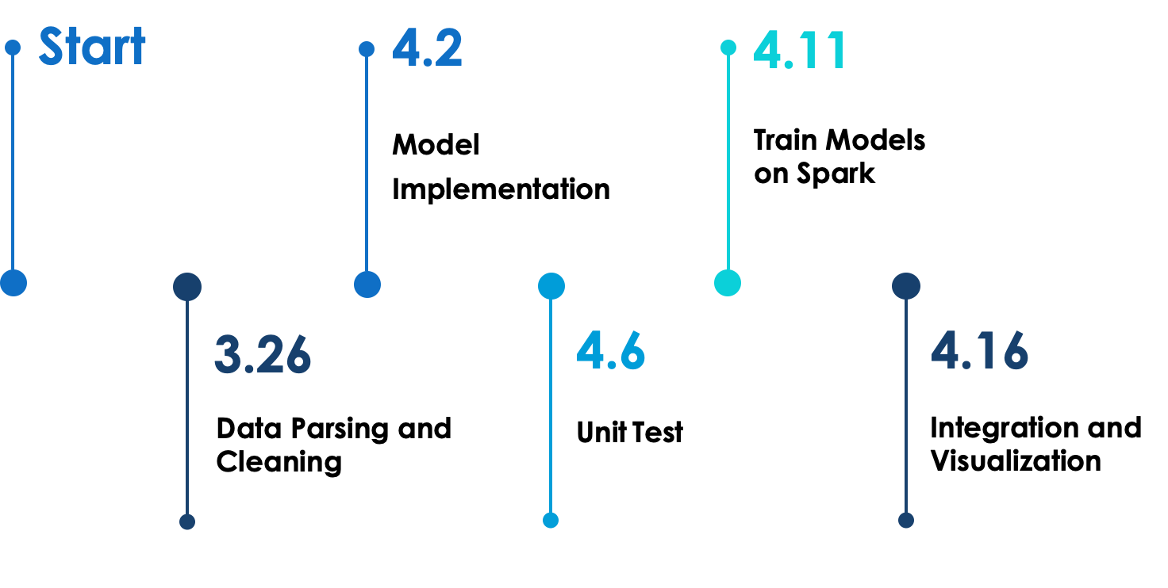
Milestones

Slide 8
How to implement
Main parts of the project
Data cleaning: parse, filter and transform
Value of Risk Algorithm Model
Technology Stock Index Algorithm Model
Result Integration and Visualization
Unit tests
Git Repository: https://github.com/MrYuan123/CSYE7200-Final

Slide 9
Acceptance Criteria
Divide the data as training sets and test sets, and the average of accuracy should reach at least 75%
The user can get respond in 5 seconds
Provide the visualization of the Technical Index

Slide 10
THANK YOU👍

