Slide 1
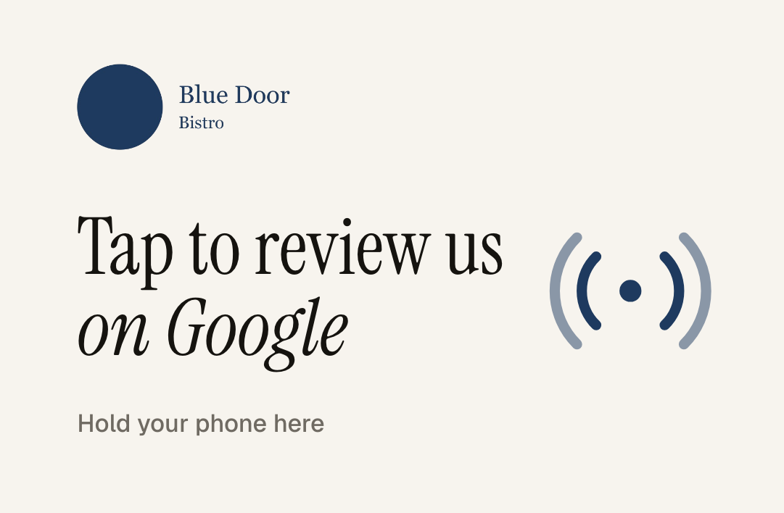
FOR BLUE DOOR BISTRO · RIVERSIDE
The review your guests meant to leave.
A card your servers drop with the check. A monthly report on what guests are saying. Nothing for you to run.
Tablenote
Prepared for Blue Door Bistro
Notes:
HOW TO EDIT THIS DECK: replace the bracketed placeholders on slides 1, 2 and 9 ([Restaurant Name], [City], [Owner], [4.3], [58], [3 months ago]). To show their own logo on the cards, open the Pitch prep page on the website (/pitch), upload their logo, click "Save preview as image", and paste that image over the card pictures on slides 1, 5 and 9.
TALK TRACK: "Most of your guests never write a review. Not because they wouldn't, but because nobody asks at the right moment. This is the card that asks."

Slide 2
BLUE DOOR BISTRO ON GOOGLE TODAY
Rating
Reviews
Most recent review
4.2
63
2 months ago
Your last Google review was two months ago, and 47% of diners skip a place with under 20 recent reviews. You have the food; the map just does not know it yet.
Only the delighted and the furious leave reviews on their own. Everyone else walks out with your best feedback.
Tablenote
Prepared for Blue Door Bistro
Notes:
Fill the three numbers from their Google listing before the visit. Say the most recent review date out loud; it is usually the moment they lean in.

Slide 3
WHAT YOUR GUESTS ALREADY SAY
We read your last reviews before we came in.
Guests praise
Comes up more than once
Dishes people name
Warm, attentive servers
Brunch, especially the shrimp and grits
The patio in summer
Weekend wait times
Music too loud after 8 pm
Shrimp and grits
Short rib
Lemon tart
House burger
A hand read of public Google reviews. The monthly report does this for every review, every month, with counts and fixes.
Tablenote
Prepared for Blue Door Bistro
Notes:
Quote one praise line back to them in their own guests' words. Then the complaint, gently: 'this came up three times in the last two months; the report would have flagged it in week one.'

Slide 4
WHY IT MATTERS
More reviews. Higher on the map. More walk-ins.
bistro riverside
Riverside Grill
Google says it plainly: “More reviews and positive ratings can help your business’s local ranking.” Fresh, steady reviews are how you earn one of the three spots people actually tap.
4.5 ★★★★★ (412) · 9 reviews last month
The Corner Table
4.4 ★★★★☆ (188) · Last review 3 weeks ago
Harbor Kitchen
97%
74%
47%
4.3 ★★★★☆ (121) · Last review 5 weeks ago
Blue Door Bistro
YOU
of consumers read reviews for local businesses
look for reviews from the last three months
skip businesses with fewer than 20 reviews
4.2 ★★★★☆ (63) · Last review 2 months ago
Ratings and counts from Google, checked before this visit. Map position also depends on relevance and distance.
Google Business Profile Help; BrightLocal Local Consumer Review Survey 2026.
Tablenote
Prepared for Blue Door Bistro
Notes:
Do not promise revenue. The Google sentence is a direct quote from Google's help page on local ranking. The map is an illustration.

Slide 5
HOW IT WORKS
Three steps. One new habit.
01
02
03
Server drops the card with the check
Guest taps, the review screen opens
You get the report every month
It lives in the check presenter. One optional line, then walk away.
iPhone or Android, no app. A link pops up, they tap it, your Google review form opens. About a minute.
Every new review read and summarized: what guests love, what to fix, who got named, drafted replies.
Tablenote
Prepared for Blue Door Bistro
Notes:
If they ask about older iPhones: iPhone 7, 8 and X need the NFC reader in Control Center; the QR code on the back covers everyone else.

Slide 6
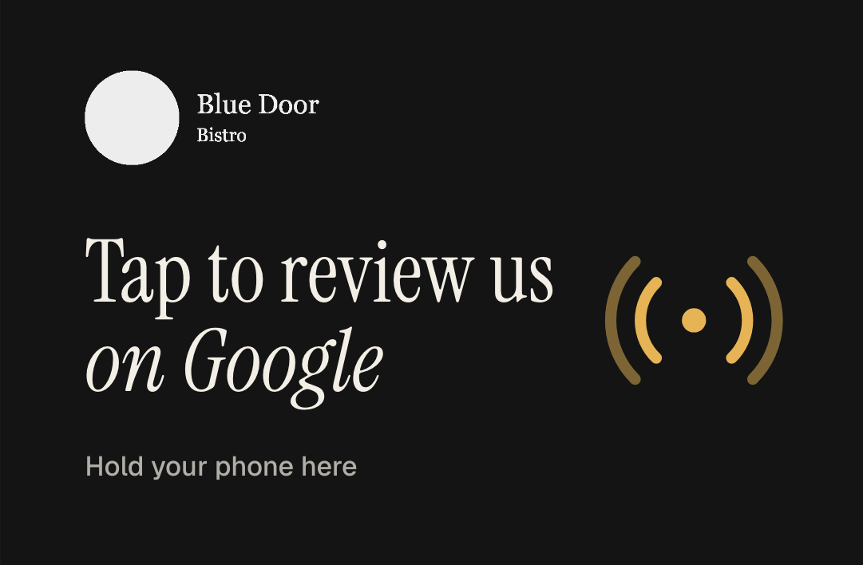
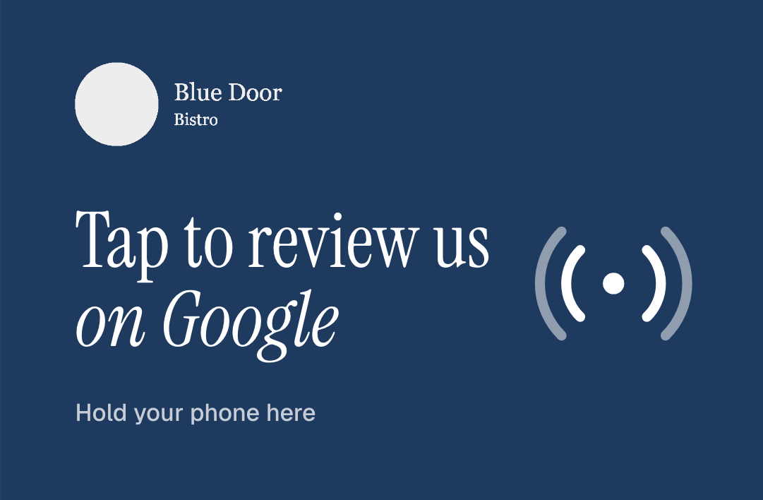
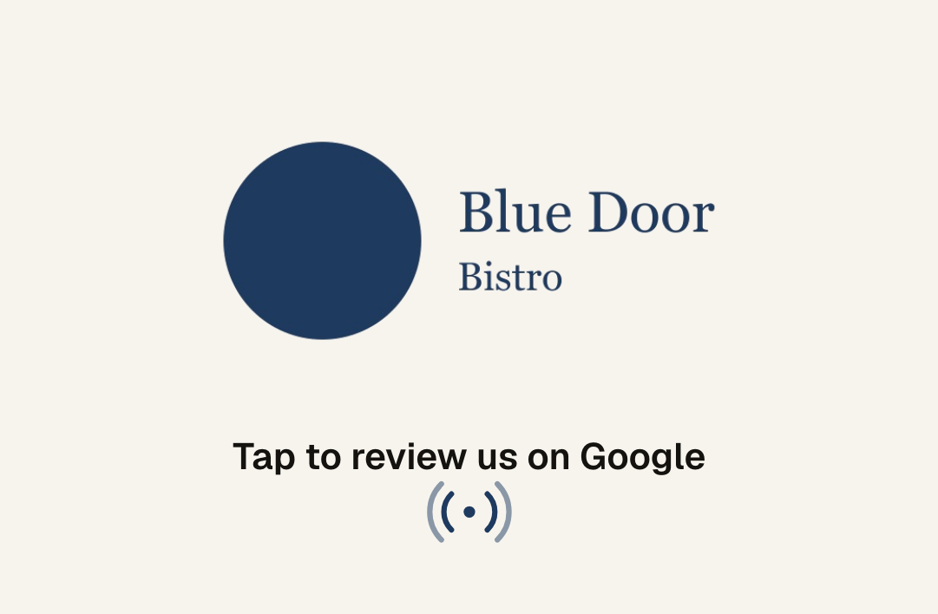
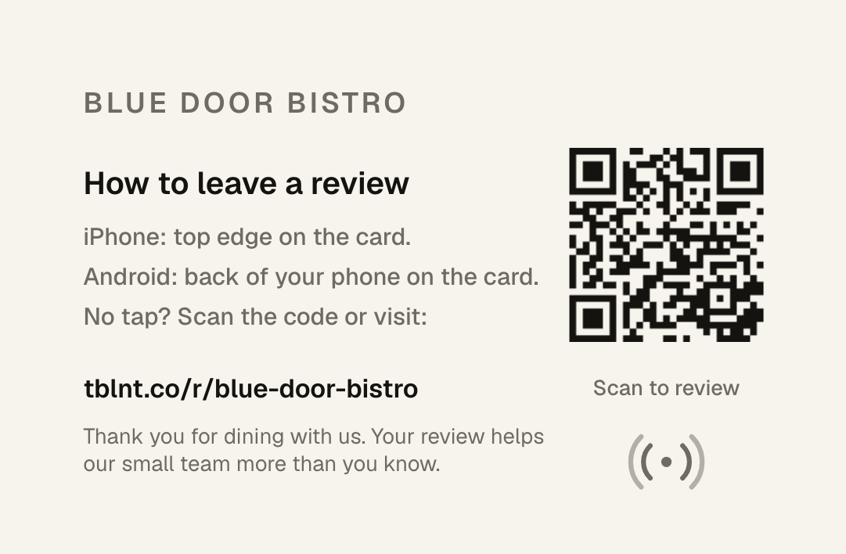
YOUR CARD
Looks like it belongs on your table.
Credit-card size, printed both sides, NFC inside and a QR code on the back. Pick one, or send us your own idea.
Classic
Noir
Brand color
Logo forward
The back explains the tap for iPhone and Android and carries a QR code for anyone without NFC. Every card points to a short link we manage, so if your Google listing ever changes, the cards keep working.
Tablenote
Prepared for Blue Door Bistro
Notes:
To show their logo: open /pitch on the website, upload the logo, Save preview as image, and paste that image over these card pictures. Hand them a printed sample card here.

Slide 7
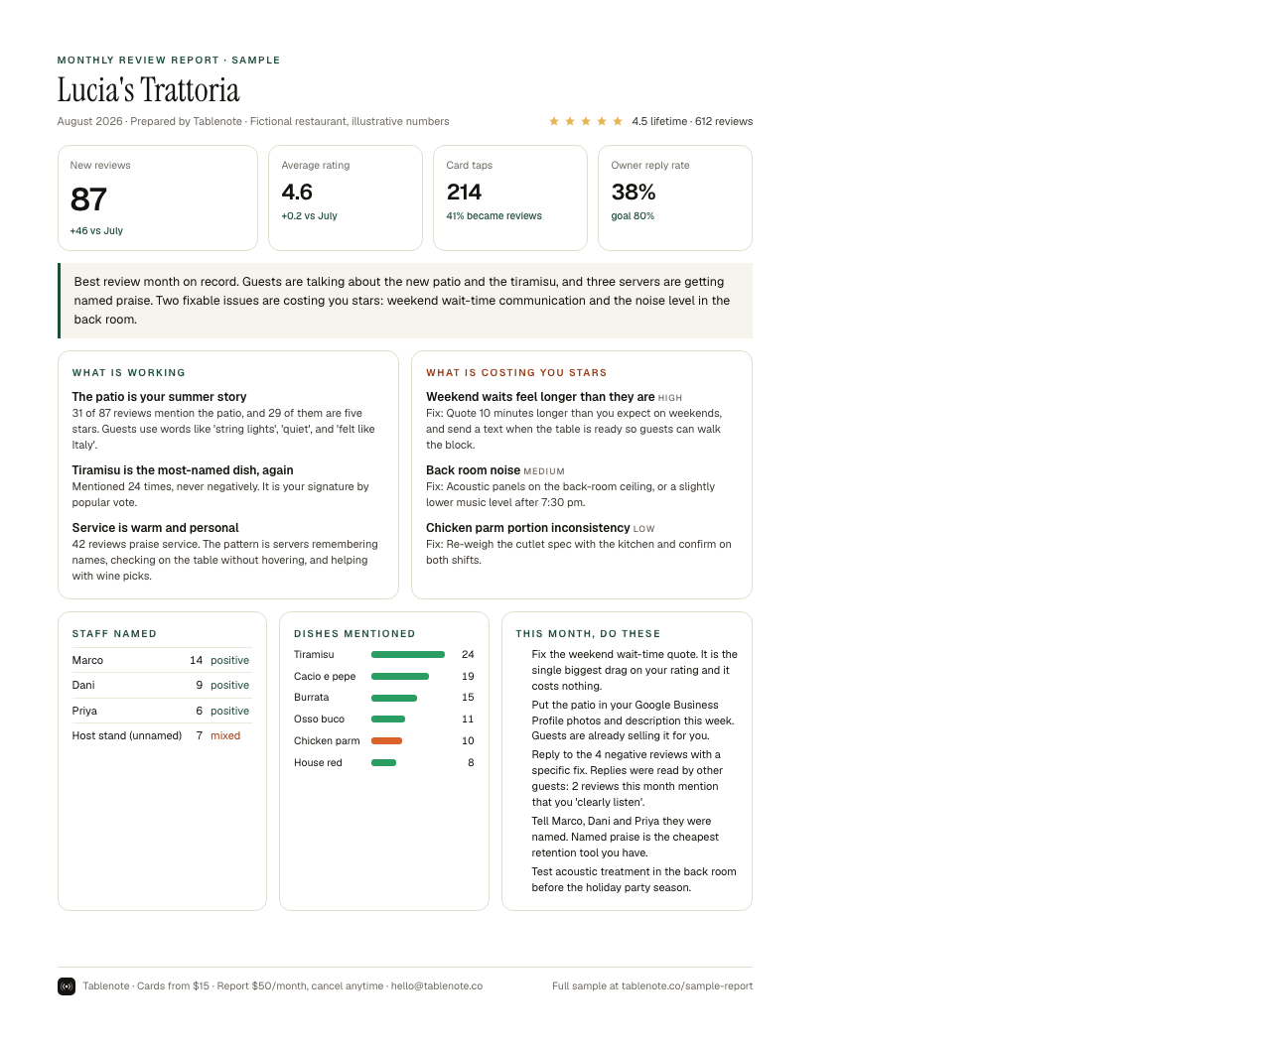
THE MONTHLY REPORT
What your guests are actually saying.
What guests love, ranked by how often it comes up
Complaints grouped by cause, each with a fix
Servers and dishes mentioned by name
Priority actions and drafted replies to negative reviews
10 free replacement cards every month
Tablenote
Prepared for Blue Door Bistro
Notes:
Hand over the printed one-page sample here. Point at the staff section and the priority actions.

Slide 8
PLAYING BY GOOGLE’S RULES
Every guest, the same card, the same ask.
Google removes reviews, and sometimes whole listings, when businesses cut corners. We built this to keep Blue Door Bistro safe.
We do
We never
Ask every table, the same way
Send every guest to the public Google page
Keep the ask optional, on the guest’s own phone
Report only what guests wrote themselves
Filter unhappy guests away from Google
Offer discounts or freebies for a review
Set review quotas for staff
Ask guests to name a server
Tablenote
Prepared for Blue Door Bistro
Notes:
This slide answers 'does Google penalize asking for reviews?' Asking is allowed. Gating, incentives, pressure on the premises, staff quotas and asking guests to name staff are not.

Slide 9
PRICING
Simple enough to explain to your accountant.
CARDS
MONTHLY REPORT
$15
per card, one time
$50
per month, cancel anytime
Your logo or one of four designs. Printed both sides. Yours to keep.
Every review read and summarized. 10 free replacement cards every month.
Start with 10 cards and the monthly report: $200 today, then $50 a month. Cancel anytime.
Tablenote
Prepared for Blue Door Bistro
Notes:
Edit the offer line for this restaurant. Do the math with their own numbers: $50 a month against what one extra table a week is worth to them.

Slide 10
NEXT STEP
Tap this card with your phone, Dana.
That is the whole guest experience. If it feels right, we can have cards with your logo on your tables in about three weeks.
Zay · Tablenote
hello@tablenote.co
Tablenote
Prepared for Blue Door Bistro
Notes:
Hand them the demo card and let them tap it with their own phone. Then stop talking.

