Slide 1
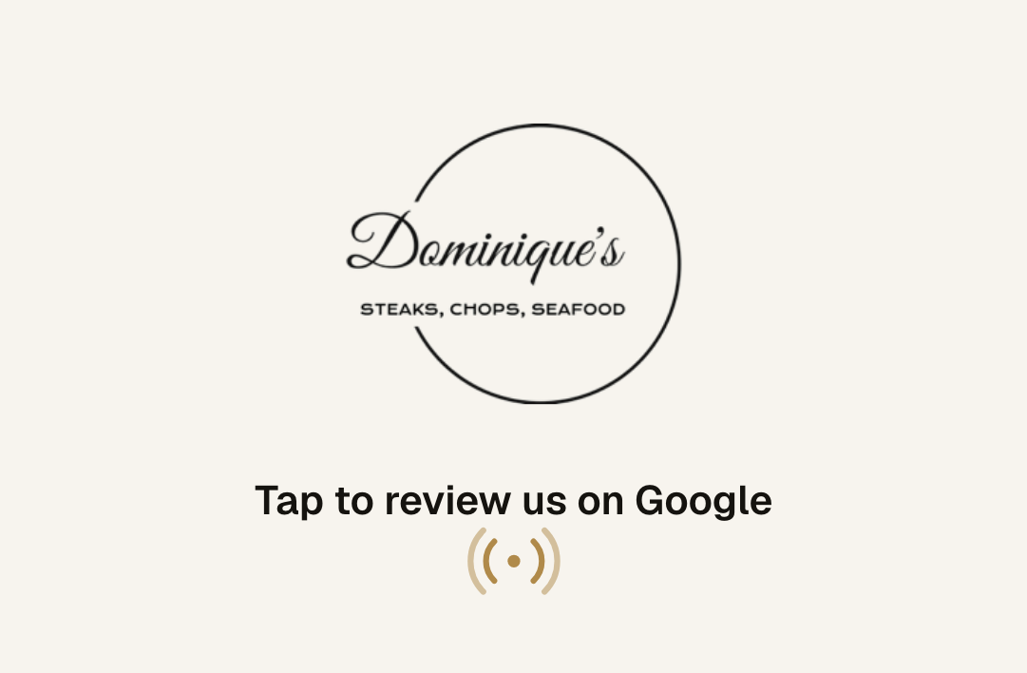
FOR DOMINIQUE'S · STONECREST, GA
The review your guests meant to leave.
A card your servers drop with the check. A monthly report on what guests are saying. Nothing for you to run.
Tablenote
Prepared for Dominique's
Notes:
HOW TO EDIT THIS DECK: replace the bracketed placeholders on slides 1, 2 and 9 ([Restaurant Name], [City], [Owner], [4.3], [58], [3 months ago]). To show their own logo on the cards, open the Pitch prep page on the website (/pitch), upload their logo, click "Save preview as image", and paste that image over the card pictures on slides 1, 5 and 9.
TALK TRACK: "Most of your guests never write a review. Not because they wouldn't, but because nobody asks at the right moment. This is the card that asks."

Slide 2
DOMINIQUE'S ON GOOGLE TODAY
Rating
Reviews
Most recent review
4.4
1,240
today, about 10 in the last 4 days
About 70 new Google reviews a month, 1,240 in total. The steak and seafood rooms you compete with are running two to three times that.
Only the delighted and the furious leave reviews on their own. Everyone else walks out with your best feedback.
Tablenote
Prepared for Dominique's
Notes:
Fill the three numbers from their Google listing before the visit. Say the most recent review date out loud; it is usually the moment they lean in.

Slide 3
WHAT YOUR GUESTS ALREADY SAY
We read your last reviews before we came in.
Guests praise
Comes up more than once
Dishes people name
Attentive servers who know the menu and recommend well
Seafood trio, rasta pasta and crab cakes cooked right
Elegant room chosen for date nights and birthdays
The Friday live band brings people back
Slow service and long waits for food
Inconsistent plates: overcooked fish, salty sides, dry chicken
Billing friction around automatic gratuity
Crab cakes with remoulade
Rasta pasta
Broiled seafood trio
Lamb chops
Calamari
A hand read of public Google reviews. The monthly report does this for every review, every month, with counts and fixes.
Tablenote
Prepared for Dominique's
Notes:
Quote one praise line back to them in their own guests' words. Then the complaint, gently: 'this came up three times in the last two months; the report would have flagged it in week one.'

Slide 4
WHY IT MATTERS
More reviews. Higher on the map. More walk-ins.
steakhouse stonecrest
Kampai Sushi & Steak
Google says it plainly: “More reviews and positive ratings can help your business’s local ranking.” Fresh, steady reviews are how you earn one of the three spots people actually tap.
3.7 ★★★★☆ (1912) · 0.2 mi, hibachi steakhouse
Rockin Crab Seafood & Bar
4.2 ★★★★☆ (1543) · 0.5 mi, Cajun seafood
Coaxum's Low Country Cuisine
97%
74%
47%
4.1 ★★★★☆ (2535) · 4.5 mi, Southern seafood, live jazz
Dominique's
YOU
of consumers read reviews for local businesses
look for reviews from the last three months
skip businesses with fewer than 20 reviews
4.4 ★★★★☆ (1,240) · Last review today, about 10 in the last 4 days
Ratings and counts from Google, checked before this visit. Map position also depends on relevance and distance.
Google Business Profile Help; BrightLocal Local Consumer Review Survey 2026.
Tablenote
Prepared for Dominique's
Notes:
Do not promise revenue. The Google sentence is a direct quote from Google's help page on local ranking. The map is an illustration.

Slide 5
THE GAP
The rooms you compete with are getting three times the reviews.
RESTAURANTS PEOPLE KEEP FINDING
DOMINIQUE'S TODAY
STK Steakhouse, Midtown
219
about 70
reviews a month
counted from your timestamped reviews, Aug 13 to Sep 5
Upscale steakhouse · 25,120 reviews · 4.6
reviews a month
Atlanta Fish Market, Buckhead
119
1,240 reviews in total, against 10,000 to 25,000 at the rooms above
Your reviews arrive in clusters on a few nights, so the ask is not reaching every table
Nothing tells you what a month of reviews added up to
Upscale seafood · 10,314 reviews · 4.6
reviews a month
Fogo de Chão, Buckhead
94
Brazilian steakhouse · 15,905 reviews · 4.7
Counted over the same 30 days, Aug 6 to Sep 5 2026, from timestamped Google reviews. These are larger rooms, so part of the gap is seats, not asking.
reviews a month
WHAT CHANGES
Every table gets the same ask, on the guest’s own phone, at the moment they are happiest.
Every new review read and summarized once a month, with the complaints counted.
Replies drafted for the reviews that need one, so none of them sit unanswered.
Tablenote
Prepared for Dominique's
Notes:
Read the three numbers on the left, then their own. If they say those rooms are bigger, agree: part of the gap is seats. The card is the lever a smaller room controls, because it raises the share of guests who leave a review.

Slide 6
HOW IT WORKS
Three steps. One new habit.
01
02
03
Server drops the card with the check
Guest taps, the review screen opens
You get the report every month
It lives in the check presenter. One optional line, then walk away.
iPhone or Android, no app. A link pops up, they tap it, your Google review form opens. About a minute.
Every new review read and summarized: what guests love, what to fix, who got named, drafted replies.
Tablenote
Prepared for Dominique's
Notes:
If they ask about older iPhones: iPhone 7, 8 and X need the NFC reader in Control Center; the QR code on the back covers everyone else.

Slide 7

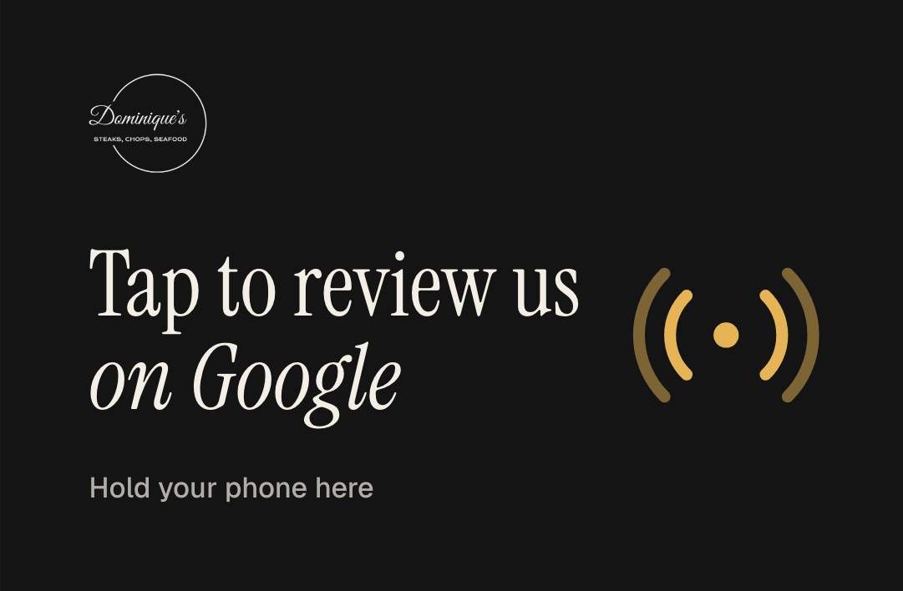

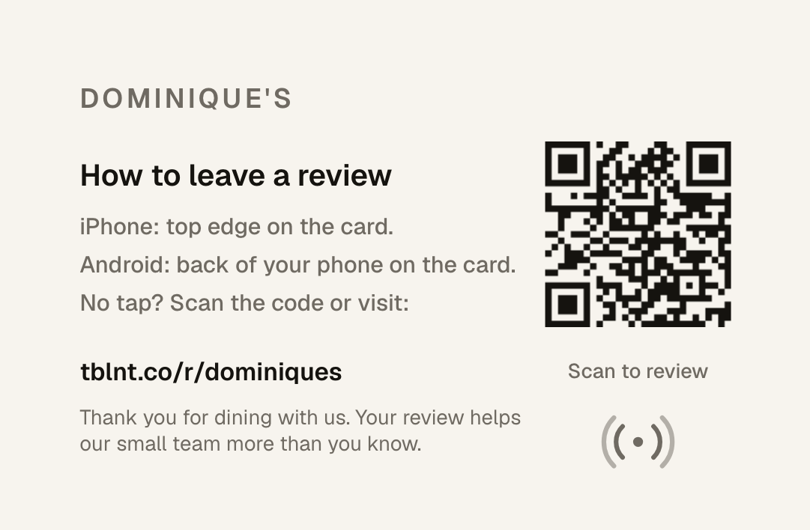
YOUR CARD
Looks like it belongs on your table.
Credit-card size, printed both sides, NFC inside and a QR code on the back. Pick one, or send us your own idea.
Classic
Noir
Brand color
Logo forward
The back explains the tap for iPhone and Android and carries a QR code for anyone without NFC. Every card points to a short link we manage, so if your Google listing ever changes, the cards keep working.
Tablenote
Prepared for Dominique's
Notes:
To show their logo: open /pitch on the website, upload the logo, Save preview as image, and paste that image over these card pictures. Hand them a printed sample card here.

Slide 8
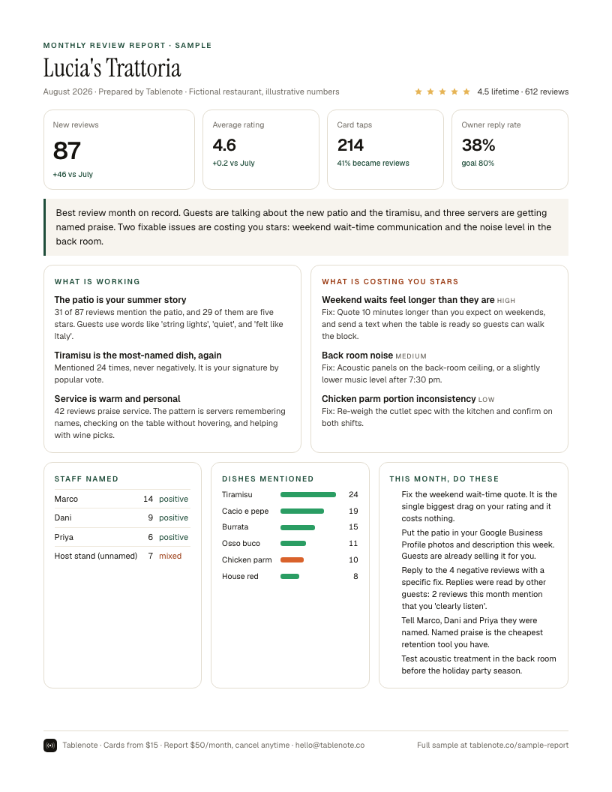
THE MONTHLY REPORT
What your guests are actually saying.
What guests love, ranked by how often it comes up
Complaints grouped by cause, each with a fix
Servers and dishes mentioned by name
Priority actions and drafted replies to negative reviews
10 free replacement cards every month
Tablenote
Prepared for Dominique's
Notes:
Hand over the printed one-page sample here. Point at the staff section and the priority actions.

Slide 9
IN YOUR INBOX
This is what arrives on the first of the month.
One page you can read standing up, plus the full report
Every new review read, grouped by what guests kept saying
Each complaint with a fix, ranked by what costs you most
Dishes and servers guests named, counted
Replies drafted for the reviews that need one
Example from another restaurant, so you can see the format. Yours is built from your own Google reviews.
Tablenote
Prepared for Dominique's
Notes:
Hand them the printed one-pager here and let them hold it while you talk.

Slide 10
PRICING
Simple enough to explain to your accountant.
CARDS
MONTHLY REPORT
$15
per card, one time
$50
per month, cancel anytime
Your logo or one of four designs. Printed both sides. Yours to keep.
Every review read and summarized. 10 free replacement cards every month.
Start with 10 cards and the monthly report: $200 today, then $50 a month. Cancel anytime.
Tablenote
Prepared for Dominique's
Notes:
Edit the offer line for this restaurant. Do the math with their own numbers: $50 a month against what one extra table a week is worth to them.

Slide 11
NEXT STEP
Tap this card with your phone.
That is the whole guest experience. If it feels right, we can have cards with your logo on your tables in about three weeks.
Zay · Tablenote
hello@tablenote.co
Tablenote
Prepared for Dominique's
Notes:
Hand them the demo card and let them tap it with their own phone. Then stop talking.

