Slide 1
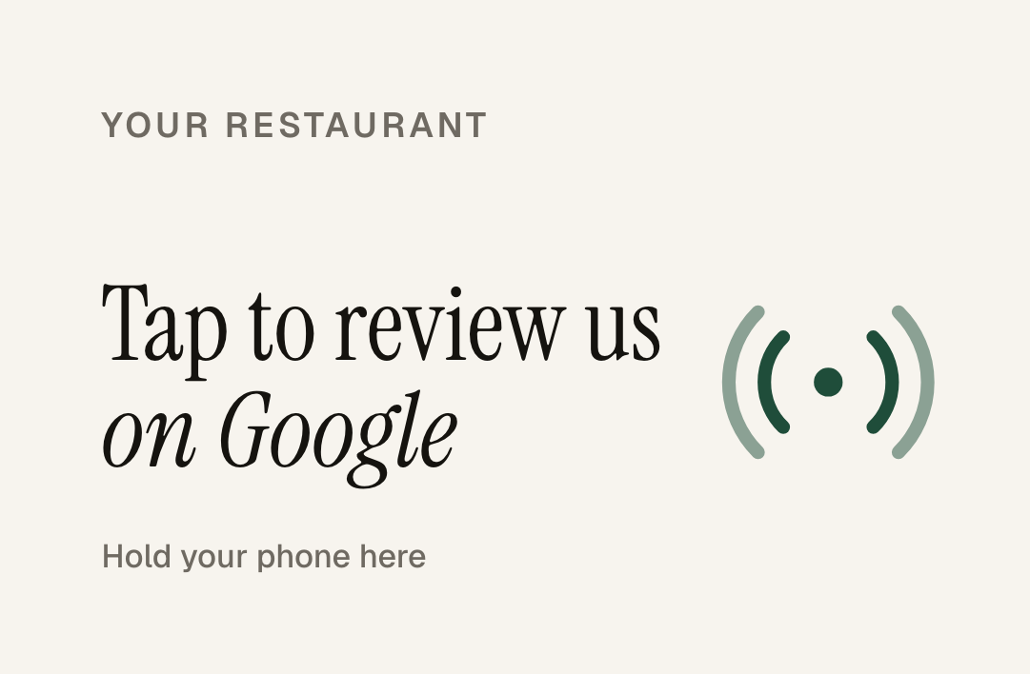
FOR [RESTAURANT NAME] · [CITY]
The review your guests meant to leave.
A card your servers drop with the check. A monthly report on what guests are saying. Nothing for you to run.
Tablenote
Prepared for [Restaurant Name]
Notes:
HOW TO EDIT THIS DECK: replace the bracketed placeholders on slides 1, 2 and 9 ([Restaurant Name], [City], [Owner], [4.3], [58], [3 months ago]). To show their own logo on the cards, open the Pitch prep page on the website (/pitch), upload their logo, click "Save preview as image", and paste that image over the card pictures on slides 1, 5 and 9.
TALK TRACK: "Most of your guests never write a review. Not because they wouldn't, but because nobody asks at the right moment. This is the card that asks."

Slide 2
[RESTAURANT NAME] ON GOOGLE TODAY
Rating
Reviews
Most recent review
[4.3]
[58]
[3 months ago]
Only the delighted and the furious leave reviews on their own. Everyone else walks out with your best feedback.
Most of your regulars have never written a word about you. Not because they would not, but because nobody asked at the right moment.
Tablenote
Prepared for [Restaurant Name]
Notes:
Fill the three numbers from their Google listing before the visit. Say the most recent review date out loud; it is usually the moment they lean in.

Slide 3
WHY IT MATTERS
More reviews. Higher on the map. More walk-ins.
dinner near me
Trattoria on Fifth
Google says it plainly: “More reviews and positive ratings can help your business’s local ranking.” Fresh, steady reviews are how you earn one of the three spots people actually tap.
4.3 ★★★★☆ (58) · Last review 3 months ago
[Restaurant Name]
YOU
4.6 ★★★★★ (612) · 87 reviews last month
97%
74%
47%
Nonna's Kitchen
4.4 ★★★★☆ (131) · Last review 5 weeks ago
of consumers read reviews for local businesses
look for reviews from the last three months
skip businesses with fewer than 20 reviews
Illustration. Positions on the map depend on relevance, distance and prominence.
Google Business Profile Help; BrightLocal Local Consumer Review Survey 2026.
Tablenote
Prepared for [Restaurant Name]
Notes:
Do not promise revenue. The Google sentence is a direct quote from Google's help page on local ranking. The map is an illustration.

Slide 4
HOW IT WORKS
Three steps. One new habit.
01
02
03
Server drops the card with the check
Guest taps, the review screen opens
You get the report every month
It lives in the check presenter. One optional line, then walk away.
iPhone or Android, no app. A link pops up, they tap it, your Google review form opens. About a minute.
Every new review read and summarized: what guests love, what to fix, who got named, drafted replies.
Tablenote
Prepared for [Restaurant Name]
Notes:
If they ask about older iPhones: iPhone 7, 8 and X need the NFC reader in Control Center; the QR code on the back covers everyone else.

Slide 5
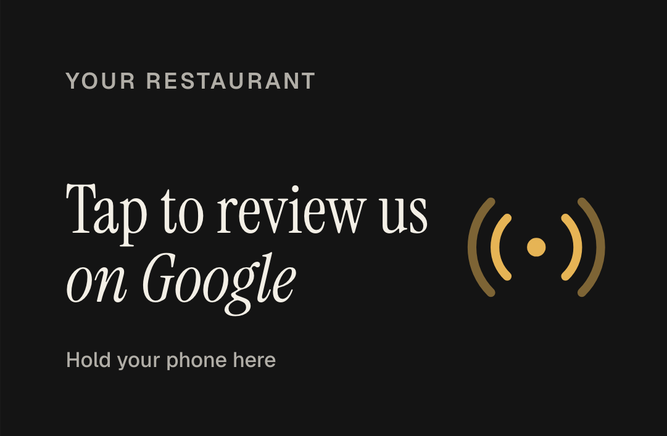
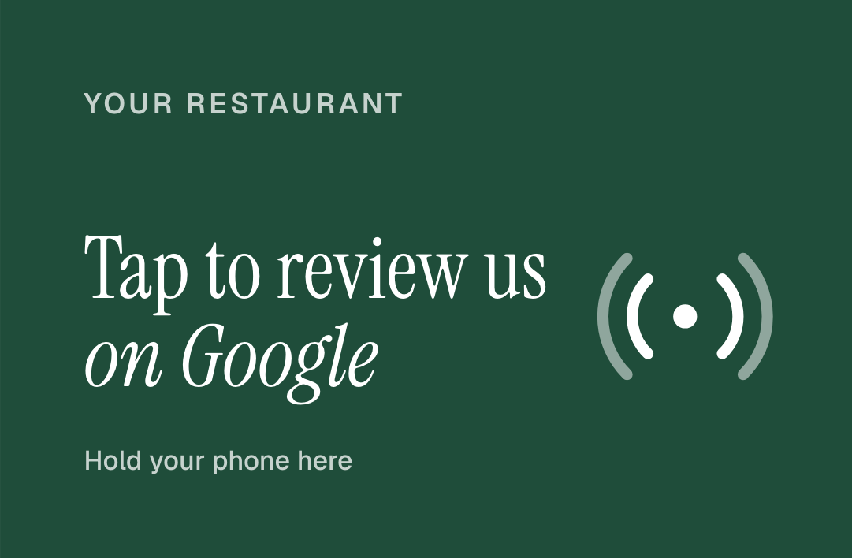
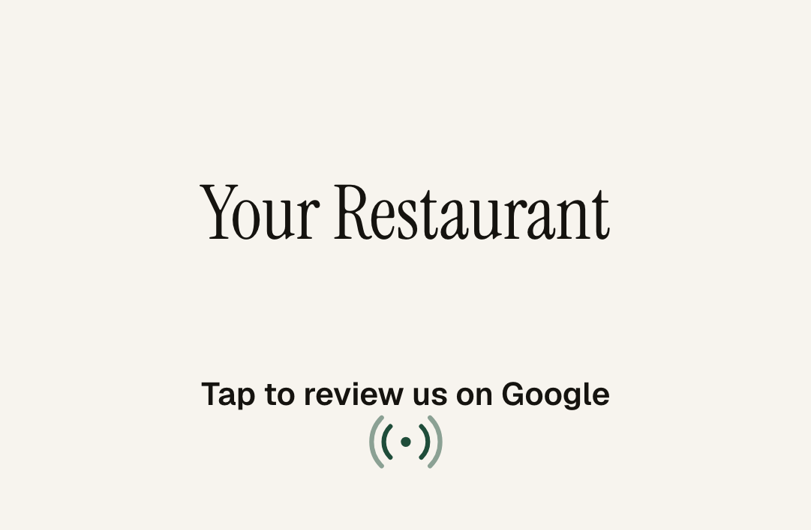
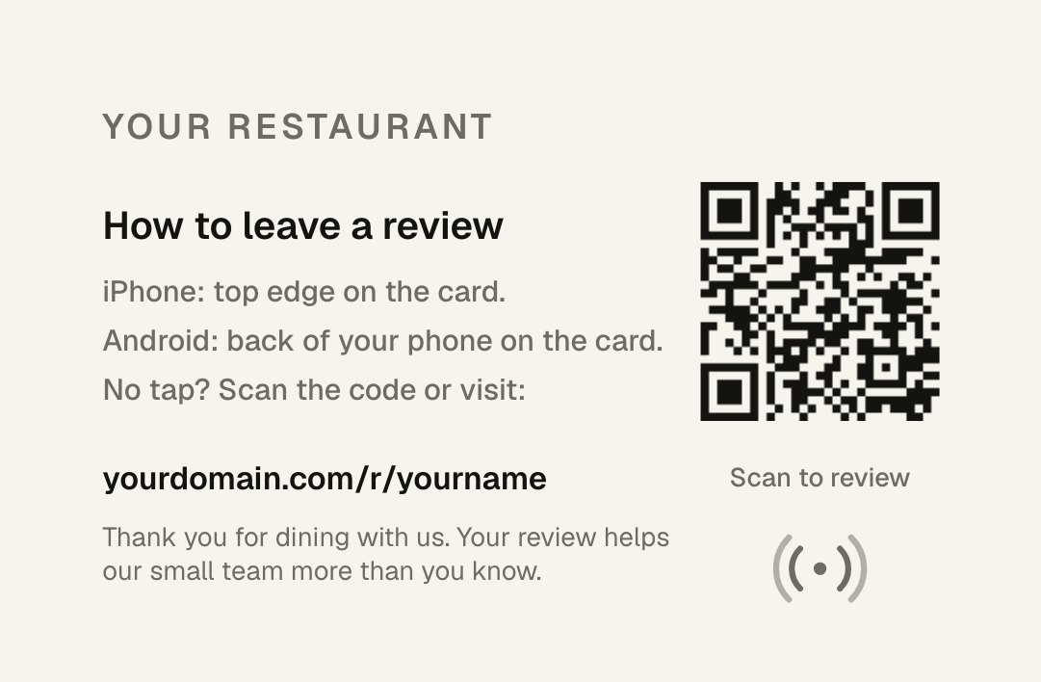
YOUR CARD
Looks like it belongs on your table.
Credit-card size, printed both sides, NFC inside and a QR code on the back. Pick one, or send us your own idea.
Classic
Noir
Brand color
Logo forward
The back explains the tap for iPhone and Android and carries a QR code for anyone without NFC. Every card points to a short link we manage, so if your Google listing ever changes, the cards keep working.
Tablenote
Prepared for [Restaurant Name]
Notes:
To show their logo: open /pitch on the website, upload the logo, Save preview as image, and paste that image over these card pictures. Hand them a printed sample card here.

Slide 6
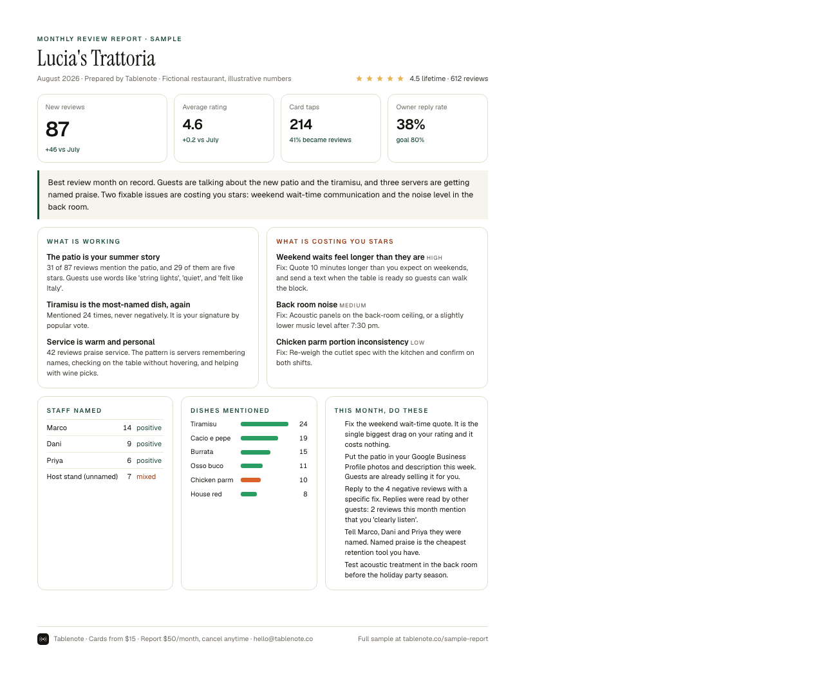
THE MONTHLY REPORT
What your guests are actually saying.
What guests love, ranked by how often it comes up
Complaints grouped by cause, each with a fix
Servers and dishes mentioned by name
Priority actions and drafted replies to negative reviews
10 free replacement cards every month
Tablenote
Prepared for [Restaurant Name]
Notes:
Hand over the printed one-page sample here. Point at the staff section and the priority actions.

Slide 7
PLAYING BY GOOGLE’S RULES
Every guest, the same card, the same ask.
Google removes reviews, and sometimes whole listings, when businesses cut corners. We built this to keep [Restaurant Name] safe.
We do
We never
Ask every table, the same way
Send every guest to the public Google page
Keep the ask optional, on the guest’s own phone
Report only what guests wrote themselves
Filter unhappy guests away from Google
Offer discounts or freebies for a review
Set review quotas for staff
Ask guests to name a server
Tablenote
Prepared for [Restaurant Name]
Notes:
This slide answers 'does Google penalize asking for reviews?' Asking is allowed. Gating, incentives, pressure on the premises, staff quotas and asking guests to name staff are not.

Slide 8
PRICING
Simple enough to explain to your accountant.
CARDS
MONTHLY REPORT
$15
per card, one time
$50
per month, cancel anytime
Your logo or one of four designs. Printed both sides. Yours to keep.
Every review read and summarized. 10 free replacement cards every month.
Start with 10 cards and the monthly report: $200 today, then $50 a month. Cancel anytime.
Tablenote
Prepared for [Restaurant Name]
Notes:
Edit the offer line for this restaurant. Do the math with their own numbers: $50 a month against what one extra table a week is worth to them.

Slide 9
NEXT STEP
Tap this card with your phone, [Owner].
That is the whole guest experience. If it feels right, we can have cards with your logo on your tables in about three weeks.
Zay · Tablenote
hello@tablenote.co
Tablenote
Prepared for [Restaurant Name]
Notes:
Hand them the demo card and let them tap it with their own phone. Then stop talking.

