Slide 1
The Goal of the Project
A web application (with user interface and server/backend) that displays the database information
Allow sorting of particular fields
Allow for modification of the database itself
Used a DBMS to store the information from the spreadsheets
A login page to ensure they have authority to edit the database
A friendly and simple user interface

Slide 2


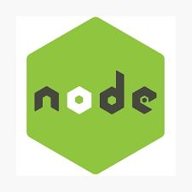


What we used to create the project
Reactjs
Nodejs
Local Security
MySQL
The front end(the visuals that the client sees)
The backend (the server-side web application)
The login page that appears before you have access to the database
The database (where all the information is stored)

Slide 3
Reactjs
What is it?
Why use it?
Reactjs is a JavaScript framework that is used to build interactive user interfaces. In our case, it displays everything that the user sees.
React uses a single page application which is better for data-driven websites and often is more efficient than simply using JavaScript.

Slide 4

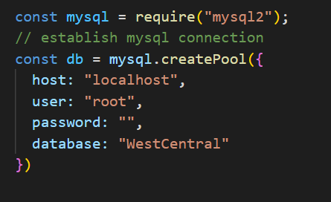
Nodejs
We use Nodejs and ExpressJS to collect data and to handle the heavy lifting of querying the database.

Slide 5
MySQL
MySQL is a database management system. Their databases are relational, meaning that they store data in separate tables rather than in one big table. This is good for scalability as more tables may be needed in the future.

Slide 6
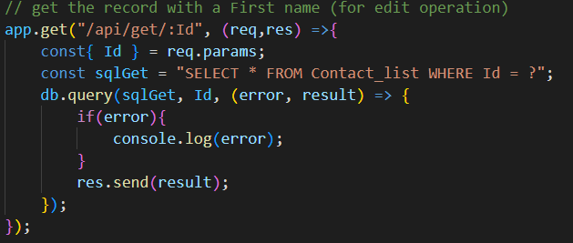

MySQL
Reactjs
React makes fetching data from the database easy. This uses a GET request to access the record for a given ID.

Slide 7
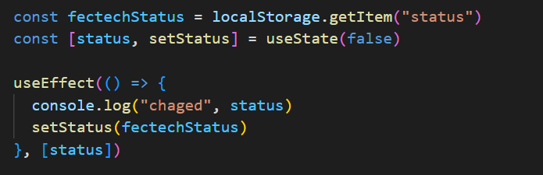
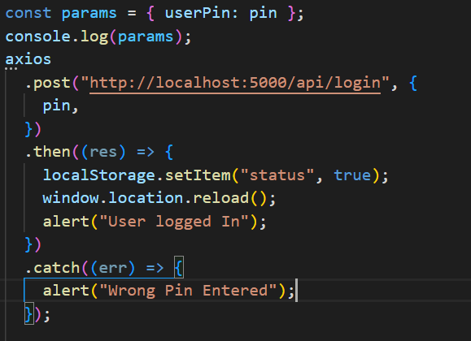
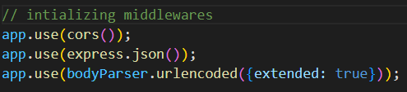
Integration
React
Middleware
Axios
React allows for the use of states and components making it easier and more efficient to display components to the browser.
Middleware is how different applications speak to one another. Nodejs uses this to interact with the Database and the frontend
Axios is a third-party HTTP client library for making network requests. Its similar to the native fetch API but easier to work with.

Slide 8
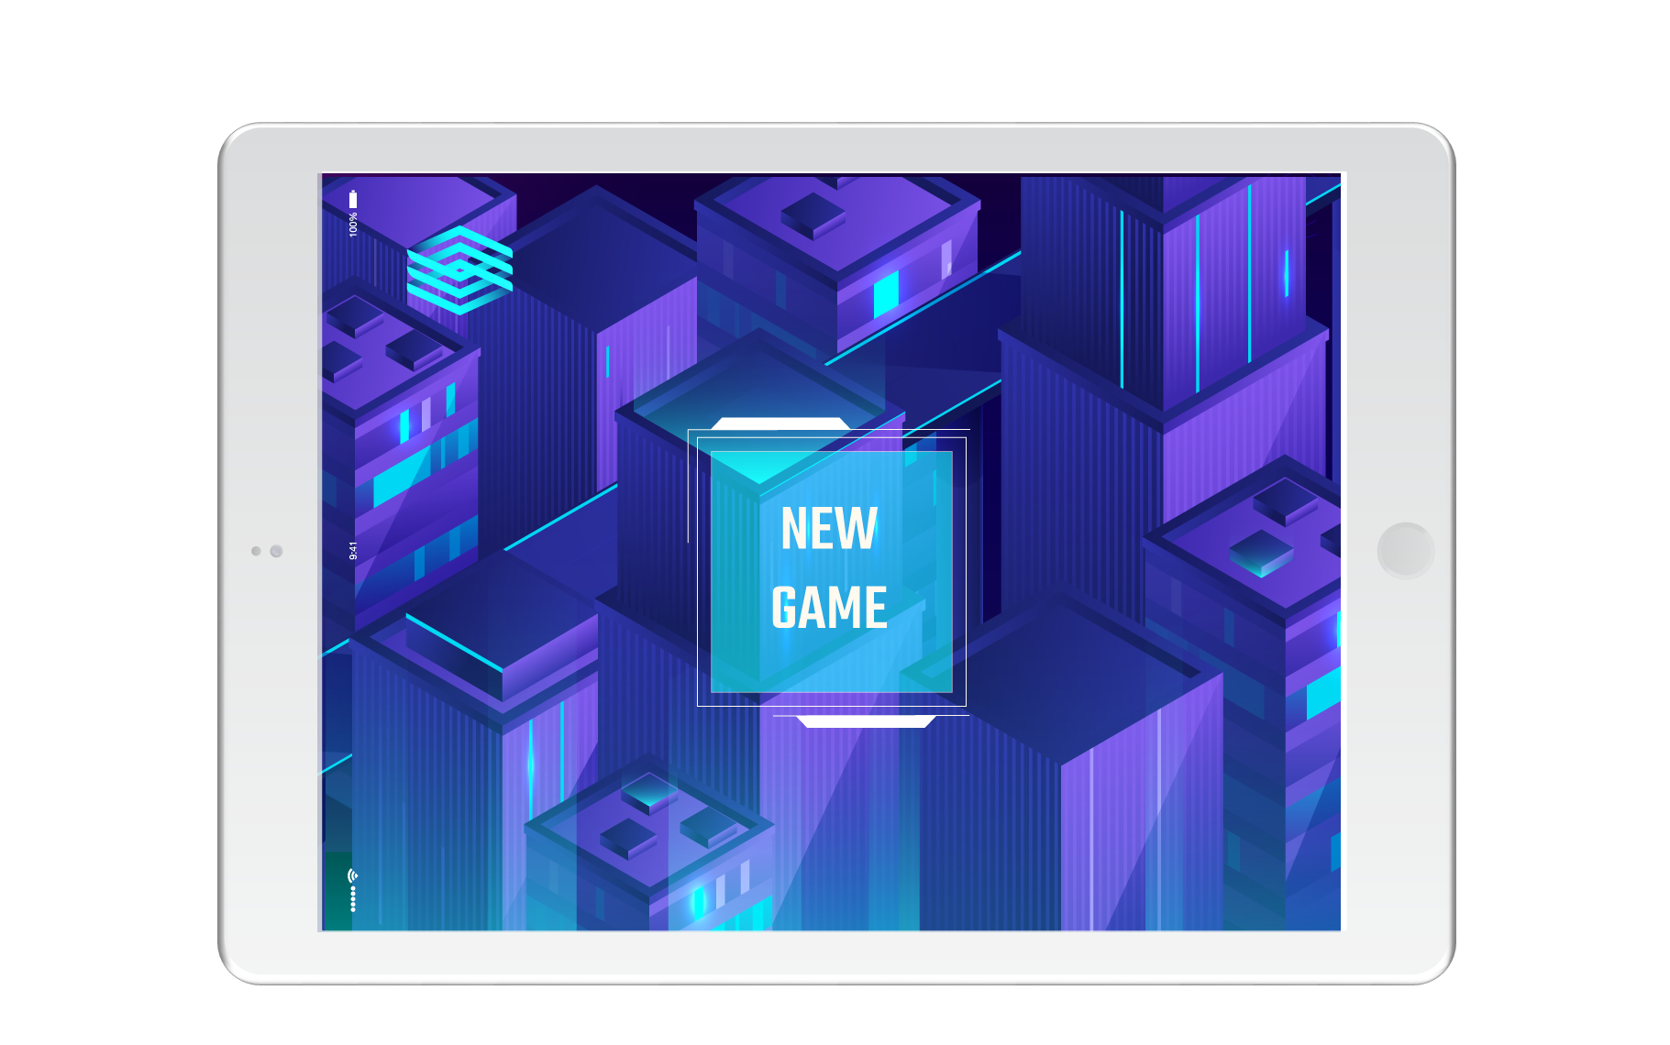
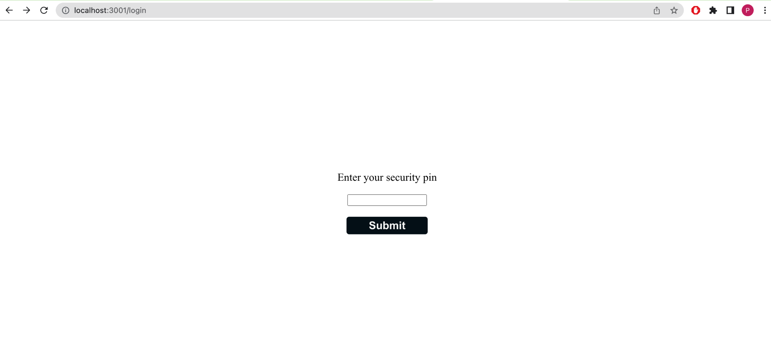
The Login Page

Slide 9
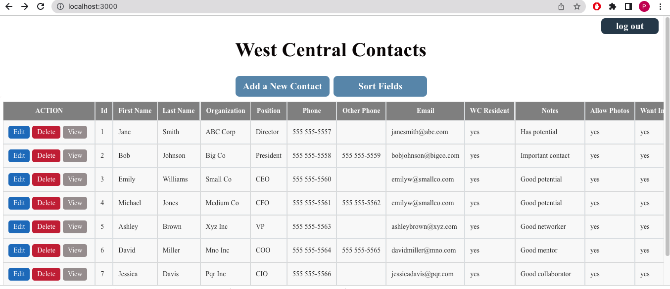
The Main Page

Slide 10
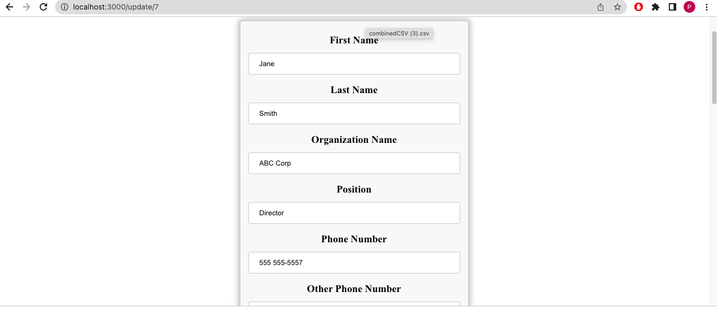
Editing Page

Slide 11
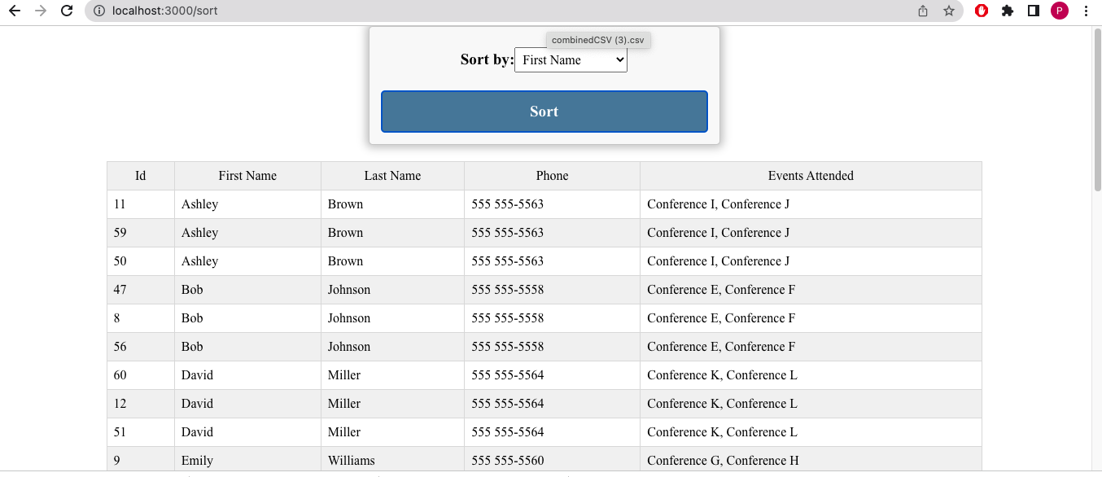
Sorting Page

Slide 12

Why MySQL instead of other Database Management Systems?
#1
MySQL provides strong data protection, ensuring the security of your data
#2
MySQL’s scalability allows it to support large databases
#3
Our group has already had experience with MySQL

Slide 13
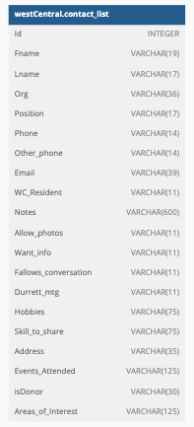
A Diagram of our MySQL Table

Slide 14
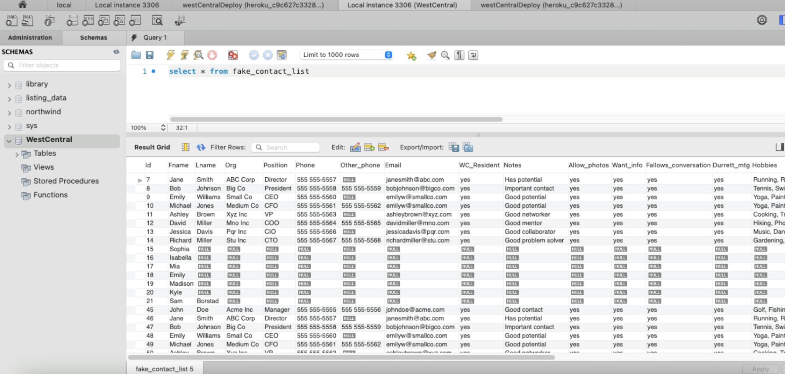
An example of MySQL Table (fake data )

Slide 15
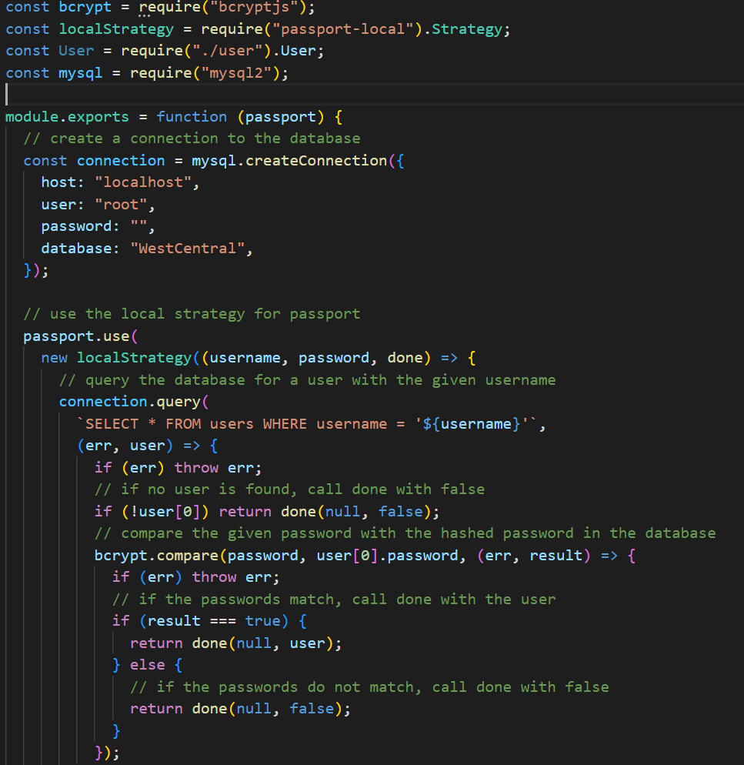
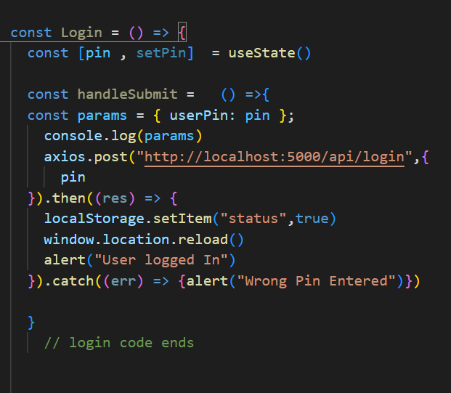
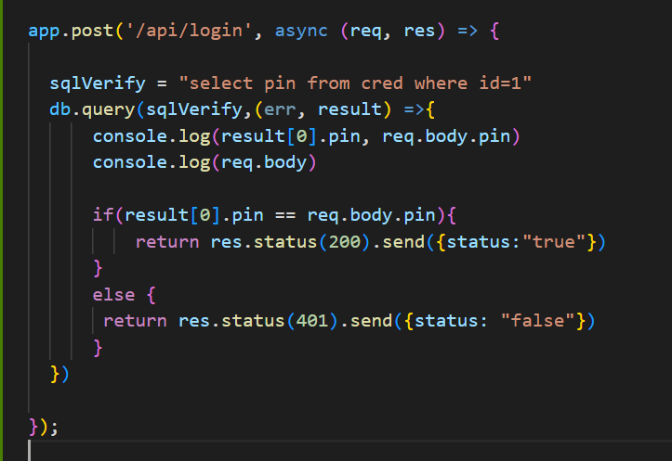
PassportJs vs Local Security
PassportJS - Very complex
Our Solution - Simple and Effective

Slide 16


The deployment
Heroku - Heroku is a Paas that enables developers easily deploy and run
Applications in many languages. It has a large system of add-ons and services.
Netlify - A platform for building and deploying web applications. Provides
Simple and intuitive workflow. Great performance and security. Free
Subdomains.

Slide 17
Ease of Maintenance
The database will be maintained by the client using the application (allows for delete/edit/add operations for data storage)
Edits to the application itself unfortunately will require a lot of work. Adding a new column for example will require changing multiple .js files to account for the new inputs.

Slide 18
Future Improvements
Create a search bar
Create a better way to verify the user
Have the sort be a part of the main page instead of a separate page
Have the application be mobile friendly

