Slide 1


TN-IMPACT 2026
IDENTIFYING INDUSTRIAL CHALLENGES
PROBLEM STATEMENT NUMBER :
PROBLEM STATEMENT TITLE :

Slide 2
Team details
Team Name :
College Mentor Name :
College Name:
S.NO | STUDENT NAME | SEMESTER | DEPARTMENT

Slide 3
Problem statement
Medical insurance claims processing is slow, opaque, and error-prone. Patients and providers face manual data entry from prescriptions, discharge summaries, and bills into insurer portals, followed by repeated back-and-forth clarifications. This delays payments, increases administrative overhead, and leaves all stakeholders with limited visibility into claim status, coverage reasoning, and denial causes. There is no trustless verification mechanism — patients must rely entirely on the insurer's word for what happened and when.

Slide 4
Problem description
Current Pain Points:
Hospital staff manually reads discharge summaries, bills, and prescriptions, then re-enters data into insurer systems — slow and error-prone
Policy coverage rules (room rent caps, waiting periods, co-pays, exclusions) are buried in dense documents — manual interpretation leads to incorrect claim submissions
Patients have zero visibility into why a claim was partially approved, queried, or denied
No tamper-proof audit trail exists — claim status changes are opaque and disputable
Fraud detection relies on manual review of high volumes of claims, missing subtle patterns
Scale of the Problem:
India processes over 1.5 crore health insurance claims annually. Manual processing takes 15-30 days on average. Up to 30% of claims face queries or rejections due to incomplete documentation or policy mismatches — most of which are preventable with intelligent pre-validation.

Slide 5
Objectives
Automate Document Intake — Use OCR + NLP (Tesseract, spaCy) to extract structured data from medical documents (discharge summaries, hospital bills, prescriptions) with confidence scoring
Intelligent Policy Validation — Deploy an Agentic RAG pipeline (LangGraph + ChromaDB) that retrieves relevant policy clauses and generates natural-language coverage verdicts with co-pay, exclusion, and waiting period analysis
Blockchain-Backed Transparency — Record cryptographic proofs (Merkle roots of document hashes + AI verdicts) on Ethereum Sepolia, giving patients a tamper-proof, publicly verifiable claim timeline
Dual-Portal Experience — Build separate Customer and Insurer portals so both sides of the claim lifecycle are visible: patients track status in real-time, insurers review AI-summarized claims with fraud risk indicators
Fraud Risk Detection — Flag anomalies (unusually high bills, short stays with expensive procedures, missing documents) with rule-based scoring to assist Special Investigation Unit (SIU) teams

Slide 6
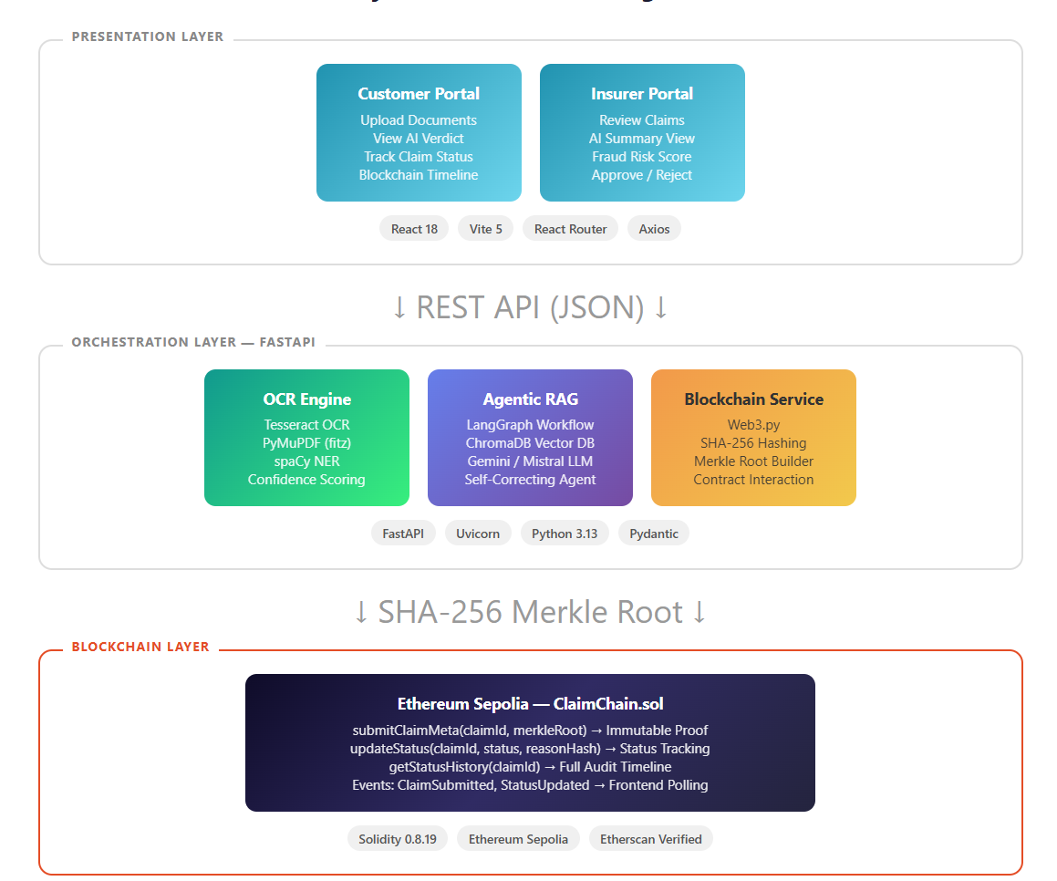
Solution Architecture

Slide 8
Findings

Slide 9
Conclusion

