Slide 1
TEAM CHAPERONE
E-TRANS
IDEA : An easy way to make payments (shopping) using QR code.

Slide 2



2.Scan QR Code
Of item
4.Scan QR Code Of vendor
3.Add to cart
USER
User’s Device
Item
Cart
QR Code
Vendor’s Device
10.Confirmation
to vendor’s
app
6.Send details to user’s bank
5.Get encrypted account number
8.Transaction details
Bank
Bank
7.Details to gateway
9.Details from
gateway
Payment Gateway

Slide 3
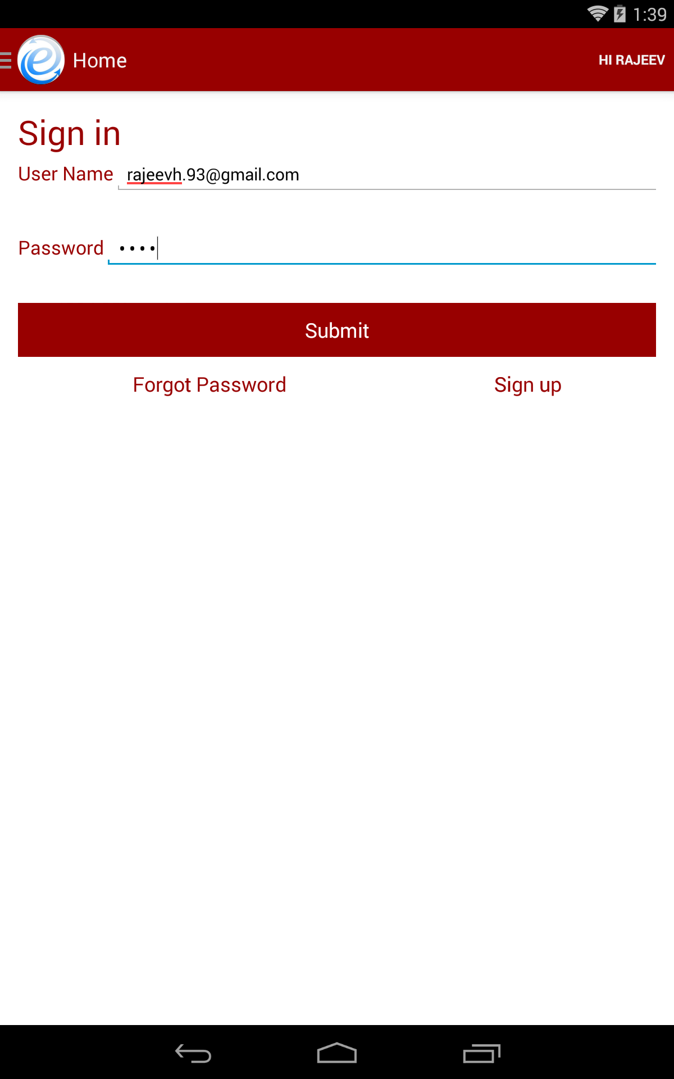
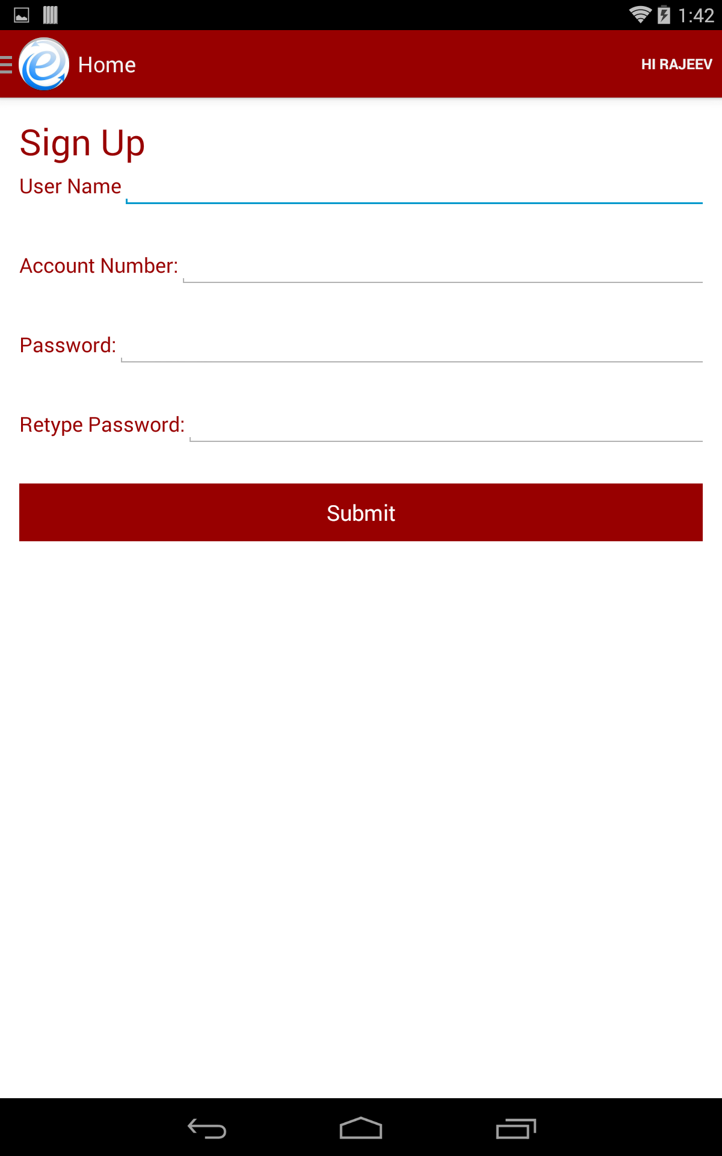

Slide 4
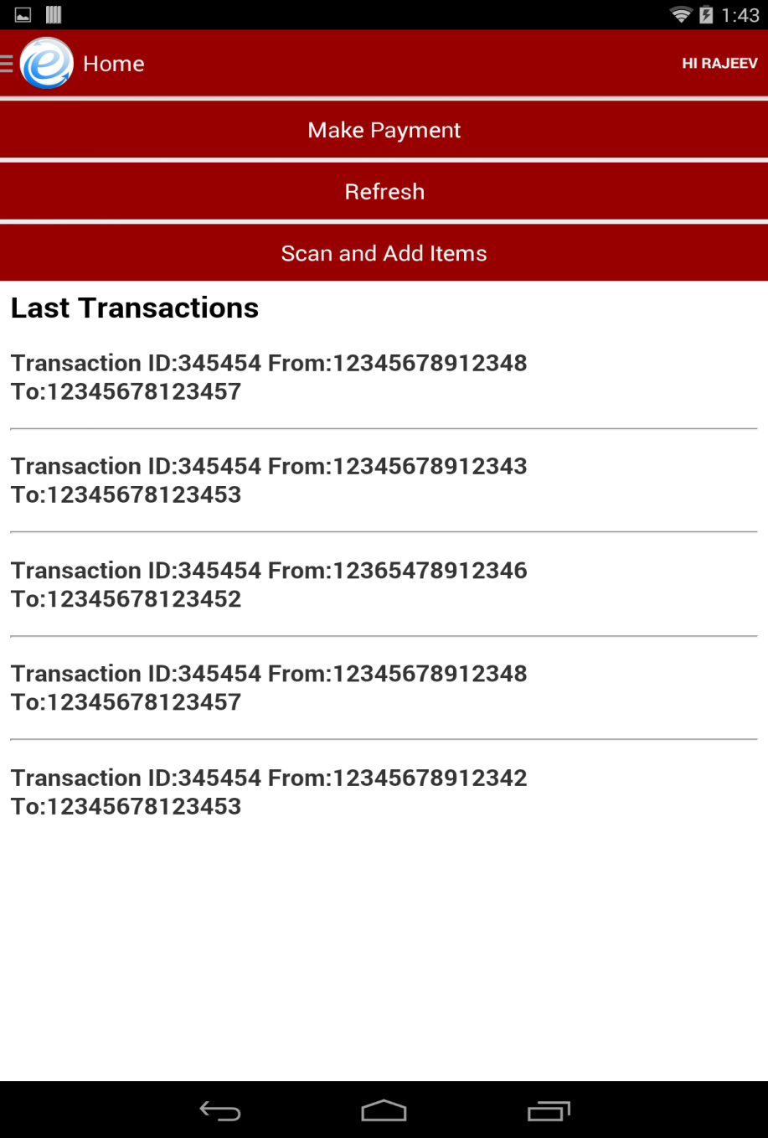
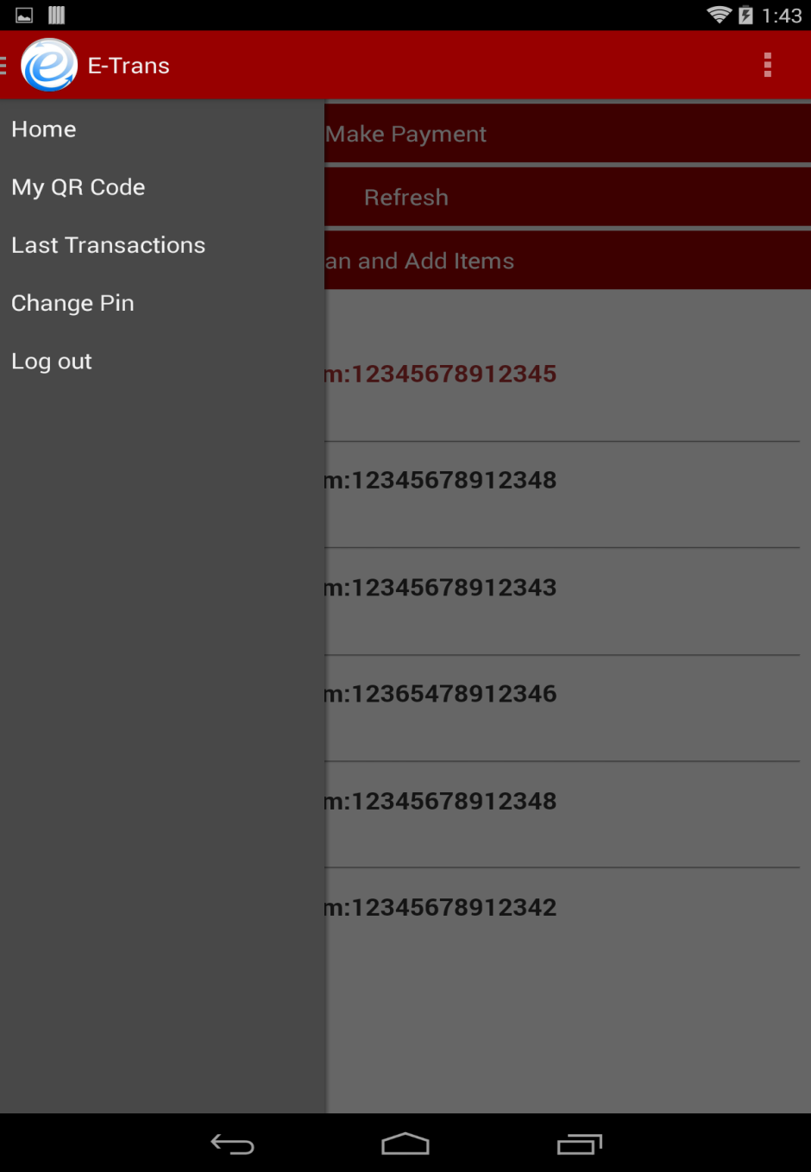

Slide 5
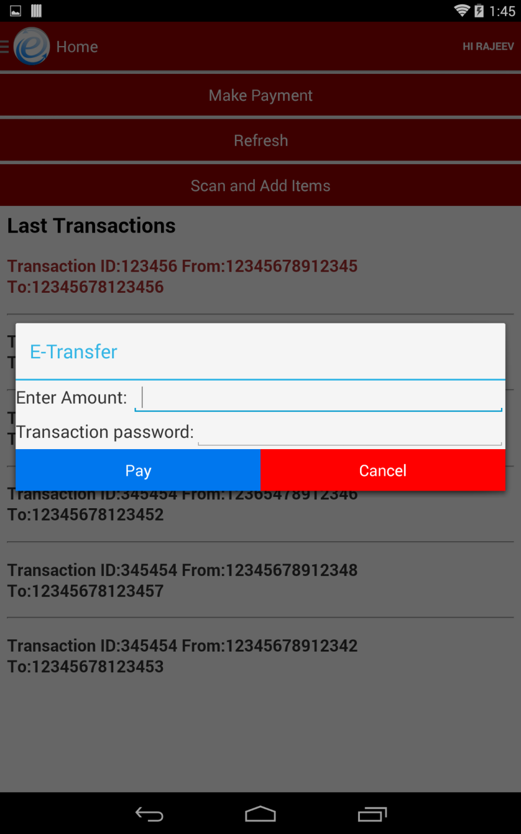
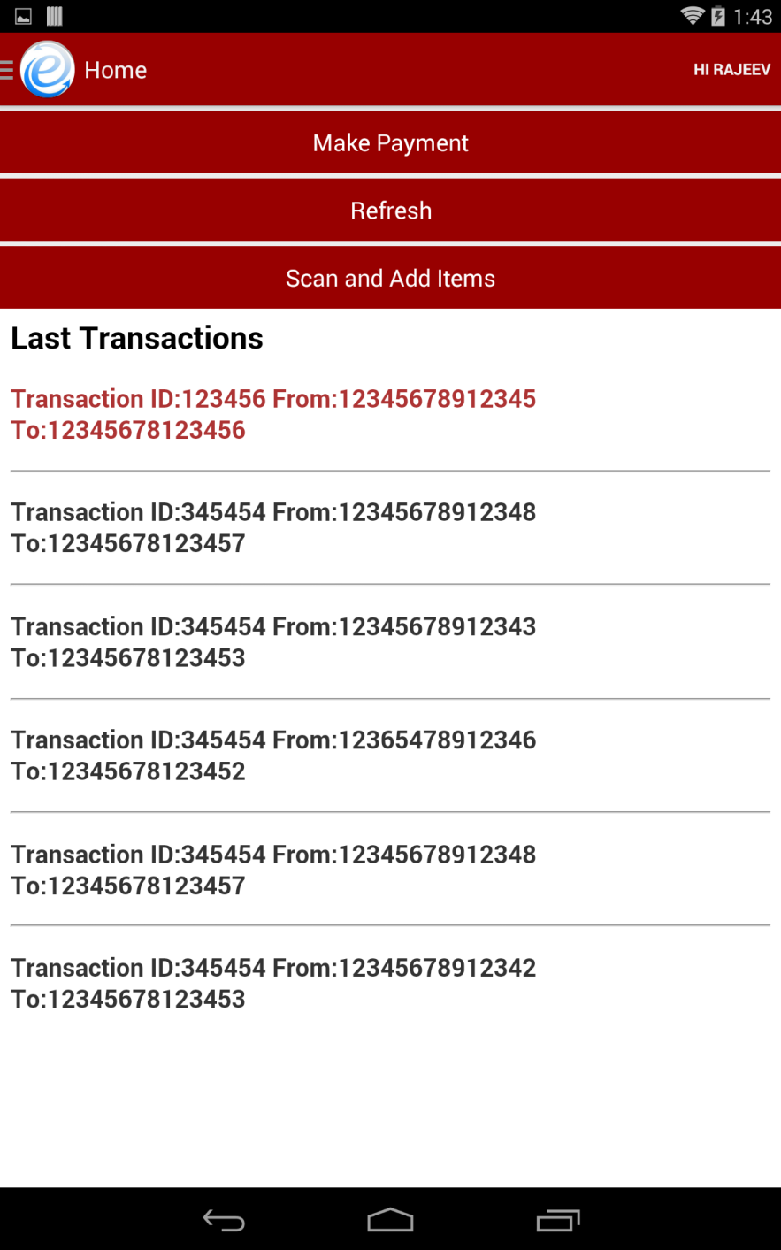

Slide 6
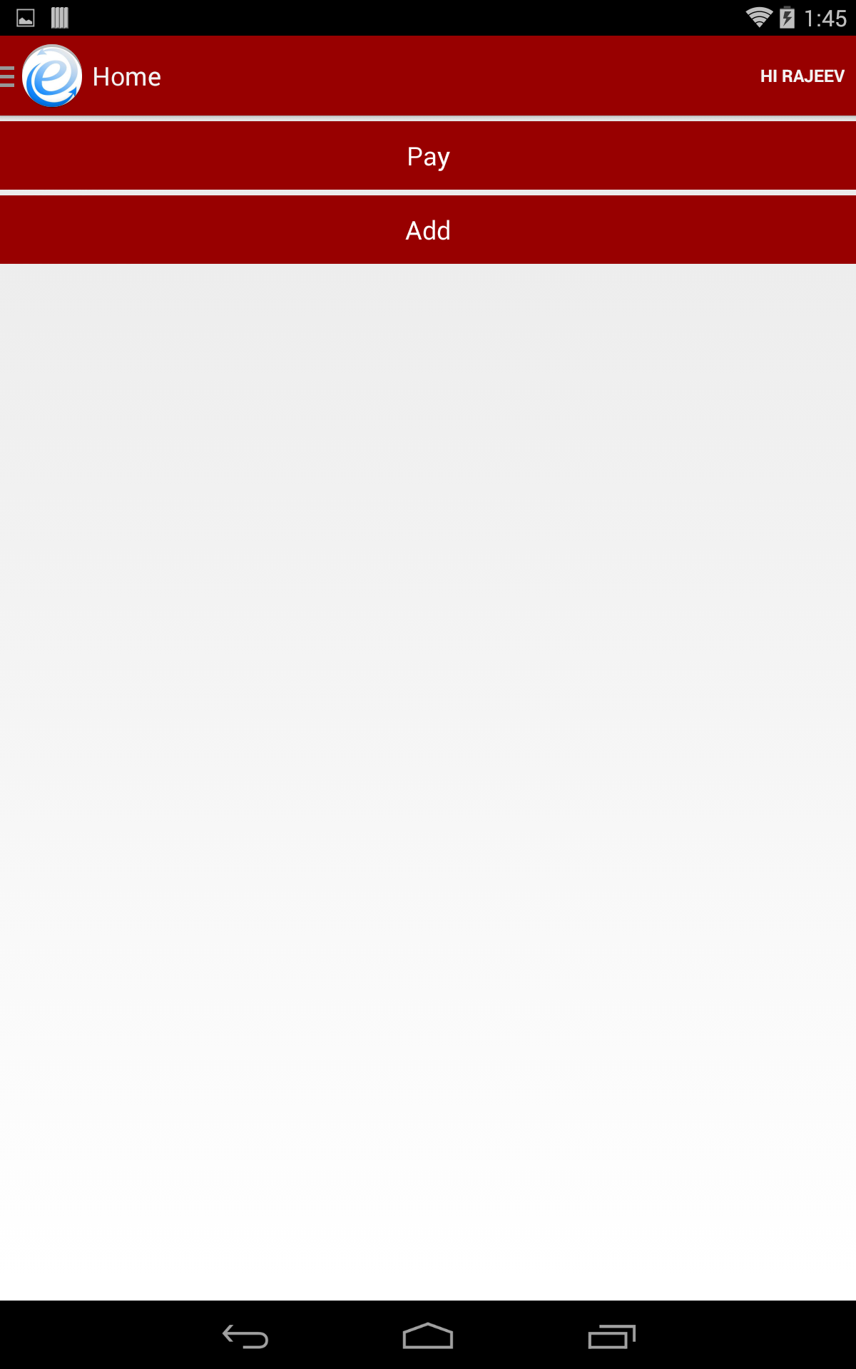
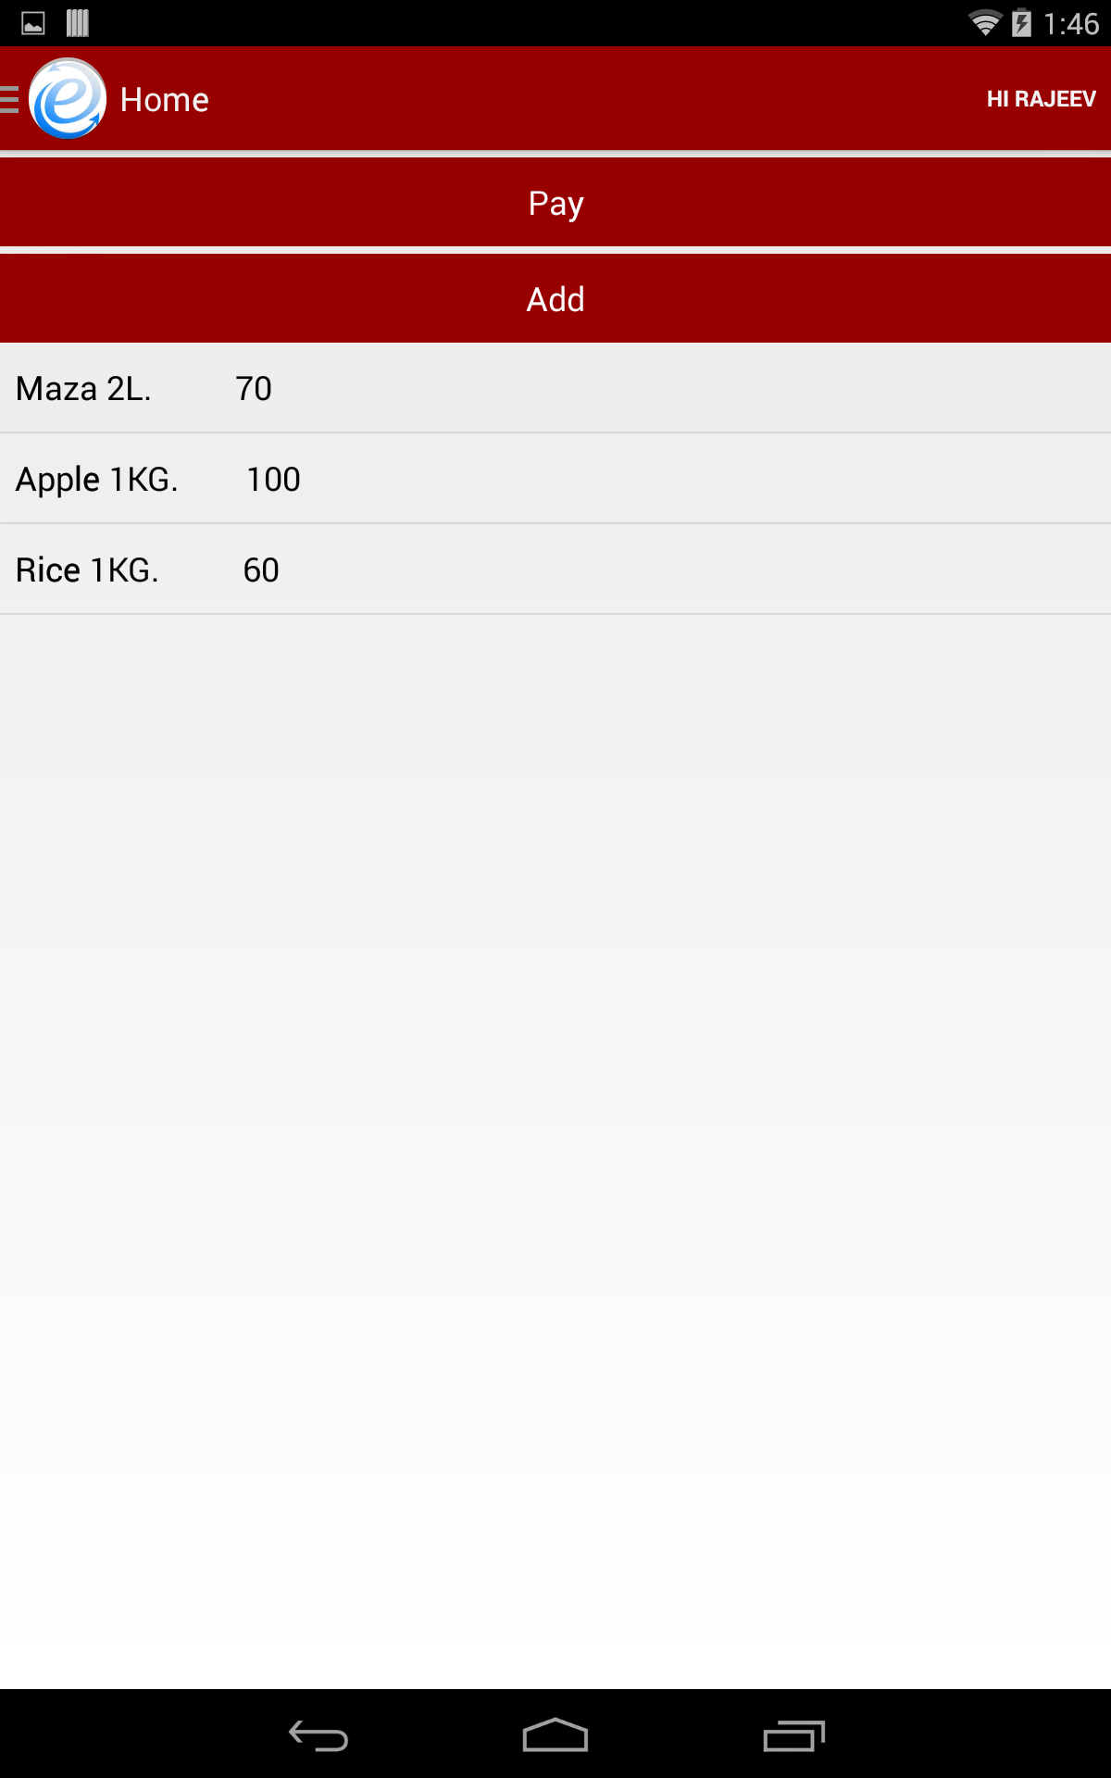

Slide 7
ADVANTAGES
SG PERSPECTIVE
First ever bank to implement transactions using QR code in India.
An application to eliminate card swiping and use of debit cards.
First attempt made by any bank to completely remove the use of hardware and head towards an eco-friendly world.
It would be the maiden attempt by any bank to replace Barcodes and barcode scanners.

Slide 8
USER PERSPECTIVE
“NO DEBIT CARDS!! NO SWIPING MACHINE!!!”
Its just a smartphone with the SG app(E-TRANS).
Gives user an easy and secure interface to make transactions through their account.
There would be no need for vendors to have barcode scanners as this app can also be used to scan each item and get its details.
Transactions get more simpler and better than before.
Can transfer money to any of his friend at any moment in the most secure way.
Instant notifications to both sender and receiver after the transfer of money, keep them relieved.

Slide 9
FUTURE IMPROVEMENTS
Can use NFC instead of QR code scanning.
Fingerprint technology can be made use of for better security purposes.
Online shopping can also be made possible using this method.

Slide 10
TEAM MEMBERS
Akshay Naik
2.MJ Siddu
3.Rajeev Hegde
4.Sanjeev Hegde

