Slide 1
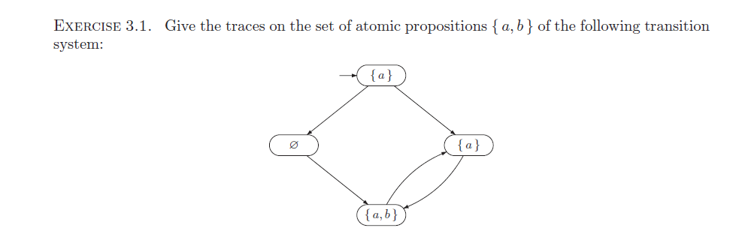

Slide 2

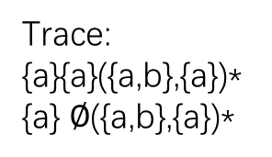
answer
Trace:
{a}{a}({a,b},{a})*
{a} $∅$({a,b},{a})*
{a} ({a}|$∅$)({a, b},{a})*

