Slide 1
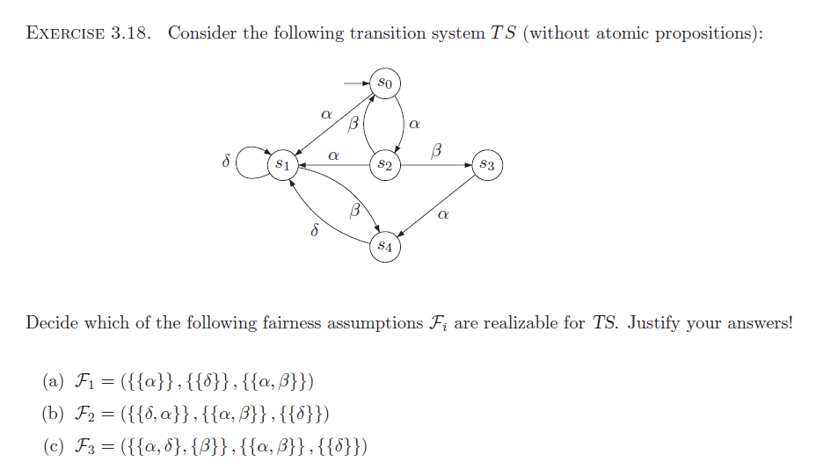

Slide 2
Answer:

