Slide 1
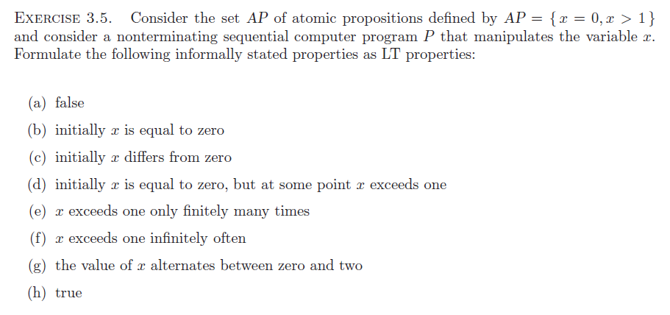

Slide 2
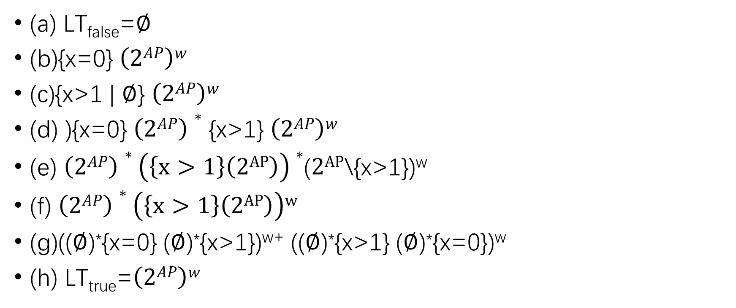
answer
(a) LT_{false}=$∅$
(b){x=0} $\left(2AP\right)w$
(c){x>1 | $∅$} $\left(2AP\right)w$
(d) ){x=0} $\left(2AP\right)∗$ {x>1} $\left(2AP\right)w$
(e) $\left(2AP\right)∗\left(\left\{x>1\right\}\left(2AP\right)\right)∗$($2AP$\{x>1})^{w}
(f) $\left(2AP\right)∗\left(\left\{x>1\right\}\left(2AP\right)\right)w$
(g)(($∅$)*{x=0} ($∅$)*{x>1})^{w+} (($∅$)*{x>1} ($∅$)*{x=0})^{w}
(h) LT_{true}=$\left(2AP\right)w$

