Slide 1

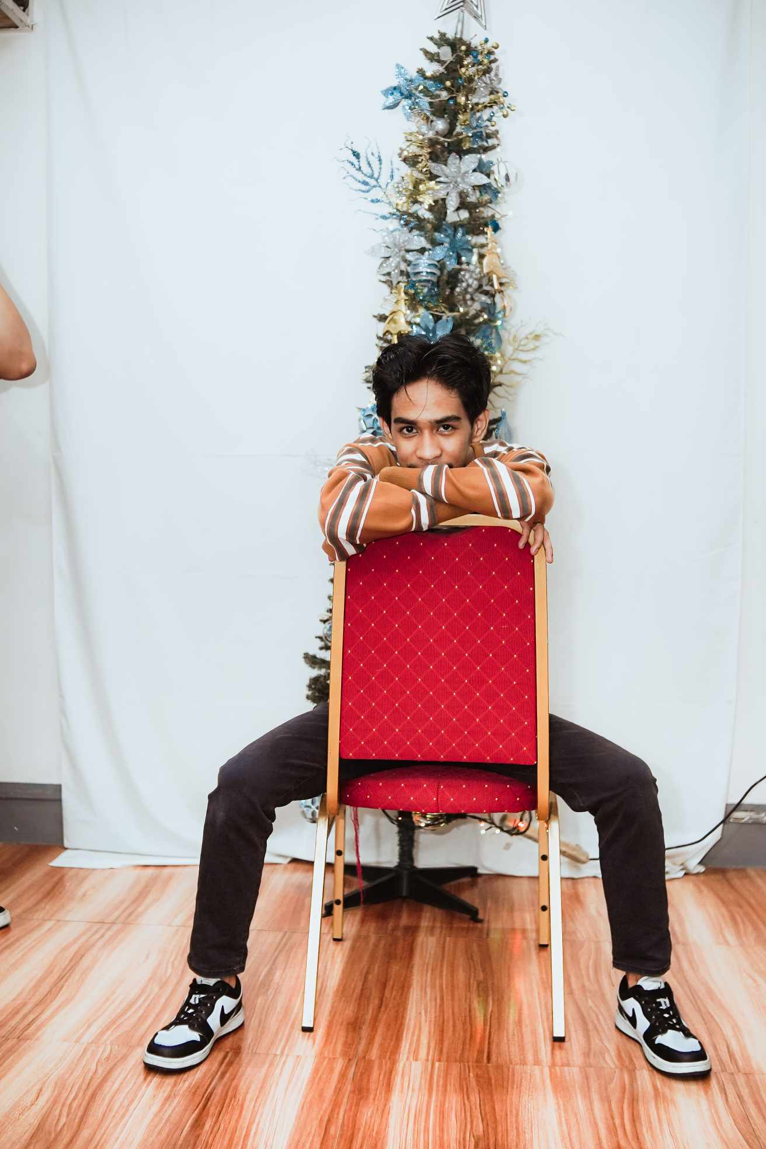
Home
About
Education
Skills
Contact Me
Hello
I am Marc Gavin Lor
Computer Science Student at NU-Laguna
Know More

Slide 2






ABOUT ME
Marc Gavin Lor
I’m a 20-year-old Computer Science Student. Studying at NATIONAL UNIVERSITY LAGUNA. Focusing on Graphic Design, Game Developing, and Web Programming. My Preference of working is flexible. I can work by myself, and I can also work with team.

Slide 3



EDUCATION
Commonwealth Elementary School
Primary Education
2009-2016

Slide 4
SKILLS
JAVA
PHP
Python
60%
50%
10%
Adobe Photoshop
HTML
CSS
80%
40%
20%

Slide 5
Contact
Name:
Email:
Email: lormarcgavin@gmail.com
Subject:
Call: (63) 905 323 6144
Your Text
Submit

Slide 6
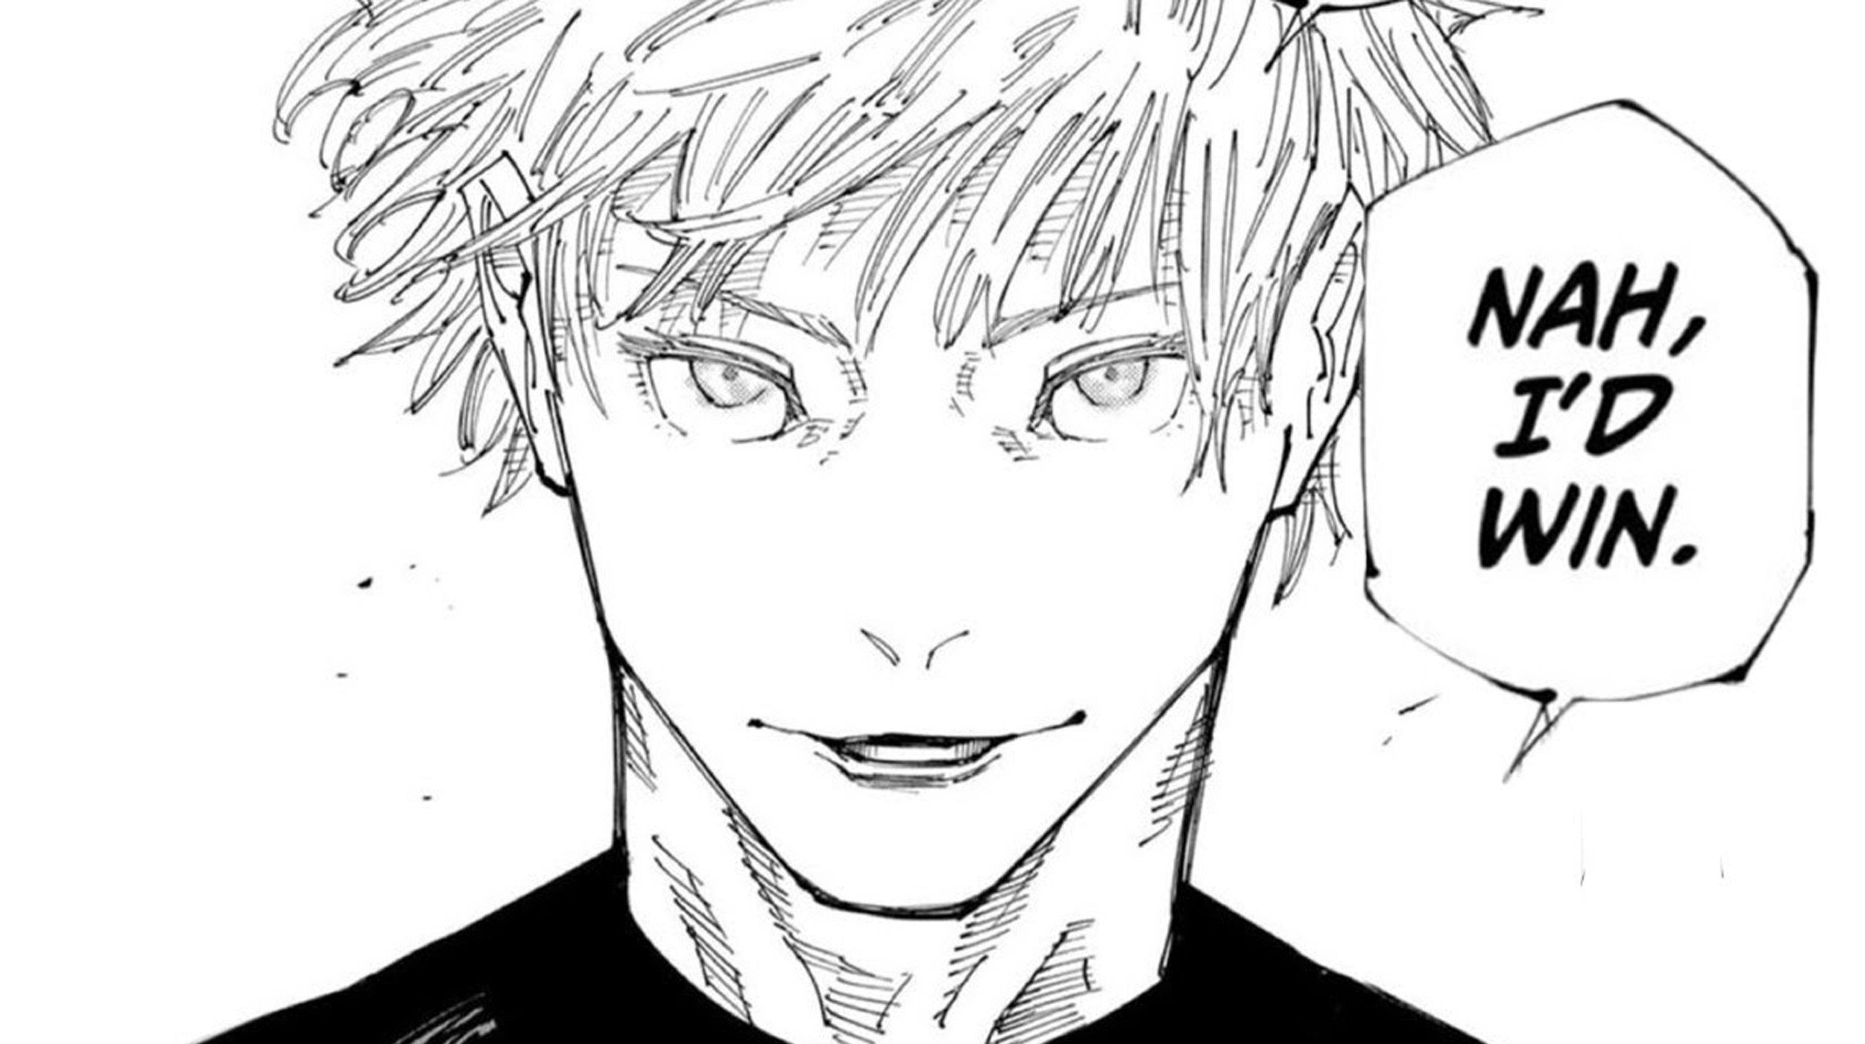
CTRL+C, CTRL+V

