Slide 1

Yunomi & $tashly

Slide 2
Stashly - MVP Definition
Stashly is an AI-powered assistant that helps individuals understand their investments, get updates on financial markets, and explore fund exposures — all through a conversational UI backed by real data and explainable AI.
It includes:
Chat interface for natural language questions
10 LangChain ReAct agents
LangGraph supervisor that routes intents to the right agent
Fund data, market data, and external APIs (FI, Yahoo, Wikipedia)
Interactive avatar with a built-in knowledge base and teaching persona
Scalable and modular architecture to expand across finance use cases

Slide 3
Stashly - What Makes This a Strong MVP
✅ Working prototype with real data (Swedish UCITS, Yahoo Finance)
✅ Conversational + agentic (LLM + reasoning + tools)
✅ Multiple real-world use cases (fund transparency, retirement planning, stock info, etc.)
✅ Interactive and explainable (avatar + chart generation + summaries)
✅ Deployed and demo-ready (clean frontend, hosted platform)

Slide 4
Stashly - Functionality
Agent Name | Functionality
portfolio_agent.py | Calculates performance, risk, and asset allocation from user portfolios
fund_position_agent.py | Loads fund holding data (Swedish UCITS XML) and analyzes exposure to companies/sectors
market_report_agent.py | Summarizes recent market events, economic indicators, and news
conversational_agent.py | Handles general finance and concept questions (e.g., “What is risk?”)
websearch_agent.py | Searches the web and Wikipedia for current or unknown information
stock_price_agent.py | Fetches real-time stock prices using ticker matching and Yahoo Finance
research_agent.py (coming) | Generates multi-part research reports using a breakdown-analyze-expert flow
Interactive Avatar | Conversational persona with a financial knowledge base and coaching persona
supervisor_agent (LangGraph) | Routes messages to the appropriate ReAct agent based on intent
forecasting_model (coming) | Lasso + regime-switching model for market predictions (based on earlier context)
. Notable Features
Multi-agent architecture
Real-time market data processing
Fund portfolio analysis
Natural language processing
Web research capabilities
Stock market analysis
Research supervision system
Content generation and editing
Agent Capabilities
Portfolio Management
Fund Analysis
Market Reporting
Conversational AI
Web Research
Stock Price Analysis
Research Analysis
Expert Consultation
Content Editing

Slide 5
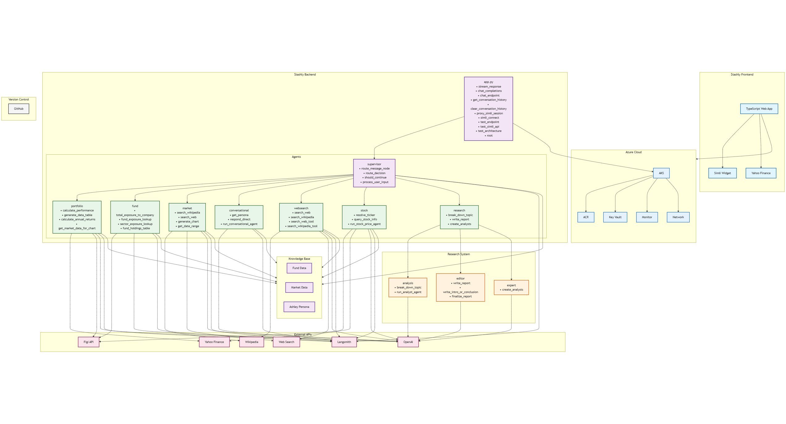
Stashly - Architecture

Slide 6
Yunomi & Stashly - Statistics
BACK END
1-2 Langgraph supervisors
7-10 ReAct Langchain agents
24 Python files
54 functions
2500 lines of code
6 APIs
Knowledge base (funddata, market data, financial knowledge, persona
FRONT END
Yunomi website
  6000 lines of source code
  9000 lines of config and depend
  8 pages
Stashly website
  Interactive avatar
  Chat function
  Fast API
  1 API to Yahoo Finance
  4000 lines of code
  16 React components

