Slide 1
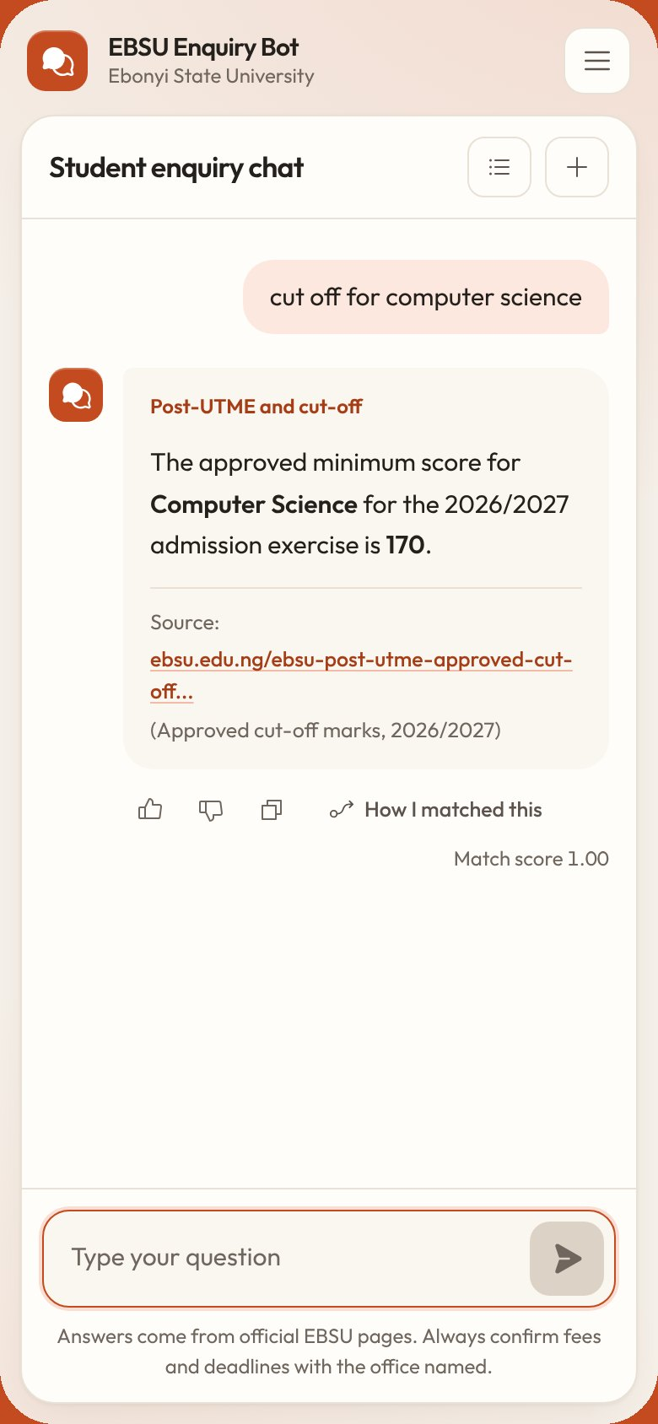

Design and Implementation of a Web-Based AI-Powered Chatbot for Student Enquiry Services in Ebonyi State University, Abakaliki
EBSU Enquiry Bot
[Your full name] · [Registration number]
Supervisor: [Supervisor's name]
Department of Computer Science, EBSU · [Month Year]
Notes:
Good morning. My project is the design and implementation of a web-based, AI-powered chatbot for student enquiries at Ebonyi State University. In the next ten minutes I will show the problem, how the chatbot understands questions written the way students write, including Pidgin and short forms, how I built and tested it, and the results. I will finish with a short live demonstration on this laptop, with the network switched off.

Slide 2




The answers exist but are hard to reach
THE PROBLEM
Scattered
7
Answers sit on at least seven EBSU websites and subdomains.
Out of date
The calendar page showed 2023/2024; the acceptance fee table was for 2022/2023.
websites and subdomains hold the answers
Exact wording only
ebsu.edu.ng
portal.ebsu.edu.ng
iportal.ebsu.edu.ng
spgs.ebsu.edu.ng
services.ebsu.edu.ng
mail.ebsu.edu.ng (older site)
orphanproject.ebsu.edu.ng
Search does not connect “wetin be the putme fee” or “admision” to the notice.
No record
Nobody learns what students looked for and could not find.
Notes:
The university publishes most of what students ask about, but the information is spread over at least seven websites and subdomains. Some of it is out of date: when I compiled the data, the academic calendar page still showed 2023/2024 and the acceptance fee table was for 2022/2023. Search only works with exact wording, so a question in Pidgin or with a spelling error finds nothing. And when a student cannot find an answer, nothing records it, so the same gap stays for the next student. [Add one figure from your interviews or questionnaire here if you have one.]

Slide 3




A chatbot that understands students
AIM AND OBJECTIVES
1
Build a knowledge base only from official EBSU sources
85
42
2
Understand Pidgin, short forms and spelling errors
answers, each with its official source
official EBSU pages used
3
Match with TF-IDF and fuzzy matching, with an honest fallback
4
Give students a chat page and staff an admin panel
307
60
5
Measure accuracy and collect user feedback
Pidgin, abbreviation and spelling rules
labelled test questions
Notes:
The aim was a chatbot that answers student enquiries accurately in natural language. The five objectives are on the left. On the right is what was built: 85 answers taken from 42 official EBSU pages, each stored with its source link; 307 language rules for Pidgin, abbreviations and common misspellings; and 60 labelled questions for testing. Facts the website does not publish, like current school fees and hostels, were not invented; they are listed in the report for the offices to supply.

Slide 4



Why retrieval, not generation
APPROACH
Chosen
Rule-based
Retrieval-based
Generative
ELIZA, AIML bots
This project
ChatGPT-style models
Hand-written patterns
Fails on new wording
Many templates
Picks a checked answer
Shows the official source
Testable, offline, free
Fluent, flexible replies
Can invent fees and dates
Needs internet, API fees
Developed by incremental prototyping in five increments, modelled with UML and data flow diagrams.
Notes:
There are three families of chatbot. Rule-based bots match hand-written patterns and break when the wording changes. Generative bots like ChatGPT write fluent replies, but they can state a wrong fee or deadline with confidence, and they need internet and paid access. I chose retrieval: the bot selects an answer that a person wrote and checked, shows the official source, can be tested question by question, and runs on one computer for free. I built it in five increments: knowledge base, matching engine, student interface, administration, and evaluation.

Slide 5







Seven steps from message to answer
HOW IT WORKS
1. Clean
lower case, no punctuation
EXAMPLE FROM THE RUNNING SYSTEM
2. Fix typos
nearest known word
wetin be the PUTME fee??
3. Language rules
Pidgin, short forms, synonyms
rules
wetin be → what
putme → postutme
fee → cost
4. Remove stopwords
the, is, abeg, years
roots
postutm, cost
match
How much is the EBSU Post-UTME form?
5. Stem
Porter stemmer
score 1.00 ≥ 0.50 → answer
6. Score
0.8 × cosine + 0.2 × trigram
The Post-UTME fee is N2,000.00 and it is non-refundable.
Source: ebsu.edu.ng, 2026/2027 Post-UTME notice
7. Decide
answer, suggest or refer
Notes:
Every message goes through seven steps. It is cleaned, typing errors are corrected against the words the knowledge base knows, and the language rules translate Pidgin and short forms: here “wetin be” becomes “what”, “putme” becomes “postutme” and “fee” becomes “cost”. Common words are removed, the rest are reduced to their roots, and the message is scored against every stored phrasing. The best match here scores 1.00 against a stored phrasing of the Post-UTME fee question, so the bot answers, with the official source under the answer.

Slide 6
How a match is scored
THE SCORING
TF-IDF weight
w = tf × idf, idf = ln((1 + N) / (1 + df)) + 1
Cosine similarity
cos(q, d) = q · d / (|q| × |d|)
Final score
score = 0.8 × cosine + 0.2 × trigram
Decision
≥ 0.50 answer · 0.32 to 0.49 suggest · below 0.32 refer to the office
Four stored questions. D1 scores 0.741 ≥ 0.50, so the bot answers (npm run example).
Notes:
Here is the mathematics, using a four-question example the panel can check by hand. TF-IDF gives each word a weight: frequent in this question, rare across the knowledge base. With four stored questions, a word in one of them has an IDF of 1.9163 and a word in two has 1.5108. Cosine similarity compares the weighted vectors. The final score is 80 per cent cosine and 20 per cent trigram similarity, which tolerates spelling differences. D1, the Post-UTME form question, scores 0.741, above the answer threshold of 0.50, so the bot answers. D2 scores 0.404, which would only have produced a suggestion. The thresholds were chosen on a separate development set.

Slide 7



Three tiers on one computer
SYSTEM DESIGN
Pages: chat, how it works, contacts, admin
Browser
Next.js server
MySQL
Student chat
API routes
qa_pairs
qa_variants
language_rules
chat_logs
unanswered_
questions
+ 6 more
Next.js server: API routes and the NLP engine
How it works
NLP engine
clean · typos · rules · stem · TF-IDF + trigram · decide
MySQL in XAMPP: 11 tables
Contacts
Index in memory
Admin area
No internet needed after installation
Login and sessions
Notes:
The system has three tiers, all on one computer. The pages run in the browser: the student chat, the How it works page, the contacts page and the admin area. The Next.js server, written in TypeScript, holds the API routes and the matching engine, which keeps an index of every stored phrasing in memory and rebuilds it when the data changes. MySQL, from XAMPP, holds eleven tables: the questions and answers, extra phrasings, language rules, chat logs, unanswered questions, admin accounts and settings. Admin passwords are bcrypt hashes and every query is parameterised. Nothing needs the internet after installation.

Slide 8
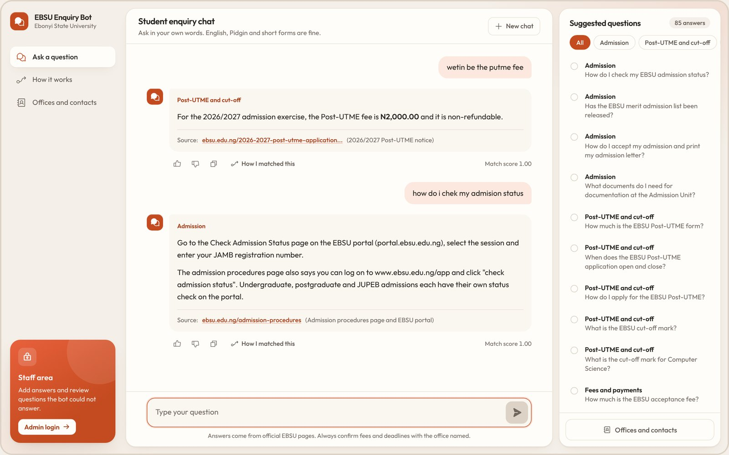
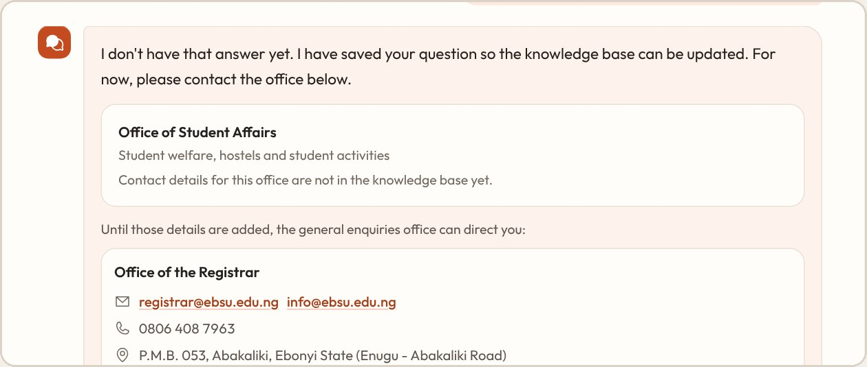
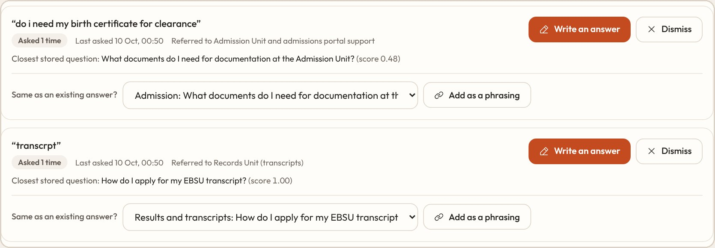
What students and staff see
THE SYSTEM
No answer yet: the bot names the office and saves the question
Answers to a Pidgin and a misspelt question, each with its official source
Admin turns saved questions into answers
Notes:
This is what students and staff see; I will show it live in a moment. On the left, a Pidgin question and a misspelt question, each answered with the official source underneath. Top right: when the bot has no answer, it says so honestly, names the office to contact and saves the question. Bottom right: in the admin area those saved questions are grouped and counted, and the administrator can write an answer or link the question to an existing one with one click. After that the bot answers it directly.

Slide 9
29 of 30 test questions correct
RESULTS ON 30 HELD-OUT QUESTIONS
96.7%
100%
accuracy
precision
29 of 30 handled correctly
no wrong answers given
96.0%
3.6 ms
recall
median reply
24 of 25 in-scope answered
per request, incl. database
Questions per bar, left to right: 16, 4, 3, 2 and 5.
Notes:
I tested on 30 questions that I kept aside and never used while tuning: formal English, Pidgin, short forms, typing errors and five questions the knowledge base cannot answer. The bot handled 29 of 30 correctly, 96.7 per cent. Precision was 100 per cent: every answer it gave was the right one, and it answered none of the out-of-scope questions. Recall was 96.0 per cent. The one miss, “who do I call when the portal is not loading”, got suggestions instead of an answer, with the right answer first. The median response time was 3.6 ms. [Add the SUS result from your feedback forms here.]

Slide 10



Conclusion and next steps
Contribution
Recommendations
Further work
Pidgin and abbreviation rule table
Offline retrieval chatbot with office referral
EBSU test set with results
Pilot in the next admission exercise
Each office keeps its answers current
Publish fees, hostels, registration
Igbo questions
Meaning-based matching, run locally
WhatsApp channel, portal links
Thank you. Questions?
Live demo: http://localhost:3000
Notes:
To conclude: a transparent, retrieval-based chatbot that understands how Nigerian students write can be a reliable first point of contact for routine enquiries. My contributions are the Pidgin and abbreviation rule table, the offline retrieval pipeline that refers students to the right office when it is unsure, and a labelled EBSU test set with results. I recommend a pilot in the next admission exercise, with each office responsible for its own answers. Next I would add Igbo, meaning-based matching and a WhatsApp channel. Thank you. I will now show the system live, and I welcome your questions.

