Slide 1
Module 5 · Application
When it fails and nobody is watching.

Slide 2
The question this module asks
How would you know if it had stopped doing the job,
while continuing to report that it had?

Slide 3
A crash is a gift
Module 4
Module 5
Inputs
One, chosen by you
Six, chosen by other people
Runs
Once
Repeatedly, on a schedule
The failure
Did it run
Did it run and quietly do nothing

Slide 4
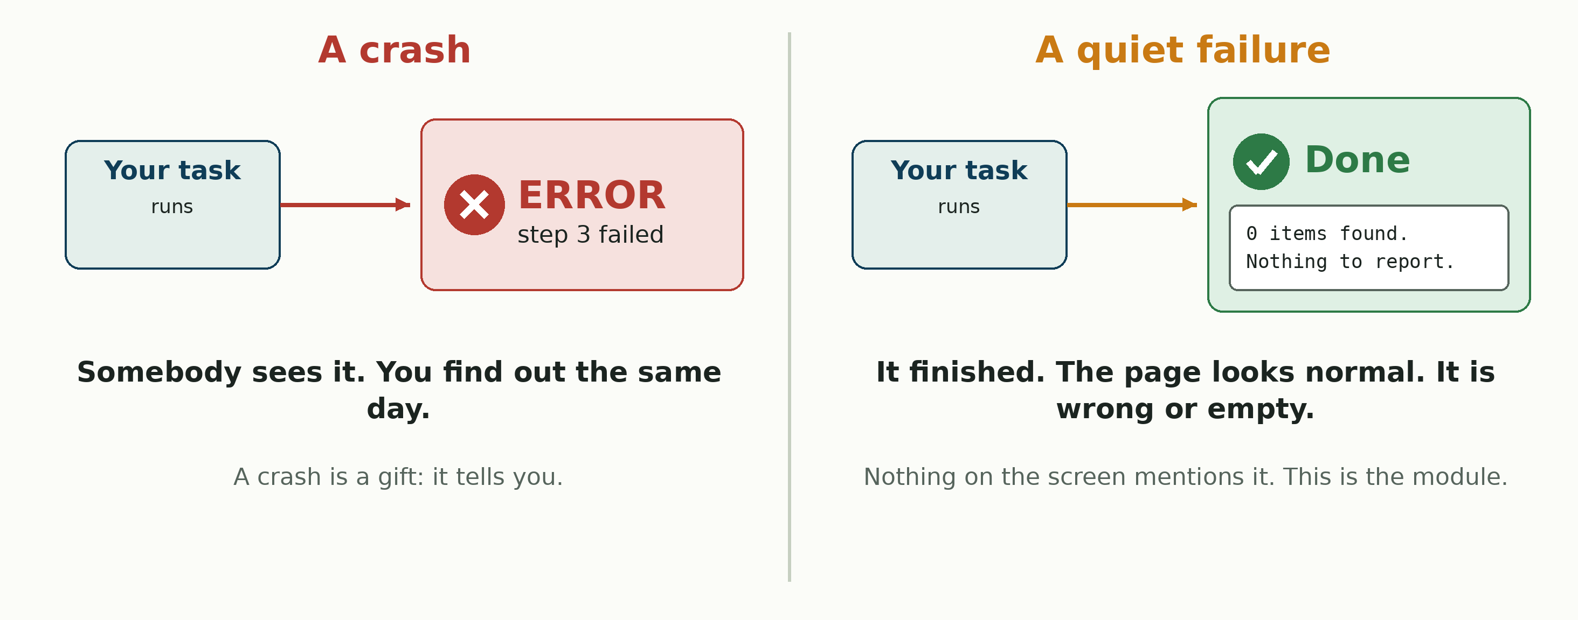
A crash tells you. This does not.

Slide 5
Where module 4 left you
In module 4 you wrote handover.md. Question 3: how would somebody know it had stopped working?
• That answer was a prediction. Nobody has tested it.
• Question 2 lists what your work relies on. Each item is a place it can fail quietly.
• This week tests both. Act 3 breaks one of those items, and you find out if you were right.

Slide 6
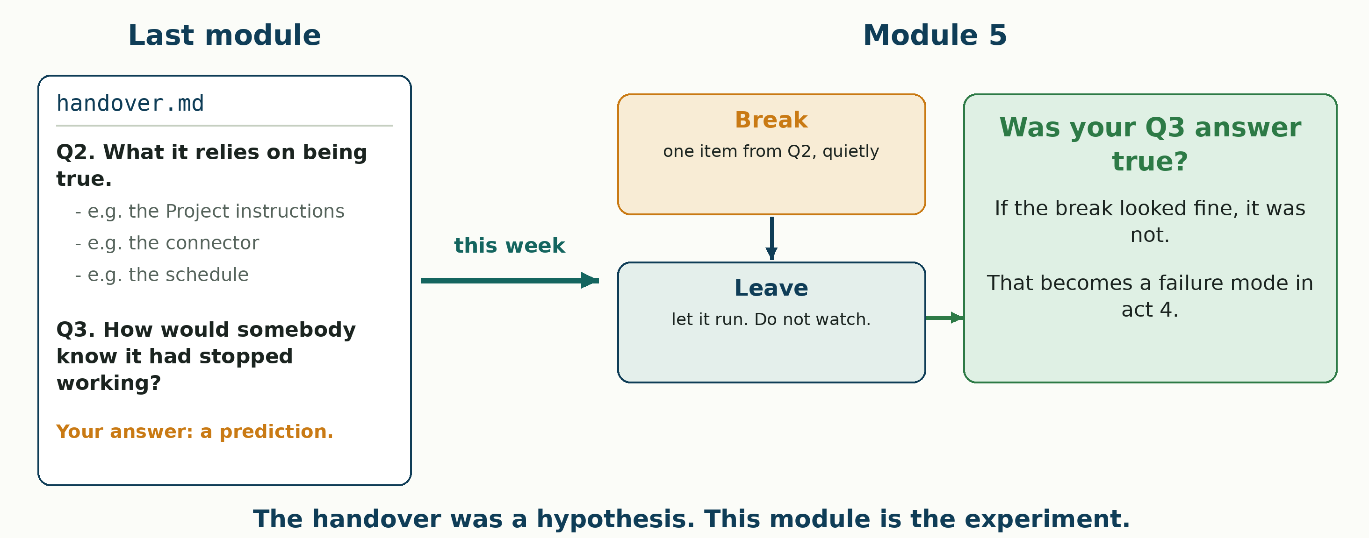
The handover was a hypothesis

Slide 7
Three terms
• Queue. Work arriving from other people, in whatever shape they sent it.
• Loop. The same procedure over each item in turn. The inputs vary, the procedure does not.
• Refusal. The procedure stopping and saying it cannot proceed. A good outcome.

Slide 8
Using an agent
• Hand off anything. You own what comes back.
• When an agent wrote most of a file: operator-notes.md beside it.
• Four lines: what you asked · two claims you checked, and how · one thing you changed or rejected · what you would not trust.
• The journal is always yours.

Slide 9
Module 5 in one picture
Module 4 got something running. This module finds out what it does when nobody is looking.
It runs
Module 4: one input, one run, while you were away
On other people's input
Six tickets, uneven on purpose
It fails quietly
Finishes, reports success, and is wrong or empty
It says when it cannot
A refusal nobody mistakes for an answer
→
→
→

Slide 10
Act 1 · Work the queue
An act is one of the four numbered sections of the lab. Each states what it is worth and how you know it worked.
Act 1 · Work the queue
Six tickets, one procedure · 4 pts
Act 2 · Every day
A morning recap, and what it cannot tell you · 3 pts
Act 3 · Break it
Predict, break it, do not watch · 7 pts
Act 4 · Teach it to stop
What it does when it cannot proceed · 4 pts
→
→
→

Slide 11
Six tickets, one procedure
Six tickets, exported Tuesday, in course/module_05/M05_queue/.
• Point your Skill at each one in turn. Do not fix the tickets first.
• Do not rewrite the procedure yet. Act 4 is where that happens.
• One row per ticket in queue-results.md, outcome handled, refused or wrong, and an owner, agent or person.

Slide 12
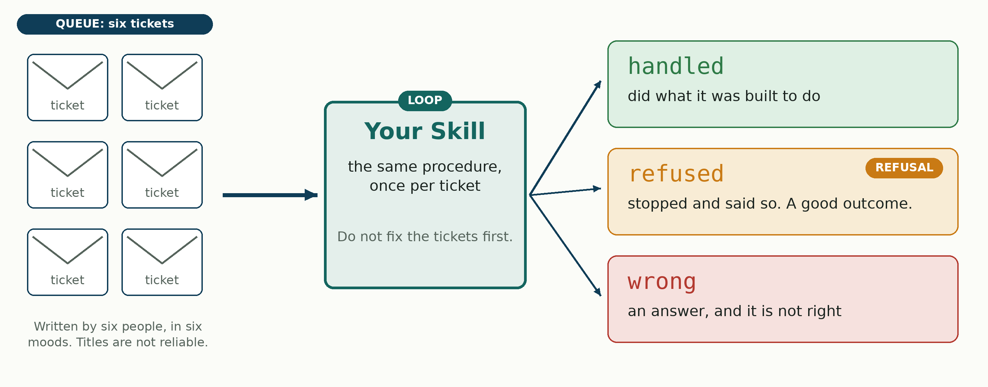
Six tickets in, three outcomes out

Slide 13
They were written by six different people
• A ticket is what somebody typed while annoyed. It is not a specification.
• Read the notes as carefully as the description. They were written by different people at different times.
• A requester who has already decided what happened is still telling you something useful. It is just not the thing they think.

Slide 14
Act 2 · Every day
A second scheduled task, the opposite kind of work: the same thing, every morning.
Act 1 · Work the queue
Six tickets, one procedure · 4 pts
Act 2 · Every day
A morning recap, and what it cannot tell you · 3 pts
Act 3 · Break it
Predict, break it, do not watch · 7 pts
Act 4 · Teach it to stop
What it does when it cannot proceed · 4 pts
→
→
→

Slide 15
A morning recap
A morning recap: what is open, what is due, what is closest.
• GitHub snapshots your issues every morning; the recap reads the snapshot.
• The snapshot goes in through the Project's Context box, then Sync.
• Daily. Bound to the same Project. Let it run at least twice.
• What can it not tell you? Look at where it reads from.

Slide 16
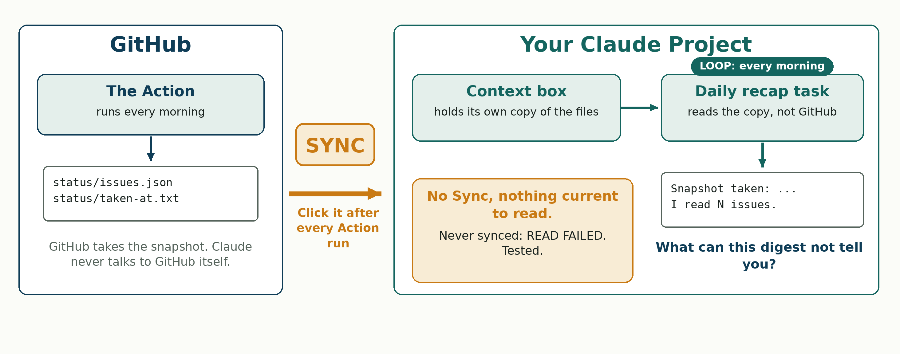
Two machines, one Sync

Slide 17
Act 3 · Break it
The largest act in the unit. 7 of 18 points.
Act 1 · Work the queue
Six tickets, one procedure · 4 pts
Act 2 · Every day
A morning recap, and what it cannot tell you · 3 pts
Act 3 · Break it
Predict, break it, do not watch · 7 pts
Act 4 · Teach it to stop
What it does when it cannot proceed · 4 pts
→
→
→

Slide 18
Predict, break it, and leave
1. Predict first, and commit it before the break exists.
2. Break something your handover.md says it relies on. Something it reads, not something it needs.
3. Let it run. Do not watch.
4. Come back and read what it produced.

Slide 19
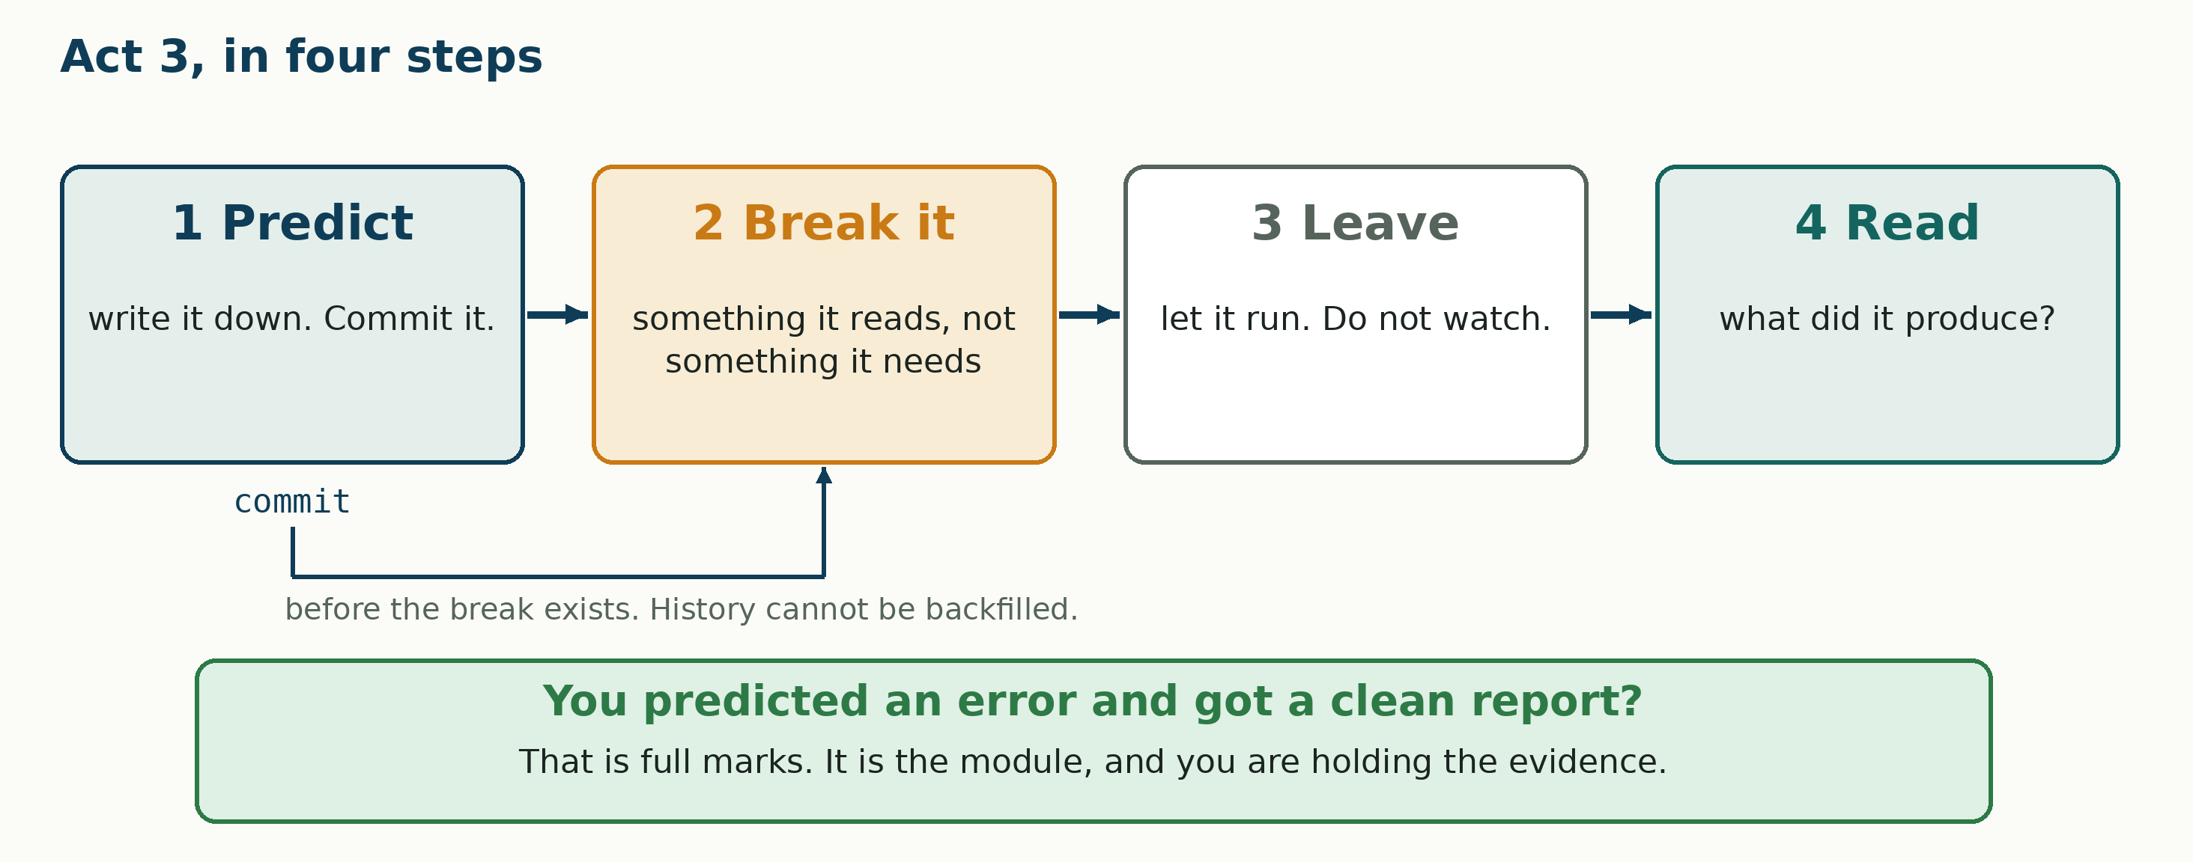
Act 3, in four steps

Slide 20
If you predicted an error and got a clean report
That is full marks.
Not a failed experiment. Not a break that did not take.
It is the thing this whole unit is about, and you are now holding the evidence.

Slide 21
Act 4 · Teach it to stop
Write down what the procedure does when it cannot proceed.
Act 1 · Work the queue
Six tickets, one procedure · 4 pts
Act 2 · Every day
A morning recap, and what it cannot tell you · 3 pts
Act 3 · Break it
Predict, break it, do not watch · 7 pts
Act 4 · Teach it to stop
What it does when it cannot proceed · 4 pts
→
→
→

Slide 22
It has no way of saying I cannot
Your procedure cannot say I cannot do this, so it answers anyway.
• What it requires before it starts.
• What is out of scope.
• What it does with an incomplete input. Asking is valid. Guessing is not.
• How a refusal is worded, so nobody mistakes it for an answer.

Slide 23
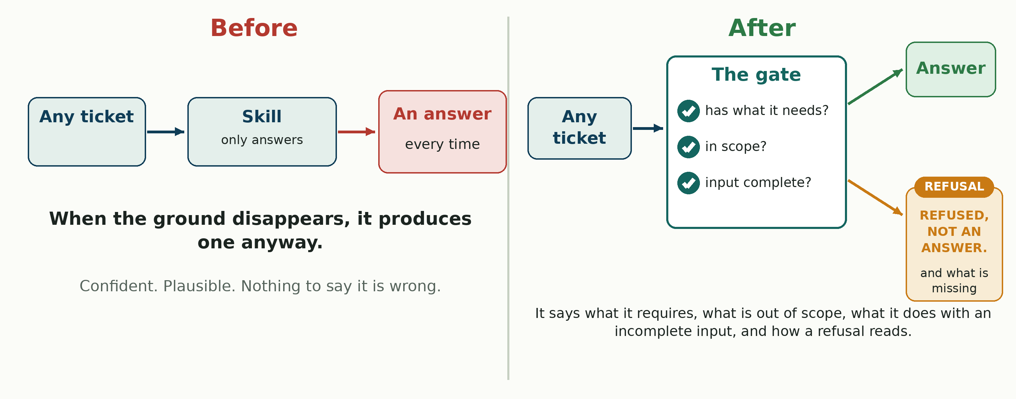
Before and after

Slide 24
Due Thursday 8 October, 9:00 pm
• The lab, 18 points: notes.md, queue-results.md, recap.md, prediction.md, break.md, handling.md, the rewritten Skill, four issues and the recap task.
• The journal, 6 points, six headings.
• One pull request carries it all in. It only bundles the files: nobody reviews it, approves it, or merges it. Open it, say what is in it, and you are done.

Slide 25
Module 5, recapped
What each act left in your repository.
Act 1 · Work the queue
queue-results.md
Act 2 · Every day
recap.md
Act 3 · Break it
prediction.md, break.md
Act 4 · Teach it to stop
handling.md, the updated Skill
→
→
→

