Slide 1
Module 6 · Synthesis
Directing the work.

Slide 2
If you are not doing the work, what are you doing?
Doing the work
Directing the work
How it fails
You get it wrong
It goes wrong and you do not notice
What you produce
The result
The plan, the standard, and the log of where you stepped in
What is marked
The result
Your direction of it

Slide 3
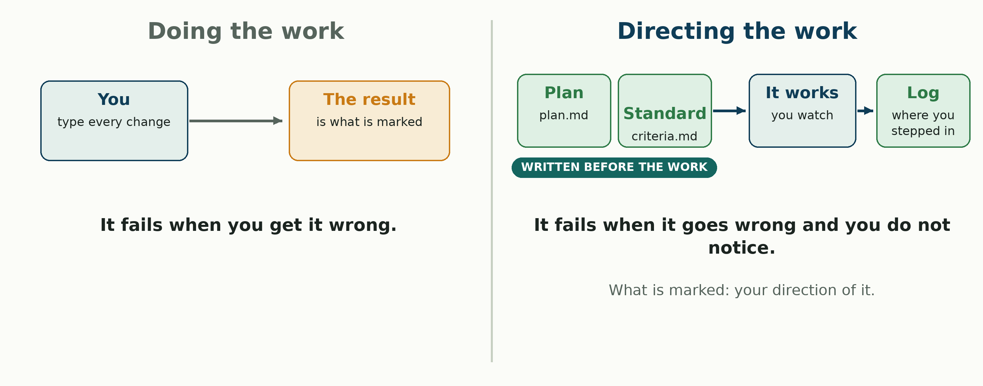
Doing, or directing

Slide 4
Unit 2 in one picture
This module is where the unit's arc closes.
Doing
Unit 1: your hands on everything
Running without you
Module 4
Failing quietly
Module 5
Directing it
Module 6: plan, standard, judgement
→
→
→

Slide 5
This week's work is your own repository
Could somebody else find your work without asking you?
• You will change your repository this week, by directing an AI platform to do it, on a module_06 branch.
• You do not have to copy our folder layout. Organise it your way.
• Nothing already graded moves. If it is somewhere odd, leave it and add a map.

Slide 6
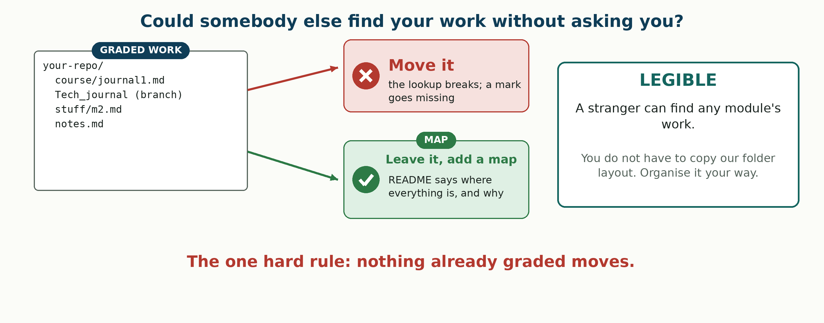
Legible, never conform

Slide 7
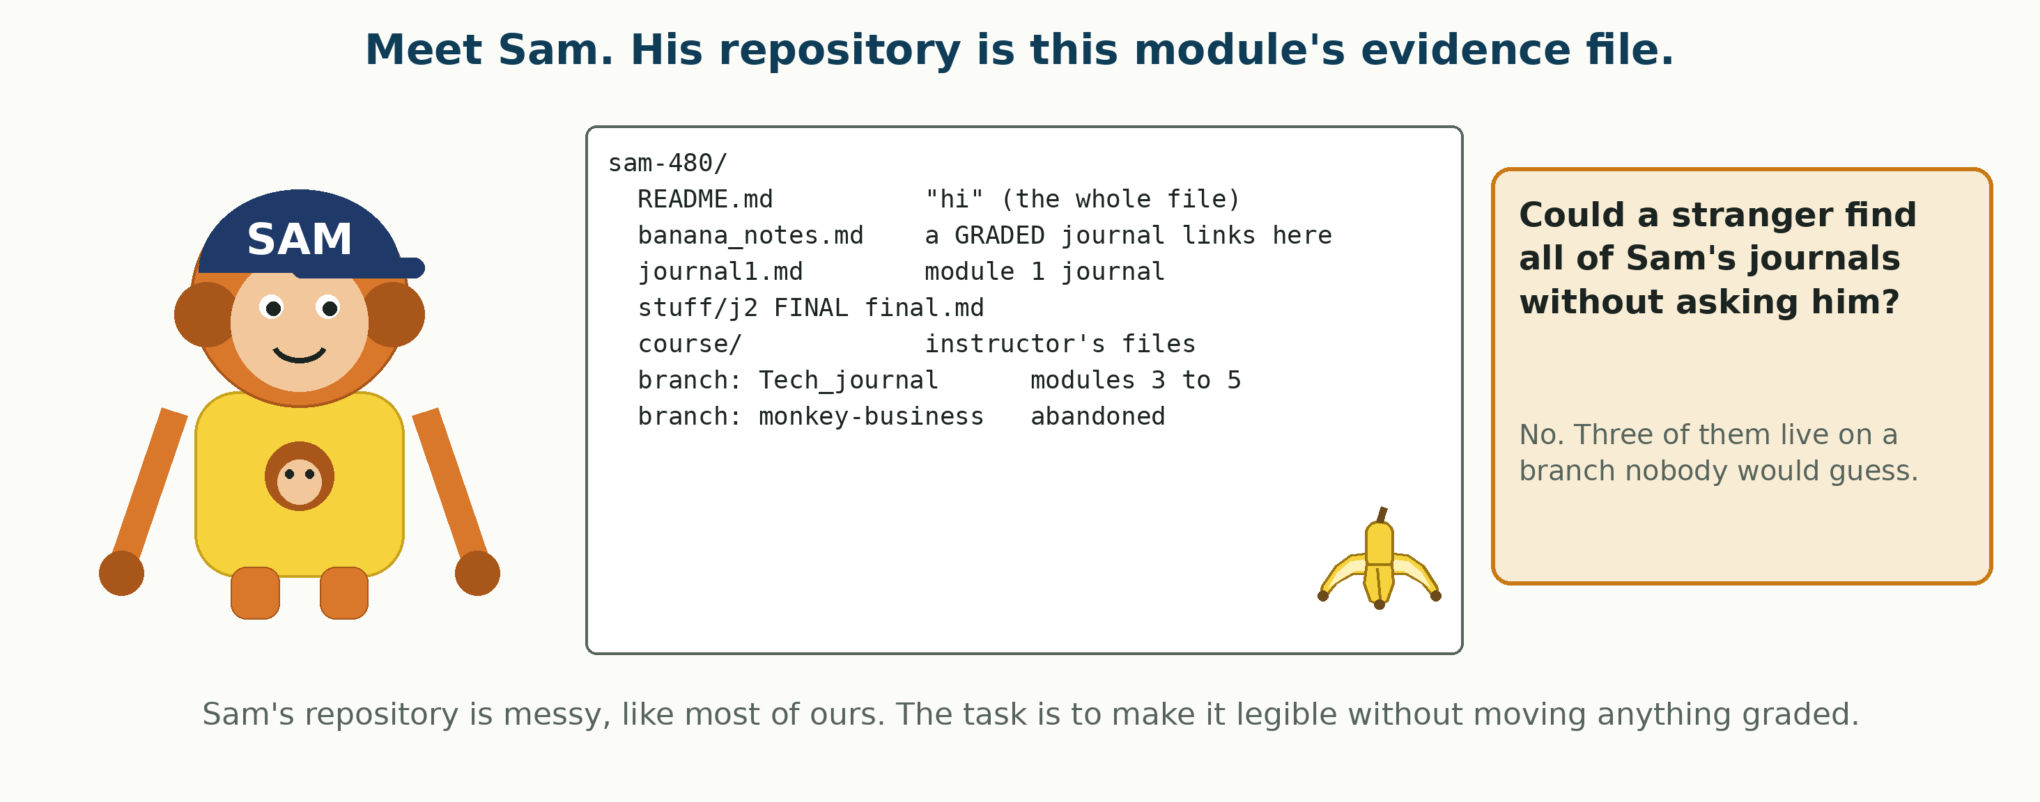
Meet Sam

Slide 8
Act 1 · Plan at depth, before anything is produced
An act is one of the four numbered sections of the lab. Each states what it is worth and how you know it worked. Nine checks, CP1 to CP9, are marked through them.
Act 1 · Plan at depth, before anything is produced
CP1 · CP2 · 2 pts
Act 2 · Write the standard before the output exists
CP3 · 1 pt
Act 3 · Direct the work, and keep the log
CP4 to CP7 · 4 pts
Act 4 · Judge it against your own criteria
CP8 · CP9 · 2 pts
→
→
→

Slide 9
Plan first, change nothing
• Set up: branch module_06, four issues (one per act, owner, date, Milestone_02) before any real work. Then walk your repo as a stranger would.
• plan.md: what you will change, in what order and why, what each change is for, and what you are not touching, graded work included.
• First line, how it gets done: Mode: project, chat or by-hand (you do it yourself). All worth the same.

Slide 10
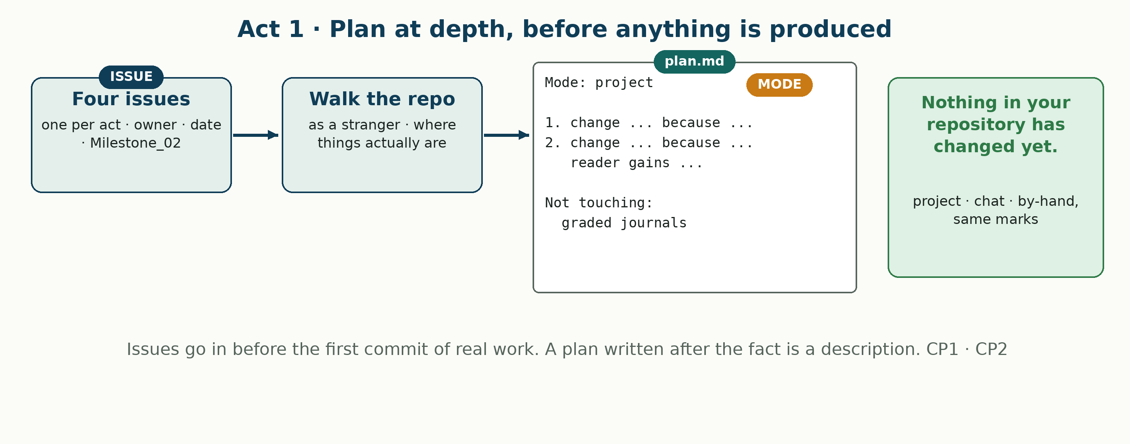
Act 1, in one picture

Slide 11
Sam's plan.md
Mode: project
1. README map of every journal, branches included. First: everything points to it.
2. Branch index: what each branch holds.
3. Plain names for new files only.
Not touching: banana_notes.md, journal1.md, j2 FINAL final.md, Tech_journal. All graded.

Slide 12
Act 2 · Write the standard before the output exists
Still nothing produced. One short file.
Act 1 · Plan at depth, before anything is produced
CP1 · CP2 · 2 pts
Act 2 · Write the standard before the output exists
CP3 · 1 pt
Act 3 · Direct the work, and keep the log
CP4 to CP7 · 4 pts
Act 4 · Judge it against your own criteria
CP8 · CP9 · 2 pts
→
→
→

Slide 13
What would make this work good?
• Six to ten checkable statements in criteria.md, in your own words.
• Checkable: somebody else could mark it met or not met without asking you.
• Commit it before the first act 3 commit.
• "Well organised" is not checkable. "Any module's journal is findable from the README in under three clicks" is.

Slide 14
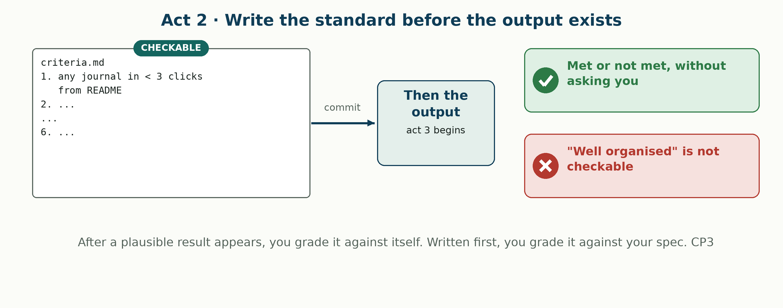
The standard comes first

Slide 15
Three of Sam's criteria
Kind
Sam's criterion
Why it is in this row
Good
A stranger finds any journal in under three clicks from the README
Checkable, and it is the point of the module
Too easy
The repository has a README
It already did. It said "hi"
Turns out wrong
Every file has a clear name
Find out in act 4

Slide 16
Act 3 · Direct the work, and keep the log
Your repository changes this act. What is marked is the log of how you steered it.
Act 1 · Plan at depth, before anything is produced
CP1 · CP2 · 2 pts
Act 2 · Write the standard before the output exists
CP3 · 1 pt
Act 3 · Direct the work, and keep the log
CP4 to CP7 · 4 pts
Act 4 · Judge it against your own criteria
CP8 · CP9 · 2 pts
→
→
→

Slide 17
Act 3 marks your log, not your repository
4 of 9 points. interventions.md is the deliverable.
Four kinds of stepping in: correcting, redirecting, rejecting, and accepting something you were unsure about.
Each entry: what it did, what you did, why.
Nothing graded moves. If it proposes a move, that is a rejection, and it goes in the log.

Slide 18
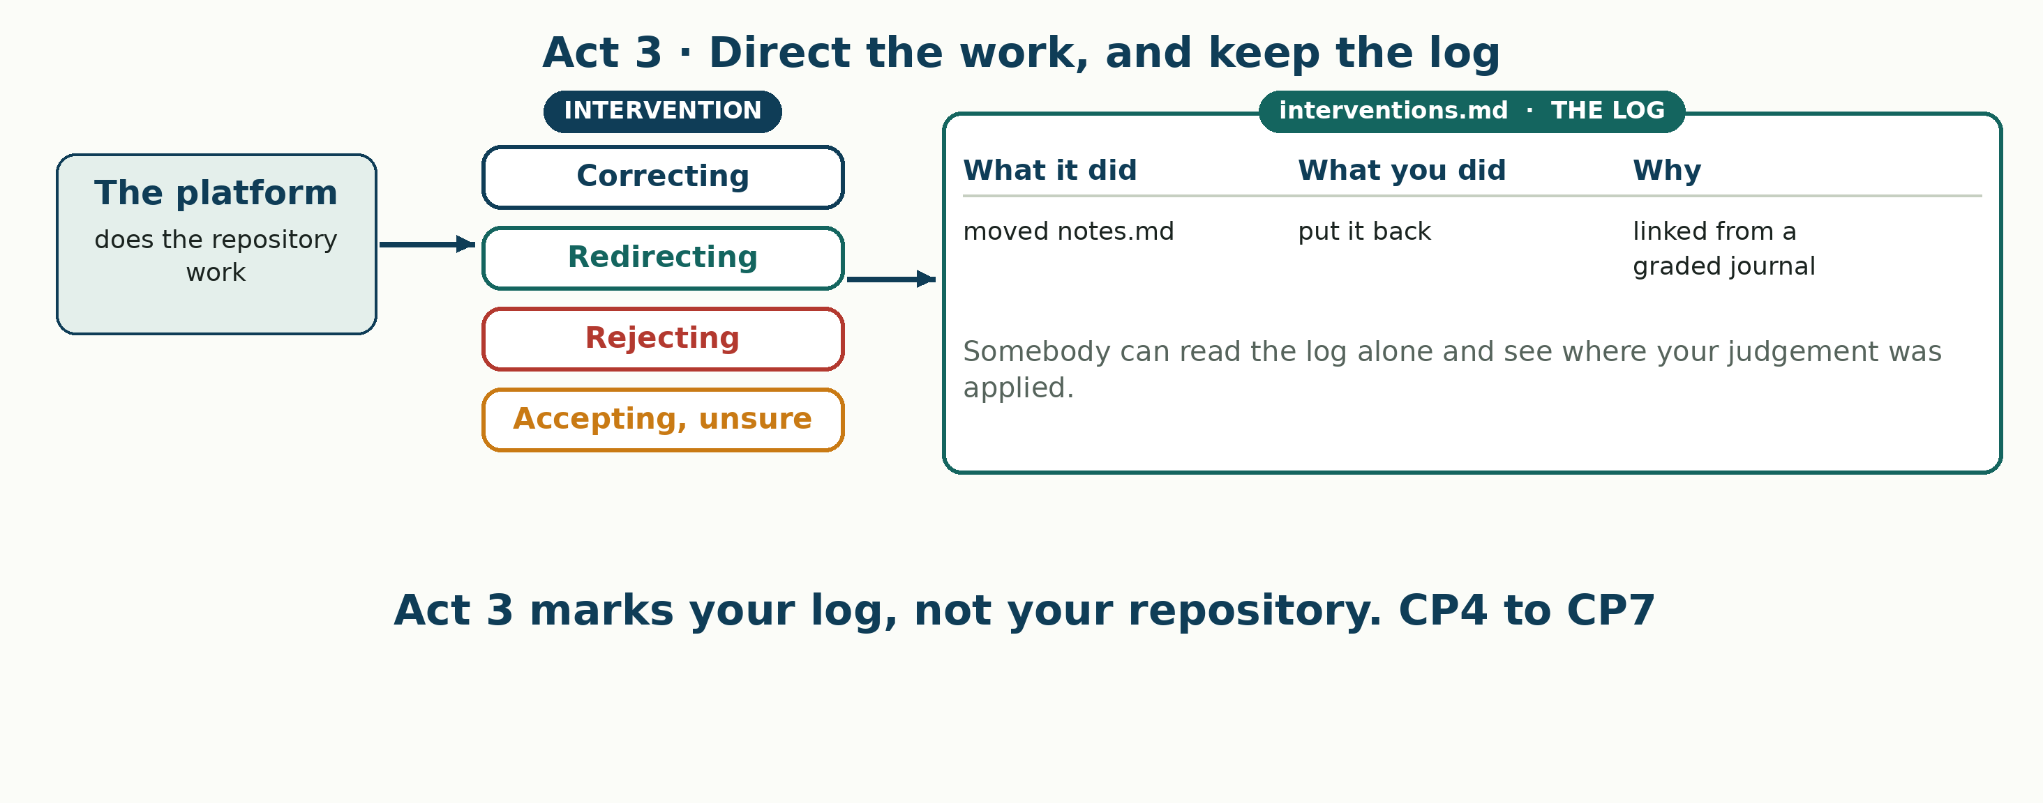
Act 3, in one picture

Slide 19
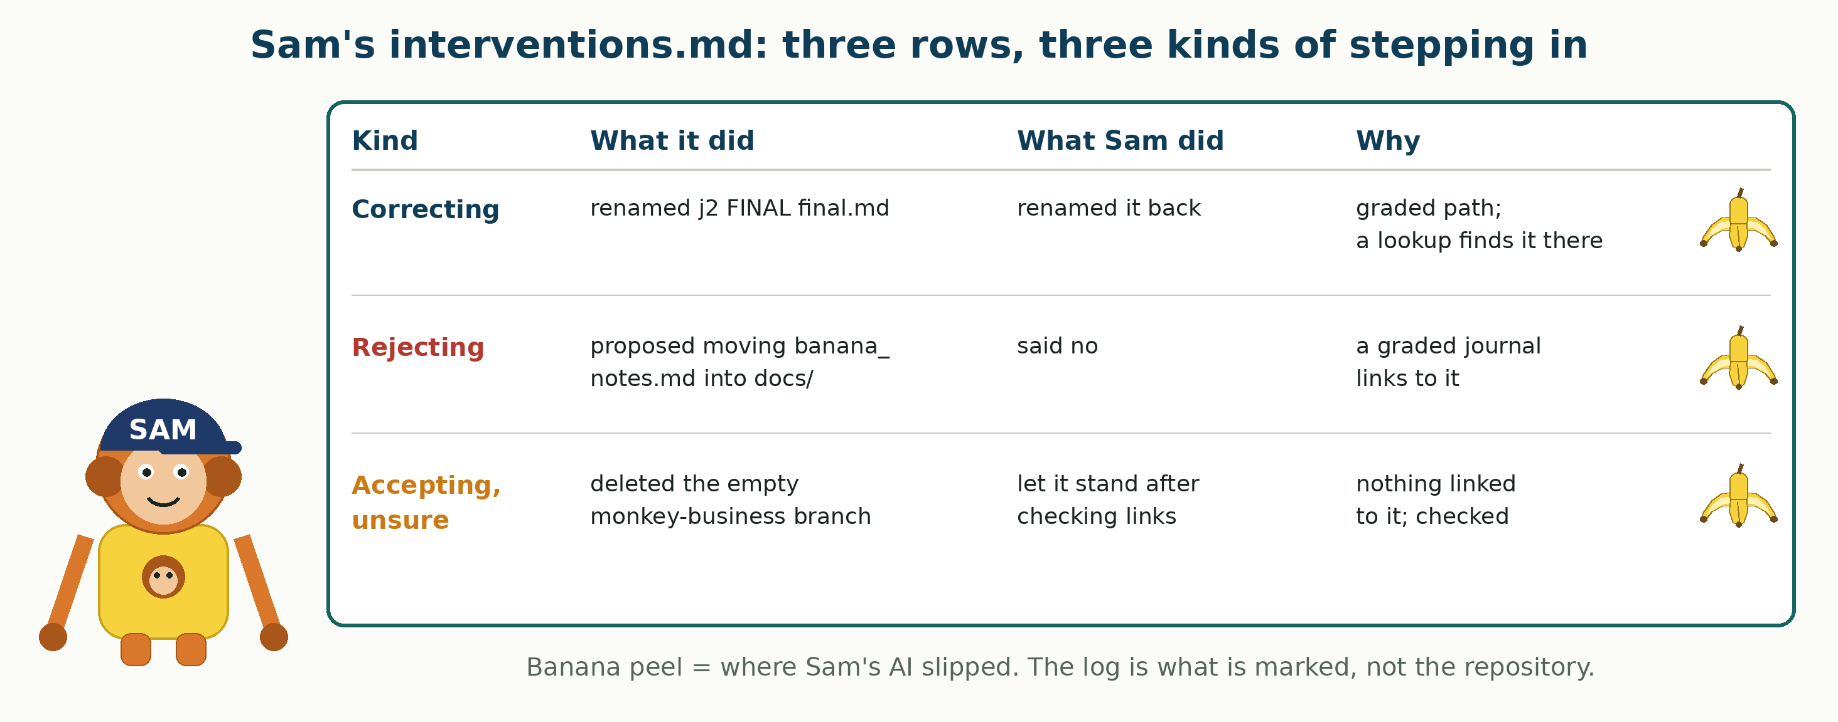
Sam's interventions.md

Slide 20
An empty log is one of two things
A job too small to need directing.
Or a person who stopped watching.

Slide 21
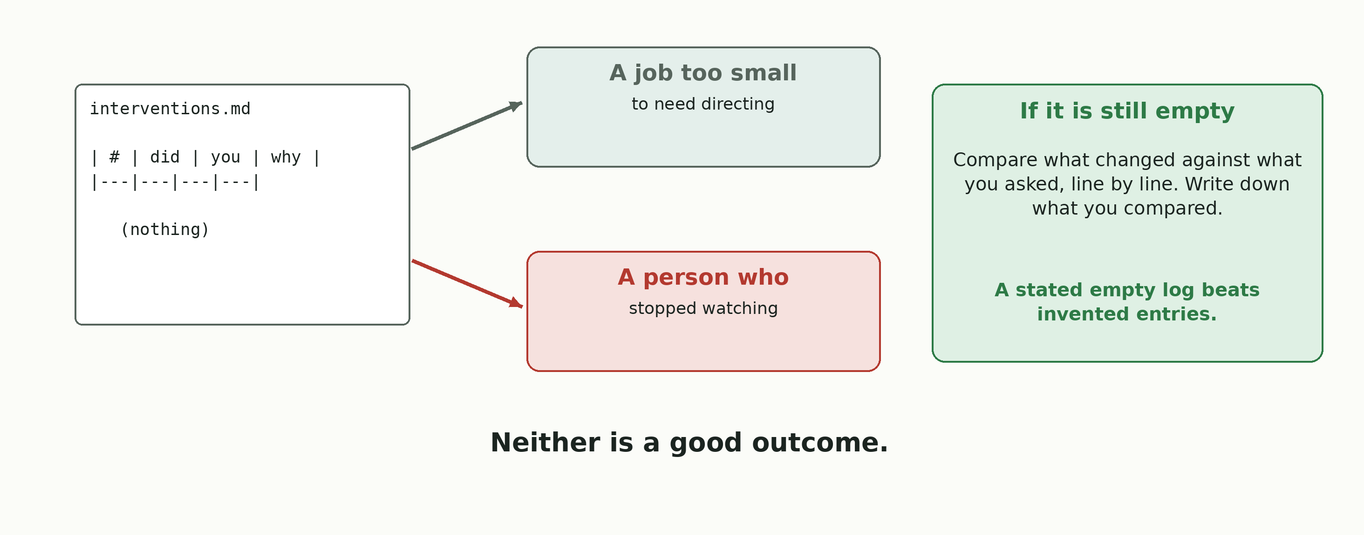
If the log is empty

Slide 22
Act 4 · Judge it against your own criteria
Every criterion, met or not met. Then the one that was the wrong thing to ask for.
Act 1 · Plan at depth, before anything is produced
CP1 · CP2 · 2 pts
Act 2 · Write the standard before the output exists
CP3 · 1 pt
Act 3 · Direct the work, and keep the log
CP4 to CP7 · 4 pts
Act 4 · Judge it against your own criteria
CP8 · CP9 · 2 pts
→
→
→

Slide 23
Which of your own criteria was wrong?
2 points. Every criterion from act 2, judged met or not met, with the evidence.
Then the part that carries it: name one criterion that was the wrong thing to ask for. It can be wrong in one of three ways:
• Easy to meet and improved nothing.
• Turned out not to be checkable after all.
• Or something that mattered and no criterion covered.

Slide 24
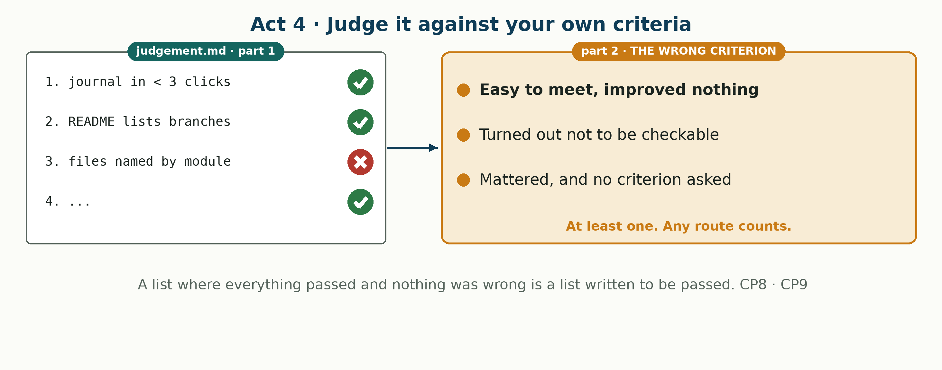
Act 4, in one picture

Slide 25
Sam's judgement.md: the same three criteria
Criterion
Met?
Evidence
Wrong to ask?
Any journal in under three clicks
Met
README to Tech_journal: two clicks
No
Has a README
Met
Already there; said "hi"
Yes: easy to meet, improved nothing
Every file has a clear name
Not met
j2 FINAL final.md kept, it is graded
Yes: meeting it breaks the hard rule

Slide 26
Module 6, recapped
What each act left in your repository. Plus Journal 6, due with the lab.
Act 1 · Plan at depth, before anything is produced
plan.md, four issues, a branch
Act 2 · Write the standard before the output exists
criteria.md
Act 3 · Direct the work, and keep the log
interventions.md
Act 4 · Judge it against your own criteria
judgement.md
→
→
→

Slide 27
From directing to leaving it alone
Module 6: the AI changed your repository while you watched, and you stepped in.
Project 2: nobody watches. Something you schedule commits on its own.
The habits carry over: a plan before it runs, a standard before you see output, a record of what it did. Those are what keep an unattended run safe.

Slide 28
Project 2 · It writes while you are away
Everything you have scheduled so far produced text a person read.
This one changes state: it commits to your repository, on a schedule, while you are elsewhere.
21 points. Due Thursday 22 October, 9:00 pm, with Survey 02.

Slide 29
Project 2 in one picture
Four acts, 21 points. Act 2 is the first thing in the course that changes state while you are away.
Act 1 · Design it
Branch or file named first · 5 pts
Act 2 · Build it and leave
It commits on a schedule · 7 pts
Act 3 · How would you know
If it stopped, while saying it worked · 4 pts
Act 4 · Hand it over
And your own judgement · 5 pts
→
→
→

Slide 30
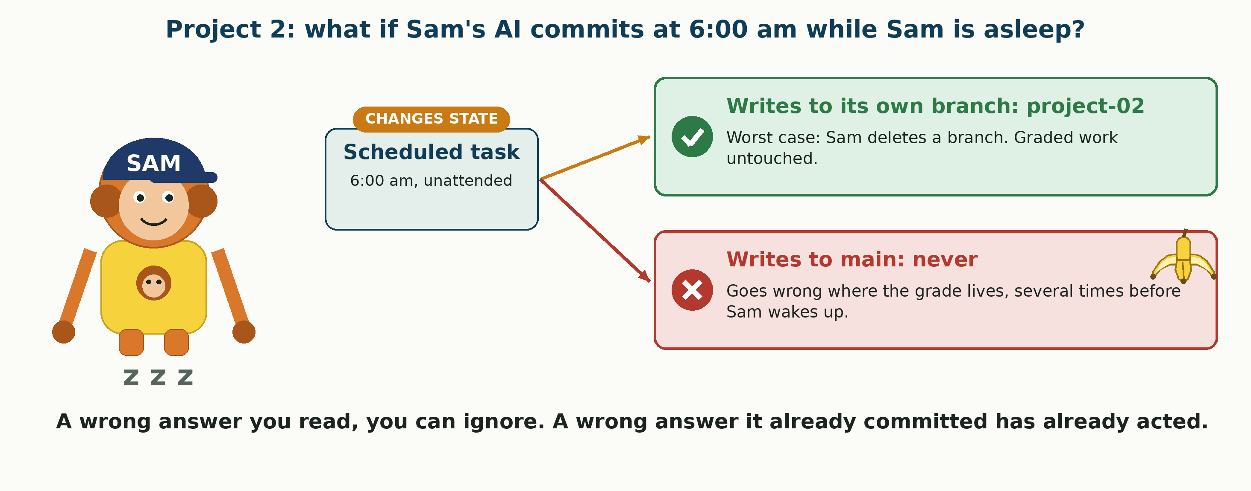
It already acted

Slide 31
Project 2 · Constraint 1: never write to main
Primary branch = main, where your graded work lives.
Your scheduled run writes only to its own branch (e.g. project-02) or one named file.
Name it in act 1, before you build anything.

Slide 32
Project 2 · Constraint 2: write permission
Your scheduled task must be able to write to your repo.
The repo is yours, but the run is not you: it is Claude, using the GitHub connector's permissions.
Connector set to read only, or no scheduling control on your account? Then it cannot write.
By-hand route, full marks: at each run time, open a fresh chat, paste the same instructions, let it write. Two sittings, hours apart, times written down.
Top of notes.md: Route: scheduled or Route: by-hand.

Slide 33
Due dates
• Module 6 lab and Journal 6: Thursday 15 October, 9:00 pm.
• Project 2 and Survey 02: Thursday 22 October, 9:00 pm.
• One pull request carries it all in. It only bundles the files: nobody reviews it, approves it, or merges it. Open it, say what is in it, and you are done.

Slide 34
Module 6 and Project 2, on one page
What you produce
Due
Module 6 lab
plan, criteria, log, judgement: one pull request
Thu 15 Oct, 9:00 pm
Journal 6
Your entry for this week
Thu 15 Oct, 9:00 pm
Project 2
A scheduled run that commits to its own branch, and the record of it
Thu 22 Oct, 9:00 pm
Survey 02
Compared against your own S01 answers
Thu 22 Oct, 9:00 pm

Slide 35
Unit 2, recapped
This closes the unit. Unit 3 starts next week with module 7.
Module 4 · Groundwork
Set something running
Module 5 · Application
Broke it on purpose, read the report
Module 6 · Synthesis
Directed the work and judged it
Project 2
It writes while nobody watches
→
→
→

