Slide 1
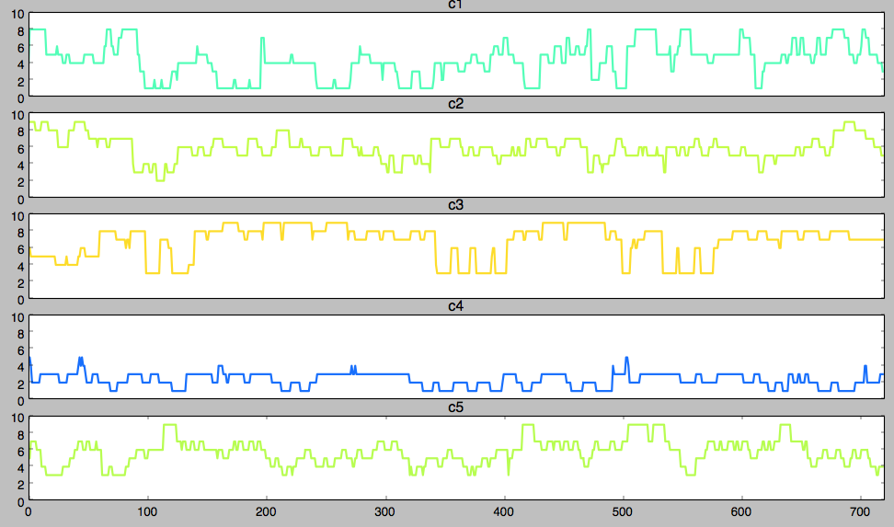
Raw Couple Data
DATA
METHODS
Data
Preprocess
Clustering
HSMM
Simulation
RESULTS
C2
M1
M2
M3
C1
C4
C3
C5
M4
M5

