Slide 1
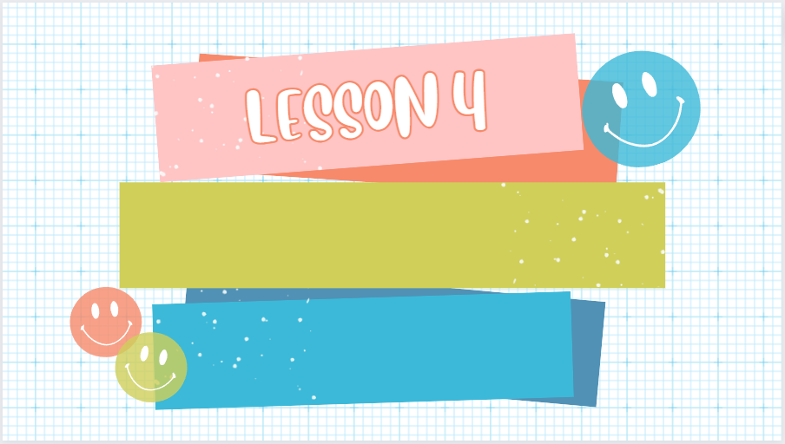
3
Employing the appropriate communicative styles for various situations
(intimate, casual, conversational, consultative, frozen)

Slide 2
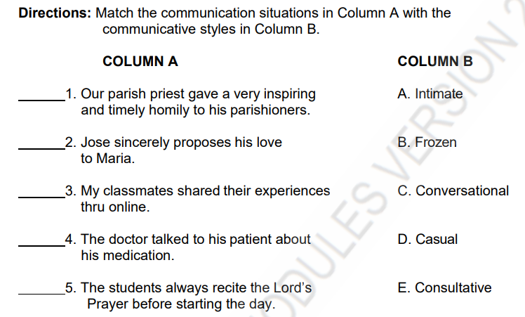
B
A
D
E
B

Slide 3
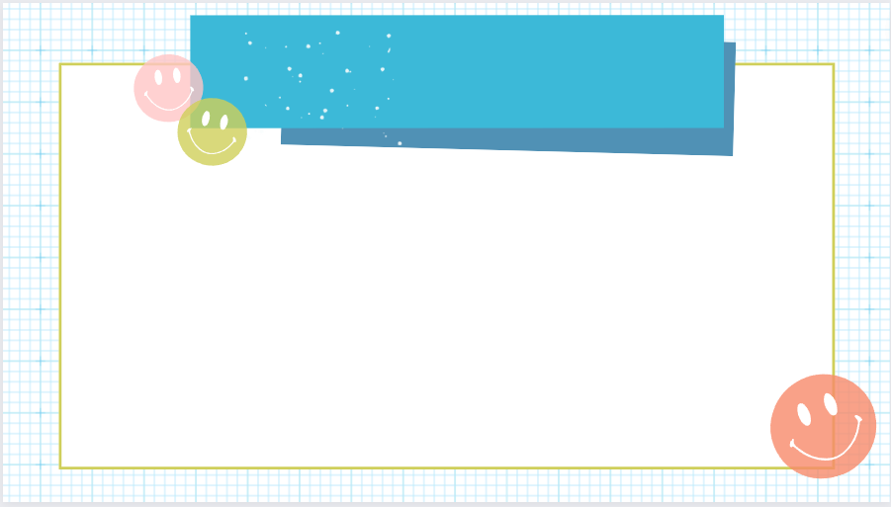
A speech style, according to Martin Joos (1976), a linguist and German professor, refers to the form of language that the speaker utilized which is characterized by the level of formality. Speech style is identified into five types:
Intimate, Casual, Conversational, Consultative and Frozen.

Slide 4

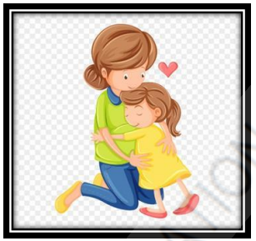
Private talk between people who are very close (family, lovers, best friends).
1. INTIMATE
How it sounds: Short lines, nicknames, inside jokes, sometimes baby-talk. Much is understood without words.
Where you hear it: At home, with a partner, with a close sibling.
Use a nickname and short phrases. You don’t need full sentences.

Slide 5
Examples:
“ I really miss you, I can’t wait to see you again.
2. “ You mean the world to me, and I love you more than words can express”
3. “ I am feeling vulnerable right now, and I need your support.”
4. “Mom : Let’s eat dinner now.
Son : Okay mom, five more minutes”

Slide 6
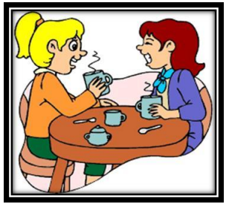
Informal talk with friends or classmates. Not rude, but relaxed.
2. Casual
How it sounds: Contractions, slang, missing some words. Simple and friendly.
Where you hear it: Hanging out, chatting after class, texting friends.

Slide 7
Examples:
“Wanna grab a bite later?”.
2. “ I had a blast at the party last night!”
3. Ana: “Hey, game tonight?”
Ben: “Sure. Meet at 7 at the café.”
Short, friendly words. Easy and relaxed.

Slide 8

Polite everyday talk between people who know each other but aren’t very close (neighbors, co-workers, classmates).
3. CONVERSATIONAL
How it sounds: Full sentences, polite words, people explain a bit so the other person understands..
Where you hear it: Everyday talks, asking for help, small group work.

Slide 9
Examples:
• Maria: “Could you explain slide three? I don’t understand the graph.”
Joel: “Of course. The red line is last month’s sales — it goes up here.”
Polite request + clear explanation. Both people share info.

Slide 10

Semi-formal talk where one person is an expert and helps the other (doctor, teacher, boss). It is respectful and helpful.
4. CONSULTATIVE
How it sounds: Clear language, some technical words if needed, the expert gives advice and background.
Where you hear it: Doctor–patient, teacher–student conference, job instruction.

Slide 11
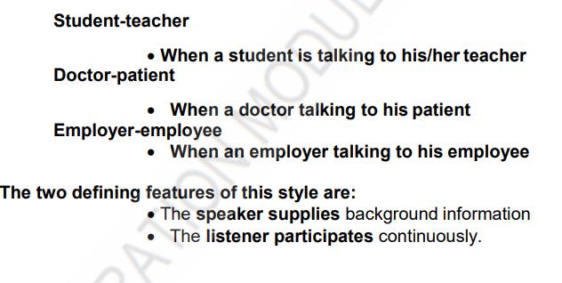
EXAMPLE :

Slide 12
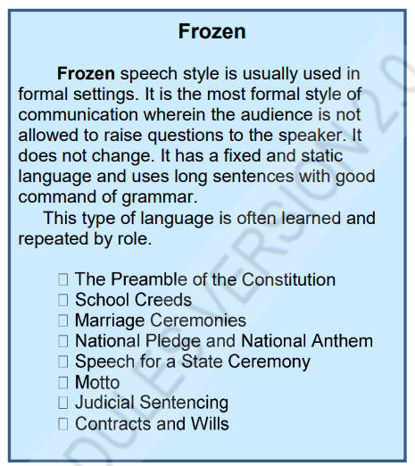

Examples:
• Using formal language with specific rules and conventions, like in ceremonies or official documents

Slide 13
Examples:
“ I hereby declare this meeting open.”.
2. “ We , the undersigned, agree to the terms and conditions stated herein”

Slide 14
Quick cheat sheet
Intimate: very close people, private words.
Casual: friends, relaxed talk.
Conversational: polite everyday talk, explain a little.
Consultative: expert helps client; clear and slightly formal.
Frozen: ritual or fixed words (oath, anthem, prayer).

Slide 15
PRACTICE

Slide 16
DIRECTIONS : Read each line and pick the style. Answers are below.
1. “Hey, let’s meet after school.”
2. “Please describe your symptoms.”
3. “I, [name], do solemnly swear…”
4. “Baby, I’m asleep.”
5. “Could you show me how to do number 5 on the worksheet?”
Casual
Consultative
frozen
intimate
conversational
Which two styles differ most in terms of language flexibility and audience participation?
Frozen and casual

Slide 17
Directions: Identify the speech style appropriate to the following situations.
consultative
________1. talking to a counselor or a physician
________2. inquiring on how to enroll
________3. delivering an oratorical speech
________4. communicating while playing sports
________5. reading school policies
________6. praying before meals
________7. having one-on-one conversation with a stranger
________8. chatting with friends about planned vacation
________9. reading the pledge of loyalty
________10. talking and laughing about memorable experiences
consultative
Frozen
casual
frozen
frozen
conversational
casual
frozen
casual

