Slide 1


SMART INDIA HACKATHON 2026
Problem Statement ID – 26106
Problem Statement Title - AI-powered Email Threat Detection, Geolocation and Forensic Intelligence Platform
Theme- Blockchain & Cybersecurity
PS Category - Software
Team ID -
Team Name (Registered on portal) - The Mentalists

Slide 2

IDEA :- Automated Email Forensics & Threat Intelligence SOC
Platform
The
Mentalists
SHA-256 hash-chained chain of custody
NLP urgency + GeoIP intelligence
• One-click standardized forensic PDF dossier
An integrated, automated Email Forensics & Threat Intelligence Platform that ingests raw email artifacts, extracts deep metadata, and generates court-admissible dossiers:
• Automated header extraction and SPF / DKIM / DMARC authentication scoring.
• Interactive SMTP Routing Topology Graph and GeoIP map visualization.
• Cryptographic hash chaining to guarantee evidence integrity for court submission.
THE PROBLEM
Modern cyber threats exploit email vectors through complex phishing, spoofed headers, and multi-hop relay obfuscation. Security Operations Center (SOC) analysts face critical bottlenecks:
• Manual .eml/.msg header analysis is slow and error-prone
• Limited SMTP-hop and GeoIP visibility
• No tamper-evident evidence ledger for legal use
PROPOSED SOLUTION
WHY IT IS DIFFERENT
EMAIL
AUTH
NLP
ROUTING
GEOIP
DOSSIER
Automated evidence journey — from raw email artifact to verifiable forensic output
@SIH Idea submission- Template

Slide 3
TECHNICAL APPROACH
The
Mentalists
FRONTEND
Next.js + TypeScript + Tailwind • SOC Dashboard • React Flow topology • Leaflet GeoIP map
BACKEND
FastAPI + Python • Email Parser • SPF/DKIM/DMARC verification • NLP urgency scoring • Threat scoring
EVIDENCE & INTELLIGENCE
Email metadata • SMTP hop data • GeoIP intelligence • SHA-256 audit ledger • Court-ready PDF dossier
Implementation Process & Pipeline :-
01
02
03
04
File Ingestion
Header & NLP Parsing
Topology & GeoIP Map
Ledger & PDF Export
Upload .eml / .msg raw emails via React Dropzone to POST /api/analyze API.
Extract Received headers, SPF/DKIM validation, & NLP urgency scoring
Reconstruct SMTP hop network graph and pin origin coordinates on Leaflet map.
Hash-chained audit log creation & 1-click generation of court PDF report.
@SIH Idea submission- Template

Slide 4
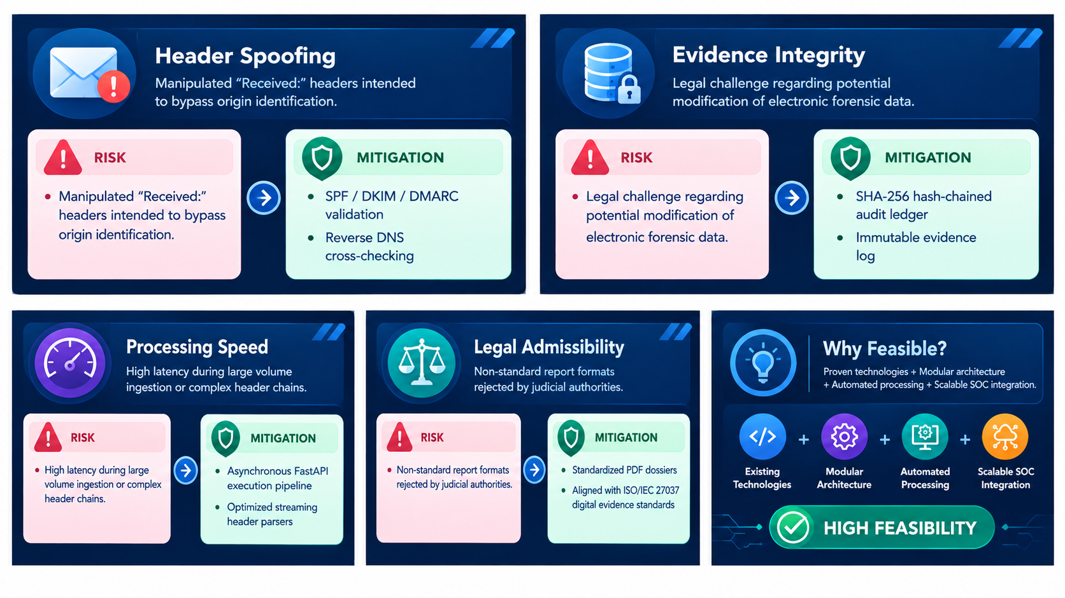
FEASIBILITY AND VIABILITY
The
Mentalists
@SIH Idea submission- Template

Slide 5
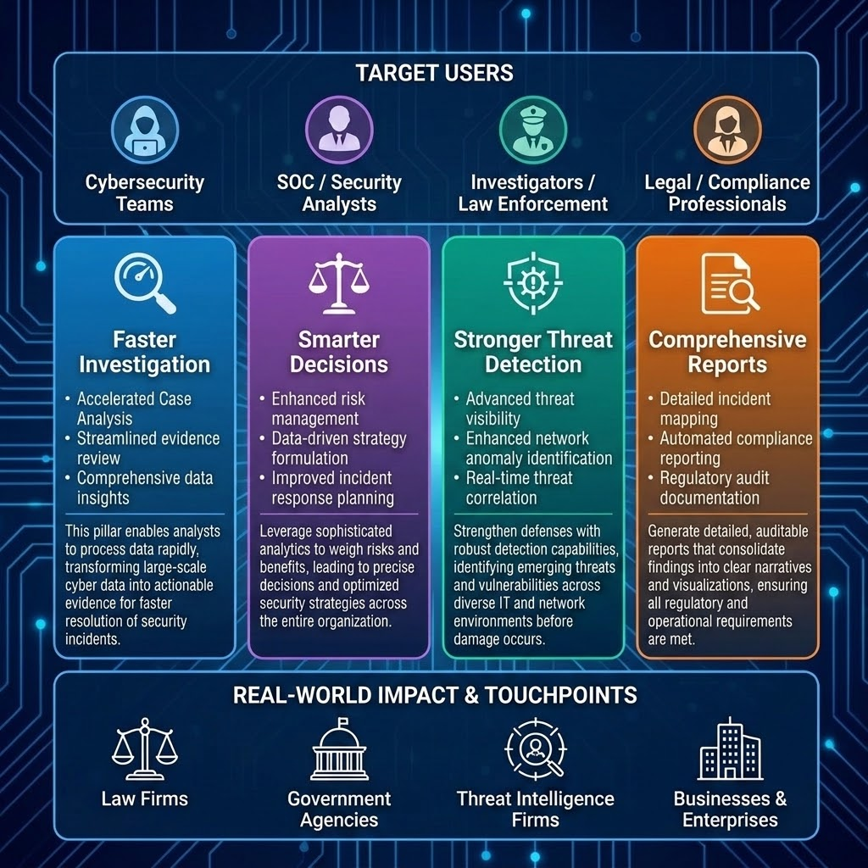
IMPACT AND BENEFITS
The
Mentalists
@SIH Idea submission- Template

Slide 6
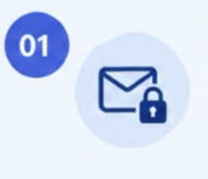

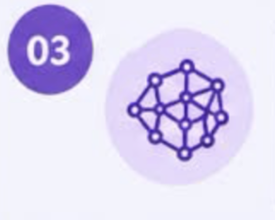
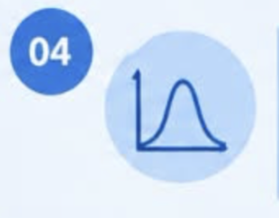
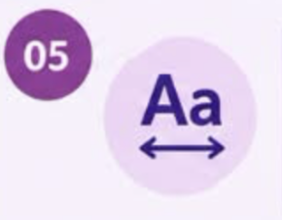

RESEARCH AND REFERENCES
The Mentalists
SMTP AUTHENTICATION
Email authentication & SMTP security
MAGIC BYTES & FILE VALIDATION
File signature /upload validation
SENTENCE TRANSFORMERS
Semantic text similarity
INFORMATION ENTROPY
Entropy - based analysis
LEVENSHTEIN DISTANCE
String similarity /typo detection
spaCy ENGLISH MODELS
NLP & language processing
@SIH Idea submission- Template

