Slide 1

Temporary Boiler Hire RAMS
Risk Assessment & Method Statement for safe delivery, installation, gas/electrical hook-up, commissioning, and continuous operation of temporary heating plant.
Project Scope Temporary Boiler Hire Installation
Compliance Standard Gas Safe / OFTEC / HSE GS6
Document Status Approved Method Statement

Slide 2


RAMS Overview & Objectives
Purpose & Scope
Key Responsibilities
This Risk Assessment and Method Statement (RAMS) establishes a standardised safe system of work for offloading, positioning, connecting, and commissioning packaged mobile boilers.
Site Engineer: Oversees mechanical connections, soundness testing, and flue gas analysis.
Appointed Lifting / Traffic: Crane/HIAB offloading in accordance with LOLER regulations by qualified operator
It eliminates operational downtime while mitigating site hazards related to operation of hot water/steam, gas supply, fuel handling, and heavy transport movements.
Site Principal Contractor: Ensures clear access routes, level hardstanding, electrical/fuel isolation permissions and overall HSE resposnibility

Slide 3
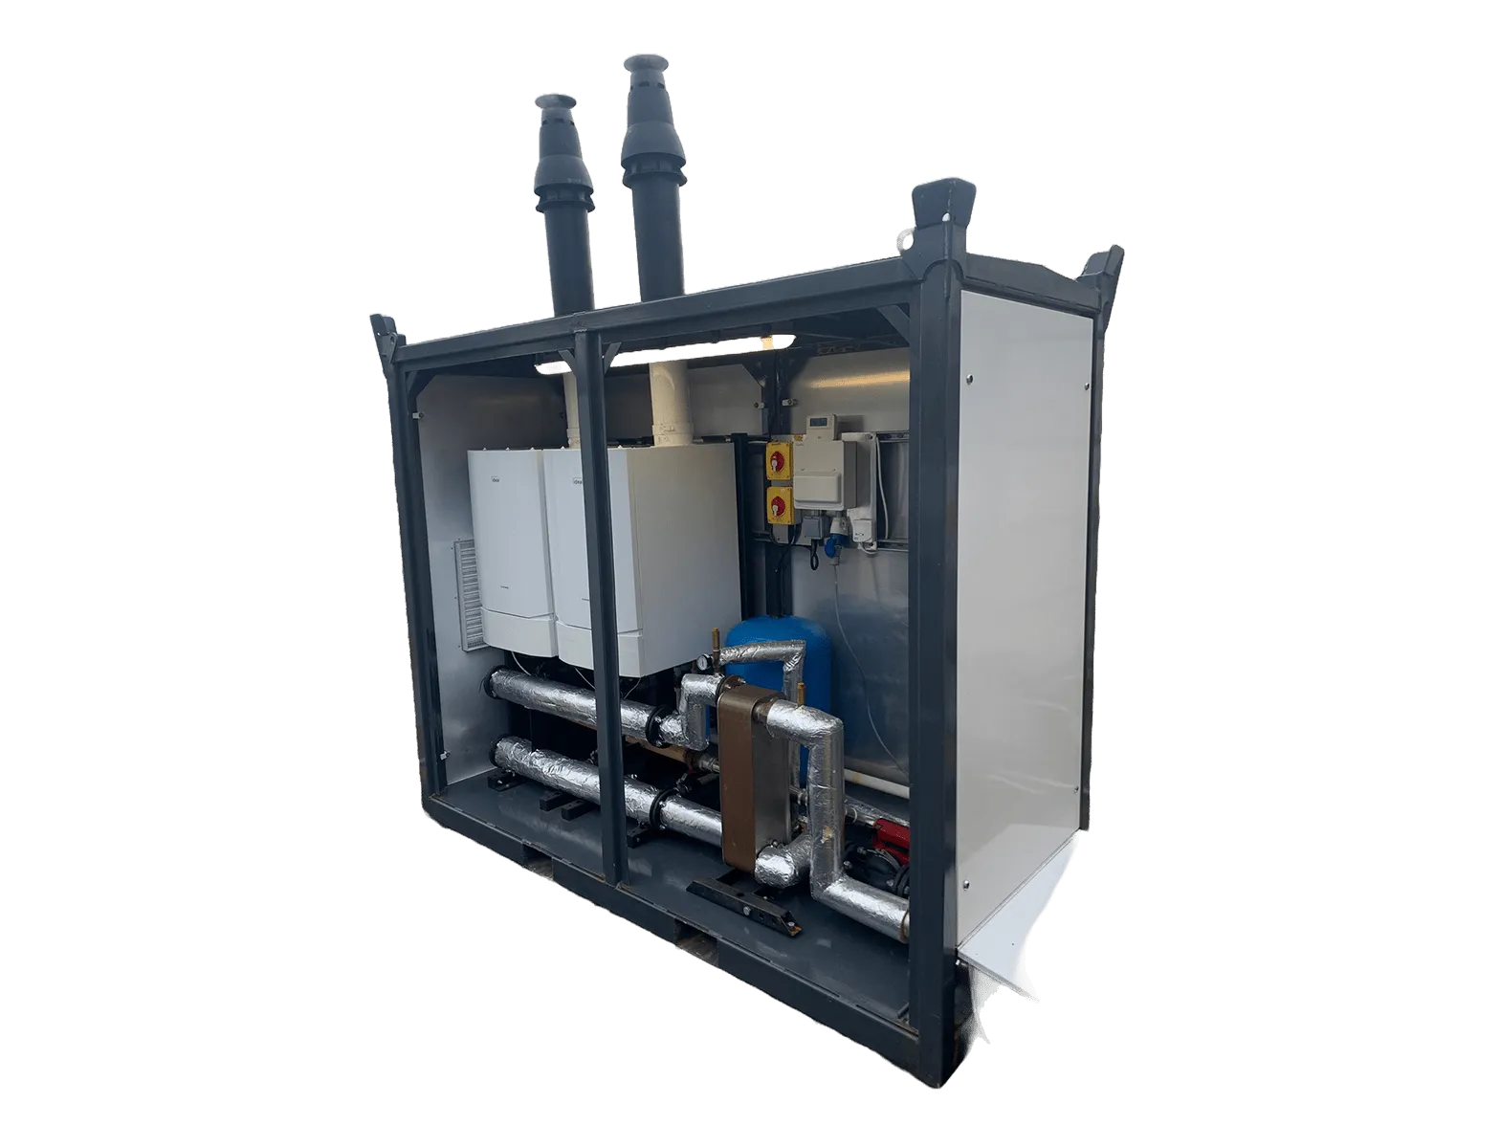

Site Survey & Pre-Installation
A mandatory pre-hire site assessment is conducted prior to dispatching mobile plant rooms to confirm site readiness: Conducted August 5Th 2026
Access Route Inspection: Verify overhead clearance, gate widths, and turning radius for 32t delivery vehicles.
Ground Bearing Capacity: Ensure concrete pad or hardstanding can support up to 15 tonnes per containerized boiler unit.
Utility Point Verification: Confirm proximity to main gas connection, water feed supply, and 3-phase electrical power.

Slide 4
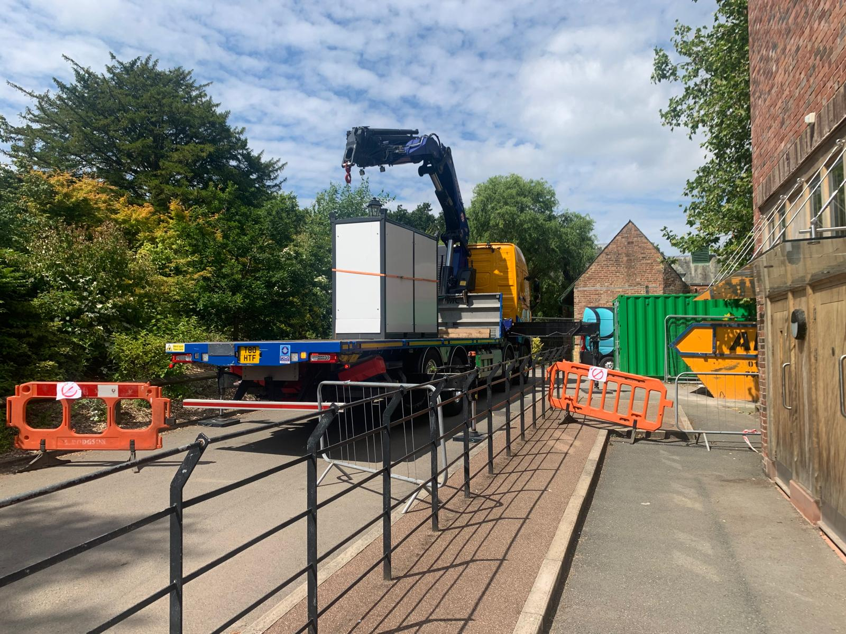
Transport & Offloading Safety
Lifting & Logistics Controls
HIAB offloading and transport positioning are controlled under BS 7121 standards. Exclusion zones are established using rigid barriers to safeguard third-party personnel during heavy crane movements.
Outriggers are deployed on load-spreading mats. Outrigger ground checks and lift plans are signed off prior to offloading containerized units onto designated pads.
There is some amount of traffic restriction to be expected during this operation and any attempts to enter the lifting zone during operation are strictly forbidden.

Slide 5






Mechanical & Electrical Hookup
Flexible Hoses
Electrical Connection
Water Feed & Dosing* if applicable
Install flexible IP and pressure rated stainless steel braided and armoured rubber flexible hoses. Ensure visual gasket checks, gas tightness, and expansion loops are applied to withstand thermal growth if running plate to plate
Connect 3-pin 240v 1-phase CEEform plug. Complete earth bonding continuity test and RCD trip checks before energising internal control panels and pumps.
Connect raw water feed with WRAS-approved backflow prevention device. Verify automatic water presurisation and chemical dosing units are calibrated and operating correctly

Slide 6
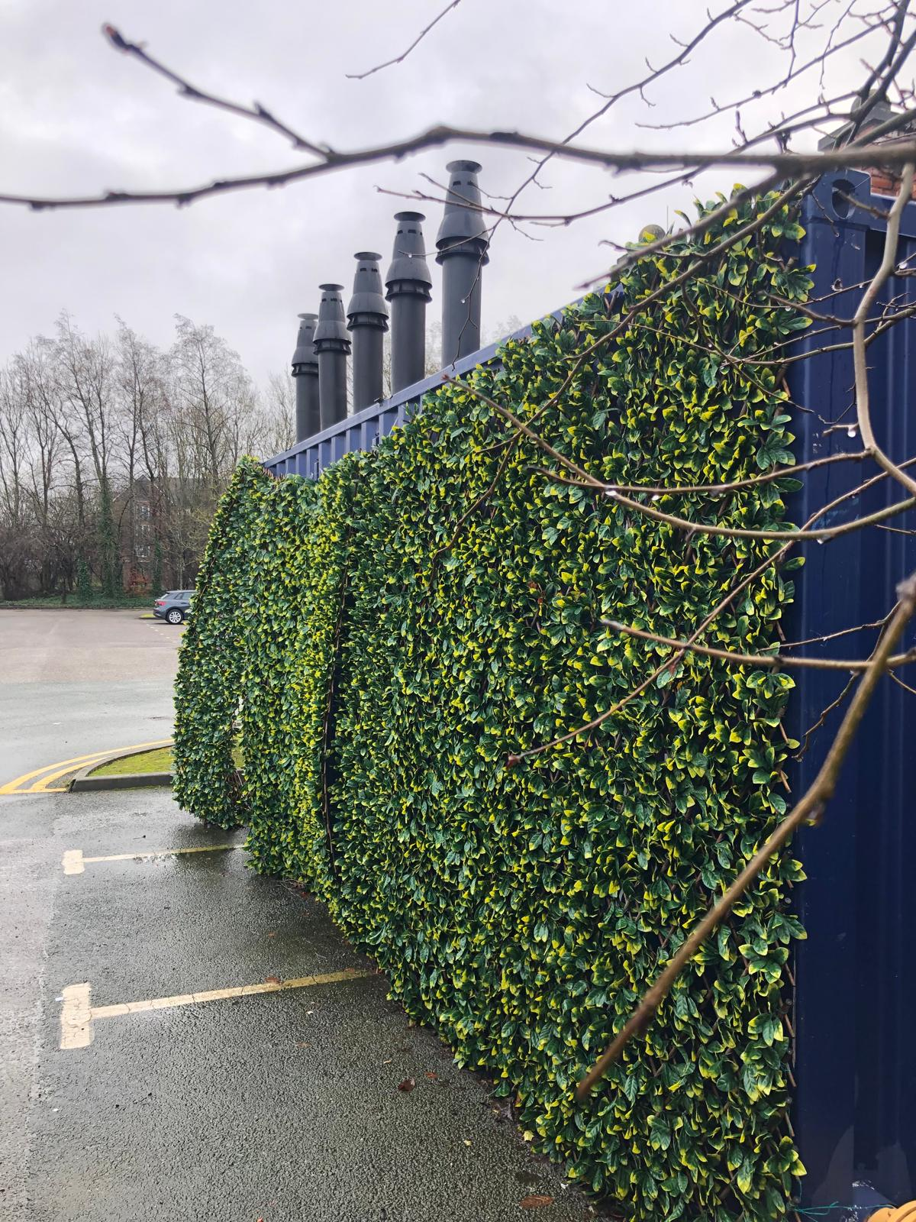
Fuel Supply & Venting Controls
Safe containment and emissions management are critical when managing gas flue positioning via vertical chimney stacks:
Gas Main Isolation: Confirm presence of quick-closing emergency shut-off valves (Solenoid/E-Stop) is linked to gas leak detection sensors.
Fuel Tank Bunding: Temporary HVO/Diesel fuel tanks must be 110% double-skinned bunded with spill response kits on standby where applicable
Flue Discharge: Extend twin-wall flue stacks above the boiler are to be sited away form building, special care to be taken near opening windows and air intakes to comply with Clean Air Act requirements.

Slide 7

Major Hazards & Risk Matrix
Identified Hazard | Risk Level | Control Measures Implemented | Residual Risk
Crane / Vehicle Collision | HIGH | Banksman control, exclusion zones, hard hats & high-vis PPE, site speed limit 5mph. | LOW
Hose puncture | HIGH | Visually check safety clips installed on all fluid lines, pressure testing / replacing old or damaged fleet. | LOW
Gas Leakage / Explosion | HIGH | Tightness test, calibrated gas sniffing tools, automatic slam-shut safety solenoid. | LOW
Scalding Hot Water / Steam | MED | Thermal pipe insulation, warning signage, lockable manifold valves, controlled drain-down points, fencing. | LOW
Electrical Shock / Short | MED | IP65 outdoor connectors, RCD protection from dedicated supply, qualified electricial signoff. | LOW

Slide 8

Commissioning & Soundness Tests
Commissioning Sequence
Before handing over heat delivery, strict hydro-testing and combustion tuning must be executed by Gas Safe / OFTEC registered engineers:
1.5x
Hydrostatic Pressure Test: Hold system at 1.5 times working pressure for 30 mins with zero pressure drop.
Working Pressure Test Limit
Burner Combustion Analysis: Calibrate burner air/fuel ratio to achieve optimal O2, CO2, and zero CO carbon monoxide hazard.
Safety Interlock Verification: Make best efforts to trigger high-limit thermostats and low-water cut-offs to confirm auto-shutdown, this is not always possible depending on client safety features.

Slide 9
Safe Operation & Daily Checks
Visual Inspections: Examine flexible hose couplings, expansion joints, pressure gauges, and if fuel oil is on site bunded fuel levels every 24 hours.
Water Chemistry & Blowdown: Perform daily TDS (Total Dissolved Solids) tests and regular boiler blowdowns to prevent scaling and corrosion. Steam boilers only
Access Control & Signage: Ensure containerised plant doors remain locked to unauthorized personnel with mandatory PPE signage posted outside.
Shift Logbook Records: Document system temperatures, fuel consumption, operating pressure, and chemical dosing logs on daily site sheets.

Slide 10




Emergency Response Workflow
2. Isolate Fuel Source
4. Contact Support
Manually isolate gas emergency lever valve or close oil tank isolation valves.
Notify 24/7 Rapid Emergency Response hotline and site Principal Safety Officer.
1. Hit Emergency Stop
3. Evacuate Zone
Press external E-Stop button on the boiler housing to immediately cut fuel & electrical power.
Safe exclusion perimeter and clear site personnel to designated assembly point.

Slide 11

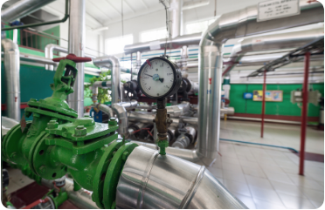
Decommissioning & Site Clearance
1. Controlled Cooldown: Safely flame-out burner, allow system water temperature to drop below 40°C prior to drain down.
2. Isolation & Cap-off: Disconnect electrics, blank off gas lines with tested caps, and purge residual fuel lines.
3. Lifting & Handover: Re-rig containerized unit, execute crane lift onto transport vehicle, and sign off site handback certificate.

Slide 12
Compliance Sign-Off
This Risk Assessment & Method Statement must be briefed to all site engineers, lifting supervisors, and client representatives before work begins.
24/7 Safety Hotline
Steve.pike@rapidchillers.co.uk
Working to Gas Safe & OFTEC standards

