Slide 1
Rust
What
Why
How
References

Slide 2
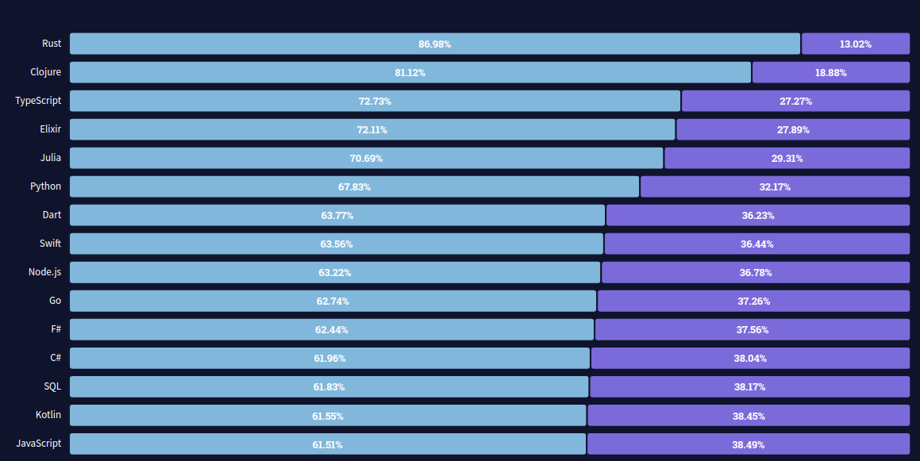
What
Notes:
https://insights.stackoverflow.com/survey/2021#section-most-loved-dreaded-and-wanted-programming-scripting-and-markup-languages

Slide 3
What: can be built by Rust
Replace C/C++ applications: OS, DB, system tool
Embedded devices
WebAssembly: Figma
Web server: Actix, Rocket

Slide 4






What

Slide 5
Why:fast, safe & compatibility
Ownership & borrowing
Zero cost abstraction
No GC
Low level control
Compatibility with C/C++ & WebAssembly
Powerful compiler
Notes:
https://blog.rust-lang.org/2015/04/10/Fearless-Concurrency.html

Slide 6
Why:cons
Learning curve
Rich Api
Notes:
https://blog.rust-lang.org/2015/04/10/Fearless-Concurrency.html

Slide 7
How: understand Rust
Syntax
Key concepts: ownership, move/ borrow, lifetime
Common Api: Strings, Vec, Map, Set, Iter, struct, trait, enum, match, Option, Result, Closure, tuple, annotation, macro
Common crate
Notes:
static type, multi paradigm: functional, OOP, generic

Slide 8
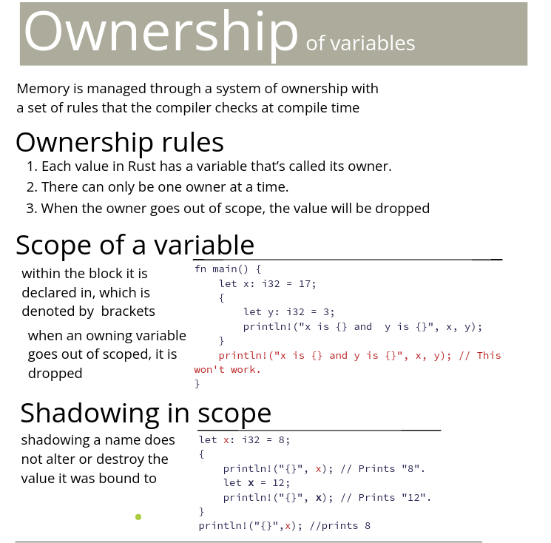

Slide 9
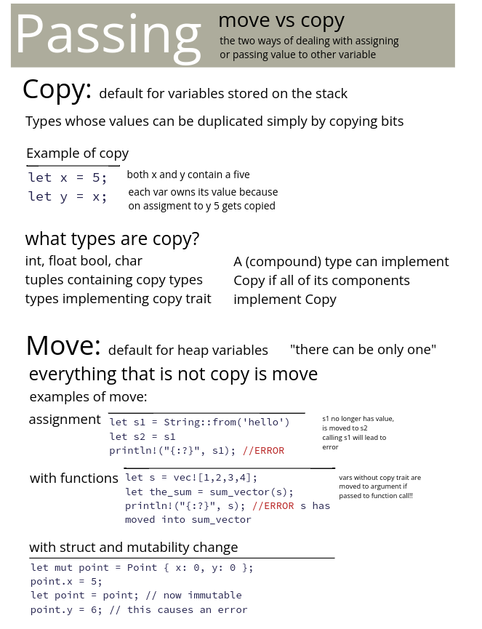

Slide 10
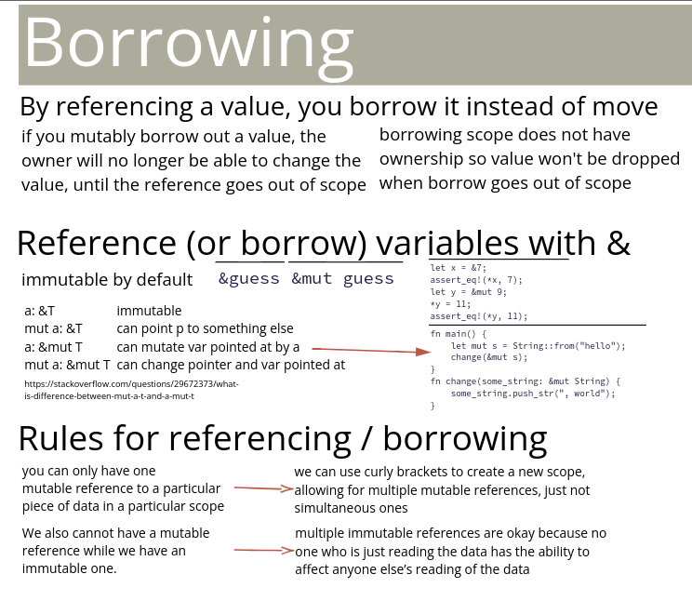

Slide 11
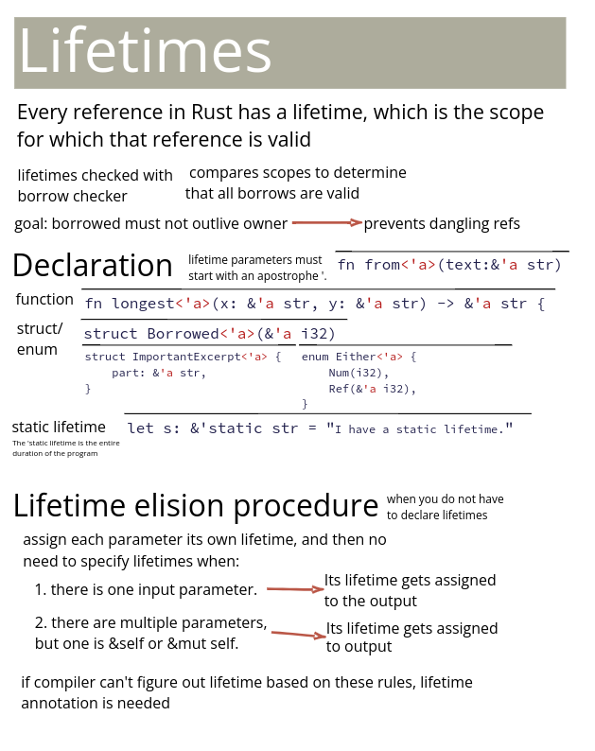

Slide 12
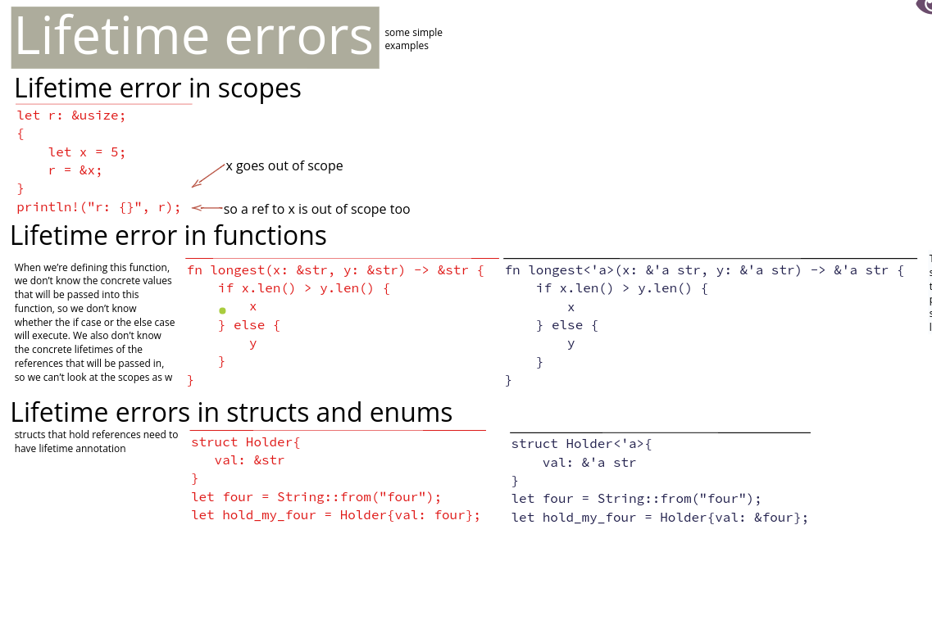

Slide 13
How: Macro
macro_rules! assert_eq {
($left:expr, $right:expr) => {
let left = $left;
let right = $right;
if left != right {
panic!("assertion failed: {:?} != {:?}", left, right);
}
}
}
assert_eq!(1 + 1, 2);

Slide 14
How: no hidden state
enum Option<T> {
Some(T),
None,
}
enum Result<T, E> {
Ok(T),
Err(E),
}
// v is Option<&T>, not &T -- cannot use without checking for None
let v = my_vec.find(|t| t >= 42);
// n is Result<i32, ParseIntError> -- cannot use without checking for Err
let n = “42”.parse();
// ? suffix is “return Err if Err, otherwise unwrap Ok”
let n = “42”.parse()?;

Slide 15
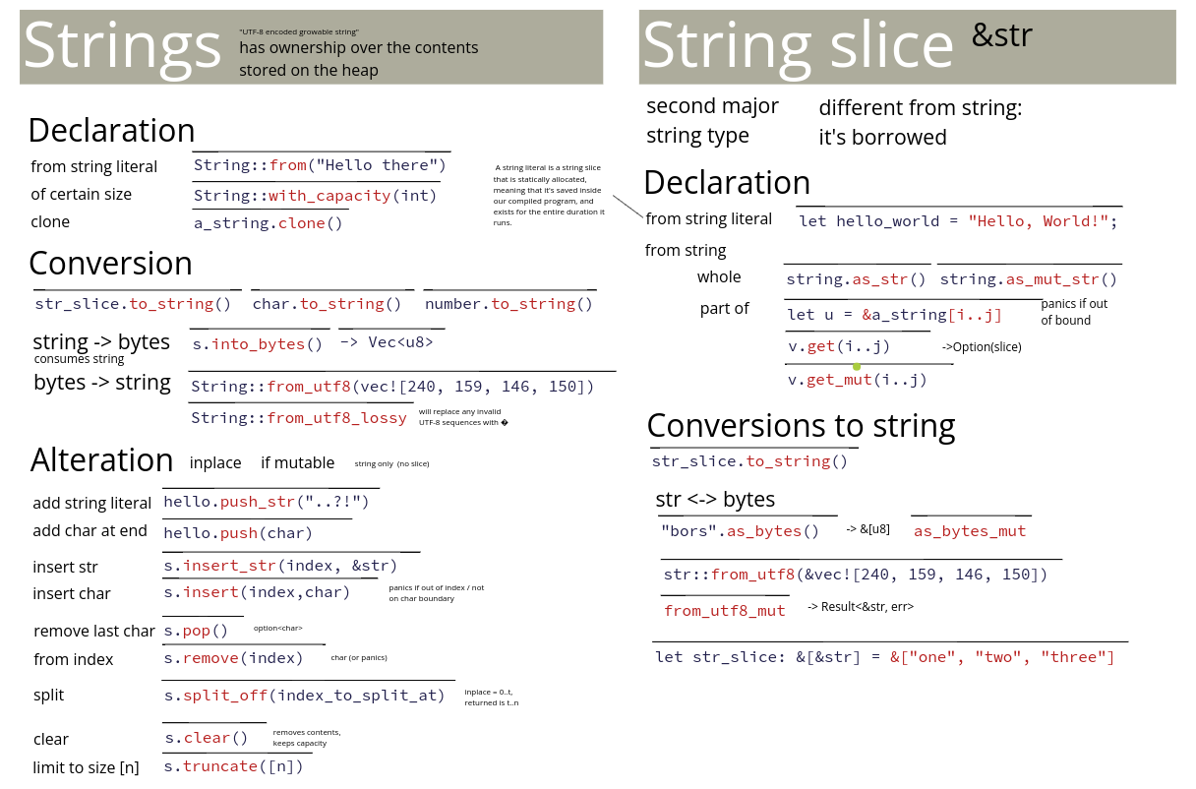
How:

Slide 16
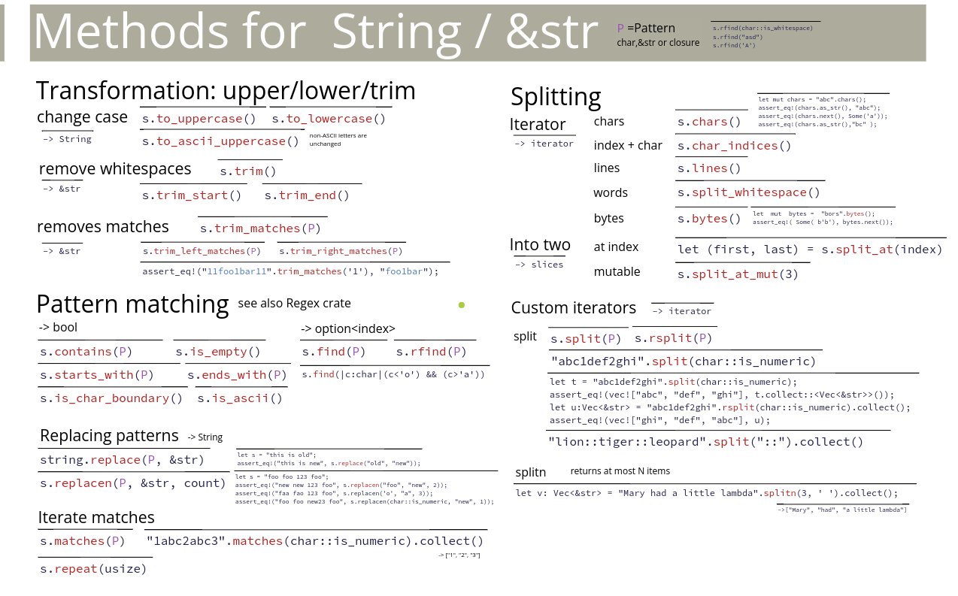

Slide 17
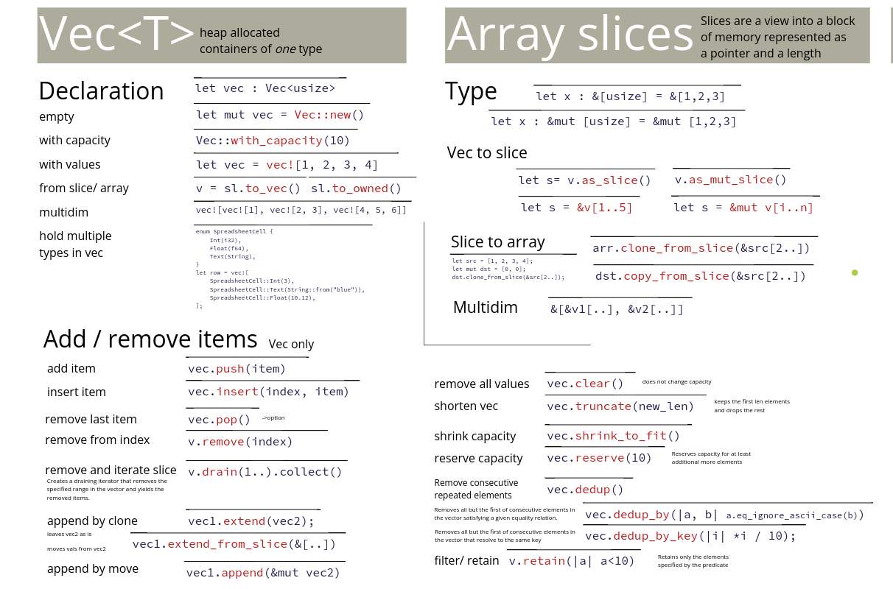
Notes:
let mut u:Vec<u8> = Vec::new(); // create empty vector of unsigned 8 bit int, can grow
let mut v = vec![3,4,5]; // initialize mutable vector using vec! macro
let w = vec![1,12,13]; // vectors can be immutable too
u.push( 2 ); // append item to vector
u.pop(); // vectors can return+remove last input (like a stack)
v.contains(&3); // true if vector contains value
v.remove(1); // remove the nth item from a vector...
v.append(u); // append v with u (u becomes empty ([]), both mutable)
v.extend(w); // extend v with w (v owns w, w can be immutable)
v.resize(200,0); // make vector have 200 elements, set them to 0
let x = &w[1..]; // get a slice of a vector (a view into it's elements)
print("{:?}",x); // [12,13];
let vs = v.len(); // length of vector

Slide 18
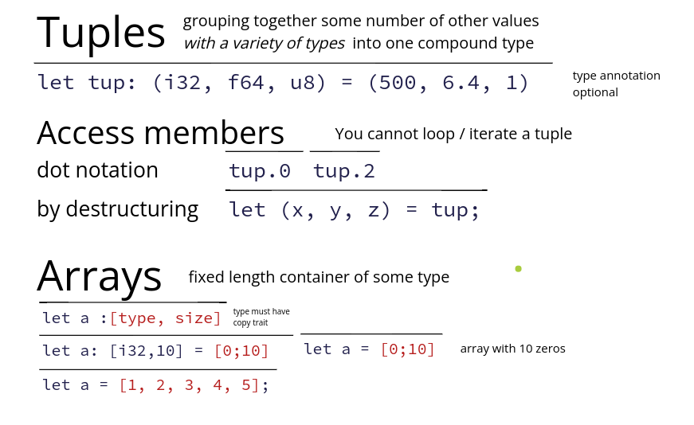
How:
Notes:
let (p,d,q) = (4,5,6); // tuple() can assign multiple variables at once
print("{}",p); // you can use them alone after tuple assignment
let m = (4,5,"a"); // tuples can have multiple different types as elements
let (a,b) = m.1, m.3; // tuple dereference with .1, .2, .3
let (a,b) = m.p, m.q; // error, cannot index into a tuple using a variable

Slide 19
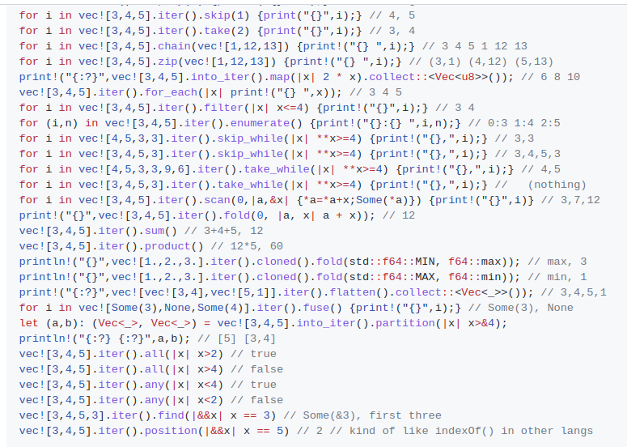
Notes:
https://github.com/donbright/rust-lang-cheat-sheet

Slide 20
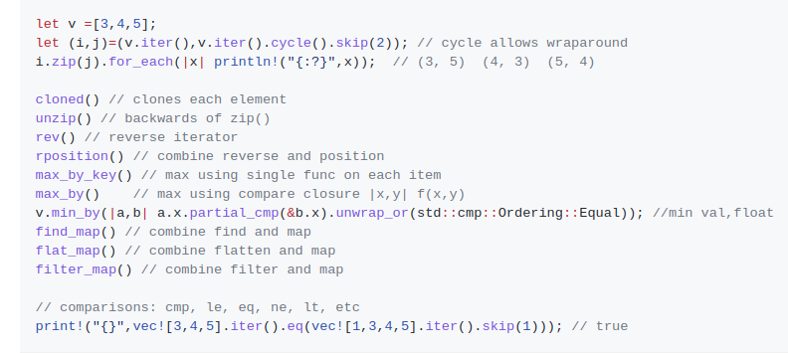

Slide 21
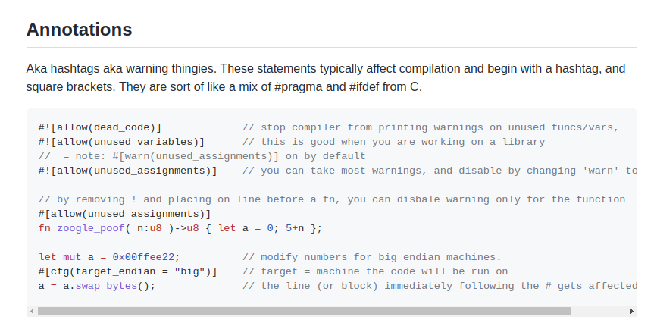

Slide 22
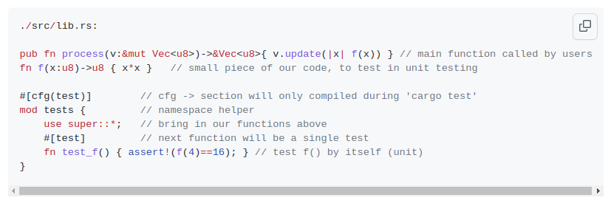
How: test
Notes:
Most unit tests go into a tests mod with the #[cfg(test)] attribute. Test functions are marked with the #[test] attribute.
Tests fail when something in the test function panics. There are some helper macros:
assert!(expression) - panics if expression evaluates to false.
assert_eq!(left, right) and assert_ne!(left, right) - testing left and right expressions for equality and inequality respectively.

Slide 23
How: common crate

Slide 24
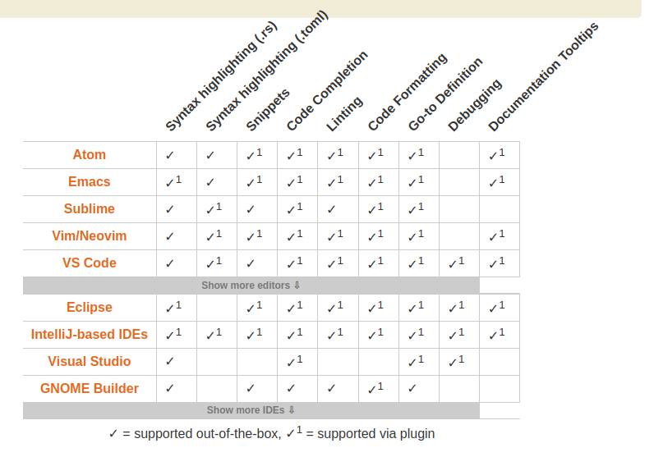

Slide 25
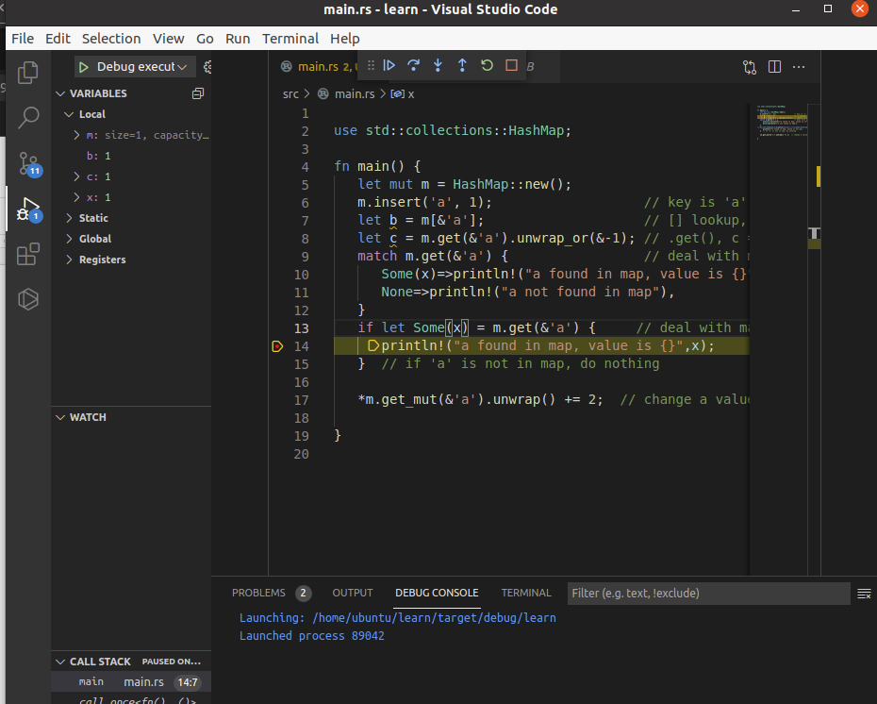
How: debug
Notes:
CodeLLDB extension

Slide 26
How: practice
https://tourofrust.com/
https://exercism.org/tracks/rust
Notes:
String, str, struct, vec, result, option, iterator

Slide 27
Ref
https://insights.stackoverflow.com/survey/2021#section-most-loved-dreaded-and-wanted-programming-scripting-and-markup-languages
https://doc.rust-lang.org/book/
https://github.com/rust-unofficial/awesome-rust
https://overexact.com/rust-for-professionals/
https://cheats.rs/
https://github.com/donbright/rust-lang-cheat-sheet
https://www.breakdown-notes.com/make/load/rust_cs_canvas/true
Notes:
String, str, struct, vec, result, option, iterator

