Slide 1



Point Cloud Segmentation : Plugin development
LEFEVRE Henry – M2 Mia parcours GICAO
SEGURET Aymeric – M2 Mia parcours GICAO

Slide 2

Introduction
M2 Project
Notes:
As part of the master 2 GICAO we are asked to complete a project.
This project aims to familiarize us with project management and not just in the coding portion, as the more administrative side.
Today we are going to present the halfway state.
2

Slide 3
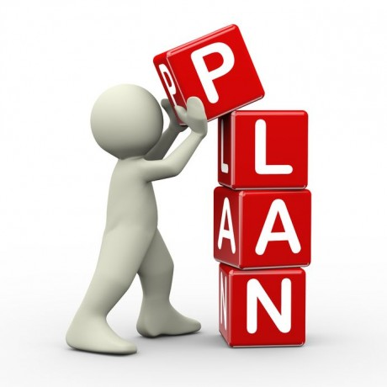
Plan
People involved
Subject
Objectives
Software and requirements
What we have to do
Organisation
Risk evaluation and responses
Work accomplished
Notes:
To introduce you to our project, we chose to follow this path.
3

Slide 4



People involved
Tutors :
Pablo Coves - INRIA
Jean-Claude Léon - INRIA
Supervisor :
Didier Morel - Staff Statistician at BD
Students :
Henry Lefèvre – M2 GICAO
Aymeric Seguret – M2 GICAO
Notes:
Initially leaders, initiators of the project and our responsibles : …
Then the head of the academic unit : …
And finally we : …
Now that we know the subject and all the actors in this project, we will present the different software used in it.
4

Slide 5
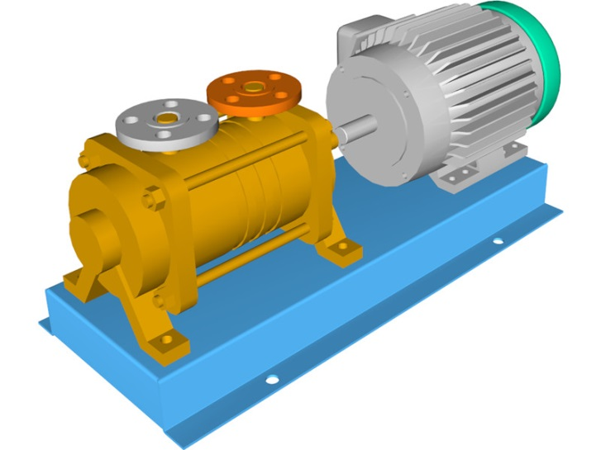
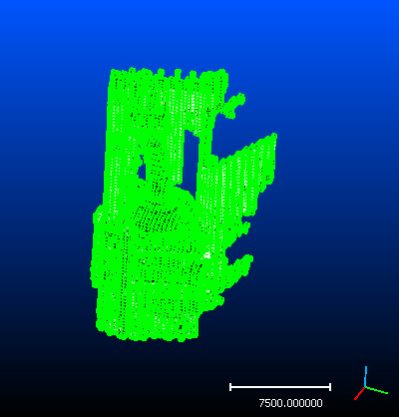
Subject
Contribution to CAD assembly reconstruction from 3D laser scanning
Manual scan done by EDF
Point cloud to clear before manipulation
Notes:
EDF has done a manuals scans of objects that comes from a pump in order to reconstruct a CAD model
Piece scanned are held by some devices (clamps, vices, V-shape, …) and a scanner is then performed
These scans generate point cloud in which some point belongs to some near devices
Before being able to manipulate a CAD model, these clouds have to undergo a clean of these foreign elements
Here is our subject. Therefore we deduced therefrom a number of objectives.
5

Slide 6
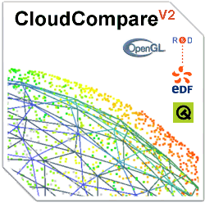
Objectives
Final objective : implement a method to segment a point cloud
Principal software used :
CloudCompare
=> write a plugin
Notes:
The ultimate goal is one, yet it is obvious that other intermediate goal come again and will add to it.
Plugin préliminaire
Prise en main des structures de données
Prise en main complète de CloudCompare
Réaliser le cahier des charges
Construire le diagramme de Gantt et poser des dates et des objectifs
To achieve this, we will use mostly software that was imposed on us : CloudCompare. CloudCompare allows us to properly handle a point cloud, but we present you this software in detail thereafter.
So much for our goal. However, this project does not concern us only. As said quickly in introduction EDF is an actor (uninvolved but an actor anyway) but it's not the only one. So let introduce you to the people involved.
6

Slide 7
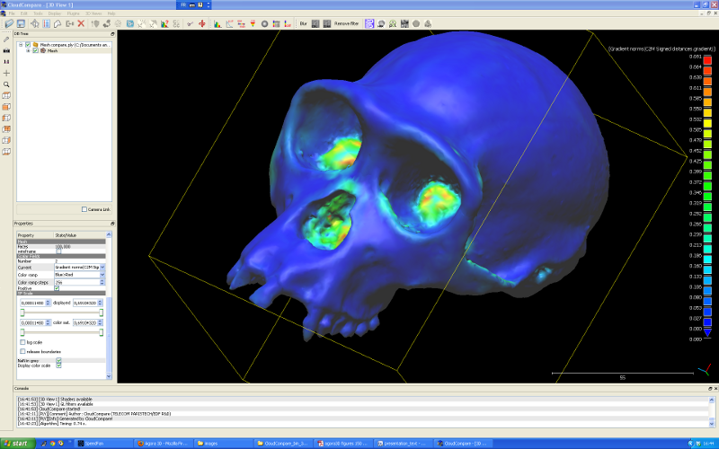
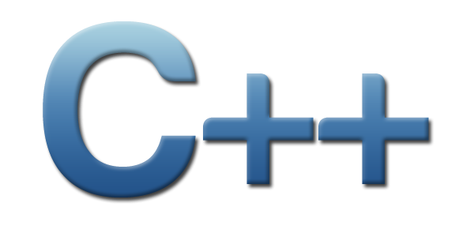

CloudCompare
CloudCompare is a 3D point cloud processing software (such as those obtained with a laser scanner).
Notes:
Open source software available on multi OS. Users can interactively handle a point cloud or a triangle mesh.
CloudCompare provides a set of basic tools for manually editing and rendering 3D points clouds
So it has not been chosen randomly
Allows users to write plugin in c++ : Can using dummyModule
Another software : Salome is free software that provides a generic platform for Pre- and Post-Processing for numerical simulation. It is based on an open and flexible architecture made of reusable components.
7

Slide 8

Requirements
Fixed :
- Data as Point Cloud
- Using CloudCompare and write plugin
- Deadline
Personal :
Data and CouldCompare comprehension
Organisation
Notes:
So we have our goals, and our software. But now it is necessary to define customer requirements (which we are so fixed) and that we set for ourselves.
In a first time, the requirements set by others (responsible or academic) : …
In a second time, ours : …
Well, the subject is clear, and software requirements are too. Let us now see our organization in time.
8

Slide 9
TO DO

Slide 10
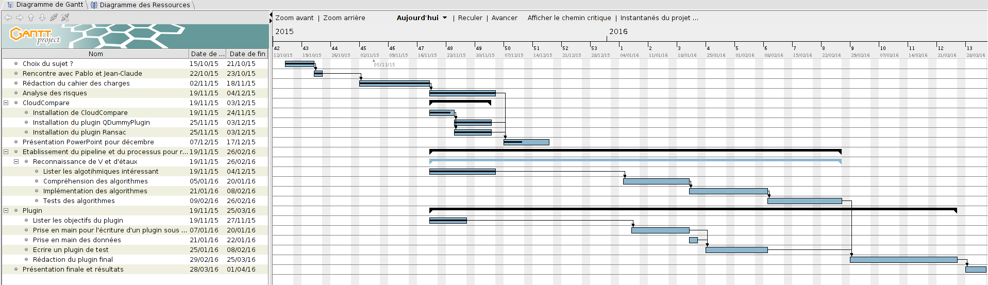
Plannification
First presentation : 17/12
Deadline : 25/03
Notes:
The Gantt chart presented above is only a tool and overviews of our organization. We're spread out the tasks and have thus set some intermediary deadlines.
[...]
Of course this is the only one provisional schedule, it is obvious that it can not be follow carrefully. This is explained by the fact that we tried to organize in providing for the risks but can not however foresee everything. Besides, what are these risks ?
10

Slide 11

Risks
We are not administrator on university network
Size of the Data (3,5 GB)
Shape recognition : thesis & research
No optimal algorithms/solutions
Work overload
Notes:
[…]
We have presented a certain amount of risks that we anticipated and analyzed, and thus we have found some few solutions.
11

Slide 12
Responses to risks
Work on personal computer
Many algorithms to try
Many papers on the subject
A good organisation
Notes:
[…]
Now that everything is explained, or are we concretely.
12

Slide 13

Work accomplished
Installation of CloudCompare on the network
Subject comprehension
Data and software handling
Long-term organization

Slide 14

Conclusion and Questions
Still a lot of work
Many line of code to write and test
Any questions ?

