Slide 1



Point Cloud Segmentation : Plugin development
LEFEVRE Henry – M2 Mia parcours GICAO
SEGURET Aymeric – M2 Mia parcours GICAO

Slide 2
Introduction

Slide 3
Plan
Introduction
Sujet
Objectifs
Rôle des intervenants
Tenant et aboutissant
Organisation dans le temps
Risques
Bilan
Réponse au risques
Conclusion
Notes:
Ca c’est le cheat

Slide 4
Subject
Contribution to CAD assembly reconstruction from 3D laser scanning
Manual scan done by EDF
Point cloud to clear before manipulation
A faire → rajouter une image du nuage de points
Notes:
EDF has done a manuals scans of objects that comes from a pump in order to reconstruct a CAD model
Piece scanned are held by some devices (clamps, vices, V-shape, …) and a scanner is then performed
These scans generate point cloud in which some point belongs to some near devices
Before being able to manipulate a CAD model, these clouds have to undergo a clean of these foreign elements

Slide 5
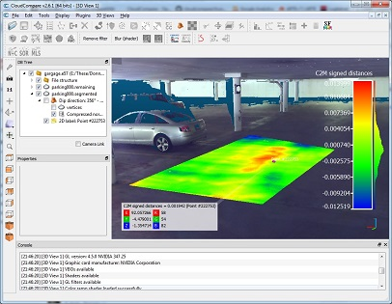
Objectifs
Final objectif : implement a method to segment a point cloud
Principal software used : CloudCompare
- write a plugin
Notes:
CloudCompare permit to us to properly handle a point cloud

Slide 6



People concerned
Tutor :
Didier Morel
Responsibles :
Pablo Coves - INRIA
Jean-Claude Léon - INRIA
Students :
Henry Lefèvre
Aymeric Seguret

Slide 7
CloudCompare
CloudCompare is a 3D point cloud processing software (such as those obtained with a laser scanner).
Image de nuage de point (un des notres)
Notes:
Présentation de cloud compare,
Open source software available on multi OS. Users can interactively handle a point cloud or a triangle mesh.
CloudCompare provides a set of basic tools for manually editing and rendering 3D points clouds
So it has not been chosen randomly
Module (c++, open source donc dummyModule)
Allows users to write plugin in c++

Slide 8
Requirements

Slide 9
Titre
texte

Slide 10
Titre
texte

Slide 11
Conclusion

