Slide 1



Point Cloud Segmentation : Plugin development
LEFEVRE Henry – M2 Mia parcours GICAO
SEGURET Aymeric – M2 Mia parcours GICAO

Slide 2

Introduction
M2 Project
Presentation to halfway
Notes:
Under the master 2 GICAO we are asked to complete a project.
This project aims to familiarize us with project management and not just in the coding portion, as the more administrative side.
Today we are going to present the state of it to halfway.

Slide 3
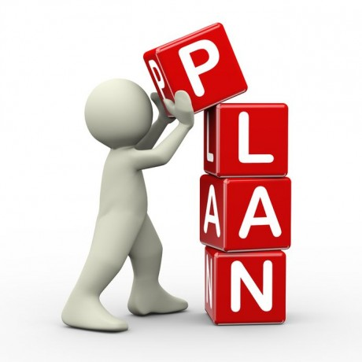
Plan
Introduction
Subject
Objectifs
People concerned
Software and requirements
Plannification
Risks (evaluation)
Responses to risks
Results // statement of accounts (terme a choisir)
Conclusion and Questions
Notes:
To introduce you to our project, we chose to follow this path.

Slide 4
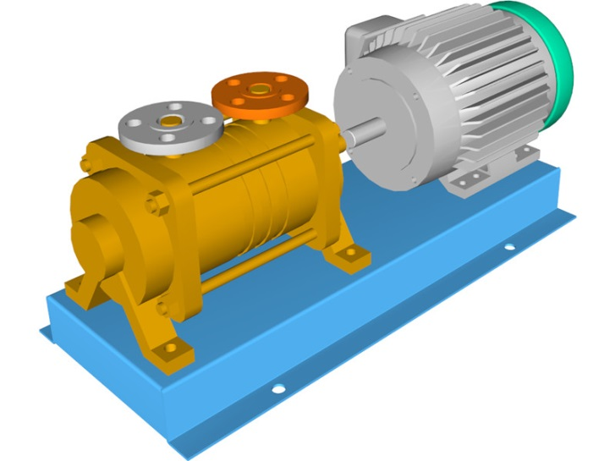
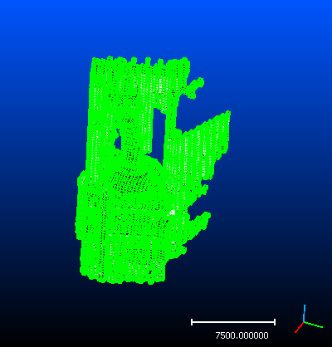
Subject
Contribution to CAD assembly reconstruction from 3D laser scanning
Manual scan done by EDF
Point cloud to clear before manipulation
Notes:
EDF has done a manuals scans of objects that comes from a pump in order to reconstruct a CAD model
Piece scanned are held by some devices (clamps, vices, V-shape, …) and a scanner is then performed
These scans generate point cloud in which some point belongs to some near devices
Before being able to manipulate a CAD model, these clouds have to undergo a clean of these foreign elements
Here is our subject. Therefore we deduced therefrom a number of objectives.

Slide 5
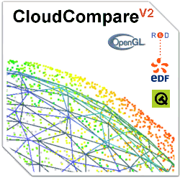
Objectifs
Final objectif : implement a method to segment a point cloud
Principal software used :
CloudCompare (write a plugin)
Notes:
The ultimate goal is one, yet it is obvious that other intermediate goal come again and will add to it.
To achieve this, we will use mostly software that was imposed on us : CloudCompare. CloudCompare permit to us to properly handle a point cloud, but we present you this software in detail thereafter.
So much for our goal. However, this project does not concern us only. As said quickly in introduction EDF is an actor (uninvolved but an actor anyway) but it's not the only one. So let introduce you to the people involved.

Slide 6



People concerned
Responsibles :
Pablo Coves - INRIA
Jean-Claude Léon - INRIA
Tutor :
Didier Morel - Staff Statistician at BD
Students :
Henry Lefèvre – M2 GICAO
Aymeric Seguret – M2 GICAO
Notes:
Initially leaders, initiators of the project and our responsibles : …
Then the head of the academic unit : …
And finally we : …
Now that we know the subject and all the actors in this project, we will present the different software used in it.

Slide 7
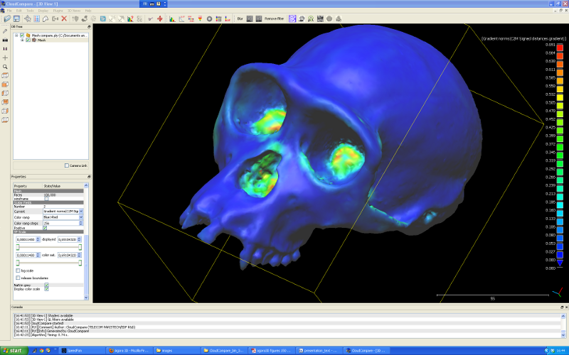
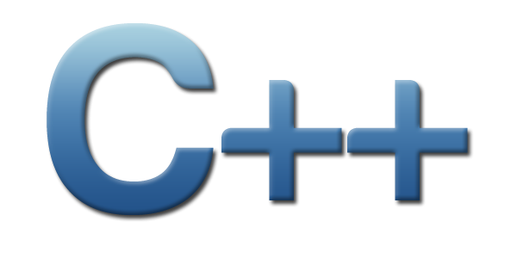

CloudCompare
CloudCompare is a 3D point cloud processing software (such as those obtained with a laser scanner).
Notes:
Open source software available on multi OS. Users can interactively handle a point cloud or a triangle mesh.
CloudCompare provides a set of basic tools for manually editing and rendering 3D points clouds
So it has not been chosen randomly
Allows users to write plugin in c++ : Can using dummyModule
Another software : Salome is free software that provides a generic platform for Pre- and Post-Processing for numerical simulation. It is based on an open and flexible architecture made of reusable components.

Slide 8

Requirements
Fixed :
- Data as Point Cloud
- Using CloudCompare and write plugin
- Date rendering
Personnal :
Data and CouldCompare comprehension
Organisation
Notes:
So we have our goals, and our software. But now it is necessary to define customer requirements (which we are so fixed) and that we set for ourselves.
In a first time, the requirements set by others (responsible or academic) : …
In a second time, ours : …
Well, the subject is clear, and software requirements are too. Let us now see our organization in time.

Slide 9
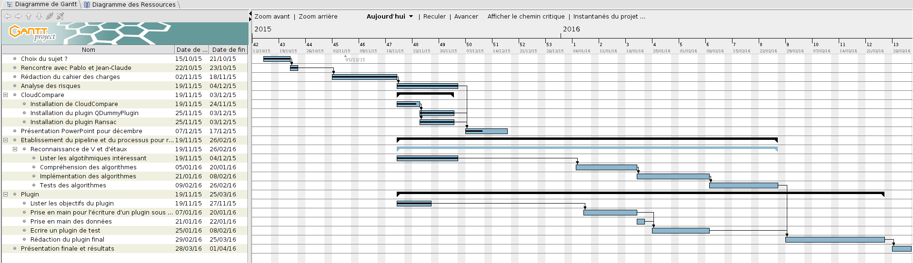
Plannification
First halfway presentation : 17/12
Deadline : 25/12
Notes:
The Gantt chart presented above is only a tool and overviews of our organization. We're spread spots and have thus set some deadline intermediary.
[...]
Of course this is the only one provisional schedule, it is obvious that it can not be observed to the letter. This is explained by the fact that we tried we organized in providing for the risks but can not however foresee everything. Besides, what are the risks?

Slide 10

Risks
We are not admin on network
Size of the Data (3,5 GB)
Shape recognition : thesis & search
No optimal algorithms/solution
Work overload
Notes:
[…]
We have presented a certain amount of risks that we anticipated and analyzed, and thus we have found some few solutions.

Slide 11
Responses to risks
Work on personnal computer
Many algorithm to try
Many papers on subject
A good organisation
Notes:
[…]
Now that everything is explained, or are we concretely.

Slide 12

Results // Statement of accounts
Installation of CloudCompare on the network
Subject comprehension
Data and software handling
Long-term organization

Slide 13

Conclusion and Questions
Still a lot of work
Many code line to write and test
Any questions ?

