Slide 1


BASIC DETAILS OF THE TEAM AND PROBLEM STATEMENT
Ministry/Organization Name/Student Innovation: Ministry of Micro, Small & Medium Enterprises (MSME) PS Code: SIH1399
Problem Statement Title:
Development of Technology for manufacturing of mind
control BIONIC hand with a sense
Team Name: ELEKTRA
Team Leader Name: SNEKHA S
Institute Code: C-6553
Institute Name: Sri Manakula Vinayagar Engineering
of touch

Slide 2
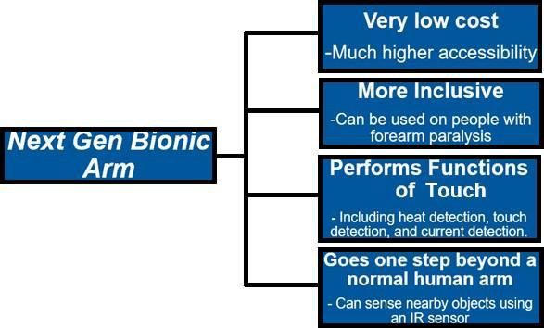
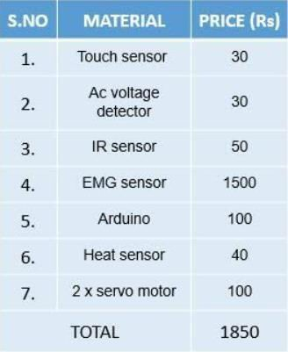
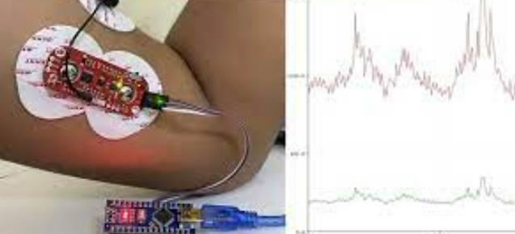
NEXT-GEN BIONIC ARM
IDEA – “A NON-INVASIVE BIONIC ARM THAT PERFORMS TOUCH FUNCTIONS AT LOW COST”
2
No surgery is required.
Can be used by people with existing, but paralyzed forearm, without amputation.
Performs actions related to usage of forearm- picking up objects/items.
Very low cost, aims to be as affordable as possible.
Performs the following functions of the sense of touch:
Detects heat, and notify the wearer, so they know how hot a cup of tea is, etc.
Detects if someone is touching/tapping the hand to call them.
Detect very nearby current. Substitute for reflex of removing our hand on touching faulty switch.
Also detects very nearby objects with IR. Used when user is in the dark and trying to navigate.
Technology stack :
Basic principle is Electromyography , a technique for recording electrical activity produced by muscles
PROTOTYPE:
Our prototype of this model is able to create opening and closing gestures when the person’s upper arm is relaxed/tightened.
Has the required touch sensors, current sensors, thermal sensors and IR sensor.
The structural support in the prototype is created using thread, cardboard and plastic.
We plan on using metal with joints in the final product, and silicone for the outer covering.
For those with a dysfunctional forearm, the next gen arm is worn over their arm.
For amputees, the next arm is filled solid and connected to their upper arm.
Expenditure of prototype has been given as well.
Electrical Signals from upper arm contraction detected by emg sensor drive a motor that operates bionic forearm.
TOUCH SENSOR –detects human touch and notifies user through a small vibration motor placed over upper arm skin (Also works through the layer of silicone over arm)
INFRARED SENSOR- emits IR rays to sense the object very near, and LED blinks if an object is near.
HEAT DETECTOR– if object too hot, small LED light blinks.
CURRENT SENSOR- senses nearby AC voltage and user notified with vibration plus LED.

Slide 3


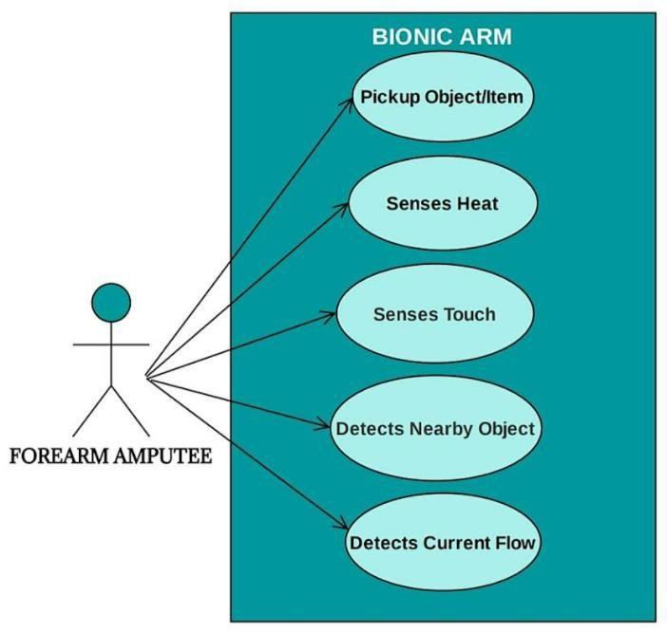

Idea/Approach Details
3
Perform tasks such as picking up object, items, etc.
Detect heat, and notify the wearer, so they know how hot a cup of coffee is , and avoid sipping it, etc.
Detect if someone is touching the hand so they know if someone taps their arm to call them.
Detect very nearby objects. Useful if user is in the dark and trying to navigate by feeling around.
Detect very nearby current and notify the wearer, prevents the danger of electric shock.
TARGET AUDIENCE:
Can be used by both forearm amputees, and also those with forearm paralysis.
Dependencies/Show Stopper:
Consultation must be performed with a doctor at first, to asses whether the person’s upper arm is functional enough to produce required contraction to use the arm.
Silicone material may get damaged if temperature is too high, so may not be suitable for people working with molten iron, gold, etc.
It may take a bit of time before the person is entirely used to the working of the arm in everyday life.
The maximum weight capacity of the arm may be suitable for regular people in day to day life, but it should be mentioned in advance if one plans to lift heavy objects such as gas cylinder, etc.
Emg sensors must be fitted correctly to avoid error.

Slide 4
Team Member Details
Team Leader Name: SNEKHA S Branch : B. Tech | Stream: ECE |  | Year: III
Team Member 1 Name: MRIDHU MALYA K I
Branch : B. Tech | Stream : ECE |  | Year : III
Team Member 2 Name: PRETHICKSHA R
Branch : B. Tech | Stream : ECE |  | Year : III
Team Member 3 Name: JAYAHSHRI M
Branch : B. Tech | Stream : ECE |  | Year : III
Team Member 4 Name: DHARSHAN S
Branch : BTech | Stream : ECE |  | Year : III
Team Member 5 Name: MAXIMUS AUGUSTE
Branch : B.Tech Team Mentor 1 Name: DR.S.DHIVYA | Stream : ECE |  | Year : III
Category : Academic | Expertise : IOT/ML | Domain Experience (in years): | 4 years
Team Mentor 2 Name: MR.K.JAMBULINGAM
Category : Academic | Expertise : IOT/CIRCUITS | Domain Experience (in years): | 5 years

