Slide 1

What rides on a district's crop mix
What a district's crop mix decides, and what this settles
A district that puts four fifths of its cropped area under one crop is exposed to that crop's price and that crop's water demand. The mix sits underneath groundwater draw, procurement exposure and what a farming household earns in a bad year. District statistics report area by crop every year and carry no measure of how that area is split.
What was open
Whether a district's crop mix follows the water it has, the markets it can reach or its agrarian structure. Cropping statistics carry area by crop and village records carry the rest, and the two have not been read together.
The record
Ministry of Agriculture district statistics: area and production by crop and season, 54 crops, 23 agricultural years, 14,089 district-year records. Village records on irrigation, markets, input supply and agrarian structure, aggregated to district.
What this settles
A measure of the crop mix that reads as a count of crops, the national picture and its geography, thirteen candidate explanations screened on one sample, and five taken forward with the coefficient that decides each.
725
districts with a cropping record
606
carrying village records too
54
crops
23
agricultural years
Half of a district's cropped area sits under its single largest crop
The largest crop takes 50.6 percent of cropped area across the 725 districts, and the top three take 80.3 percent.
Note. The join matches 99.6 percent of the cropping record, and 64 of the 606 districts sit on a shared pre-2011 parent, which every estimate is tested against.
Ministry of Agriculture and Farmers Welfare; SHRUG 2.1, Development Data Lab
1

Slide 2
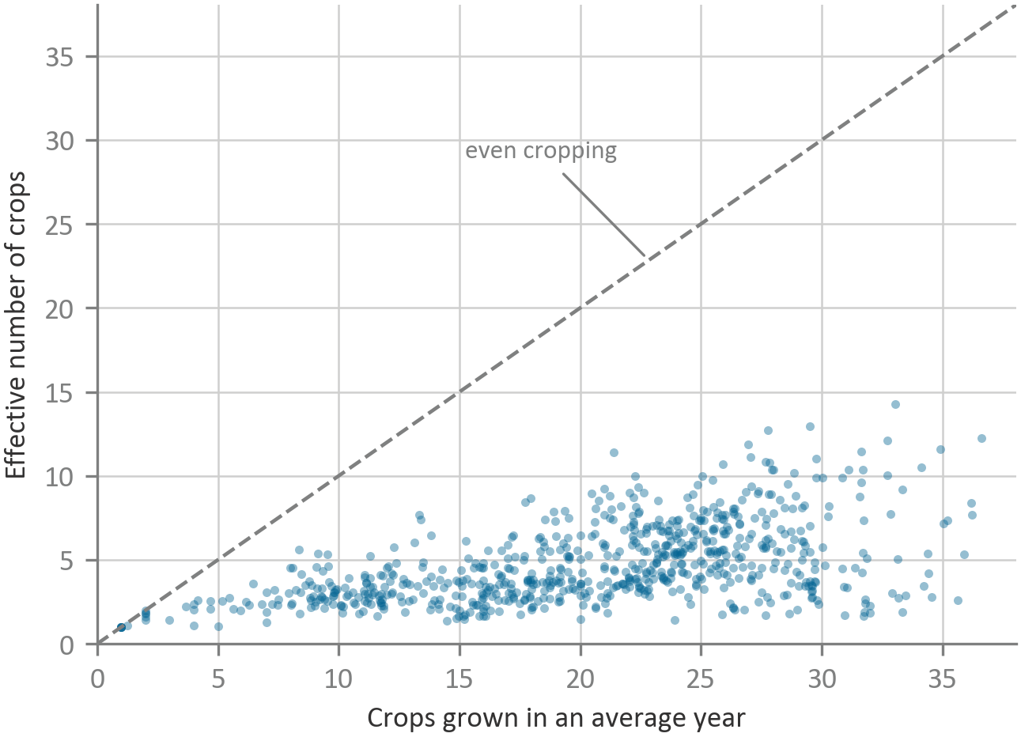
Counting crops and weighting them
The effective number of crops against crops grown in an average year, by district
Measure
Mean
What it reads as
Crops grown in an average year
21.2
crops with any recorded area
Effective number of crops
4.9
equally common crops giving the same diversity
Effective number weighted to the dominant crops
3.5
the same, with rare crops discounted further
Evenness
0.254
the effective number over the count
Across the 606 districts the effective number of crops runs 2.4 at the tenth percentile, 4.3 at the median and 8.1 at the ninetieth.
The effective number of crops is the exponential of the Shannon entropy of a district's cropped-area shares, taken within each year and then averaged. It reads as a count. A district growing twenty crops with four fifths of its land under paddy farms like one growing three, and the measure says three.
The average district is effectively growing five crops
It grows 21.2 crops in an average year, and evenness across the 606 districts averages 0.254.
Note. Measured within an agricultural year and then averaged. The composite index used in earlier work is a min-max blend whose district scores move by up to 0.0156 when the sample changes.
Ministry of Agriculture and Farmers Welfare; SHRUG 2.1, Development Data Lab
2

Slide 3
The national picture in numbers
Cropping, composition and rural structure across 606 districts in 30 states
Cropping, across the 606 districts
Share of national cropped area
Share of a district's villages
Measure
Mean
10th
Median
90th
Category
Share
Facility
Mean share
Crops grown in an average year
21.2
11.1
22.4
29.3
cereals
56.8
producer organisation
0.231
Effective number of crops
4.9
2.4
4.3
8.1
oilseeds
16.2
fertiliser shop
0.175
Evenness
0.254
0.137
0.242
0.382
pulses
12.9
weekly haat
0.143
Irrigation share of sown area
0.546
0.235
0.529
0.879
fibre crops
7.0
farm-gate processing
0.114
Cropping intensity
1.75
1.44
1.77
2.03
sugar
2.5
regular market
0.098
Mean holding size, hectares
1.96
0.61
1.35
2.95
fodder
1.6
seed centre
0.098
Eight districts in ten sit between 0.24 and 0.88 on the irrigation share of sown area, so the sample spans the range of Indian water availability rather than one end of it. Mean holding size is inferred from village records rather than measured. It is carried through every estimate on this deck and is not distinguishable from zero in any of them.
spices
1.2
custom hiring
0.092
vegetables
1.1
cold storage
0.084
fruit
0.4
soil testing
0.043
mandi
0.030
40 districts have no mandi and 30 have no weekly haat.
Cereals take 57 percent of India's cropped area
Fruit and vegetables together take 1.5 percent, and a mandi sits in 3 of every hundred villages against a weekly haat in 14.
Note. Percentiles are across the 606 districts. Crop shares are weighted by each district's mean annual cropped area. Village shares come from the 2019 village records.
Ministry of Agriculture and Farmers Welfare; SHRUG 2.1, Development Data Lab
3

Slide 4
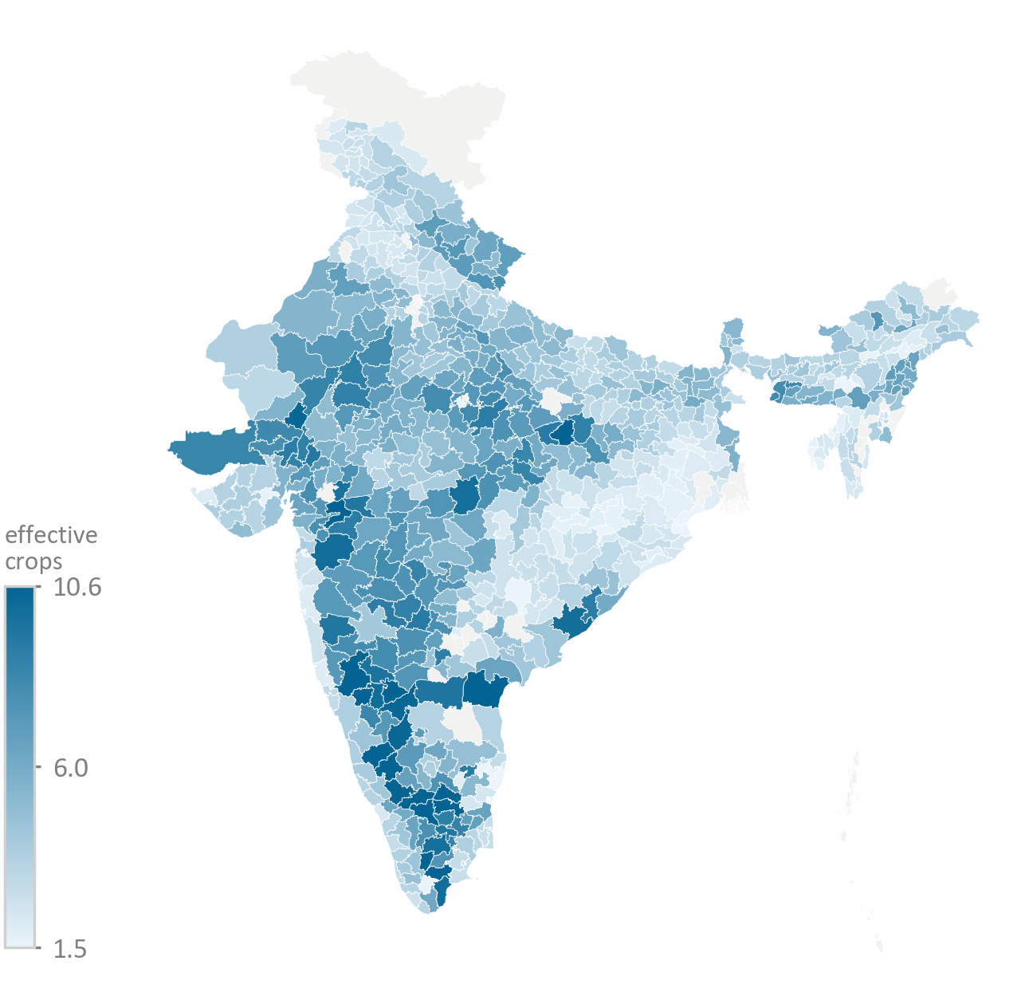
Effective number of crops by district
Averaged over each district's years, 1997-98 to 2019-20
Widest
Narrowest
State
Effective crops
State
Effective crops
Karnataka
8.0
Tripura
2.0
Andhra Pradesh
6.9
Puducherry
2.4
Nagaland
6.4
Odisha
2.5
Uttarakhand
6.2
Punjab
2.8
Madhya Pradesh
6.2
Mizoram
2.8
Chhattisgarh grows 31.6 crops in an average year, more than any other state, and is effectively growing 3.2 on an evenness of 0.107.
Punjab reaches the narrow end through wheat and Odisha through paddy. Both grow enough crops, and the land sits under one of them.
The dark districts run through the peninsular and central belt, and the pale ones through the eastern rice belt and the irrigated northwest.
Karnataka districts average 8.0 effective crops, the highest of any state
Odisha districts average 2.5 and Punjab districts 2.8, reaching the same place through paddy and through wheat.
Note. State figures are unweighted means of their districts, over 30 districts in Karnataka, 55 in Madhya Pradesh, 30 in Odisha and 22 in Punjab. Grey districts carry no agricultural record.
Ministry of Agriculture and Farmers Welfare; SHRUG 2.1, Development Data Lab
4

Slide 5
The crop that takes the most land
Largest single land use by district, and what each quarter of districts plants
Largest land use, of the 725 districts
Crop
Districts
Share of cropped area
Crop
Districts
Share of cropped area
Rice
350
59.5%
Jowar
19
28.5%
Wheat
147
42.1%
Bajra
16
40.4%
Maize
36
45.7%
Groundnut
12
47.0%
Cotton
33
38.7%
Rapeseed and mustard
10
36.5%
Soyabean
28
39.5%
Sugarcane
10
45.2%
Coconut
19
64.8%
Ragi
9
39.0%
Composition by quarter of the effective number of crops, percent of cropped area
Quarter
cereals
oilseeds
pulses
fibre crops
spices
sugar
vegetables
fruit
Least diverse quarter
76.7
10.3
5.2
2.0
3.7
0.9
0.8
0.3
Second
70.0
11.2
5.6
4.5
1.8
3.4
1.7
1.2
Third
63.6
13.8
10.4
4.1
2.5
2.1
2.2
0.5
Most diverse quarter
49.9
16.6
17.3
7.5
2.3
2.3
2.0
1.1
Rice or wheat is the largest land use in 497 of 725 districts
Where cereal area gives way it goes to pulses and oilseeds, and fruit and vegetables stay near a fiftieth of the land.
Note. Districts are sorted into quarters on the effective number of crops across the 725 with a cropping record. Category shares are averaged within the quarter.
Ministry of Agriculture and Farmers Welfare; SHRUG 2.1, Development Data Lab
5

Slide 6
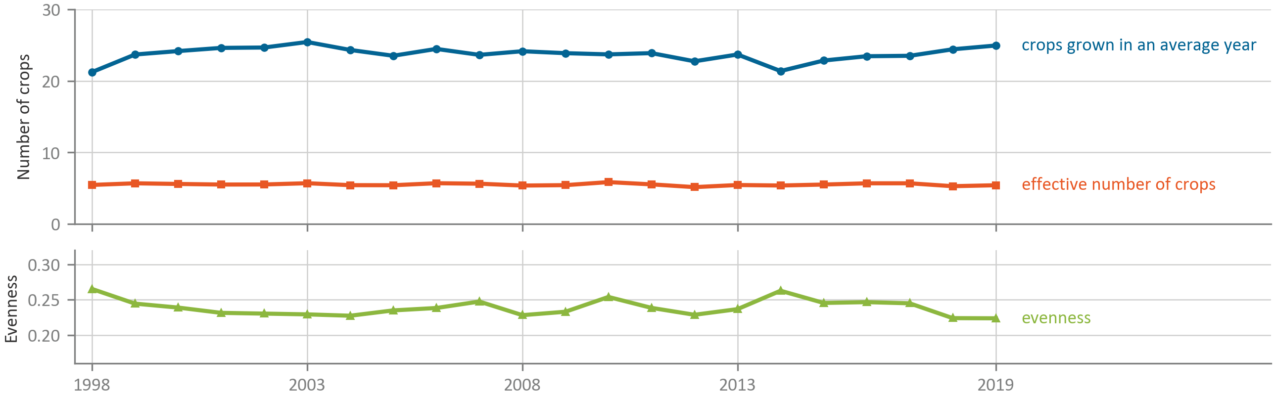
Crop diversity over two decades
Fixed panel of 429 districts reporting in every year, 1998 to 2019
Effective number of crops
165 districts up, 264 down, median -0.19
Crops grown in an average year
199 up, 226 down, median -0.29
Evenness
200 up, 229 down, median -0.004
The effective number of crops held at about 5.4 across two decades
Crops grown in an average year rose from 21.2 to 24.9 and evenness fell from 0.265 to 0.224, so the added crops sit on small patches.
Note. The panel holds the same 429 districts in every year, unweighted across districts. Each district's 2013 to 2019 mean is compared against its 1998 to 2004 mean.
Ministry of Agriculture and Farmers Welfare; SHRUG 2.1, Development Data Lab
6

Slide 7
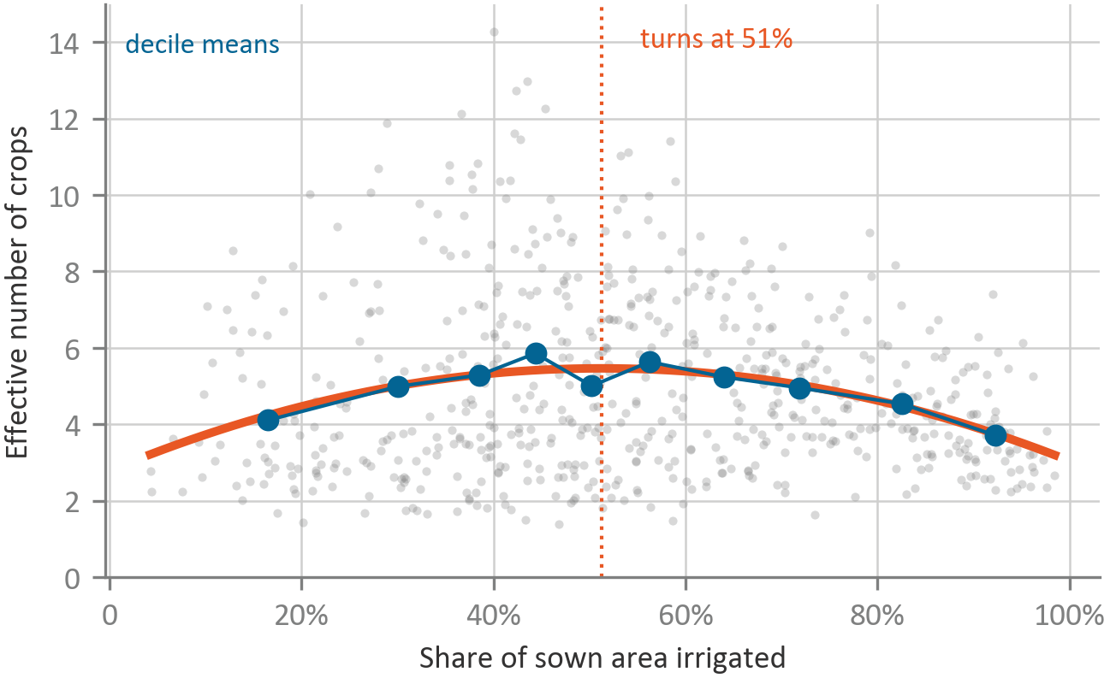
Crop diversity against irrigation
Effective number of crops by irrigation share of sown area, 606 districts
Decile
Districts
Irrigation
Effective crops
Crops grown
Cereal share
1
61
0.165
4.11
19.1
0.718
2
61
0.300
4.99
21.2
0.669
3
60
0.385
5.29
21.9
0.617
4
61
0.444
5.86
21.1
0.638
5
60
0.502
5.01
20.5
0.618
6
61
0.563
5.63
22.1
0.587
7
60
0.640
5.24
21.5
0.574
8
61
0.718
4.96
24.3
0.604
9
60
0.826
4.54
22.0
0.772
10
61
0.922
3.71
18.0
0.793
Deciles are of the irrigation share of sown area across the 606 districts, 1 = driest and 10 = wettest, about 61 districts each.
The effective number of crops rises with the irrigation share of sown area and then falls
Districts in the wettest tenth average 3.71 effective crops against 5.86 in the fourth tenth.
Note. The fitted curve carries no state fixed effects and turns at 51 percent of sown area. State fixed effects move it to 28 percent, and across the eight samples it runs 25 to 51 percent.
Ministry of Agriculture and Farmers Welfare; SHRUG 2.1, Development Data Lab
7

Slide 8
Thirteen candidate explanations
Association with the effective number of crops, before and after adjustment. One star is p below 0.10, two below 0.05, three below 0.01
Candidate
Districts
Unadjusted
Adjusted
Where it comes from
Water
irrigation share of sown area
606
-0.753**
+3.901***
the shape on the previous page
canal village share
606
-1.265***
-0.246
command-area rotations
Agrarian structure
mean holding size, log hectares
606
+0.339***
+0.019
small farms spreading risk
cultivator share of agricultural workers
606
-1.134***
-0.060
labour supply and crop choice
landless share
592
-0.204
-0.939
rural deprivation records
Markets and infrastructure
mandi village share
606
-1.931
-0.142
assured procurement
weekly haat village share
606
-0.148
+0.857
smallholder selling points
regular market village share
606
-2.307***
-0.716
daily retail demand
producer organisation village share
606
+2.188***
+1.905**
collective aggregation
cold storage village share
606
+6.308***
+1.335
perishables need cold
Population and land use
SC population share
606
+1.368
+1.233
caste and land access
ST population share
606
-0.350
+0.730
forest-fringe cropping
cropping intensity
606
+0.845**
+2.265***
an accounting identity as much as a lever
Three of the thirteen candidates keep a significant coefficient after adjustment
The irrigation share of sown area, producer organisation coverage and cropping intensity.
Note. Adjusted models add state fixed effects, log mean holding size and the irrigation share of sown area with its square. Cropping intensity matches published state figures at 0.65.
Ministry of Agriculture and Farmers Welfare; SHRUG 2.1, Development Data Lab
8

Slide 9
The five hypotheses and what would falsify each
Set down before the estimates, with the test each one gets
Hypothesis
Mechanism
What would confirm it
What would falsify it
H1 Water quantity
Irrigation lifts the constraint on what can be grown at low levels, and at high levels it pays for one assured package
A negative squared term on the irrigation share of sown area that holds across sample and index choice
A null or positive squared term, or a sign that depends on which index is used
H2 Water type
Canal water arrives on a rotation the system sets and groundwater arrives when the cultivator chooses, so fewer crops fit the canal calendar
Source coefficients that stay large with the level of irrigation held constant
Null source coefficients once the level of irrigation is in
H3 Somewhere to sell
A weekly haat lets a smallholder sell small volumes of many things, so crops with no other outlet get planted
Haat coverage raising crops grown in an average year, surviving development controls
Null haat coefficients, or coefficients that vanish under those controls
H4 Collective marketing
A producer organisation aggregates volume for crops a single farm cannot market, so land shifts between crops already grown
Producer organisation coverage raising the effective number of crops with crops grown flat
Both institutions moving both measures together
H5 Assured procurement
Dense procurement and input supply make the cereal package the only paying choice once water is plentiful, which is what pulls the curve down after the peak
A steeper fall after the peak where mandi and input coverage is dense, and a higher cereal share where mandis are dense
A positive interaction, or a negative mandi coefficient on cereal share
Each hypothesis names the coefficient that decides it
The outcome is the effective number of crops throughout, with state fixed effects on every estimate.
Note. Adjusted models carry the irrigation share of sown area and its square, log mean holding size, ST population share, log night lights, non-farm establishment density and a connectivity index.
Ministry of Agriculture and Farmers Welfare; SHRUG 2.1, Development Data Lab
9

Slide 10
Fourteen versions of the irrigation estimate
H1, eight variations of the specification and six alternative indices
H1 holds
Specification
Districts
Linear term
Squared term
p on squared
Turn
R-squared
specification
No fixed effects
606
+10.444
-10.185
<0.001
0.513
0.065
State fixed effects
606
+3.874
-6.877
<0.001
0.282
0.530
Irrigation from the 2011 village directory
573
+2.749
-5.428
<0.001
0.253
0.534
Drop shared pre-2011 parents
542
+3.396
-6.382
<0.001
0.266
0.538
Inverse-parent weighted
606
+3.641
-6.612
<0.001
0.275
0.531
Drop source-conflict districts
530
+3.235
-6.615
<0.001
0.245
0.547
Full 23 years only
506
+3.107
-6.270
<0.001
0.248
0.516
Weighted by cropped area
606
+5.778
-8.083
<0.001
0.357
0.533
index
Crops grown in an average year
606
+10.088
-10.910
0.0001
0.462
0.828
Effective number weighted to the dominant crops
606
+1.760
-3.925
0.0001
0.224
0.500
Evenness
606
+0.066
-0.188
0.013
0.177
0.543
Shannon
606
+0.936
-1.432
<0.001
0.327
0.578
Simpson
606
+0.268
-0.367
0.0003
0.364
0.611
Composite index, for comparison
606
+0.310
-0.417
<0.001
0.372
0.668
The squared term on the irrigation share of sown area is negative in all fourteen estimates
Eight of them vary the specification and six substitute a different index, and the weakest still carries p = 0.013.
Note. The turn is the maximum of the fitted curve, on the irrigation share of sown area. Crops grown pooled across years shows no hump at p = 0.19 and within each year it does at p = 0.0001.
Ministry of Agriculture and Farmers Welfare; SHRUG 2.1, Development Data Lab
10

Slide 11
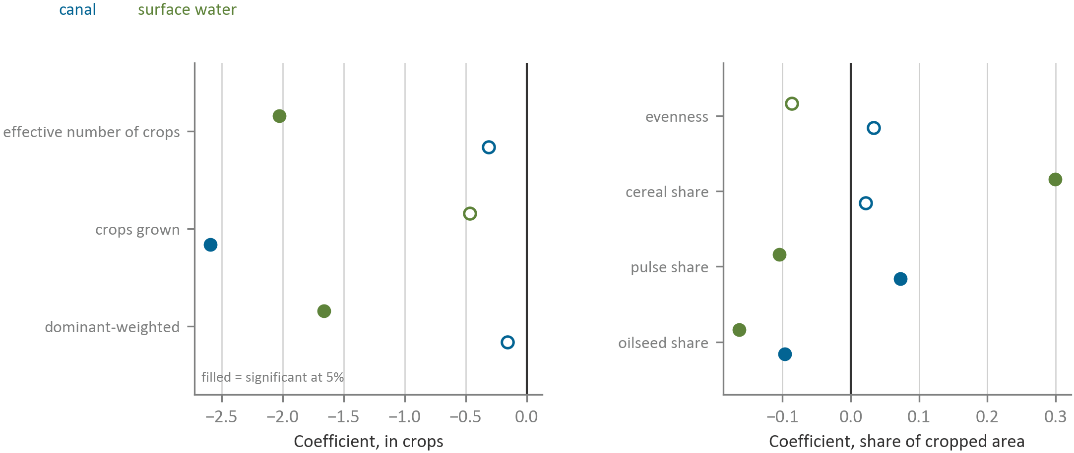
Irrigation source and what a district grows
H2, canal and surface water against groundwater at the same irrigation share
H2 holds
Outcome
Canal
p
Surface water
p
Effective number of crops
-0.310
0.42
-2.030
0.026
Crops grown in an average year
-2.593
0.003
-0.467
0.73
Effective number weighted to the dominant crops
-0.155
0.59
-1.660
0.019
Evenness
+0.034
0.073
-0.087
0.11
Cereal share
+0.022
0.60
+0.300
0.0001
Pulse share
+0.073
0.0005
-0.104
0.002
Oilseed share
-0.097
0.002
-0.164
0.008
The irrigation share of sown area and its square are held in every row, so these are differences between water sources at the same amount of water.
Groundwater is the omitted source and covers 50.5 percent of villages, other sources 21.1, canal 17.2 and surface water 11.3.
Surface-water districts average two fewer effective crops at the same irrigation share
Canal dependence takes 2.6 crops off the list, adds 0.073 to the pulse share and leaves the effective number alone.
Note. Coefficients are on the share of a district's villages naming that source, so they read from none to all. State fixed effects, errors clustered on the pre-2011 parent district.
Ministry of Agriculture and Farmers Welfare; SHRUG 2.1, Development Data Lab
11

Slide 12
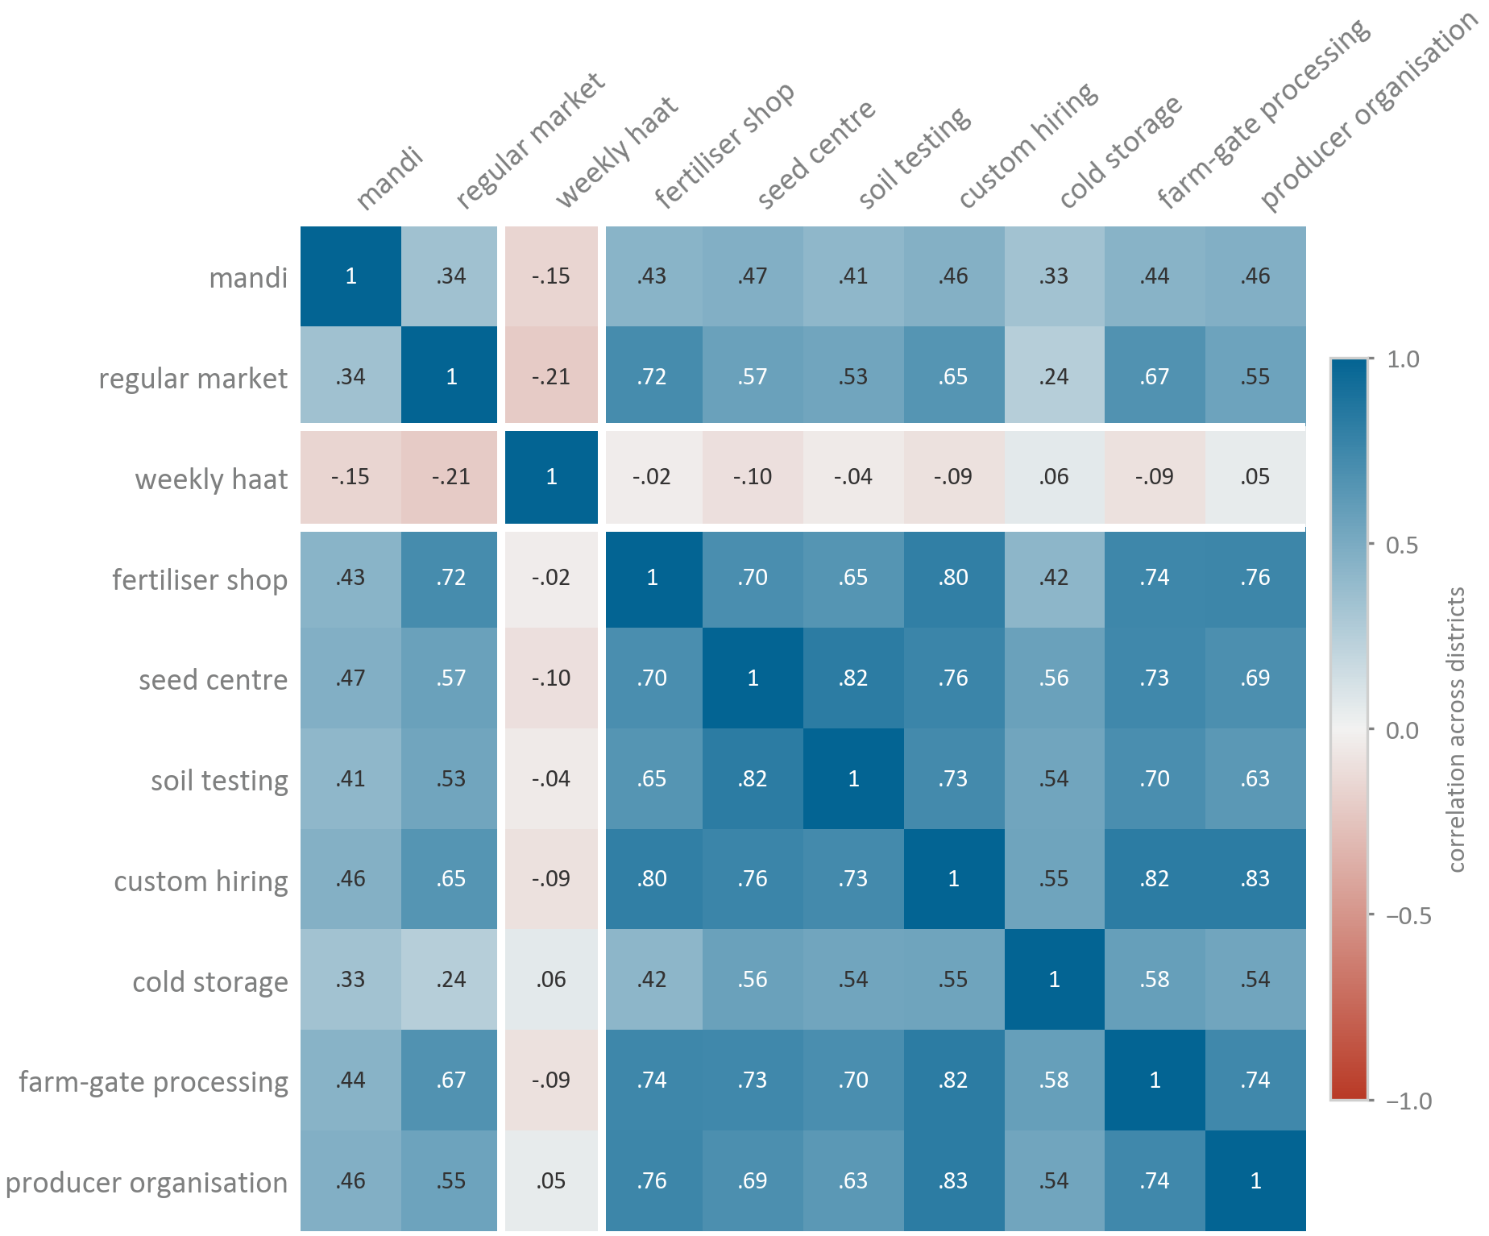
How the rural facilities sit together
Correlation across districts between the share of villages carrying each facility
The weekly haat against the other nine
Facility
Correlation
What the block means
Nine of the ten facilities correlate between 0.24 and 0.83 with each other. A district that has one tends to have the rest, so they carry one piece of information between them and not nine.
Regular market
-0.21
Mandi
-0.15
Seed centre
-0.10
Custom hiring
-0.09
Farm-gate processing
-0.09
Soil testing
-0.04
Fertiliser shop
-0.02
Producer organisation
+0.05
Cold storage
+0.06
Why the weekly haat is treated on its own
It correlates at -0.21 with regular markets and -0.15 with mandis, at 0.04 with night-time lights and -0.16 with the density of non-farm establishments. A periodic market sits where the rest of this infrastructure does not, which is what lets H3 be asked separately from H4.
Nine of the ten facilities move together across districts
The weekly haat is the only one that does not, and it runs mildly negative against the output markets.
Note. Each cell is the correlation across 606 districts between the share of villages carrying one facility and the share carrying the other.
Ministry of Agriculture and Farmers Welfare; SHRUG 2.1, Development Data Lab
12

Slide 13
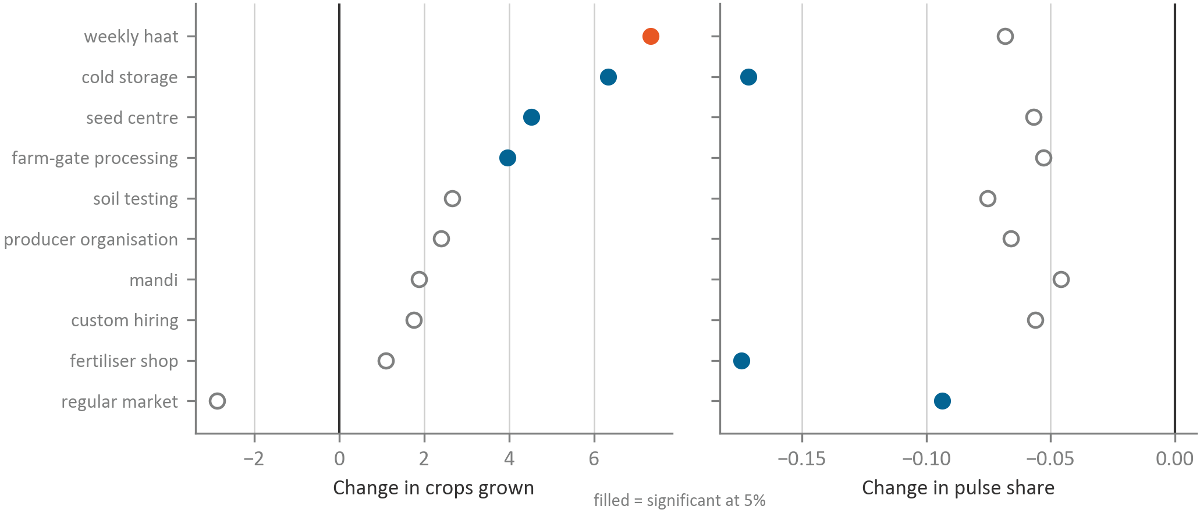
Rural facilities and cropping
H3 and H4, each facility entered on its own with the full control set
H3 holds on crops grown only; H4 holds
Facility
Effective crops
Crops grown
Cereal share
Pulse share
Weekly haat
+0.49 (0.56)
+7.33 (0.000)
-0.050 (0.42)
-0.068 (0.11)
Cold storage
+0.75 (0.65)
+6.34 (0.039)
+0.141 (0.13)
-0.172 (0.001)
Seed centre
-0.38 (0.71)
+4.53 (0.022)
-0.010
-0.057
Farm-gate processing
+0.20 (0.82)
+3.96 (0.047)
+0.035
-0.053
Soil testing
+0.32 (0.75)
+2.67 (0.17)
+0.111
-0.075
Producer organisation
+1.95 (0.032)
+2.39 (0.19)
-0.134*
-0.066*
Mandi
+0.23 (0.91)
+1.88 (0.54)
-0.235*
-0.046
Custom hiring
+0.11 (0.93)
+1.75 (0.48)
-0.032
-0.056
A one standard deviation rise in haat coverage, 0.117 of a district's villages, goes with about 0.9 more crops against a mean of 21.2, and the coefficient runs +6.44 to +8.02 across every control specification tried.
Fertiliser shop
+0.28 (0.78)
+1.10 (0.57)
-0.198 (0.021)
-0.174 (0.000)
Regular market
-0.69 (0.39)
-2.88 (0.12)
+0.049 (0.55)
-0.094 (0.004)
Weekly haat coverage goes with 7.3 more crops grown in an average year
Producer organisation coverage adds 1.95 to the effective number of crops and leaves crops grown flat.
Note. Nine of the ten facilities correlate 0.24 to 0.83 with one another and the weekly haat runs -0.21 to +0.06 against them. Errors cluster on the pre-2011 parent district.
Ministry of Agriculture and Farmers Welfare; SHRUG 2.1, Development Data Lab
13

Slide 14
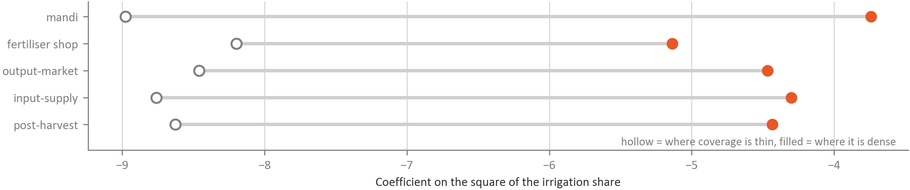
Market density and the fall after the peak
H5, curvature of the irrigation relationship where infrastructure is thin and where it is dense
The other half of the same hypothesis
Mandi coverage was expected to raise the cereal share. Entered alone with the full control set it goes with a cereal share 0.235 lower (p = 0.054), and entered with the other output markets, 0.240 lower.
H5 does not hold
Districts split at the median on market density run 3.79 to 5.99 effective crops raw, and all three adjusted contrasts are null.
Infrastructure
Curvature where thin
Curvature where dense
Interaction
p
Mandi village share
-8.98
-3.74
+2.62
0.033
Input-supply density
-8.76
-4.30
+2.23
0.056
Post-harvest density
-8.63
-4.43
+2.10
0.087
Output-market density
-8.46
-4.47
+2.00
0.102
Fertiliser shop village share
-8.20
-5.14
+1.53
0.143
All five interaction terms run the opposite way to the hypothesis
A positive term means the fall after the peak is gentler where infrastructure is dense, not sharper, and the mandi one is the only one under 5 percent.
Note. Curvature is the coefficient on the square of the irrigation share of sown area, read one standard deviation below and above the mean of each measure.
Ministry of Agriculture and Farmers Welfare; SHRUG 2.1, Development Data Lab
14

Slide 15
The five hypotheses and their verdicts
Five hypotheses, the test applied and the number that decides each
Hypothesis
The test
The deciding number
Verdict
H1 Water quantity
A negative squared term on the irrigation share of sown area across fourteen specifications
Negative in all fourteen, weakest p = 0.013, turn between 25 and 51 percent of sown area
Holds
H2 Water type
Source coefficients with the irrigation share and its square held
Surface water -2.03 effective crops (p = 0.026) and cereal share +0.300 (p = 0.0001); canal -2.59 crops grown (p = 0.003)
Holds
H3 Somewhere to sell
Haat coverage on crops grown under seven specifications
+6.44 to +8.02 with controls and +16.99 without, p below 0.001 throughout, with the effective number at +0.49 (p = 0.56) and evenness at -0.071
Holds on crops grown only
H4 Collective marketing
Producer organisation coverage read on both measures at once
+1.95 entered alone (p = 0.032) and +1.91 in the screen (p = 0.026), with crops grown flat at +2.39 (p = 0.19)
Holds
H5 Assured procurement
A steeper fall after the peak where coverage is dense, and a higher cereal share where mandis are dense
All five interactions positive, mandi +2.62 (p = 0.033), and mandi coverage on cereal share -0.235
Does not hold
Agrarian structure was screened out before the hypotheses: mean holding size +0.02 (p = 0.88), cultivator share -0.06 (p = 0.93), landless share -0.94 (p = 0.11).
Water quantity, water source and producer organisation coverage move the effective number of crops
Mandi density, market type and agrarian structure do not.
Note. 606 districts across 30 states. Irrigation systems and market facilities sit where terrain and aquifers already favoured them, and the rural record is a single 2019 cross-section.
Ministry of Agriculture and Farmers Welfare; SHRUG 2.1, Development Data Lab
15

