Slide 1

NUMERICAL MODEL
Geometry, Soil Properties
METOCEAN DATA
Wind and Wave Data (Statistical Distribution)
LOAD TIME HISTORIES
Aerodynamic, Hydrodynamic, (Hydrostatic, Gravity, Inertia)
SIMULATIONS
> 10000 Simulations
RESPONSE TIME HISTORIES
BM, SF, Rotation
Limit State Formulation (ULS, FLS, SLS)
Failure Mode Define
ANALYSIS
INDIAN
INSTITUTE OF
TECHNOLOGY
JODHPUR
1

Slide 2
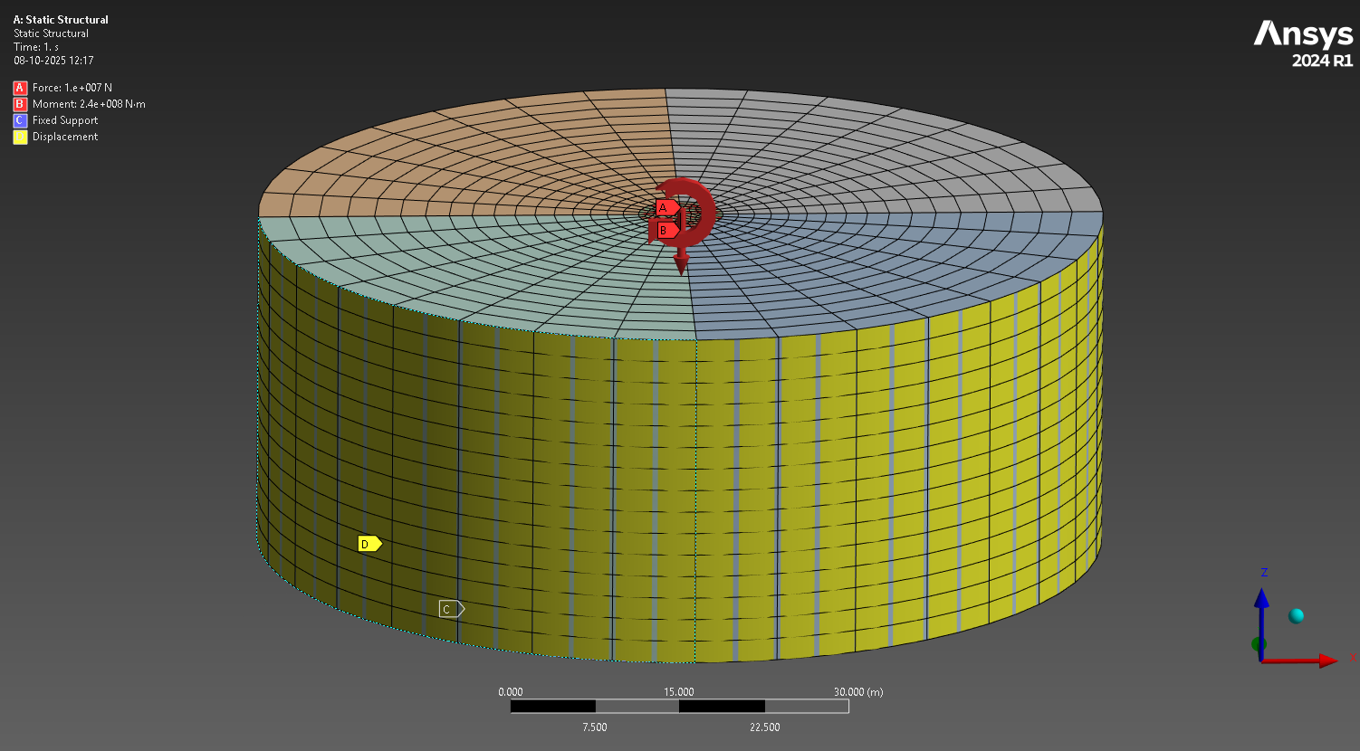
NUMERICAL MODEL
Reference Model – Abdel Rahman and Achmus
Turbine Specifications
Embedment Depth = 30m
Diameter (D) = 7.5m
Soil Domain = 10D
Friction Coefficient (Soil & Pile) = 0.5
Vertical Load = 10MN (Self-weight)
Lateral Moment = 240 MN (8MN force acting 30m above seabed)
Material Specifications
Steel Pile
Density = 7890 kg/m2
E = 2.1*10^11 Pa
µ = 0.2
Dense Sand (Mohr-Coulomb)
Friction Angle = 35
Dilatation Angle = 5
C = 0kPa
ℽsub = 11kN/m3
µ = 0.25
FEM Specifications
No of Elements = 11490
No of Nodes = 54282
Element Type = Hex20 (Quadratic)
BCs = Soil Sides lateral constraint
Soil bottom fixed
INDIAN
INSTITUTE OF
TECHNOLOGY
JODHPUR
2

Slide 3
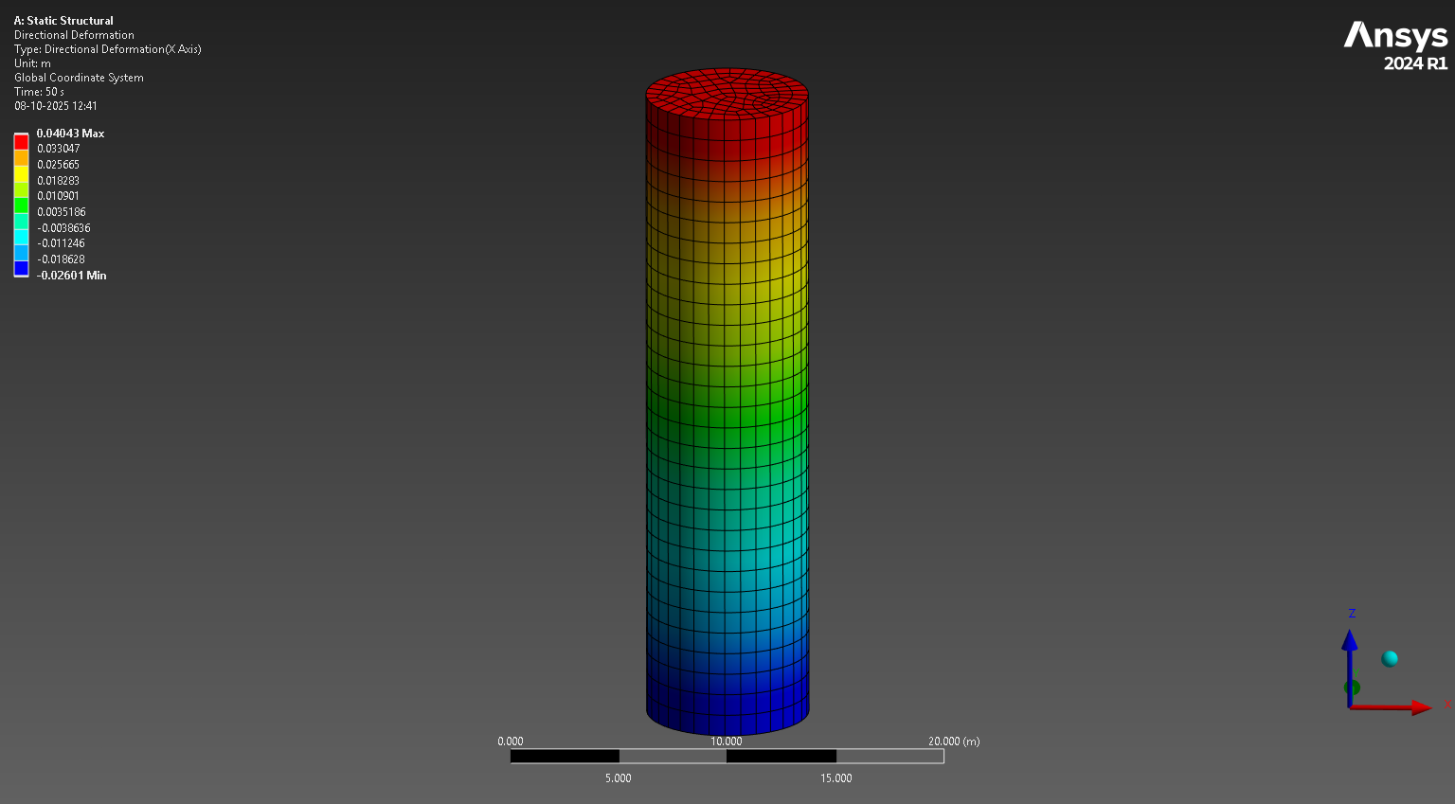
Displacement at the Seabed
Result = 4.043cm
Paper = 4cm
Angle of Rotation
Result = 0.13
Paper = 0.17
INDIAN
INSTITUTE OF
TECHNOLOGY
JODHPUR
3

Slide 4
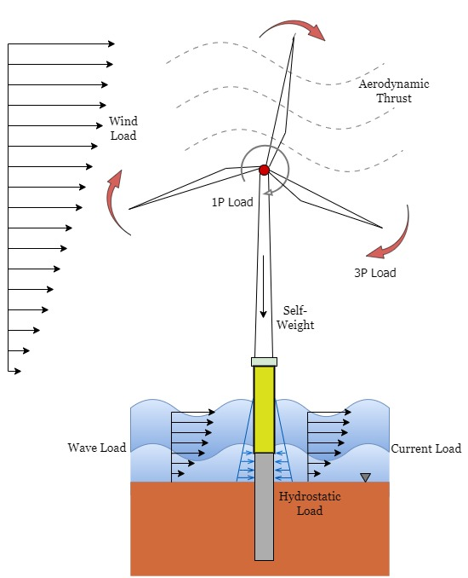
Offshore Environment
1. Aerodynamic Loads - Thrust Force
- Drag Force
2. Hydrodynamic Loads - Wave Load
- Current Load
3. Hydrostatic Loads
4. Turbine Load - Self Weight
- 1P Load
-2P/3P Load
5. Seismic Loads
6. Marine Growth
7. Ice Load
INDIAN
INSTITUTE OF
TECHNOLOGY
JODHPUR
4

Slide 5
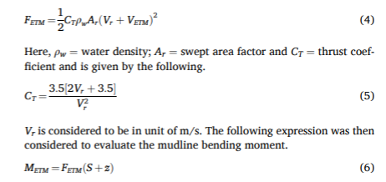
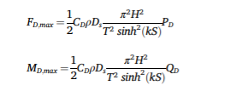
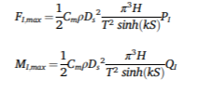

LOADS
Extreme Scenario
ETM at rated wind speed with 50-year EWH
50-year EOG Wind Load with 1-year MWH
Static Analysis
ETM
Drag Force
Inertia Force
EOG
INDIAN
INSTITUTE OF
TECHNOLOGY
JODHPUR
5

Slide 6
Dynamic Analysis
Simulation- ANSYS
Aerodynamic - CFX
Hydrodynamic- FLUENT
Simulation- FAST/ openFAST
Aerodynamic - Aerodyn
Hydrodynamic- Hydrodyn
Load Time Histories
Wind Speed Time History Wind Spectrum
Water Particle Velocity, Water Particle Acceleration Wave Spectrum (Significant Wave Height)
INDIAN
INSTITUTE OF
TECHNOLOGY
JODHPUR
6

