Slide 1
Go2Kin, Reimagined
A modern UI/UX redesign: from Tkinter to React
Adelaide University · Allied Health & Human Performance
Team · Kento Kawazoe, Mridul Chopra, Isaac Nguyen, Darcy Jude
Notes:
KENTO (~35 s)
Good morning everyone, and thank you for having us. I'm Kento, and with me are Mridul, Isaac and Darcy. This semester we redesigned Go2Kin for Adelaide University's Allied Health and Human Performance team. We'll cover the client and the problem, how we built our solution, what changed, and then show it to you live.
→ Mridul

Slide 2



Our client and their world
Go2Kin is an open-source Python app from Adelaide University's Allied Health & Human Performance team: markerless motion capture using up to four GoPros.
Who uses it
What it does
Why UX matters
Researchers in indoor motion capture labs studying human movement
Calibrates cameras, records synced trials and processes them into OpenSim kinematics
A low-cost alternative to Vicon only works if researchers find it easy to use
Notes:
MRIDUL (~35 s)
Go2Kin is an open-source Python app for markerless motion capture. Instead of an expensive marker-based system like Vicon, researchers use up to four GoPros to calibrate, record synchronised trials, and process them into OpenSim kinematics.
Its users are researchers, not software engineers. So for Go2Kin to be a real low-cost alternative, it has to be easy to use.

Slide 3


From pain points to project objectives
The problem
Our objectives
Dated Tkinter interface that felt hard to use
Workflow steps scattered and hard to learn
Limited styling, layout and responsiveness
Deliver a modern, intuitive workflow
Design with real users, not for them
Prototype and evaluate UI technologies
Integrate with the existing Python system
Notes:
MRIDUL (~30 s)
The old Tkinter interface looked dated and cramped, and the workflow was spread across five tabs, so new researchers didn't always know what to do next.
So our objectives were a modern, intuitive workflow, designed with the client, built on the right technology, while keeping the existing Python system that already works.
→ Darcy

Slide 4





How we worked: design first, then build
Discover
Prototype
Approve
Connect
Build
Explored the Tkinter app with the client
Designed every screen in Figma
Client signed off the prototypes
Designed an API to the existing backend
Built the tabs in React, sprint by sprint
Sprints: 6 × 2-week Rituals: stand-ups, client reviews, retros Tools: Jira, GitHub, Figma
Notes:
DARCY (~40 s)
We worked in six two-week Agile sprints, design first. We designed every screen in Figma, and the client signed off the prototypes before we wrote any code.
Then, as a team, we agreed on the API design: how the new interface would talk to the existing backend. After that, each of us built the API endpoints and the React screens for our own part, with a client review every sprint.
→ Isaac

Slide 5
Why we moved from Tkinter to React
Criteria | Tkinter | React
Look & feel | Basic, dated | Modern, themeable
Reusable components | Manual | Built in
Responsive layouts | Limited | Flexible
Ecosystem | Small | Huge
Python core | Native | Via our API
React 19 + TypeScript UI
Our FastAPI layer
Existing Go2Kin Python core
REST over HTTP lets the new UI drive the existing backend
Notes:
ISAAC (~40 s)
We moved from Tkinter to React because it gives us modern, reusable components and flexible layouts. The key was keeping the Python core.
Our React and TypeScript interface talks to a FastAPI layer, which drives the existing Go2Kin code underneath. So the analysis researchers already trust is unchanged; only the interface is new. And long jobs like processing run in the background, so the app never freezes.
→ Mridul
(Tech stack details are on the backup slide at the end, for Q&A only.)

Slide 6
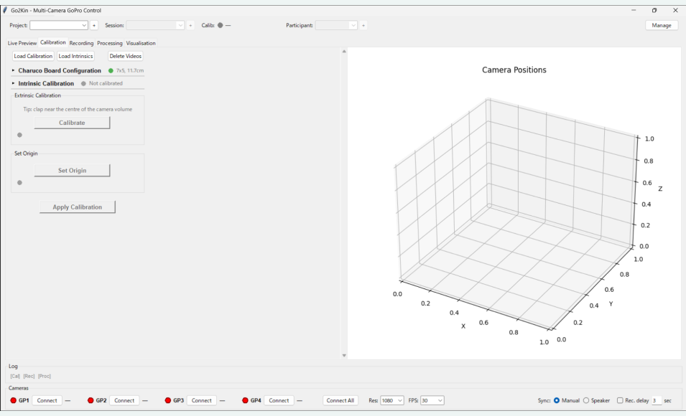
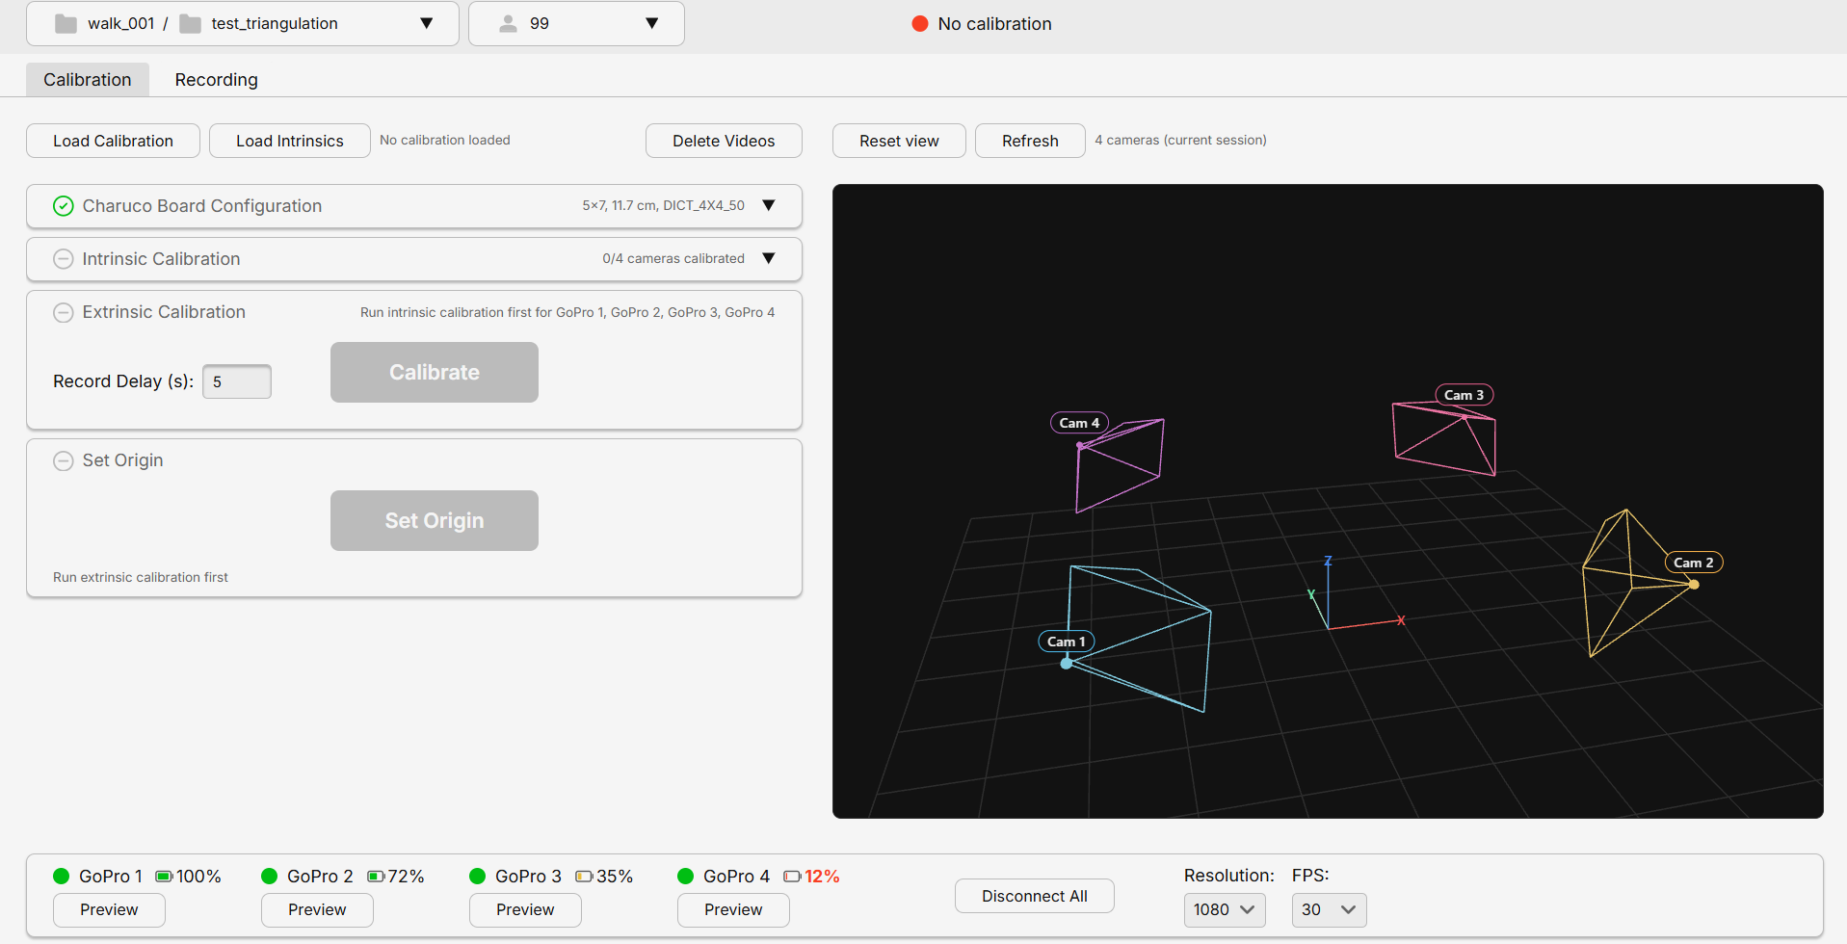

Tab 1: Calibration
BEFORE · Tkinter
AFTER · React
Cramped controls, five separate tabs, little guidance
Clear step cards with status and guidance
Notes:
MRIDUL (~30 s)
I worked on the Calibration tab. The old one had small controls and no guidance.
Now each step is its own card with a status icon. A step stays disabled until it's ready, and tells you why, like "Connect at least 2 cameras". So researchers can follow it top to bottom without training.
→ Darcy

Slide 7
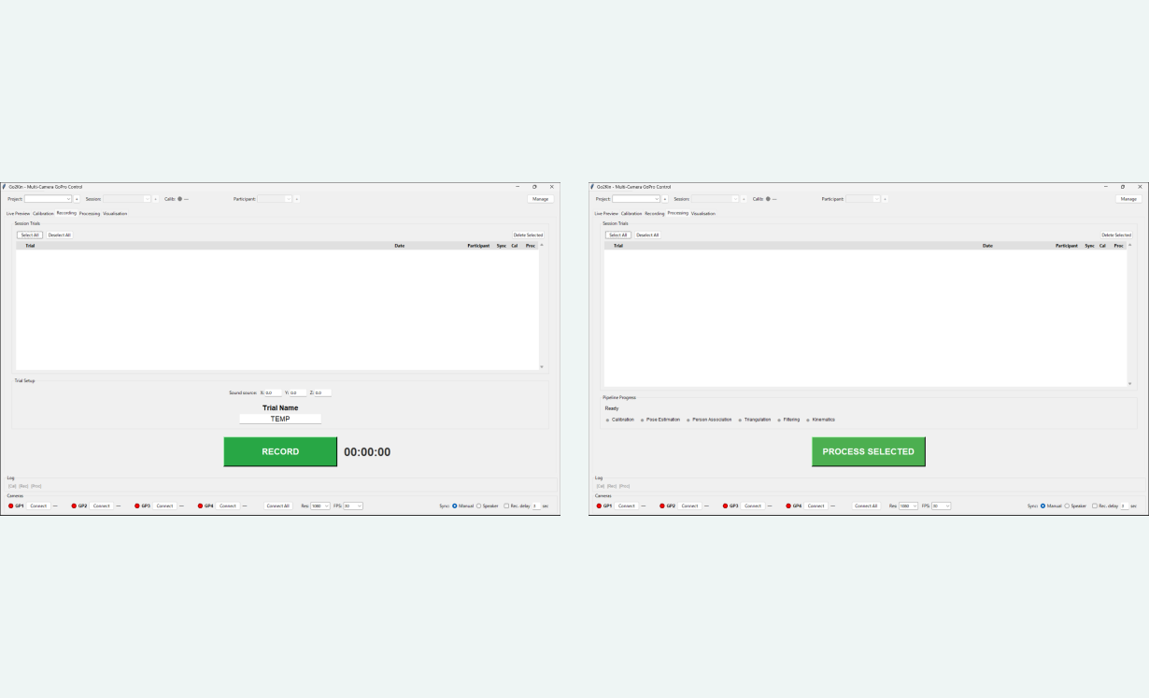
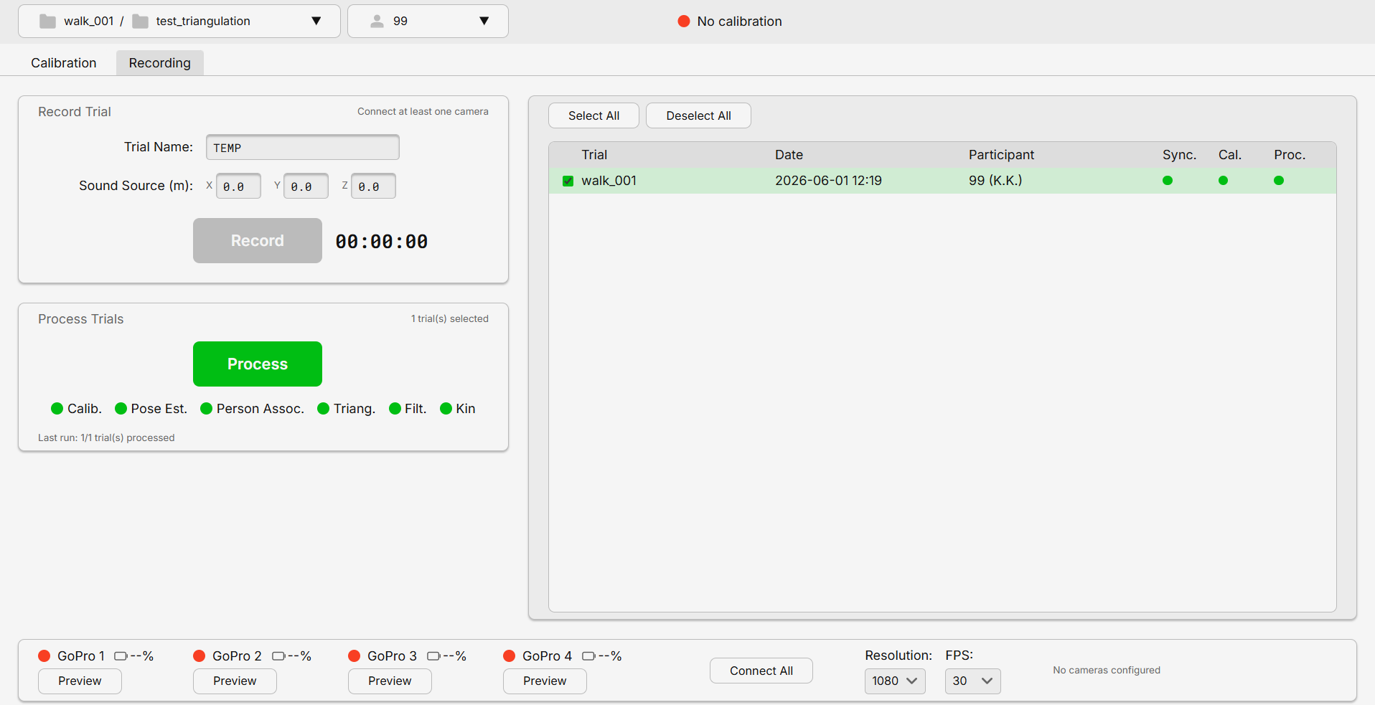
Tab 2: Recording + Processing, now one
BEFORE · Tkinter
AFTER · React
Recording and Processing were two separate tabs
One merged tab: record, then process, without switching
Notes:
DARCY (~20 s)
Isaac and I merged Recording and Processing, because researchers always do them back to back. You name a trial and press Record, and Record stays disabled until a project and session are picked.
ISAAC (~20 s)
Next to it, one trial list shows what's been synced, calibrated and processed, and you process selected trials from the same screen.
→ Kento

Slide 8
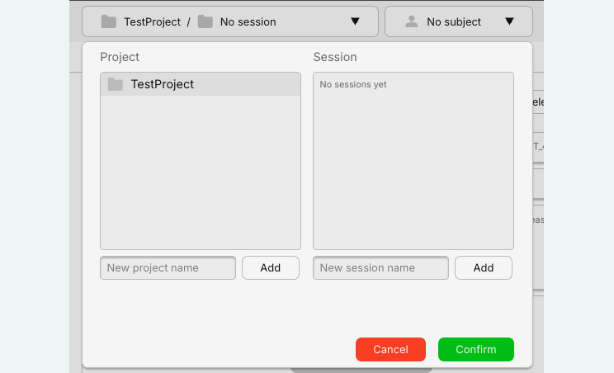

Project Explorer: a file explorer built in
BEFORE · Windows Explorer
AFTER · React
No explorer in the app
Users dug through project folders in Windows File Explorer, outside Go2Kin
Switching to Windows Explorer to find project files
Pick or create project, session and subject in-app
Notes:
KENTO (~30 s)
I built the top and bottom bars. Before, researchers had to leave the app and use Windows File Explorer to find their projects.
Now the Project Explorer in the top bar lets you pick or create a project, session and subject without ever leaving Go2Kin.

Slide 9




Camera bar: clearer at a glance
BEFORE · Tkinter
AFTER · React
Battery % for every camera
Preview opens a side window
Plain-language status
Bigger, clearer controls
Notes:
KENTO (~25 s)
The camera bar at the bottom now shows full camera names, battery for each GoPro, and plain status messages. And Preview opens the footage in a side window, so you never leave your tab.
→ Mridul

Slide 10
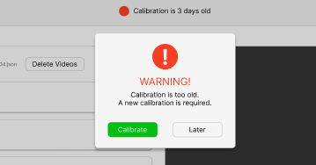

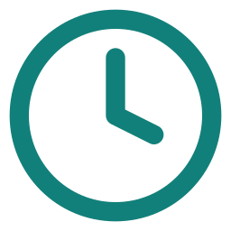


New: calibration age warning
STATUS
Fresh: under 24 hours
Too old: 24 hours or more
Missing: no calibration file
WHEN IT CHECKS
On project load
Every 60 seconds
Previously missing: nothing told users their calibration was out of date. Now they are warned before they record.
After calibrating
Clicking the status
Calibrate jumps to the tab · Later snoozes it for this session
Notes:
MRIDUL (~30 s)
The client also wanted a warning for old calibrations, which was missing before. Our API checks the calibration file's age. If it's over 24 hours old, or missing, the researcher is warned: when the project loads, every minute, after calibrating, or by clicking the status. They can calibrate straight away or snooze it.
Q&A prep: /calibration/freshness endpoint reads the file's modified time; useCalibrationFreshness hook polls every 60 s; "Later" is saved per project in sessionStorage.

Slide 11

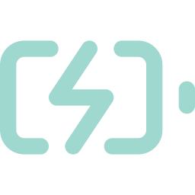

Beyond the brief: live GoPro battery
The ask
The client wanted each GoPro's battery level visible before recording
The research
Studied the GoPro API and found a new release that exposes battery level
Live battery %
for all 4 GoPros
The result
Battery % now shows beside every camera in the bottom bar
No more cameras dying mid-session
Notes:
MRIDUL (~25 s)
And battery. A camera dying mid-trial means redoing the whole trial. The original app couldn't show battery, so I researched the Open GoPro API, found a newer release that exposes it, and now all four cameras show live battery percentage.

Slide 12



Live demo
One research session in the new Go2Kin, start to finish
1. Connect cameras
Battery % + preview window
2. Pick a project
Project Explorer
3. Calibrate
Tab + age warning
4. Record & process
Merged tab
Notes:
MRIDUL
Let's show you all of this working.
DEMO: keep it to 3 minutes, about 45 seconds each
1. KENTO: Connect All, point out battery %, open a Preview side window, then pick the project and session.
2. MRIDUL: show the calibration warning, then the calibration cards.
3. DARCY: name a trial and record it.
4. ISAAC: process the trial and show the status columns update.
Before you present: connect all 4 GoPros, pre-create a test project and session, and have a backup screen recording ready.

Slide 13

Value delivered and lessons learned
Delivered
What we learned
Two redesigned tabs and a custom Project Explorer
Figma first saved us rework later
Early client sign-off kept us aligned
Digging into APIs unlocked new features
Figma prototypes approved by the client before build
Live GoPro battery %, beyond the original brief
Notes:
DARCY (~35 s)
So we delivered two redesigned tabs, a Project Explorer, a new camera bar with battery and preview, and a calibration warning, all running on our FastAPI layer over the existing Python core.
Our biggest lessons: Figma first saved us rework, early sign-off kept us aligned, and digging into the GoPro API let us go beyond the brief.
→ Mridul

Slide 14
Thank you. Questions?
We'd love your feedback on the new Go2Kin experience.
Notes:
MRIDUL (~15 s)
Thank you for listening, and thank you to our client for their support throughout the project. We're happy to take any questions.
Q&A (everyone stays at the front)
Client, requirements, Project Explorer, camera bar, preview: KENTO
Calibration, calibration warning, GoPro battery API: MRIDUL
Recording and the merged tab: DARCY
Processing, background jobs, API design, tech stack: ISAAC
API questions: whoever built that router answers for their own part.

Slide 15

Our tech stack
Front end
API
React 19 + TypeScript
Vite 8 + Tailwind CSS v4
Three.js + React Three Fiber for the 3D camera view
React Router for tabs
REST / HTTP
FastAPI on Uvicorn
Pydantic typed schemas
Background threads run Pose2Sim jobs
fetch + CORS
:5173 ↔ :8000
MODULAR ROUTERS
CODE QUALITY
projects
cameras
preview
ESLint 10
strict types
hot reload
recording
calibration
processing
config
Notes:
BACKUP SLIDE: not presented. Only open it if the panel asks about the tech stack.
ISAAC answers: React 19 + TypeScript, Vite (fast dev server and builds), Tailwind (consistent styling quickly), Three.js for the 3D camera positions after calibration. FastAPI on Uvicorn with Pydantic schemas, split into routers: projects, cameras, preview, recording, calibration, processing, config. Pose2Sim jobs run in background threads. CORS is needed because the front end runs on port 5173 and the API on 8000.

