Slide 1
CL420 MID TERM PROJECT SUBMISSION
Dynamic comparison of Monod
and substrate inhibition models
Recombinant lipase production in a methanol fed batch bioreactor
Mridul Sharma · Sneha Shandilya · Diggaj Maheshwari
Notes:
Speaker 1, 0:00 to 0:15.
Good morning. Our project studies the dynamic comparison of Monod and substrate inhibition models for recombinant lipase production in a methanol fed batch bioreactor. We use a published Pichia pastoris process and simulate its behaviour under different feeding strategies.

Slide 2
PROCESS
Methanol is both feed and inducer
Pichia pastoris
Methanol is the carbon source and the inducer.
Yeast cell factory
Recombinant Rhizopus oryzae lipase
Low methanol limits growth.
High methanol can inhibit the cells.
Product activity, U/mL
CL 420
02
Notes:
Speaker 1, 0:15 to 1:00.
The process uses Pichia pastoris as the host organism and produces recombinant Rhizopus oryzae lipase. Methanol has two roles. It is the carbon and energy source, and it induces the AOX1 promoter that supports recombinant product formation.
This creates the central process tradeoff. Too little methanol can limit growth. Too much methanol can inhibit growth and product formation. Our study asks how Monod and substrate inhibition models represent this tradeoff under the same reactor operation.
Transition to Speaker 2. The next slide explains the two kinetic assumptions.

Slide 3
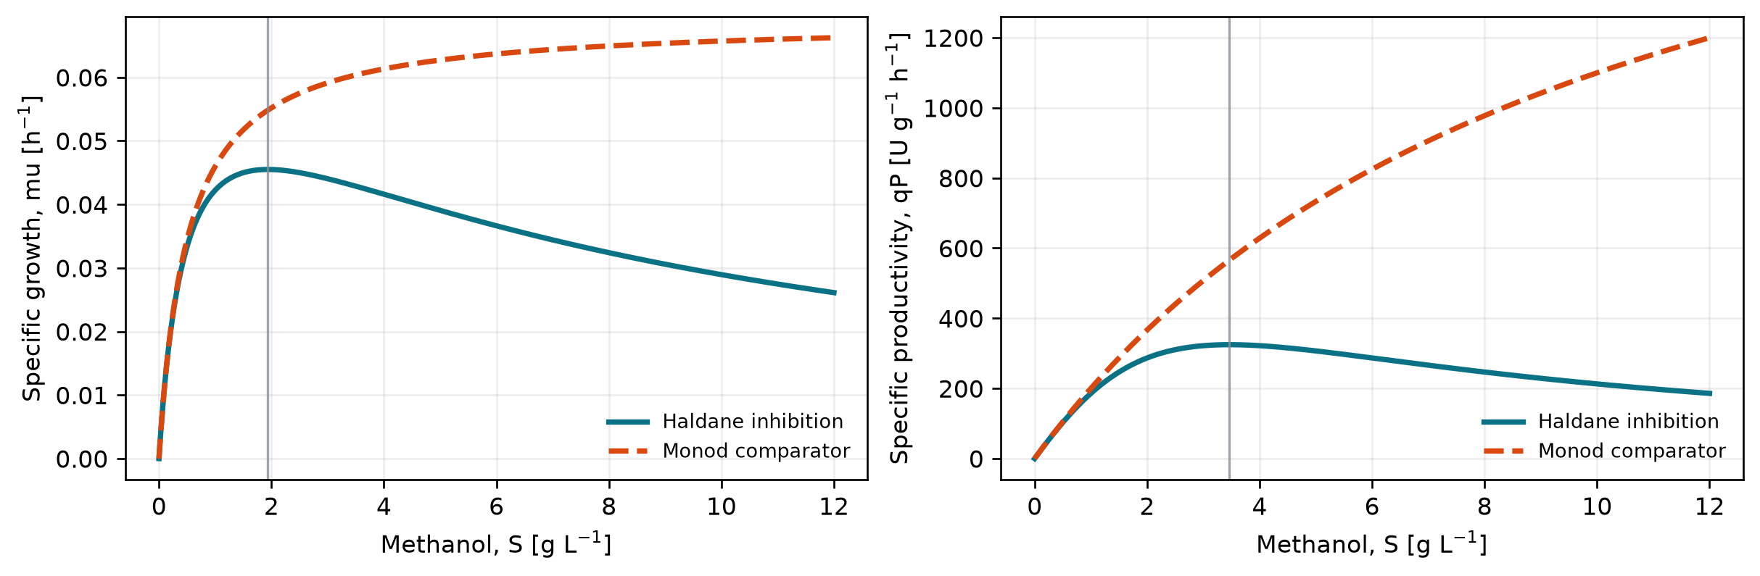
KINETICS
More methanol is not always better
Monod
Rate rises, then saturates.
Substrate inhibition
Rate rises, peaks, then falls.
Growth peak ≈ 1.9 g/L | Product peak ≈ 3.5 g/L
CL 420
03
Notes:
Speaker 2, 1:00 to 1:30.
The Monod model assumes that the rate increases with methanol and then reaches saturation. The substrate inhibition model includes a high-substrate penalty. Its rate rises, reaches a maximum, and then decreases.
Using the published parameters, the growth rate peaks near 1.9 grams per litre, while product formation peaks near 3.5 grams per litre. This difference means that the best methanol concentration for cell growth is not exactly the best concentration for lipase production.

Slide 4
MATHEMATICAL MODEL
Four balances turn rates into trajectories
V, XV, SV, PV
Volume
Feed increases the broth volume
Volume · biomass · methanol · product
Biomass
dV/dt = F / ρₘₑₜₕₐₙₒₗ
d(XV)/dt = μXV
d(SV)/dt = F − qₛXV
d(PV)/dt = qₚXV
μ increases the total cell mass
Methanol
Feed minus cellular uptake
Product
qₚ accumulates enzyme activity
CL 420
04
Notes:
Speaker 2, 1:30 to 2:00.
Point to the four-state vector on the left. These states are reactor volume, total biomass, total methanol, and total product activity.
Point to the four balance equations. The first describes volume increase through feeding. The second describes biomass growth. The third describes methanol feed minus cellular uptake. The fourth describes product formation.
Point to the interpretation labels on the right. The equations convert kinetic rates into reactor trajectories. The four feeding strategies and their results are shown next.

Slide 5
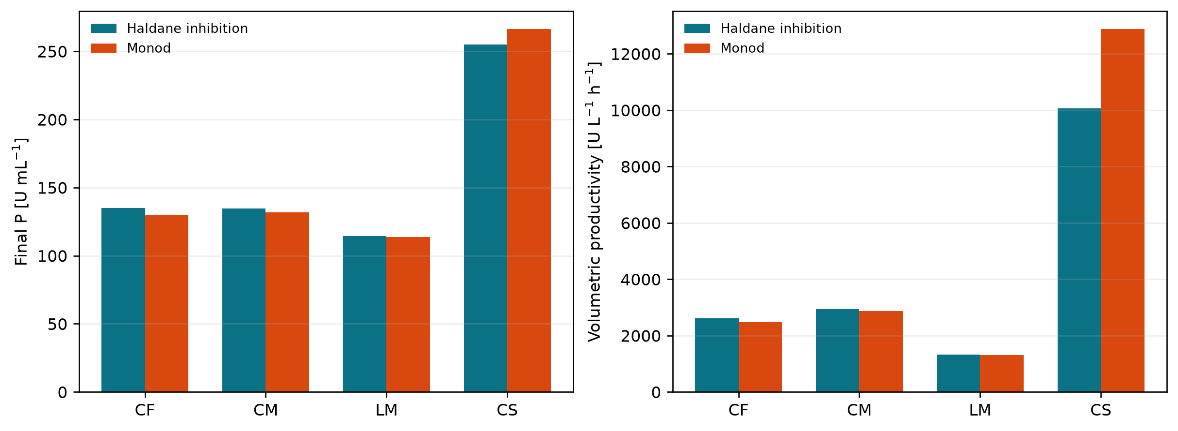
RESULTS
CS gives the strongest predicted performance
Four feeding strategies are compared under both kinetic formulations.
255.01
U/mL final product activity
10,057
FEEDING METHODS
CF
Constant feed, 14 g/h
U/L/h volumetric productivity
CM
Target growth rate, μ = 0.03 h⁻¹
LM
Target μ rises from 0.01 to 0.04 h⁻¹
CS
Constant methanol, S = 2 g/L
Monod CS predicts 266.18 U/mL.
CL 420
05
Notes:
Speaker 3, 2:00 to 2:40.
Point to the CF, CM, LM, and CS labels in the original report figure. The constant-substrate strategy gives the strongest predicted performance. Under the substrate inhibition model, CS gives a final product activity of 255.01 units per millilitre and a volumetric productivity of about 10,057 units per litre per hour.
The Monod model predicts a higher CS product value of 266.18 units per millilitre because it excludes substrate inhibition. This difference comes from the kinetic assumption, not from a change in the initial conditions or the feed strategy.
The linearly increasing strategy performs worst because it takes the longest time to reach the biomass limit and gives lower productivity.

Slide 6
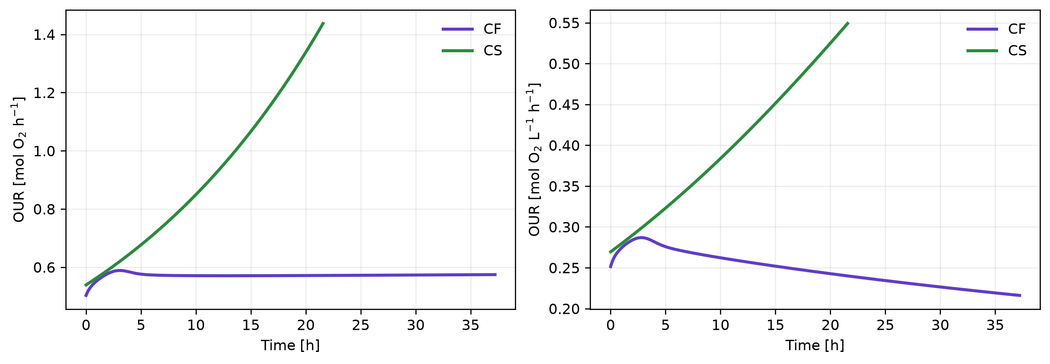
ENGINEERING MEANING
The best product strategy needs the most oxygen
1.437
mol O₂/h maximum OUR
Next design step
Compare oxygen demand with OTR and kLa.
Kinetic model selection changes the operating decision.
CL 420
06
Notes:
Speaker 3, 2:40 to 3:00.
The final engineering result is oxygen demand. CS gives the best product performance, but it also gives the highest oxygen requirement. For the substrate inhibition CS case, the maximum total oxygen uptake rate is about 1.437 moles of oxygen per hour.
Therefore, the best product strategy still needs a reactor feasibility check. The next design step is to compare oxygen demand with oxygen transfer rate and kLa. In conclusion, the kinetic model changes the predicted operating decision. Thank you.

