Slide 1
CL420 FINAL PROJECT SUBMISSION
IIT BOMBAY
Dynamic comparison of Monod
and substrate inhibition models
Recombinant lipase production
and oxygen transfer design
GROUP 21
Mridul Sharma
Sneha Shandilya
Diggaj Maheshwari
23B0353
23B0345
23B0358
Notes:
Good morning. We are Group 21. Our project compares Monod and substrate inhibition models for recombinant lipase production, and connects the simulations to bioreactor design.

Slide 2
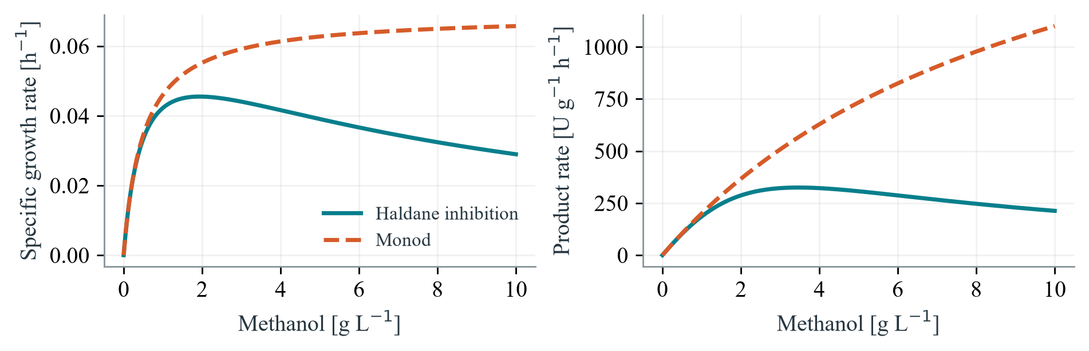
PROCESS AND KINETICS
Methanol is both feed and inducer
Pichia pastoris
Rhizopus oryzae lipase
Methanol induced yeast
Extracellular industrial enzyme
5 L vessel. 30 °C. pH 5.5. DO 25% air.
CL420 GROUP 21
02
Notes:
The host is Pichia pastoris, a yeast that secretes Rhizopus oryzae lipase into the culture broth. The proposed product is a concentrated liquid enzyme for industrial lipid processing.
Methanol provides carbon and energy. It also induces the AOX1 promoter, which supports lipase production. Too little methanol limits the process. Excess methanol can inhibit growth and production.
The Monod curves rise towards saturation. The inhibition curves reach a peak and then decline. The growth and production peaks occur at different methanol concentrations. This is why the feeding policy matters.
The bench process uses thirty degrees Celsius, pH five point five, and controlled dissolved oxygen.
Sources
Final report, pages 2 to 4.
Ponte Font, 2017, Chapters 4 and 5. https://ddd.uab.cat/pub/tesis/2017/hdl_10803_457712/xpf1de1.pdf
Figure embedded unchanged from report/final/figures/kinetic_models.png.

Slide 3
MATHEMATICAL MODEL
Four balances define the process
V, B, M, A
CF
Constant feed
14 g/h
Volume, biomass, methanol, activity
CM
Prescribed growth target
dV/dt = aF
μ = 0.03 h⁻¹
dB/dt = μB
LM
Ramped growth target
dM/dt = F − qₛB
0.01 to 0.04 h⁻¹ over 60 h
dA/dt = qₚB
CS
Constant methanol
a = 1/792 + 0.12/200
Reference S = 2 g/L
Includes nutrient feed volume
CL420 GROUP 21
03
Notes:
The mathematical model tracks four quantities. These are liquid volume, biomass amount, methanol amount, and total enzyme activity.
The balances describe liquid addition, cell growth, substrate feed minus consumption, and enzyme formation. The volume calculation includes the linked nutrient solution as well as methanol.
Four feeding methods are compared. CF supplies fourteen grams of methanol per hour. CM uses a prescribed constant growth target. LM gradually raises that target over sixty hours. CS holds methanol concentration constant using the ideal feed balance.
Diggaj will now explain the simulation results and the setpoint selection.
Sources
Final report, page 5.
Balances implemented in simulation/rol_final_design.py.
The 60 hour LM ramp is a study assumption. CS is an ideal balance policy, not a simulated physical controller. B is biomass amount, M methanol amount, A activity. a is in L per g methanol.

Slide 4
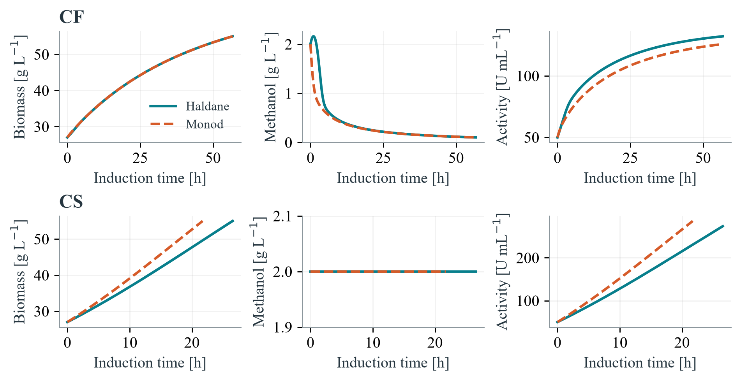
DYNAMIC SIMULATION
CS more than doubles CF activity
CL420 GROUP 21
04
Notes:
Eight reference cases compare four feeding policies under each model. Each model pair shares its initial conditions and process limits.
The graphs show constant feed and constant substrate operation. Under inhibition kinetics, constant feed gives about one hundred and thirty two units per millilitre. Constant substrate operation at two grams per litre gives about two hundred and seventy four.
Monod predicts a faster constant substrate process. Its final activity is not higher under every feeding policy.
Numerical checks used smaller steps, material balances, and an independent analytical solution.
Sources
Final report, page 6, Figure 2 and Table 4.
Computed data in output/data/final/summary_metrics.csv. Haldane CF 132.15 U/mL, CS 273.67 U/mL.
All results are model predictions. CS uses model dependent feed under a common setpoint policy.
Original report image embedded unchanged.

Slide 5
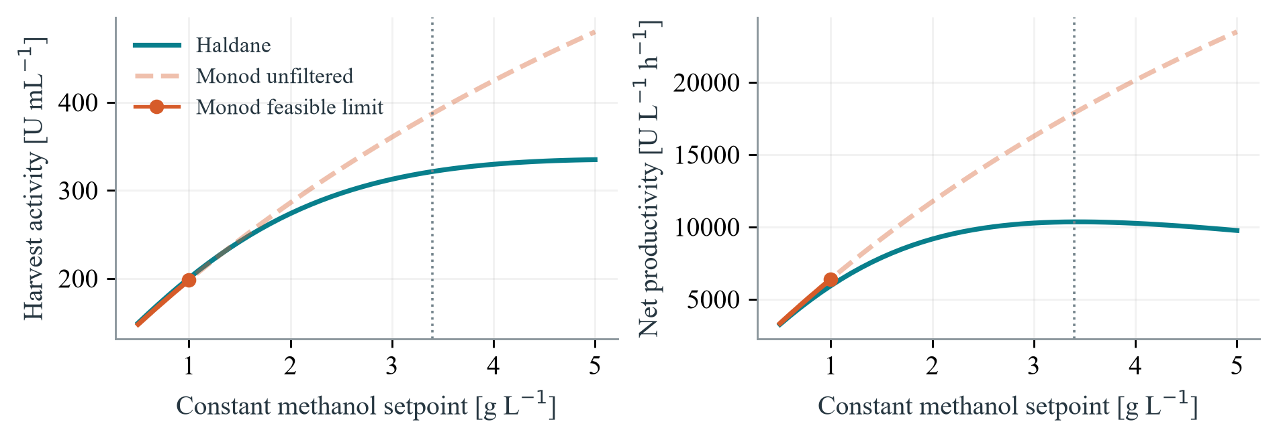
SETPOINT SCREEN
Setpoints change the operating decision
3.4
Predicted activity and productivity
321.35 U/mL
10,349 U/L/h
g/L candidate setpoint
CL420 GROUP 21
05
Notes:
The next calculation screens constant methanol setpoints together with oxygen capacity.
The inhibition model selects a candidate near three point four grams per litre. It predicts three hundred and twenty one units per millilitre after about twenty eight hours of induction. Net productivity is about ten thousand three hundred and forty nine units per litre per hour. This is almost thirteen percent above the two gram per litre reference.
Nearby setpoints give similar productivity, so three point four is not a uniquely proven biological optimum.
Under the same oxygen screen, Monod selects one gram per litre. Its higher growth predictions use more oxygen. Model choice therefore changes the feasible feeding recommendation.
Mridul will explain the oxygen requirement and practical design.
Sources
Final report, page 8, Figure 4.
Computed data in output/data/final/setpoint_scan.csv.
Selected Haldane case gives 321.353 U/mL and 10348.541 U/L/h after 28.126 h. Improvement relative to CS at 2 g/L is 12.9 percent.
The best oxygen feasible Monod grid point is 1.0 g/L, giving 6391.5 U/L/h.
Each scan starts at its own setpoint. This is a nominal grid screen, not experimental validation. Original report image embedded unchanged.

Slide 6
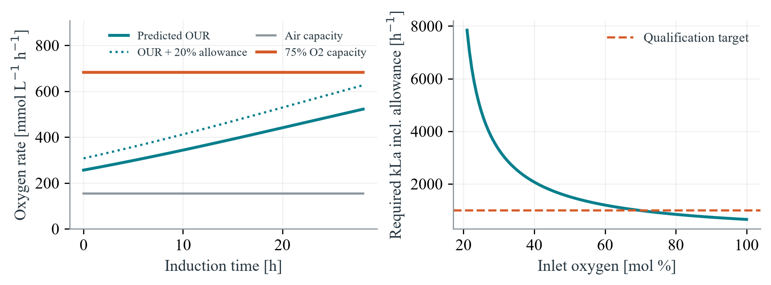
OXYGEN TRANSFER
Oxygen supply sets an operating limit
909
1,000
required kLa, h⁻¹
broth qualification target, h⁻¹
CL420 GROUP 21
06
Notes:
The selected process needs about one point seven two three moles of oxygen per hour at peak demand.
The oxygen calculation includes depletion between inlet and outlet gas. It uses a seventy five percent inlet oxygen blend, two volumes of gas per volume of broth per minute, and an allowance of twenty percent above demand.
The required kLa is about nine hundred and nine per hour. The proposed qualification target is one thousand per hour in the actual broth.
The word qualification is important. The transfer correlations give a wide range, so the proposed equipment is not proven to achieve this value. Air alone fails the screen. If measured capacity is insufficient, the operating point must change.
Sources
Final report, pages 7 and 8.
Selected OUR 1.72333 mol/h and 0.52204 mol/L/h.
The RQ equal to one plug flow gas balance is integrated self-consistently. At 75 percent inlet O2, 2 vvm, 30 C and 1 bar, capacity is 0.68243 mol/L/h at kLa 1000 per hour. Required kLa 908.7 per hour supplies 1.20 times demand.
The 1000 per hour value remains a qualification target, not a measurement.
Original report figure embedded unchanged.

Slide 7
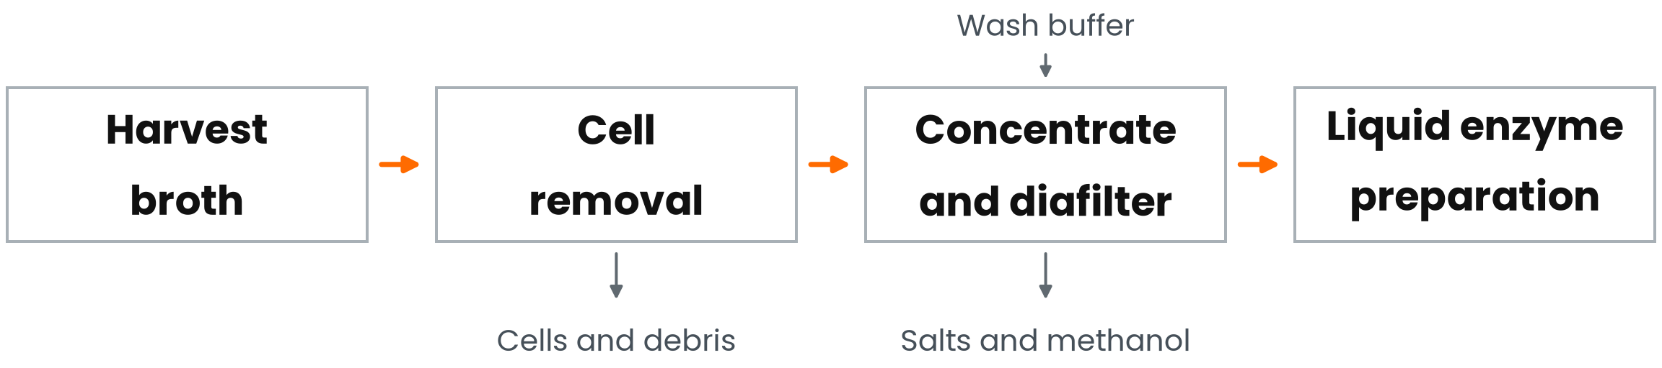
RECOVERY AND COST
Recovery determines the activity cost
₹10,016
70%
illustrative batch budget
assumed activity recovery
₹13,487 per million recovered U
Industrial transfer needs pilot oxygen and mixing checks.
CL420 GROUP 21
07
Notes:
The enzyme is recovered from the liquid after removing cells. The proposed sequence uses clarification, ultrafiltration and diafiltration, followed by a concentrated liquid preparation.
Assuming seventy percent activity recovery, the illustrative batch budget is about ten thousand rupees. This corresponds to about thirteen thousand five hundred rupees per million recovered activity units. Recovery and budget rates are assumptions. Reactor occupancy is the largest estimated cost.
Industrial scaling needs pilot oxygen transfer and mixing checks. The same lipase process lost performance at fifty litres, so the bench productivity cannot simply be multiplied by industrial volume.
The main conclusion is that kinetic model selection affects feeding, oxygen supply and useful product output. Thank you.
Sources
Final report, pages 10 and 11. All prices and recovery are planning assumptions.
The Python-generated recovery figure is the same image used in final report Figure 6.
Industrial ROL scale up evidence, Ponte Font 2017, Chapter 7.
Different product demonstration scale context, Liu et al. 2016, Scientific Reports 6, 18439, https://doi.org/10.1038/srep18439.
Budget quantities are calculated in output/data/final/batch_budget.csv.

