Slide 1
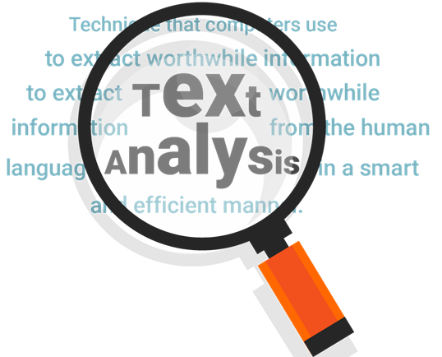
NLP PROJECT TEXT ANALYSIS
By: Mridul Singh
Sap id: 500094181
Batch: DevOps B1 H

Slide 2
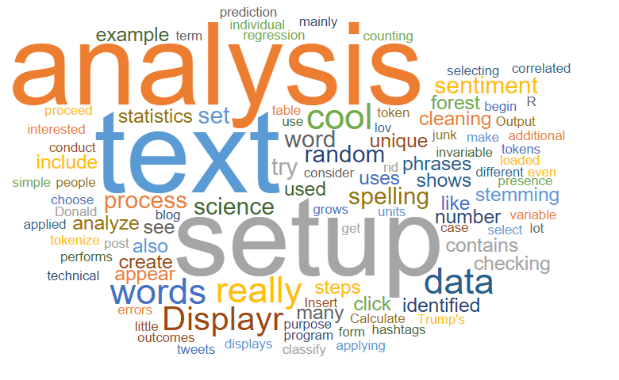
INTRODUCTION
The objective of this project is to extract textual data articles from the given URL and perform text analysis to compute positive score, negative score, avg sentence length, fog index, avg no. of word per sentence, word count, syllable per word, complex word count and avg word count.
Input is given in form of .xlsx file which contain URL_ID and URL. And output is given in .csv file after performing text analysis.

Slide 3
PYTHON LIBRARIES USED
NLTK is an open-source library that provides tools for tasks such as classification, stemming, tagging, parsing, semantic reasoning, and tokenization.
Pandas is an open-source Python library that provides high-performance, easy-to-use data structures and data analysis tools for working with structured data.
Beautiful Soup library is used for parsing HTML and XML websites or documents. It is mainly used for web scrapping.
Pyphen is a Python library that is used for hyphenating text. It is a pure Python module that does not require any external dependencies.
Requests module allows you to send HTTP requests using Python. The HTTP request returns a Response Object with all the response data (content, encoding, status, etc).

Slide 4
Positive Score: This score is calculated by assigning the value of +1 for each word if found in the Positive Dictionary and then adding up all the values.
Negative Score: This score is calculated by assigning the value of -1 for each word if found in the Negative Dictionary and then adding up all the values. We multiply the score with -1 so that the score is a positive number.
Average Sentence Length = the number of words / the number of sentences
Complex words are words in the text that contain more than two syllables (is a part of a word that contains a single vowel sound and that is pronounced as a unit).
Percentage of Complex words = the number of complex words / the number of words
Analysis of Readability is calculated using the Gunning Fox index formula
Fog Index = 0.4 * (Average Sentence Length + Percentage of Complex words)
Fog index describes the readability of the document.
Parameters for Text Analysis

Slide 5
Parameters for Text Analysis
Average Number of Words Per Sentence = the total number of words / the total number of sentences.
Syllable Count Per Word: A syllable is a part of a word that contains a single vowel sound and that is pronounced as a unit. So, for example, exclamation has 4 syllables which are ex, cla, ma, tion. And another example "book" has only one syllable. It is calculated with the help of NLTk and pyphen library.
Average Word Length = Sum of the total number of characters in each word/Total number of words

Slide 6
Conclusion
This project demonstrates the efficacy of natural language processing (NLP) techniques coupled with the versatility of Pandas for text analysis. We effectively calculated various metrics such as sentiment scores, readability indices, and text statistics. Through this process, we gained valuable insights into the underlying patterns and characteristics of the text data. These insights are crucial for making informed decisions in a wide range of applications, from sentiment analysis in customer feedback to readability assessment in educational materials. This project underscores the importance of harnessing advanced tools for extracting actionable insights from textual data.

