Slide 1
BLOGR
A BLOGGING WEBSITE

Slide 2
GROUP PROJECT
IIT2019127 MRIDUL MITTAL
IIT2019145 PARAS AGRAWAL
IIT2019146 KSHITIJ KUMAR
IIT2019148 PIYUSH GURJAR

Slide 3
INTRODUCTION
“Blogr” is a web application, which provides user a platform to share users ideas with the whole world in form of text/audio.
It is a blogging website with additional feature to maximize the learning capabilities of the user.
It has a good user interface..

Slide 4
FEATURES
Authentication
Add content
Feedback
Mark as favourite
Discussion Platform
Voice Assistance
Audio Conversion
Search Blogs
Blog Tagging

Slide 5
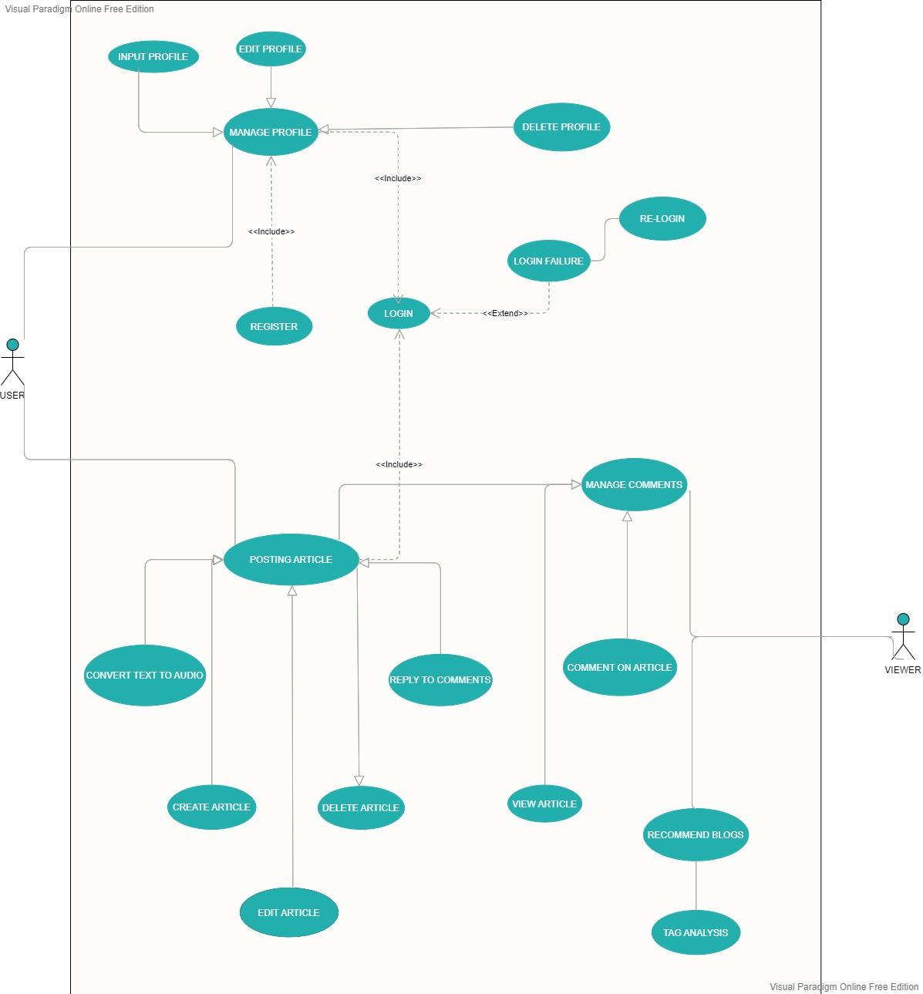
USE CASE
DIAGRAM

Slide 6
TECH STACK
MongoDB / Mongoose
Express
NodeJs

Slide 7
DEMO

