Slide 1
UNIVERSITY MANAGEMENT SYSTEM
GROUP 9
Mridul Mittal IIT2019127
Piyush Gurjar IIT2019148
Amit Jain IIT2019150
Medha Balani IIT2019021
Aniket Jaiswal IIT2019085

Slide 2
Introduction
The need for an online-virtual-remote learning platform has become inevitable, which comes with a multitude of challenges, including usability, security, privacy, and real-time adoption
The project is an implementation of transparent grading and attendance system for an university. It also provides a certificate generator for university and a verification system for the certificates.

Slide 3
Need For Blockchain
Integrity and Transparency
Verification of Authenticity
Decentralisation

Slide 4
Project Features
The functions of the project are :-
Manage students
Add Students
Enroll students in courses
Track attendance and marks

Slide 5
Project Features
Manage professor
Add Professor
Enroll professor to course
Manage course
Add Course
Add exam for a course
Add marks of students for a course

Slide 6
Project Features
Universities
Issue academic certificates.
View academic certificates issued.
Students
Receive academic certificates from universities.
View and manage received academic certificates.
Share academic certificates with third party verifiers
Verifier
Receive certificate data from students.
Verify certificate authenticity with blockchain platform.

Slide 7
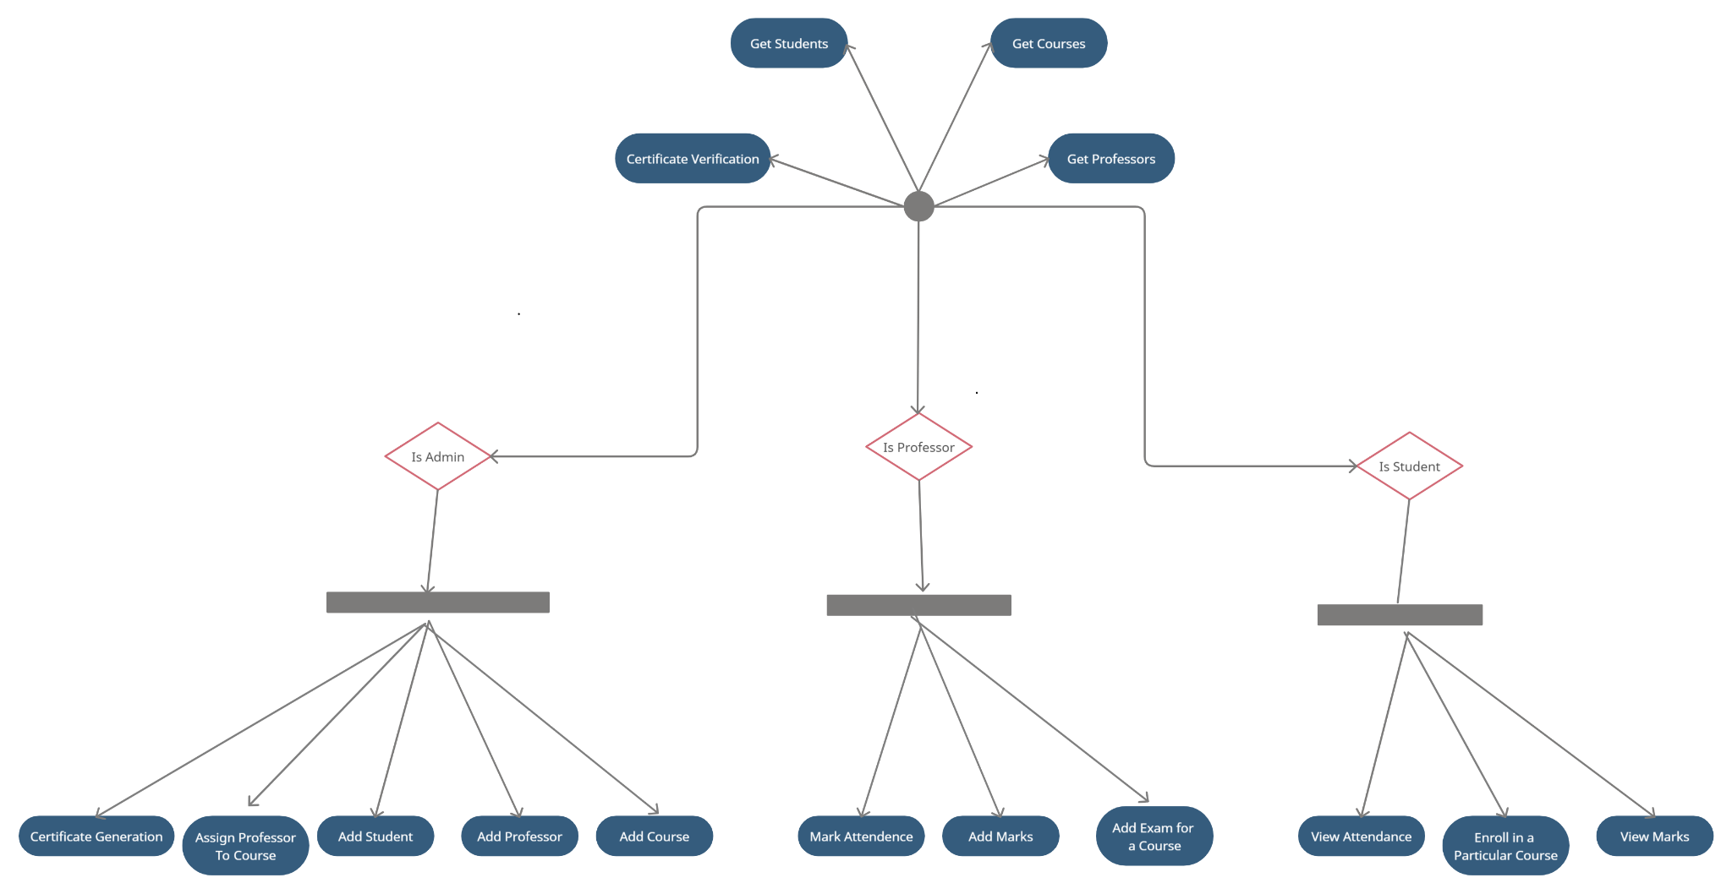
Activity diagram

Slide 8
Existing work in Education Sector
The are various application available in education sector using blockchain.
The blockchain-based management system is easy to use and transparent with errorless auditable records in real-time.
Library Management System^{[1]}
Course Management^{[2]}
Hostel Management System^{[3]}

Slide 9
Existing work in Education Sector
Many Universities have already used blockchain to create a trusted, distributed, and shared infrastructure that will become the standard for issuing, storing, displaying, and verifying academic credentials, digitally.
Certificates and identity management
Digital Credentials Consortium(MIT)^{[4]}
BCDiploma ^{[5]}

Slide 10
DEMO

Slide 11
References
[1]-https://www.researchgate.net/publication/348602358_Blockchain_Technology_and_its_Application_in_Libraries
[2]-https://github.com/Amrita-TIFAC-Cyber-Blockchain/Distributed-Ledger-Framework-for-an-Adaptive-University-Management-System
[3]-https://www.researchgate.net/publication/351330735_Implementation_of_Blockchain-based_technique_to_a_Hostel_Room_Booking_System_Practical_Aspects
[4]-https://digitalcredentials.mit.edu/
[5]-https://www.bcdiploma.com/en

