Slide 1

SPOTR
A PROFILE GENERATION WEB APPLICATION
SOFTWARE ENGINEERING PROJECT
PROJECT NO. : 52
(http://spotr.pythonanywhere.com/)
IVth Semester B.Tech, Department of Information Technology, IIIT, Allahabad, INDIA

Slide 2
MOTIVATION
Suppose we want to search the person in that platform where you don’t have your account. Then, in that case it was not possible.
But, “SPOTR” provides you with basic information about the person even in that platform where you don’t have your account.
(But for detailed information you must have an account)
Even, in case of emergency suppose any law official needs to trace a person on social media platforms, then they needs to search every website for clues, but our website will help them to search the required person in just “ONE CLICK” across various social media platforms.

Slide 3
Challenges
API’s of most of the social media platforms are paid so we left with limited numbers of searches for usernames.
For sentiment analysis we used NLP algorithm of Machine Learning i.e text analysis which was only available in Twitter tweets.Other platforms only provided basic information which were not sufficient for sentiment analysis.

Slide 4
REQUIREMENTS
If using web link :
A working internet connection and a web browser
A code editor eg Visual Studio Code or Atom
Should have account on all the social media sites on which we need to see the profile of user

Slide 5
REQUIREMENTS
If setting up project locally :
A working internet connection and a web browser
A code editor eg Visual Studio Code or Atom
Should have account on all the social media sites on which we need to see the profile of user
Should have account on Github and git version control installed
A memory space of at least 21 MB is required to store the datafiles.
All the libraries described in requirements.txt file present on github repo
should be installed

Slide 6
Potential customers/users
Our Potential customers can be any user who wants to find information about a particular person from his/her username from various social media platforms.

Slide 7
GOALS AND POTENTIAL APPLICATION
The main goal of the project is to make searching and finding the person across various social media platforms easy and fast efficient.
It is very difficult to search the user having similar username by browsing each and every website. So, in order to reduce the burden and minimise the time taken, “SPOTR” provides a fast and efficient platform to serve this purpose.
We have also implemented ‘Sentiment Analysis’ which will show how the user’s positive, negative and neutral tweets along with the other informations.

Slide 8
Useful Links
CodeBase | Link
LiveLink | Link
SRS | Link
SDS | Link
Traceability Matrix | Link
Test Plan | Link

Slide 9
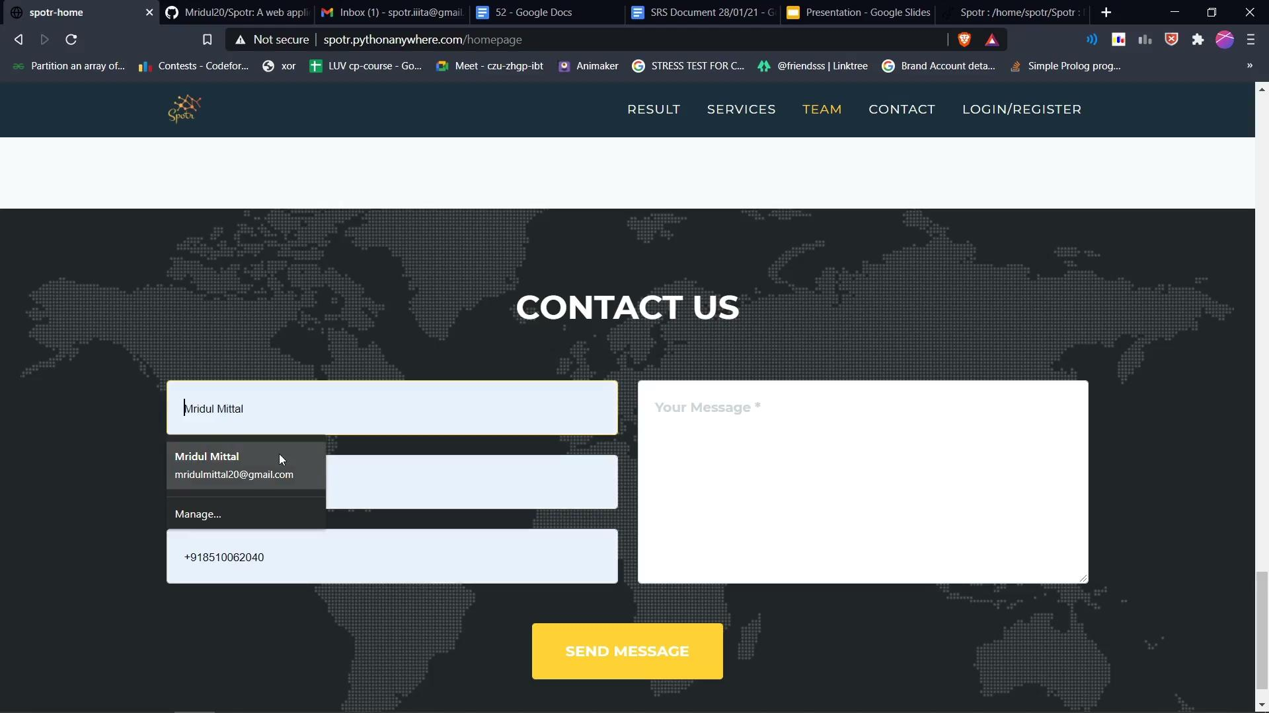
Video

Slide 10
USE CASES
In our project, we have a total of 14 test cases.
These 14 test cases serves various purposes which helps the website work effectively.
We have implemented all the 14 test cases and they are working fine.

Slide 11
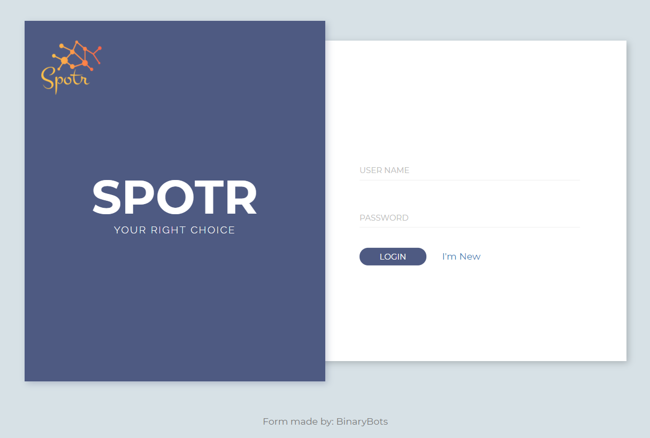
USER LOGIN
It helps the already registered user to login and perform the search based on their requirements.

Slide 12
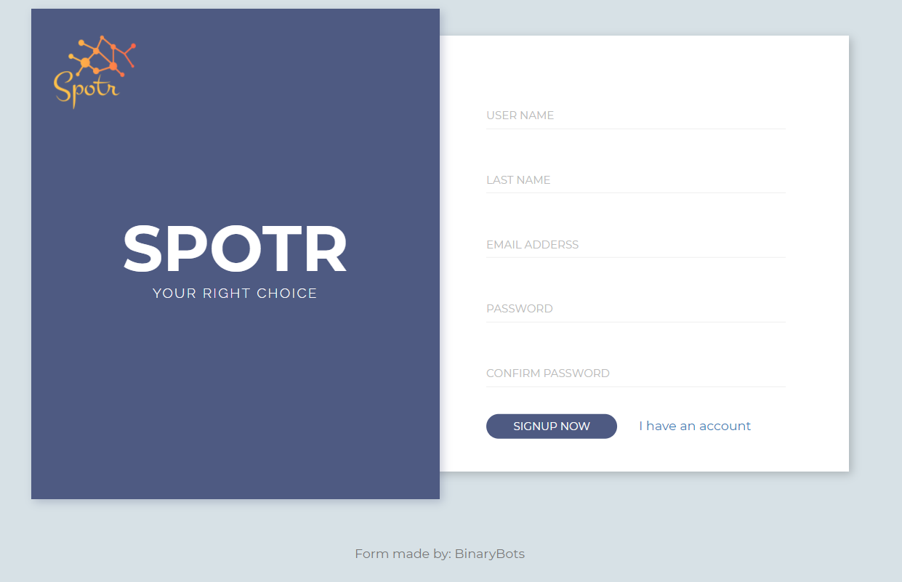
NEW USER REGISTER
Here, any new user can register themselves (by entering basic information) and then use the website for their purpose.

Slide 13
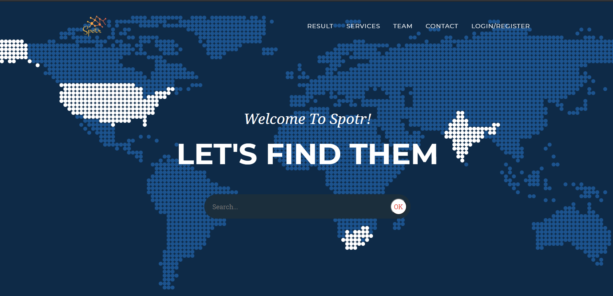
SEARCH USERNAME
Now, you are just “ONE CLICK” away from finding the person.
Just enter the username and click “OK”.
You will get the required profile.

Slide 14
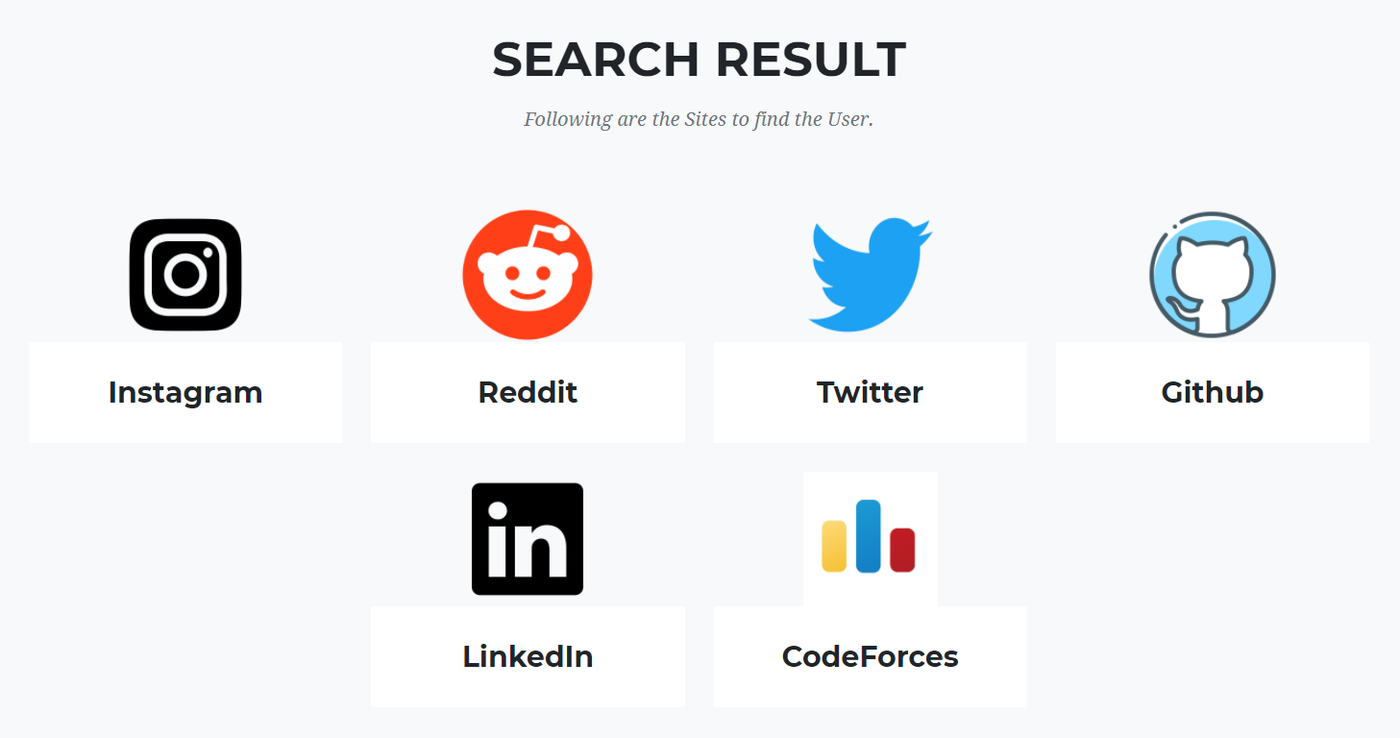
Instagram, Reddit, Twitter, Github, Linkedin, CodeForces
These are the platforms where you can find the person.
Just click on the icon and you will see the information.
(The coloured logo indicates that the username searched exists in these platforms only)

Slide 15
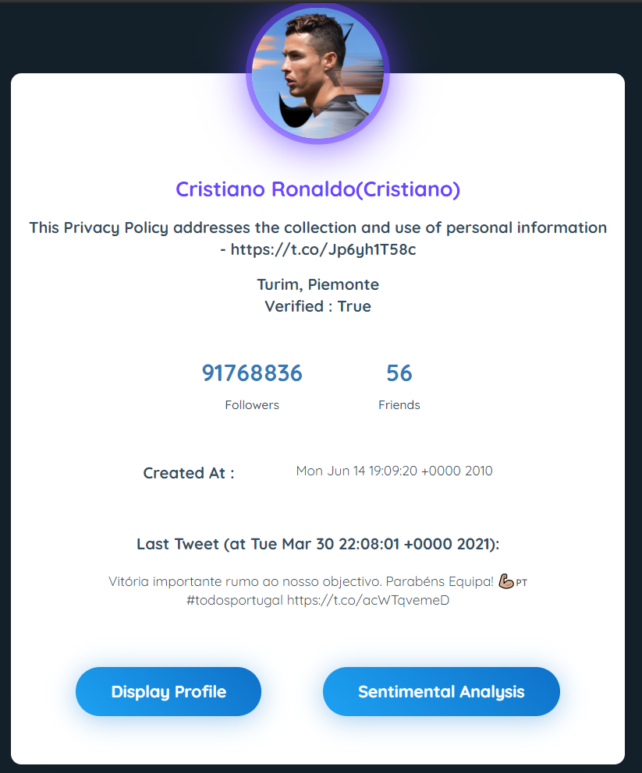
PLATFORM DETAILS
It will show the basic details of the user which is searched.
(It contains “Display Profile” and “Sentimental Analysis” button which perform the required functions)

Slide 16
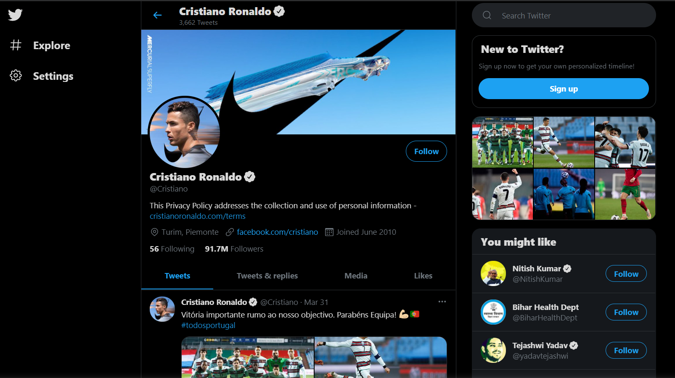
SHOW PROFILE
Redirect user to the platform profile of the username.

Slide 17
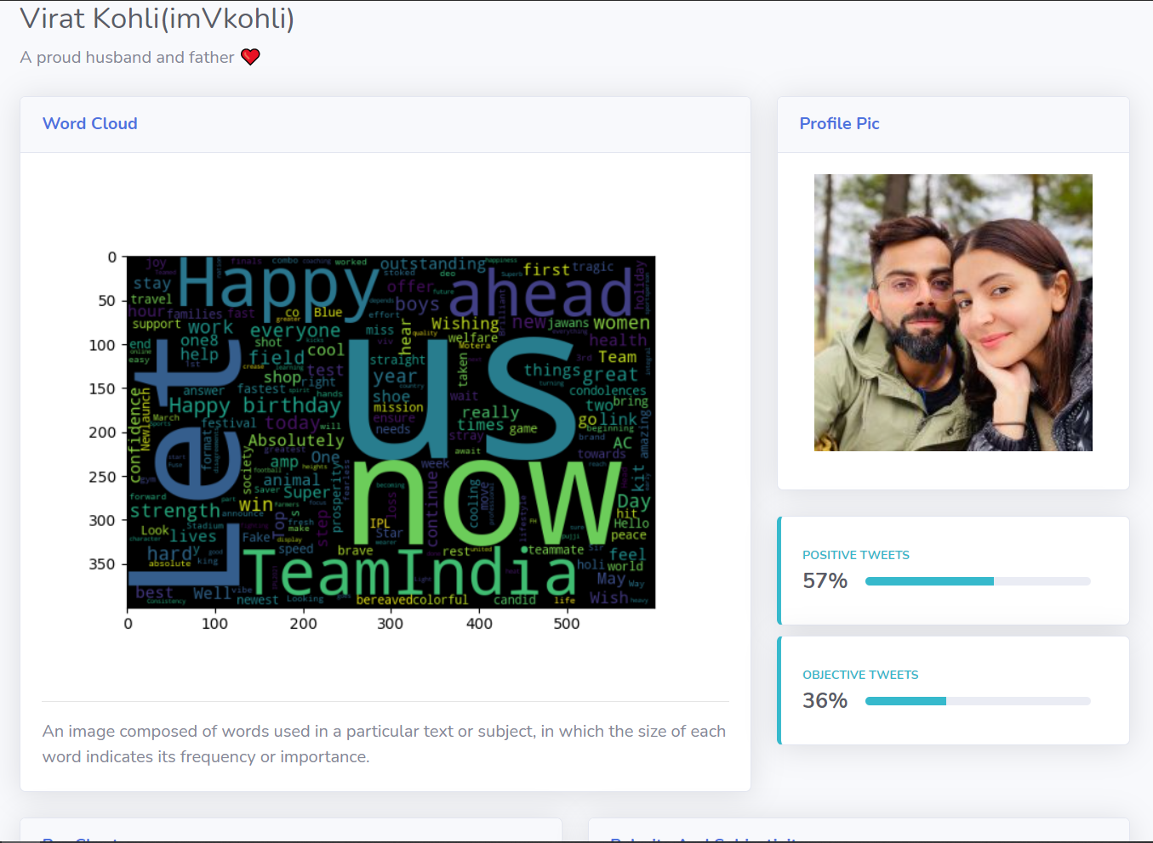
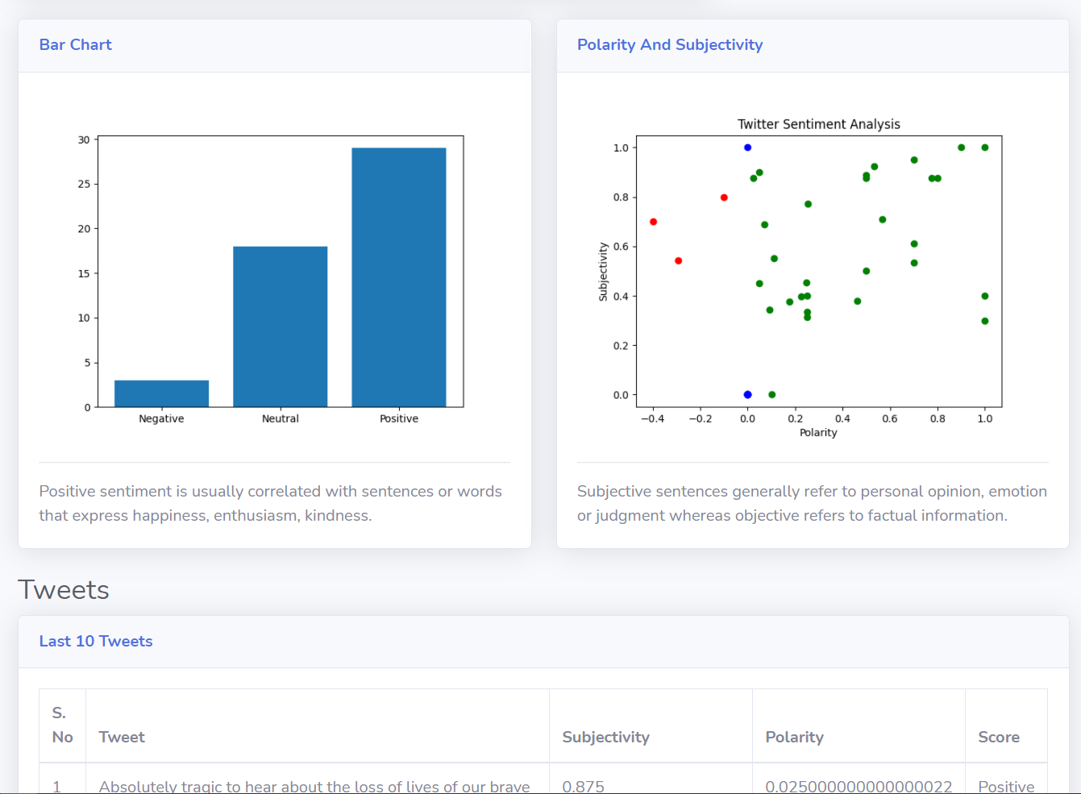
SENTIMENT ANALYSIS
This will show the Sentiment Analysis of the user based on tweets and actions performed.
(we have used ‘twitter’ for this purpose)
It will show the last 10 tweets, word cloud, bar chart, polarity and subjectivity.

Slide 18
WORK DISTRIBUTION
PARAS AGRAWAL IIT2019145 - APIs data and Contact Mail
KSHITIJ KUMAR IIT2019146 - Database and missing data
PIYUSH GURJAR IIT2019148 - Frontend and Online hosting
MRIDUL MITTAL IIT2019127 - Backend Django, Online hosting, Sentimental analysis

Slide 19
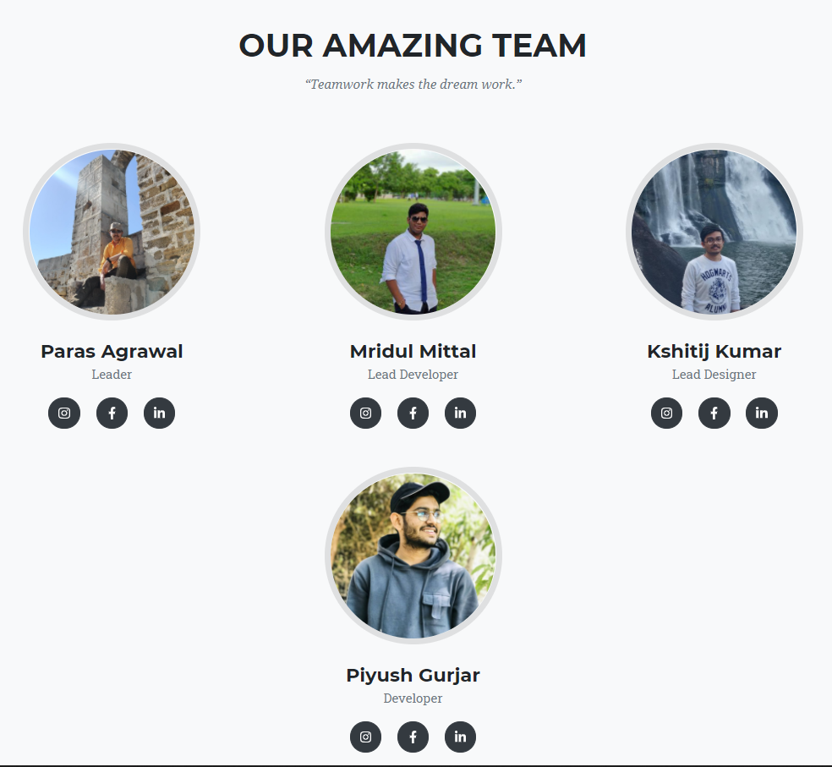
THANK YOU
Group Members -
Mridul Mittal IIT2019127
Paras Agarwal IIT2019145
Kshitij Kumar IIT2019146
Piyush Gurjar IIT2019148

