Slide 1

EARLY DETECTION OF PARKINSON’S DISEASE USING MACHINE LEARNING
CAPSTONE PROJECT (2023-24)

Slide 2

PRESENTED BY
20BDS0191 - MRIDUL MADNANI
20BCE0807 - DEVANSH BAJPAI
20BDS0381 - SRIJAN SINGH SOMVANSHI
Under the guidance of
Sayan Sikder
Associate Professor Senior Grade 1

Slide 3

AGENDA
Aim / Objective of the project
Motivation
Analysis and Literature Survey
Explanation of the working principle
Demonstration of Experimental result and Analysis
Conclusion and Future development
3

Slide 4
INTRODUCTION
Parkinson's disease is a chronic neurodegenerative disorder that primarily affects motor functions. It results from the progressive degeneration of dopaminergic neurons in the substantia nigra region of the brain. This degeneration leads to a range of motor symptoms, including tremors, bradykinesia (slowness of movement), rigidity, and postural instability. As the disease advances, it may also manifest non-motor symptoms, such as cognitive impairment and emotional changes. The exact cause of Parkinson's disease is not fully understood, and its prevalence increases with age.
The challenge lies in identifying the disease in its early stages when intervention can be most effective. Early diagnosis allows for timely medical management, lifestyle modifications, and potential participation in clinical trials. This project aims to leverage machine learning techniques to facilitate the early detection of Parkinson's disease.

Slide 5

OBJECTIVE
Develop a machine learning model for the early detection of Parkinson’s disease.
Improve Diagnostic Precision: Enhance accuracy through effective feature selection and engineering.
Facilitate Timely Intervention: Enable prompt medical management by integrating the model into healthcare systems.

Slide 6
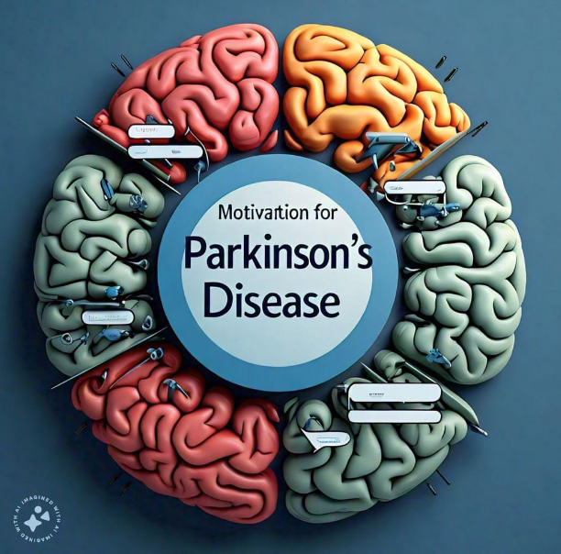
Motivation
Developing a system that can detect it early could significantly improve patients' quality of life by enabling early intervention and treatment.
By detecting Parkinson's disease at an early stage, it may be possible to slow down its progression or even prevent some of its debilitating symptoms from manifesting.
Overcoming challenges in feature selection, data preprocessing, and model optimization offers valuable learning experiences, enhancing my machine learning skills.
This project would allow me to collaborate with experts from different fields, broadening my understanding and perspective.
6

Slide 7


PROBLEM STATEMENT
Despite advancements in medical technology, the early diagnosis of Parkinson's disease remains a significant challenge. Current diagnostic tools often rely on clinical observation and subjective assessments, leading to delayed detection. This delay can result in missed opportunities for interventions that could alleviate symptoms and slow disease progression. Additionally, existing diagnostic methods may lack the precision required for accurate and early detection.
This project addresses these challenges by harnessing the power of machine learning algorithms to analyze relevant data and identify subtle patterns indicative of early-stage Parkinson's disease.

Slide 8
ANALYSIS AND LITERATURE SURVEY
S.no | Paper Title | Year | Summary | Drawbacks
1. | Machine learning approaches to identify Parkinson's disease using voice signal features | 2023 | This project focuses on Parkinson's Disease (PD) detection using various Machine Learning and Deep Learning models, including SVM, RF, DT, KNN, and MLP, applied to voice signal features from a dataset of 195 recordings. Techniques such as SMOTE, Feature Selection, and hyperparameter tuning were employed to enhance model performance. | The study does not discuss how the proposed model may perform in real-world clinical conditions with factors such as background noise, varying patient conditions, or different recording equipment. The model's robustness in practical healthcare settings needs consideration.
2. | Early detection of Parkinson's disease using machine learning | 2023 | This paper addresses the challenge of early Parkinson's disease (PD) detection through telemedicine using machine learning techniques. Research conducted on MDVP audio data from 30 Parkinson's patients and healthy individuals trained four ML models, emphasizing the potential for remote and accurate early PD diagnosis. | The paper does not mention validation on external datasets. Evaluating the models' performance on independent datasets is crucial to confirm their generalizability and robustness across different patient populations.

Slide 9
S.no | Paper Title | Year | Summary | Drawbacks
3. | A Parkinson Disease Classification Using Stacking Ensemble Machine Learning Methodology | 2022 | This paper proposes a stacked ensemble model utilizing vocal analysis techniques for early Parkinson's disease diagnosis, achieving high accuracy rates of 90-91% in validation/testing and 98-100% in training. The model integrates various machine learning algorithms and dimensionality reduction techniques to effectively distinguish between Parkinson's patients and healthy individuals, offering potential benefits for the Indian healthcare sector. | Potential overfitting due to high training accuracy, limited generalizability to diverse populations, and reliance on a single dataset.
4. | A Novel Ensemble Stacking Learning Algorithm for Parkinson’s Disease Prediction | 2022 | This research introduces ESLA, an ensemble stacking learning algorithm, for early Parkinson's disease detection using voice data. Comparing with other methods, ESLA shows improved classification accuracy, utilizing various classifiers like RF, XGBoost, linear regression, AdaBoost, and MLP. | Potential limitations in the diversity of the dataset, possible overfitting due to high accuracy claims, and lack of validation on external datasets to assess generalizability to different populations.
5. | Early Detection of Parkinson’s Disease Using Deep Learning and Machine Learning | 2020 | This study employs an innovative deep-learning technique to detect early-stage Parkinson's disease by monitoring premotor features. It considers indicators such as Rapid Eye Movement, olfactory loss, cerebrospinal fluid data, and dopaminergic imaging markers for accurate and timely identification of individuals affected by PD. | The study is based on a relatively small dataset comprising 584 individuals (183 healthy and 401 early PD). This limited sample size may impact the generalizability of the proposed deep learning model, and its performance might vary with larger and more diverse datasets.

Slide 10
The literature review underscores significant progress in utilizing machine learning for early detection of Parkinson's disease, showcasing diverse methodologies such as deep learning, ensemble methods, and feature selection techniques. However, several gaps persist. These include the need for more robust and interpretable models, validation on external datasets, consideration of real-world clinical conditions, and addressing comorbid conditions like depression. Additionally, the reliance on small datasets raises concerns about generalizability. Addressing these gaps is crucial for developing clinically applicable ML models that can accurately detect PD in its early stages, thereby improving patient care and healthcare decision-making.

Slide 11
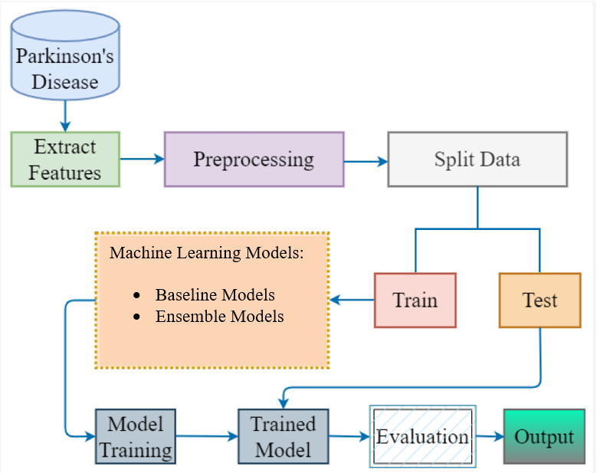
SYSTEM MODEL

Slide 12
Working Principle
Module 1: Data Acquisition and Preprocessing
Data Sourcing:
Gathered raw data relevant to Parkinson's disease (PD) from clinical databases, research studies, and public repositories.
Ensured comprehensive coverage of pertinent information from multiple channels.
Data Cleaning and Harmonization:
Addressed inconsistencies, errors, and missing values within the dataset.
Implemented rigorous quality control measures to validate data accuracy and reliability.
Module 2: Preprocessing and Feature Engineering
Data Collection and Cleaning:
Collected raw data associated with Parkinson's disease from diverse sources.
Conducted data cleaning and harmonization to ensure dataset integrity.
Quality Control and Validation:
Validated data accuracy and reliability through quality control measures.

Slide 13
Module 3: Running Baseline ML Models
Algorithm Selection:
Utilized various algorithms including logistic regression, K-nearest neighbors (KNN), Naive Bayes, random forest, decision tree, support vector machine (SVM), and XGBoost.
Model Evaluation:
Optimized hyperparameters and assessed model performance using accuracy, precision, recall, and F1-score metrics.
Module 4: Model Development and Training
Algorithm Evaluation:
Conducted comprehensive evaluation of machine learning algorithms for Parkinson's disease diagnosis.
Hyperparameter Optimization:
Fine-tuned algorithms to enhance performance and generalization.
Cross-Validation Techniques:
Split dataset into training, validation, and test sets for model training.
Implemented cross-validation to assess performance across different data subsets.
Module 5: Comparison and Stacking Ensemble Techniques
Model Comparison:
Compared individual baseline models based on performance metrics and interpretability.
Ensemble Methods:
Implemented stacking ensemble techniques to combine predictions from diverse base models.
Trained a meta-learner to improve overall predictive performance.

Slide 14
Module 6: Validation and Evaluation
Model Validation:
Evaluated developed models against baseline algorithms using validation techniques.
Assessed model performance metrics (accuracy, precision, recall, F1-score) and visualized results using ROC curves and confusion matrices.
Model Selection:
Selected effective models for potential clinical deployment based on evaluation outcomes and domain knowledge.
Module 7: Building a User Interface
Web Application Development:
Integrated selected models into a user-friendly web application.
Enabled easy access and interaction with predictive models for Parkinson's disease diagnosis.

Slide 15
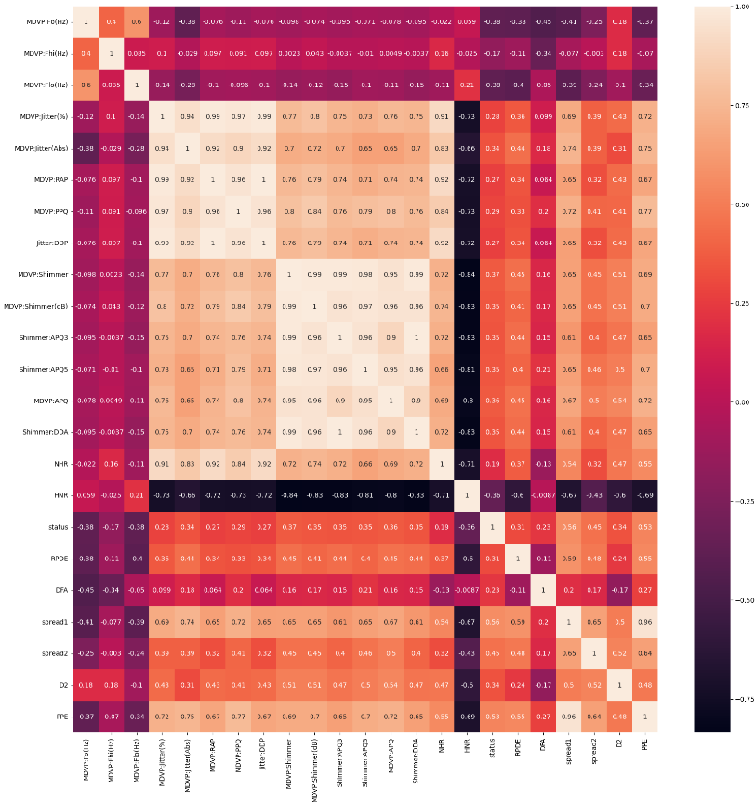
DEMONSTRATION OF EXPERIMENTAL RESULT AND ANALYSIS
1. Heatmap Showing Correlation Between Dataset Points
- Created a heatmap to visualize correlations between different variables in our dataset.
- Used colors to highlight strong positive or negative correlations, helping us understand the relationships within our data.

Slide 16
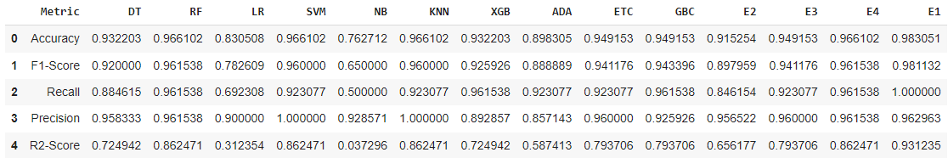
DEMONSTRATION OF EXPERIMENTAL RESULT AND ANALYSIS
2. Running and Comparing Baseline ML Models
- Implemented several baseline ML models including Decision Tree Classifier, Random Forest Classifier, Logistic Regression, SVM, Naive Bayes, KNN Classifier, XGBoost Classifier, AdaBoost Classifier, Extra Trees Classifier, and Gradient Boosting Classifier.
- Trained and tested these models on our dataset to compare their accuracies.
- Discovered that models like Random Forest, SVM, and KNN achieved the highest accuracy of 96%.

Slide 17
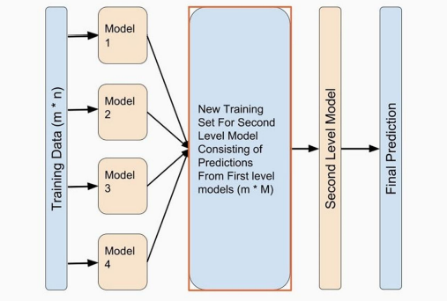
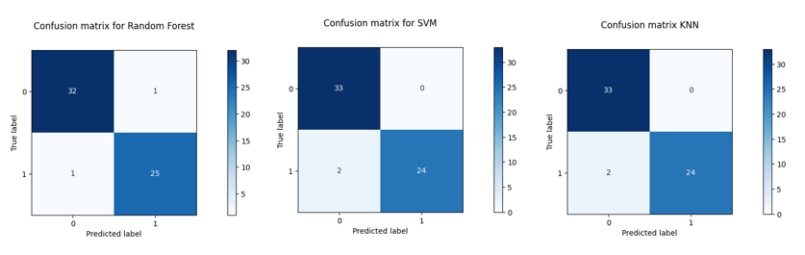
DEMONSTRATION OF EXPERIMENTAL RESULT AND ANALYSIS
3. Using Stacking Ensemble Techniques to Improve Prediction
- Employed stacking ensemble techniques to enhance prediction accuracy.
- Explored different combinations of models at both the 1st and 2nd levels of the ensemble.
- Iteratively tested various combinations to identify the most effective ensemble configuration.

Slide 18
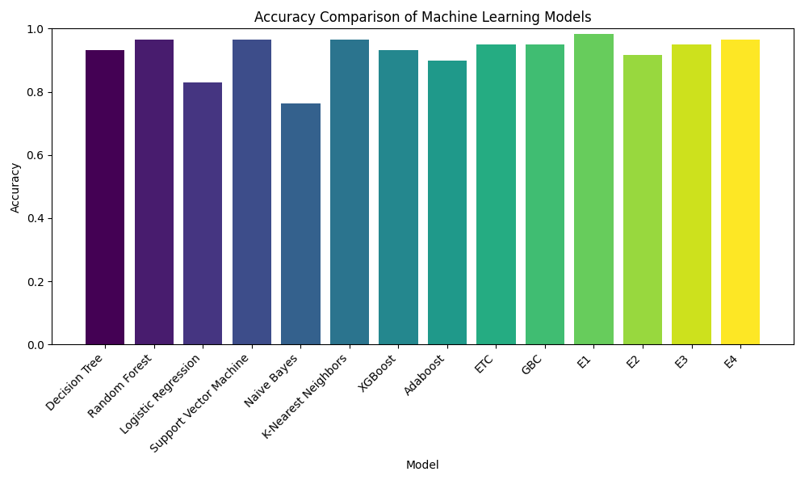
DEMONSTRATION OF EXPERIMENTAL RESULT AND ANALYSIS
4. Concluding the Best Ensemble Model
- Concluded that the 2nd level ensemble consisting of SVM, KNN, and Random Forest achieved the highest accuracy of 98%.
- Determined that this ensemble model would be the optimal choice for our project.
- Planned to showcase and integrate this model into our web application for demonstrating early detection of Parkinson's disease using machine learning.

Slide 19
CONCLUSION AND FUTURE DEVELOPMENT
In conclusion, the developed ensemble stacking model, combining Random Forest, SVM, and KNN classifiers, demonstrated strong accuracy of approximately 98% in early detection of Parkinson's disease. This signifies the robustness and effectiveness of the ensemble approach in leveraging the diverse strengths of individual classifiers. Future work could focus on validating the model on larger and more diverse datasets, enhancing interpretability through feature importance analysis, and exploring additional ensemble techniques or incorporating domain-specific knowledge for further performance improvements. Additionally, extending the model's applicability to real-world clinical settings and addressing potential biases or limitations could enhance its practical utility in healthcare decision-making.

Slide 20


THANK YOU

