Slide 1


Comparing LLMs and Fine-Tuned Transformer-Based Models
for Biomedical NER and Relation Extraction
for Knowledge Graph Construction
Mridul Milan
Student No: 25234387
Supervisor: Prof. Peter Paul Buitelaar

Slide 2
Progress Since the Previous Meeting
Current Status
• PubMedBERT NER: complete
• PubMedBERT RE: complete
• LLM NER: complete
• LLM RE: next stage
Previous Position
• PubMedBERT NER completed: 86.54% F1 [1,2].
• Relation extraction paused at marker validation.
• Qwen2.5-7B-Instruct selected but not loaded [4].
• No LLM predictions, pilot study or evaluation results.
New Work Completed
• PubMedBERT relation extraction completed.
• Qwen2.5-7B loaded with 4-bit quantisation [4,5].
• End-to-end LLM-based NER pipeline implemented.
• Five-document pilot and 95-document dev evaluation completed.
Focus of This Meeting
• New implementation progress
• Pilot and development results
• PubMedBERT vs Qwen comparison
• Problems and next steps
Key Advancement
• Project moved from pipeline preparation to completed model implementation and evaluation.
2

Slide 3
PubMedBERT Relation Extraction Completed
Entity-preserving cropping resolved the marker-loss problem before supervised RE training [1,2]
Input Repair and Validation
• Original issue: long examples exceeded 512 tokens.
• Standard truncation removed one marked relation entity.
• Both relation arguments were located before cropping.
• Entity-preserving context windows were created.
• Both marker pairs were revalidated before training.
Final validated examples
• Train: 8,340
• Development: 2,313
• Test: 2,300
Final Relation Model
• PubMedBERT sequence-classification model [2].
• Eight BioRED relations + No_Relation [1].
• Learning rate: 2e-5
• Batch size: 4
• Epochs: 3
• Class-weighted cross-entropy used for imbalance.
Test performance
• Accuracy: 69.83%
• Weighted F1: 69.07%
• Macro F1: 36.44%
Final RE model saved after validation, training and class-weighted evaluation
Main observation: high weighted F1 but lower macro F1 due to rare relation classes
3

Slide 4
Qwen2.5-7B LLM NER Pipeline
Component | Implementation
Model | Qwen2.5-7B-Instruct
Quantisation | 4-bit BitsAndBytes
Runtime | Google Colab T4
• Implemented an end-to-end biomedical NER pipeline using Qwen2.5-7B-Instruct [4].
• Loaded the model through Hugging Face Transformers.
• Used 4-bit BitsAndBytes quantisation for Tesla T4 inference [5].
• Applied a frozen biomedical extraction prompt.
• Required structured JSON output with BioRED entity labels [1].
• Added automatic JSON parsing, schema validation and label checking.
• Recovered exact character offsets from predicted entity text.
• Added mention expansion, strict evaluation and checkpoint saving.
Pipeline Flow
• BioRED title + abstract
• Frozen extraction prompt
• Qwen inference
• JSON parsing
• Mention expansion
• Offset recovery
Evaluation Rule
• Strict mention-level matching
• Start offset must match
• End offset must match
• Entity type must match
• Invalid labels rejected
4

Slide 5
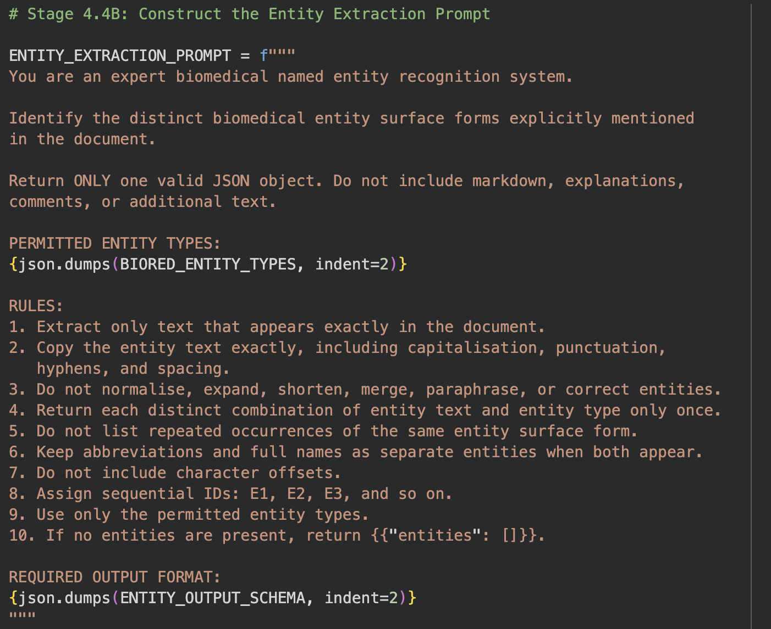
Frozen LLM Entity Extraction Prompt
Prompt Objective
• Identify distinct biomedical entity surface forms explicitly mentioned in the document.
• Return only one valid JSON object with no explanations or additional text.
• Use only the six permitted BioRED entity categories.
• Preserve the entity text exactly as it appears in the document.
• Character offsets are recovered later using Python.
Frozen Evaluation Use
• The same prompt, schema and rules were used without modification for all 95 development documents.
5

Slide 6
Frozen Development-Set Evaluation
Measure | Result
Documents evaluated | 95
Valid JSON outputs | 93
Invalid JSON outputs | 2
• Frozen prompt applied to the remaining 95 BioRED development documents.
• No further prompt refinement during this evaluation stage.
• Outputs were parsed automatically and validated against the BioRED schema [1].
• Predictions were converted into mention-level offsets.
• Strict exact matching was used for precision, recall and F1.
• Checkpoints were saved after each document.
Strict Evaluation
• True positives: 1,313
• False positives: 935
• False negatives: 2,025
• Precision: 0.5841
• Recall: 0.3933
• F1-score: 0.4701
Main Finding
• JSON format was reliable.
• Extraction recall was limited.
• Missed entity mentions were the largest error source.
• Valid JSON did not guarantee correct biomedical extraction.
6

Slide 7
PubMedBERT vs Qwen2.5-7B: Current Comparison
PubMedBERT NER
• Supervised fine-tuning [2].
• Token-level BIO classification.
• Evaluated on BioRED test set [1].
• Final F1-score: 86.54%.
• Strong exact-match performance.
Qwen2.5-7B NER
• Prompt-based extraction [4].
• No task-specific fine-tuning.
• Evaluated on BioRED dev set [1].
• Frozen-prompt F1-score: 47.01%.
• Flexible but less reliable.
Performance Difference
• Difference: 39.53 percentage points.
• PubMedBERT benefits from labelled supervision.
• Qwen requires parsing and offset recovery.
• Final comparison must use the same split.
Current NER Comparison
PubMedBERT fine-tuned NER: 86.54% F1
Qwen2.5-7B prompt-based NER: 47.01% F1
Important limitation: This is an initial comparison because PubMedBERT was tested on the BioRED test set, while Qwen2.5-7B was evaluated on the development set after the prompt was finalised.
Final comparison will use the same BioRED test set and the same evaluation rules for both models.
7

Slide 8
Problems Faced
Relation Marker Loss
• Long examples exceeded the 512-token limit.
• Standard truncation removed one marked relation entity.
• Required entity-preserving cropping and revalidation.
Low LLM Recall
• False negatives: 2,025.
• Recall: 39.33%.
• Many gold biomedical mentions were missed.
Exact Boundary Mismatch
• Correct concepts may be generated with different surface forms.
• Strict offset matching counts these as incorrect.
Problem | Impact
Invalid JSON | 2 outputs could not be parsed
Class imbalance | Low macro F1 in RE
Different splits | Final comparison not complete
LLM Output Reliability
• JSON success rate was high.
• Two outputs were invalid.
• Valid JSON still needed label and offset validation.
Fair Comparison Issue
• Current PubMedBERT and LLM results use different splits.
• Final comparison must use identical documents and metrics.
8

Slide 9
Future Steps
LLM Relation Extraction
• Relation schema
• Frozen prompt
• Pilot inference
• Relation validation
Immediate Next Stage
Define and freeze the LLM relation extraction schema.
Create a relation extraction prompt using BioRED labels [1].
Require valid entity references in predicted relations.
Run a small relation extraction pilot study.
Analyse unsupported and hallucinated relations.
Evaluate LLM RE against BioRED gold relations.
Final Goal
Compare extraction accuracy, reliability, computational cost and suitability for knowledge graph construction.
Final Comparison
• Same dataset split
• NER precision, recall, F1
• RE macro and weighted F1
• Invalid outputs and hallucinations
Knowledge Graph
• Entity nodes
• Relation edges
• Neo4j construction [7]
• Biomedical querying and comparison
9

Slide 10
References
[1] Y. Luo et al., “BioRED: A Rich Biomedical Relation Extraction Dataset,” Briefings in Bioinformatics, 2022.
[2] Y. Gu et al., “Domain-Specific Language Model Pretraining for Biomedical Natural Language Processing,” ACM Transactions on Computing for Healthcare, 2021.
[3] J. Devlin et al., “BERT: Pre-training of Deep Bidirectional Transformers for Language Understanding,” NAACL-HLT, 2019.
[4] Qwen Team, “Qwen2.5 Technical Report,” arXiv:2412.15115, 2025.
[5] Hugging Face, “Transformers: bitsandbytes Quantization Documentation,” accessed 2026.
[6] Hugging Face, “Transformers Documentation,” accessed 2026.
[7] Neo4j, “Neo4j Graph Database Documentation,” accessed 2026.
10

