Slide 1



Comparing LLMs and Fine-Tuned Transformer Models for Named Entity Recognition and Relation Extraction in Biomedical Knowledge Graph Construction
Literature Review Report
University
ofGalway.ie
Name: Mridul Milan
Student ID:25234387
Supervisor: Peter Paul Buitelaar

Slide 2
Project Background and Research Objective
Problem
Biomedical research abstracts contain large amounts of useful information, including diseases, genes, chemicals and their relationships, but this knowledge is embedded in unstructured text.
Manual extraction is slow, difficult to scale and unsuitable for constructing large, continuously updated knowledge resources.
Research Objective
Compare a fine-tuned biomedical transformer pipeline with an LLM prompt-based pipeline for Named Entity Recognition and relation extraction.
Evaluate both approaches on the same BioRED data using Precision, Recall and F1-score, then examine their suitability for biomedical knowledge graph construction.

Slide 3
Evolution of the Literature Review
Initial scientific extraction foundation
S2ORC introduced large-scale scientific text and metadata.
Luan et al. and Wadden et al. showed how entities and relations can be extracted from scientific text.
These studies established the original knowledge graph direction.
Inclusion Shift to biomedical information extraction
BioBERT and PubMedBERT demonstrated the value of biomedical domain-specific pretraining.
BioRED provided labelled biomedical entities and relations.
EMBRE supported the relation extraction component.
Introduction of LLM-based extraction
Recent studies showed that LLMs can perform biomedical extraction through prompting.
However, output consistency and reliability remain important concerns.

Slide 4
Comparative Analysis and Key Findings
Fine-Tuned Biomedical Models
Provide controlled, task-specific predictions and benefit from domain-specific pretraining, but depend on labelled data, training time and computational resources.
LLM Prompt-Based Extraction
Supports zero-shot or few-shot extraction with less task-specific training, but outputs can vary in wording, format, entity boundaries and relation labels.
Comparative Insight
The literature usually evaluates supervised biomedical models and LLMs separately. A meaningful comparison therefore requires the same input abstracts, annotation schema, gold labels and evaluation metrics.
Overall Finding
Neither approach is automatically superior: fine-tuned models prioritise control and reproducibility, whereas LLMs prioritise flexibility and reduced training effort.
4

Slide 5
Research Gap and Project Refinement
Research Gaps
• Limited direct comparison between fine-tuned biomedical transformers and LLM-based extraction under identical experimental conditions.
• Limited evaluation of LLM output consistency, schema compliance and reliability against biomedical gold-standard annotations.
• Limited attention to how entity and relation extraction errors affect the quality of a downstream knowledge graph.
Project Refinement
The original project focused on general scientific extraction using S2ORC. The literature review refined the scope to biomedical NER and relation extraction using BioRED, enabling a fair and measurable comparison.
5

Slide 6
Implementation Results So Far
Stage 1: BioRED Inspection — Completed
Loaded train/dev/test splits and reconstructed document text.
Validated entity offsets across all splits with 0 offset errors.
Extracted gold relations and resolved relation references successfully.
Stage 2.1: NER Preparation — Completed
Tokenised documents and aligned entity spans with tokens.
Created BIO labels, label IDs and ignored special tokens using -100.
Prepared NER datasets for transformer model training.
Stage 2.2: Relation Preparation — In Progress
Created positive relation examples and relation label IDs.
Added entity markers into relation text.
Remaining: apply markers to all splits, tokenise marked examples, save datasets, and optionally create negative examples.
6

Slide 7
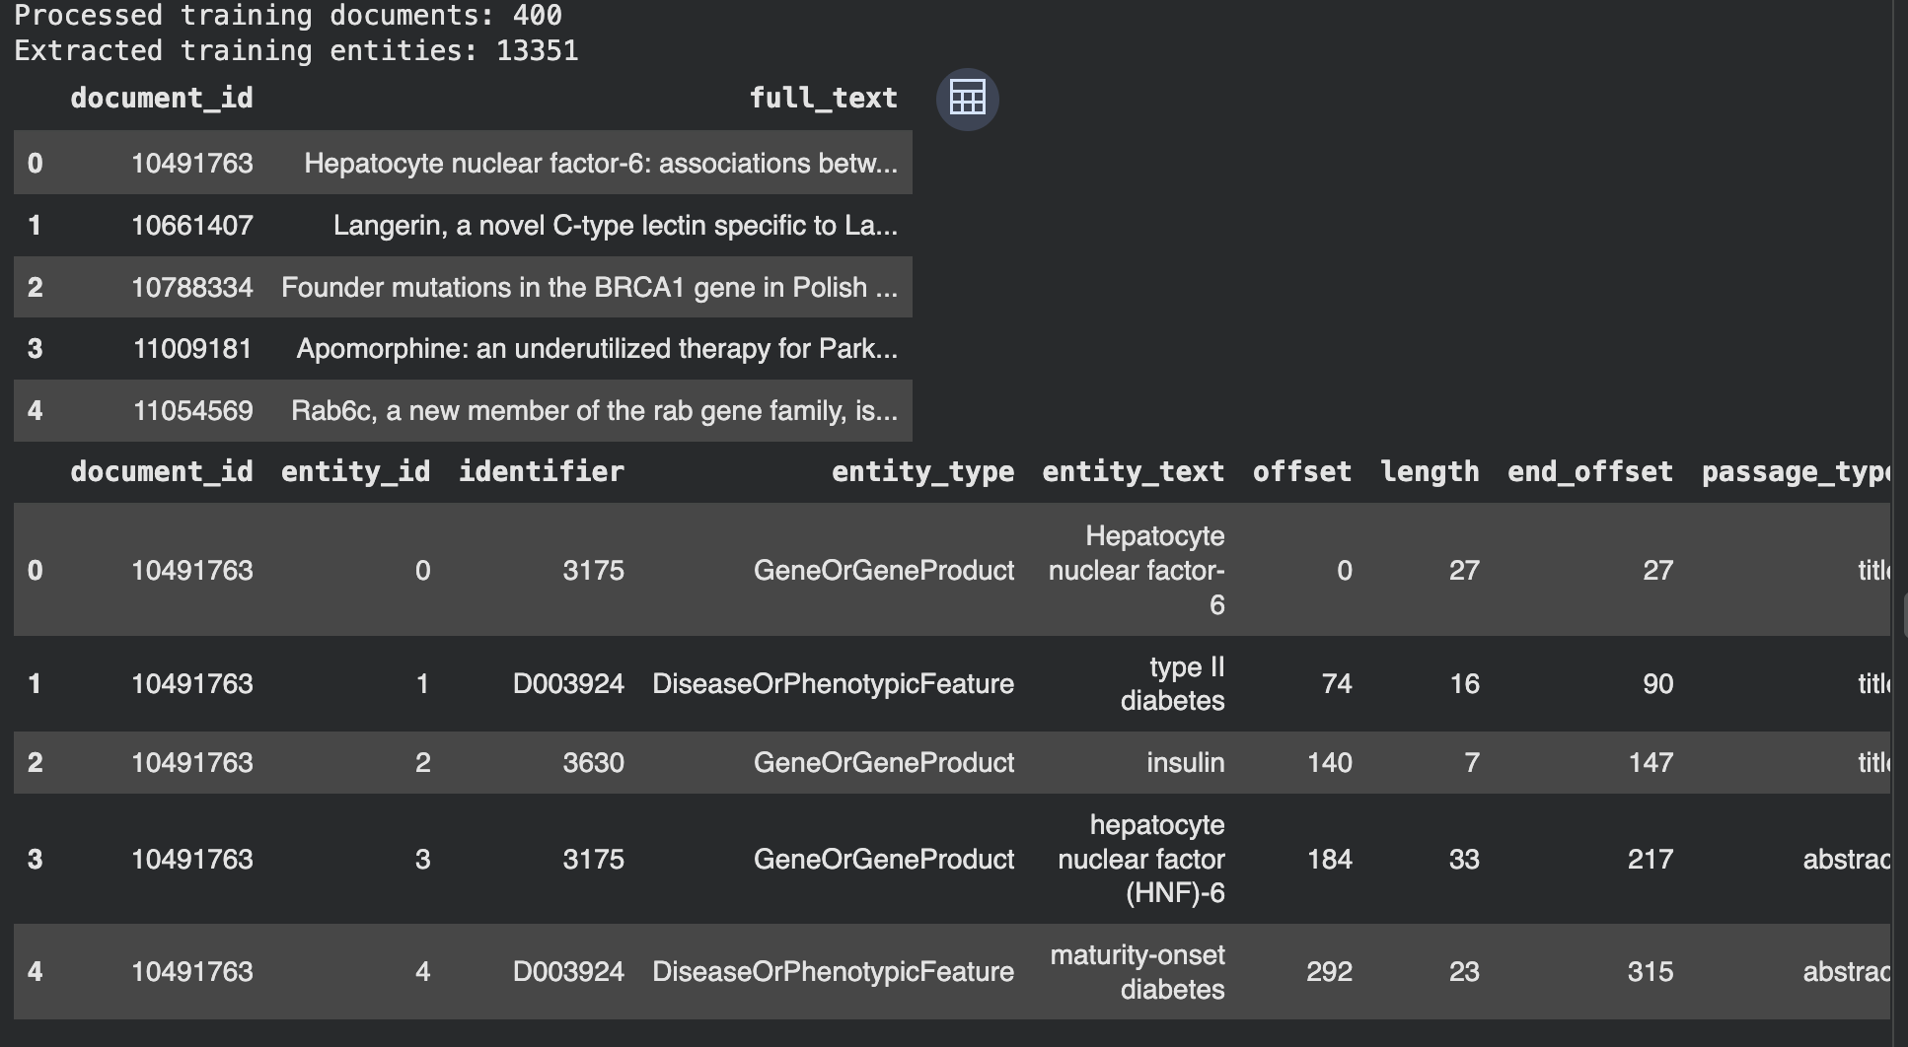
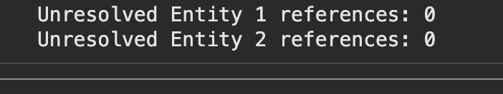
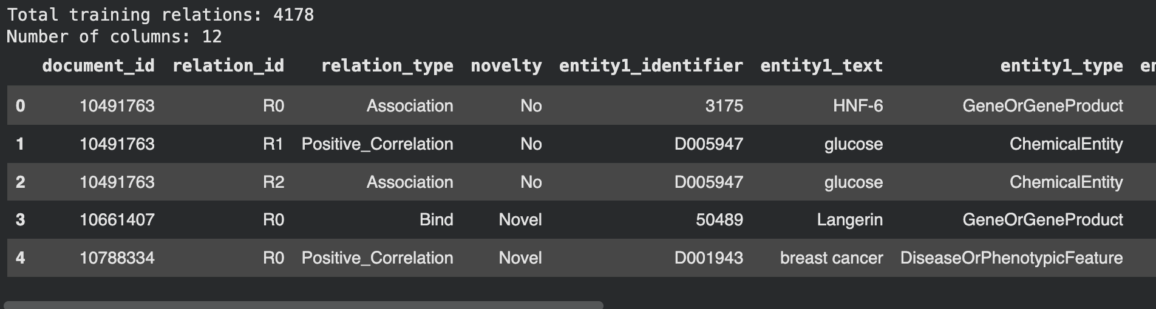
Implementation Snippets

Slide 8

Final Methodology, Next Steps and Conclusion
Final Comparative Methodology
• Pipeline 1: fine-tune a biomedical transformer such as BioBERT or PubMedBERT for entity and relation extraction.
• Pipeline 2: apply structured zero-shot or few-shot LLM prompts to the same BioRED abstracts and convert responses into a fixed schema.
• Evaluate NER and relation extraction separately using Precision, Recall and F1-score against BioRED gold labels.
Immediate Next Steps
Prepare model-ready NER labels and relation-classification instances; select the final transformer model; design fixed LLM prompts; and implement comparable output normalisation.
Conclusion
The literature review established the research gap, justified the biomedical focus and directly guided the completed BioRED preprocessing work and the two-pipeline experimental design.
8

