Slide 1
Comparing LLMs and fine-tuned Transformer based models for NER and relation extraction for knowledge graph construction from scientific text
Student Name - Mridul Milan
Student ID- 25234387
Project Details:
To extract structured biomedical entities and relationships from unstructured biomedical research abstracts.
To compare fine-tuned transformer models and LLM-based prompt extraction for biomedical information extraction.
To evaluate both approaches using labelled biomedical data.
To construct a biomedical knowledge graph from the extracted entities and relations.
Gaps Identified:
General scientific datasets are useful for large-scale text mining but may not provide direct gold-standard labels for biomedical NER and relation extraction.
Fine-tuned transformer models usually achieve strong performance but require labelled training data.
LLMs are flexible for zero-shot and few-shot extraction, but their outputs may be inconsistent or unsupported by the text.
There is limited direct comparison between fine-tuned biomedical transformer models and LLM-based extraction for biomedical knowledge graph construction.
Dataset References
Main Labelled Dataset: Luo, L., Lai, P.-T., Wei, C.-H., Arighi, C. N., and Lu, Z., “BioRED: A rich biomedical relation extraction dataset,” Briefings in Bioinformatics, vol. 23, no. 5, pp. 1–12, Sep. 2022, doi: 10.1093/bib/bbac282.
Transformer Model Reference: Lee, J. et al., “BioBERT: a pre-trained biomedical language representation model for biomedical text mining,” Bioinformatics, vol. 36, no. 4, pp. 1234–1240, Feb. 2020, doi: 10.1093/bioinformatics/btz682.
LLM Literature Reference: Zhang et al., “A Study of Biomedical Relation Extraction Using GPT Models,” 2024.

Slide 2
Dataset Change and Motivation
Previous Dataset Considered: S2ORC
Large collection of scientific papers.
Useful for scientific text mining and knowledge modelling.
Contains structured metadata and parsed paper text.
However, it is not a ready-made labelled dataset for NER and relation extraction.
Limitation of S2ORC:
No direct gold-standard labels for selected entity types.
No direct relation labels for evaluation.
Difficult to calculate Precision, Recall, and F1-score.
Would require manual annotation or extra labelling work.
New Dataset: BioRED
Provides labelled biomedical entities and relations.
Suitable for both Named Entity Recognition and Relation Extraction.
Allows fair comparison between fine-tuned models and LLM-based extraction.
BioRED is more suitable for this project because it provides gold-standard biomedical entity and relation annotations, while S2ORC mainly provides large-scale scientific text and metadata.

Slide 3
Literature Review Outcome:
Paper Title | Details
[1] J. Lee et al., “BioBERT: a pre-trained biomedical language representation model for biomedical text mining,” Bioinformatics, 2020. | BioBERT is a BERT-based model pre-trained on biomedical corpora such as PubMed abstracts and PMC full-text articles. It improves performance on biomedical NLP tasks such as Named Entity Recognition, Relation Extraction, and Question Answering. The study shows that domain-specific pre-training helps models understand biomedical terminology better than general language models.
[2] Zhang et al., “A Study of Biomedical Relation Extraction Using GPT Models,” 2024. | This paper investigates the use of GPT-style Large Language Models for biomedical relation extraction. It shows that LLMs can be applied to extract relations between biomedical entities using prompt-based methods. The study is relevant because it highlights both the potential and limitations of LLMs, especially their dependence on prompt design and consistency.
[3] L. Luo et al., “BioRED: A rich biomedical relation extraction dataset,” Briefings in Bioinformatics, 2022. | BioRED introduces a biomedical dataset containing annotated entities such as genes, diseases, chemicals, variants, species, and cell lines. It also includes manually annotated relations between entities at document level. This dataset provides gold-standard labels, making it suitable for evaluating both NER and relation extraction models.

Slide 4
Adaptations from these papers:
BioBERT: Biomedical Transformer Model
Use a biomedical transformer instead of a general transformer model.
Fine-tune the model for biomedical NER and relation extraction.
Use BioBERT or PubMedBERT as the supervised baseline.
Compare transformer performance against LLM prompt-based extraction.
2. GPT Models for Biomedical Relation Extraction
Use structured prompts for extracting biomedical relations.
Test whether LLMs can identify relations without task-specific fine-tuning.
Evaluate the consistency and reliability of LLM outputs.
Compare zero-shot or few-shot extraction with fine-tuned transformer models.
3. BioRED Dataset
Use BioRED as the main labelled evaluation dataset.
Extract biomedical entities first, then identify relations between them.
Use the dataset schema to design the knowledge graph.
Evaluate using Precision, Recall, and F1-score.

Slide 5
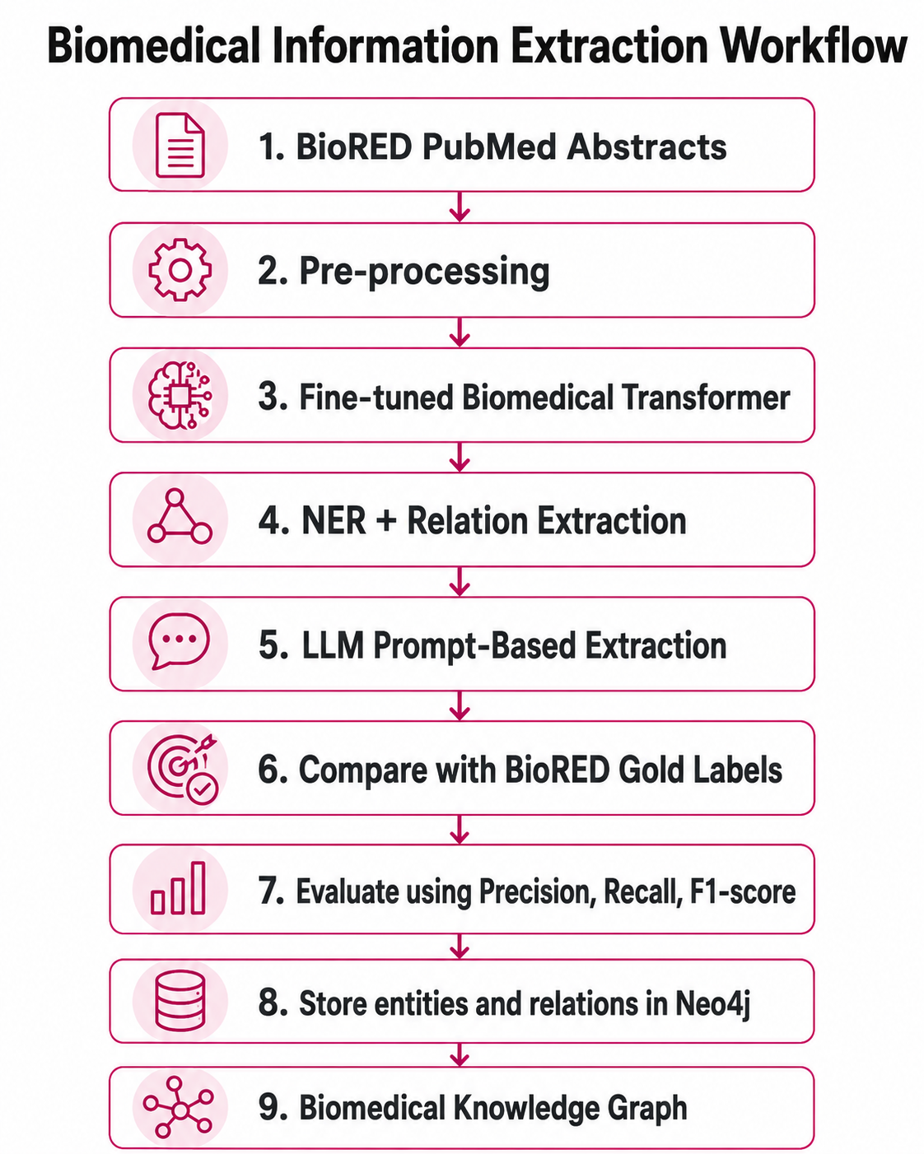
Updated Dataset and Methodology
Dataset: BioRED
BioRED contains biomedical abstracts with annotated entities and relations.
Entity Types:
Gene/Protein
Disease
Chemical
Variant
Species
Cell line
Relation Examples:
Gene–Disease
Chemical–Disease
Chemical–Chemical
Gene–Gene
Variant–Disease

Slide 6
Literature Insights & Project Influence
Insights Identified
Domain-specific models perform better on specialised biomedical text
Labelled datasets are essential for reliable evaluation
LLMs are flexible but may lack consistency
Relation extraction is more challenging than entity recognition
Knowledge graph quality depends on accurate entity and relation extraction
Impact on Project Design
Use BioRED as the main labelled dataset
Compare fine-tuned biomedical transformers with LLM prompting
Evaluate both NER and relation extraction
Store extracted biomedical relationships in Neo4j
Core Research Gap
Limited direct comparison between fine-tuned biomedical transformers and LLM-based extraction for biomedical knowledge graph construction.

Slide 7
Thank you

