Slide 1
IM39003 OHM LAB TERM PROJECT
Optimizing bank lending decisions using metaheuristics
Mridul Gupta 19IM30025

Slide 2
Objective
To find optimum bank lending decisions that maximize the bank profit in a credit crunch environment using Genetic Algorithm (GA).

Slide 3
Formulation
Variables
Loan Interest Rate r_{L}
Loan Size L
Loss
Customer transaction rate r_{T}
Institutional Transaction Cost T
Interest rate of bank r_{D}
Financial Institution’s Deposit D
Required Reserved Ratio K

Slide 4






Objective Function maximize F_{x}
Constraint

Slide 5
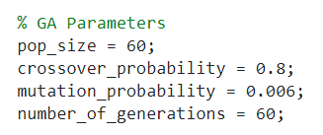
Steps for genetic algorithm
1. Start
2. Initialize GA parameters
3. Generate random population and check validation
4. Calculate fitness of each individual and select the best
5. For i = 1 to population size
Selecting Parents using Roulett Wheel Selection
One point crossover
Bitwise Mutation
Validation of the solution
Update the population with childrens
Finding best solution by evaluating fitness
6. Check for termination criteria if fulfilled then end else continue from step 5

Slide 6
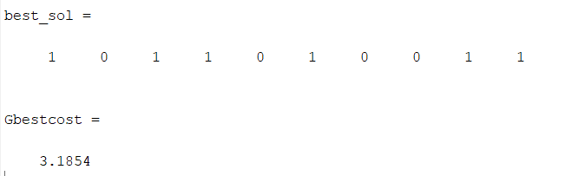
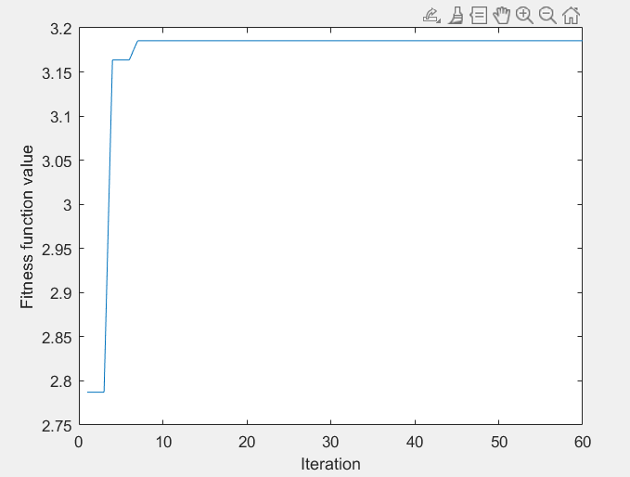
Results
Best solution found is to choose customers 1, 3, 4, 6, 9 and 10 for lending loan.
Objective Function value with the above best solution = 3.1854
Graph between fitness value versus iteration

Slide 7
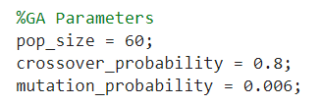
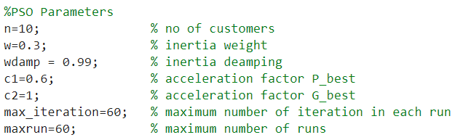
Steps for genetic algorithm + particle Swarm Optimization
1. Start
2. Initialize GA parameters and PSO parameters
3. For i = 1 to maxrun
Generate random population and check validation
Calculate fitness of each individual and initialize the velocity, local best and global best solution
While no_of_iteration <= max_iteration
Update inertia weight, velocity and position of each individual.
Check for boundary violations
One point crossover
Bitwise Mutation
Validation of the solution
Evaluating fitness and updating global and local best solution
Check for termination criteria (no_of_iteration > max_iteration) if fulfilled then end else continue
6. Check for termination criteria (i > maxrun) if satisfied then end else continue from step 3

Slide 8
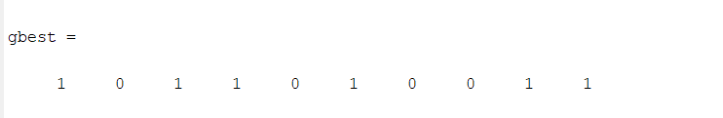
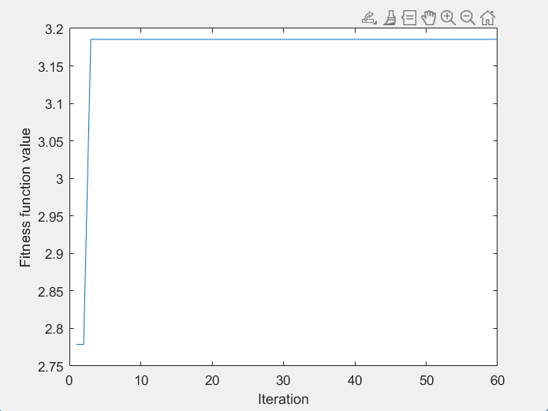
Results
Best solution found is to choose customers 1, 3, 4, 6, 9 and 10 for lending loan.
Objective Function value with the above best solution = 3.1854
Graph between fitness value versus iteration

Slide 9
Comparison in result between GA and Ga+PSO Code GA Code GA + PSO Code
Convergance rate is slightly better in case of GA + PSO code in comparison to GA code only.
Both the algorithm gave same optimal solution having fitness value of 3.1854

