Slide 1
COLLEGE MINOR PROJECT • 2026
MailMint ✉️🌿
Turn Casual Thoughts into Fresh, Polished Professional Emails
Project Team
• Anmolpreet Singh — Developer
• Mridul Sharma — Co-Developer
• Category: Full-Stack Web & Free LLM Integration
Core Highlights
• Simple Languages: HTML5, CSS3, JavaScript & Python
• Supports 5 Free BYOK AI Providers In-Browser
• Zero Paid Services • Zero Database • 100% Privacy

Slide 2
01 • CONTEXT & MOTIVATION
Why Professional Email Writing Needs MailMint
Everyday Communication Challenges
• Students & employees spend 15–25 minutes agonizing over wording for simple emails.
• Striking the right tone (Apologetic vs. Urgent vs. Persuasive) under stress is difficult.
• Poorly structured emails without clear subject lines get ignored or misunderstood.
• Generic templates leave embarrassing '[Your Name]' or '[Company]' brackets behind.
Limitations of Existing AI Tools
• Paid SaaS subscriptions ($15–$30/month) exclude college students.
• Mandatory sign-ups & cloud databases store sensitive personal messages.
• Locked to a single vendor — breaks immediately if free quota runs out.
• Over-engineered tech stacks make academic maintenance difficult.
MailMint ✉️🌿 • Anmolpreet Singh & Mridul Sharma • College Minor Project Slide 2 / 12

Slide 3
02 • PROPOSED SOLUTION
Introducing MailMint — Fast, Stateless & 100% Free
1. Casual Input
• Type rough thoughts in plain, everyday language.
• 5 one-click example scenarios for instant testing.
• Optional Sender & Recipient fields eliminate placeholders.
2. Tone & Category Engine
• 5 Tones: Formal, Friendly, Urgent, Apologetic, Persuasive.
• 6 Types: Job Application, Leave Request, Follow-Up, Complaint, Thank You, General.
• 30 unique tone × category combinations.
3. Ready-to-Send Output
• Structured Subject Line, Greeting, 100–200w Body & Sign-off.
• Inline editing directly inside the email preview.
• One-click Copy, Regenerate & Open in Mail Client.
MailMint ✉️🌿 • Anmolpreet Singh & Mridul Sharma • College Minor Project Slide 3 / 12

Slide 4
03 • PRODUCT CAPABILITIES
Core Features Engineered into MailMint
Bring Your Own Free API Key (BYOK)
• Users enter their own free key directly on the website.
• Keys stay in browser localStorage — zero server storage.
Built-In 60-Second Key Guide
• Step-by-step instructions & direct links for 5 free providers.
• Auto-detects key prefixes (AIza..., gsk_..., sk-or-...).
Smart Regeneration & Draft History
• Not satisfied? Click Regenerate for fresh phrasing.
• Stores up to 5 drafts in client memory to compare versions.
One-Click Productivity Actions
• Copy Full Email or Copy Subject Line independently.
• Direct 'Open in Mail' (mailto:) integration.
MailMint ✉️🌿 • Anmolpreet Singh & Mridul Sharma • College Minor Project Slide 4 / 12

Slide 5
04 • TECHNOLOGY STACK
Built with Clean, Foundational & 100% Free Languages
HTML5
• Semantic single-page layout (index.html).
• Accessible ARIA live toast regions & labels.
• Zero external JS build complexity.
CSS3
• Slate-900 Dark Glassmorphism.
• Indigo-500 & Emerald-400 palette.
• Mobile-first responsive CSS Grid & Flexbox.
JavaScript (ES6+)
• Pure Vanilla JS state management.
• localStorage BYOK vault & prefix detector.
• Async Fetch API & clipboard handler.
Python 3 (Flask)
• Lightweight REST API server (app.py).
• Multi-LLM adapter (llm_providers.py).
• Structured email parser & HTTP error mapper.
MailMint ✉️🌿 • Anmolpreet Singh & Mridul Sharma • College Minor Project Slide 5 / 12

Slide 6
05 • MULTI-LLM INTEGRATION
5 Supported Free AI Providers (Zero Vendor Lock-In)
Supported Free API Providers
• 1. Google Gemini (aistudio.google.com) — gemini-2.5-flash
• 2. Groq Cloud (console.groq.com) — llama-3.3-70b-versatile
• 3. OpenRouter (openrouter.ai) — openrouter/free & :free models
• 4. Mistral AI (console.mistral.ai) — mistral-small-latest
• 5. Cohere (dashboard.cohere.com) — command-a-03-2025
Engineering Resilience Highlights
• Live 'Verify Key' button pings provider before email generation.
• OpenRouter auto-fallback retries with 'openrouter/free' if a free model is busy.
• Gemma system-prompt compatibility adapter prevents role errors.
• Supports both user browser keys AND optional server .env keys.
MailMint ✉️🌿 • Anmolpreet Singh & Mridul Sharma • College Minor Project Slide 6 / 12

Slide 7
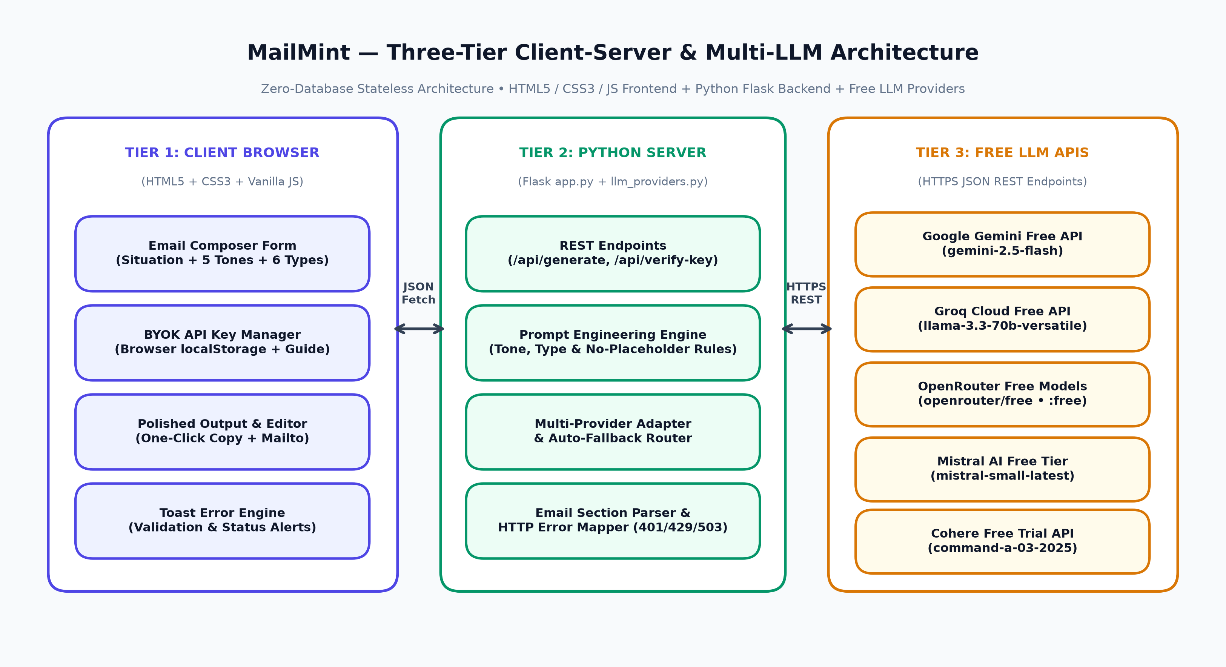
06 • SYSTEM DESIGN
Three-Tier Stateless System Architecture
MailMint ✉️🌿 • Anmolpreet Singh & Mridul Sharma • College Minor Project Slide 7 / 12

Slide 8
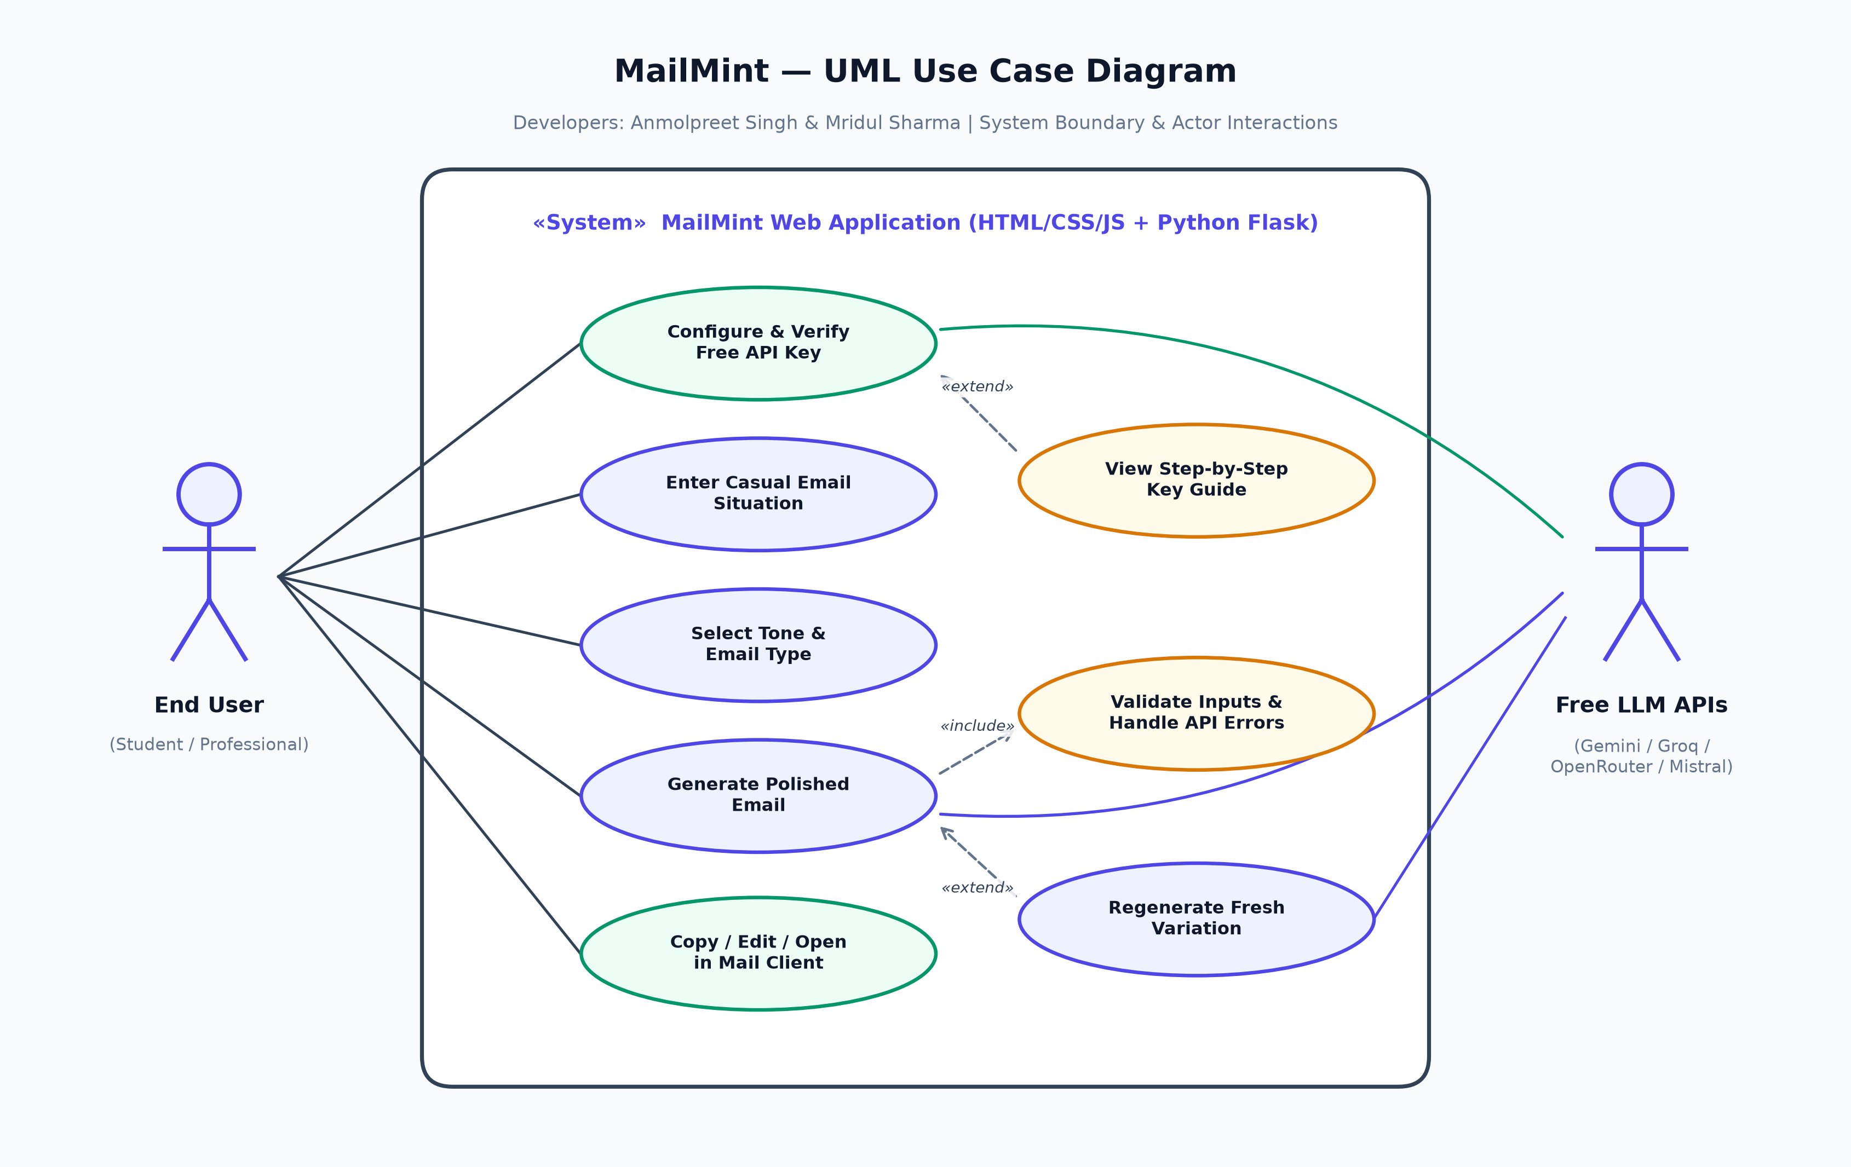
07 • BEHAVIORAL MODELING
UML Use Case Diagram
MailMint ✉️🌿 • Anmolpreet Singh & Mridul Sharma • College Minor Project Slide 8 / 12

Slide 9
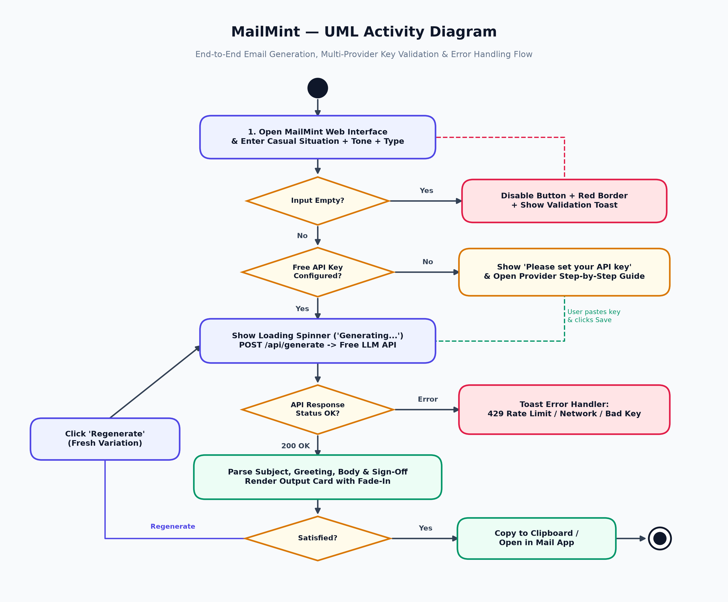
08 • EXECUTION WORKFLOW
UML Activity & Error-Handling Flow
MailMint ✉️🌿 • Anmolpreet Singh & Mridul Sharma • College Minor Project Slide 9 / 12

Slide 10
09 • RELIABILITY & GUARDRAILS
6-Layer Mandatory Error Handling (100% Toast-Driven)
Input & Credential Safeguards
• Missing API Key -> Shows 'Please set your API key' toast & highlights setup guide.
• Empty Input -> Disables Generate button + applies rose-red border & inline hint.
• Invalid API Key -> Catches HTTP 401/403 & prompts user to verify key.
Network & Runtime Safeguards
• API Rate Limit (HTTP 429) -> Shows 'Too many requests, try again in 30s'.
• Network Failure -> Shows 'Connection failed, check internet'.
• Loading State -> Displays animated spinner + 'Generating...' & locks button.
MailMint ✉️🌿 • Anmolpreet Singh & Mridul Sharma • College Minor Project Slide 10 / 12

Slide 11
10 • QUALITY ASSURANCE
Software Verification & Test Suite Results
QA Metrics Summary
• 20 Comprehensive Test Cases Executed
• 20 / 20 Passed (100% Pass Rate)
• 0 Critical or Minor Defects
• Verified across Desktop & 375px Mobile
Key Verified Scenarios (MailMint_Test_Cases.xlsx)
• TC-01..03: Dark glassmorphism load, disabled empty button & red validation state.
• TC-04..08: Missing key toast, 5-provider guide switch, prefix auto-detect & Verify Key.
• TC-09..13: All 5 tones & 6 email types tested with zero [Your Name] placeholders.
• TC-14..20: Spinner lock, 429 rate limit, offline toast, clipboard copy & draft history.
MailMint ✉️🌿 • Anmolpreet Singh & Mridul Sharma • College Minor Project Slide 11 / 12

Slide 12
11 • CONCLUSION & FUTURE SCOPE
Summary & Live Demonstration
Key Takeaways
• Delivers studio-grade professional emails using simple HTML, CSS, JS & Python.
• Eliminates subscription costs via 5 free BYOK LLM integrations.
• Preserves user privacy with stateless zero-database design.
Future Roadmap & Q&A
• Multilingual email generation (English, Hindi, Punjabi, Spanish).
• Voice-to-Email microphone dictation using Web Speech API.
• Thank You! Ready for Live MailMint Demonstration & Viva Questions.
MailMint ✉️🌿 • Anmolpreet Singh & Mridul Sharma • College Minor Project Slide 12 / 12

