Slide 1
Algorithm
An algorithm is a finite set of instructions that accomplishes a particular task

Slide 2
Properties of an Algorithm
Input: Zero or more quantities are supplied externally.
Output: Atleast one quantity is produced.
Definiteness: Each instruction is clear and unambiguous
Finiteness: For all cases, algorithm terminates after a finite number of steps
Effectiveness: Each instruction must be very basic.

Slide 3
Algorithms that are definite and effective are also called computational procedures.
A program is the expression of an algorithm in a programming language.
Active areas in study of algorithms:
How to devise algorithms: Certain design techniques are available.
How to validate algorithms: To show that algorithm produces correct answer for all possible legal inputs independently of the issues concerning programming language. Once an algorithm is validated, program is written and verified.
How to analyze algorithms: Determining how much computing time and storage an algorithm requires. Helps in making quantitative judgments about one algorithm over the other. Helps in predicting whether software will meet efficiency constraints?
How to test a program: Two phases: debugging and profiling (performance measurement)

Slide 4
Algorithm Specification
Algorithm specification using pseudo code that resembles C.
Comments begin with //
Block is represented by braces { }
Identifier begins with a letter. Simple data types are assumed. Compound data types can be formed using record.
node = record
{ datatype_1 data1;
…
datatype_n datan;
node* link;
}
. And -> can be used to denote the fields of type node.
Assignment := operator is used to assign values.
Two boolean values are assumed true and false. Logical and relative operators are provided.

Slide 5
Multidimensional array is accessed as A[i,j]
Looping constructs for, while and repeat until are provided.
for i:= 1 to 10 step 1 do {…..}
while i<10 do { … }
Repeat {…..} until (i>10)
Break statement results in exit from innermost loop.
Return statement results in exit of the function.
Conditional statements if and case are provided.
if (a>b) then c:=a else c:=b
case
{ :a=1: c:=10;
:a=2: c:=20;
:else: c:=100;
}
Input and output is performed using read and write statements respectively.
Only one type of procedure ‘Algorithm’ is provided having a heading and a body.
Simple variables are passed by value. Arrays are passed by reference.

Slide 6
Example: Selection sort algorithm.
for i:=1 to n do
{
Examine a[i] to a[n] and suppose the smallest element is at a[j];
Interchange a[i] and a[j];
}
Example: Selection sort pseudo code program
1 Algorithm SelectionSort (a,n)
2 // sort the array a[1:n] into increasing order.
3 {
4 for i:=1 to n do
5 {
6 j:=i;
7 for k:= i+1 to n do
8 if (a[k]<a[j]) then j:=k;
9 t:=a[i]; a[i]:=a[j]; a[j]:=t;
10 }
11 }

Slide 7
Recursive Algorithms:
A function that is defined in terms of itself is called recursive function.
An algorithm can be direct recursive or indirect recursive.
Any algorithm that can be written using assignment, if-then-else and while statement can also be written using assignment, if-then-else and recursion. Sometimes given problem is itself recursively defined.
Example: Towers of Hanoi:
Three diamond towers are there out of which one diamond tower has 64 golden disks arranged in decreasing size from bottom to top. Disks are required to move from one tower to another using the third tower. Only one disk can be moved at a time and at no time can a disk be on top of a smaller disk.

Slide 8
Towers of Hanoi using recursion:
Algorithm TowersOfHanoi(n,x,y,z)
{
if (n>=1) then
{
TowersOfHanoi(n-1,x,z,y);
write (“move top disk from tower”, x, “to top of tower”, y);
TowersOfHanoi(n-1,z,y,x)
}
}

Slide 9
Another example: Permutation Generator:
Given a set of n>=1 elements, problem is to print all possible permutations. If set is {a, b, c} then set of permutations is {(a,b,c), (a,c,b), (b,a,c), (b,c,a), (c,a,b), (c,b,a)}. For given n numbers there are n! different permutations.
Algorithm Perm(a,k,n)
{
if (k=n) then write (a[1:n]);
else
for i:=k to n do
{
t:=a[k];a[k]:=a[i];a[i]:=t;
Perm(a,k+1,n);
t:=a[k];a[k]:=a[i];a[i]:=t;
}
}

Slide 10
Performance Analysis
Space Complexity of an algorithm is the amount of memory it needs to run to completion.
Time Complexity is the amount of computer time it needs to run to completion.
Performance Evaluation is divided into two major phases:
A priori estimates (performance analysis)
A posteriori testing (performance measurement)

Slide 11
Space Complexity:
Space needed is sum of following components:
Fixed part that is independent of characteristics of inputs and outputs (instance characteristics). For eg. Space for code, space for constants.
Variable part consists of space needed by variables whose size is dependent on particular problem instance.
S(P) = c+Sp where c is constant and Sp depends on instance characteristics. Focus is basically on Sp (instance characteristics). It is also important to determine which instance characteristics to use to measure space requirements.
Example:
1. Algorithm abc(a,b,c)
2. {
3. return a+b+b*c+(a+b-c)/(a+b)+4.0;
4. }
Space needed by this algorithm is independent of instance characteristics so Sp=0

Slide 12
Example 2:
Algorithm Sum(a,n)
{
s:=0.0;
for i:=1 to n do
s:=s+a[i];
return s;
}
This problem instance is characterized by n. n, s and i are using one word. Array a is using >= n words. So S_{sum}(n) >= (n+3)
Example 3:
1. Algorithm Rsum(a,n)
2. {
3. if (n<=0) then return 0.0;
4. else return Rsum(a,n-1)+a[n];
5. }
This problem instance is characterized by n. Recursion stack space includes space for formal parameters, local variables and return address. Each call requires atleast three words (for n, return address and pointer to a[]) As depth of recursion is n so space needed is >= 3n

Slide 13
Time Complexity:
Time T(P) taken by a program P is sum of compile time and run time. As compile time does not depend on instance characteristics so focus is on run time denoted by t(p).
One way to calculate run time is to add additions, multiplications, compares etc.
Tp(n) = c_{a}ADD(n)+c_{s}SUB(n)+c_{m}MUL(n)……………
It is impossible to obtain such an exact formula.
Another way is to count number of program steps (meaningful segment of a program that has an execution time).
Return a+b+b*c+(a+b-c)/(a+b)+4.0 can be regarded as one step.
Number of steps any program statement is assigned depends on kind of statement. A comment can be assigned as zero steps, assignment statement as one step and so on.

Slide 14
One way to determine number of steps is to introduce count (initialized to zero) in the program.
Example:
Algorithm Sum(a,n)
{
s:=0.0;
count:=count +1;
for i:=1 to n do
{
count:=count+1;//For for i
s:=s+a[i]; count := count+1// For assignment
}
count:=count+1 //For last time of for
count:=count+1;//For return
return s;
}

Slide 15
Simplified Algorithm
Algorithm Sum(a,n)
{
for i:=1 to n do count:=count+2;
count:=count+3;
}
In the for loop value of count will increase by 2n. So each invocation of Sum executes total of 2n+3 steps.

Slide 16
Example 2:
Algorithm Rsum(a,n)
{
count:=count+1; //For if condition
if (n<=0), then
{
count:=count+1; //For return
return 0.0;
}
else
{
count:=count+1; //for addition, function invocation & //return
return Rsum(a,n-1)+a[n];
}
}
Let t_{RSum}(n) be the increase in value of count when algorithm terminates. t_{RSum}(0) = 2. When n >0, count increases by 2 plus increase results from invocation of RSum from within else ie. t_{RSum}(n-1).
t_{RSum(n)} =
2 If n=0 (These recursive formulas are called
2+t_{RSum} (n-1) if n>0 recurrence relations)

Slide 17
These relations can be solved by repeated substitutions
t_{RSum}(n) = 2 + t_{RSum}(n-1)
= 2 + 2 + t_{RSum}(n-2)
= 2(2) + t_{RSum}(n-2)
= n(2) + t_{RSum}(0)
= 2n+2
This step count tells that run time for a program changes with changes in instance characteristics. If n is doubled, run time doubles ie run time grows linearly in n.
Example 3:
Algorithm Add(a,b,c,m,n)
{
for i:=1 to m do
for j:=1 to n do
c[i,j]:=a[i,j]+b[i,j];
}

Slide 18
Algorithm with counting
Algorithm Add(a,b,c,m,n)
{
for i:= 1 to m do
{
count:=count+1; //For for i
for j:=1 to n do
{
count:=count +1; //For for j
c[i,j]:=a[i,j]+b[i,j];
count:=count+1; //For assignment
}
count:=count+1; //for last time of for j
}
count:=count+1; //For last time of for i
}

Slide 19
Simplified Algorithm
Algorithm Add(a,b,c,m,n)
{
for i:=1 to m do
{
count:=count+2;
for j:=1 to n do
count:=count+2;
}
count:=count+1;
}
Line 7 is executed mn times. Line 5 is executed m times and line 9 is executed 1 time. When algorithm terminates value of count will be 2mn+2m+1.

Slide 20
Second method to determine step count is to build a table.
Example:
Statement | s/e | Frequency | Total steps
Algorithm Sum(a,n) { s:=0.0; for i:=1 to n do s:=s+a[i]; return s; } | 0 0 1 1 1 1 0 | - - 1 n+1 n 1 - | 0 0 1 n+1 n 1 0
Total |  |  | 2n+3

Slide 21
Example 2:
x=t_{RSum}(n-1)
Statement | s/e | Frequency n=0 n>0 | Total steps n=0 n>0
Algorithm Rsum(a,n) { if (n<=0) then return 0.0; 4. else return Rsum(a,n-1+a[n]; 5. }
Total |  |  | 2 2+x

Slide 22
Statement | s/e | Frequency n=0 n>0 | Total steps n=0 n>0
Algorithm Rsum(a,n) { if (n<=0) then return 0.0; 4. else return Rsum(a,n-1+a[n]; 5. } | 0 0 1 1 1+x 0 | - - - - 1 1 1 0 0 1 - - | 0 0 0 0 1 1 1 0 0 1+x 0 0
Total |  |  | 2 2+x
x=t_{RSum}(n-1)

Slide 23
Example 3:
Statement | s/e | Frequency | Total steps
Algorithm Add(a,b,c,m,n) { for i:=1 to m do for j:=1 to n do c[i,j]:=a[i,j]+b[i,j]; } | 0 0 1 1 1 0
Total |  |  | 2mn+2m+1

Slide 24
Statement | s/e | Frequency | Total steps
Algorithm Add(a,b,c,m,n) { for i:=1 to m do for j:=1 to n do c[i,j]:=a[i,j]+b[i,j]; } | 0 0 1 1 1 0 | - - m+1 m(n+1) mn - | 0 0 m+1 mn+m mn 0
Total |  |  | 2mn+2m+1

Slide 25
After obtaining sufficient experience step count can be calculated without making any table
Example: To obtain nth fibonacci term (f_{n}=f_{n-1}+f_{n-2}, n>=2:
Algorithm Fibonacci(n)
//Compute nth fibonacci number.
{
if (n<=1) then
write(n);
else
{
fnm2:=0; fnm1:=1;
for i:=2 to n do
{
fn:=fnm1+fnm2;
fnm2:=fnm1; fnm1:=fn;
}
write(fn);
}
}
Two cases need to be considered:
Case1: When n=0 or 1
Lines 4 and 5 get executed once each. So total step count is 2.
Case2: When n>1
Lines 4, 8 and 14 are executed once. Line 9 gets executed n times and lines 11 and 12 get executed n-1 times. Lines 8 and 12 have s/e of 2. So total steps for n>1 is 4n+1

Slide 26
Summarized Time Complexity:
Time Complexity is not dependent solely on number of inputs or outputs. An algorithm can terminate in one step also.
Three types of step counts can be defined:
Best case: Minimum no. of steps executed for the given parameters.
Worst case: Maximum no. of steps executed for the given parameters.
Average case: Average no. of steps executed for the given parameters.
Aim is to be able to compare time complexities of two algorithms that compute same function and also to predict the growth in run time as instance characteristics change.
Determining exact step count is exceedingly difficult and also not very worthwhile as notion of a step is itself inexact.
It is adequate to make a statement like t(n,m)=c₁n+c₂m or c₁n²<=t(n)<=c₂n²

Slide 27
If we have two algorithms with complexity of c₁n²+c₂n and c₃n respectively then the one with complexity c₃n will be faster than the one with complexity c₁n²+c₂n for sufficiently large value of n. For small value of n either algorithm could be faster. For eg. c₁=1, c₂=2 and c₃=100 then c₁n²+c₂n <= c₃n for n<=98 and c₁n²+c₂n > c₃n for n>98.
Irrespective of the values of c₁, c₂ and c₃ there will be an n beyond which the algorithm with complexity c₃n will be faster then the other algorithm. This value of n is called break-even point. If break even point is zero then the algorithm with complexity c₃n will always be faster.

Slide 28
Asymptotic Notation
Most often people are interested in the rate of growth of the time and space required to solve larger and larger instances of a problem.
Time needed by an algorithm expressed as a function of the size of a problem is called time complexity.
The limiting behavior of the complexity as size increases in called the asymptotic time complexity.
It is assumed that functions f and g are nonnegative functions.
Big “oh”(O): f(n)=O(g(n)) iff there exist positive constants c and n₀ such that f(n)<=c*g(n) for all n, n>=n₀.
O(1) is used for computing time that is constant. O(n) is called linear. O(n²) is called quadratic, O(n³) is called cubic and O(2^{n}) is called exponential.
Algorithm that takes time O(log n) is faster, for sufficiently large n, than the algorithm that takes time O(n). Similarly O(nlogn) is better than O(n²) but not as good as O(n)
g(n) is basically an upper bound on the value of f(n) for all n, n>=n₀. g(n) should be as small a function of n as one can come up with for which f(n)=O(g(n)).
For eg. For 3n+3=O(n), 3n+3=O(n²) is also correct but we never use it.

Slide 29
Example:
f(n)=3n+2=O(n) if we take c=4, n₀=2.
3n+2 ≠ O(1) as 3n+2 is not less than equal to c for any value of c and n.
10n²+4n+2 ≠ O(n)
Theorem: If f(n)=a_{m}n^{m}+…..a₁n+a₀, then f(n)=O(n^{m})
Omege (Ω): f(n) = Ω(g(n)) iff there exist positive constants c and n₀ such that f(n)>=c*g(n) for all n, n>=n₀.
g(n) is only a lower bound on f(n) and it should be as large a function of n as possible.
For eg. 3n+3= Ω(n). 3n+3= Ω(1) is also correct but we never use it.
Example:
3n+2= Ω(n) as 3n+2>=3n for n>=1.
10n²+4n+2 = Ω(n²) as 10n²+4n+2 >=n² for n>=1.
Theorem: If f(n)=a_{m}n^{m}+…..a₁n+a₀, and a_{m}>0 then f(n)= Ω(n^{m})

Slide 30
Theta(Θ): f(n)= Θ(g(n)) iff there exist positive constants c₁, c₂ and n₀ such that c₁g(n)<=f(n)<=c₂g(n) for all n, n>=n₀.
This notation is more precise that both the big oh and omega notations. g(n) is both an upper and lower bound on f(n).
Theorem: If f(n)=a_{m}n^{m}+…..a₁n+a₀, and a_{m}>0 then f(n)= Θ(n^{m})
In accordance with practice, the coefficients in all g(n)’s are 1.
Little “oh”: f(n)=o(g(n)) iff lim f(n) =0
n->∞g(n)
For eg. 3n+2=o(n²) as lim n-> ∞ 3n+2/n²=0. 3n+2=o(nlogn). But 3n+2 ≠ o(n)
Little omega: f(n) = ω(g(n)) iff lim g(n) =0
n->∞f(n)
For algorithm Sum tsum(n)=2n+3, so tsum(n)= Θ(n)

Slide 31
Statement | s/e | Frequency | Total steps
Algorithm Sum(a,n) { s:=0.0; for i:=1 to n do s:=s+a[i]; return s; } | 0 0 1 1 1 1 0 | - - 1 n+1 n 1 - | Θ(0) Θ(0) Θ(1) Θ(n) Θ(n) Θ(1) Θ(0)
Total |  |  | Θ(n)

Slide 32
Practical Complexities
Time complexity is generally some function of instance characteristics. Complexity function can be used to compare two algorithms P and Q that perform the same task.
An algorithm P with complexity Ө(n) is better than an algorithm Q with complexity Ө(n²) for sufficiently large n. As P is bounded from above by cn for some constant c and n>=n1 and Q is bounded from below by dn² for some constant d and n>=n2. As cn<=dn² for n>=c/d so P is faster than Q whenever n>= max{n1,n2,c/d}
Following table shows how a function grows with n.
log n | n | nlogn | n² | n³ | 2^{n}
0 | 1 | 0 | 1 | 1 | 2
1 | 2 | 2 | 4 | 8 | 4
2 | 4 | 8 | 16 | 64 | 16
3 | 8 | 24 | 64 | 512 | 256
4 | 16 | 64 | 256 | 4096 | 65536
5 | 32 | 160 | 1024 | 32768 | 4294967296

Slide 33
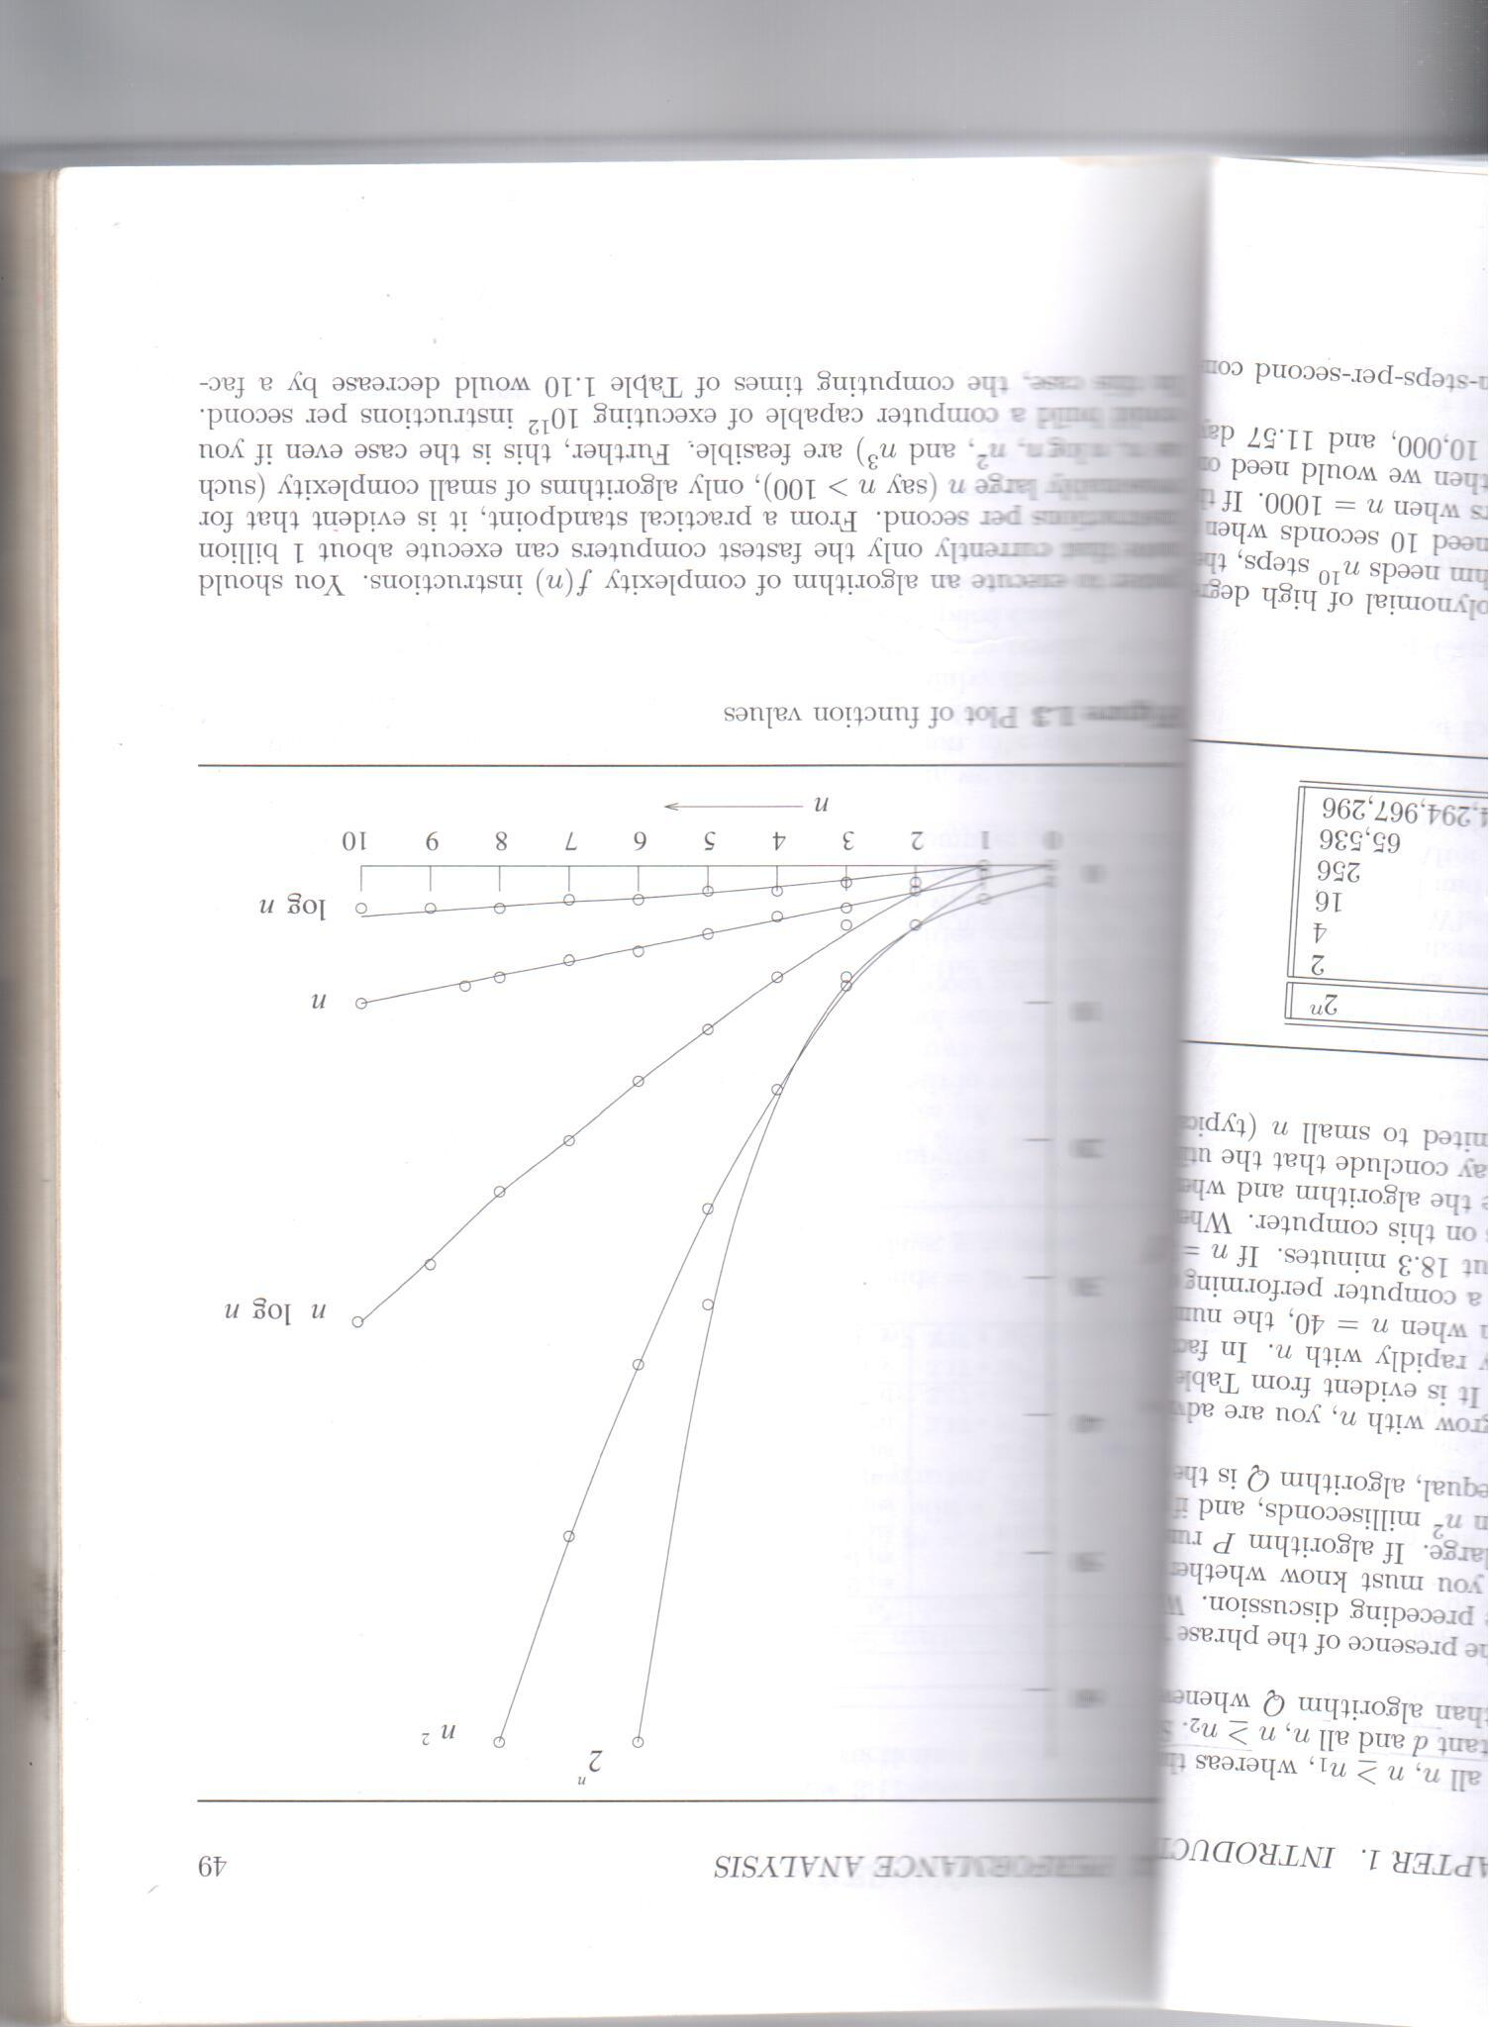
Plot of function values

