Slide 1
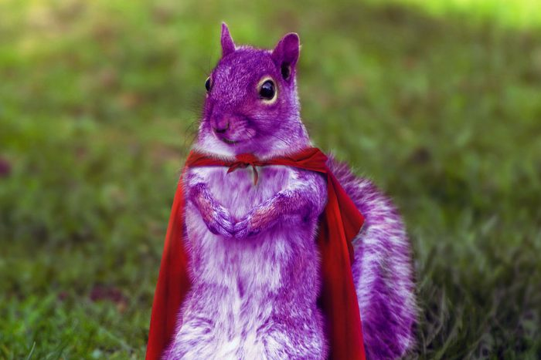
Purple Squirrel.IO
FICTION
The future of AI driven open predictive digital forensics

Slide 2
Purple SQUIRREL
FICTION
We are a (fictional) start-up in stealth mode and we want to create an open-source (business) strategy.
We created a service to provide a digital forensics observability/monitoring technology to collect, store, analyze all kind of data streams to detect and predict (cyber)crime.
Our goal today is to research and develop an open-source strategy before we publicly launch our service.

Slide 3
Purple SQUIRREL
ARCHITECTURE
Intelligence agencies around the globe
Forensics Data
(internet, deepweb)
Open Source
Building Blocks
PS LittleBigHands (Hamsteren!)
Pluggable data ingestion/observability collectors
PS LittleBigTree
Visualization
PS LittleBigMouth
Data Ingestion & shaping
PS LittleBigEars
AI driven technology for analysis
PS LittleBigNose
AI driven technology for detection
PS LittleBigBrains
AI driven technology for prediction
PS LittleBigBodyBase
Revolutionary secure, HA, optimized for bigdata and AI DB technology
Cloud Agnostic (Scale Out – Storage/Compute/Network)

Slide 4
Purple SQUIRREL
Which Open Source business model are we going for?
ACTION: Research (5 minutes of Google time) at least three different open source business models (eg. Open-Core, Hosting, Professional Services, Marketplace…). Choose one and give an example of a real company.
Why is this the best option for Purple Squirrel?
Why? …
Why? …
Why? …
NOTE: Assume we start with the PS LittleBigBodyBase to be part of our strategy

Slide 5
Purple SQUIRREL
Which Open Source license are we going for?
ACTION: Research (5 minutes of Google time) at least three different open source licenses (MIT, Apache, AGPL, SSPL, ... ). Choose one!
Why is this the best license for Purple Squirrel?
Why? …
Why? …
Why? …

Slide 6
Purple SQUIRREL
How does our Open governance looks like?
ACTION: Research (5 minutes of Google time) which Governance fits best (CNCF, Apache, Others?) . Choose one.
Why is this the best governance for Purple Squirrel?
Why? …
Why? …
Why? …

Slide 7
Purple SQUIRREL
How do we want to manage our soon to be Open Source Community?
ACTION: Research (5 minutes of Google time) what an open source community is and sum three best practices (marketing, code of conduct, core maintainers, …).
Why are those the best practices we need to implement Purple Squirrel?
Why? …
Why? …
Why? …

Slide 8
Purple SQUIRREL
How do we deal with Open Source building blocks @ Purple Squirrel?
ACTION: Research (5 minutes of Google time) what are biggest three challenges/risks of using Open Source building blocks.
How are we going to mitigate the risk of using OSS components @ Purple Squirrel?
How? …
How? …
How? …

Slide 9
Purple SQUIRREL
Open Discussion about Open Topics ;-)
Use the remaining time to Ask Me (Us) Anything

Slide 10
Purple Squirrel.IO
THANK YOU.
HAPPY OPEN SOURCING!
The future of AI driven open predictive digital forensics

