Slide 1



TEAM Numero Uno
Tola: the fair-price desk for MCX gold · Hack in Hills ’26 · PS-03 Commodity Derivatives Intelligence · tola-gold.vercel.app
1
2
Mrigank Singh
Lakshita Deopura
Data and quant
Product and pitch
MCX fetcher, polled spot, versioned specs; gap decomposition, G0 gate, walk-forward and delivery-leg model
Product, UI and pitch: the “which contract?” chooser, notice log, design system; market research, deck and demo video
Notes:
Introduce the two of us: one owns data and quant (fetching, decomposition, validation), the other owns product and pitch (UI, chooser, research, deck).

Slide 2
PROBLEM STATEMENT & THEME
One gram of gold, five prices
Problem
GOLDGUINEA +79 bp and GOLDPETAL +94 bp over GOLDTEN, though all three settle to the same price per gram. Every cycle, 18 of 18 (Apr 2025 – Sep 2026).
30 Jan crash
Import duty 6→15%
Impact
Hold to delivery: ≈ ₹1,170–1,390 per 10 g.
Exit early: ≈ 6–11 bp. No trading app shows either.
Theme alignment
Relative value · gaps decomposed per gram
Carry · implied from each contract’s curve
Walk-forward · pre-registered G0, then M4
Trader intelligence · chooser, quiet alert log
Lifecycle · tender windows, versioned specs
Source: MCX bhavcopy + polled spot (our pipeline), Apr 2025 – Sep 2026 expiries; pre-tender days, ≥ ₹1 Cr per leg. Settlement price per gram identical for GOLDTEN and GOLDGUINEA in 18/18 cycles. Dashed lines: context, not cause. ₹ at ≈ ₹14,800/g.
Notes:
One gram of gold has five prices on MCX. The chart shows the 8 gram and 1 gram contracts trading above the 10 gram contract in every one of 18 monthly cycles, 79 and 94 basis points on average, even though all three settle to exactly the same price per gram. If you hold to delivery that is roughly 1,200 to 1,400 rupees per 10 grams. If you exit early it costs only the change, 6 to 11 basis points. No trading app shows either number. This maps directly onto the five PS-03 directions on the right.

Slide 3
SOLUTION
Every gap explained, then a decision
Tola splits each price gap into unit, carry, settlement reference, delivery terms and residual, measured against the exchange’s own polled spot price.
Which contract should I hold?
Quantity
5 g
Holding
to delivery
Broker
Zerodha rates
Basis anatomy every contract, every day: timing, carry, reference, premium
Convergence monitor the premium today against 18 expired cycles
GOLDPETAL × 5 lots
₹77,250
Best: 1 g bars/coins, incl. premium + making charge
Walk-forward verdict including the delivery leg
Retail 1 g coins × 5
₹80,300
Coin shop, incl. GST
“Which contract?” chooser grams, holding period, exit or deliver
GOLDGUINEA
n/a
Lot is 8 g, too big for 5 g
Quiet notice log speaks only when a condition starts
GOLDTEN
n/a
Lot is 10 g, too big for 5 g
Unique value The first PS03 build on the settlement reference, with measured costs and a named user.
Saves ≈ ₹3,050 vs the coin shop. Exit before delivery instead and the premium costs ≈ ₹9–16/g.
Chooser panel: the Round 1 worked example (13 Oct 2026 prices). The live chooser at tola-gold.vercel.app now ranks every contract for any quantity, with exit-by dates, from MCX data to 23 Oct 2026. Vault, assaying and transport: ₹10/g assumed.
Notes:
Tola explains every price gap and turns it into a decision. Five features: the decomposition, a monitor for contracts that settle to the same price, a walk-forward verdict, the chooser, and an alert log that stays quiet unless a gap beats costs. The panel shows the chooser's logic with our real numbers: for 5 grams to take home, GOLDPETAL delivery beats the coin shop by about 3,000 rupees even after paying the premium. If you only trade, the premium costs you 9 to 16 rupees a gram.

Slide 4
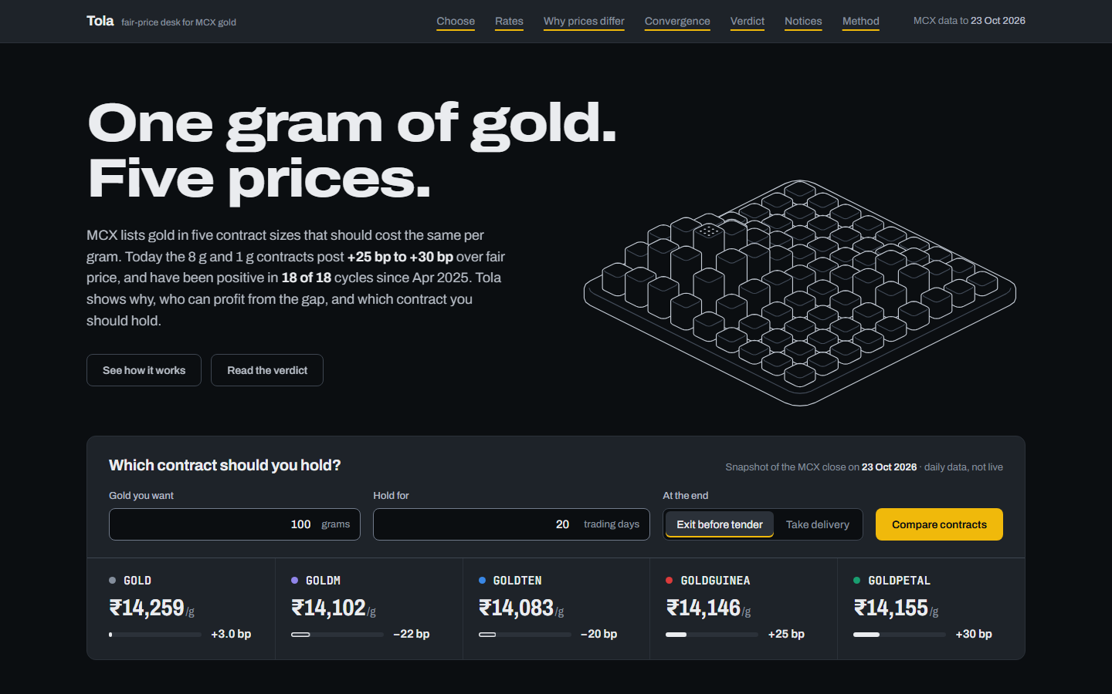
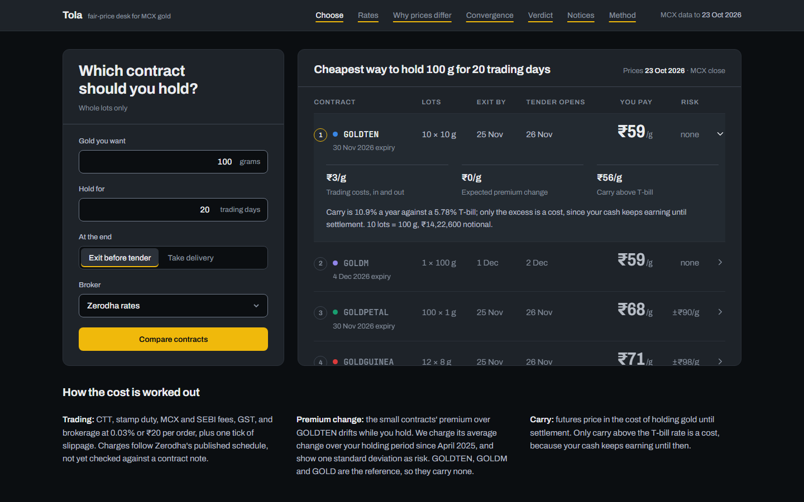
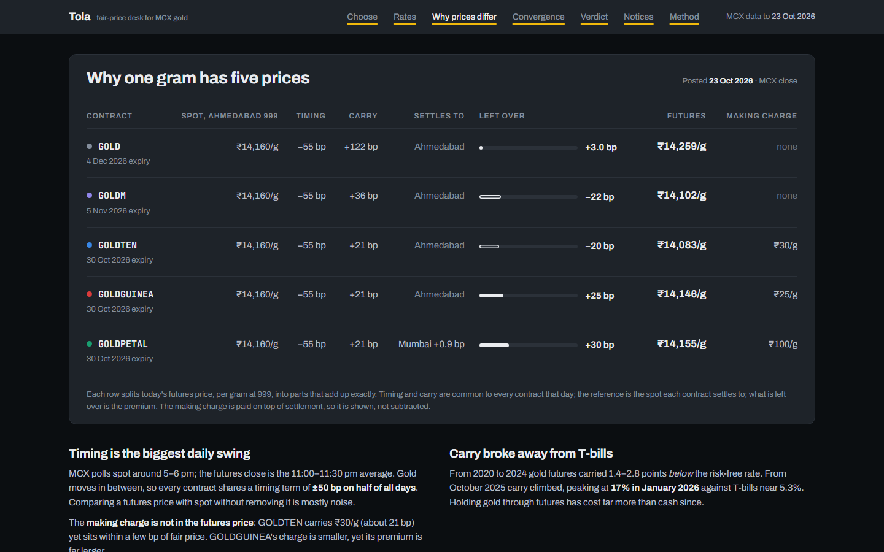
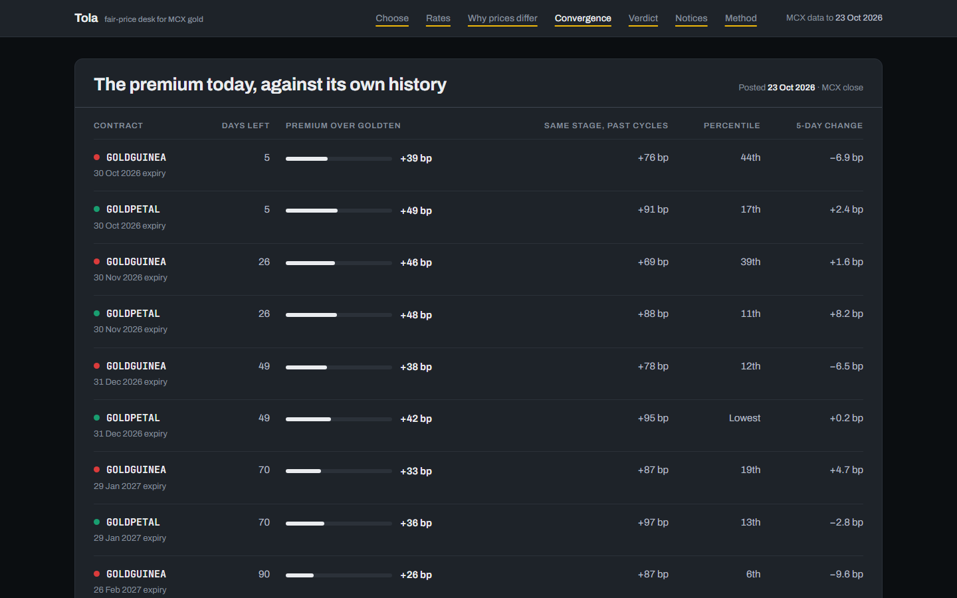
PROTOTYPE
Live, working, and on real MCX data
Try it
tola-gold.vercel.app
1
Read the claim
one gram, five prices, and today’s premium
2
Ask the chooser
your grams and holding period, ranked in ₹/g
Landing: the claim, today’s five rates and a working chooser in the first screen
Chooser: every contract ranked by all-in ₹/g, with the date to exit by
3
Check the evidence
basis, convergence and verdict pages
4
See what changed
a quiet notice log and contract calendar
Static React site, no server. 8 pages, data to 23 Oct 2026. The chooser runs in the browser and matches the Python model in 9 tests.
Why prices differ: each price split into timing, carry, reference and premium
Convergence: today’s premium ranked against 18 expired cycles
Notes:
This is the working prototype, live at tola-gold.vercel.app. The landing page states the problem with today's rates and has a working chooser. The chooser ranks every contract by what you actually pay per gram and gives the date to exit by. The evidence pages show why prices differ and how today's premium compares with 18 expired cycles. Everything runs in the browser from a validated data snapshot.

Slide 5
ARCHITECTURE
Exchange data in, verified verdicts out
1
2
3
4
5
6
Fetch
Store
Model
Validate
Publish
Refresh
curl_cffi
Parquet snapshot
pandas · SciPy · bidask
45 tests + 7 data checks
React + Vite, Vercel
python -m tola.refresh
bhavcopy, contract histories, polled spot; raw cache
keyed by symbol × expiry × date; 15 spec versions
anatomy, carry, convergence, costs, delivery
walk-forward, look-ahead test; nothing ships if a check fails
JSON export to a static site; the chooser runs in the browser
about 37 MCX calls a day; rebuilds and re-exports
MCX APIs used (public, no key)
Getting past the bot wall
Date-wise bhavcopy
GET /market-data/bhavcopy/GetDateWiseBhavCopy
Akamai returns HTTP 403 to scripted clients. A Chrome-TLS client (curl_cffi) gets through, and every response is cached.
The endpoints older libraries use are dead; we traced the live ones from MCX’s own page scripts.
Full 2020–2026 backfill: 260 requests.
Contract-wise bhavcopy
GET /market-data/bhavcopy/GetCommoditywiseBhavCopy
Polled spot archive
GET /GetSpotMarketArchive (the settlement reference)
Notes:
Six stages: fetch, store, model, validate, publish, refresh. Everything comes from three public MCX endpoints. The hard part was access: MCX sits behind Akamai, which blocks scripts, so we use a Chrome-grade TLS client and cache every response. One request returns a whole contract's life, so a full backfill is about 260 requests. The site is static, so nothing breaks on stage.

Slide 6
EVIDENCE & VALIDATION
A test we could have failed, and didn’t
Price mark | GOLDGUINEA bp | 95% CI | GOLDPETAL bp | 95% CI
Close | +78.9 | 61.6 – 98.0 | +94.6 | 80.6 – 109.8
Open | +81.8 | 65.6 – 99.3 | +92.9 | 80.3 – 106.5
(High+Low)/2 | +78.7 | 60.6 – 97.4 | +93.2 | 79.5 – 107.8
VWAP | +78.7 | 61.0 – 97.4 | +94.1 | 80.4 – 108.8
Rule fixed before the data was pulled
GO needed ≥ 8 cycles, and every mark ≥ +15 bp with its CI above 0 and ≥ 75% of cycles positive. Every condition passed.
Same target, verified
GOLDTEN = GOLDGUINEA settlement price per gram in 18/18 cycles (≤ 0.11 bp); 999/995 applied in every spec version.
18 of 18 cycles positive on every mark. Bootstrap over whole cycles; pre-tender days; ≥ ₹1 Cr per leg.
Holds under every sensitivity run (VWAP)
Walk-forward verdict (M4): done
Next-day fills, real charges, scored only on trades it never trained on. Holding the premium earns nothing reliable; trading its swings earned +5 to +15 bp a trade, about 90% of it in Jan–Mar 2026.
Look-ahead truncation test passes · Deflated Sharpe · EDGE-measured costs · settlement rebuilt 145/145
Turnover floor ₹0.25 Cr / ₹5 Cr: GOLDGUINEA +79.4 / +76.7, GOLDPETAL +94.0 / +93.7
3-day tender exclusion: +78.9 / +94.4 Without the Jan–Mar 2026 crash cycles: +69.4 / +88.4
Notes:
Here is why you can trust the chart. We wrote the pass or fail rule down before pulling the history, used four different price marks including VWAP, which ignores when the last trade happened, and resampled whole cycles. Every condition passed, in every cycle, under every sensitivity run. The contracts really do settle to the same price, and our rebuilt settlement prices match MCX's own on all 145 contracts we can check. The walk-forward verdict is now done: scored only on trades it never trained on, holding the premium earns nothing reliable, and trading its swings earned a small edge, mostly in one crisis quarter.

Slide 7
THE VERDICT (M4)
Only a coin maker can collect the premium
0 of 18
cycles in which delivering coins against the premium paid, for either contract
+5 to +15 bp
a trade from the premium’s swings, out of sample; about 90% of it in the Jan–Mar 2026 crisis
20 Nov
a forward test, rules frozen and pre-registered, keeps scoring until the finale
For a trader: hold GOLDTEN or GOLDM unless you need under 10 g. The chooser applies this to any quantity.
Short the small contract, buy GOLDTEN, hold both into settlement, deliver coins. Mean of 18 expired cycles; retail coin prices observed 13 Oct and 10 Jun 2026.
Notes:
We tested whether anyone can collect the premium. To profit from delivery, 8 gram coins would have to cost under 0.27% over spot and 1 gram coins under 1.13%. The cheapest coins we found cost 3.6% and 5.5%, so it paid in none of the 18 cycles. Trading the premium's swings earned a small edge, mostly in one crisis quarter, and a forward test frozen for the finale keeps scoring it. So only a coin maker can collect it, and a trader should simply avoid paying it.

Slide 8
MARKET RESEARCH / ANALYSIS
₹10 crore a year rides into delivery
Target users
· Retail and HNI gold traders (primary)
· Prop desks (secondary)
· MCX and SEBI: the fairness angle
Revenue model
· Free chooser
· Paid desk tier: alerts and history
· B2B licence to brokers, beside the order ticket
Growth
44% → 57%
bullion’s share of MCX average daily turnover, Q2 FY26 vs Q2 FY25 (MCX results release)
Market size from our pipeline: GOLDGUINEA + GOLDPETAL open interest entering the final 3 trading days × cycle premium × settlement price. Last 12 cycles: ₹10.3 Cr (₹1.65 Cr on positions held to settlement). Cycle-mean premium used as a proxy.
Notes:
We sized the market ourselves rather than quote an industry number. Positions in the small contracts entering the delivery window carried about 10 crore rupees of premium over the last 12 cycles, up from a few lakh per cycle in mid-2025. Users: retail and HNI traders first, prop desks second, and the exchange and regulator as the fairness angle. Revenue: a free chooser, a paid desk tier, and licensing to brokers. Growth: bullion went from 44 to 57 percent of MCX turnover.

Slide 9
ROUND 2 PROGRESS
Five milestones built, one live product
M1 ✓ built
M2 ✓ built
M3 ✓ built
M4 ✓ built
M5 ✓ built
Web ✓ built
Data layer
Basis anatomy
Convergence
Verdict
Chooser + notices
Live product
34,415
4 parts
18 / 18
0 / 18
302 / 403
8 pages
contract-days, 7 checks, 0 errors
timing, carry, reference, premium on every row
cycles positive; settles within 0.11 bp
cycles where delivery arbitrage paid
trading days with no notice, by design
on Vercel, data to 23 Oct 2026
Next, by the finale on 20 November
1
2
3
4
Forward test results
Pre-registered rules, scored on data that did not exist when they were frozen
Daily refresh in the cloud
Scheduled pipeline and an unedited live notice track record
Silver family
SILVER, SILVERM and SILVERMIC through the same engine
Chooser in the broker
The ranked answer beside the order ticket
Notes:
In Round 2 we built all five milestones: the data layer, the basis anatomy, the convergence monitor, the walk-forward verdict, and the chooser with notices, and shipped them as a live web app. By the finale we will report the forward test, move the refresh to a daily schedule, and extend to silver.

Slide 10
Thank you
Try it live: tola-gold.vercel.app
Tola · PS-03 · Team Numero Uno · Repo: https://github.com/Mrigank005/Tola
Notes:
Thank you. The repo and the live demo are linked here.

