Slide 1
SECURE DATA HIDING IN IMAGES USING STEGANOGRAPHY
CAPSTONE PROJECT
Presented By: Mrigen Deka
Student Name: Mrigen Deka
College Name : The Assam Kaziranga University
Department : Computer Science and Engineering

Slide 2
OUTLINE
Problem Statement
Technology used
Wow factor
End users
Result
Conclusion
Git-hub Link
Future scope

Slide 3
Problem Statement
Develop a Image Steganography application using any language with a GUI to securely hide and retrieve text messages in images. Users can select an image, encrypt a message using pixel manipulation, and save the modified image. Decryption is enabled by extracting the hidden message with the correct passcode. The system ensures data integrity, user-friendly interaction, and secure access to hidden messages.

Slide 4
Technology used
Programming Language:
- Python (Tkinter for GUI)
Libraries & APIs:
Tkinter – For building the Graphical User Interface (GUI) components (buttons, labels, text fields, file dialog).
OpenCV – For image processing tasks such as reading, writing, and modifying image pixels (used for encoding and decoding the hidden message in the image).
Pillow (PIL) – For image handling (used to display images in the GUI).
OS – For file handling and system operations (e.g., saving and opening files).
Platform Compatibility:
Operating System: Windows, macOS, Linux.
Python Version: Python 3.6 (or later)
Development Environment:
IDE: Visual Studio Code, PyCharm, Jupyter Notebook, or any other Python-supported IDE.
Build Tool: No specific build tool required (just Python environment with necessary libraries installed)

Slide 5
Wow factors
Python-Based GUI with Tkinter – This project leverages Python’s simple and lightweight Tkinter library to build an intuitive GUI, making it accessible to all users.
Integrated Image Processing with OpenCV – This application directly handles pixel manipulation using OpenCV, a powerful image processing library, to securely embed messages into image files without external dependencies.
Real-Time User Feedback – Unlike many traditional tools, this GUI-based application provides real-time feedback with clear status updates during the encryption and decryption processes.
Threaded Operations for Smooth Performance – Encryption and decryption tasks are run in background threads, which ensures that the user interface remains responsive even when processing large images or long messages, enhancing the overall user experience.
Cross-Platform Compatibility – This Python application is designed to work seamlessly across Windows, macOS, and Linux, making it accessible to a wide range of users without the need for additional configuration or modifications.
Secure Passcode Protection – The application ensures secure access to the hidden message with passcode-based decryption, allowing only authorized users to view the secret information embedded within the image.

Slide 6
End users
1. Cybersecurity Enthusiasts & Researchers – Individuals exploring data hiding techniques and secure communication methods.
2. Journalists & Whistleblowers – People who need to hide sensitive information inside images for secure transmission without raising suspicion.
3. Students & Educators – Those learning about steganography, cryptography, and Java image processing in computer science courses.
4. Forensic Experts & Law Enforcement – Investigators analyzing hidden messages in digital images for cybercrime detection.
5. Privacy-Conscious Users – General users who want to securely share messages without using traditional encryption methods that might attract attention.
6. Military – Military personnel involved in covert operations who require secure, concealed communication for exchanging classified information without raising suspicion, even when using untrusted or public communication channels.

Slide 7
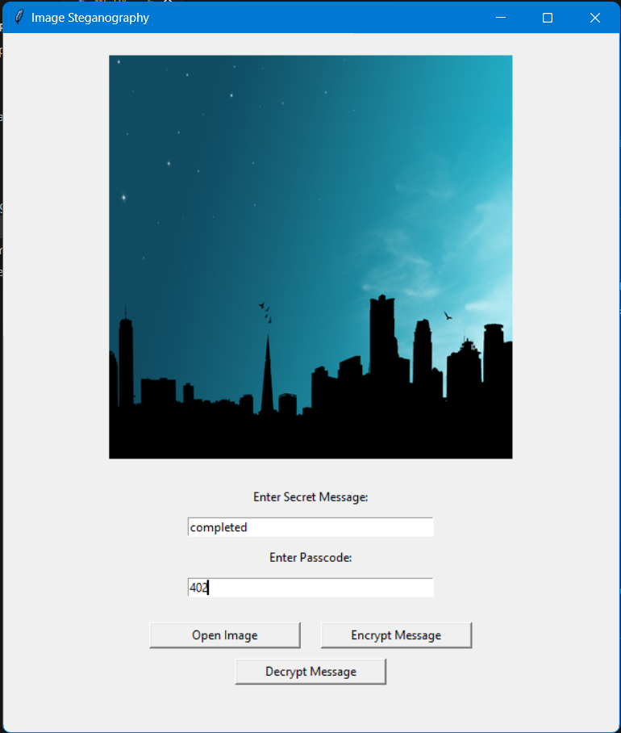
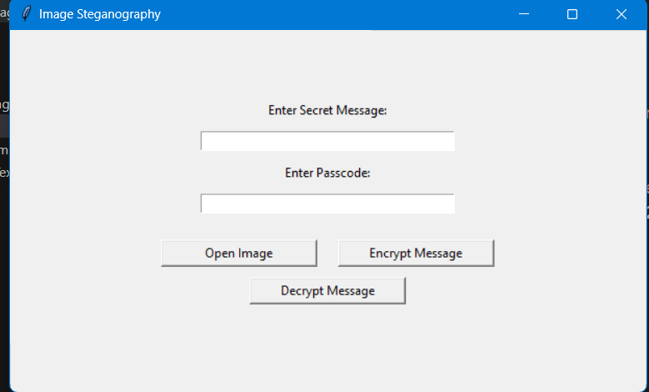
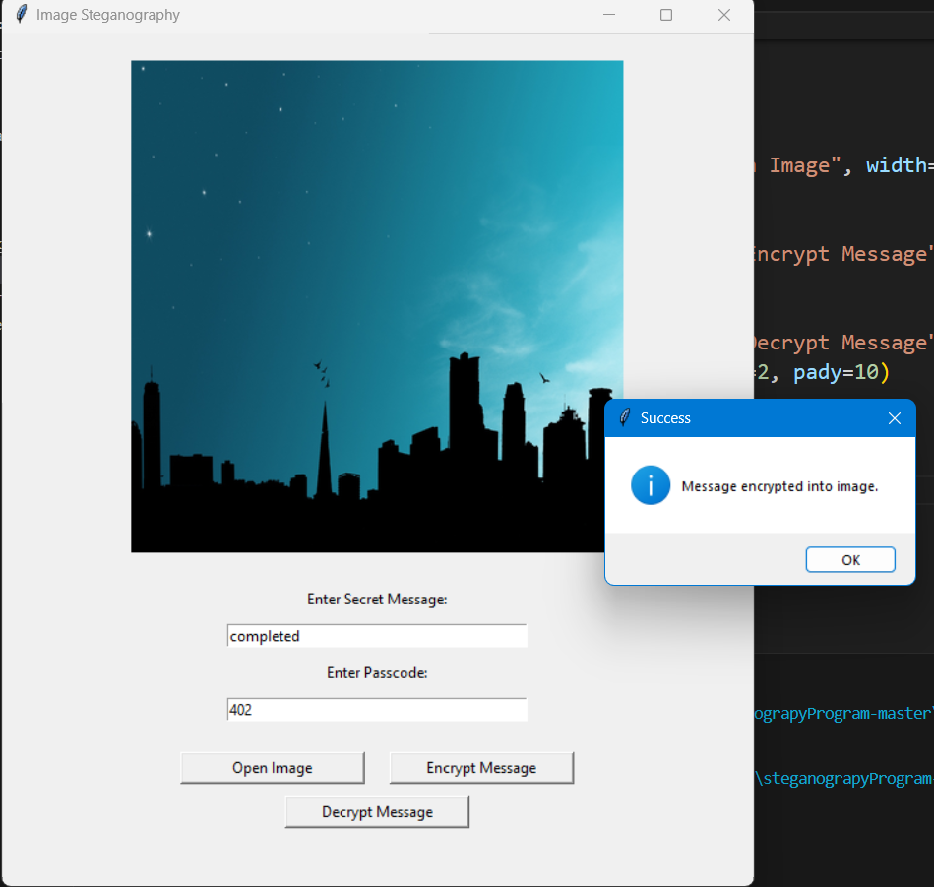
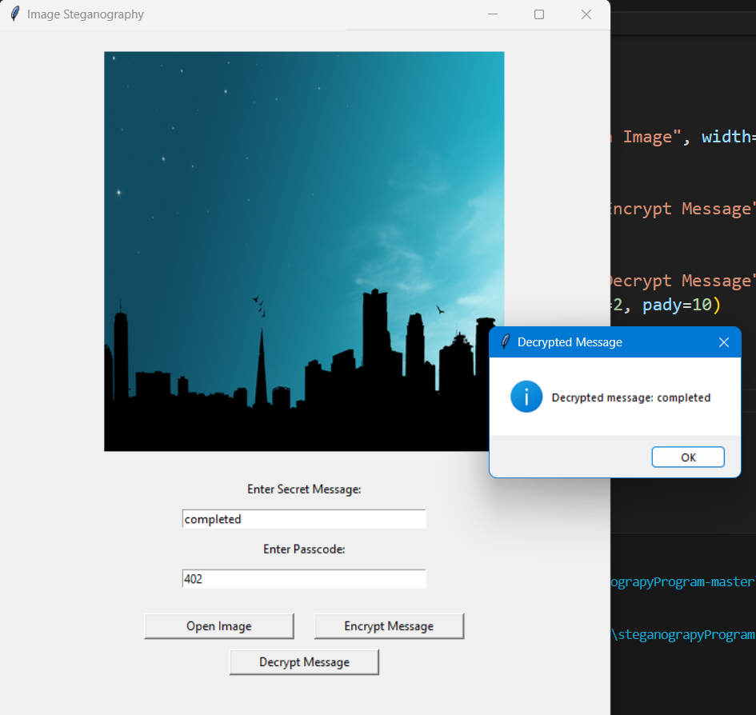
Results
Selecting image and storing message
Interface
Decryption successful
Encryption successful

Slide 8
Conclusion
This project showcases the use of Python-based image steganography to securely hide and retrieve messages within images. With a user-friendly GUI and cross-platform support, it provides a simple yet effective solution for secure communication. Whether for cybersecurity experts, military use, or privacy-conscious individuals, this tool ensures that sensitive information remains protected. The integration of image manipulation and encryption principles makes it a valuable asset in real-world security applications.
The core functionality allows users to embed text messages into images, utilizing techniques that are undetectable to the human eye. Additionally, the encryption mechanism adds an extra layer of security, ensuring that only authorized users can extract the hidden data. This project emphasizes the importance of data privacy and the role of steganography in safeguarding confidential communications.

Slide 9
GitHub Link
https://github.com/MrigenDeka04/Steganography-python

Slide 10
Future scope(optional)
Advanced Encryption Techniques – Integrating more sophisticated encryption algorithms like AES or RSA for added security in message encoding and decoding.
Steganography in Video – Expanding the project to embed messages in video files, providing an even more discreet medium for secure communication.
Mobile Application – Developing a mobile version of the tool for Android or iOS to allow users to easily perform steganography directly from their smartphones.
File Type Support – Enhancing the tool to support a wider range of file formats, such as PNG, BMP, or TIFF, for greater flexibility.
Watermarking Integration – Incorporating digital watermarking techniques for both image security and copyright protection in sensitive content.
Real-time Messaging – Allowing real-time encryption and decryption of messages exchanged through live video or streaming platforms.

Slide 11

THANK YOU

