Slide 1

REPORT
ANALAYSIS and FINDINGS
MRIGENDRA PRATAP SINGH

Slide 2
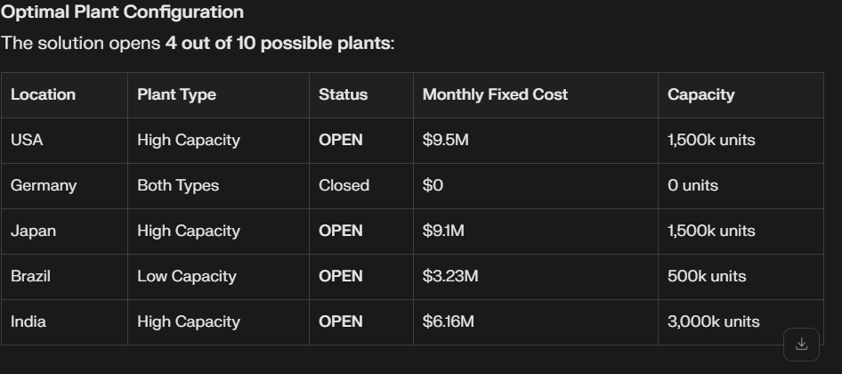
Optimal Plant Locations:

Slide 3


Strategic Insights
Germany eliminated from production due to high costs relative to alternatives
India selected for high-capacity production leveraging low manufacturing costs
Regional production strategy emerges with plants serving nearby markets
Capacity utilization balances economies of scale with market proximity
Cost Structure Analysis
Fixed Costs: $27.99M/month (30.1% of total)
Variable Costs: $64.99M/month (69.9% of total)

Slide 4

Demand Fulfillment Strategy
All regional demands are fully met, ensuring no shortage or surplus.
The shipment plan is regionally optimized: plants often serve nearby markets to minimize freight costs.
India’s low manufacturing costs and high capacity enable it to supply a large share of the demand economically.
Cost Efficiency Drives Exclusion of Locations
Germany’s plants are excluded from the network despite being a demand location, reflecting how location-specific cost factors (high manufacturing and fixed costs) can outweigh benefits in supply chain design.

Slide 5
Operational Implications
High capacity plants should be prioritized in low-cost locations to optimize production.
Regional plants with lower capacity can still be critical for meeting local demand efficiently.
Transport costs and capacities are key drivers, so optimizing freight logistics along with facility decisions is vital.
Model Validation and Decision Support
The model confirms feasibility of meeting all demands.
Visualizations of shipping flows and plant status provide clear insight into operation.
Decision-makers can leverage these insights for capacity expansion planning and cost reduction strategies.

Slide 6
Summary
- Total Monthly Cost (USD): $ 92,981,000
- Open Plants:
- USA: High Capacity
- Japan: High Capacity
- Brazil: Low Capacity
- India: High Capacity
- Germany: No plant opened due to high cost.
- Shipping Plan: Demand is fully met at all sites with optimal cost breakdown.

Slide 7
THANK YOU

