Slide 1
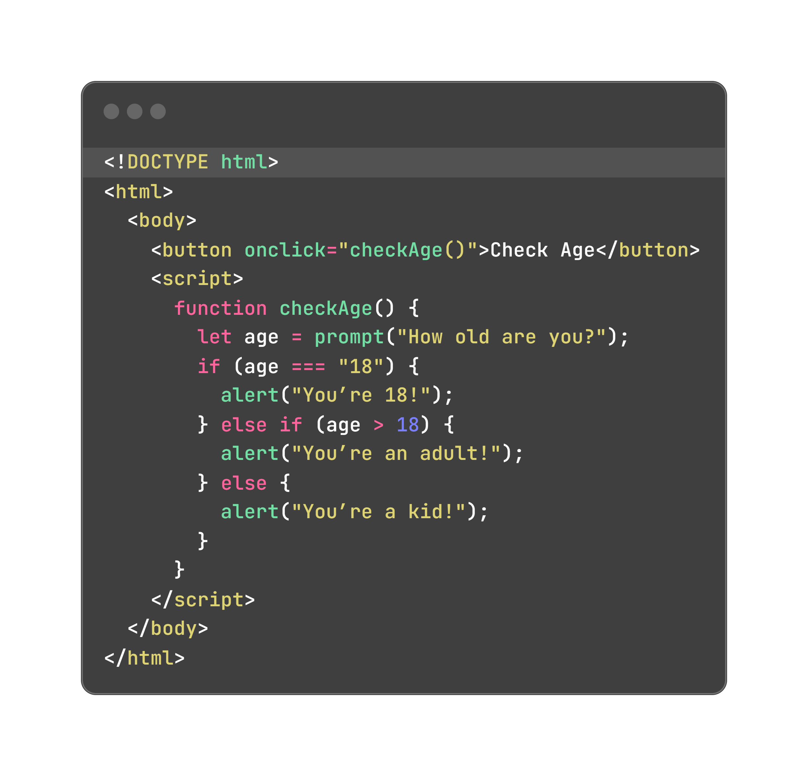
How does a website decide what to do? Like, show a message if you’re old enough?

Slide 2
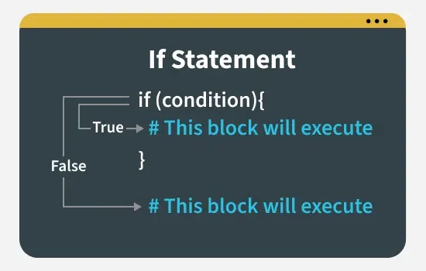
if Statements

Slide 3
What are if Statements ??

Slide 4
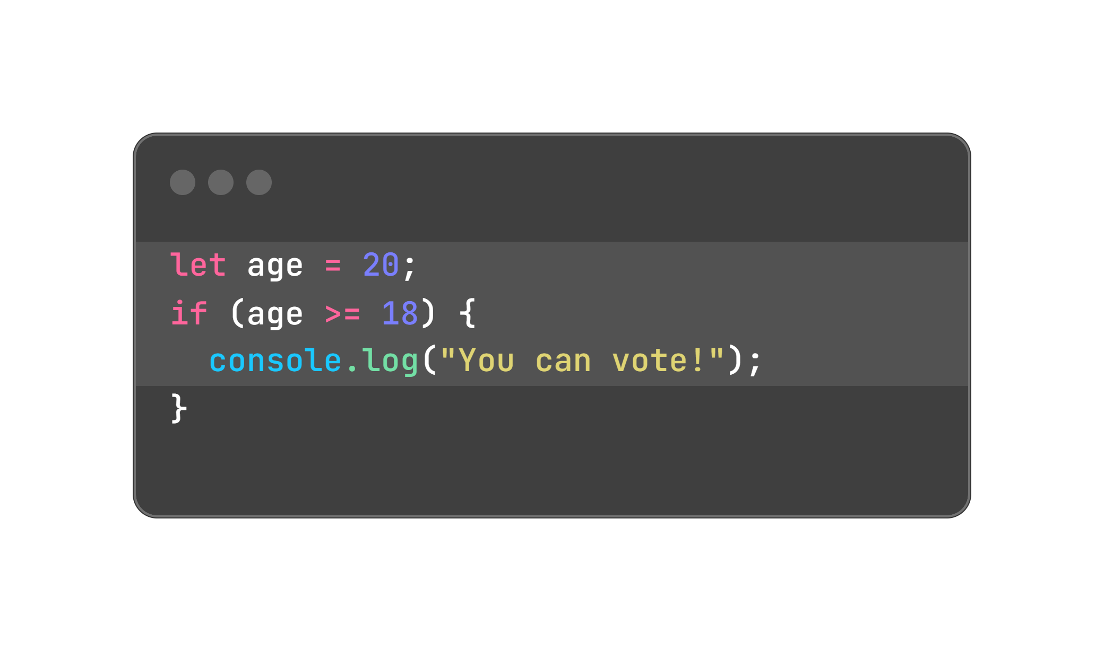
How They Work:
Use if to check if something is true.

Slide 5
Adding else if and else:
else if: Check another condition if the first one is false.
else: Do something if nothing else is true.

Slide 6
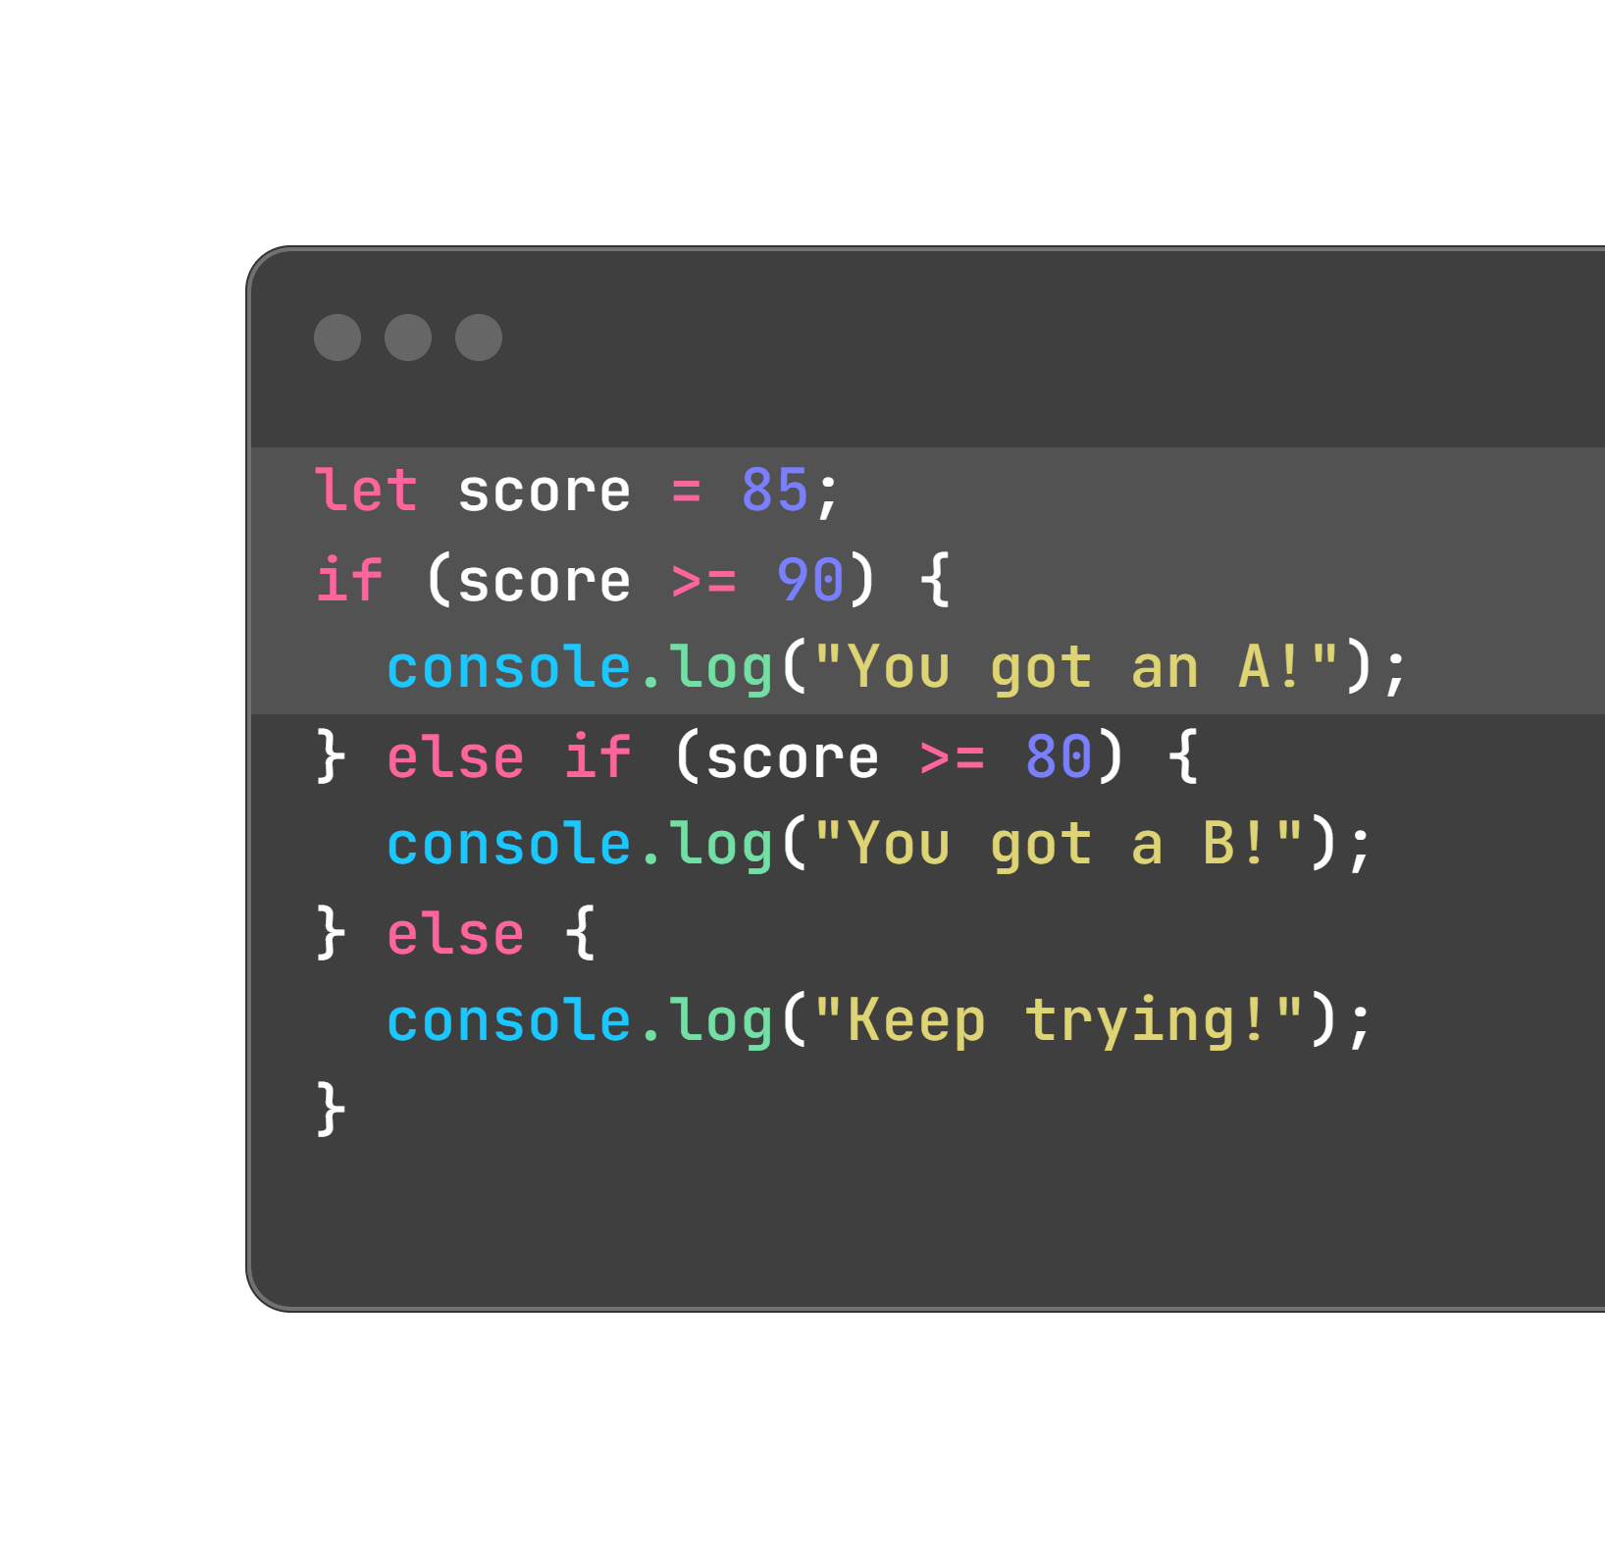
Adding else if and else:

Slide 7
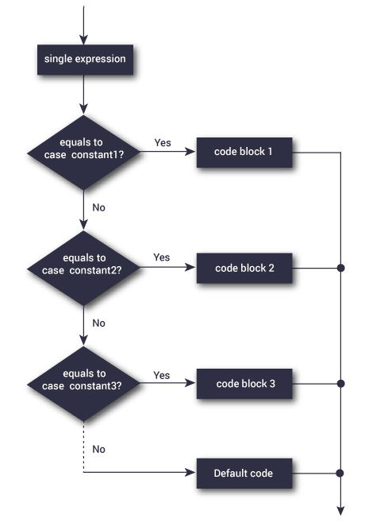
switch Statements

Slide 8
What are switch Statements ??

Slide 9
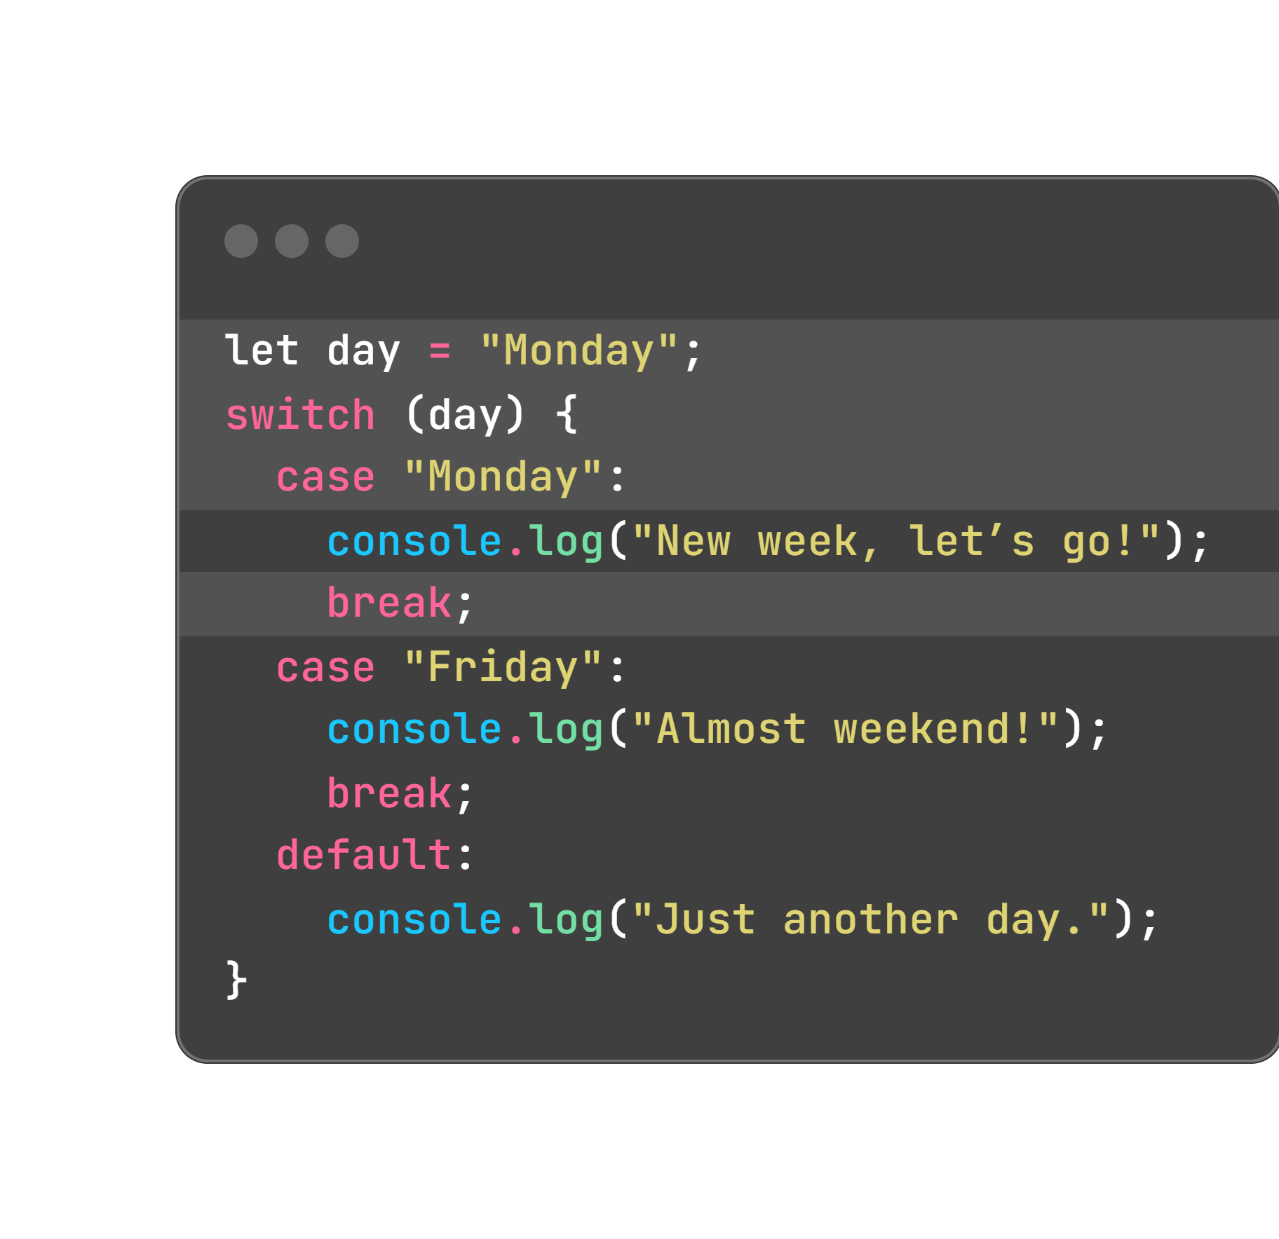
Switch Statements
A simpler way to check one thing against many options, like a menu.
Better than lots of else if statements for specific values.

Slide 10
Switch Statements
break stops the code from running the next case.
default is like else—it runs if nothing matches.
Use switch for exact matches (like "Monday", 5), not ranges (like score > 90).

Slide 11
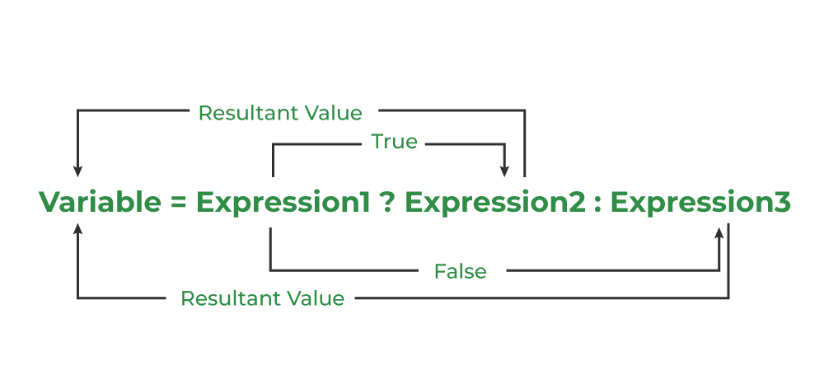
Ternary Operator

Slide 12
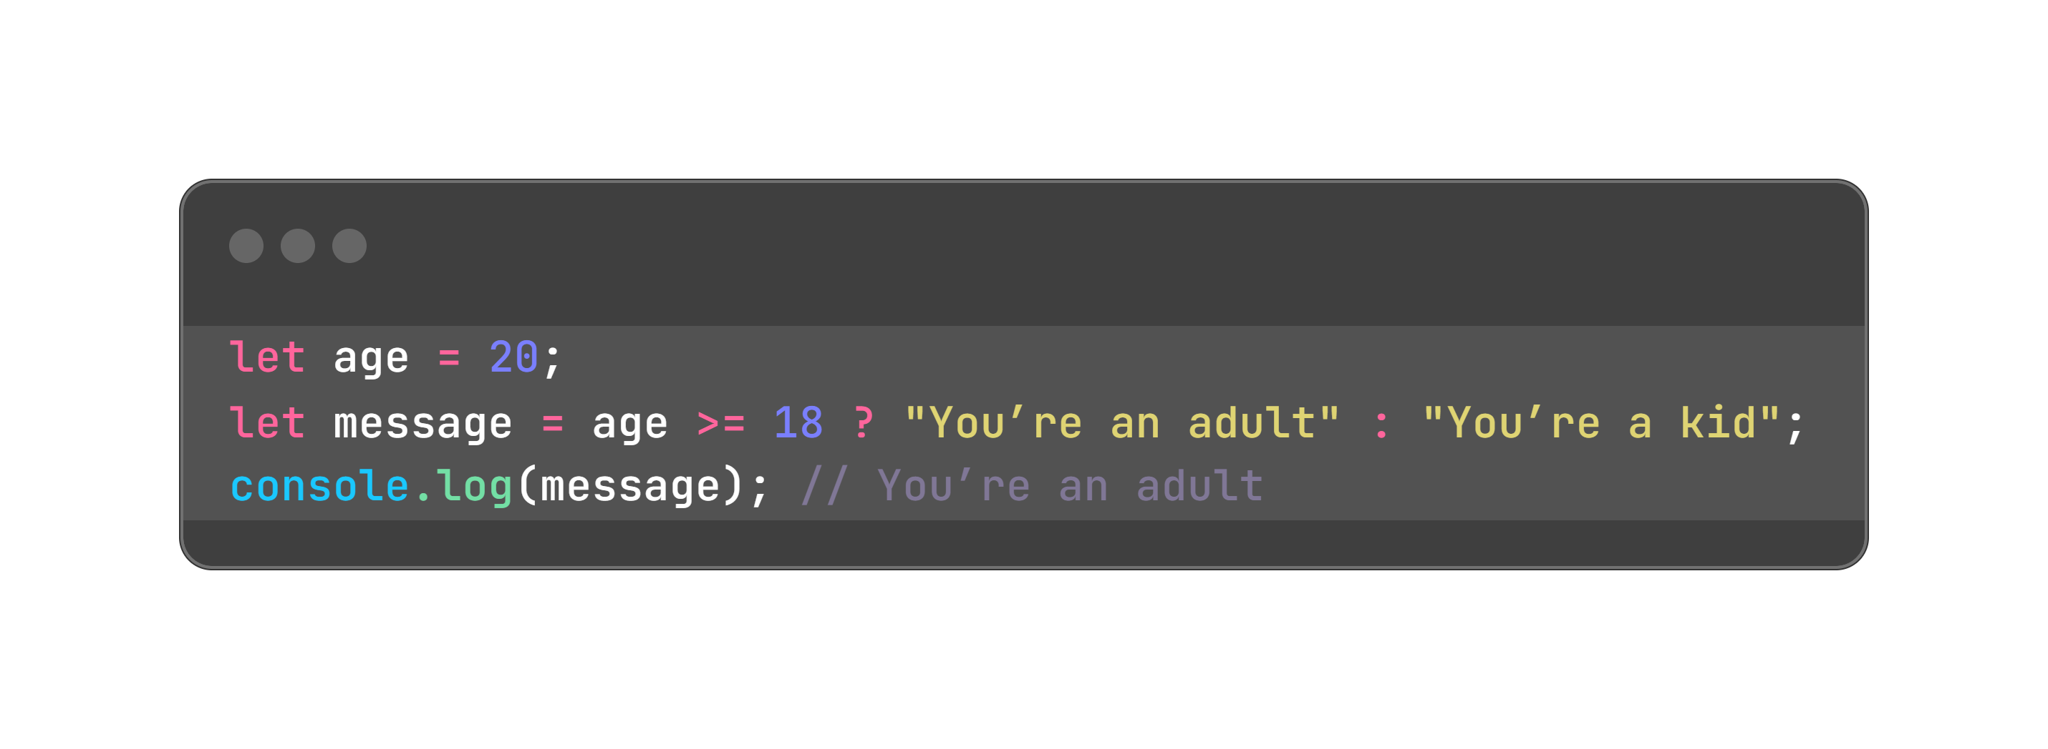
What are ternary Statements ??

Slide 13
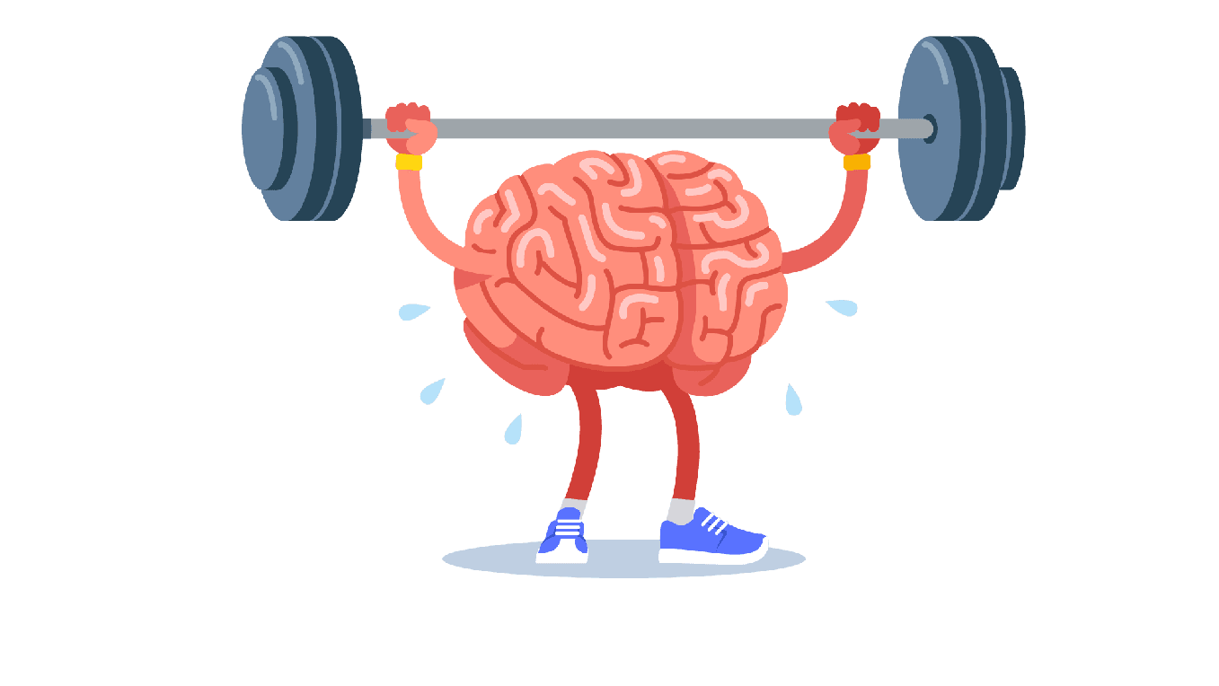
Exercise

Slide 14
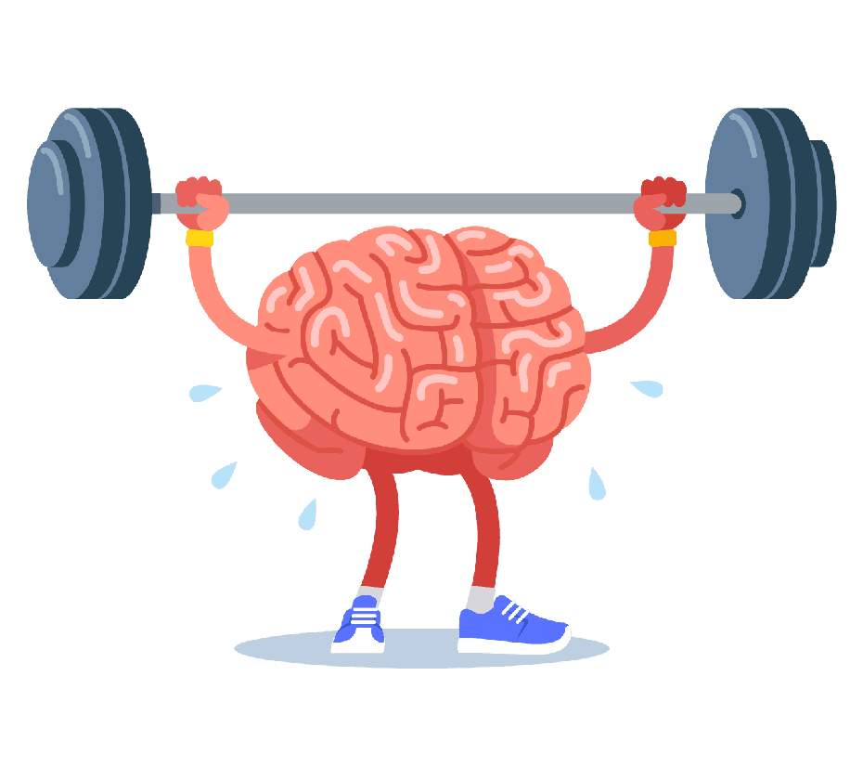
Exercise 1: Grade Calculator
Goal: Make a grade checker with if.
Create a variable score (e.g., 88).
Set a grade:
90 or more: "A"
80–89: "B"
70–79: "C"
60–69: "D"
Below 60: "F"
Print: Your grade is: B.
Try different scores (e.g., 95, 50).

Slide 15
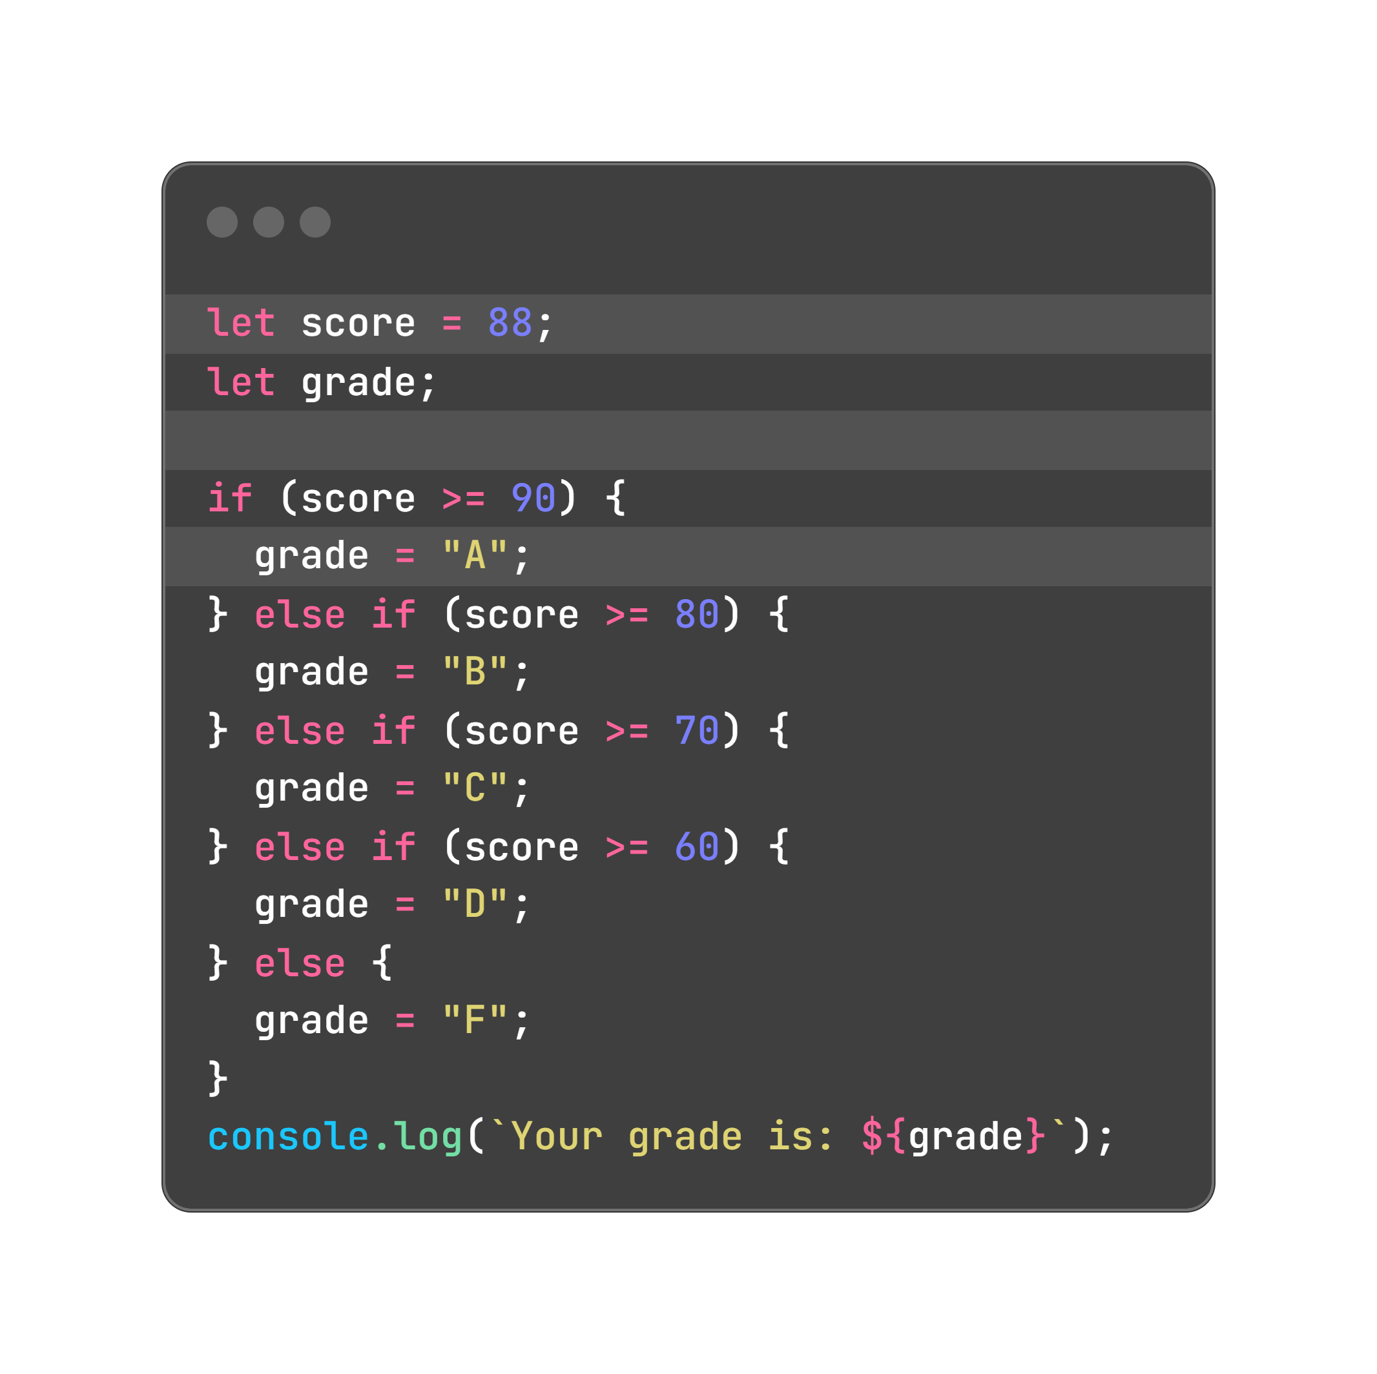
Answer

Slide 16
Number Analyzer
Check if a number is : - positive or negative - even or odd - a multiple of 5

Slide 17
Day Categorizer
Given a variable day check whether it’s a weekday or weekend - use string comparison and case insensitivity

Slide 18
Exercise 2: Days with switch
Goal: Show messages for days using switch.
Create a variable day (e.g., "Friday").
Use switch to print:
"Monday": "Week starts!"
"Friday": "Weekend’s close!"
"Saturday" or "Sunday": "Enjoy the weekend!"
Other days: "Keep working!"
Test with "Monday", "Sunday".

Slide 19
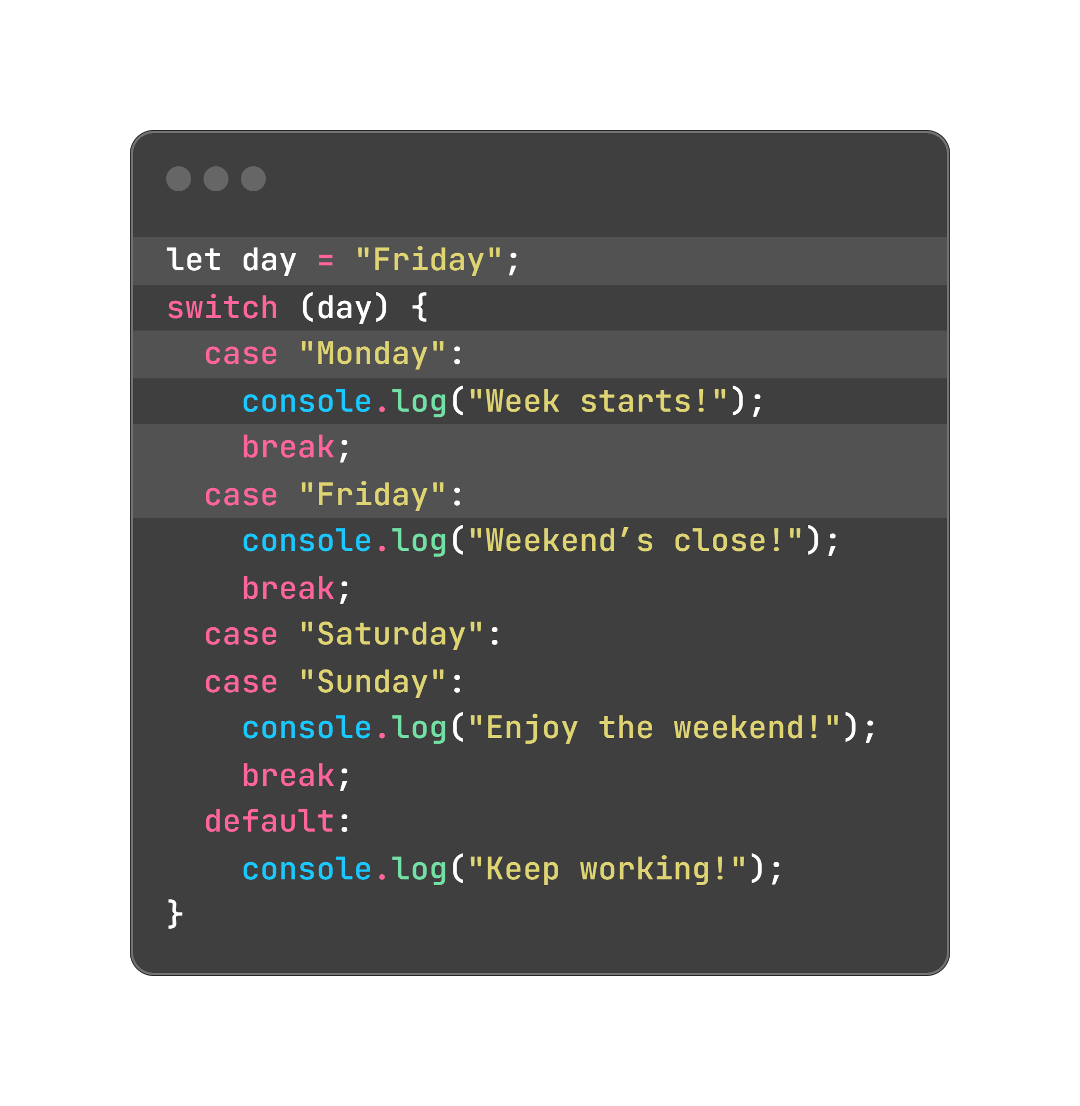
Answer

Slide 20
Exercise 3: Ternary Operator
Goal: Use ternary for quick checks.
Create variables:
age (e.g., 15).
isMember (e.g., true).
Use ternary to:
Set status to "Can join" if age >= 18, else "Too young".
Set discount to 10 if isMember is true, else 0.
Print: Status: Too young, Discount: 10%.

Slide 21
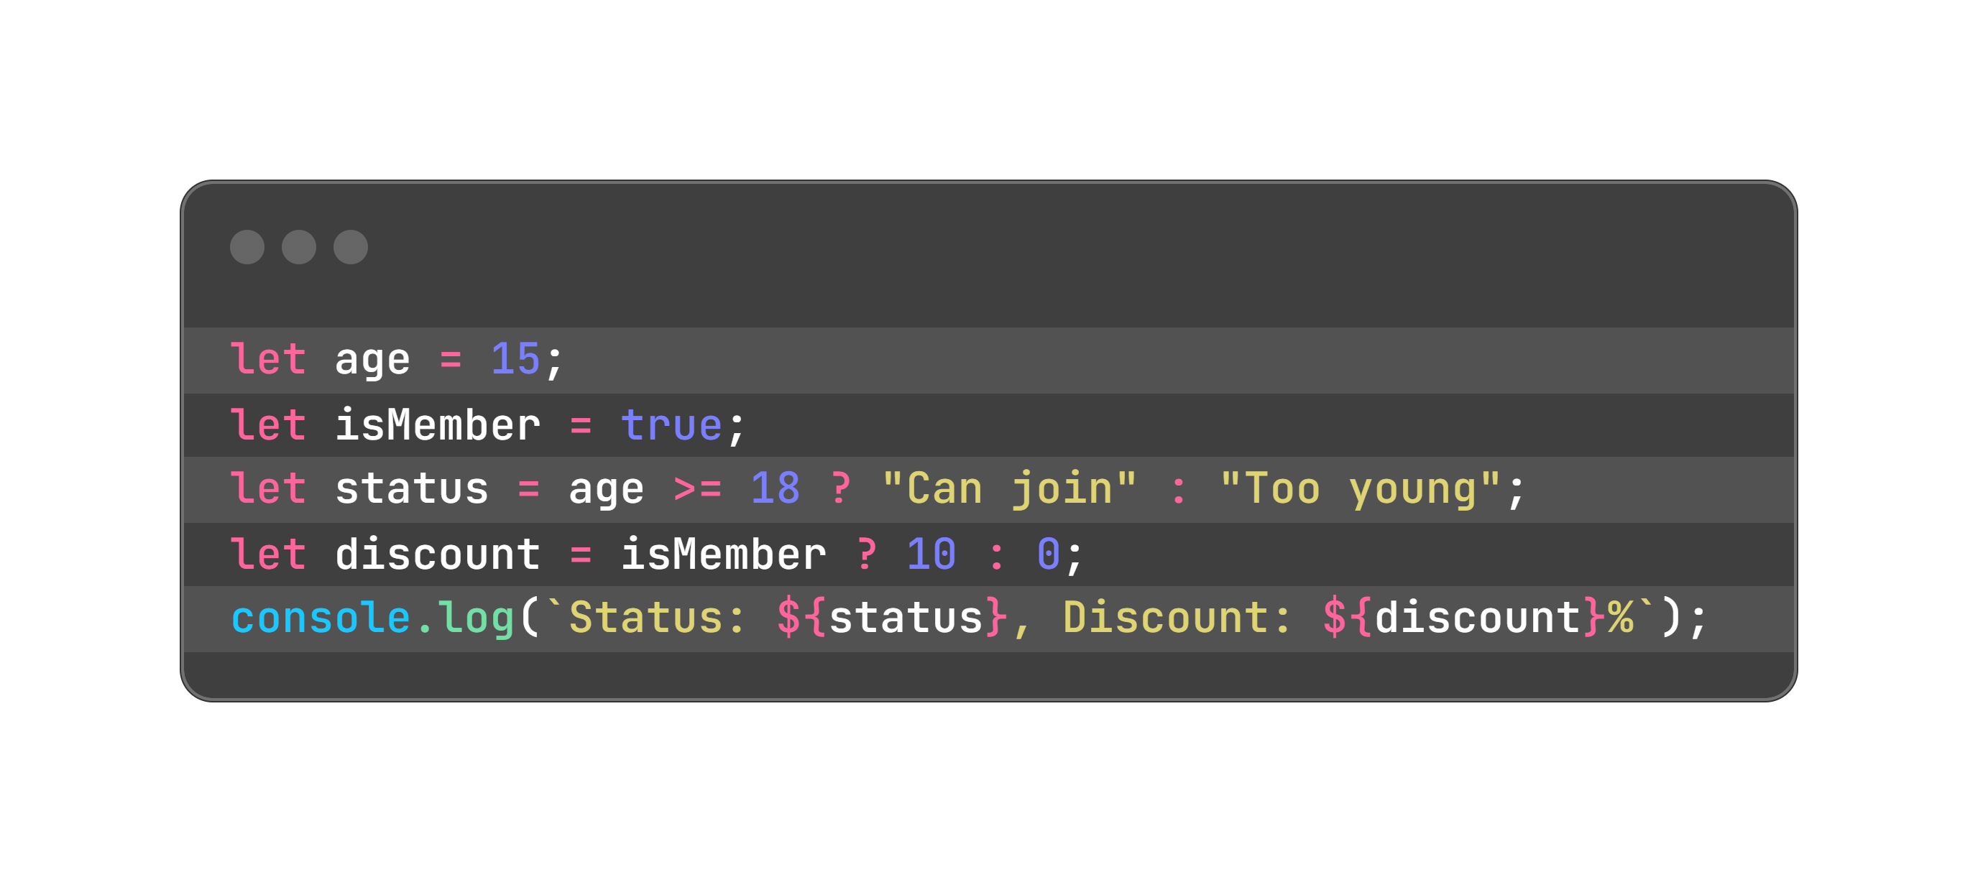
Answer

Slide 22
Bonus Challenge
Goal: Use ternary for quick checks.
Create variables:
age (e.g., 15).
isMember (e.g., true).
Use ternary to:
Set status to "Can join" if age >= 18, else "Too young".
Set discount to 10 if isMember is true, else 0.
Print: Status: Too young, Discount: 10%.

Slide 23


Slide 24

Recap...
if Statements: Choose what to do based on conditions.
switch: Pick from specific options, like a menu.
Ternary Operator: Quick if-else in one line.
Short-Circuit: Use && or || for fast checks or defaults.
Use console.log to check your code.

Slide 25

When do I use switch instead of if ?

Slide 26
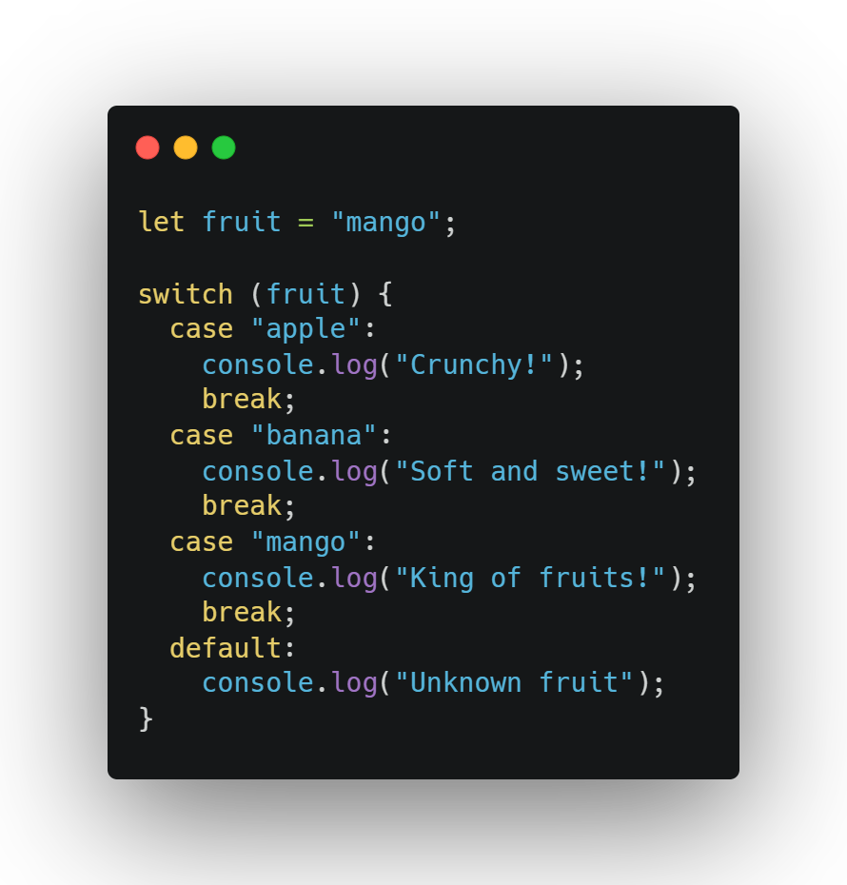
When do I use switch instead of if ?
Use switch when you are checking one variable against many values.
Good for: Clean code when checking multiple fixed cases

Slide 27
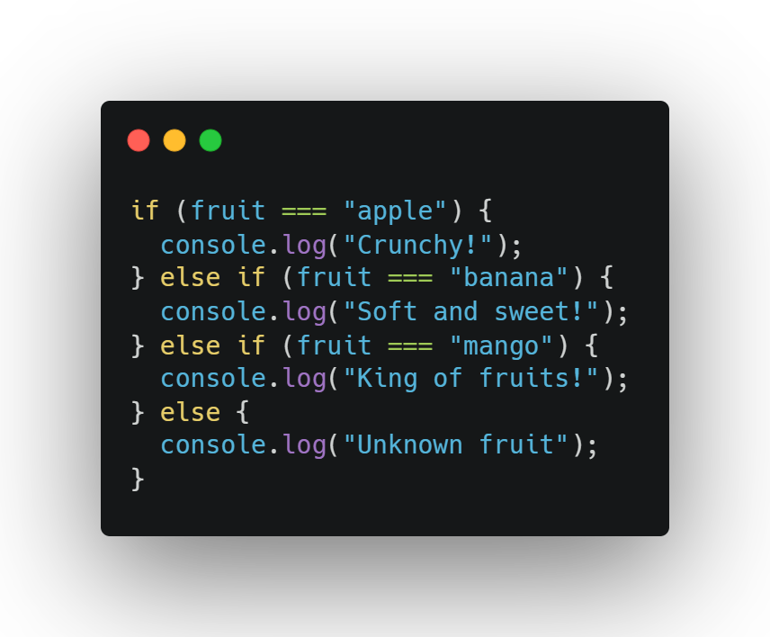
When do I use switch instead of if ?
Same thing with if, but longer and harder to read

Slide 28
Why not use ternary for everything?

Slide 29
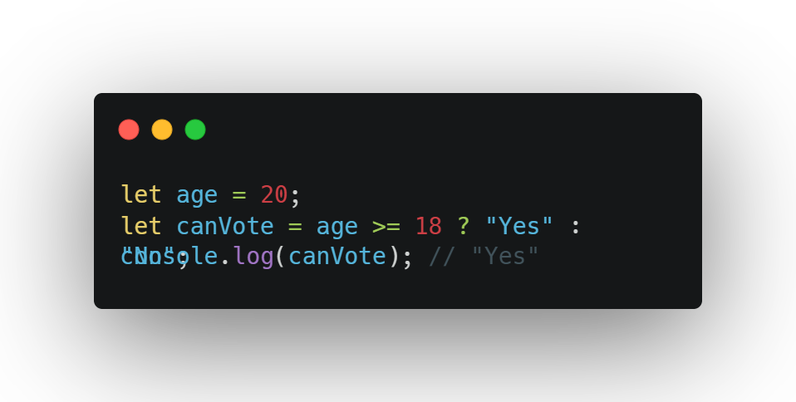
Why not use ternary for everything?
Ternary is like a shortcut for simple choices—like yes/no, true/false.
Use it for: Quick decisions

Slide 30
Why not use ternary for everything?
Don’t use if:
You have more than 2 choices
You are writing multiple actions
It gets too confusing to read

Slide 31

Thank-You !!!

